Slide 1


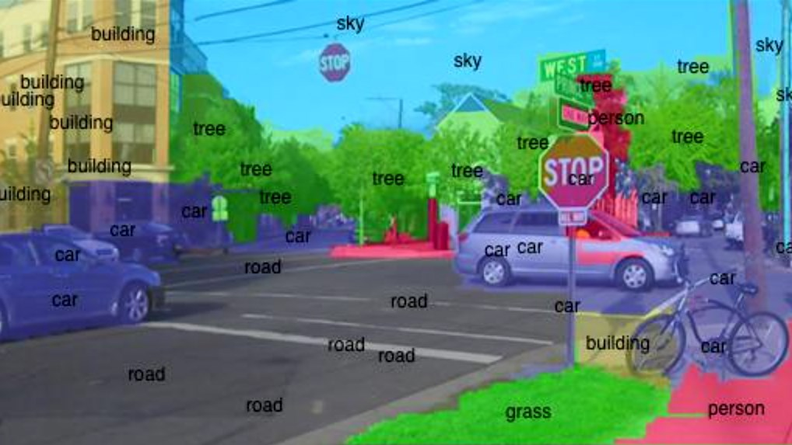
Validation Study of Image Recognition Algorithms Southwestern Oklahoma State University
Jacob Miller | Dr. Jeremy Evert | Department of Computer Science and Engineering Technology
Introduction
Methods
Data
Developments in machine learning in recent years have created opportunities that previously never existed. One such field with an explosion of opportunity is image recognition, also known as computer vision; the process in which a machine analyzes a digital image. In order for a machine to ‘see’ as a human does, it must break down the image in a process called image segmentation. The way the machine goes about doing this is important, and many algorithms exist to determine just how a machine will decide to group the pixels in an image. This research is a validation study of related papers on image segmentation algorithms for machine learning. Algorithms for this study will be written in Python and tested on three different hardware environments: a laptop, a desktop, and a server. Many fields have great use for computer vision, and its improvement is a good sign that more possibilities will open up with its application. Additionally, this study opens opportunities for students to see sophisticated code first hand. This research was funded in part by the Dr. Snowden Memorial Scholarship with the NASA OKLAHOMA Space Grant Consortium. This material is based upon work supported by the National Aeronautics and Space Administration issued through the Oklahoma Space Grant Consortium.
This project will make use of open source software and segmentation algorithms from several journal articles to verify the results.
To begin, articles were selected that offered a segmentation algorithm.
Then, these algorithms will be implemented into independent builds of the same software, and be instructed to analyze the same set of images. The Corel database is widely used in Computer Vision and has more than 40,000 images to choose a large sample from. Currently, that is where the images are planned to come from.
This process will be done three times: once on a laptop, a desktop, and then a server.
Algorithms will be ranked against each other based on Accuracy, Efficiency, and Scalability.
The above image is a good example of both Image Segmentation (the colored areas) and Computer Vision (shown through the labels).
Future
Project Effects
Works Cited
Other Considerations
Bhatia, R. (2018, April 10). Deeplearning.jpg [Digital image]. Retrieved November 7, 2018, from https://www.analyticsindiamag.com/how-to-build-a-career-in-computer-vision/
Objectives
This project serves as an introduction to machine learning and the research around image segmentation. The goal for the researchers is an increase familiarity with tools and fundamental concepts. Emphasis was placed on projects related to current research trajectories for NASA, general robotics applications, and Southwest Research Institute.
This material is based upon work supported by the National Aeronautics and Space Administration under Grant No. NNX15AK02H issued through NASA Education.

