Slide 1


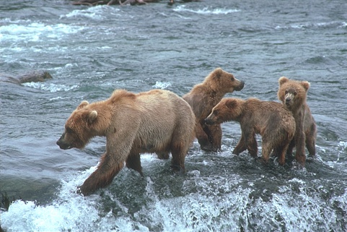
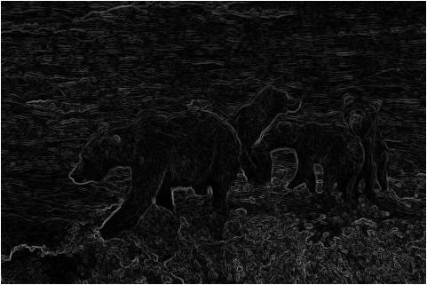
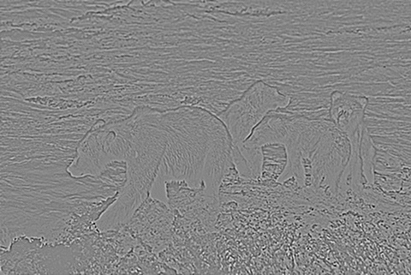
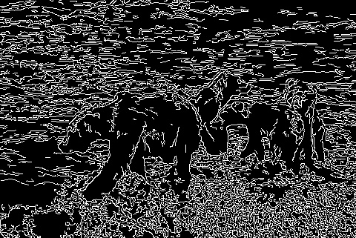
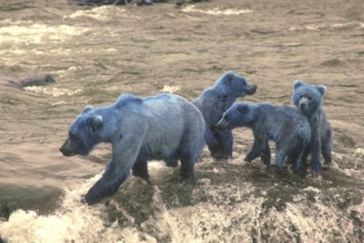
Arbeaez, P., Maire, M., Fowlkes, C., & Malik, J. (2010). Contour Detection and Hierarchical Image Segmentation. IEEE Transactions on Pattern Analysis and Machine Intelligence, 898 - 916.
Validation Study of Image Segmentation Algorithms Southwestern Oklahoma State University
Jacob Miller | Dr. Jeremy Evert | Department of Computer Science and Engineering Technology
Introduction
Methods
Example Segmentations
Developments in machine learning and computing capability in recent years have created opportunities that were previously not cost effective. One such area is image recognition and computer vision, where a machine analyzes an image and classifies it. After classification, the machine can pass the information off to a different algorithm for decision making. Before a machine can classify parts of an image as a human does, it must break down the image in a process called image segmentation. This task is an open research area. Many algorithms exist to determine how pixels are grouped. This research poster details a validation study of related papers on image segmentation algorithms for machine learning. The first author has selected three different image segmentation approaches. Algorithms for this study will be reproduced in Python and utilize many pre-existing libraries. Our team has acquired a small robotic research platform to provide evaluation of our research. A Robot Operating System based robot will be assembled and tested with the three different algorithms to assess their real-world effectiveness. This study may lead to more research platforms. Additionally, this undergraduate research study opens opportunities for students to work with sophisticated code first-hand. This research was funded in part by the Dr. Snowden Memorial Scholarship with the NASA Oklahoma Space Grant Consortium. This material is based upon work supported by NASA issued through the OSGC.
Selected articles that offered an approachable segmentation algorithm
Studied three algorithms:
Sobel filter
Laplacian filter
Canny Edge Detector
Implemented algorithms in Python, using a Jupyter Notebook
Measured using scale of accuracy
Original Image
Sobel Filter
Project Effects
Two main benefits:
Prepares researcher to find other avenues of research
Gives newer students in area resources
Laplacian Filter
Canny Edge Detector
Sobel: Estimates derivative at each location
Laplacian: Estimates second derivate at each location
Both Sobel and Laplacian are especially susceptible to image noise
Canny Edge: Applies a Gaussian Filter, then a Sobel Filter
Gaussian Filter
References
Objectives
Arbelaez, P., Maire, M., Fowlkes, C., & Malik, J. (2010). Contour Detection and Hierarchical Image Segmentation. IEEE Transactions on Pattern Analysis and Machine Intelligence, 898 - 916
Christophe Andrieu, N. D. (2003). An Introduction to MCMC for Machine Learning. Machine Learning, 50, 5-43.
David Martin, C. F. (2001). A Database of Human Segmented Natural Images and its Application to Evaluating Segmentation Algorithms and Measuring Ecological Statistics. Vancouver: IEEE.
Larry Matthies, M. M. (2007). Computer Vision on Mars. International Journal of Computer Vision, Volume 75, Issue 1, 67-92.
P.C.H. Martens, e. a. (2012). Computer Vision for the Solar Dynamics Observatory (SDO). Solar Physics, Volume 275, Issue 1-2, 79-113.
Introduce machine learning and the research around image segmentation
Increase familiarity with tools and fundamental concepts
Emphasize projects related to current research trajectories for NASA, general robotics applications, and Southwest Research Institute
This material is based upon work supported by the National Aeronautics and Space Administration under Grant No.NNX15AK02H issued through NASA Education.
Notes:
1

