Slide 1


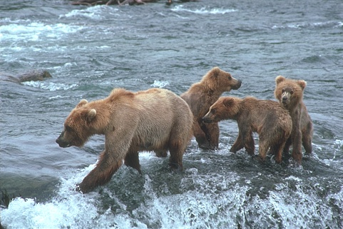
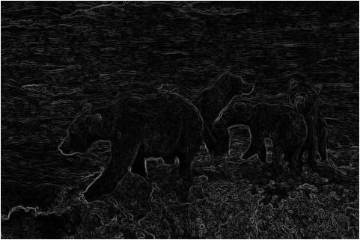
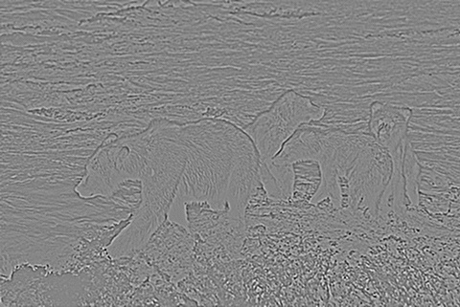
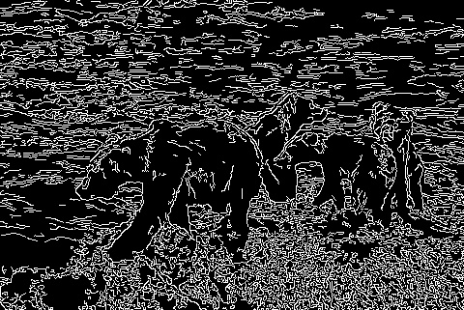
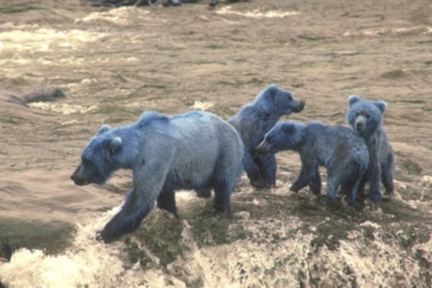
Arbeaez, P., Maire, M., Fowlkes, C., & Malik, J. (2010). Contour Detection and Hierarchical Image Segmentation. IEEE Transactions on Pattern Analysis and Machine Intelligence, 898 - 916.
Validation Study of Image Segmentation Algorithms Southwestern Oklahoma State University
Jacob Miller | Dr. Jeremy Evert | Department of Computer Science and Engineering Technology
Introduction
Methods
Example Segmentations
Developments in machine learning and computing capability in recent years have created opportunities that were previously not cost effective. One such area is image recognition and computer vision, where a machine analyzes an image and classifies it. After classification, the machine can pass the information off to a different algorithm for decision making. Before a machine can classify parts of an image as a human does, it must break down the image in a process called image segmentation. This task is an open research area. Many algorithms exist to determine how pixels are grouped. This research poster details a validation study of related papers on image segmentation algorithms for machine learning. The first author has selected three different image segmentation approaches. Algorithms for this study will be reproduced in Python and utilize many pre-existing libraries. Our team has acquired a small robotic research platform to provide evaluation of our research. A Robot Operating System based robot will be assembled and tested with the three different algorithms to assess their real-world effectiveness. This study may lead to more research platforms. Additionally, this undergraduate research study opens opportunities for students to work with sophisticated code first-hand. This research was funded in part by the Dr. Snowden Memorial Scholarship with the NASA Oklahoma Space Grant Consortium. This material is based upon work supported by NASA issued through the OSGC.
To begin, articles were selected that offered an approachable segmentation algorithm.
The research team set aside time to research and understand three algorithms. These three are a Sobel filter, a Laplacian filter, and a Canny Edge Detector.
Then, these algorithms were implemented in Python, using a Jupyter Notebook. Each algorithm will include a implementation by the researcher and with an open source library known as OpenCV.
Each algorithm will be measured against one another using a measure of accuracy and efficiency. Accuracy will be tested through an open source resource detailed in Arbelaez's paper. Efficiency will be verified on a machine with a better CPU and again on a machine with a better GPU.
Original Image
Sobel Filter
Laplacian Filter
Canny Edge Detector
Shown above is an example image with each segmentation algorithm considered in this project applied to it. The Sobel filter estimates the derivative at each pixel location in the image, and draws a line at all places where the derivative changes. The Laplacian filter is similar, however it estimates the second derivative at each location. Both the Sobel and Laplacian are especially susceptible to image noise. The Canny Edge Detector addresses this by applying a Gaussian Filter to it, then applying a Sobel Filter.
Project Effects
One of the goals of this project is for the team to familiarize themselves with machine learning concepts and tools. This benefit is two-fold, in that it prepares the researcher to continue to research more specific and advanced topics as well as allows new students interested in the topic a resource they would have easy access to.
Gaussian Filter
References
Objectives
Arbelaez, P., Maire, M., Fowlkes, C., & Malik, J. (2010). Contour Detection and Hierarchical Image Segmentation. IEEE Transactions on Pattern Analysis and Machine Intelligence, 898 - 916
Christophe Andrieu, N. D. (2003). An Introduction to MCMC for Machine Learning. Machine Learning, 50, 5-43.
David Martin, C. F. (2001). A Database of Human Segmented Natural Images and its Application to Evaluating Segmentation Algorithms and Measuring Ecological Statistics. Vancouver: IEEE.
Larry Matthies, M. M. (2007). Computer Vision on Mars. International Journal of Computer Vision, Volume 75, Issue 1, 67-92.
P.C.H. Martens, e. a. (2012). Computer Vision for the Solar Dynamics Observatory (SDO). Solar Physics, Volume 275, Issue 1-2, 79-113.
This project serves as an introduction to machine learning and the research around image segmentation. The goal for the researchers is an increase familiarity with tools and fundamental concepts. Emphasis was placed on projects related to current research trajectories for NASA, general robotics applications, and Southwest Research Institute.
This material is based upon work supported by the National Aeronautics and Space Administration under Grant No.NNX15AK02H issued through NASA Education.
Notes:
1

