Slide 1


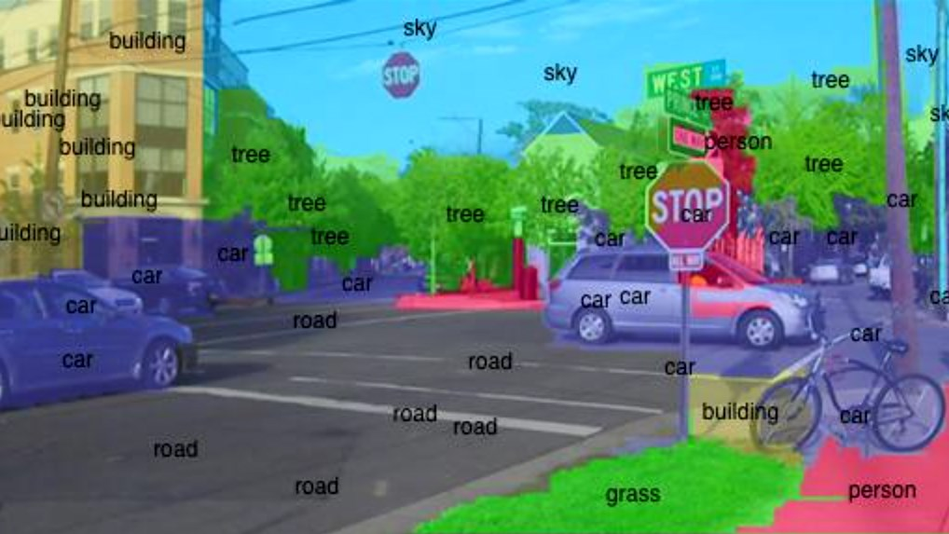
Validation Study of Image Recognition Algorithms Southwestern Oklahoma State University
Jacob Miller | Dr. Jeremy Evert | Department of Computer Science and Engineering Technology
Introduction
Methods
Example
Developments in machine learning in recent years have created opportunities that previously never existed. One such field with an explosion of opportunity is image recognition, also known as computer vision; the process in which a machine analyzes a digital image. In order for a machine to ‘see’ as a human does, it must break down the image in a process called image segmentation. The way the machine goes about doing this is important, and many algorithms exist to determine just how a machine will decide to group the pixels in an image. This research is a validation study of related papers on image segmentation algorithms for machine learning. Algorithms for this study will be written in Python and tested on three different hardware environments: a laptop, a desktop, and a server. Many fields have great use for computer vision, and its improvement is a good sign that more possibilities will open up with its application. Additionally, this study opens opportunities for students to see sophisticated code first hand. This research was funded in part by the Dr. Snowden Memorial Scholarship with the NASA OKLAHOMA Space Grant Consortium. This material is based upon work supported by the National Aeronautics and Space Administration issued through the Oklahoma Space Grant Consortium.
This project will make use of open source software and segmentation algorithms from several journal articles to verify the results.
To begin, articles were selected that offered a segmentation algorithm.
Then, these algorithms will be implemented into independent builds of the same software, and be instructed to analyze the same set of images. The Corel database is widely used in Computer Vision and has more than 40,000 images to choose a large sample from. Currently, that is where the images are planned to come from.
This process will be done three times: once on a laptop, a desktop, and then a server.
Algorithms will be ranked against each other based on Accuracy, Efficiency, and Scalability.
The above image is a good example of both Image Segmentation (the colored areas) and Computer Vision (shown through the labels).
References
Project Effects
One of the goals of this project is for the team to familiarize themselves with machine learning concepts and tools. This benefit is two-fold, in that it prepares the researcher to continue to research more specific and advanced topics as well as allows new students interested in the topic a resource they would have easy access to.
Bhatia, R. (2018, April 10). Deeplearning.jpg [Digital image]. Retrieved November 7, 2018, from https://www.analyticsindiamag.com/how-to-build-a-career-in-computer-vision/
Christophe Andrieu, N. D. (2003). An Introduction to MCMC for Machine Learning. Machine Learning, 50, 5-43.
David Martin, C. F. (2001). A Database of Human Segmented Natural Images and its Application to Evaluating Segmentation Algorithms and Measuring Ecological Statistics. Vancouver: IEEE.
Larry Matthies, M. M. (2007). Computer Vision on Mars. International Journal of Computer Vision, Volume 75, Issue 1, 67-92.
P.C.H. Martens, e. a. (2012). Computer Vision for the Solar Dynamics Observatory (SDO). Solar Physics, Volume 275, Issue 1-2, 79-113.
Other Considerations
Objectives
This project’s primary goal was not to discover the best algorithm, or to develop a more accurate or efficient one. That could certainly be approached with the results of this study, however.
It is certainly possible that these algorithms have strengths and weaknesses outside the scope of this study. It was only checked that the they were accurate.
This project serves as an introduction to machine learning and the research around image segmentation. The goal for the researchers is an increase familiarity with tools and fundamental concepts. Emphasis was placed on projects related to current research trajectories for NASA, general robotics applications, and Southwest Research Institute.
This material is based upon work supported by the National Aeronautics and Space Administration under Grant No.XXXXXX issued through NASA Education.
Notes:
1

