Slide 1

LLVM
The LLVM Compiler Infrastructure

Slide 2
Contents
  What is LLVM
  Compiler Pipeline
  LLVM Componenents in Detail
  LLVM Intermediate Representation
  LLVM Features

Slide 3

What is LLVM
  „(...) is a collection of modular and reusable compiler and toolchain technologies.“
  Consists of:
    C++ Libraries (API)
    Command Line Tools

Slide 4
Compiler Pipeline
Lexer
Parser
Semantic
Analysis
LLVM
IR Generation
IR Optimization
Code Generation

Slide 5
LLVM Components in Detail
Libraries
CLI Tools
IR Generation
llvm-prof
llvm-diff
IR Optimization
opt
llvm-as
llvm-link
Code Generation
llc
lli
llvm-dis

Slide 6
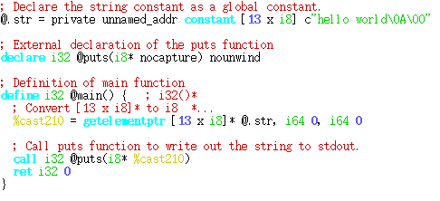
LLVM Intermediate Representation
  Three Representations of LLVM-IR
    In Memory (not specified)
    ASCII IR (see left)
    Bitcode format
  Bitcode and ASCII IR are equivalent
  llvm-as and llvm-dis convert between ASCII and bitcode format
Sample.ll

Slide 7
Features of LLVM
  Large set of optimization passes, easy to write new passes
  Well defined, self contained intermediate representation
  Many targets, easier to write new targets than, i.e. for GCC
  Abstraction level supports easier llvm emission
  (derived types/functions exist)
  Modular architecture allows reuse of individual features
  Interfacing with C possible (but not always platform independent)
  Continuous development over the recent years
  Permissive license

Slide 8
The End...
...thanks for Listening!

