Slide 1
LAB 7 Implementation of Sequential Logic and 7-segment Combination Logic
SNU VLSI LAB
2022-11-01

Slide 2
Goal
BCD counter implementation and sequential logic understanding
BCD counter implemented as 7-segment display
Simulation of the given test bench using the given Verilog code with Modelsim

Slide 3
LAB 7 Prelab report
No prelab-report for LAB7

Slide 4
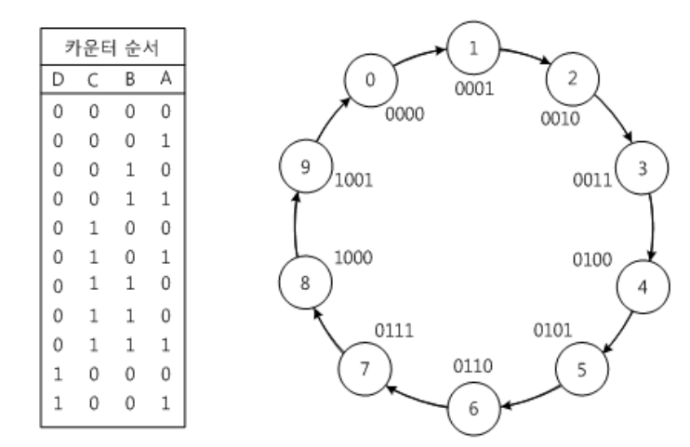
LAB (1)
BCD Counter
Implement BCD counter incrementing from 0 to 9
Write down code for ‘TODO’ of bcd_counter.v (do not modify the provided variables)
When the clock is rising edge and if toggle is low (active low), the counter value increases by 1.
Reset is active low

Slide 5
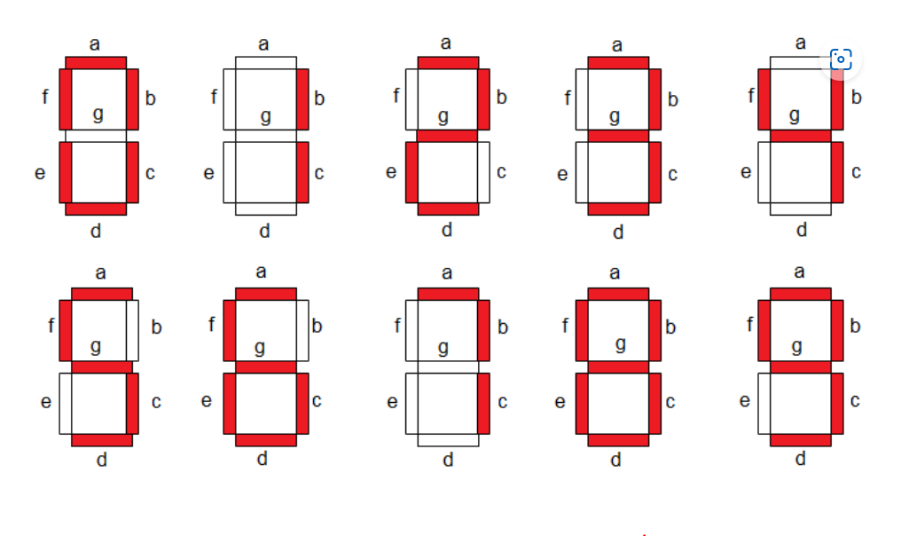
LAB (2)
7-segment Display
Write down code for TODO part of bin2seg.v file (do not modify existing variable)
Binary input (0~9) & 7-segment output
7-segment is active low
The 7-segment output is 8-bit, and the position according to the index is fixed as follows. 00000000 -> xabcdefg (x is don't care)
Example)
11001111 displays 1

Slide 6
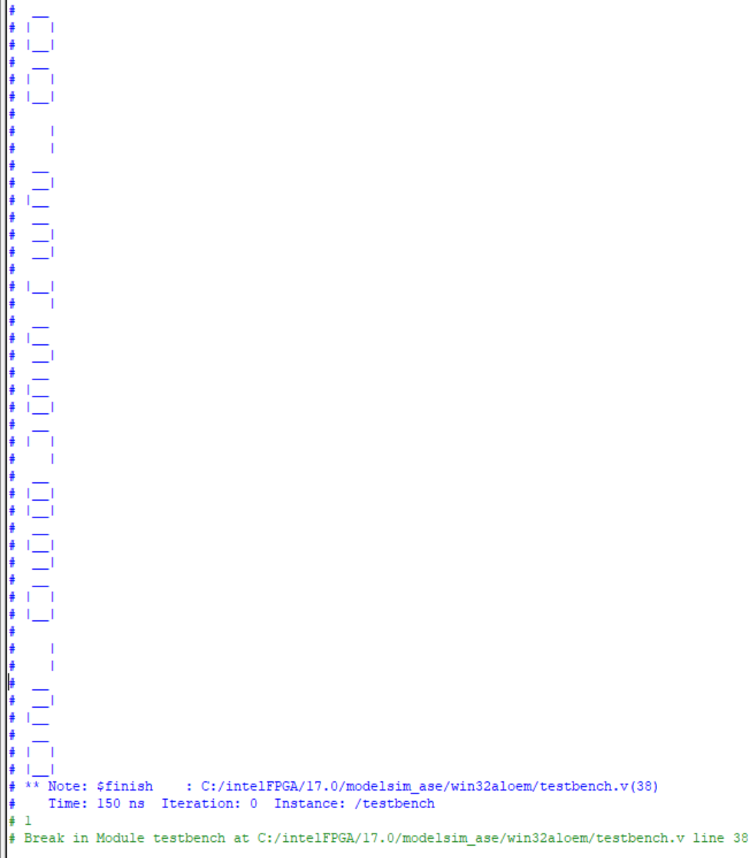
LAB (3)
Test Bench Simulation
Testbench Simulation
Add the provided testbench.v and top.v files to your project
Do not edit any other parts!
When the simulation is in progress, check with the assistant that the following is the output in the transcript window

Slide 7
Postlab-report Guide
Test bench simulation waveform
Test bench simulation result displayed in the Transcript window (seven segment result)
Simple analysis of the above results within 1 page

