Slide 1
실험6 : Verilog Tutorial
논리 설계 및 실험
SNU VLSI LAB
Oct 26, 2022

Slide 2
Verilog Introduction
Reference : https://www.chipverify.com/verilog/verilog-tutorial

Slide 3
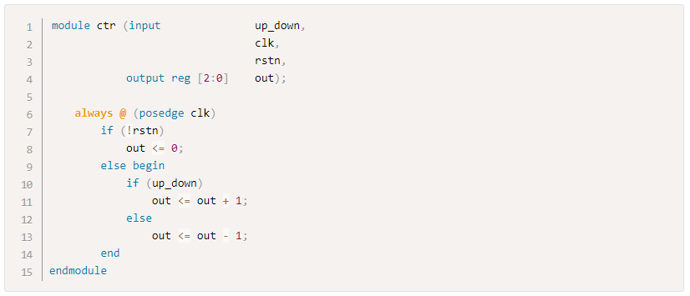
What is Verilog
In the early days, integrated circuit engineers had to manually draw transistors and their connections on paper to design the integrated circuit
As circuits become larger and more complex, there was a need to have a better way of designing integrated circuits
HDL : Hardware Description Language
The language that describes hardware functionality
VHDL, Verilog
EX) Functionality of a up-down counter can be described easily

Slide 4
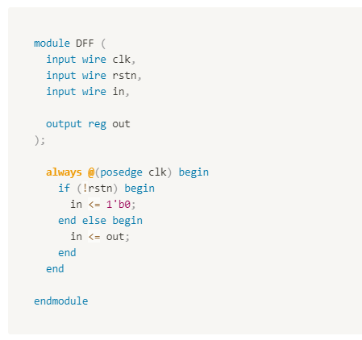
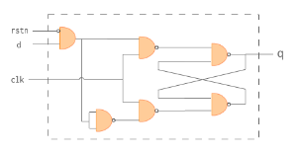
What is Verilog
Hardware schematic : diagram with logic gates and interconnection
Software toolchain converts Verilog code to netlist
EX) Synopsys Design compiler, Xilinx Vivado
Hardware schematic : visualization of netlist
Low development cost with HDL!
Converted to hardware schematic by software toolchain

Slide 5
Verilog Data Types
Reference : https://www.chipverify.com/verilog/verilog-tutorial

Slide 6
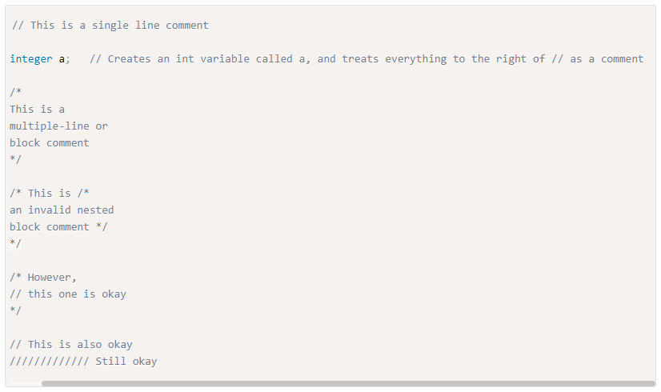
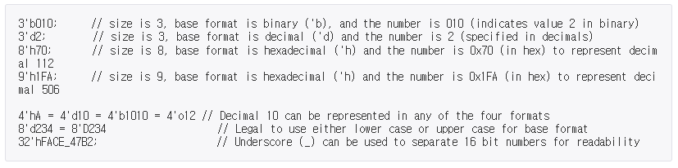
Verilog syntax
Comments : // or /* … */
Number Format
Decimal, hexadecimal, binary, octal
[size]’[base_format][number]

Slide 7
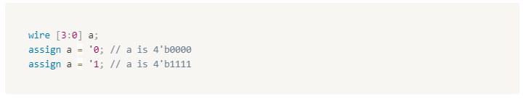
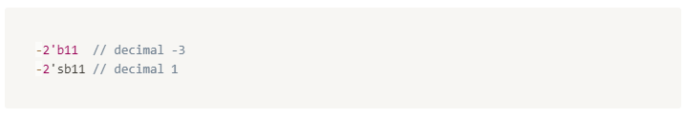
Verilog syntax
Number Format
Unsized
‘0 : all zeros
‘1 : all ones
Negative
Negative numbers are specified by placing a minus sign (-) before the size of a number
2’b11 : decimal 3
2’sb11 : decimal -1

Slide 8
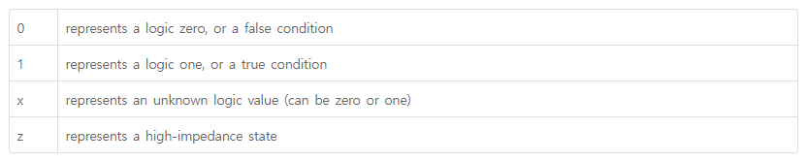
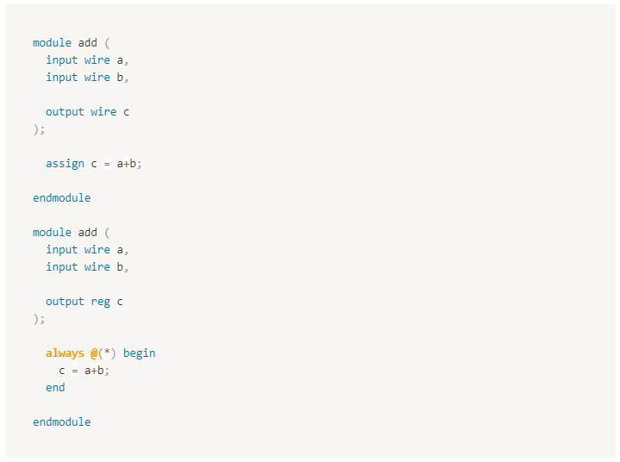
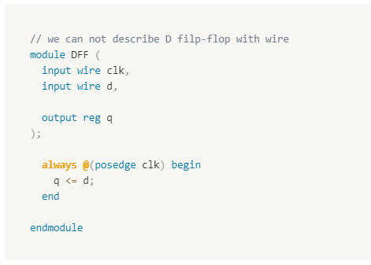
Verilog Date types
Data Types
Net : EX) wire
Variable : EX) reg
Each bit position stores one of the four different values (0, 1, x, z)
Wire : used to connect between hardware entities
Reg : used to model hardware register or combinational logic
Wire and reg have different ways to use

Slide 9
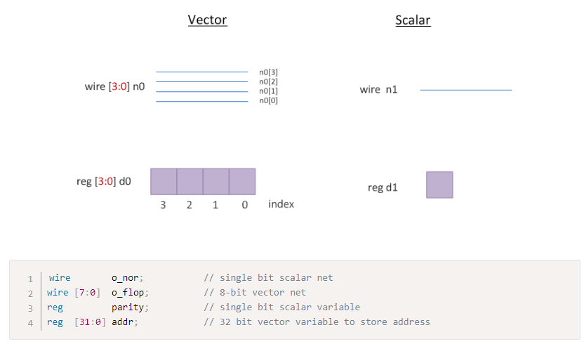
Verilog scalar and vector
Scalar : 1bit
Vector : multi bit

Slide 10
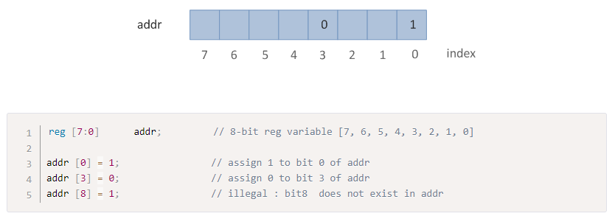
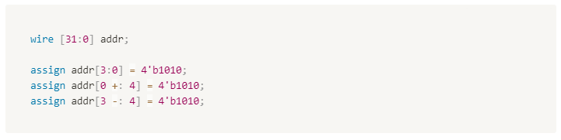
Verilog scalar and vector
Bit-selects
Any bit in a vectored net or variable can be individually selected and assigned a new value
Part-selects
A range of contiguous bits can be selected and assigned a new value

Slide 11
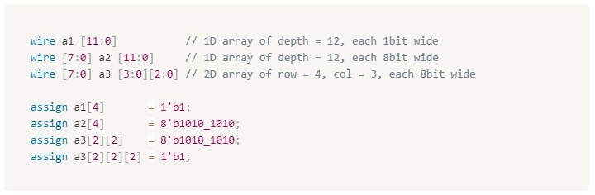
Verilog array
Each element of array can be scalar or vector
Any number of dimensions can be created by specifying an address range after the identifier name
Left to right indexing

Slide 12
Verilog Building Blocks
Module
Reference : https://www.chipverify.com/verilog/verilog-tutorial

Slide 13
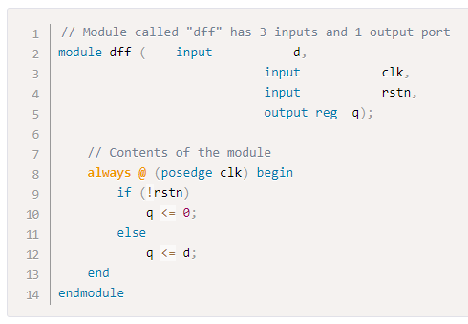
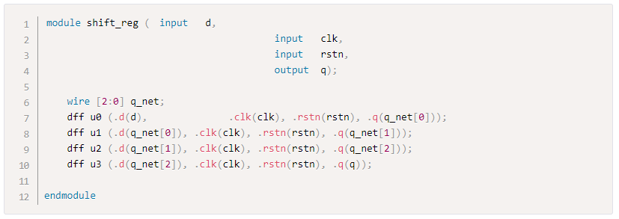
Verilog module
Block of Verilog code that implements a certain functionality
The same module can be reused to form bigger modules that implement more complex hardware
EX) use dff module to form shift_reg module

Slide 14
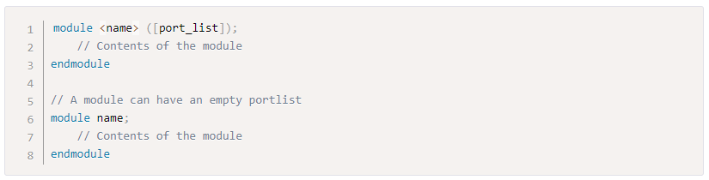
Verilog module
Module should be enclosed within module and endmodule keyword
Name of the module should be given right after the module keyword
Optional list of ports may be declared

Slide 15
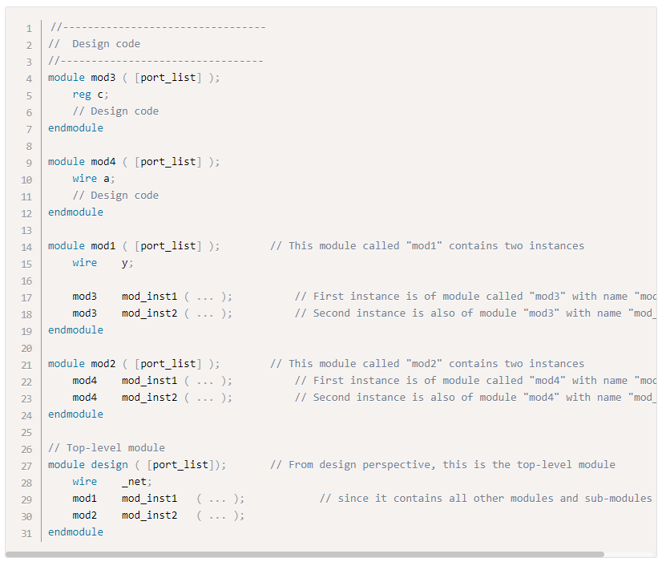
Verilog module
A module can contain multiple instances of other modules
A top level module is one which contains all other modules.
A top level module is not instantiated within any other module

Slide 16

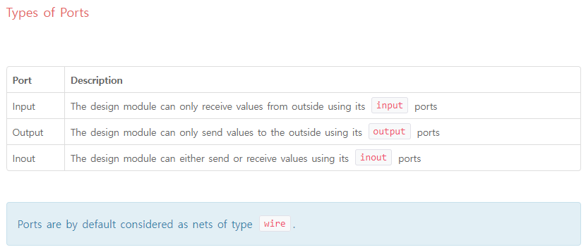
Verilog module
Port
Set of signals that act as inputs and outputs to a particular module
Direction : input, output, inout
Default : wire

Slide 17
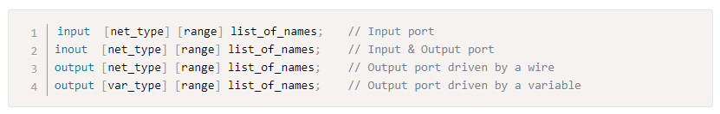
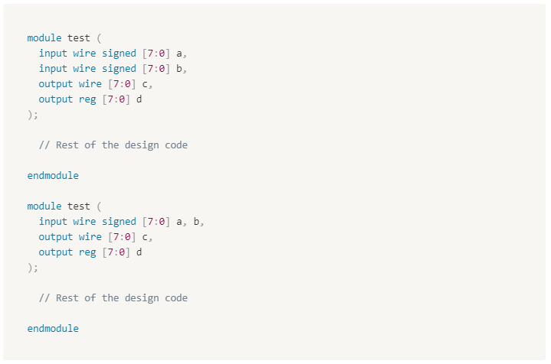
Verilog module
<direction> [net_type] [signed] [range] <signal name>

Slide 18
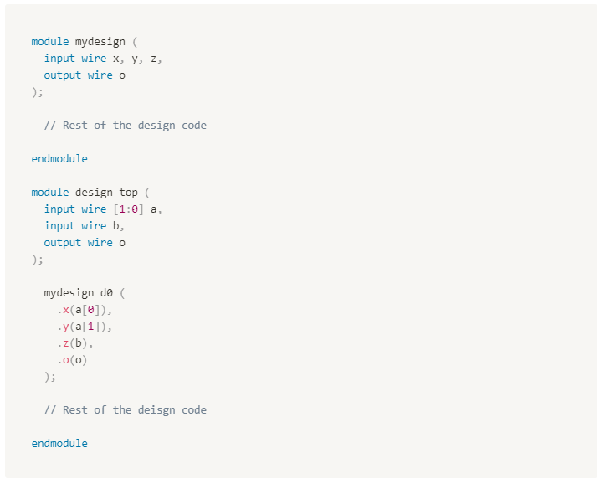
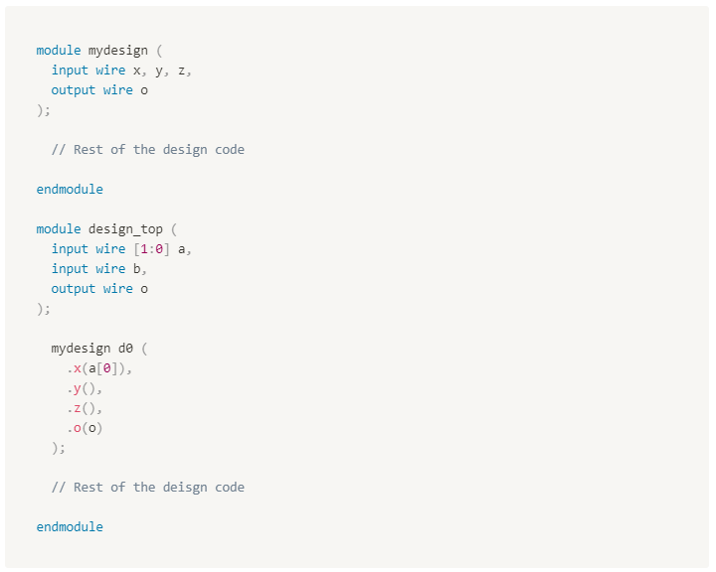
Verilog module
Module instantiations
Modules can be instantiated within other modules and ports of these instances can be connected with other signals inside the parent module
<module name> <instance name> (<port list>);
Port connection by ordered list, Port connection by name
Ports that are not connected to any wire will have a high-impedance value
Ports of type Input or inout cannot be declared as reg

Slide 19
Verilog Building Blocks
Statements
Reference : https://www.chipverify.com/verilog/verilog-tutorial

Slide 20

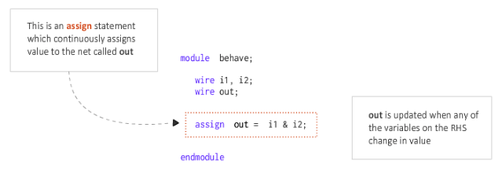
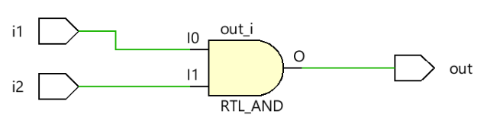
Verilog assign statement
Signals of type wire requires the continuous assignment of a value.
When the circuit is running, the wire is continuously driven by some source
This concept is realized by the assign statement where any wire can be driven continuously with a value. The value can either be a constant or an expression comprising of a group of signals
Assign statement rules
LHS should always be wire type
Whenever any operand on the RHS changes in value, LHS will be updated
Example #1 : AND gate
Wire out is continuously driven by an expression of signals i1 & i2.

Slide 21
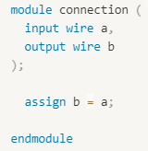
Verilog assign statement
Example #1 : connection
Example #2 : AND gate
Wire out is continuously driven by an expression of signals i1 & i2.
a
b

Slide 22
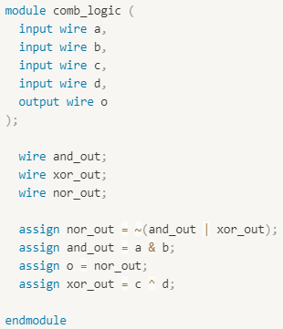
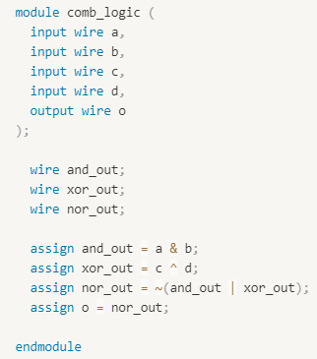

Verilog assign statement
Example #3 : Combinational Logic
and operation : &
or operation : |
xor operation : ^
not operation : ~
Relative order of assign statements doesn’t matter.
All assign statements are evaluated concurrently and continuously.

Slide 23
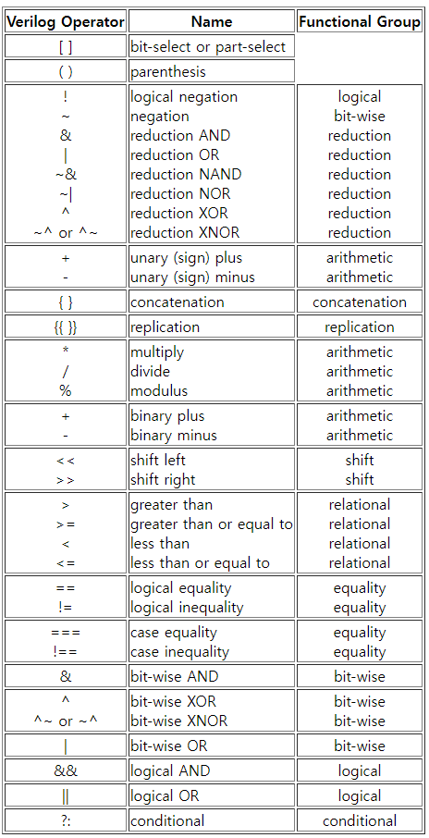
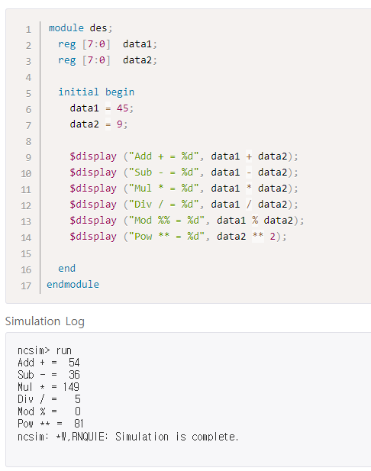
Verilog Operators
https://class.ece.uw.edu/cadta/verilog/operators.html

Slide 24
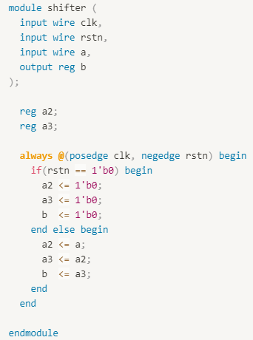
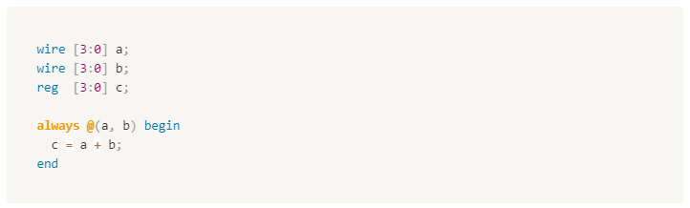
Verilog always statement
An always block is one of the procedural blocks. Statements inside an always block are executed sequentially
Sensitivity list
Expression that defines when the always block should be executed.
Specified after @ operator within parenthesis ()
LHS in always block must be reg type

Slide 25
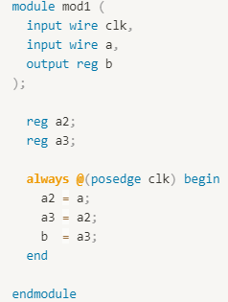
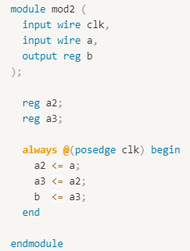
Verilog always statement
Blocking assignment
The statements below the blocking assignment will be evaluated after the blocking assignment is evaluated
Non-blocking assignment
The statements below the blocking assignment will be evaluated concurrently with the Non-blocking assignment
Just connection
Shift register

Slide 26
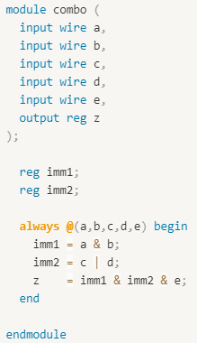
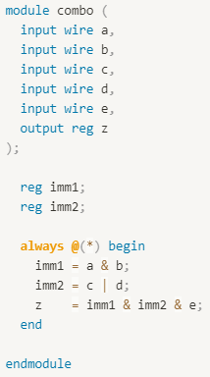
Verilog always statement
Combinational logic with always statement
Use only blocking statement
Consider using “*” in sensitivity list (* means all signals on RHS)

Slide 27
Verilog always statement
Sequential logic with always statement
Use only Non-blocking statement
@(negedge rstn) means async reset
Just connection
Shift register

Slide 28
Verilog Behavioral modeling
Reference : https://www.chipverify.com/verilog/verilog-tutorial

Slide 29
Verilog Control blocks
Hardware behavior cannot be implemented without conditional statements and other ways to control the flow of logic
multiplexer, decoder, etc…
Conditional statements
If - else – if
case
Iterative statements
for

Slide 30
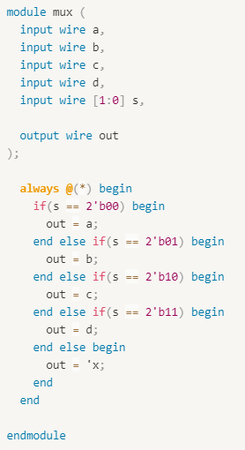
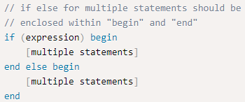
Verilog Control blocks
Conditional statements
If - else – if
If the expression evaluates to true, then the first statement will be executed. If false, else part will be executed.
If else must be used in always statement
else part is optional

Slide 31
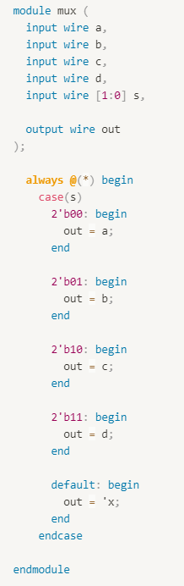
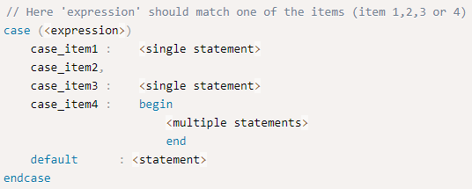
Verilog Control blocks
Conditional statements
case
The case statement checks if the given expression matches one of the other expressions in the list and branches accordingly.
Matching is done in order (item1 → itme2 → item3 → item4).
First matched item is executed.
If no item is matched, default statement is executed. But if there is no default statement, case statement is done without doing anything.

Slide 32

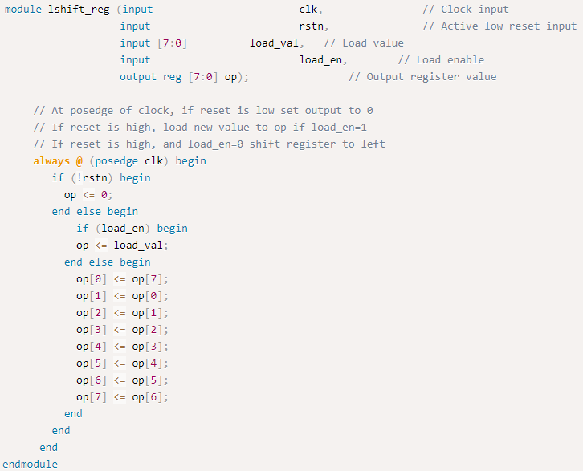
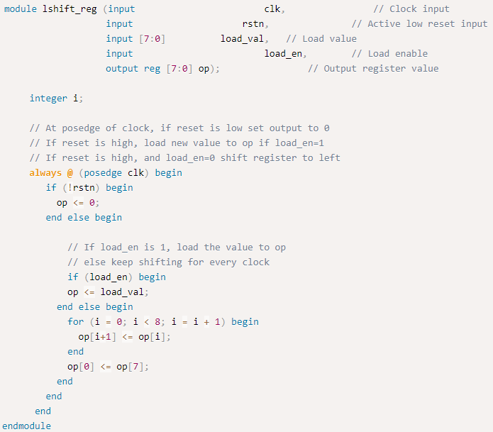
Verilog Control blocks
Iterative statement
For
for loop is to iterate a set of statements given within the loop as long as the given condition is true.
for loop is just unrolled when running module

Slide 33
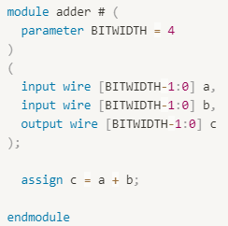
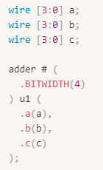
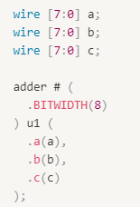
Verilog Parameters
Parameters are Verilog constructs that allow a module to be reused with a different specification.
Adder with different bit width

Slide 34
Verilog Simulation
Reference : https://www.chipverify.com/verilog/verilog-tutorial

Slide 35
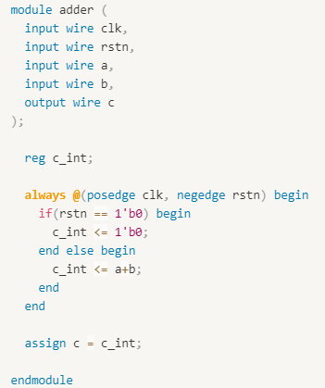
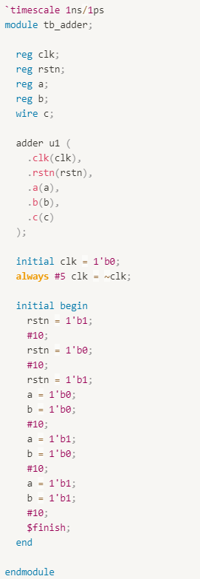
Verilog Simulation Basics
Simulation
Applying different input stimulus to the design at different times to check if the RTL code behaves the intended way.
Testbench
module including a design module and testing it.

Slide 36
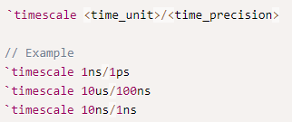
Verilog Simulation Basics
Timescale
`timescale directive specifies the time unit and precision
<time_unit> : measurement of delays and simulation time
#1 = 1ns delay when `timescale 1ns/<time_precision>
<time_precision> : how delay values are rounded before used in simulation
#1.4 = 1ns delay when `timescale 1ns/1ns
#1.5 = 2ns delay when `timescale 1ns/1ns
#1.1 = 1.1ns delay when `timescale 1ns/1ps

Slide 37
Verilog Simulation Basics
initial statement
Only for simulation. Not synthesizable
initial block is started at the beginning of a simulation at time 0 unit.
This block will be executed only once.
$finish : system task for finishing the simulation

Slide 38
Verilog Appendix
Reference : https://www.chipverify.com/verilog/verilog-tutorial

Slide 39
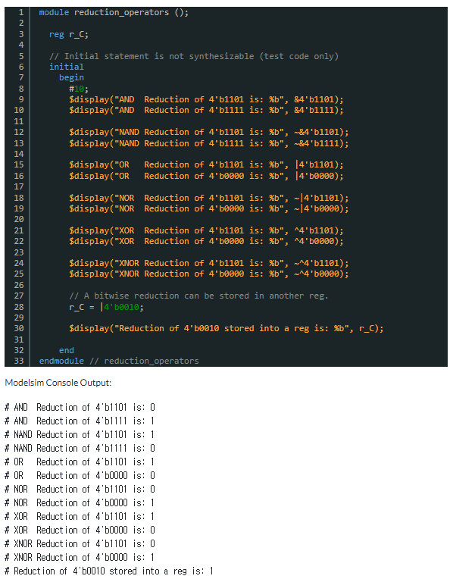
Verilog Operators
https://nandland.com/reduction-operators/

Slide 40
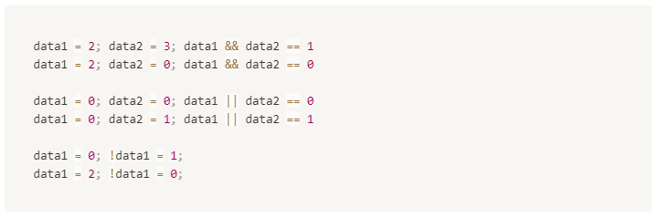
Verilog Operators
Zero or not
All numbers except 0 are treated equally.

Slide 41



Verilog Operators
If unsigned and signed wire signals are compared, signed signals will be treated as unsigned type.

Slide 42


Verilog Operators
Bitwise operation
Apply operator bit by bit
Concatenation, replication

Slide 43


Verilog Operators
Shift operation
Logical shift, arithmetic shift
Ternary conditional operation

