Slide 1
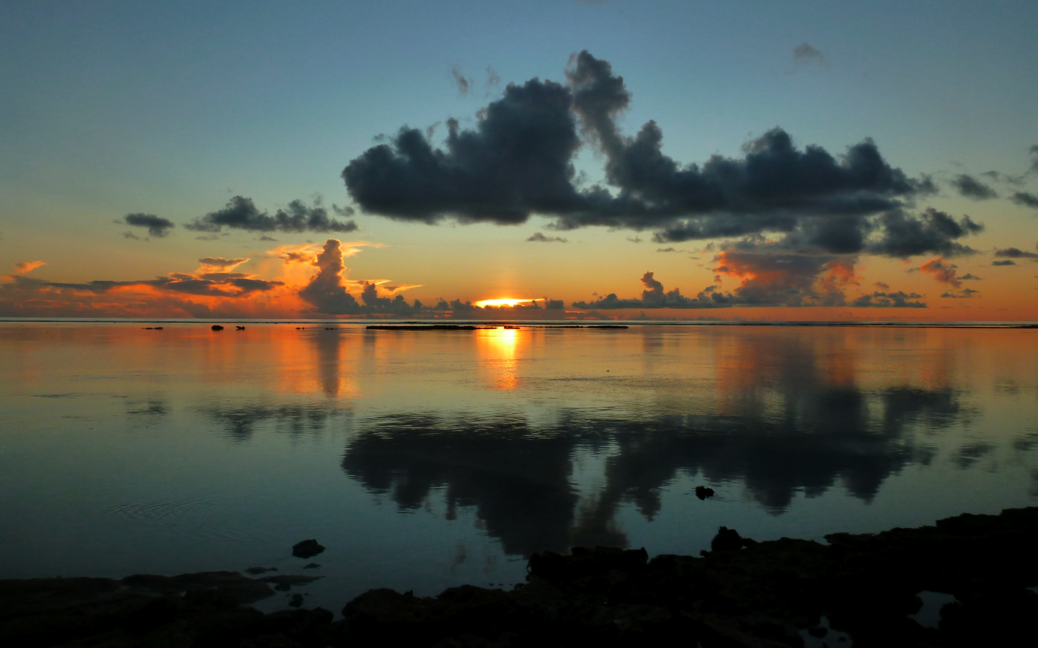
Evolution of Tropospheric Humidity and Convection Prior to MJO Onset
Scott W. Powell and Robert A. Houze, Jr.
University of Washington, Seattle, WA
March 5, 2013
MJO Field Data and Science Workshop, Kohala Coast, HI
Breakout Session 3A
This work was supported by NSF grant AGS-1059611 and DOE grants DE-SC0001164 / ER-64752 and DE-SC0008452.

Slide 2
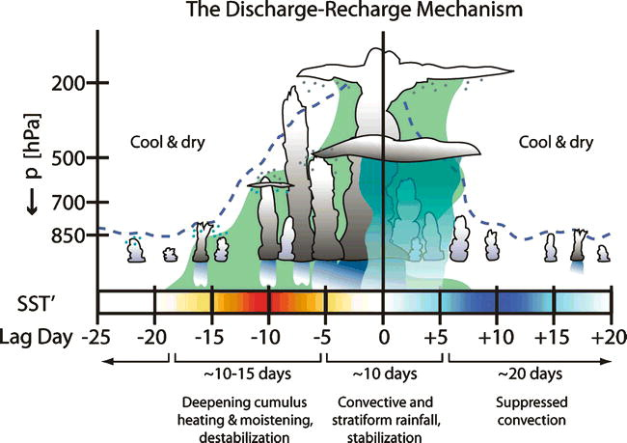
Bladé and Hartmann (1993); Kemball-Cook and Weare (2001); Benedict and Randall (2007)

Slide 3
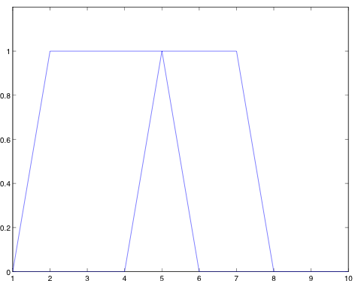
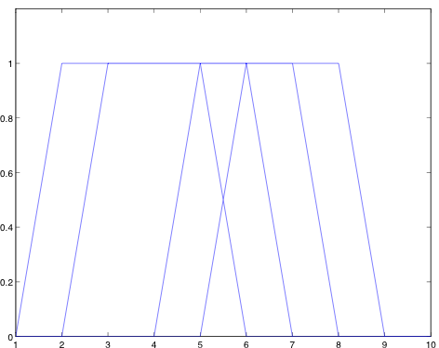
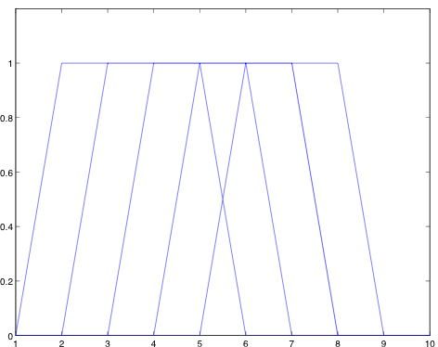
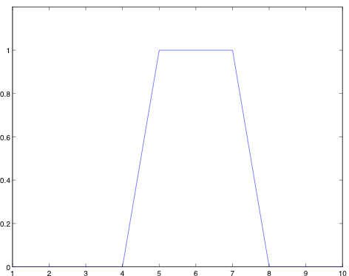
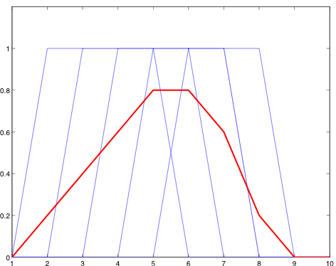
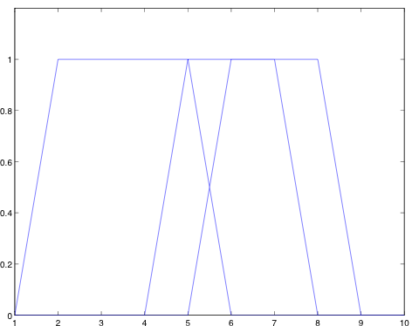
Variability in precipitating clouds
By MJO Phase (Wheeler &
Hendon, 2004)
Relative to filtered precipitation
maximum

Slide 4
Composite
CE1 (October)
CE2 (November)
CE3 (December)

