Slide 1
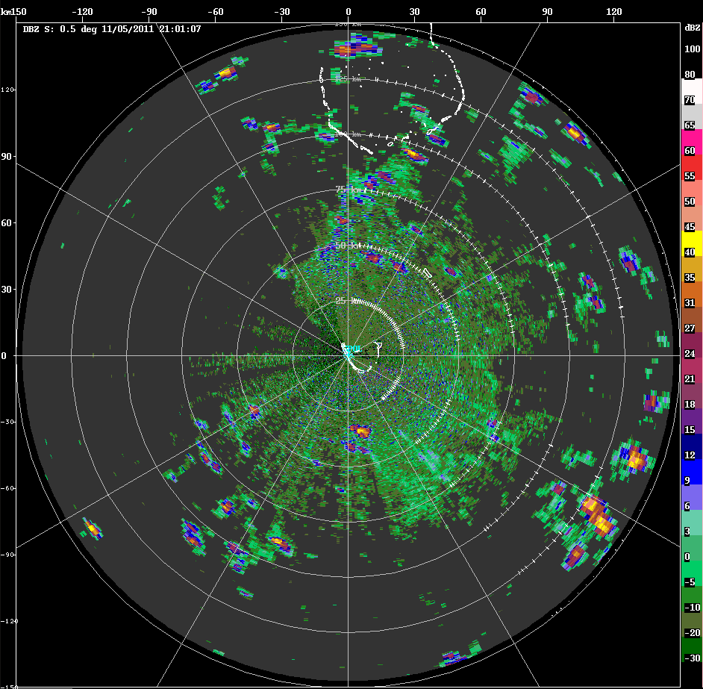
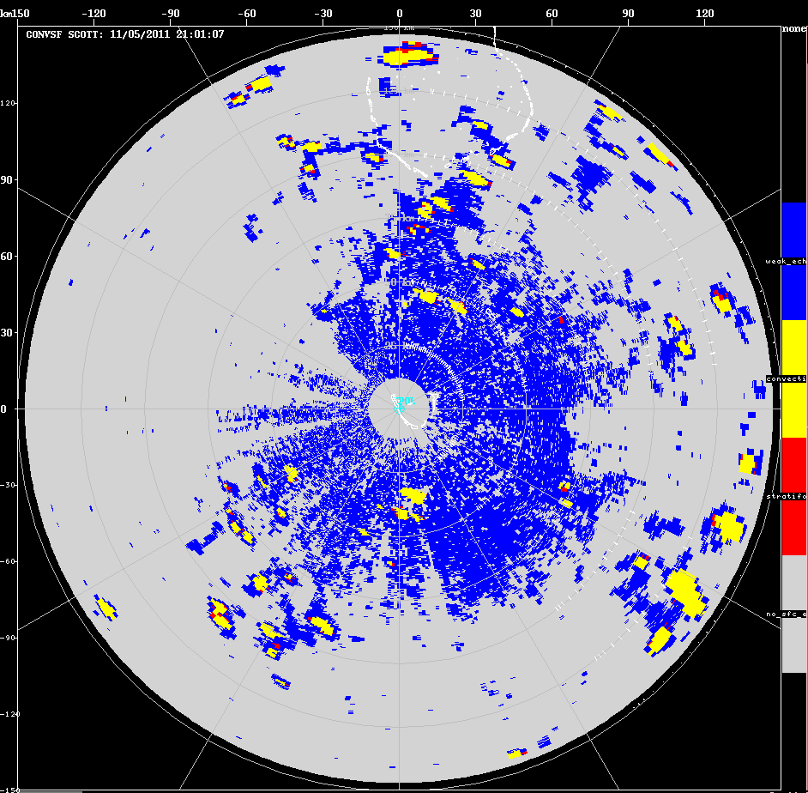
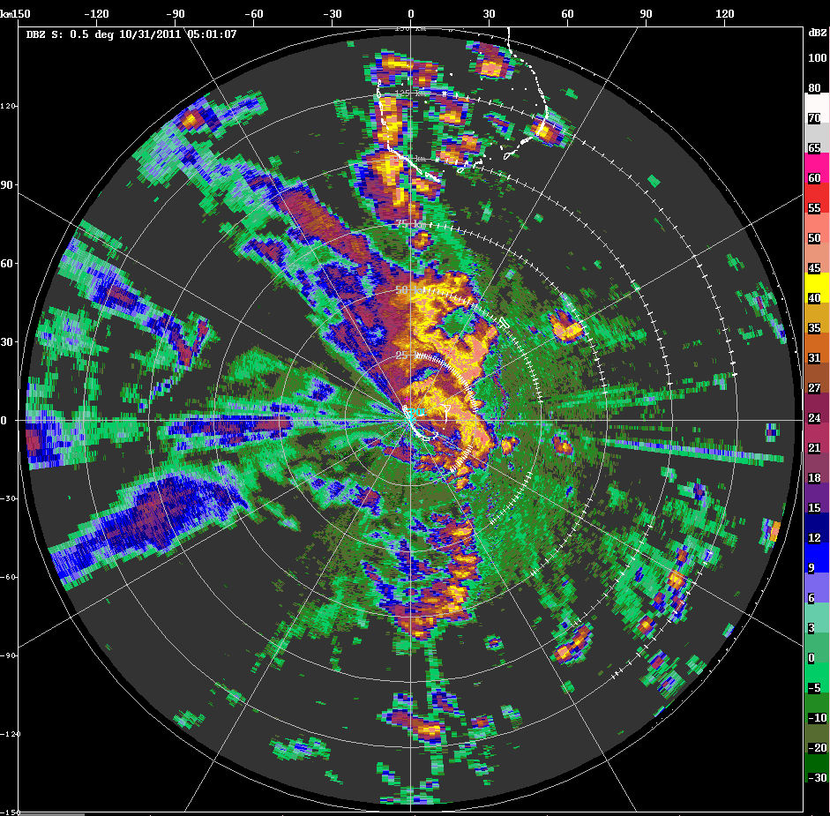
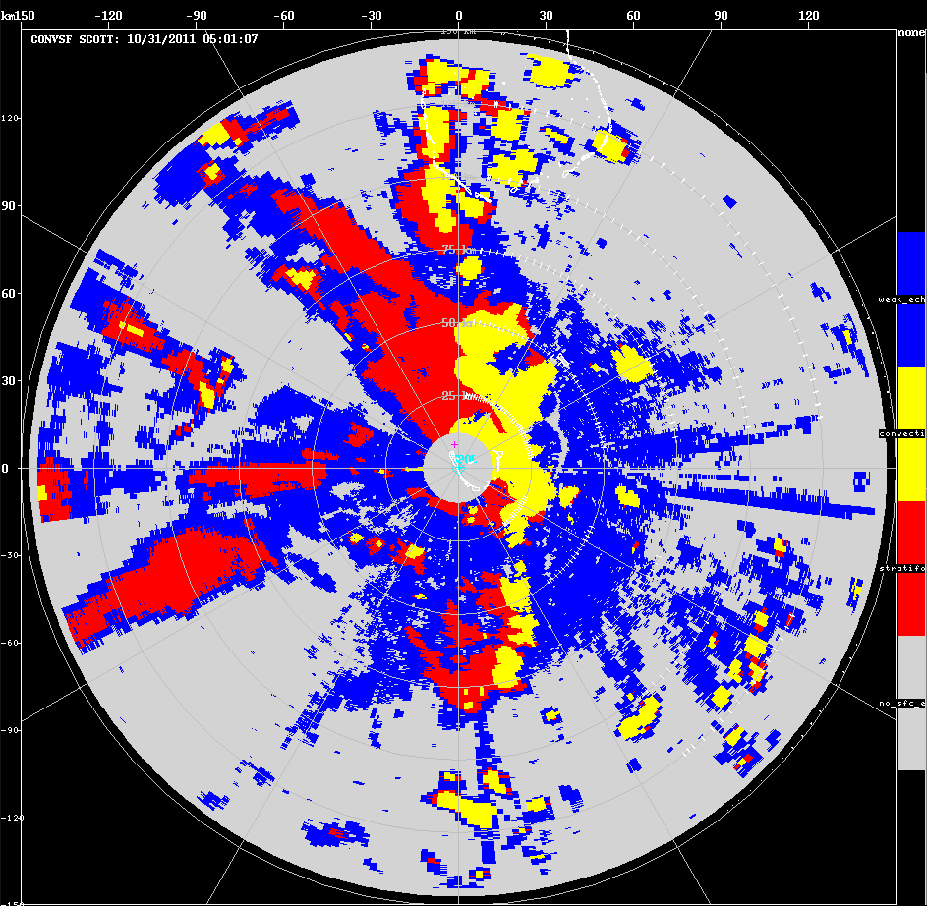
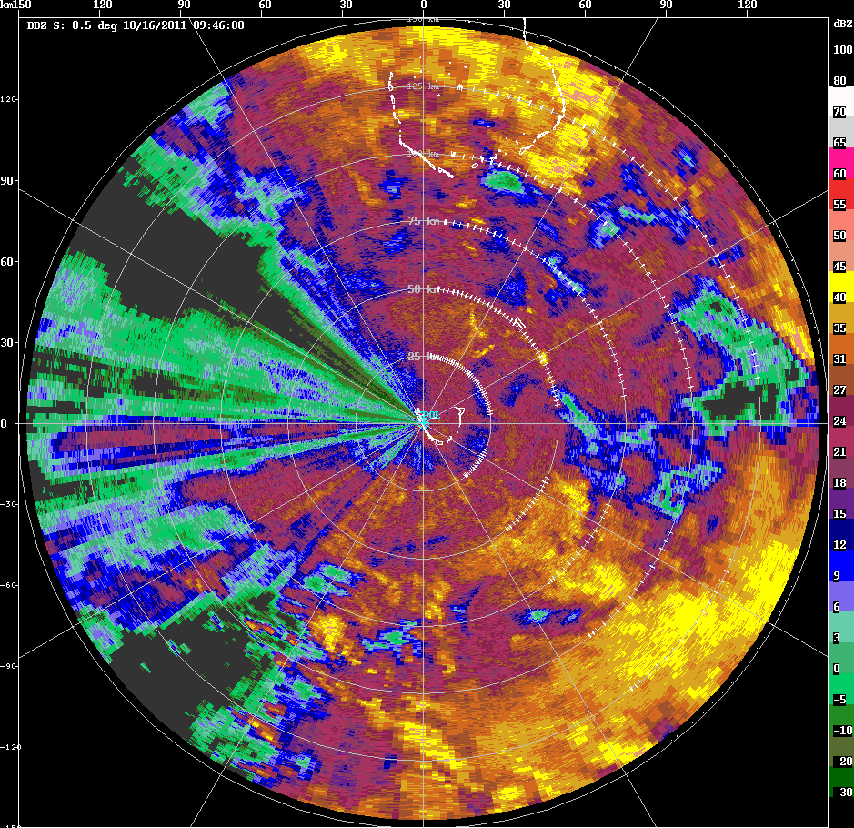
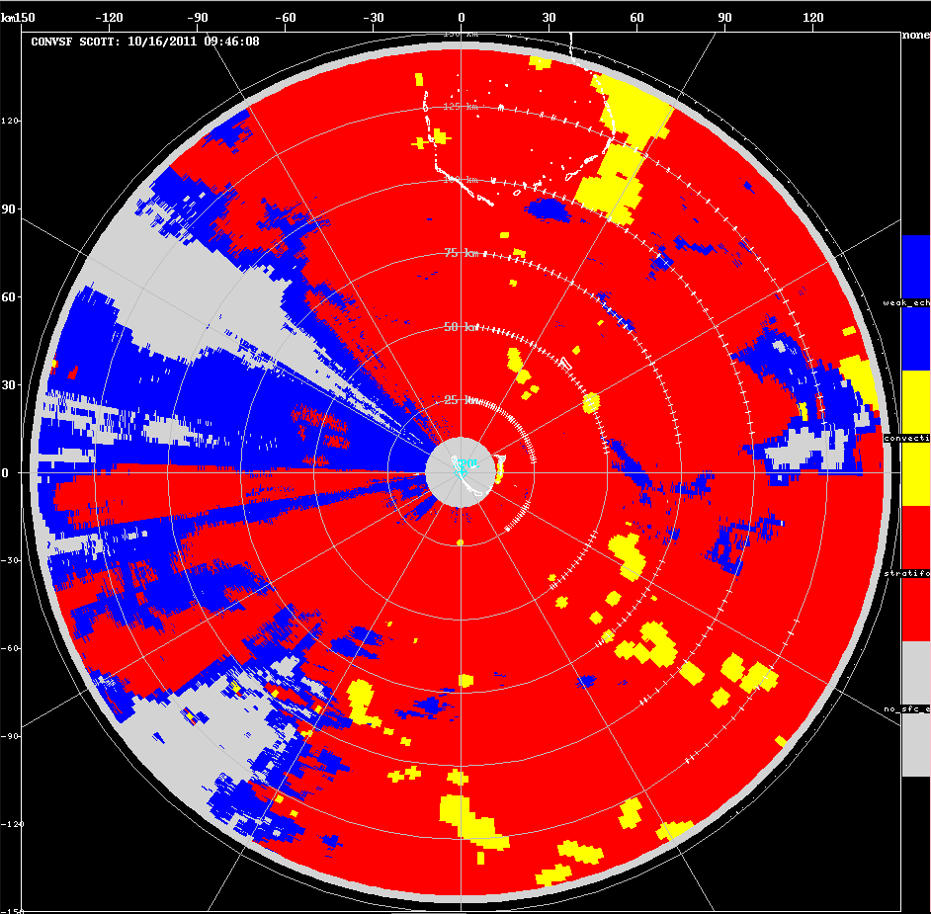
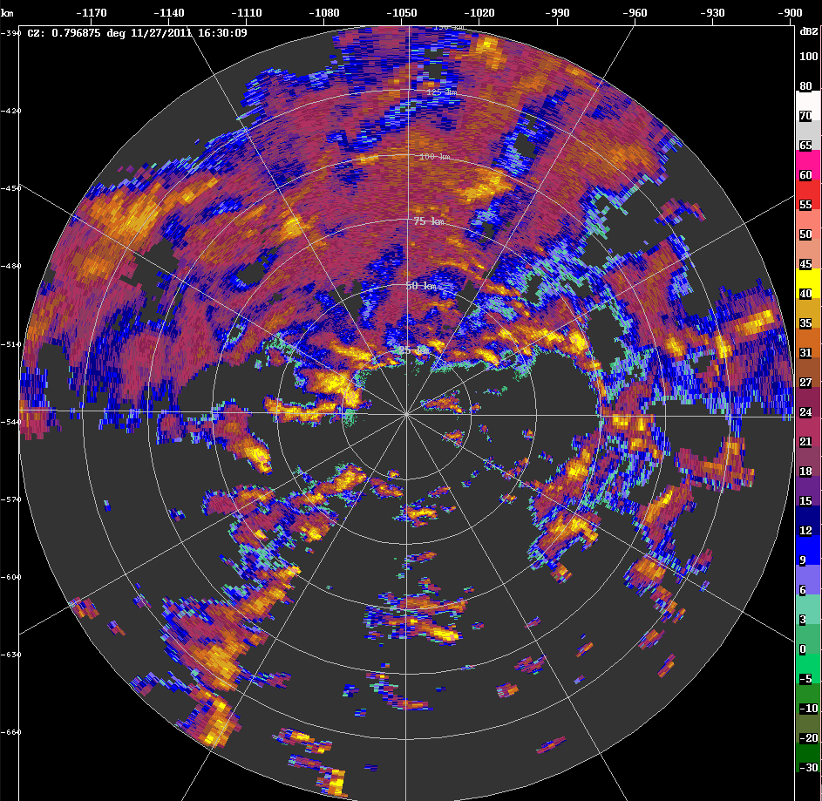
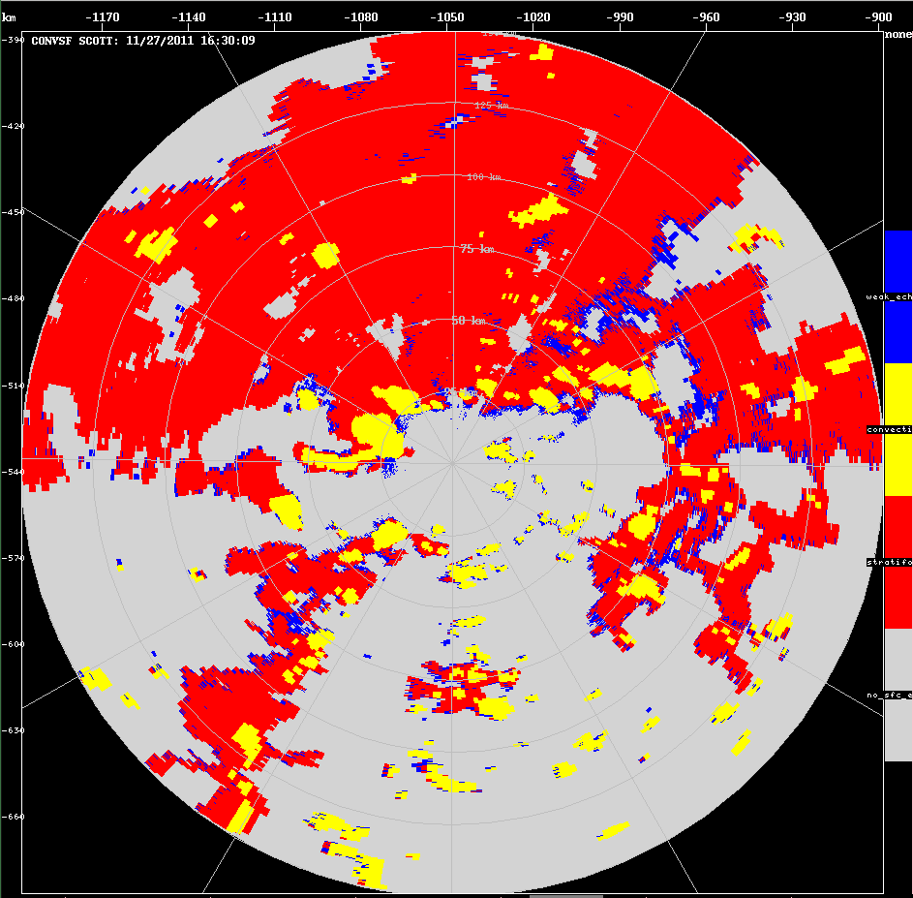
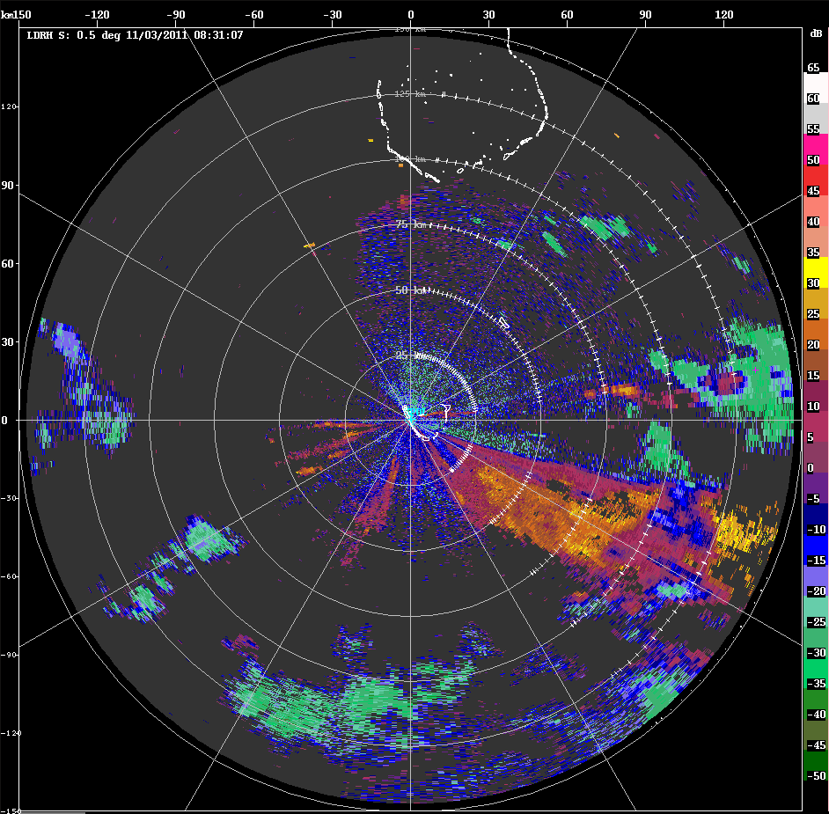
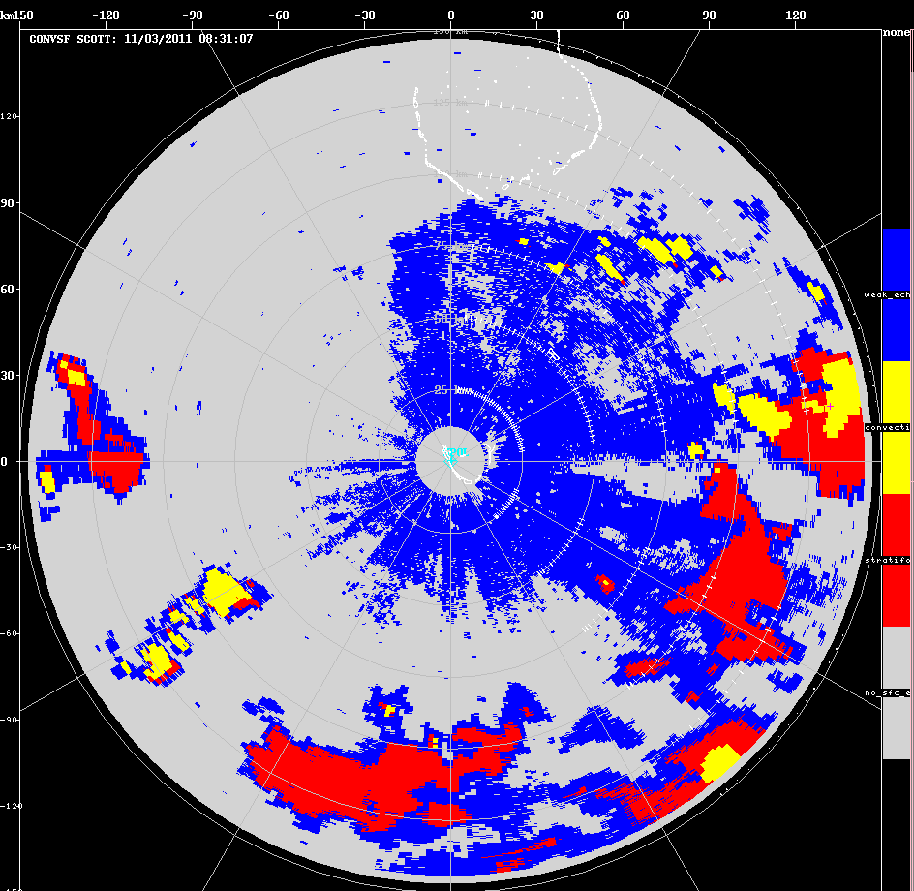
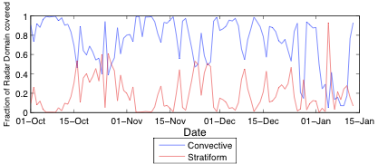
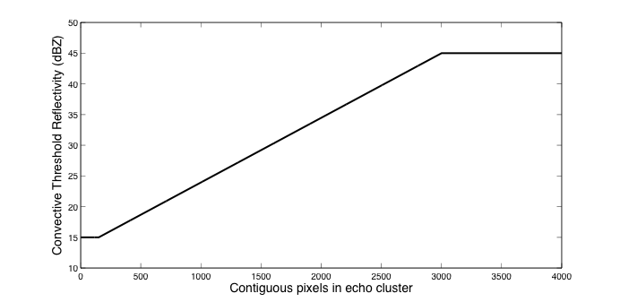
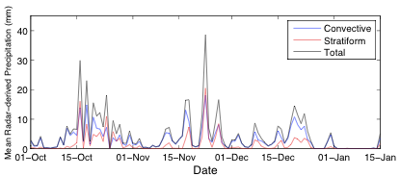
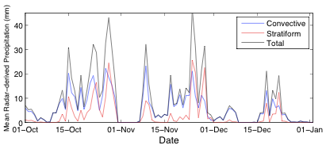
An Improved Algorithm for Radar-derived Classification of Convective and Stratiform Precipitation Echoes
Scott W. Powell and Stacy R. Brodzik
University of Washington, Seattle, WA
1. Introduction
4. Results
Classification of convective and stratiform precipitation echoes has been used to constrain latent heating profiles in the tropics (Schumacher et al. 2004). Thus, an accurate classification of precipitation derived from convective elements or stratiform cloud is needed.
The commonly used current algorithm is based on Churchill and Houze (1984) and was updated by Steiner et al. (1995).
Isolated Convective Echoes
Squall Lines
2. Limitations of Current
Algorithm
Widespread Stratiform Echoes
Also works for Revelle C-band!
1) The Steiner et al. (1995), hereafter SHY95, algorithm requires an interpolated reflectivity field at a single height. Traditionally, reflectivity is interpolated to a 2 km or 500 m grid, and the classification is based on the interpolated field. However, interpolating to a resolution greater than that of the data results in “creation” of data. In contrast, interpolating to a resolution less than that of the data requires smoothing over features—such as potentially narrow convective echoes embedded within stratiform echo.
2) SHY95 determines a convective center in one of two ways: 1) An echo exceeds a user-defined threshold, or 2) An echo sufficiently exceeds the mean reflectivity within a specified distance of a point. However, echoes associated with isolated convection may be classified inadvertently as stratiform because their reflectivities are not sufficiently high nor higher than the background—which consists only of the echoes in that small cluster.
S-Pol Precipitation Estimates
TOGA Precipitation Estimates
3. Improvements and New Features
Left: Radar-derived convective and stratiform precipitation amounts (top) and fraction of total amount attributed to convective and stratiform echoes (bottom).
Right: Same as left but for old algorithm. Both panels use hybrid polarimetric rain estimate.
Results are comparable. We note two things:
1) Estimated precipitation is less for new algorithm, possibly because we use the lowest scan angle for estimates.
2) Stratiform rain fractions are improved during periods of low rainfall (orange circles). Rain during such periods originates primarily from shallow, suppressed convection. New isolated convection scheme corrects high bias in stratiform rain during such periods caused by interpolation of reflectivity field in old algorithm.
TOGA Radar-derived precipitation. Gray shaded areas indicate when radar was not operational.
A single Z-R relationship was used to estimate precipitation using reflectivity from the lowest scan angle: Z = 129.56 R^{1.37}.
For most days, the amount of convective rainfall exceeds that of stratiform rainfall. However, more stratiform rainfall still appears to have fallen on several days near the end of each month during wide stratiform events. Such was hardly ever observed at S-PolKa.
There is little reason to believe that the relative fractions of convective and stratiform precipitation—and thus the latent heating profiles present--at two sites within a few hundred km over open ocean differ significantly. Additional tuning of the new algorithm for each site, or use of a separate Z-R relationship for stratiform precipitation may remedy the discrepancy.
1) Use of the native resolution of radar data
- No interpolation of reflectivity field required. This alone makes the current scheme superior to SHY95.
- Distances between data points are needed to determine background reflectivity. To obtain these, we map the radar data from native polar coordinates onto an irregular Cartesian grid.
- Takes advantage of high resolution of radar data along a radial (150m for S-Pol).
Isolated/shallow convection scheme
- Small, isolated convective echoes, which are often detected during suppressed periods, are usually weaker than deep or widespread convective echoes.
- Lower threshold for automatic convective classification for smaller contiguous echo objects.
5. Known Issues/Upcoming Improvements
Overcoming Beam Blockage
Other Improvements
S-Pol experienced substantial blockage of its lowest elevation sweep to the west of the radar.
For sectors experiencing beam blockage, a higher scan angle can be used, provided the height of the reflectivity echo does not exceed some predetermined level—2.5 to 3 km would be acceptable.
1. Eliminate second-trip echo using LDR return
2. Mask out islands not removed by clutter filter.
Positive LDR = second-trip echo
Some second-trip echo classified as convective or stratiform.
3. Make code portable for other file formats in at least one universal programming language.
4. Update isolated convection scheme to determine echo object size in terms of area—and not number of pixels—covered.
- Size of echo cluster currently based on number of contiguous pixels with reflectivities in excess of a user-defined value.
- Helps prevent inadvertent classification of shallow and isolated convection as stratiform.
Creation of this poster was supported by grant AGS-1059611 from the National Science Foundation. S. Powell was also supported by DOE grant DE-SC0008452.

