Slide 1
Physics of Sea Spray
Impact on Tropical Cyclone Intensity
Scott W. Powell^{1,2}, Jian-Wen Bao¹, Christopher W. Fairall¹, Laura Bianco¹
¹ NOAA/ESRL/PSD, Boulder, Colorado
² Rosenstiel School of Marine and Atmospheric Science, University of Miami, Miami, Florida
July 30, 2008

Slide 2
Background
Hurricane intensity forecasts remain difficult.
Improving physics in computer models can help improve guidance.
Coupled air-sea modeling system shows affect of sea spray on intensity and structure with minimal effect on track. (Bao, et al., 2000, Bao, et al., 2008).

Slide 3
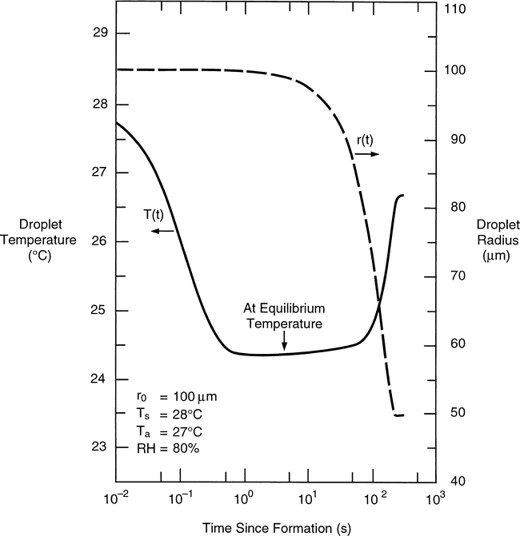
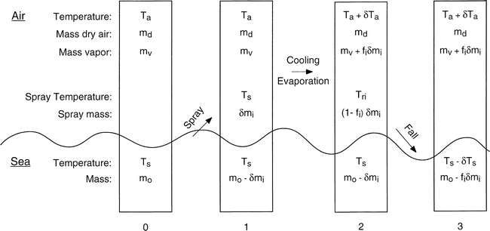
Physics
Thermodynamics of sea spray (Andreas and Emanuel, 2001)

Slide 4
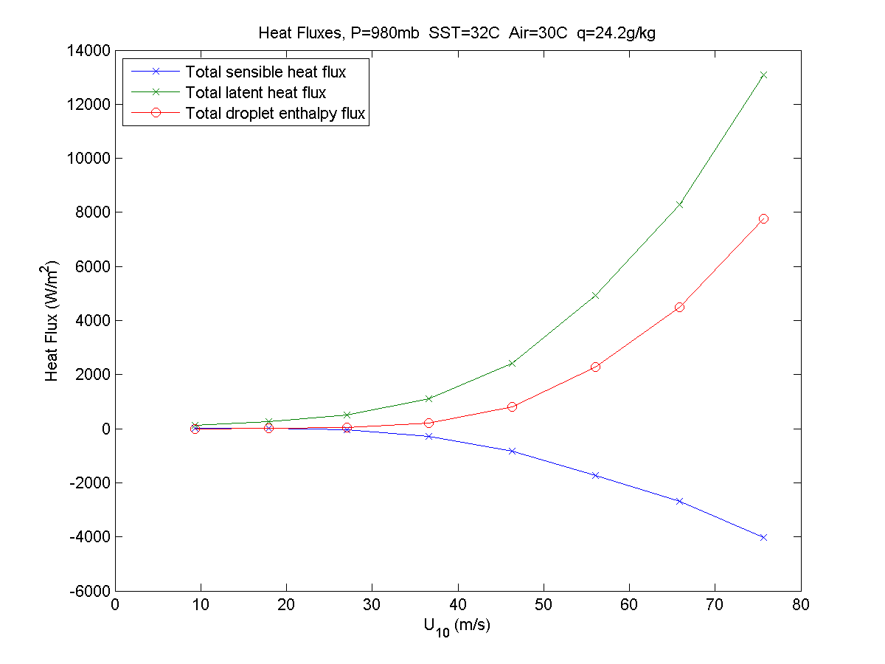
Physics

Slide 5
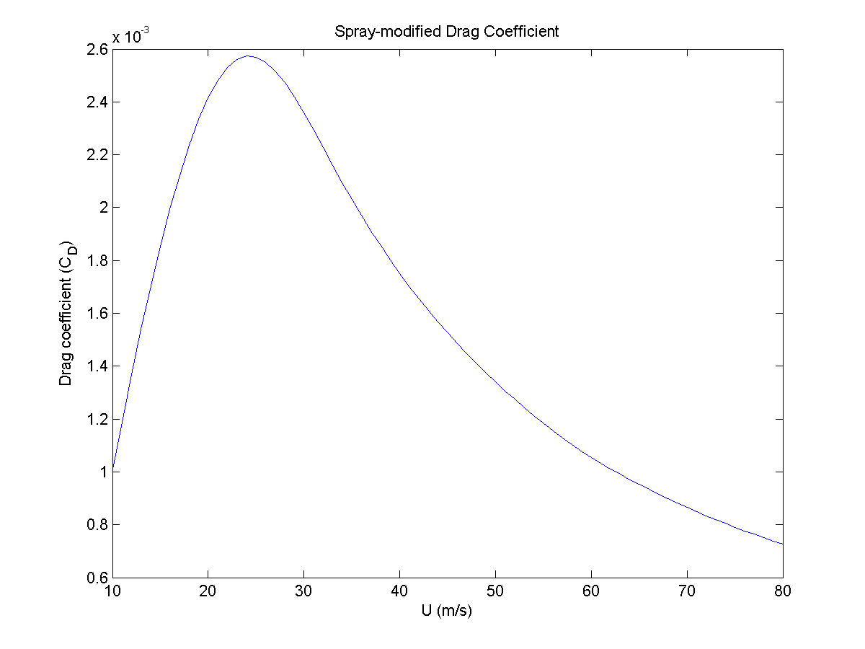
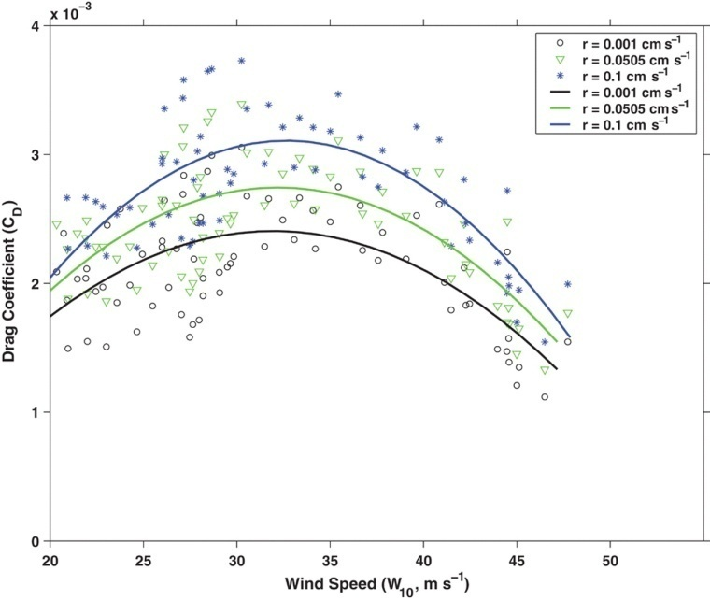
Physics
Above: Jarosz, et al., 2007
Left: Corresponds well quantitatively also with Andreas (2004), and Kudryavtsev (2006).

Slide 6
Model
WRF ARW version 3.0
27 vertical layers
30km resolution
Kain-Fritsch cumulus parameterization
YSU PBL scheme
WSM3 microphysics (simple ice scheme)
GRIB1 GFS and SST data from UCAR/MMM
  Hurricane Katrina (2005) case study

Slide 7
Updates
Droplet source function (Fairall, et al., 2008) for incorporation into spray parameterization.
Explicit calculations from physics.
Kinematic effects of spray (Lykossov, 2001).

Slide 8
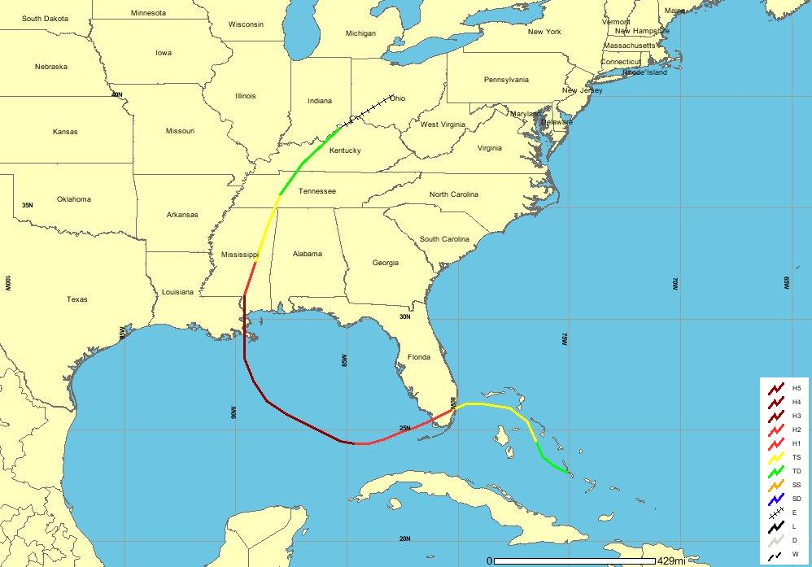
Hurricane Katrina (2005)
Courtesy: NOAA Coastal Services Center

Slide 9
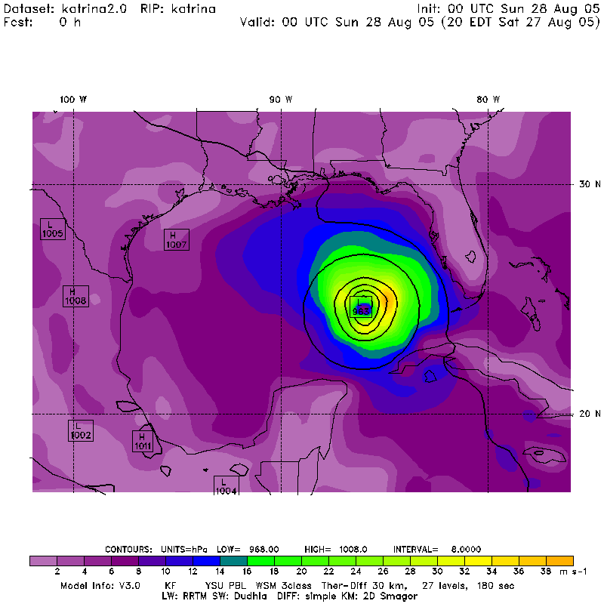
Model Output

Slide 10
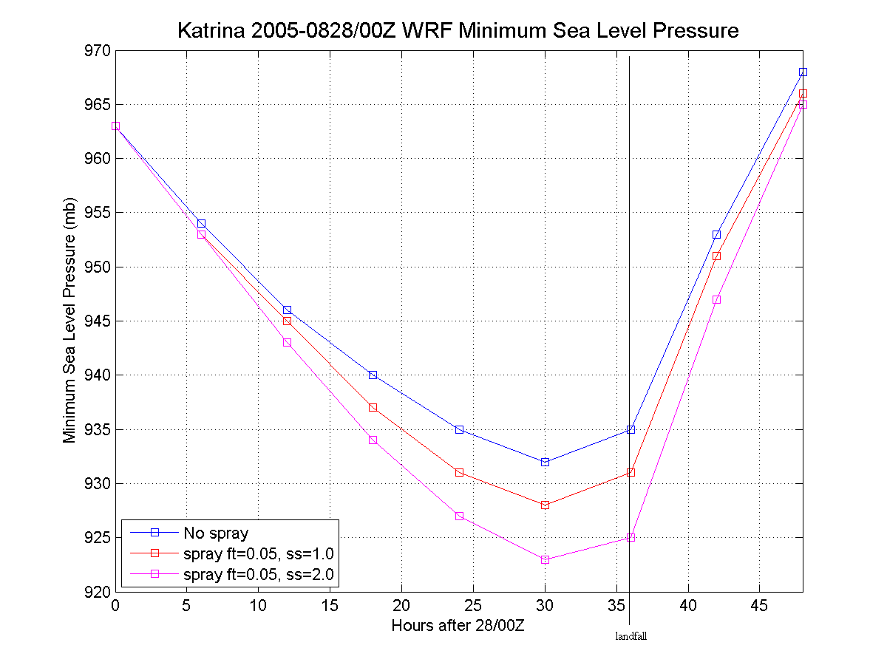
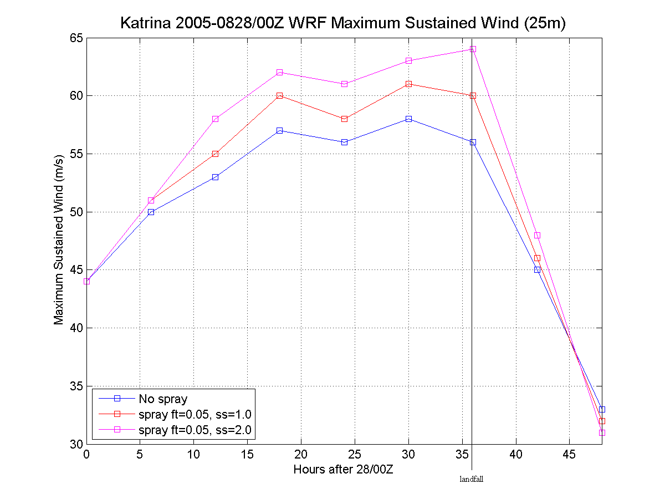
Model Output

Slide 11
Closing Remarks
Sea spray has affect on intensity.
Higher resolution
Cumulus parameterization adjustment
“Accidentally” correct model predictions

Slide 12
Acknowledgements
Also, thanks to Simon de Szoeke for helping with the installation of WRF3 and to Sara Michelson for locally running initial conditions for input into the model.
This work was supported by the NOAA Office of Education under the Ernest F. Hollings Undergraduate Scholarship Program.

Slide 13
References
Andreas, E.L. and K.A. Emanuel, 2001: Effects of Sea Spray on Tropical Cyclone Intensity. J. Atmos. Sci., 58, 3741-3751.
Andreas, E.L., 2004: Spray stress revisited. J. Phys. Oceanogr., 34, 1429-1440.
Bao, et al., 2000: Numerical Simulations of Air-Sea Interaction under High Wind Conditions Using a Coupled Model: A Study of Hurricane Development. Mon. Wea. Rev., 128, 2190-2210.
Bao, et al., 2008: Evaluation and Improvement of Spray-Modified Air-Sea Enthalpy and Momentum Flux Parameterizations for Operational Hurricane Prediction. 62nd Interdepartmental Hurricane Conference, Charleston, SC, OFCM, March 5, 2008.
Fairall, et al., 2008: Investigation of the physical scaling of sea spray spume droplet production. J. Geophys. Res., submitted
Jarosz, et al., 2007: Bottom-Up Determination of Air-Sea Momentum Exchange Under a Major Tropical Cyclone. Science. 315, 1707-1709
Kudryavtsev, V.N., 2006: On the effect of sea drops on the atmospheric boundary layer. J. Geophys. Res., 111, C07020 doi: 10.1029/2005JC002970
Lykossov, V.N., 2001: Atmospheric and Oceanic Boundary Layer Physics. Wind Stress over the Ocean (Eds. Ian S.F. Jones and Yoshiaki Toba), Cambridge University Press, pp. 54-81.
NOAA Cosatal Services Center, "Historical Hurricane Tracks." 15 May 2008. NOAA/CSC. 17 Jul 2008 <http://maps.csc.noaa.gov/hurricanes/viewer.html>.

