Slide 1
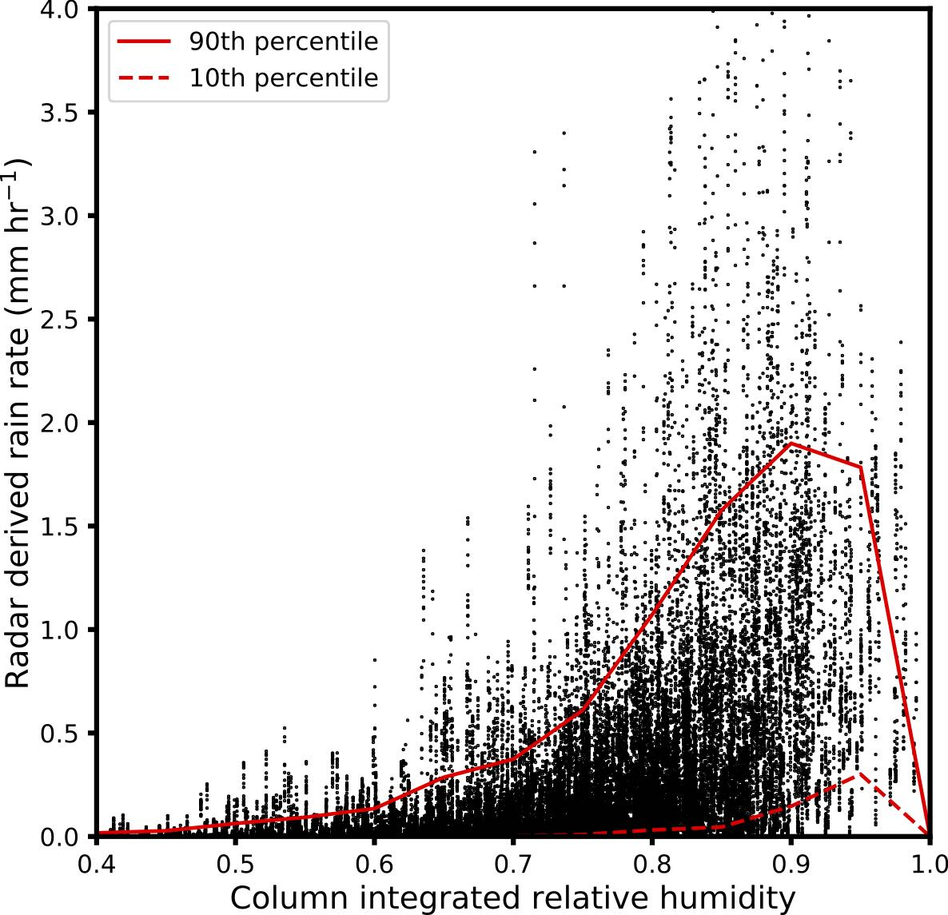
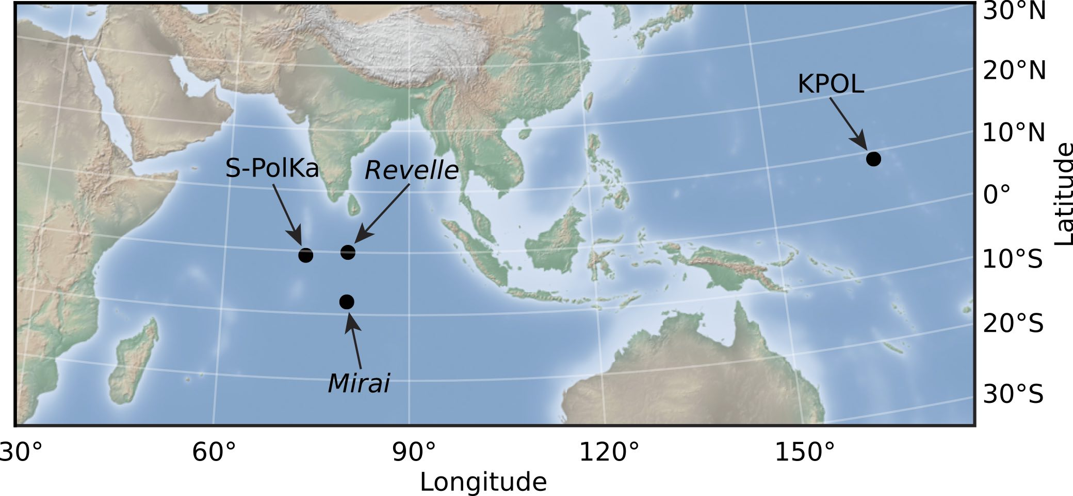
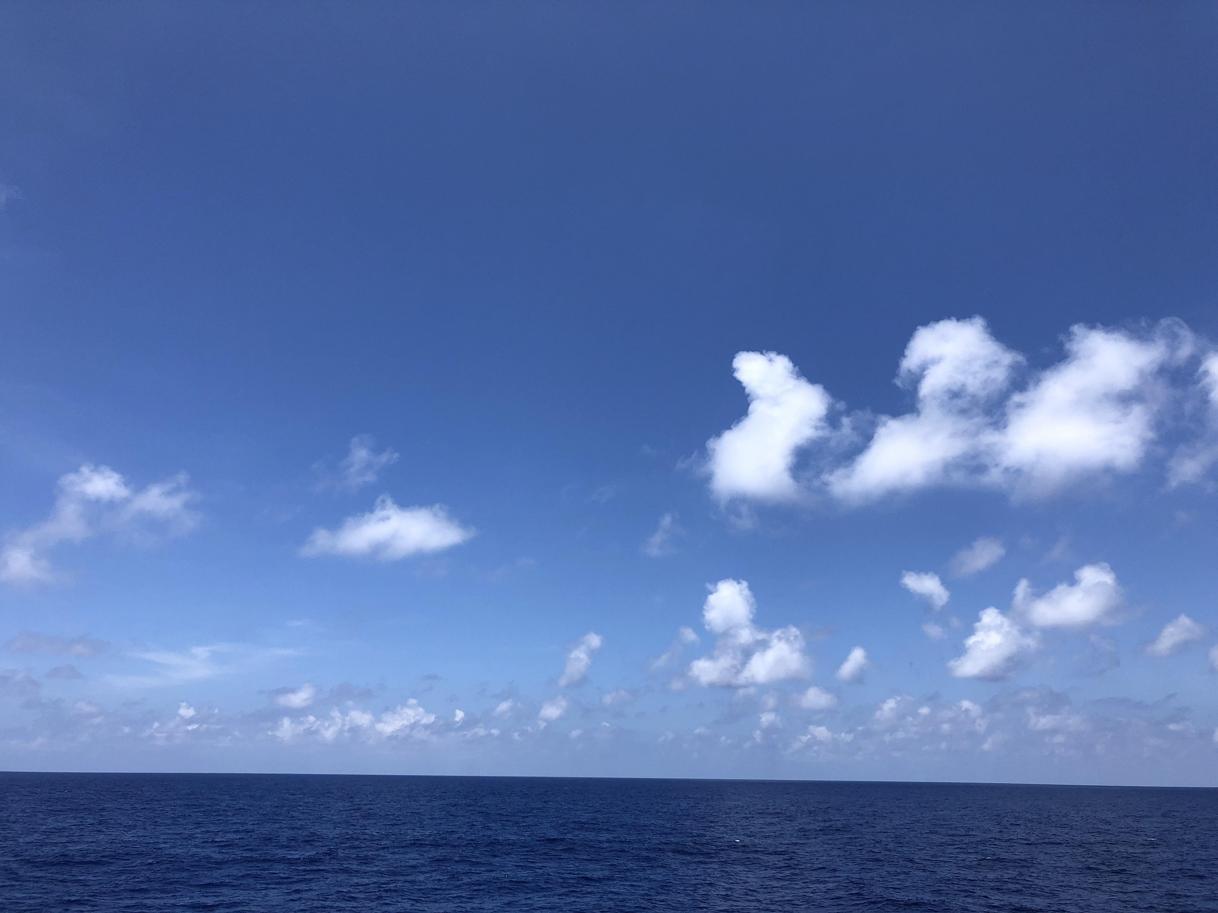
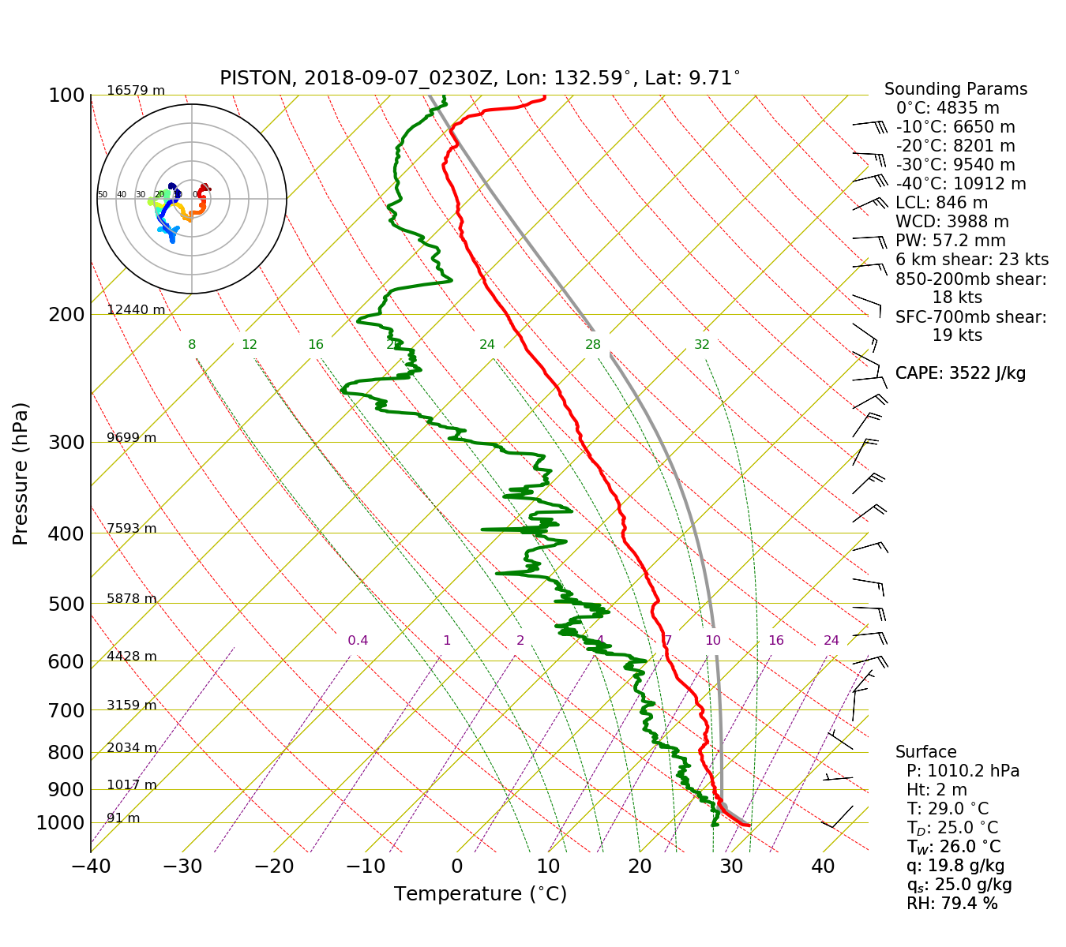
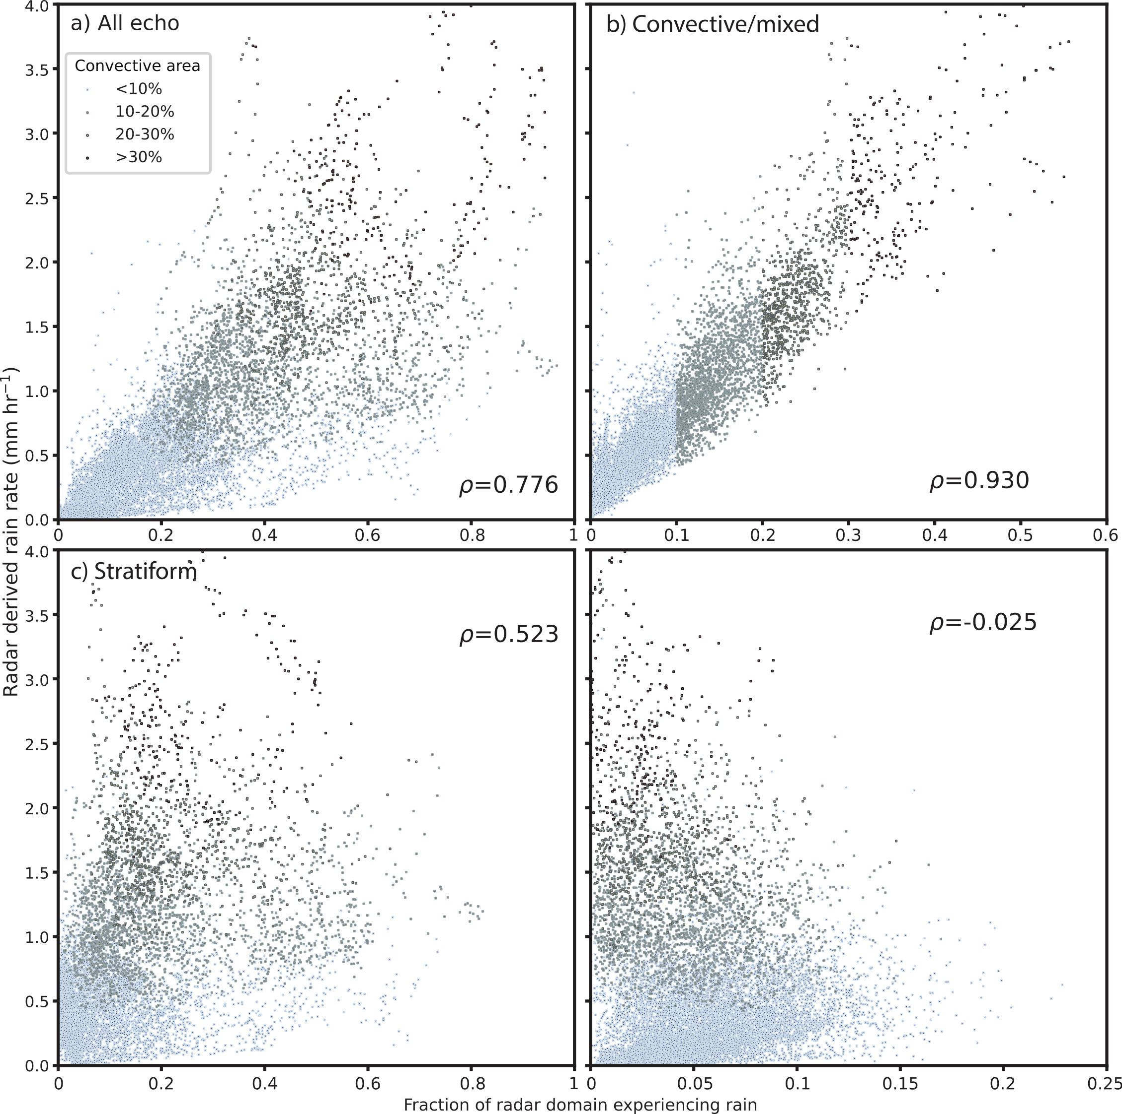
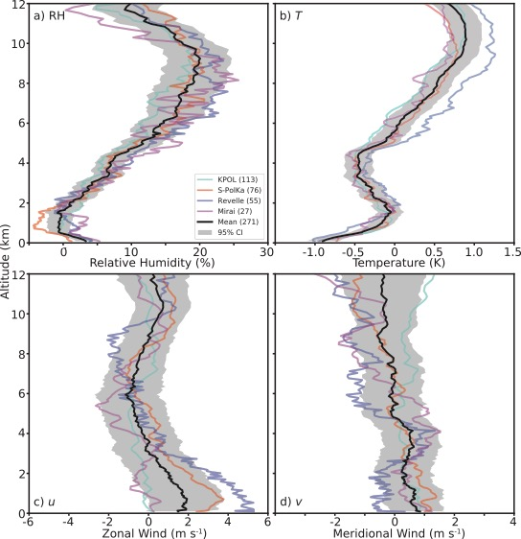
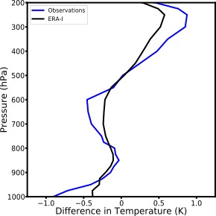
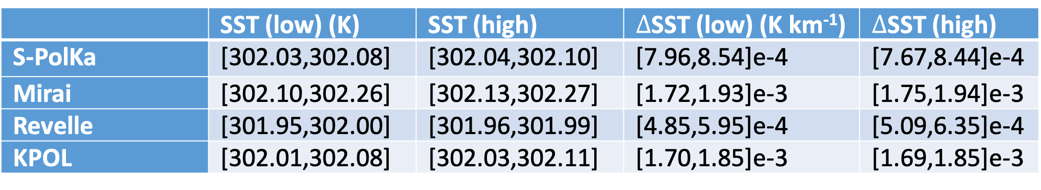
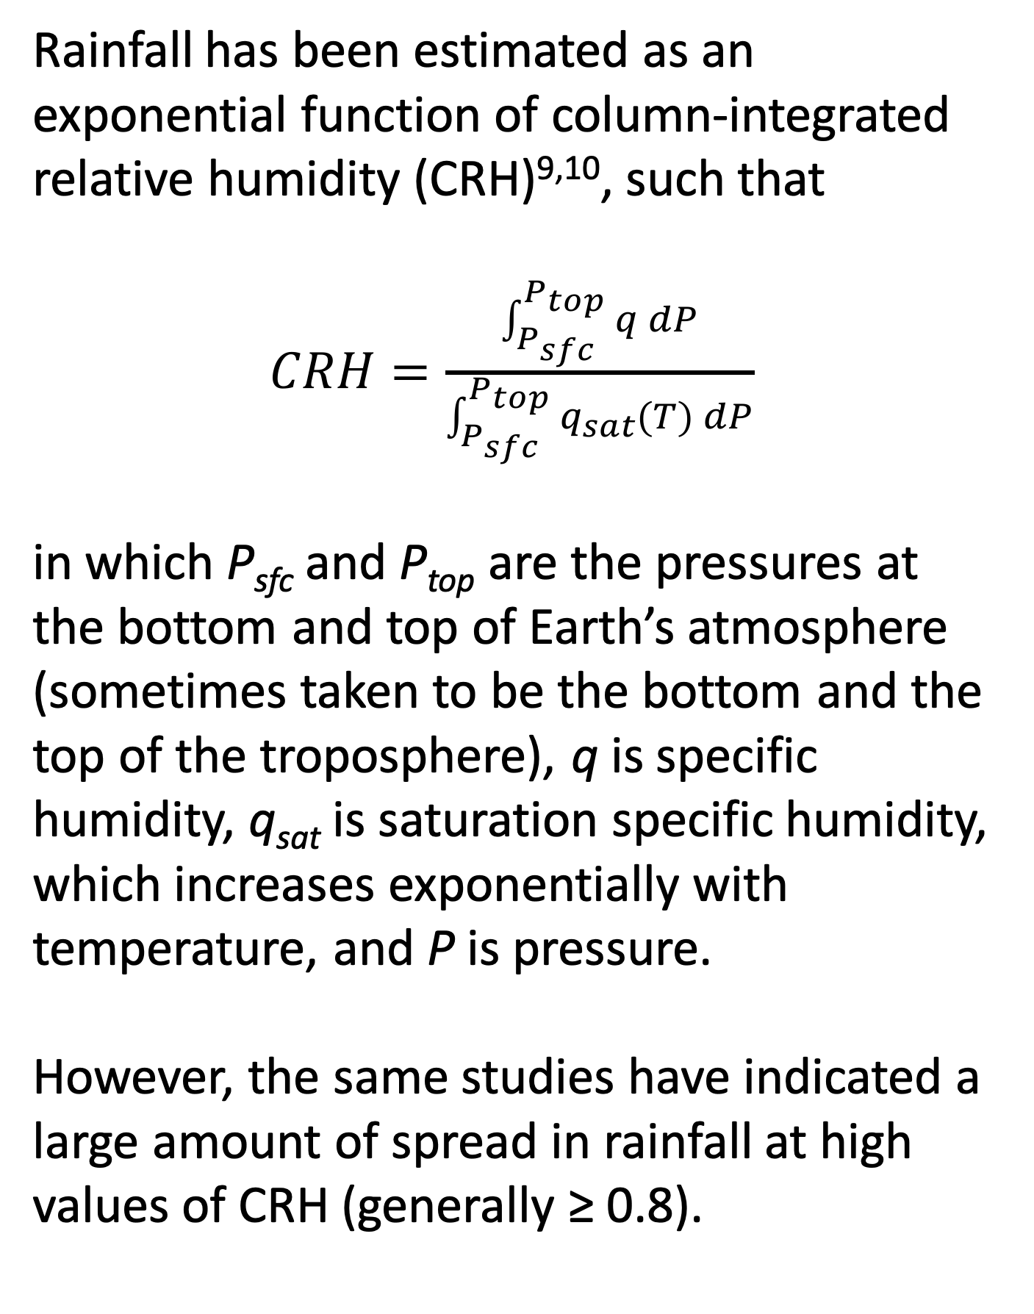
Rainfall Minima during Periods of High Relative Humidity in Tropical Maritime Regions
Scott W. Powell, Naval Postgraduate School, Monterey, CA
1. Introduction
2. Radar Data
3. Visualizing the Question
Dependence of tropical maritime precipitation on tropospheric humidity is well understood. Many observational^{1,2} and modeling^{3,4,5,6} studies have indicated that deepening of tropical convection is most sensitive to water vapor in the lower half of the troposphere.
However, often times, little or no rain occurs when the atmosphere is very moist. Why? Some possibilities, although not all:
Increased static stability above boundary layer
Less favorable wind/shear profiles
Lower sea surface temperature or gradient
Less boundary layer convergence
Unfavorable cloud properties, such as cloud size or vicinity of updraft to edge of cloud and environmental air
I utilized radar data from three locations. Three datasets were collected during DYNAMO in the central Indian Ocean, and one is the NASA KPOL radar at Kwajalein Atoll. S-PolKa and KPOL were/are dual-polarized. The radar data were used to estimate rain rate.
Rainfall has been estimated as an exponential function of column-integrated relative humidity (CRH)^{9,10}, such that
$CRH=\frac{\int_{P_{sfc}}^{P_{top}}{q dP}}{\int_{P_{sfc}}^{P_{top}}{q_{sat}(T) dP}}$
in which P_{sfc} and P_{top} are the pressures at the bottom and top of Earth’s atmosphere (sometimes taken to be the bottom and the top of the troposphere), q is specific humidity, q_{sat} is saturation specific humidity, which increases exponentially with temperature, and P is pressure.
However, the same studies have indicated a large amount of spread in rainfall at high values of CRH (generally ≥ 0.8).
Top, left: CRH vs radar-derived rain rates. The red lines denote the 10th and 90th percentiles of rain rate as a function of CRH.
Bottom, left: Picture taken from R/V Thompson during PISTON on 7 Sept 2018 at 0230 UTC.
Bottom, right: Sounding from 0230 UTC 7 Sept 2018.
Cloud population in a very moist environment (see sounding)
Figure 1: Locations of radars used so far in this study.
Rain-type classification⁷ was run on the reflectivity data, and rain rate was computed using dual-pol data if possible⁸.
Picture from E. Maloney (Colo. State)
TPW = 57.2 mm
4. Areal Coverage of Precipitation vs. Rain Rate
5. Environmental Characteristics
6. Next Steps
Left: Radar-derived mean rain rates as a function of the fraction of the radar domain experiencing precipitation (reflectivity ≥ 7 dBZ). In panels a, b, c, and d, respectively, areal coverage of all echo, convective echo, stratiform echo, and isolated echo is plotted. Darker shades of blue indicate higher area coverages of convective rainfall. The rain rates shown occurred only when CRH exceeded 0.8.
Not surprisingly, a positive correlation existed between areal coverage of rainfall and domain-mean rain rate. However, even when areal coverage exceeded half the domain (panel a), rain rate ranged from near 0 to near 4 mm hr-¹. On the other hand, radar-derived rain rate was strongly correlated with the fraction of the domain experiencing convective rainfall.
Rawinsonde data were co-located with each of the radar datasets. I used these data to compute kinematic and thermodynamic properties of the troposphere. Rawinsonde data was matched with radar data collected within 1.5 hours of launch.
Utilize additional radar datasets from throughout the Tropics for similar analysis.
LES modeling studies of tropical cloud populations using different sounding profiles as forcing
Critique of models’ abilities to reproduce observed variability in rain rate at high CRH.
Left: Mean sounding profiles during upper quartile of echo areal coverage minus mean profiles during the lower quartile. The colored lines denote results from different sites, and the black line is the composite. Shading represents the 95% confidence interval.
Below: Table derived from ERA-I reanalysis of SST and SST gradient at the radar site during times when echo areal coverages were less than (greater than) low and high quartiles.
d) Isolated Convection
Right: 800 to 600 hPa lapse rate vs. radar-derived rain rate when CRH ≥ 0.8 for KPOL. Obviously, this relationship is not linear. Is static stability actually a cause of reduced echo, or is it sometimes an effect?
Use satellite-based datasets to check consistency between large-scale and mesoscale
Radar-based studies of cloud properties such as echo size, shape, updraft distance from environment, etc.
The part of the convective lifecycle (e.g. early convective or mature stratiform) observed in the radar domain is one factor in the spread of rain rates at high CRH. If echo covers half the domain, but all of the echo is stratiform, then radar-domain mean rain rate will be small. However, sometimes total areal coverage is near 0. What causes little to no echo to occur when CRH is high?
7. References
¹ Brown and Zhang (1997), JAS, 54, 2760–2774
² Powell and Houze (2013), JGR-Atmos., 118, 11979–11995, doi:10.1002/2013JD020421
³ Derbyshire et al. (2004), QJRMS, 130, 3055–3079, doi:10.1256/qj.03.130
⁴ Muller et al. (2009), JGR-Atmos., 36, L16804, doi:10.1029/2009GL039667
⁵ Kuang (2010), JAS, 67, 941–962, doi:10.1175/2009JAS3260.1
⁶ Wang and Sobel (2012), JGR-Atmos., 117, doi:10.1029/2011JD016847
⁷ Powell et al. (2016), J Tech., 33, 523–538, doi:10.1175/JTECH-D-15-0135.1
⁸ Thompson et al. (2018), JAMC, 57, 755–775, doi: 10.1175/JAMC-D-0160.1
 | SST (low) (K) | SST (high) | $∆$SST (low) (K km⁻¹) | $∆$SST (high)
S-PolKa | [302.03,302.08] | [302.04,302.10] | [7.96,8.54]e-4 | [7.67,8.44]e-4
Mirai | [302.10,302.26] | [302.13,302.27] | [1.72,1.93]e-3 | [1.75,1.94]e-3
Revelle | [301.95,302.00] | [301.96,301.99] | [4.85,5.95]e-4 | [5.09,6.35]e-4
KPOL | [302.01,302.08] | [302.03,302.11] | [1.70,1.85]e-3 | [1.69,1.85]e-3
Above: Same as panel b in Section 5, but the blue line is approximately the black line in Section 5, and the black line is from ERA-I.
Above: Aspect ratio of isolated convective echo objects by echoes observed by S-PolKa during DYNAMO.
⁹ Bretherton et al. (2004), J. Climate, 17, 1517–1528
¹⁰ Rushley et al. (2018), GRL, 45, 1133–1140, doi:10.1002/2017GL076296
This poster was supported by Research Initiation Program funding from the Naval Postgraduate School and a NOAA Climate and Global Change Postdoctoral Fellowship, administered by UCAR’s Cooperative Programs for the Advancement of Earth System Science.

