Slide 1
Genome-Wide Maps of Circulating miRNA Biomarkers for Ulcerative Colitis
Shadow Pritchard

Slide 2
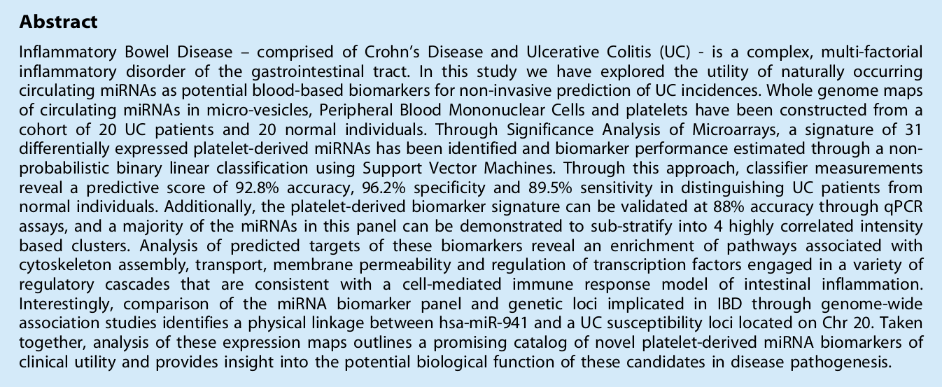
Abstract

Slide 3
Abstract Summary
"non- probabilistic binary linear classification using Support Vector Machines"
"92.8% accuracy, 96.2% specificity and 89.5% sensitivity"
Uses 31 miRNA derived from platelet fractions

Slide 4
Analysis and Conclusion of Paper
Very good accuracy, specificity, and sensitivity
But very small training/test size (36/4)
Platelet biomarkers are much better predictors than micro-vesicle biomarkers

