Slide 1
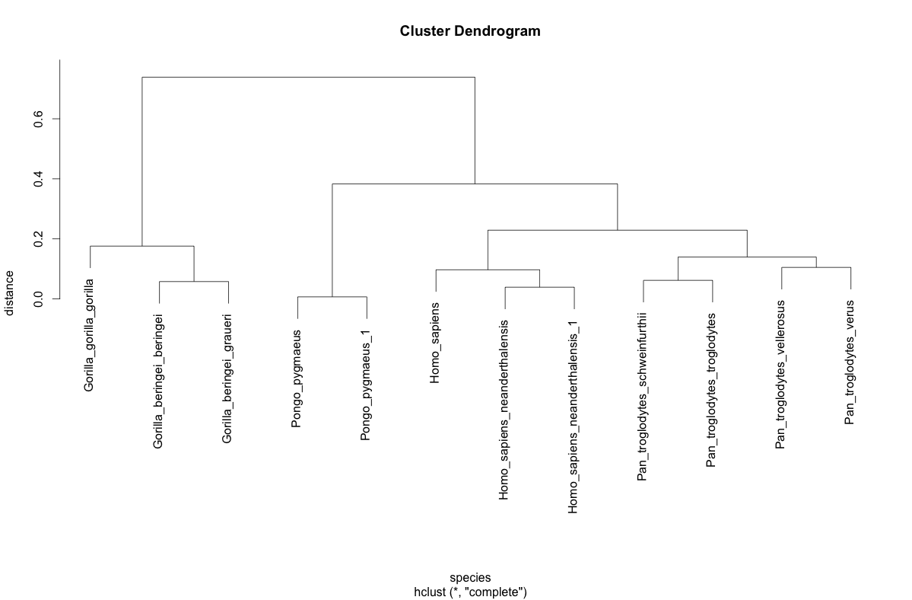
Hierarchical clustering (trees, dendrogram)

Slide 2
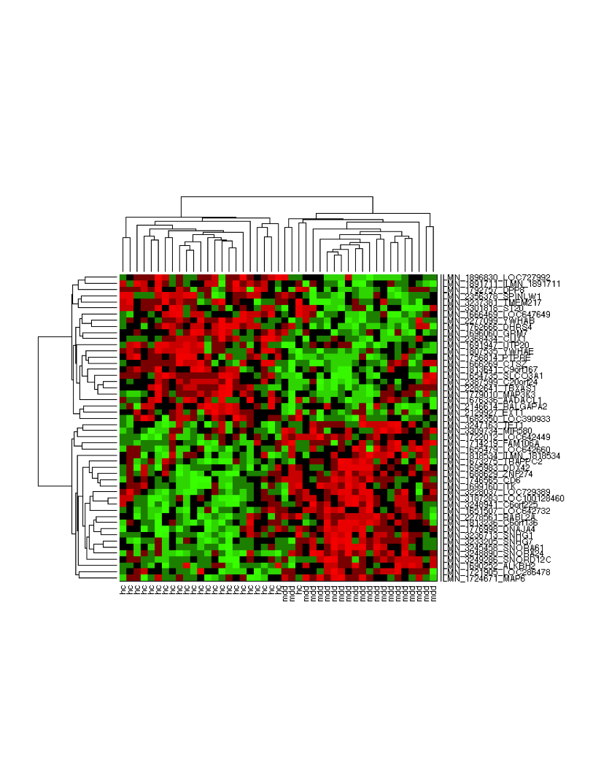

Slide 3
Tree-building methods: UPGMA
UPGMA (1958) is
unweighted pair group method
using arithmetic mean
1
2
3
4
5

Slide 4
Tree-building methods: UPGMA
Step 1: compute the pairwise distances of all
the proteins. Get ready to put the numbers 1-5
at the bottom of your new tree.
1
2
3
4
5

Slide 5
Tree-building methods: UPGMA
Step 2: Find the two genes with the
smallest pairwise distance. Cluster them and
make the pair a new unit.
1
2
3
1
2
4
5

Slide 6
Tree-building methods: UPGMA
Step 3: Repeat. Find the next two genes or units
with the smallest pairwise distance. Cluster them.
1
2
1
2
4
5
3
4
5

Slide 7
Tree-building methods: UPGMA
Step 4: Repeat. Find the nearest species
or grouping.
1
2
3
4
1
2
4
5
3
5

Slide 8
Tree-building methods: UPGMA
Step 4: Your tree is finished when all sequences are
connected.
9
1
2
8
7
3
4
6
5
1
2
4
5
3

Slide 9
Algorithm: UPGMA
Given distance matrix d for n genes/objects
Form n clusters, 1 for each genes/objects
Assign height h=0 of each cluster in the tree T
While there is > 1 cluster
find the two closest cluster C1 and C2
merge C1 and C2 into new cluster C
|C|=|C1|+|C2|
for every other cluster (C* !=C)
(compute new distance matrix with new cluster)
end for

Slide 10
Algorithm: UPGMA
Add a new vertex C to T with h(C)=d(C1,C2)/2
Add branches from C1 and C2 to C with lengths
h(C)-h(C1)
h(C)-h(C2)
Remove rows and columns from d corresponding
to C1 and C2.
Add a row and column to d for new cluster C
Repeat finding nearest clusters
end while

Slide 11
distance matrix between objects A-F
 | A | B | C | D | E | F
A | x | 2 | 4 | 6 | 6 | 8
B |  | x | 4 | 6 | 6 | 8
C |  |  | x | 6 | 6 | 8
D |  |  |  | x | 3 | 8
E |  |  |  |  | x | 8
F |  |  |  |  |  | x
Find minimum and merge
Find minimum and merge
Change d(D,E) to 3 to make min unique

Slide 12
distance matrix between objects A-F
 | A | B | C | D | E | F
A | x | 2 | 4 | 6 | 6 | 8
B |  | x | 4 | 6 | 6 | 8
C |  |  | x | 6 | 6 | 8
D |  |  |  | x | 3 | 8
E |  |  |  |  | x | 8
F |  |  |  |  |  | x
Merge A and B because minimum
Recompute distances between AB and other nodes
to create a merged distance matrix that we can use
to find the next minimum to merge
d(AB,C) = (d(A,C) + d(B,C))/|AB||C| = (4 + 4)/2/1 = 4
d(AB,D) = (d(A,D) + d(B,D))/|AB||D| = (6 + 6)/2/1 = 4
d(AB,E) = (d(A,E) + d(B,E))/|AB||E| = (6 + 6)/2/1 = 6
d(AB,F) = (d(A,F) + d(B,F))/|AB||F| = (8 + 8)/2/1 = 8
The rest can be read directly
Create next matrix

Slide 13
distance matrix between objects A-F
 | A | B | C | D | E | F
A | x | 2 | 4 | 6 | 6 | 8
B |  | x | 4 | 6 | 6 | 8
C |  |  | x | 6 | 6 | 8
D |  |  |  | x | 3 | 8
E |  |  |  |  | x | 8
F |  |  |  |  |  | x
Remove A and B, replace with merged node AB
Create merged distance matrix
Find next minimum
 | AB | C | D | E | F
AB | x | 4 | 6 | 6 | 8
C |  | x | 6 | 6 | 8
D |  |  | x | 3 | 8
E |  |  |  | x | 8
F |  |  |  |  | x
There is a tie, so choose to merge
AB with C. Equally optimal to
merge D with E.
Calculate distance of ABC with other
nodes (D, E, F)

Slide 14
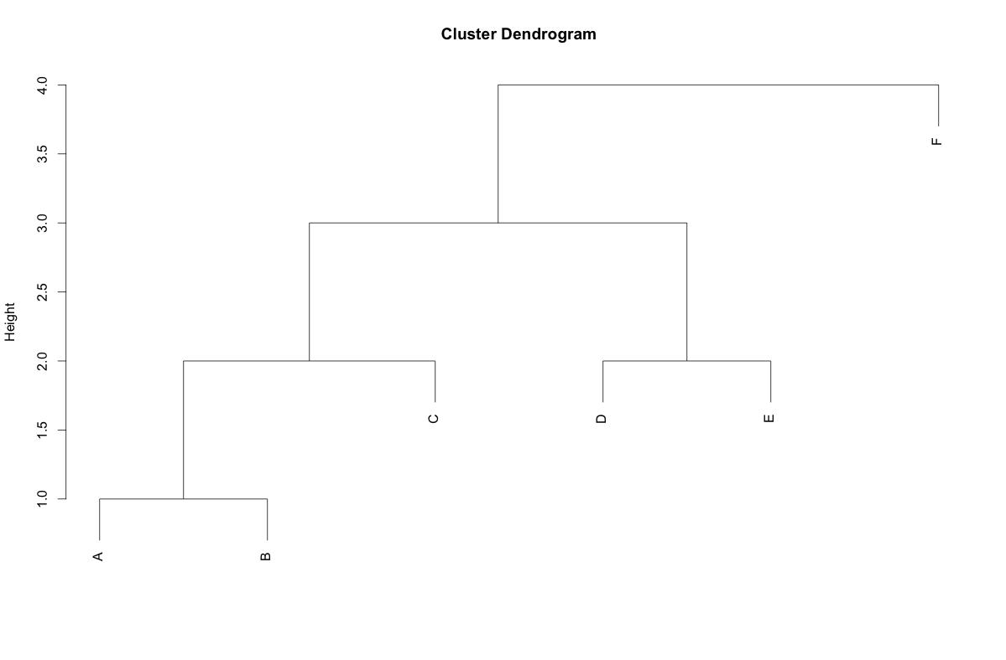
# make a tree by hand with R hclust
a <- list() # initialize empty object
# define merging pattern:
# negative numbers are leaves,
# positive are merged clusters (defined by row number in $merge)
a$merge <- matrix(c(-1, -2, # 1 A-B
1, -3, # 2 (A-B)-C
-4, -5, # 3 D-E
2, 3, # 4 root ((A-B)-C)-(D-E)
4, -6 ), ncol = 2, byrow=TRUE )
a$height <- c(1, 2, 2, 3, 4) # define merge heights
a$order <- 1:6 # order of leaves(trivial if hand-entered)
a$labels <- LETTERS[1:6] # labels of leaves
class(a) <- "hclust" # make it an hclust object
plot(a) # look at the result
#convert to a dendrogram object if needed
ad <- as.dendrogram(a)

Slide 15
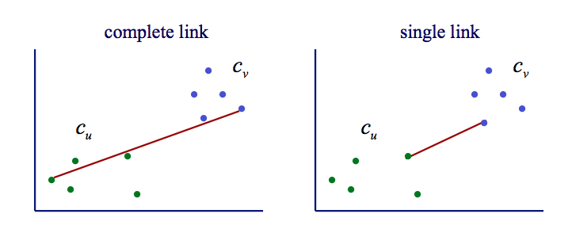


Linkage Choice
Also average link

Slide 16
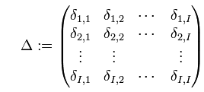

MDS – multidimensional scaling
Given I sequences and
distances δij between sequence i and j.
Fix the MDS space to N=2 or 3, typically
Find I N-dimensional vectors
such that
for all

Slide 17
Dendrogram for primate Mt DNA

Slide 18
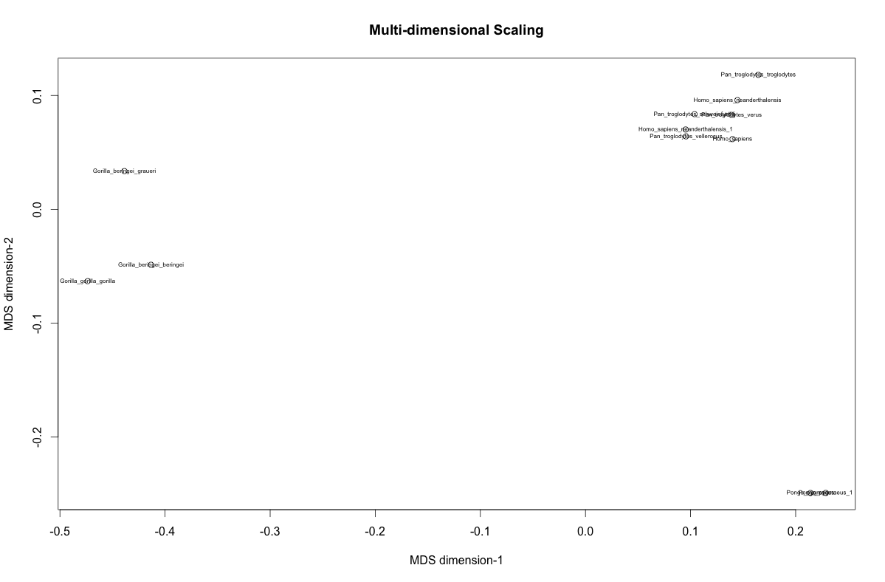
2 MDS dimensions

Slide 19
3 MDS dimensions

