Slide 1
DNA mutations and Disease
Genome-wide association study (GWAS)
Single nucleotide polymorphism (SNP)
Synonymous and non-synonymous SNPs
Common Disease Common Variant
Classic Genetic Disease: Sickle Cell
Why do we have genetic diseases?

Slide 2
Sickle cell anemia mutation
1 in 500 African Americans
Autosomal recessive disease
Mutated red blood cells are more protected against malaria: normal cells
are more easily destroyed by the parasite.
Thus, in an environment where malaria is a problem, there was a
selective advantage to preserve this mutation in the population

Slide 3
Mutation & Selection
Natural Selection
Bad mutations, individual’s genes are not propagated
Negative selection
Beneficial mutations, individual’s genes are propagated
Positive selection
No effect, Hardy-Weinberg Equilibrium
Neutral selection
Environments change, positive can become negative
Sickle cell anemia / Malaria resistance
Mutations are random, but natural selection is not random - it is a gradual filter of mutations based on the environment. The gradual nature of mutations can make rapid environment changes disastrous (extinction).

Slide 4
Inheritance Models in Single Gene Trait
A
a

Slide 5
Inheritance Models in Single Gene Trait
 | Genotype Group
Model | AA | Aa | aa

Slide 6
Inheritance Models in Single Gene Trait
 | Genotype Group
Model | AA | Aa | aa
A is Dominant

Slide 7
Inheritance Models in Single Gene Trait
 | Genotype Group
Model | AA | Aa | aa
A is Dominant

Slide 8
Inheritance Models in Single Gene Trait
 | Genotype Group
Model | AA | Aa | aa
A is Dominant
A is Recessive

Slide 9
Inheritance Models in Single Gene Trait
 | Genotype Group
Model | AA | Aa | aa
A is Dominant
A is Recessive
A is Co-Dominant

Slide 10
SNPs
DNA sequence variations that occur when a single nucleotide is altered.
Must be present in at least 1% of the population to be a SNP.
Occur every 100 to 300 bases along the 3 billion-base human genome.
Many have no effect on cell function but some could affect disease risk and drug response.

Slide 11
CFTR ΔF508
Cystic fibrosis mutation (of hundreds)
Autosomal recessive (incomplete?)
Heterozygous advantage theory
Overdominance -- heterozygotes have a benign form of disease
Cholera or Tuberculosis
Theory makes sense for malaria and sickle cell, which is incompletely recessive
Notes:
Overdomiancne: Heterozygotes have better selective advantage over either homozygote parent. Sickle cell heterozygotes have a benign version of sickle cell, which is enough to provid resistance to malaria.

Slide 12
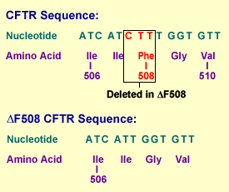
Δ508 Cystic Fibrosis gene deletion mutation
rs121909001 http://www.ncbi.nlm.nih.gov/projects/SNP/snp_ref.cgi?rs=121909001
Allele change: [TTT/-]GGT

Slide 13
Three gateways to access the human genome
NCBI map viewer
www.ncbi.nlm.nih.gov
Ensembl Project (EBI/Sanger Institute)
www.ensembl.org
UCSC (Golden Path)
www.genome.ucsc.edu

Slide 14
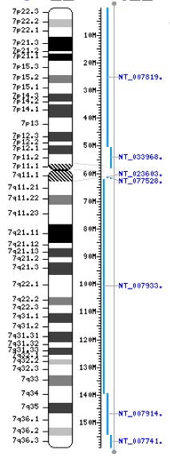
Anatomy of a chromosome
p arm
Centromere
Telomeres
q arm

Slide 15
TABLE 19-14. Human chromosome groups
Group | Chromosomes | Description
A | 1-3 | Largest chromosomes; chr1 3,141 genes
B | 4,5 | Large chromosomes; chr4 lower GC content that genomewide
C | 6-12, X | Medium size chromosomes
D | 13-15 | Medium size chromosomes
E | 16-18 | Small; 16 is metacentric; chr18 lowest gene density 337 genes
F | 19,20 | Small, chr19 highest gene density 26 genes/Mb
G | 21,22,Y | Smallest chromosomes; Y repetitive, hard to sequence
Notes:
Acrocentric – p arm hard to see

Slide 16
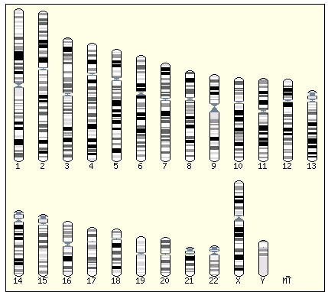
A
B
C
D
D
E
F
G
G

Slide 17
Population Genetics
Expression back to Sequence (SNPs)
Expression: closer to biological endpoint but more noise and variation
Population genetics uses statistics (and increasingly machine learning) to understand how genes affects large numbers of individuals.
Mostly based on easily observed phenotypes
Association studies, family based studies
Genome-wide Association Studies (GWAS)
Single nucleotide polymorphisms (SNPs)

Slide 18
Some Genetics Terminology
We are diploid organisms
Each chromosome has a pair
The pairs are not exactly the same.
When coupled, the pair yields a genotype
Germ cells are haploid (one of the pair)
Each position on a chromosome is a locus
Each variant at a locus is an allele
A genotype with (two) of one allele is called homozygous
...with two different alleles, heterozygous.

Slide 19
Chromosome pairs fragments for 3 individuals
1:ACGACTCAGATCACTACGTACGACT
1:ACGACTCAGATAACTACGGACGACT
2:ACGACTCAGATCACTACGTACGACT
2:ACGACTCAGATCACTACGTACGACT
3:ACGAGTCAGATCACTACGTACGACT
3:ACGAGTCAGATAACTACGGACGACT

Slide 20
Single nucleotide polymorphisms
1:ACGACTCAGATCACTACGTACGACT
1:ACGACTCAGATAACTACGGACGACT
2:ACGACTCAGATCACTACGTACGACT
2:ACGACTCAGATCACTACGTACGACT
3:ACGAGTCAGATCACTACGTACGACT
3:ACGAGTCAGATAACTACGGACGACT

Slide 21
Collapse Pairs:
ACGA[C|C]TCAGAT[C|A]ACTACG[T|G]ACGACT
ACGA[C|C]TCAGAT[C|C]ACTACG[T|T]ACGACT
ACGA[G|G]TCAGAT[C|A]ACTACG[T|G]ACGACT
Genotypes: Heterozygotes AB and BA are the same (can use phasing or family studies to get maternal or paternal source)

Slide 22
Phenotype Examples
Quantitative
Obesity, BMI
Lipids and lipoproteins
Nicotine dependence
Gene Expression
Antibody Titer
Insulin resistance
Height
Bone Mineral Density
Uric Acid Levels
Qualitative
Bipolar Disorder
MDD
Alzheimer's
Cancer
Diabetes
Cystic Fibrosis
Sickle-cell disease
Blood Group
Eye Color

Slide 23
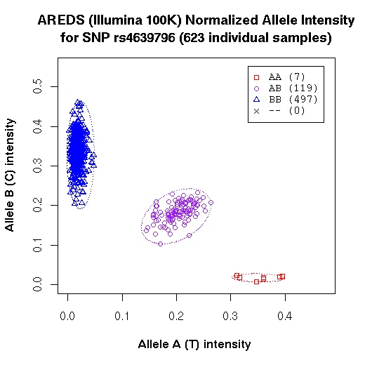
Discrete Genotypes come from Signal Intensity Scatter Plots
Age-Related Eye Disease
http://www.ncbi.nlm.nih.gov/sites/entrez
Notes:
Signal intensity plot and transformed signal intensity plot
Can be dealt with by revised clustering algorithms, genomic control, fuzzy calls

Slide 24
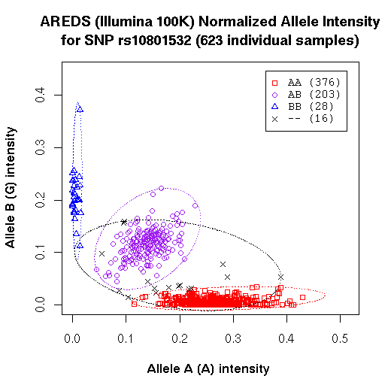
Genotypes for some SNPs are more ambiguous than others
Need to look at Intensity Plots
for significant SNPs
http://www.ncbi.nlm.nih.gov/sites/entrez
Notes:
Signal intensity plot and transformed signal intensity plot
Can be dealt with by revised clustering algorithms, genomic control, fuzzy calls

Slide 25
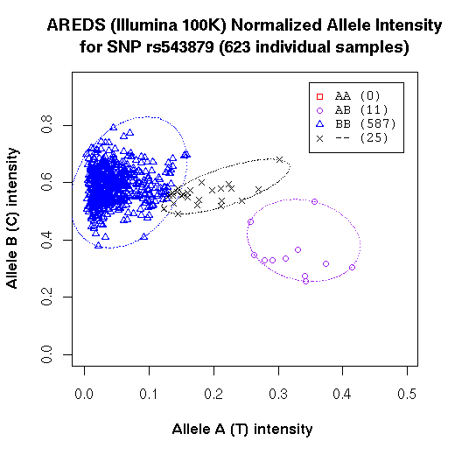
rs572515
http://www.ncbi.nlm.nih.gov/sites/entrez
Notes:
Signal intensity plot and transformed signal intensity plot
Can be dealt with by revised clustering algorithms, genomic control, fuzzy calls

Slide 26
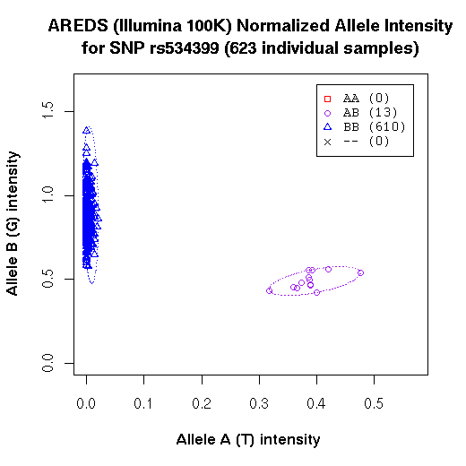
Some SNPs are monomorphic Or can have > 3 clusters (CNV)
http://www.ncbi.nlm.nih.gov/sites/entrez
Notes:
Signal intensity plot and transformed signal intensity plot
Can be dealt with by revised clustering algorithms, genomic control, fuzzy calls

Slide 27
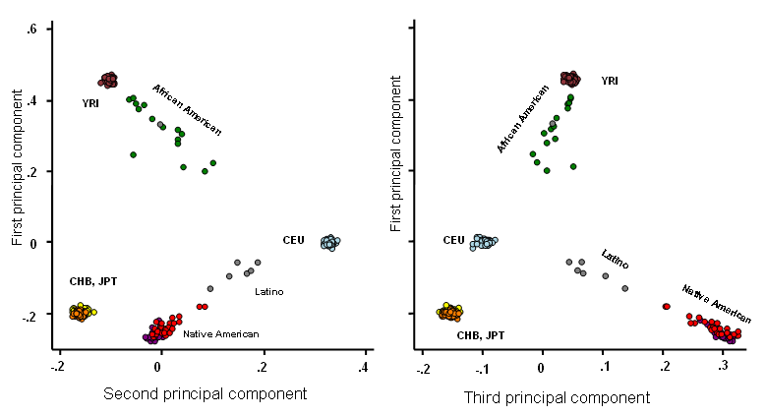
Principal Component Analysis of Structured Population: First to Third Components
Courtesy, G. Thomas, NCI

Slide 28
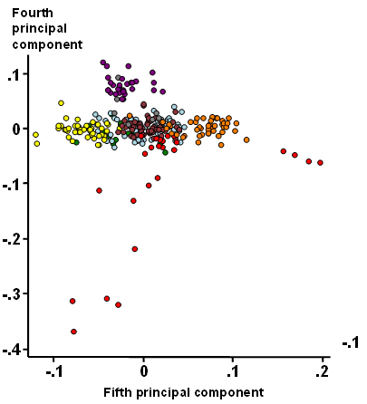
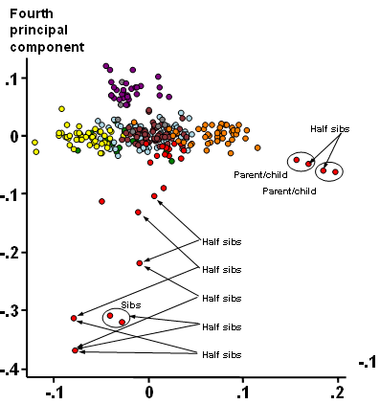
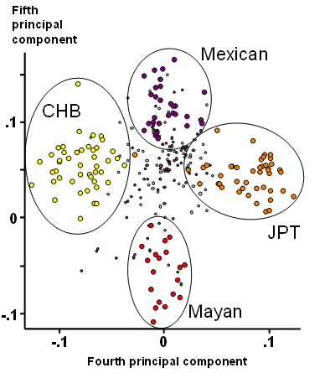
Influence of Relatedness on Principal Component Analysis
Courtesy, G. Thomas, NCI

Slide 29
Basic Genetic Study File Format Plink pedigree file (.ped)
 | Sex | Pheno | SNP 1 A | SNP 1 B | SNP 2 A | SNP 2 B | SNP 3 A | SNP 3 B
Subject 1 | M | 1 | C | C | C | A | T | G
Subject 2 | F | 1 | C | C | C | C | T | T
Subject 3 | F | 0 | G | G | C | A | T | G
… |  |  |  | … |  |  |  | …
Usually column 6 is the phenotype

Slide 30
Analyzing a SNP
A C
C C
A C
C C
A C
A C
C C
A A
A A
A C
A A
A A
A A
A C
C C
C C
A A
A C
rs607499
Subject 1
Subject 2
…

Slide 31
Example SNP
A C
C C
A C
C C
A C
A C
C C
A A
A A
A C
A A
A A
A A
A C
C C
C C
A A
A C
rs607499
Two Variables: Disease Status (2 states) and
Genotype (3 states)
Does a genotype occur more frequently
in cases than controls?
Need to count combinations.
Cases
 | AA | AC | CC
Case
Control
Controls

Slide 32
Example SNP
Two Variables: Disease Status (2 states) and
Genotype (3 states)
Does a genotype occur more frequently
in cases than controls?
A C
C C
A C
C C
A C
A C
C C
A A
A A
A C
A A
A A
A A
A C
C C
C C
A A
A C
rs607499
 | AA | AC | CC
Case
Control
Cases
 | AA | AC | CC
Case | #AA&#case |  |  | Total case
Control |  |  |  | Total ctl
 | Total AA | Total AC | Total CC | Total N
Controls
Marginal counts (totals in rows/columns)
Independent of other col/row variable

Slide 33
Example SNP
A C
C C
A C
C C
A C
A C
C C
A A
A A
A C
A A
A A
A A
A C
C C
C C
A A
A C
rs607499
 | AA | AC | CC
Case |  | 4
Control |  | 3
 |  | 7
Cases
Does a SNP occur more frequently
in cases than controls?
We can do this by treating the pairs
as genotypes…
Slightly more AC in Cases
Controls

Slide 34
Example SNP
A C
C C
A C
C C
A C
A C
C C
A A
A A
A C
A A
A A
A A
A C
C C
C C
A A
A C
rs607499
Genotype Contingency Table
 | AA | AC | CC
Case | 2 | 4 | 3 | 9
Control | 4 | 3 | 2 | 9
 | 6 | 7 | 5 | 18
Cases
Controls

Slide 35
Example SNP
A C
C C
A C
C C
A C
A C
C C
A A
A A
A C
A A
A A
A A
A C
C C
C C
A A
A C
rs607499
Genotype Contingency Table
 | AA | AC | CC
Case | 2 | 4 | 3 | 9
Control | 4 | 3 | 2 | 9
 | 6 | 7 | 5 | 18
Cases
Controls
“Margins”
Hence “Marginal Probabilities”
Probability regardless of the other variable
E.g., p(AA)=6/18, p(AC)=7/18, p(CC)=5/18

Slide 36
Example SNP
A C
C C
A C
C C
A C
A C
C C
A A
A A
A C
A A
A A
A A
A C
C C
C C
A A
A C
rs607499
“Observed” Table
Genotype Contingency Table
Chi-square test for count differences
 | AA | AC | CC
Case | 2 | 4 | 3 | 9
Control | 4 | 3 | 2 | 9
 | 6 | 7 | 5 | 18
Cases
Controls
Next create “Expected” Table
From margins

Slide 37
Example SNP
p(AA)=6/18, p(AC)=7/18, p(CC)=5/18
Observed
Expected
E
 | AA | AC | CC
Case | 2 | 4 | 3 | 9
Control | 4 | 3 | 2 | 9
 | 6 | 7 | 5 | 18
Expected AA Cases
P(AA)*Total Cases
6/18*9=3
 | AA | AC | CC
Case | 3 |  |  | 9
Control | 3 |  |  | 9
 | 6 | 7 | 5 | 18
Expected AA Controls
P(AA)*Total Controls
6/18*9=3

Slide 38
Example SNP
p(AA)=6/18, p(AC)=7/18, p(CC)=5/18
Observed
Expected
E
 | AA | AC | CC
Case | 2 | 4 | 3 | 9
Control | 4 | 3 | 2 | 9
 | 6 | 7 | 5 | 18
Expected AC Cases
P(AC)*Total Cases
7/18*9=3.5
 | AA | AC | CC
Case | 3 | 3.5 |  | 9
Control | 3 | 3.5 |  | 9
 | 6 | 7 | 5 | 18
Expected AC Controls
P(AC)*Total Controls
7/18*9=3.5

Slide 39
Example SNP
p(AA)=6/18, p(AC)=7/18, p(CC)=5/18
Observed
Expected
E
 | AA | AC | CC
Case | 2 | 4 | 3 | 9
Control | 4 | 3 | 2 | 9
 | 6 | 7 | 5 | 18
Expected CC Cases
P(CC)*Total Cases
5/18*9=2.5
 | AA | AC | CC
Case | 3 | 3.5 | 2.5 | 9
Control | 3 | 3.5 | 2.5 | 9
 | 6 | 7 | 5 | 18
Expected AC Controls
P(CC)*Total Controls
5/18*9=2.5

Slide 40
Observed
Expected
E
 | AA | AC | CC
Case | 2 | 4 | 3 | 9
Control | 4 | 3 | 2 | 9
 | 6 | 7 | 5 | 18
 | AA | AC | CC
Case | 3 | 3.5 | 2.5 | 9
Control | 3 | 3.5 | 2.5 | 9
 | 6 | 7 | 5 | 18

Slide 41
This is pretty low,
meaning not much difference
between case and control
genotype frequencies.
P-value will be high, not significant.
Degrees of freedom:
df=(rows-1)x(columns-1)
=(2-1) x (3-1)
=2
You would need
chi-square > 5.99 to reject
null a .05 significance
Columns: x + y +z=9
Observed
Expected
E
 | AA | AC | CC
Case | 2 | 4 | 3 | 9
Control | 4 | 3 | 2 | 9
 | 6 | 7 | 5 | 18
 | AA | AC | CC
Case | 3 | 3.5 | 2.5 | 9
Control | 3 | 3.5 | 2.5 | 9
 | 6 | 7 | 5 | 18

Slide 42
A more intuitive number to report is the Odds Ratio
Observed
Expected
E
 | AA | AC | CC
Case | 2 | 4 | 3 | 9
Control | 4 | 3 | 2 | 9
 | 6 | 7 | 5 | 18
 | AA | AC | CC
Case | 3 | 3.5 | 2.5 | 9
Control | 3 | 3.5 | 2.5 | 9
 | 6 | 7 | 5 | 18

Slide 43
Logistic regression
The odds ratio estimated from the contingency table directly has a skewed sampling distribution.
A better (discriminative) approach is to model the log likelihood ratio log(Pr(D=case|G)/Pr(D=control|G)) as a linear function. In other words:
Why:
Log likelihood ratio is a powerful statistic
Modeling as a linear function yields a simple algorithm to estimate parameters
You can also adjust for covariates like age, gender, smoking, …
G is number of copies of the risk allele
With some manipulation this becomes

Slide 44
odds ratio from logistic regression
By exponentiating both sides we get
And by taking the ratio with G=1 and G=0 we get

Slide 45
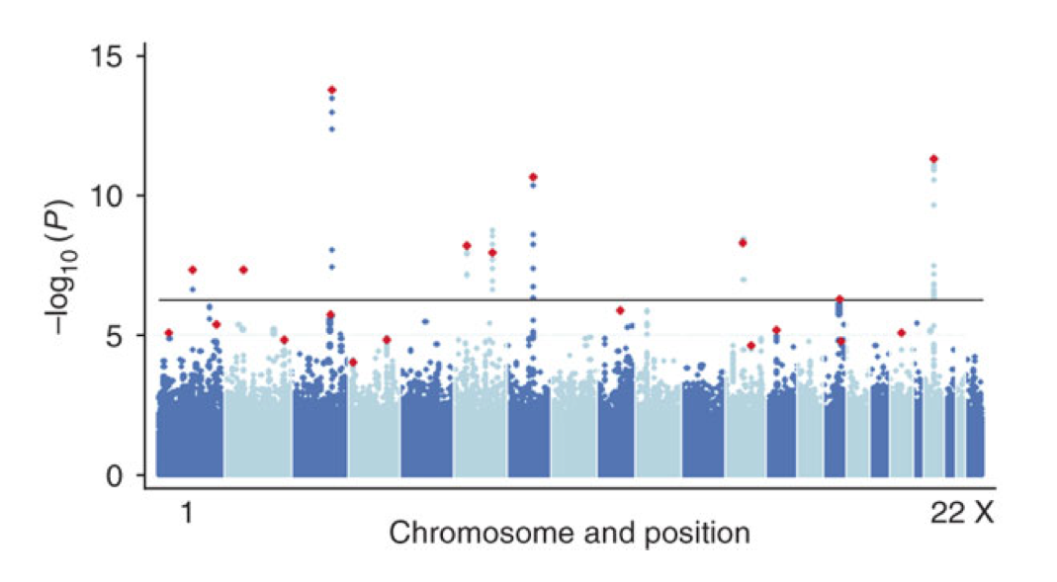
Quantitative trait Manhattan Plot

