Slide 1

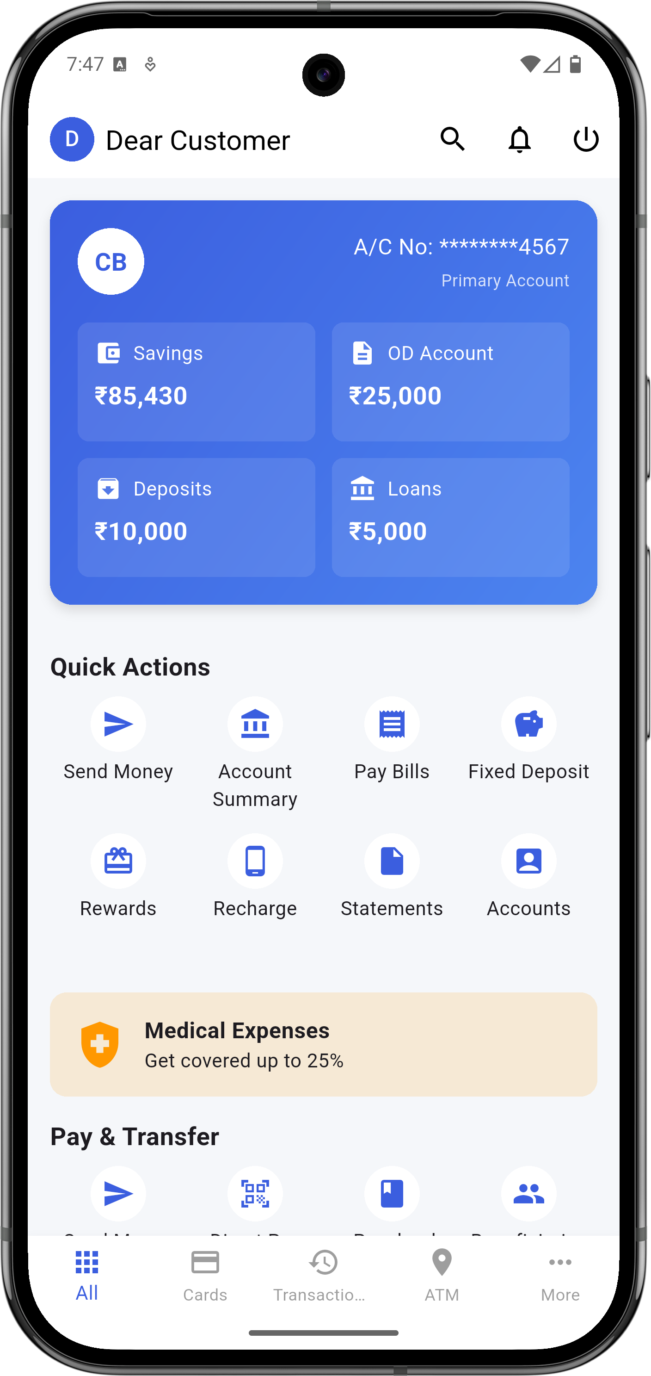
SuRaksha Cyber Hackathon
Team SudoCode
Manya Singh Moteesh A Nikhil T Nainan Swaraj Kumar

Slide 2
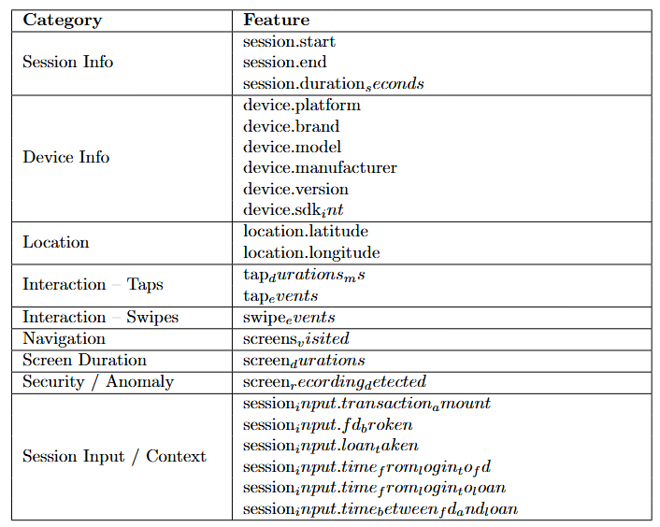
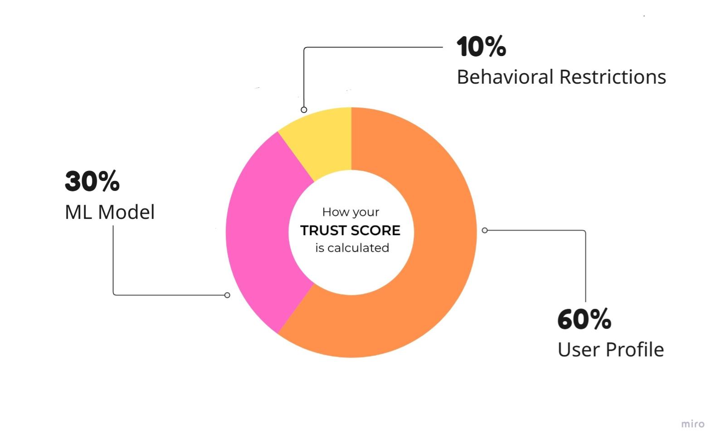
PhishSafe - SDK
Features Collected
- An SDK is a set of tools to build software for a particular platform.
What does it do?
The PhishSafe SDK enables mobile apps especially banking applications to continuously monitor user behavior and detect anomalies that may indicate phishing or account compromise.
It collects behavioral data (like tap speed, swipe patterns, and navigation flow) and generates a trust score in real time to decide if the user is genuine.
Trust Score
The Trust Score is a dynamic score calculated during a user session that reflects how closely the current behavior matches that of a legitimate user.
Score-based Actions:
0–20 → Logout (highly suspicious)
20–40 → Force Re-authentication
40–70 → Trigger OTP verification
70–100 → Continue session normally
4

Slide 3

Technology
3. ML Pipeline (Offline Model Training)
Language: Python
Libraries:
Scikit-learn for model training (MLP / Logistic Regression)
NumPy, pandas for feature engineering
Joblib for model serialization
Features Used:
Statistical metrics (mean, std, frequency)
Interaction zones (tap/swipe heatmaps)
Session sequence patterns
1. SDK Development
Framework: Flutter
Language: Dart
Integration Type: Plug-and-play SDK with minimal coupling to host app
Data Collection:
Gesture tracking via GestureDetector
Screen navigation via NavigatorObserver
Custom hooks for tap/swipe timing and screen durations
4. Inference (On-Device)
Model Format: .h5 converted to TensorFlow Lite (TFLite)
Execution:
TfLite interpreter in Dart using tflite_flutter
Feature vector passed at session end or periodically
Output:
Fraud probability → Mapped to Trust Score [0–100]
2. Data Handling & Security
Session logs stored in local JSON files (sandboxed storage)
Periodic clean-up after model processing
No internet access required – fully offline inference
5

Slide 4
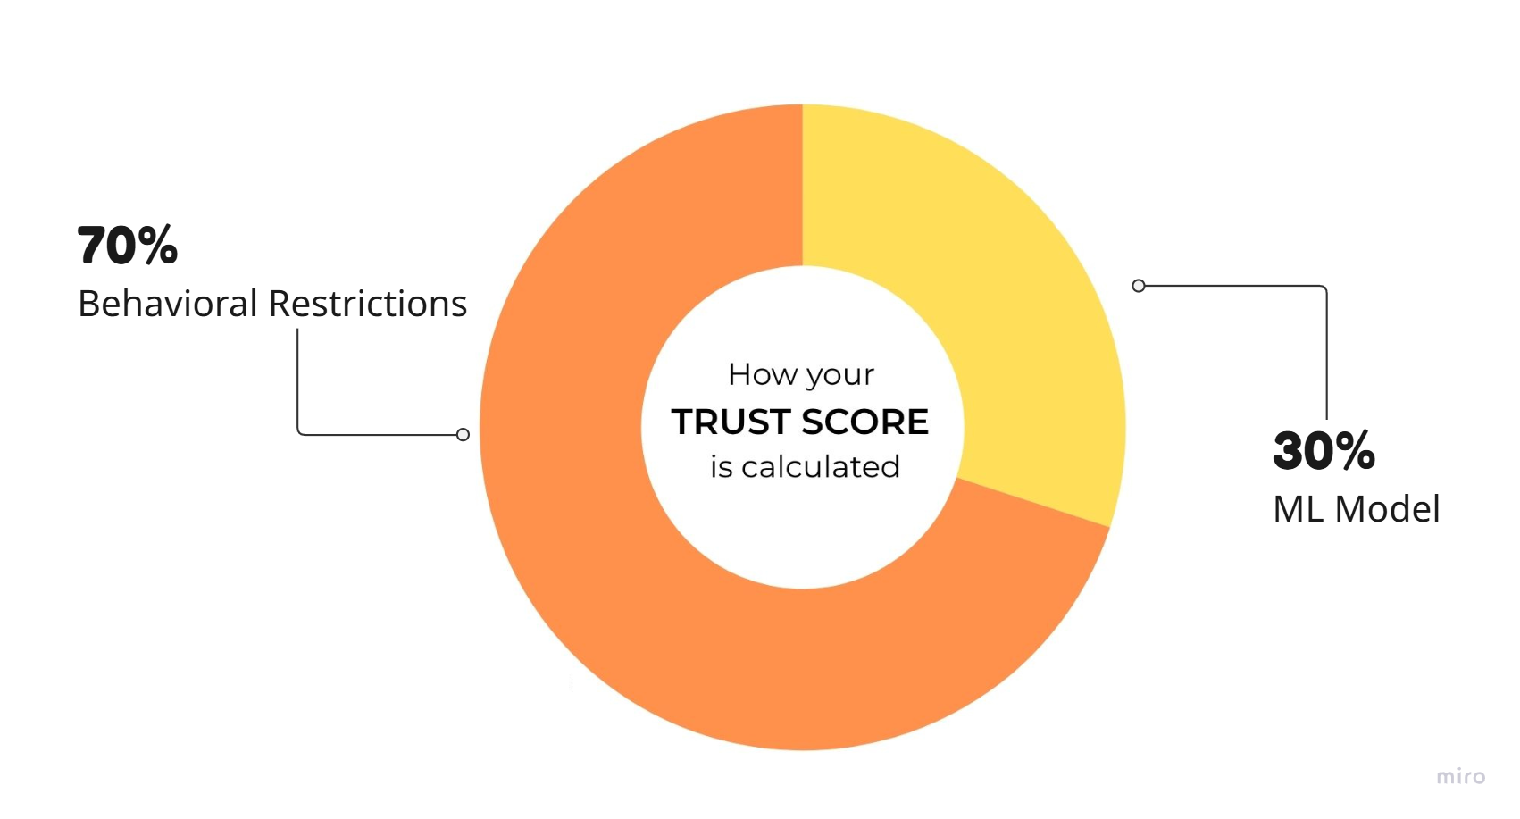
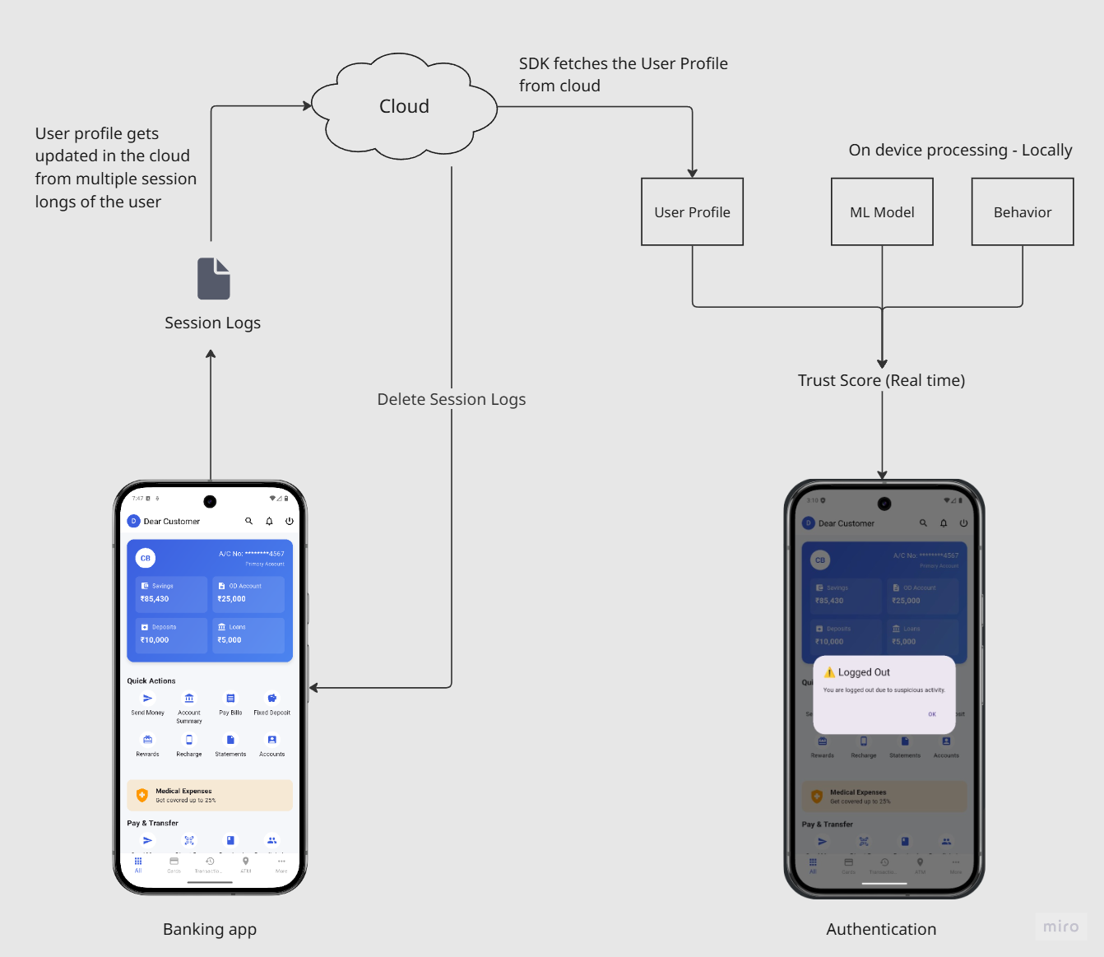
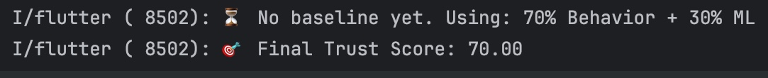
Workflow
Without User Profile
With User Profile
8

Slide 5

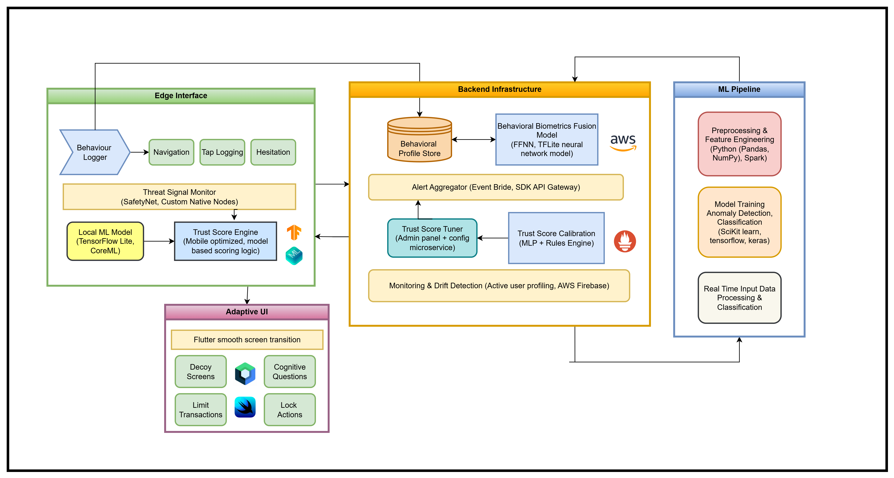
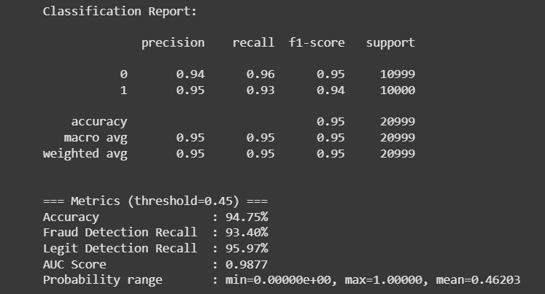
Architecture
Model Type:
Multilayer Perceptron (MLP) – a type of feedforward neural network
Built for binary classification: Legitimate vs Fraudulent behaviour
Model Architecture:
Neural Network Layers:
Input layer: 14–20 behavioral features
Hidden layers: 2–3 fully connected layers (ReLU activation)
Output layer: Sigmoid activation → fraud probability (0 to 1)
System Architecture
Features:
System context (device details, rooted device barring)
Location context (Geographic location, Connection details)
Past action context (past transaction patterns, past used features)
Temporal context (Session durations, navigation durations, action delays)
Use case context (background running activities monitoring and validation)
17
Model accuracy

Slide 6
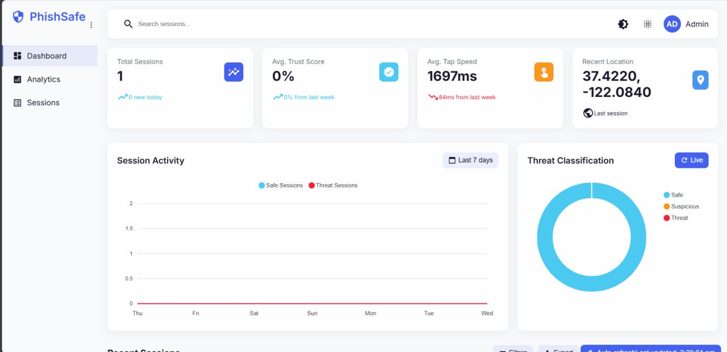
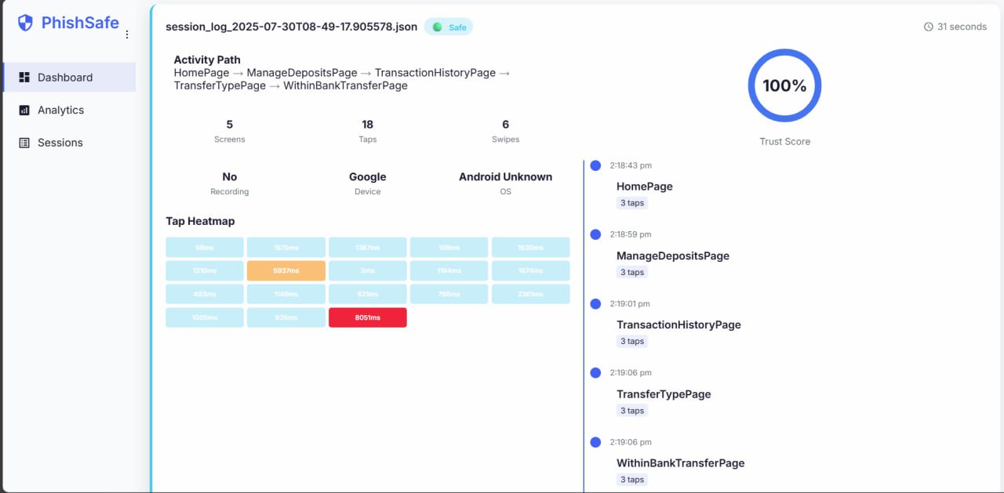
Unique Selling Proposition
4. On device trust scoring engine
Behavioral logs are stored locally and can only be exported with admin control.
1. Plug and Play SDK Integration
3. Privacy first design
Behavioral logs are stored locally and can only be exported with admin control.
No commercial side UI overhaul or complete backend rewrites required for integrating in any banking platform, simplified functionality integrations.
5. Silent and seamless behavior fingerprinting
Goes beyond login authentication, monitors entire session behavior in real-time.
2. Secure Admin Dashboard
For bank admin monitoring and easier user support and recovery.
6. Context-aware threat detection
Effective anomaly detection with responses which actively adapt to risks.
7. Dynamic Risk Responses
Triggers UI lockouts, steps up authentication, or alerts admins- based on trust score thresholds.
19

Slide 7

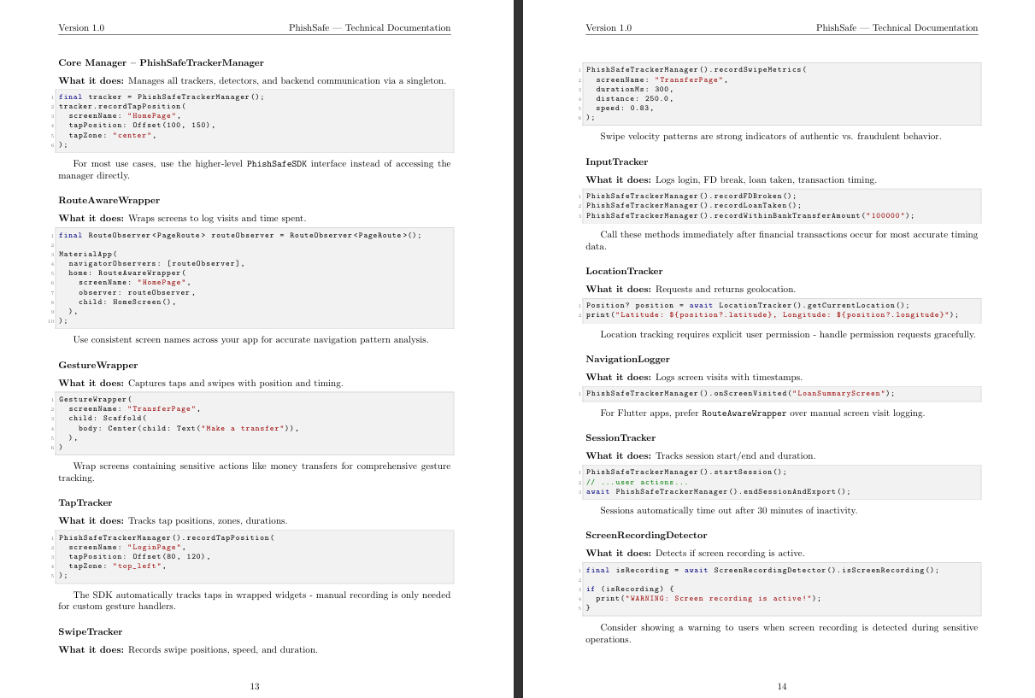
Documentation
1. SDK Doc – Implentation Guide
2. GitHub – Source Code
https://github.com/manya7s/SudoCode-Suraksha
3. Google Colab
https://colab.research.google.com/drive/1icvGL5U2TMI2aVHATqYh4ktDKzEcSwsW?usp=sharing
https://drive.google.com/file/d/1aKZFFUf0kuVtzjfxCK5d7crs8gpBrTJ8/view?usp=sharing
10

Slide 8
Thank You

Slide 9

SuRaksha Cyber Hackathon
Team SudoCode
Manya Singh Moteesh A Nikhil T Nainan Swaraj Kumar

