Slide 1

SuRaksha Cyber Hackathon Prototype Phase Submission
Team SudoCode
Swaraj Kumar Sahu, Nikhil T Nainan, Moteesh A, Manya Singh

Slide 2
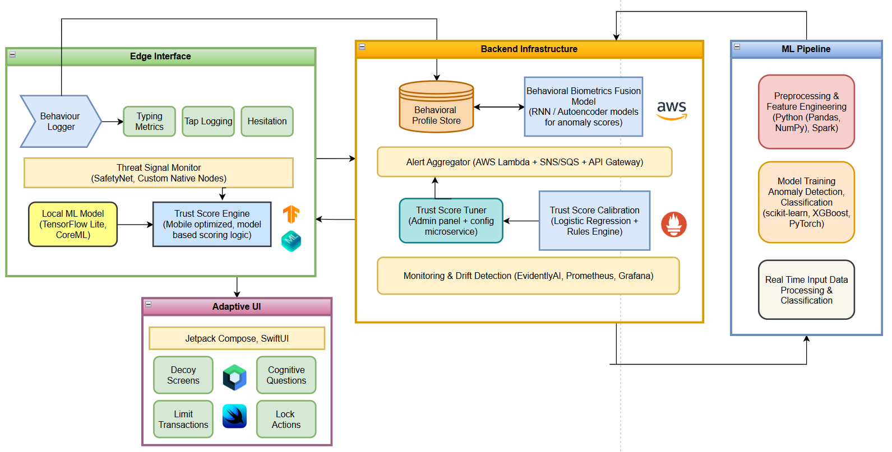
Architecture

Slide 3
Anomaly Detection:
Edge-friendly models like Isolation Forest, One-Class SVM, Autoencoders
Adaptive UI responses on trust score drops
Backend:
Firebase / Supabase / AWS Amplify (for logging, alerting, session sync)
Version Control:
GitHub (public repository for transparency)
Data Source:
Synthetic user behaviour logs
Testing usage
Technologies Used
Platforms:
Mobile: Flutter (Dart for cross platform ui)
Security Layer: Kotlin (on device secure ML inference integration)
Admin Platform: React (Admin dashboard)
Demonstration: Render (presentative hosting)
ML Inference Engine:
TensorFlow Lite
PyTorch Lite mobile dependency for ML
Local Learning + Fallback logic

Slide 4
Core Functionalities
Real-Time, Passive Verification which authenticates users silently through natural behaviour
On device processing capability to ensure speed and reliability at all times
Behavior + Context Fusion which combines usage behaviour characteristics with fallback logic system and pattern recognition based actionables
Lightweight ML Inference which uses energy-efficient PyTorch models optimized for low-end devices
Dynamic Risk Responses which triggers UI lockouts, steps up authentication, or alerts admins based on trust score thresholds.
Continual User Adaptation which learns each user’s habits over time, thus boosting accuracy and reducing false positives.

Slide 5
Model:
Type: Semi-supervised anomaly detection + Fraudulent anomaly trapping with sound logic
Features:
Temporal context (Session durations, navigation durations, action delays)
Location context (Geographic location, Connection details)
Past action context (past transaction patterns, past used features)
System context (device details, rooted device barring)
Use case context (background running activities monitoring and validation)
Detection Layer: Isolation forest ensemble + SVM + autoencoder logic + pattern data validation
Adaptive Action Layer: Trust score based policy engine (uses sound numeric trust scoring logic for highly accurate analysis heuristics) + pattern learning (preventing fraudulent anomaly actions)

Slide 6
Capabilities
Relevance in Bank Industry:
A leading retail bank integrating PhishSafe into its mobile app to address rampant post-login fraud such as phishing attacks and session hijacking will observe a significant reduction in unauthorized transactions during live sessions.
This not only reduces financial losses from fraud but also improved customer trust by delivering clean, always-on session protection that met both regulatory standards and user expectations
User Experience & Walkthrough
App Launch & Login
Navigating and Performing Transactions
Silent Authentication
Handling Suspicious Activity
Session Continuation or Escalation
The adaptive security actions allows legitimate customers to bank smoothly while blocking fraudsters even if they bypassed login credentials.

Slide 7
Unique Selling Proposition
Silent, Session-Scoped Identity Verification: Goes beyond login authentication, monitors entire session behavior in real-time.
On-Device ML for Trust Scoring: Fully offline, with no cloud dependency. Instant response without latency or privacy risks.
Context-Aware Threat Detection: Effective anomaly detection.
Plug-and-Play SDK Integration: no UI overhaul or backend rewrites required for integrating in any banking platform.
Privacy-First Design: Behavioral logs are stored locally and can only be exported with admin control.
Tailored to Banking Threat Vectors: Addresses specific fraud scenarios like phishing, session hijacking, and screen mirroring

Slide 8
SDK Documentation
https://drive.google.com/file/d/1wIqSa4k5k7rRtrz8f3I3k9pvcYLUf6Zh/view?usp=sharing
Github
https://github.com/manya7s/SudoCode-Suraksha

