Slide 1
Towards Theoretical Understanding of Hard Negative Sampling in Recommendation
User Identification and Recommendation
for Shared Accounts
Presented by: Wentao Shi | 石文焘
shiwentao123@mail.ustc.edu.cn
2023.2.19

Slide 2

Outline
Introduction
Negative Sampling in Recommendation
Revisite Hard Negative Sampling
Overview of Theoretical Structure
Preliminary
Theoretical Analysis and Guidelines
Experiments

Slide 3
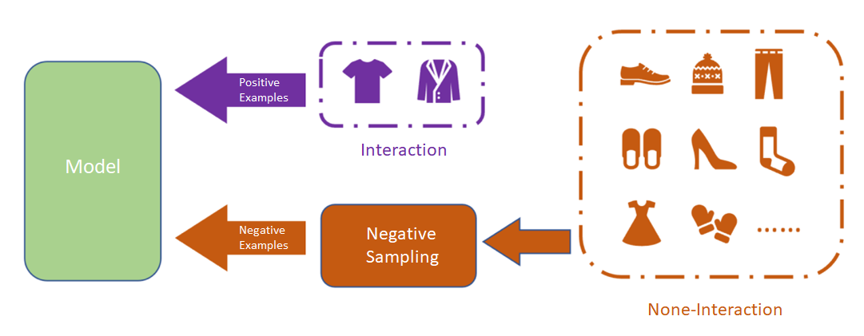
1.1 Negative Sampling in Recommendation
Negative sampling
In implict feedback, pair-wise loss functions require to select negative sample from large scale of non-interacted items.
The effectiveness and efficiency of learning are limited.
Negative samping in implict feedback

Slide 4
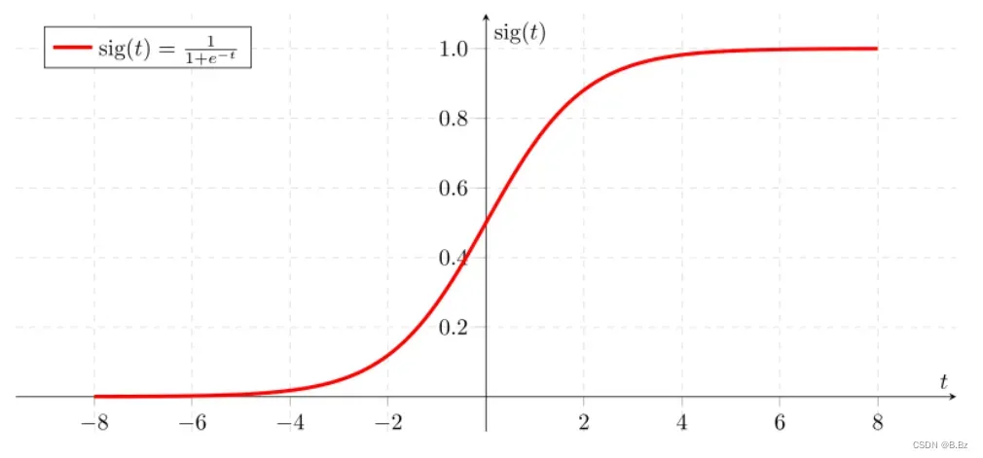

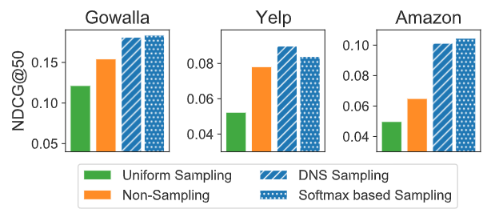
1.1 Negative Sampling in Recommendation
Classical sampling strategy
Static Sampler: RNS, PNS
Adaptive Sampler: DNS, Softmax based Sampler
↑ gradients
↓ gradients
Well Convergence is always at the heart of
understanding of hard negative sampling !
Empirical Experiments analysis
Full sampling: use all negative items to accelerate convergence.
Well convergence may not be the only justification !

Slide 5
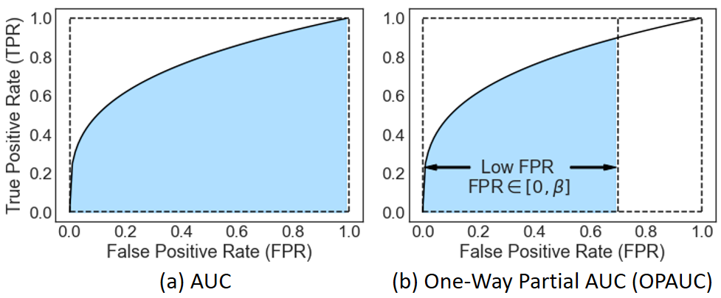
1.2 Revisit Hard Negative Sampling
Different Opimization Objective
BPR optimizes AUC measure.
BPR equipped with hard negative sampling optimizes One way Partial AUC (OPAUC) measure. [Theoretical Analysis]
 |  | Label
 |  | True | False
Prediction | Positive | TP | FP
 | Negative | FN | TN
TPR = TP / (TP + FN)
FPR = FP / (FP + TN)

Slide 6
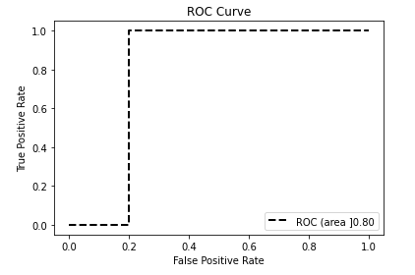
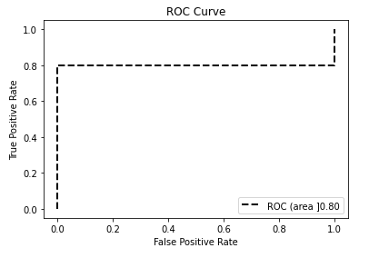
1.2 Revisit Hard Negative Sampling
OPAUC and TopK evaluation measures
Top3
AUC
OPAUC(0.4)
NDCG@3
Case 1:
0.800
0.200
0.531
Case 2:
0.800
0.320
1.000
Case 1:
Case 1:
Two simple cases that have the same overall ranking performance but quite different top ranking performance.
OPAUC has stronger connection with TopK evaluation measures.

Slide 7
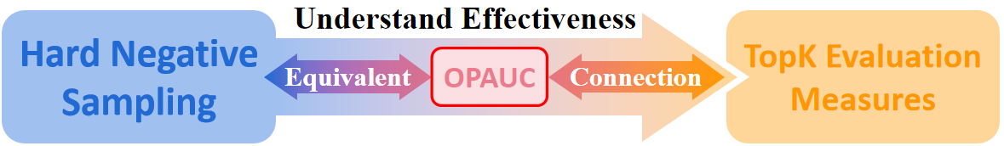
1.3 Overview of Theoretical Structure
Why Hard Negative Sampling is effective?
Future guidelines
Hard negative sampling strategy should have hyper parameter to adjust the level of sampling hardness.
The smaller the 𝐾we considered in Top𝐾evaluation measures, the harder the negative samples we should draw.

Slide 8
Outline
Introduction
Preliminary
Hard Negative Sampling Strategies
Distributionally Robust Optimization (DRO)
Theoretical Analysis and Guidelines
Experiments

Slide 9
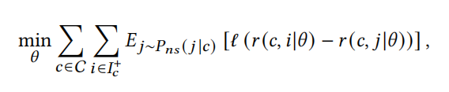

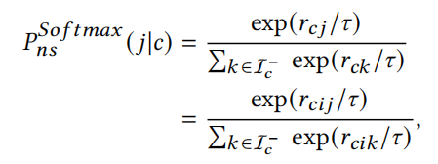

2.1 Hard Negative Sampling Strategies
Implicit Feedback
$P_{ns}(j|c)$denotes the negative sampling probability that a negative item $j ∈ I_{c}^{−}$ in the context c is drawn
Dynamic Negative Sampling (DNS)
Softmax based Sampling
$S_{I_{c}^{−}}^{↓}[1,M]⊂$ $I_{c}^{−}$ denotes the subset of negative samples who rank in topM.

Slide 10
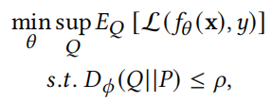


2.2 Distributionally Robust Optimization (DRO)
Formally Definition
DRO aims to minimize the expected risk over the worst-case distribution Q, where Q is in a divergence ball around training distribution P.
Commen Divergence
KL divergence
CVaR divergence

Slide 11
Outline
Introduction
Preliminary
Theoretical Analysis and Guidelines
Hard Negative Sampling Meets OPAUC
OPAUC Meets TopK Evaluation Measures
Hard Negative Sampling Understanding
Experiments

Slide 12

3.1 Hard Negative Sampling Meets OPAUC
Arguement:
The model equipped with hard negative sampling approximately optimizes OPAUC.

Slide 13
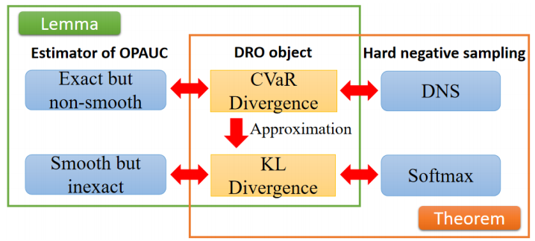

3.1 Hard Negative Sampling Meets OPAUC
Theoretical Structure
The Lemma $1^{[1]}$ shows the equivalence between estimator of OPAUC and DRO object.
Based on DRO object, we prove the equivalence between hard negative sampling and OPAUC in Theorem 1 and Theorem 2.
[1] Dixian Zhu et al. 2022, When AUC meets DRO: Optimizing Partial AUC for Deep Learning with Non-Convex Convergence Guarantee

Slide 14
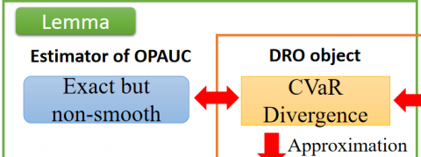
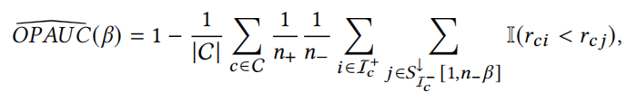
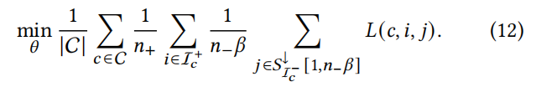
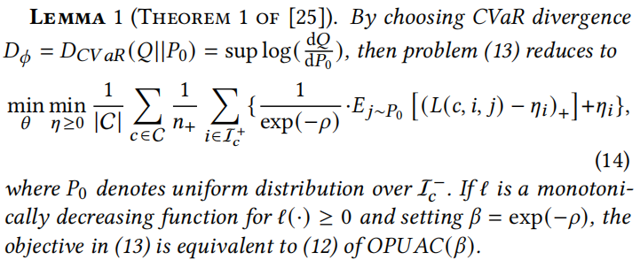
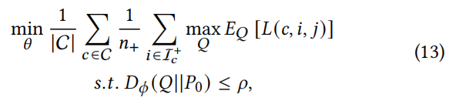
3.1 Hard Negative Sampling Meets OPAUC
Lemma 1
OPAUC Estimator
DRO object
DRO over negative distribution $P_{0}$

Slide 15


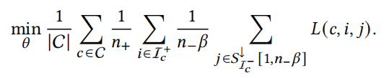

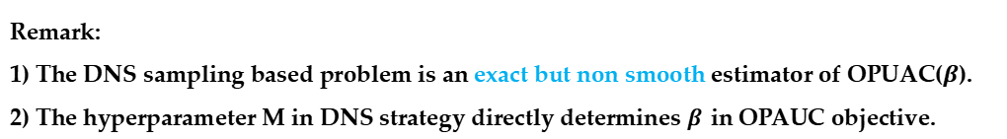
3.1 Hard Negative Sampling Meets OPAUC
Theorem 1
(12)
(1)
Remark:
1) The DNS sampling based problem is an exact but non smooth estimator of OPUAC($β$).
2) The hyperparameter M in DNS strategy directly determines 𝛽in OPAUC objective.

Slide 16
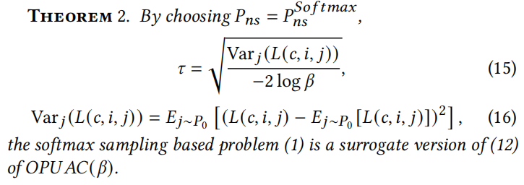
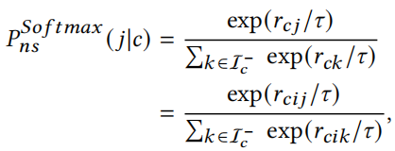
3.1 Hard Negative Sampling Meets OPAUC
Theorem 2
(1)
Remark:
1) The softmax distribution based sampling problem is a smooth but inexact estimator of OPAUC(𝛽).
2) We propose to use an adaptive 𝜏, instead of a fixed 𝜏 in softmax distribution. This ensures the optimization objective OPAUC(𝛽) remains the same during training

Slide 17
3.1 Hard Negative Sampling Meets OPAUC
Arguement:
Compared to AUC measure, OPAUC(𝛽) has stronger correlation with Top𝐾 evaluation measures.
A smaller 𝐾 in Top𝐾 evaluation measures has stronger correlation with a smaller 𝛽 in OPAUC(𝛽).

Slide 18
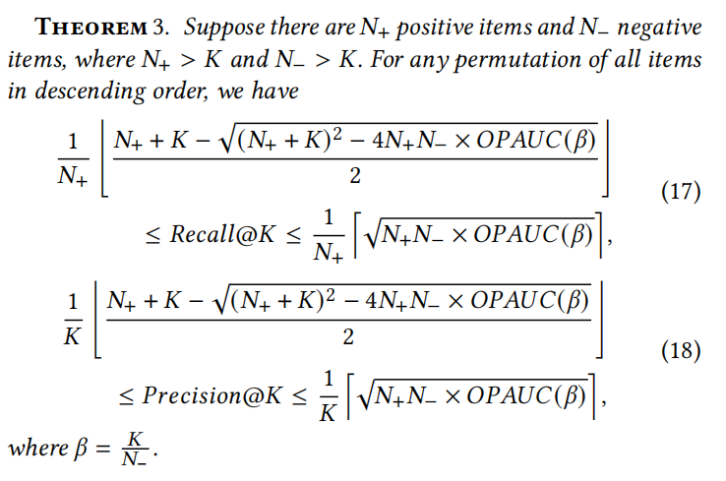

3.2 OPAUC Meets TopK Evaluation Measures
Theoretical Analysis
Remark:
1) The top𝐾evaluation measure Precision@𝐾and Recall@𝐾are higher and lower bounded by specific OPAUC(𝛽), where 𝛽 = $\frac{K}{N_{−}}$.
2) The smaller the 𝐾 is, the smaller the𝛽 (= $\frac{K}{N_{−}}$) should be considered.

Slide 19
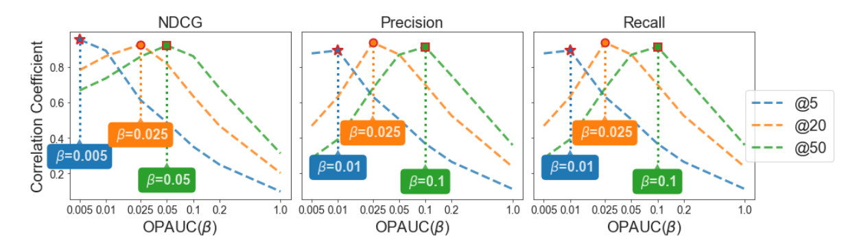
3.2 OPAUC Meets TopK Evaluation Measures
Simulation Experiments
Remark:
1) The correlation coefficient of the highest point of the curve is much larger than the correlation coefficient when 𝛽 is equal to 1.
2) Given a specific 𝐾 in Top𝐾 measure, the correlation coefficient with Norm_OPAUC(𝛽) get the maximum value at a specific 𝛽.

Slide 20
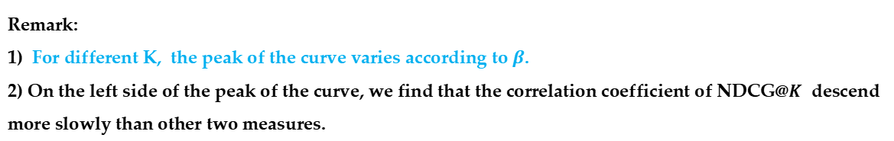
3.2 OPAUC Meets TopK Evaluation Measures
Simulation Experiments
Remark:
1) For different K, the peak of the curve varies according to $β$.
2) On the left side of the peak of the curve, we find that the correlation coefficient of NDCG@𝐾 descend more slowly than other two measures.

Slide 21
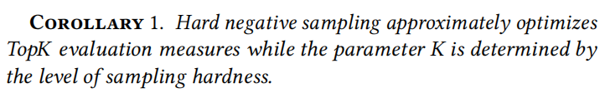
3.3 Hard Negative Sampling Understanding
Corollary:
Guidelines:
To adapt to different Top𝐾 evaluation measures and datasets, hard negative sampling strategy should have hyperparameter to adjust the level of sampling hardness.
The smaller the 𝐾 we considered in Top𝐾 evaluation measures, the harder the negative samples we should draw.

Slide 22
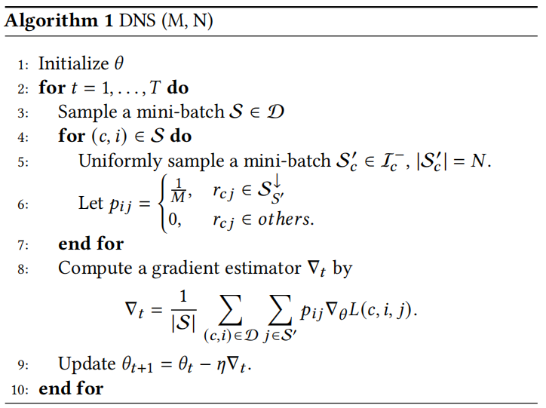
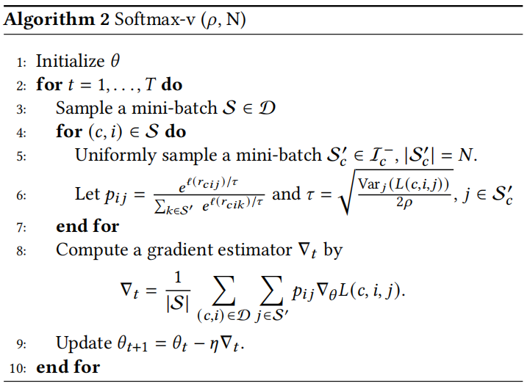
3.3 Hard Negative Sampling Understanding
Converted Algorithms:

Slide 23
Outline
Introduction
Preliminary
Theoretical Analysis and Guidelines
Experiments
Q1: Can experiment results validate our guidelines?
Q2: How do fine tuned parameters benefit models?
Q3: Can the converted model outperform baselines?

Slide 24
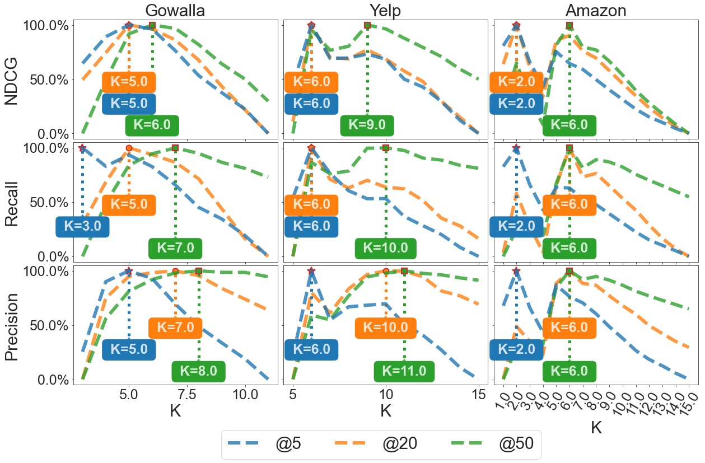
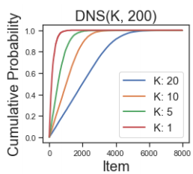

(RQ1) Performance with Different Sampling Distributions
Smaller M in DNS(M,N) means higher sampling hardness.
For all datasets and all measures, the lower the 𝐾 in Top𝐾measures is, the smaller the M in DNS(M, N) when the curve achieve its maximum performance.

Slide 25
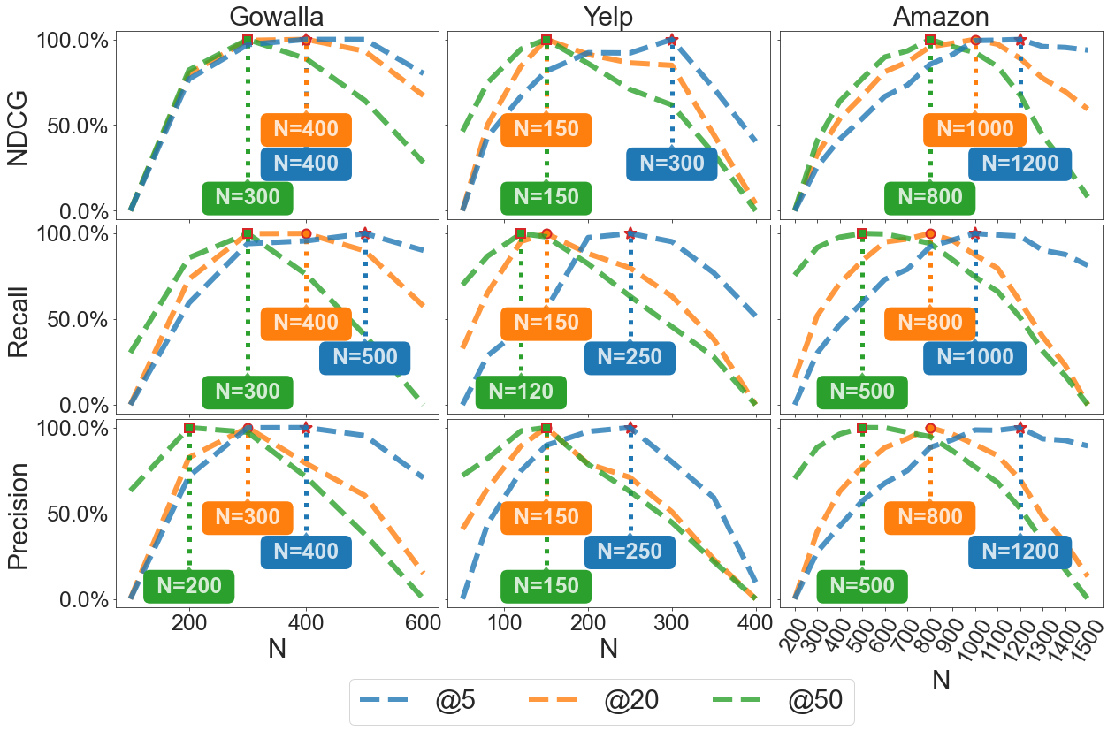
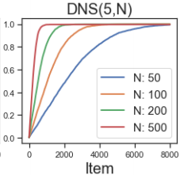

(RQ1) Performance with Different Sampling Distributions
Larger N in DNS(M,N) means higher sampling hardness.
For all datasets and all measures, the lower the 𝐾 in Top𝐾 measures is, the larger the N in DNS(M, N) when the curve achieve its maximum performance.

Slide 26
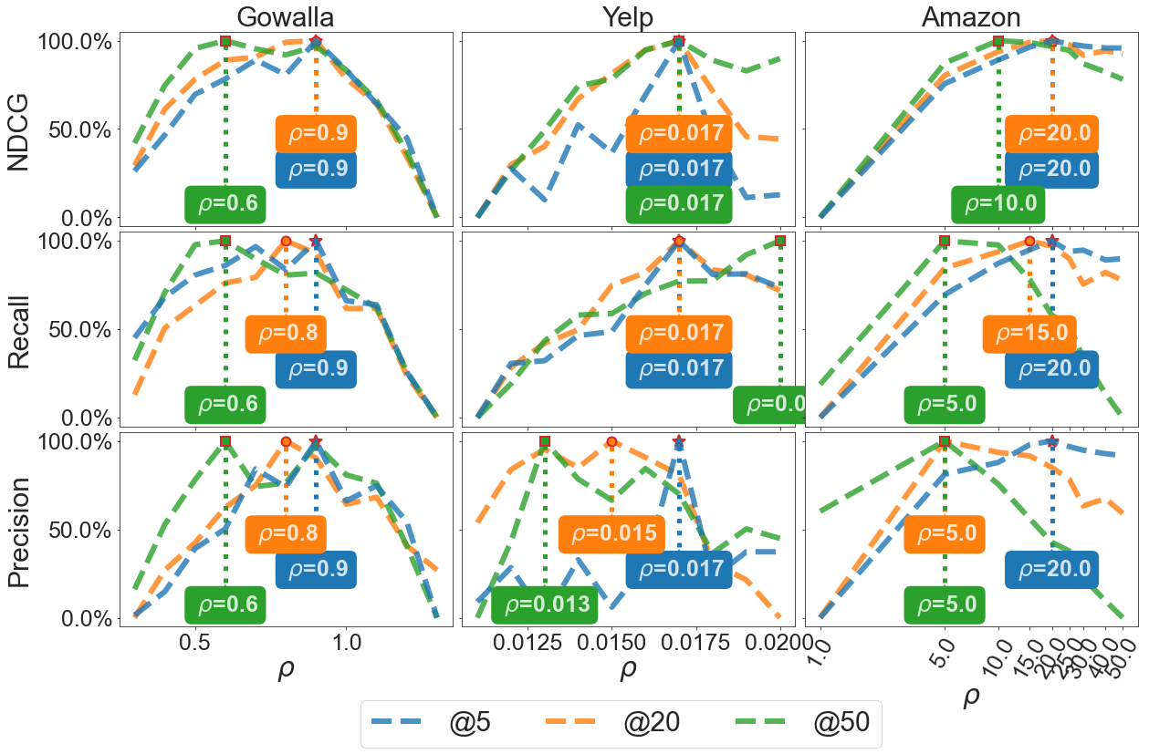
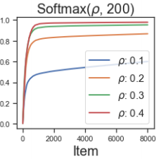

(RQ1) Performance with Different Sampling Distributions
Larger 𝜌 in Softmax-v(𝜌,N) means higher sampling hardness.
For all datasets and all measures, the lower the 𝐾 in Top𝐾 measures is, the larger the 𝜌 in Softmax-v(𝜌, N) when the curve achieve its maximum performance.

Slide 27
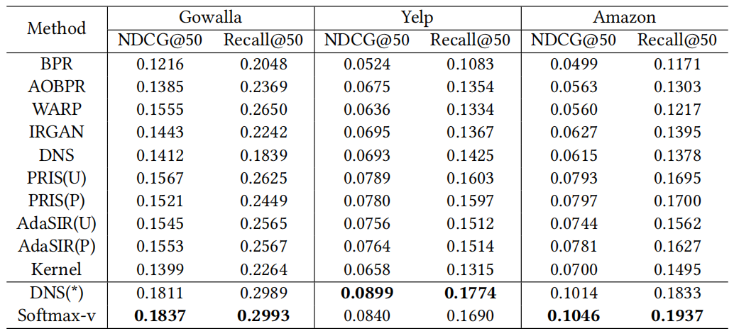
(RQ2, RQ3) Performance Comparison
Remark:
1) Benefited from the adjustable sampling hardness, the converted DNS(M*, N) and Softmax-v significantly outperform their original versions.
2) The converted hard negative sampling methods perform state-of-the-art baselines.

Slide 28
5. Conclusion
We prove that the model equipped with hard negative sampling approximately optimizes OPAUC, where DNS is an exact estimator and softmax based sampling is a soft estimator.
We conduct theoretical analysis, simulation studies, and real world experiments to validate the stronger correlation between OPAUC and Top𝐾evaluation measures.
We provide two important guidelines on how to design hard negative sampling strategies. Through theoretical analysis and experiments analysis, we conclude that the smaller the 𝐾 in Top𝐾measure is, the harder the negative items we should sample.

Slide 29
Thanks!
User Identification and Recommendation
for Shared Accounts
Wentao Shi | 石文焘
shiwentao123@mail.ustc.edu.cn

