Slide 1
CS30500:
Introduction to Software Engineering
Spring 2025
Lecture #16
Prof. In-Young Ko
School of Computing

Slide 2
Software Design
Transforms requirements into the form that can help developers to build a software system effectively
Design classification:
  Architectural design – defines relationships among the major software structural elements
  Component-level design – transforms structural elements into procedural descriptions of software components
  Data/Class design – transforms analysis classes into implementation classes and data structures
  Interface design – defines how software elements, hardware elements, and end-users communicate
[PrMa20 ]

Slide 3
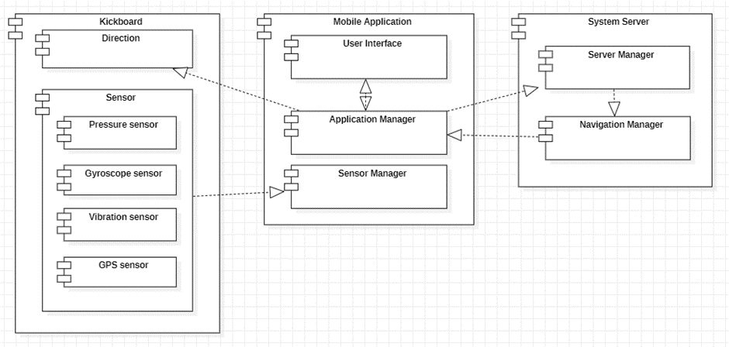
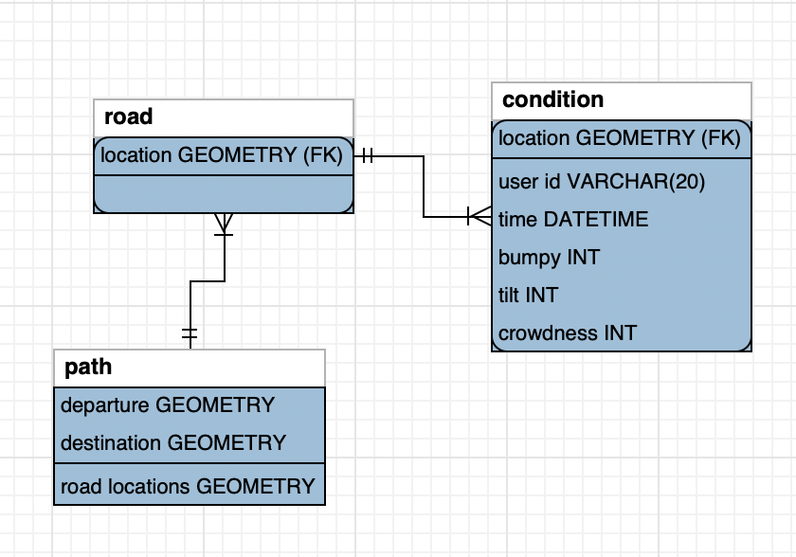
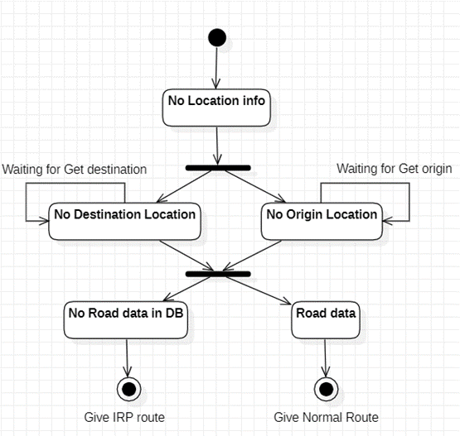
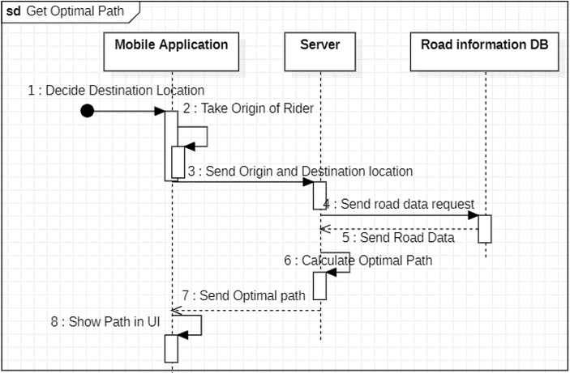
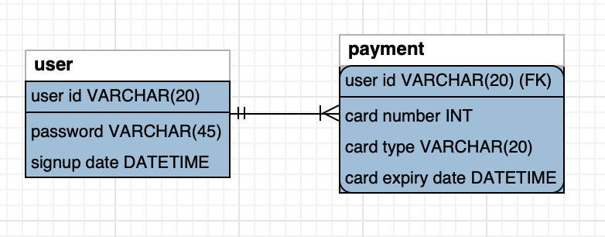
What are the things to design? (1/2)
Team AVOCOADO, Spring 2022
Conceptual Architecture
System Architecture (Components)
Data
Flows & Interactions

Slide 4
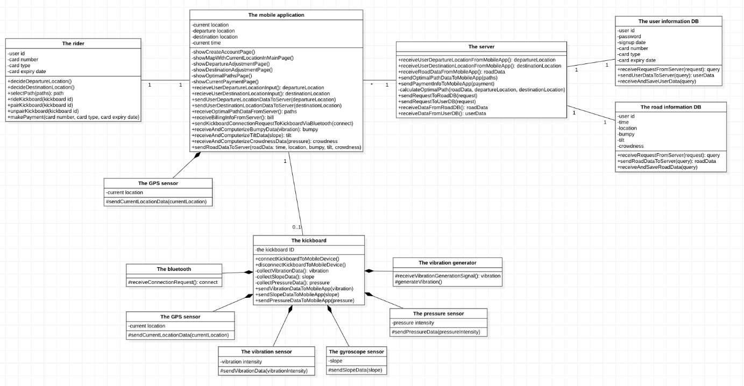
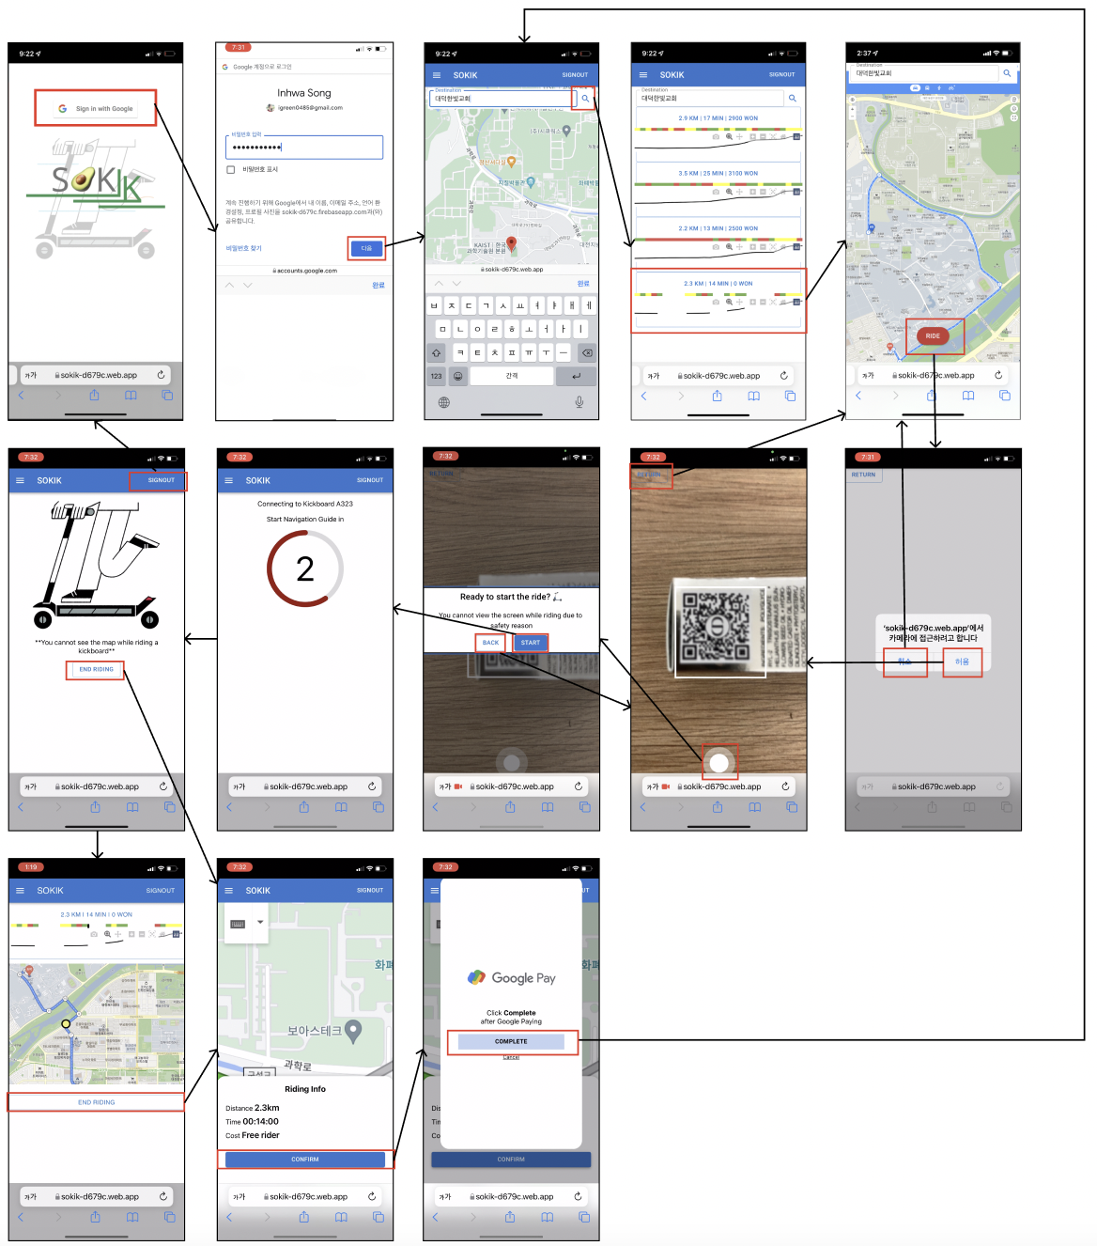
What are the things to design? (2/2)
Team AVOCOADO, Spring 2022
Implementation Classes
User Interface

Slide 5
Architecture Patterns

Slide 6
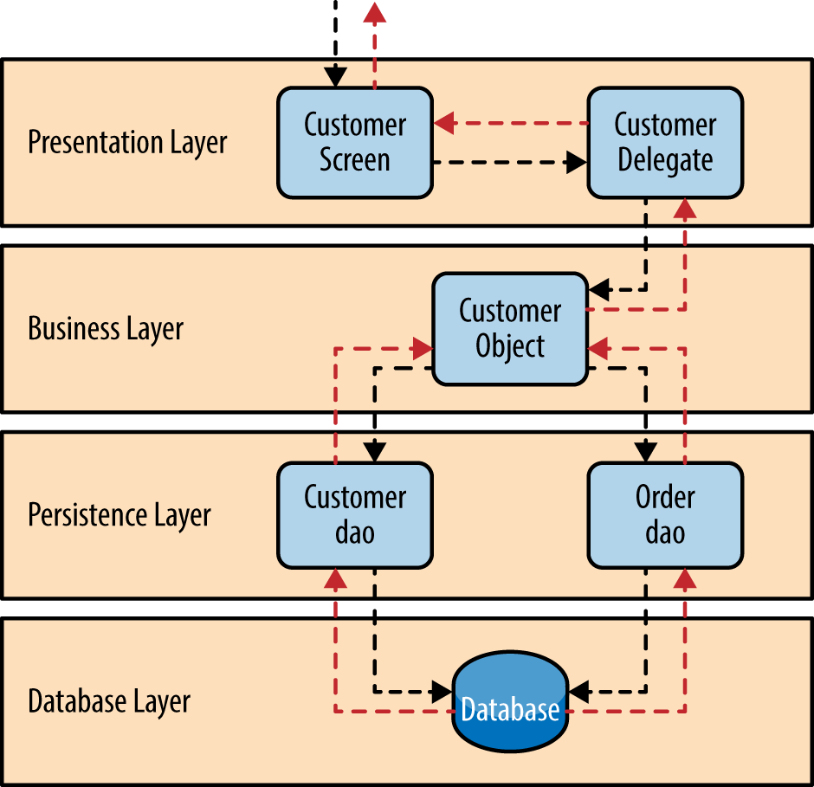
Architectural Design
An architectural model is derived from three sources:
  Information about the application domain for the software to be built
  Specific requirements model elements such as data flow analysis classes and their relationships (collaborations) for the problem at hand
  Availability of architectural patterns and styles
[PrMa20 ]
Goal
  To develop a modular program structure
  To represent the control relationships between modules
  To integrate the program structure and data structures
  To define interfaces
Adopted from Prof. Doo-Hwan Bae’s CS350 lecture material
https://towardsdatascience.com/software-architecture-patterns-98043af8028

Slide 7
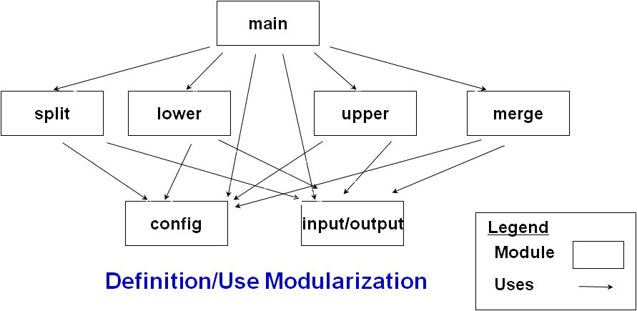
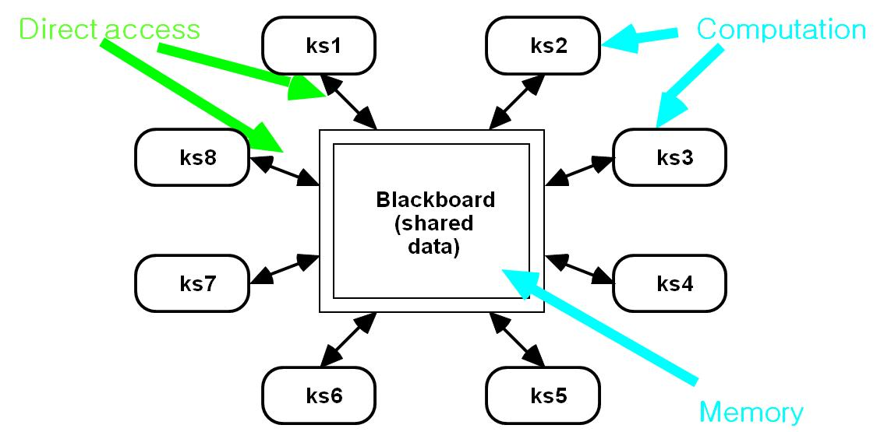
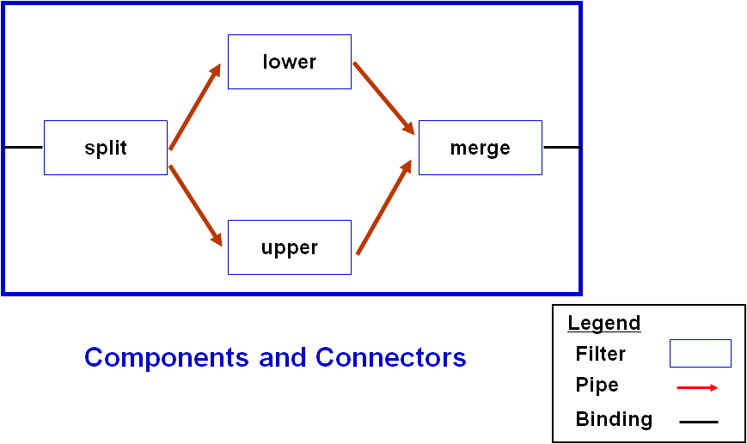
Architectural Styles (Patterns)
Common and reusable patterns of software architecture observed in different systems
Specialization of element and relation types, together with a set of constraints
Represents common properties
Can be associated with different architectural views
Most widely used architectural patterns
  Layered
  Client-server
  Pipe-filter
  Broker
  Event-bus
Adopted from Prof. Doo-Hwan Bae’s CS350 lecture material

Slide 8
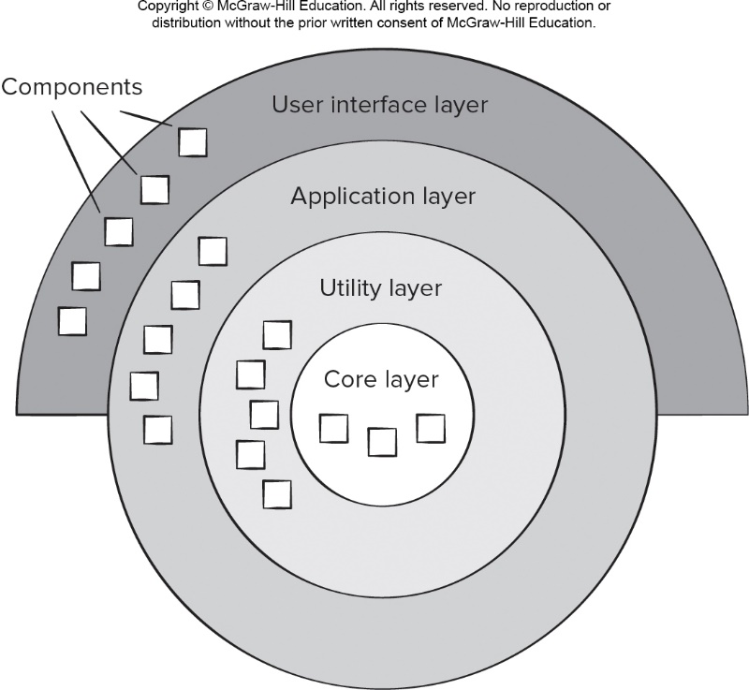
Layered Pattern (1/2)
Decomposed into groups of subtasks, each of which is at a particular level of abstraction
Each layer provides services to the next higher level
Common examples:
  Network systems
  E-commerce
[PrMa20 ]
https://towardsdatascience.com/software-architecture-patterns-98043af8028
Adopted from Prof. Doo-Hwan Bae’s CS350 lecture material

Slide 9
Layered Pattern (2/2)
Pros
  Separate of concern – we only need to consider a smaller scope in each layer, which makes the problem much more straightforward
  More testable – each layer has less case to test and thus more testable
  Isolation – changes in one layer will not affect downstream layers
  Changeability – if you are not satisfied with the implementation of one layer, you can replace it with another layer, as long as they implements the same interface
Cons
  Management cost if there are too many layers
  The performance is getting slower as more and more layers added
https://enqueuezero.com/layered-architecture.html
Adopted from Prof. Doo-Hwan Bae’s CS350 lecture material

Slide 10

Client-Server Pattern (1/2)
The server component listens client requests, provides services to multiple client component
Server does not need to know clients
Online applications such as Web, email, banking, etc.
https://en.wikipedia.org/wiki/Client%E2%80%93server_model
Adopted from Prof. Doo-Hwan Bae’s CS350 lecture material
Notes:
…

Slide 11
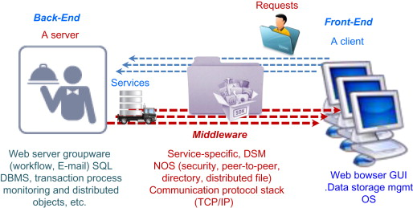
Client-Server Pattern (2/2)
A producer/consumer computing architecture
  A server acts as the producer, providing services such as application access, storage, file sharing, printer access, …
  A client acts as the consumer
Pros and Cons
  Scalable?
  Centralized control
  Cost? – high maintenance
  In case of failure?
Adopted from Prof. Doo-Hwan Bae’s CS350 lecture material
https://www.sciencedirect.com/topics/computer-science/client-server-architecture

Slide 12
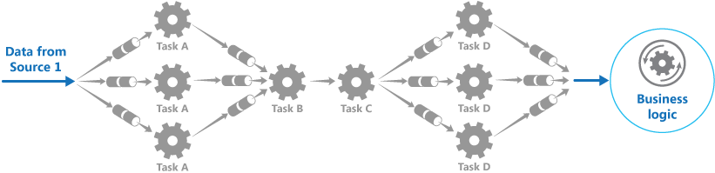
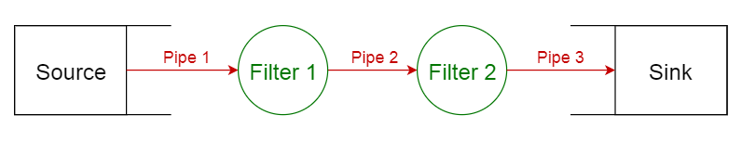
Pipe and Filter (Data Flow) Pattern
The structure of a system that produces and processes a stream of data
Each processing unit is enclosed within a filter component
Data to be processed is passed through pipes
e.g., Compiler, workflow machine,.. IoT, Digital Twins in CPS,..
Adopted from Prof. Doo-Hwan Bae’s CS350 lecture material
Notes:
Compiler: lexical analysis, parsing, semantic analysis, code generation,

Slide 13
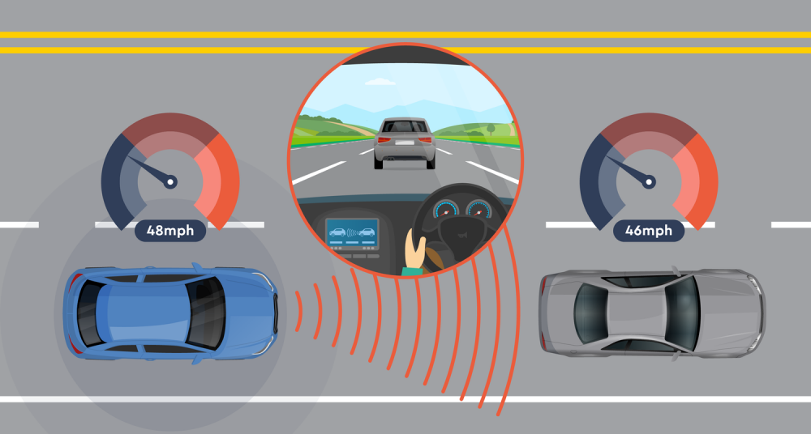
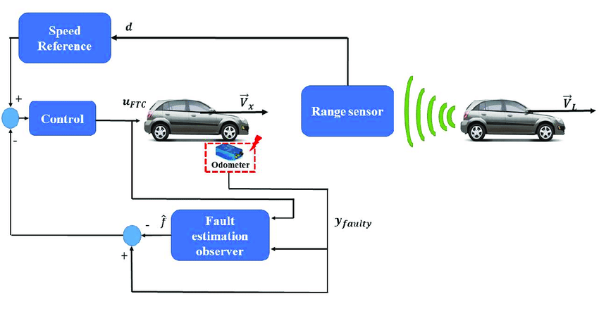
Pipe and Filter Example
Adopted from Prof. Doo-Hwan Bae’s CS350 lecture material
Automated Cruise Control System
  Maintain a speed set by the driver
    Sensor, processing unit, actuator
  How to measure the current speed?
https://www.thewindscreenco.co.uk/adas-guide/adaptive-cruise-control-acc/
https://www.researchgate.net/figure/Adaptive-Cruise-Control-ACC-fault-tolerant-paradigm_fig1_325702711
Notes:
Under what occasions do you have this structure?
- Parallel processing for fault tolerance or performance reasons.

Slide 14
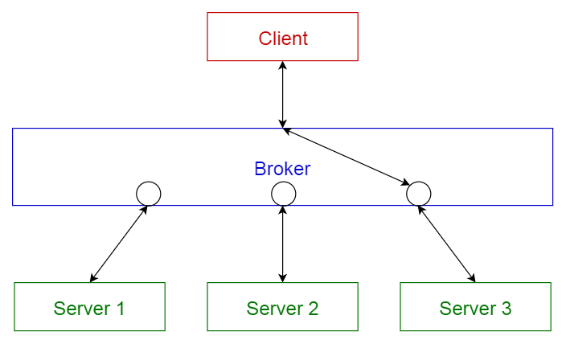
Broker Pattern
Structure of a distributed system with decoupled components
Broker component is responsible for the coordination and communication among components
Servers publish their capabilities to a broker
Clients request a service from the broker, and the broker redirects the client to a suitable service
Message brokers:
  Apache ActiveMQ
  JBoss Messaging
Adopted from Prof. Doo-Hwan Bae’s CS350 lecture material
Notes:
Clients does not need to know existence of specific servers, unlike Client-Server pattern.

Slide 15
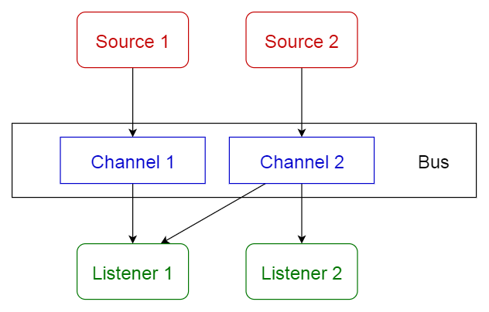
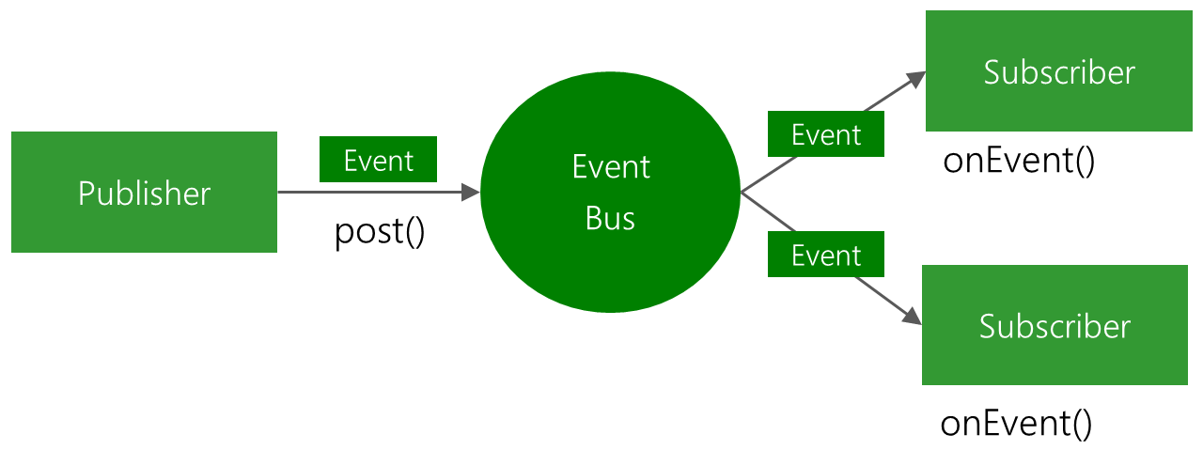
Event-bus Pattern
Has 4 components
  Event source – publishes messages to particular channels
  Event listener – subscribes to particular channels to get notifications of messages
  Channel
  Event bus (Common API)
Publish–subscribe (pub-sub) pattern
e.g., Android EventBus
https://github.com/greenrobot/EventBus
Adopted from Prof. Doo-Hwan Bae’s CS350 lecture material
Notes:
Event-bus vs broker ???
https://neiljbrown.com/2017/05/13/message-broker-or-bus-whats-the-difference/

Slide 16

Model-view-controller (MVC) Pattern
Isolates business logic from user interface
Makes it easier to modify applications either their visual appearance or the underlying business rules without affecting others
Model: the domain-specific representation of the information on which the application operates
View: renders the model into a form suitable for interaction, typically a user interface element
Controller: processes and responds to events, typically user actions, and may invoke changes on the model
[Wikipedia]
Notes:
The solid line represents a direct association, the dashed an indirect association (via an observer for example).

Slide 17
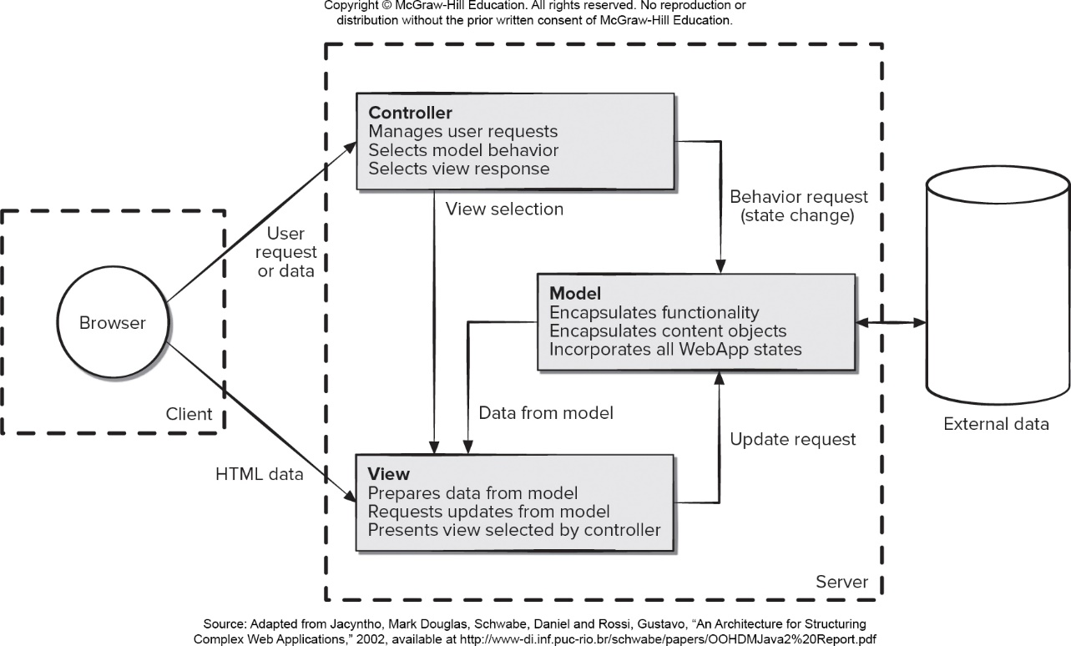
MVC Example – Dynamic Web Applications
[PrMa20 ]

Slide 18
Component-based Design Pattern
Software Components: “Binary (executable) units that are independently produced, acquired and deployed, and can be connected to each other to form a composite system.” [Szyperski 1998]
[BBB+00] Felix Bachmann, Len Bass, Charles Buhman, Santiago Comella-Dorda, Fred Long, John Robert, Robert Seacord, and Kurt Wallnau, "Volume II: Technical Concepts of Component-Based Software Engineering, 2nd Edition”, Software Engineering Institute, Carnegie Mellon University, Pittsburgh, Pennsylvania, Technical Report CMU/SEI-2000-TR-008, 2000.

Slide 19
Why Component-based?
Reusability
Flexibility
  Easier to customize a software system
  Easier to satisfy changing user requirements
Maintainability
  Independent extensions (shorter upgrade cycle)
  Easier to maintain state-of-the-art software
Productivity
  Reduced time-to-market
  More outsourcing components (component markets)
  Better cost efficiency
  Higher quality (improved predictability & reliability)
Notes:
Components are for solving general problems, not just for a specific application.

Slide 20
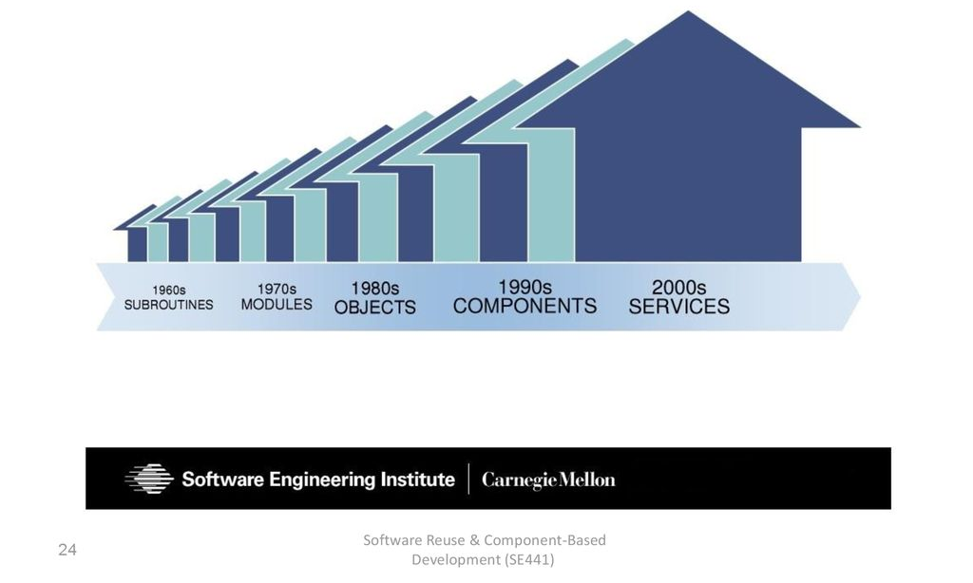
Software Reuse History

