Slide 1
CS350:
Introduction to Software Engineering
Spring 2025
Lecture #19
Prof. In-Young Ko
School of Computing

Slide 2
Software Quality Assurance

Slide 3
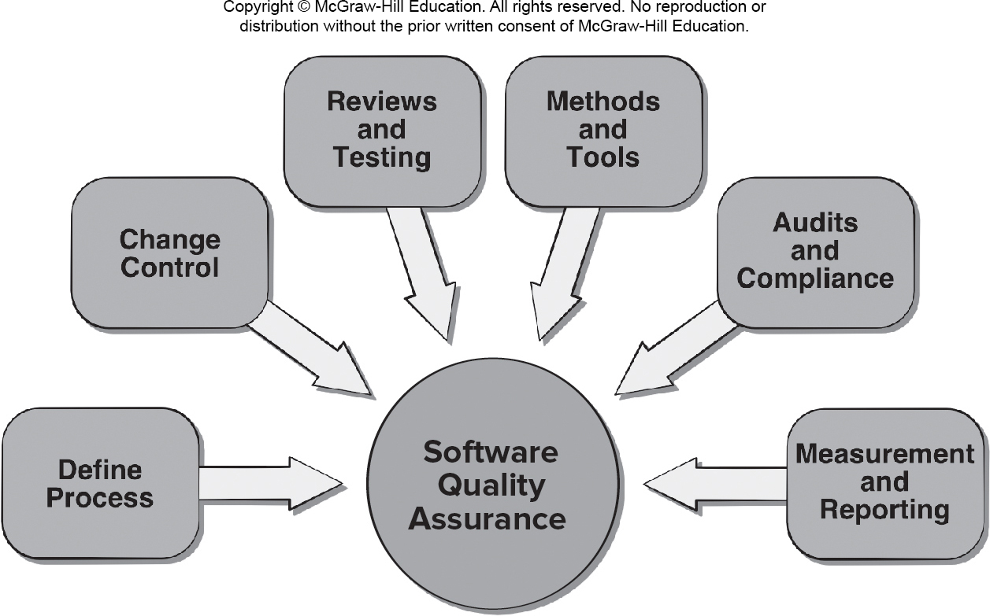
Software Quality Assurance (SQA)
Elements of SQA
Standards
Reviews and Audits
Testing
Error/defect collection and analysis
Change management
Education
Vendor management
Security management
Safety
Risk management
[PrMa20 ]

Slide 4
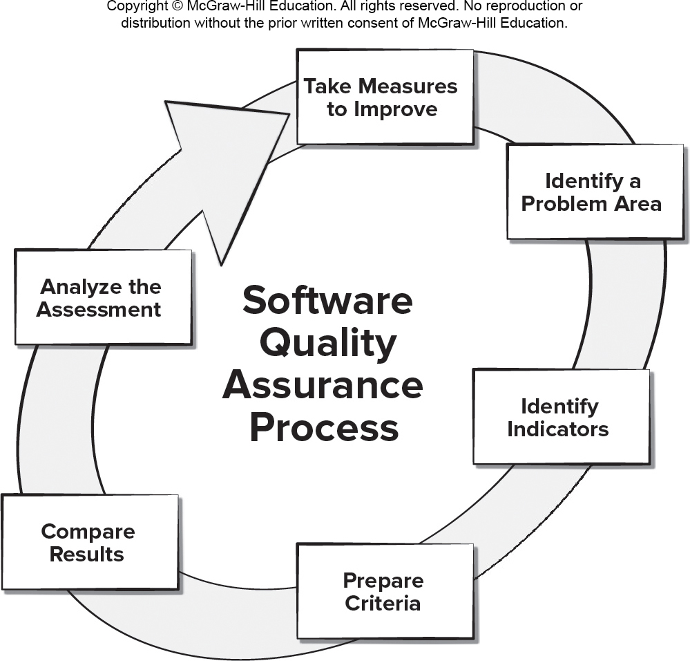
Data Driven SQA
Modern SQA is often data driven
Stakeholders define goals and quality measures
Identifying problem areas → measuring indicators → making change decision
SQA tasks are performed by an independent SQA group
[PrMa20 ]

Slide 5
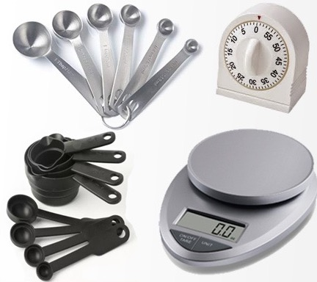

SQA Tasks (1/2)
Prepares an SQA plan for a project which identifies:
  Evaluations to be performed
  Audits and reviews to be performed
  Standards that are applicable to the project
  Procedures for error reporting and tracking
  Documents to be produced by the SQA group
  Amount of feedback provided to the software project team
Participates in the development of the project’s software process description
  Reviews the process description for compliance with organizational policy, internal software standards, externally imposed standards (e.g., ISO-9001), and other parts of the software project plan
https://www.tangylife.com/blog/best-baking-measuring-tools/
[PrMa20 ]
https://www.postermywall.com/index.php/posterbuilder/copy/60eaad5688764f4ce14f3e157127bd02

Slide 6

SQA Tasks (2/2)
Reviews software engineering activities to verify compliance with the defined software process
  Identifies, documents, and tracks deviations from the process and verifies that corrections have been made
https://www.koreatimes.co.kr/www/nation/2018/06/617_202747.html
Audits designated software work products to verify compliance with those defined as part of the software process
  Reviews selected work products; identifies, documents, and tracks deviations; verifies that corrections have been made
  Periodically reports the results of its work to the project manager
Ensures that deviations in software work and work products are documented and handled according to a documented procedure
Records any noncompliance and reports to senior management
  Noncompliance items are tracked until they are resolved
[PrMa20 ]

Slide 7
SQA Goals
Requirements quality. The correctness, completeness, and consistency of the requirements model will have a strong influence on the quality of all work products
Design quality. To ensure that it exhibits high quality and that the design itself conforms to requirements
Code quality. Source code and related work products must conform to local coding standards and exhibit characteristics that will facilitate maintainability
Quality control effectiveness. A software team should apply limited resources in a way that has the highest likelihood of achieving a high quality result
[PrMa20 ]

Slide 8
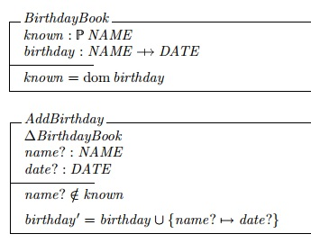
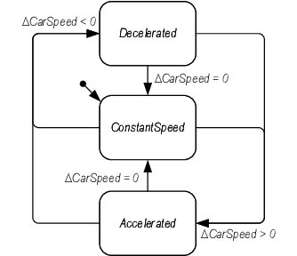
Formal SQA
Assumes that a rigorous syntax and semantics can be defined for every programming language
Allows the use of a rigorous approach to the specification of software requirements
Applies mathematical proof of correctness techniques to demonstrate that a program conforms to its specification
https://www.neverletdown.net/2009/01/thoughts-on-formal-methods-in-software.html
[PrMa20 ]
https://www.researchgate.net/publication/265628720_Using_Task_Analytic_Behavior_Modeling_Erroneous_Human_Behavior_Generation_and_Formal_Methods_to_Evaluate_the_Role_of_Human-automation_Interaction_in_System_Failure/figures?lo=1

Slide 9
Statistical SQA
Collect and categorize information about software errors and defects
Trace each error and defect to its underlying cause (e.g., design error, violation of standards, non-conformance to specifications, poor communication with the customer)
Using the Pareto principle (80 percent of the defects can be traced to 20 percent of all possible causes), isolate the 20 percent (the vital few)
Correct the problems that caused the errors and defects
[PrMa20 ]

Slide 10
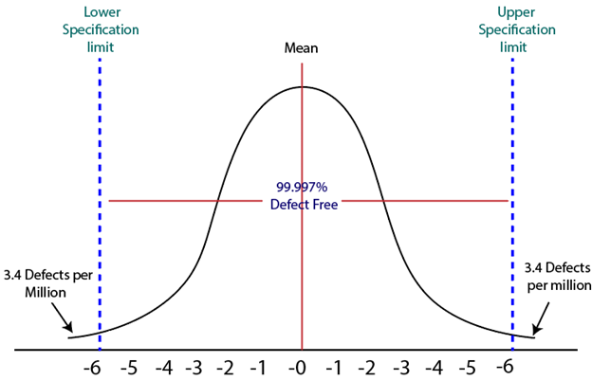
Six Sigma for Software Engineering (1/3)
The term “six sigma” is derived from six standard deviations from the mean – 3.4 instances (defects) per million occurrences - implying an extremely high quality standard
[PrMa20 ]
https://www.javatpoint.com/software-engineering-six-sigma

Slide 11
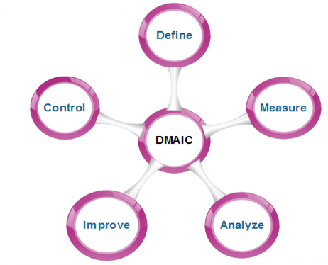
Six Sigma for Software Engineering (2/3)
The three cores steps:
  Define customer requirements and deliverables and project goals via well-defined methods of customer communication
  Measure the existing process and its output to determine current quality performance (collect defect metrics)
  Analyze defect metrics and determine the vital few causes
https://www.javatpoint.com/software-engineering-six-sigma
[PrMa20 ]

Slide 12
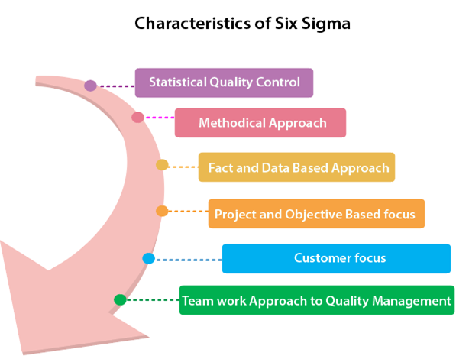
Six Sigma for Software Engineering (2/2)
For an existing process the needs improvement:
  Improve the process by eliminating the root causes of defects
  Control the process to ensure that future work does not reintroduce the causes of defects
For a new process being developed:
  Design the process to: (1) avoid the root causes of defects and (2) to meet customer requirements
  Verify that the process model will, in fact, avoid defects and meet customer requirements
https://www.javatpoint.com/software-engineering-six-sigma
[PrMa20 ]

Slide 13
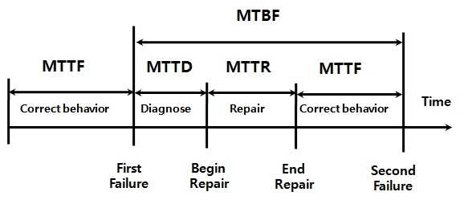
Software Reliability and Availability
A simple measure of reliability is mean-time-between-failure (M T B F):
M T B F = M T T F + M T T R
  M T T F: mean-time-to-failure
  M T T R: mean-time-to-repair
Software availability is the probability that a program is operating according to requirements at a given point in time and is defined as
Availability = (M T T F / M T BF) × 100%
Woo, Seongwoo. (2020). Modern Definitions in Reliability Engineering. 10.1007/978-981-13-7236-0_3.
[PrMa20 ]

Slide 14
AI and Reliability Models
Software reliability is the probability of failure-free software operation for a specified time period in a specified environment
Bayesian inference can be used to estimate probabilistic quantities using historic data even when some of the information is missing
Predictive data analytics tools such as a regression model can be used to estimate where and what types of defects might occur in future prototypes
Genetic algorithms can be used to grow reliability models by discovering relationships using historic system data to predict future software component failures
[PrMa20 ]
Notes:
P

Slide 15
Software Safety
Software safety is a SQA activity that focuses on the identification and assessment of potential hazards that may affect software negatively and cause an entire system to fail
If hazards can be identified early in the software process, software design features can be specified that will either eliminate or control potential hazards
[PrMa20 ]

Slide 16
ISO 9001:2015 Standard
ISO 9001:2015 is the quality assurance standard that applies to software engineering
The requirements delineated by ISO 9001:
  Management responsibility, quality system, contract review, design control, document and data control, product identification and traceability, process control, inspection and testing, corrective and preventive action, control of quality records, internal quality audits, training, servicing, and statistical techniques
For an organization to become registered to ISO 9001, it must establish procedures to address each of the requirements listed and able to demonstrate these policies and being followed
[PrMa20 ]

Slide 17
IEEE Std 730 – Software Quality Assurance Plans (SQAP)
https://ieeexplore.ieee.org/document/1040117
1) Purpose
2) Reference documents
3) Management
4) Documentation
5) Standards, practices, conventions, and metrics
6) Software reviews
7) Test
8) Problem reporting and corrective action
9) Tools, techniques, and methodologies
10) Media control
11) Supplier control
12) Records collection, maintenance, and retention
13) Training
14) Risk management
15) Glossary
16) SQAP change procedure and history

Slide 18
Questions?

