Slide 1
Chapter 23
Software Metrics and Analytics

Slide 2
McCall’s Triangle of Quality
M
a
i
n
t
a
i
n
a
b
i
l
i
t
y
M
a
i
n
t
a
i
n
a
b
i
l
i
t
y
P
o
r
t
a
b
i
l
i
t
y
P
o
r
t
a
b
i
l
i
t
y
F
l
e
x
i
b
i
l
i
t
y
F
l
e
x
i
b
i
l
i
t
y
R
e
u
s
a
b
i
l
i
t
y
R
e
u
s
a
b
i
l
i
t
y
T
e
s
t
a
b
i
l
i
t
y
T
e
s
t
a
b
i
l
i
t
y
I
n
t
e
r
o
p
e
r
a
b
i
l
i
t
y
I
n
t
e
r
o
p
e
r
a
b
i
l
i
t
y
P
R
O
D
U
C
T
R
E
V
I
S
I
O
N
P
R
O
D
U
C
T
R
E
V
I
S
I
O
N
P
R
O
D
U
C
T
T
R
A
N
S
I
T
I
O
N
P
R
O
D
U
C
T
T
R
A
N
S
I
T
I
O
N
P
R
O
D
U
C
T
O
P
E
R
A
T
I
O
N
P
R
O
D
U
C
T
O
P
E
R
A
T
I
O
N
C
o
r
r
e
c
t
n
e
s
s
C
o
r
r
e
c
t
n
e
s
s
U
s
a
b
i
l
i
t
y
U
s
a
b
i
l
i
t
y
E
f
f
i
c
i
e
n
c
y
E
f
f
i
c
i
e
n
c
y
R
e
l
i
a
b
i
l
i
t
y
I
n
t
e
g
r
i
t
y
R
e
l
i
a
b
i
l
i
t
y
I
n
t
e
g
r
i
t
y
ISO 9126 Quality Factors
- Functionality, reliability, usability, efficiency, maintainability, portability

Slide 3
Measures, Metrics and Indicators
A SW engineer collects measures and develops metrics so that indicators will be obtained
  A measure provides a quantitative indication of the extent, amount, dimension, capacity, or size of some attribute of a product or process
  The IEEE defines a metric as “a quantitative measure of the degree to which a system, component, or process possesses a given attribute.”
    IEEE Standard Glossary of Software Engineering Terminology (IEEE Std 610.12-1990)
  An indicator is a metric or combination of metrics that provide insight into the software process, a software project, or the product itself
Ex. Moonzoo Kim
  Measure: height=170cm, weight=65 kg
  Metric: fat metric= 0.38 ( =weight/height)
  Indicator: normal health condition (since fat metric < 0.5 )

Slide 4
Measurement Principles
The objectives of measurement should be established before data collection begins
  Ex. It is useless for black-box testers to measure a # of words in a C file.
  Ex. It is useful for C compiler developers to measure a # of words in a C file.
Each technical metric should be defined in an unambiguous manner
  Ex. For measuring a total line number of a C program
    Including comments? Including empty lines?
Metrics should be derived based on a theory that is valid for the domain of application
  Metrics for design should draw upon basic design concepts and principles and attempt to provide an indication of the presence of a desirable attribute
  Metrics should be tailored to best accommodate specific products and processes

Slide 5
Measurement Process
Formulation.
The derivation of software measures and metrics appropriate for the representation of the software that is being considered.
Collection
The mechanism used to accumulate data required to derive the formulated metrics.
Analysis.
The computation of metrics and the application of mathematical tools.
Interpretation.
The evaluation of metrics results in an effort to gain insight into the quality of the representation.
Feedback.
Recommendations derived from the interpretation of product metrics transmitted to the software team.
Example of Formulation
To check whether a give software is hot-spotted (i.e. has intensive loops)
Example of Collection
Instrument a source program/binary to count how many time a given statement is executed in one second
Example of Analysis.
Using Excel/MatLab to get average numbers of executions of statements
Example of Interpretation.
If there exist statements which were executed more than 10⁸ , on a 3 Ghz machine, then the program is hot-spotted
Example of Feedback.
Try to optimize those hot-spotted statements. Or those hot-spotted statement might have logical flaws

Slide 6
Goal-Oriented Software Measurement
The Goal/Question/Metric Paradigm
  establish an explicit measurement goal
  define a set of questions that must be answered to achieve the goal
  identify well-formulated metrics that help to answer these questions.
Goal definition template
  Analyze
  {the name of activity or attribute to be measured}
  for the purpose of
  {the overall objective of the analysis}
  with respect to
  {the aspect of the activity or attribute that is considered}
  from the viewpoint of
  {the people who have an interest in the measurement}
  in the context of
  {the environment in which the measurement takes place}.

Slide 7
Ex> Goal definition for SafeHome
Analyze the Safehome SW architecture
for the purpose of evaluating architectural components
with respect to the ability to make Safehome more extensible
from the viewpoint of the SW engineers performing the work
in the context of enhancement over the next 3 years
Questions
  Q1: Are architectural components characterized in a manner that compartmentalizes function and related data?
    Answer: 0 … 10
  Q2: Is the complexity of each component within bounds that will facilitate modification and extension?
    Answer: 0 … 1

Slide 8
Metrics Attributes
Simple and computable.
It should be relatively easy to learn how to derive the metric, and its computation should not demand inordinate effort or time
Empirically and intuitively persuasive.
The metric should satisfy the engineer’s intuitive notions about the product attribute under consideration
Consistent and objective.
The metric should always yield results that are unambiguous.
Consistent in its use of units and dimensions.
The mathematical computation of the metric should use measures that do not lead to bizarre combinations of unit.
ex. MZ measure of a software complexity: kg x m⁴
An effective mechanism for quality feedback.
That is, the metric should provide a software engineer with information that can lead to a higher quality end product

Slide 9
Collection and Analysis Principles
Whenever possible, data collection and analysis should be automated
Valid statistical techniques should be applied to establish relationship between internal product attributes and external quality characteristics
Interpretative guidelines and recommendations should be established for each metric
  Ex. Fat metric greater than 0.5 indicates obesity. A person who has more than 0.7 fat metric should consult a doctor.

Slide 10
Overview of Ch23. Product Metrics
23.3.1 Metrics for the Requirement (Analysis) Model
  Function point metrics
23.3.2 Design Metrics for Conventional Software
23.3.3 Design Metrics for OO Software
  Class-oriented metrics
  Component-level design metrics
  Operation oriented metrics
23.3.4 User Interface Design Metrics
23.3.5 Metrics for Source Code
23.4 Metrics for Testing
23.5 Metrics for Maintenance

Slide 11
Metrics for the Analysis Model
These metrics examine the analysis model with the intent of predicting the “size” of the resultant system
Size can be an indicator of design complexity
Size can be an indicator of increased coding, integration, and testing efforts
Example
  Function-based metrics
  Metrics for specification quality

Slide 12
Function-Based Metrics
The function point metric (FP), first proposed by Albrecht [ALB79], can be used effectively as a means for measuring the functionality delivered by a system.
Function points are derived using an empirical relationship based on countable (direct) measures of software's information domain and assessments of software complexity
Information domain values are defined in the following manner:
  # of external inputs (EIs)
    often used to update internal logical files
  # of external outputs (EOs)
  # of external inquiries (EQs)
  # of internal logical files (ILFs)
  # of external interface files (EIFs)

Slide 13
Function Points
FP = count total x (0.65 + 0.01 x ∑(F_{i}))
where Fi’s are value adjustment factors based on responses to the 14 questions

Slide 14
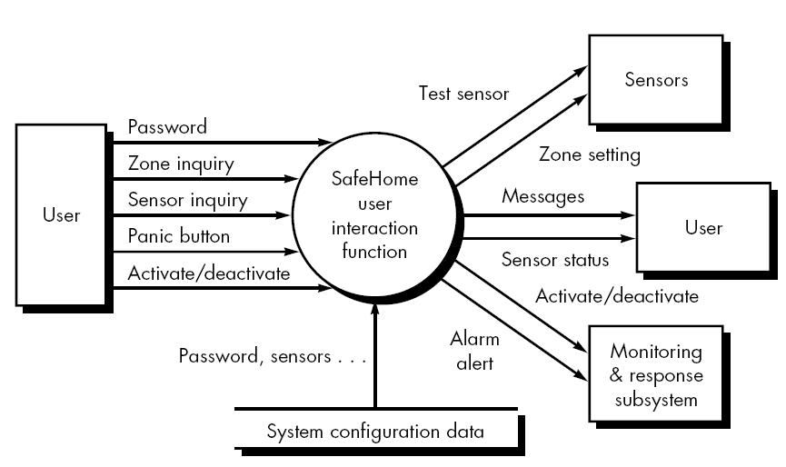
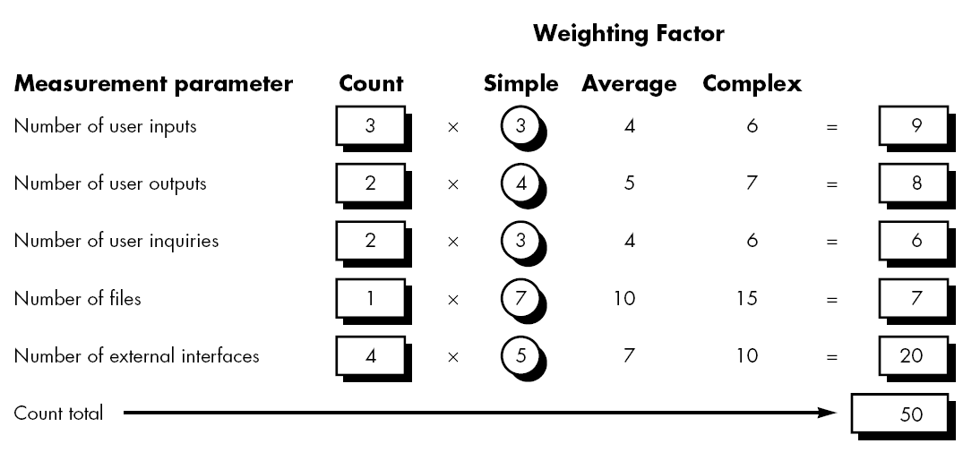

Slide 15
Value Adjustment Factors (F_{i})
Following questions should be answered using a scale that ranges from 0 (not important) to 5 (absolutely essential)
  Does the system require reliable backup and recovery?
  Are specialized data communications required to transfer information to or from the application?
  Are there distributed processing functions?
  Is performance critical?
  Will the system run in an existing, heavily utilized operational environment?
  Does the system require on-line data entry?
  Does the on-line data entry require the input transaction to be built over multiple screens or operations?

Slide 16
Usage of Function Points
Assume that
  past data indicates that one FP translates into 60 lines of code
  12 FPs are produced for each person-month of effort
  Past projects have found an average of 3 errors per FP during analysis and design reviews
  4 errors per FP during unit and integration testing
These data can help SW engineers assess the completeness of their review and testing activities.
Suppose that Safehome has 56 FPs
  56 =50 x [0.65 +0.01 x ∑(F_{i}) (= 46)]
Safehome will be
  Expected size: 60 lines * 56 =3360 lines
  Expected required man-month: 1/12 MM * 56 = 4.7 MM
  Total analysis/design errors expected: 3 * 56 = 168 errors
  Total testing errors expected: 4 * 56 = 224 errors

Slide 17
Metrics for the Design Model
The design of engineering products (i.e. a new aircraft, a new computer chip, or a new building) is conducted with well-defined design metrics for various design qualities
  Ex 1. Quality does matter, see AMD’s success in 2000~2006.
  Ex 2. Pentium X should have
    Heat dispense ratio < 100 Kcal/s
    Should operate 99.99% time correctly at 10 Ghz
    Should consume less than 100 watts/h electric power
The design of complex software, however, often proceeds with virtually no metric measurement
  Although design metric is not perfect, design without metric is not acceptable.

Slide 18
Architectural Design Metrics
Architectural design metrics put emphasis on the effectiveness of modules or components within the architecture
  These metrics are “black box”
Architectural design metrics
  Structural complexity of a module m= (# of fan-out of module m)²
    Fan-out is the number of modules immediately subordinate to the module
      i.e. the # of modules that are directly invoked by the module
  Data complexity = (# of input & output variables)/ (fan-out+1)
  System complexity = structural complexity + data complexity

Slide 19
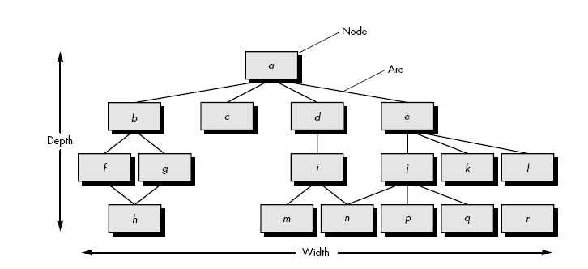
Morphology Metrics
Morphology metrics: a function of the number of modules and the number of interfaces between modules
  Size = n + a
  Depth = the longest path from the root node to a leaf node
  Width =maximum # of nodes at any one level of the architecture
  Arc-to-node ratio

Slide 20

Design Structure Quality Index (DSQI)
Developed by U.S. Air Force Systems Command
It rates how well a SW design is 1) structured, 2) modularized, and 3) maintainable, producing a score from 0 (worst) to 1 (best) from the following factors:
Evaluation Factor | Meaning
# of modules | Design modularity and separation of concerns
Interfaces between modules | Dependency complexity
Data structures used | Data clarity and organization
Global/shared data usage | Risk of side-effects / tight coupling
Component reuse | Efficiency and maintainability
Known design flaws | Problems found during review
Evaluation Factor | Meaning
Interfaces between modules | Dependency complexity

Slide 21
Metrics for OO Design-I
Whitmire [WHI97] describes nine distinct and measurable characteristics of an OO design:
  Size
    Size is defined in terms of the following four views:
      Population: a static count of OO entities such as classes
      Volume: a dynamic count of OO entities such as objects
      Length: a measure of a chain of interconnected design elements
      Functionality: value delivered to the customer
  Complexity
    How classes of an OO design are interrelated to one another
  Coupling
    The physical connections between elements of the OO design
      The # of collaborations between classes
  Sufficiency
    “the degree to which an abstraction possesses the features required of it, ... from the point of view of the current application.”
    Whether the abstraction (class) possesses the features required of it

Slide 22
Metrics for OO Design-II
  Completeness
    An indirect implication about the degree to which the abstraction or design component can be reused
  Cohesion
    The degree to which all operations working together to achieve a single, well-defined purpose
  Primitiveness
    Applied to both operations and classes, the degree to which an operation is atomic
  Similarity
    The degree to which two or more classes are similar in terms of their structure, function, behavior, or purpose
  Volatility
    Measures the likelihood that a change will occur

Slide 23
Distinguishing Characteristics
Berard [BER95] argues that the following characteristics require
that special OO metrics be developed:
Encapsulation
the packaging of data and processing
Information hiding
the way in which information about operational details is hidden by a secure interface
Inheritance
the manner in which the responsibilities of one class are propagated to another
Abstraction
the mechanism that allows a design to focus on essential details
Localization
the way in which information is concentrated in a program

Slide 24
Class-Oriented Metrics
Proposed by Chidamber and Kemerer (CK metrics suite):
Weighted Methods per Class (WMC)
  Weighted methods per class ∑C_{i} where C_{i} is a normalized complexity 0~1 for method i (e.g., cyclometric complexity)
  The # of methods and their complexity are reasonable indicators of the amount of effort required to implement and test a class
  As the # of methods grows for a given class, it is likely to become more application specific -> less reusability
  Counting the # of methods is not trivial
Depth of the inheritance tree (DIT)
  As DIT grow, potential difficulties when attempting to predict the behavior of a class

Slide 25
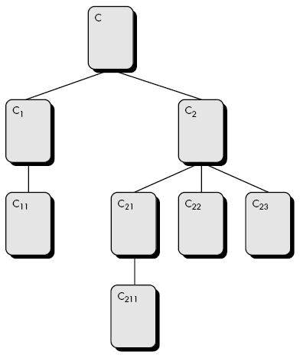
Class-Oriented Metrics
Number of children/subclasses (NOC)
  As NOC grows, more reuse, but the abstraction of the parent class is diluted
  As NOC grows, the amount of testing will also increase
Coupling between object classes (CBO)
  CBO is the # of collaborations listed on CRC index cards
  As CBO increases, reusability decreases
Response for a class (RFC)
  A set of methods that can be executed in response
  to a request
  As RFC increases, test sequence grows
Lack of cohesion in methods (LCOM)
  A # of methods that access same attributes

Slide 26
Applying CK Metrics
The scene:
  Vinod's cubicle.
The players:
  Vinod, Jamie, Shakira, Ed
  members of the SafeHome software engineering team, who are continuing work on component-level design and test case design.
The conversation:
Vinod: Did you guys get a chance to read the description of the CK metrics suite I sent you on Wednesday and make those measurements?
Shakira: Wasn't too complicated. I went back to my UML class and sequence diagrams, like you suggested, and got rough counts for DIT, RFC, and LCOM. I couldn't find the CRC model, so I didn't count CBO.
Jamie (smiling): You couldn't find the CRC model because I had it.
Shakira: That's what I love about this team, superb communication.
Vinod: I did my counts . . . did you guys develop numbers for the CK metrics?
26

Slide 27
(Jamie and Ed nod in the affirmative.)
Jamie: Since I had the CRC cards, I took a look at CBO, and it looked pretty uniform across most of the classes. There was one exception, which I noted.
Ed: There are a few classes where RFC is pretty high, compared with the averages . . . maybe we should take a look at simplifying them.
Jamie: Maybe yes, maybe no. I'm still concerned about time, and I don't want to fix stuff that isn't really broken.
Vinod: I agree with that. Maybe we
should look for classes that have bad numbers in at least two or more of the CK metrics. Kind of two strikes and you're modified.
Shakira (looking over Ed's list of classes with high RFC): Look, see this class? It's got a high LCOM as well as a high RFC. Two strikes?
Vinod: Yeah I think so . . . it'll be difficult to implement because of complexity and difficult to test for the same reason. Probably worth designing two separate classes to achieve the same behavior.
Jamie: You think modifying it'll save us time?
Vinod: Over the long haul, yes.
27

Slide 28
Class-Oriented Metrics
The MOOD Metrics Suite
Method inheritance factor (MIF) MIF = ∑ M_{i}(C_{i})/ ∑M_{a}(C_{i})
  M_{i}(C_{i}) = the # of methods inherited (and not overridden) in C_{i}
  M_{d}(C_{i}) = the # of methods declared in the class C_{i}
  M_{a}(C_{i}) = M_{d}(C_{i}) + M_{i}(C_{i})
Coupling factor CF = ∑ ∑ is_client(C_{i},C_{j})/ (T_{c}²-T_{c})
  Is_client = 1 if and only if a relationship exists between the client class C_{c} and C_{s} (C_{c} != C_{s})
  High CF makes trouble to understandability, maintainability and reusability.

Slide 29
Component-Level Design Metrics
Cohesion metrics
a function of data objects and the locus of their definition
Coupling metrics
a function of input and output parameters, global variables, and modules called
Complexity metrics
hundreds have been proposed (e.g., cyclomatic complexity)

Slide 30
Operation-Oriented Metrics
Proposed by Lorenz and Kidd [LOR94]:
average operation size
# of messages sent by the operation
operation complexity
average number of parameters per operation

Slide 31
Metrics for Source Code
Halstead’s Software Science: a comprehensive collection of metrics based on the number (count and occurrence) of operators and operands within a component or program
  n₁: # of distinct operators that appears in a program
  n₂: # of distinct operands that appears in a program
  N₁: # of operator occurrences
  N₂: # of operand occurrences
Program length N = n₁ log₂ n₁ + n₂ log₂ n₂
Program volume V= N log₂ (n₁ + n₂)
And many more metrics

Slide 32
Cyclometic Complexity
A quantitative measure of the logical complexity
Cyclomatic complexity defines the # of independent paths to test for complete statement/branch coverage
- number of simple decisions + 1
- number of edge – number of node +2p
- number of enclosed areas + 1
- In this case, V(G) = 4

Slide 33
Metrics for Testing
Testing effort can also be estimated using metrics derived from Halstead measures
Binder [BIN94] suggests a broad array of design metrics that have a direct influence on the “testability” of an OO system.
  Lack of cohesion in methods (LCOM).
  Percent public and protected (PAP).
  Public access to data members (PAD).
  Number of root classes (NOR).
  Fan-in (FIN).
  Number of children (NOC) and depth of the inheritance tree (DIT).

Slide 34
Metrics for Maintenance
IEEE Std 982.1-1998 Software Maturity Index (SMI)
  SMI = [M_{t} - (F_{a} + F_{c} + F_{d})]/M_{t}
    M_{t} = # of modules in the current release
    F_{c} = # of modules in the current release that have been changed
    F_{a} = # of modules in the current release that have been added
    F_{d} = # of modules from the preceding release that were deleted in the current release

Slide 36
Class-Oriented Metrics
Proposed by Lorenz and Kidd [LOR94]:
class size
number of operations overridden by a subclass
number of operations added by a subclass

