Slide 1
HW Announcement
CS 350

Slide 2
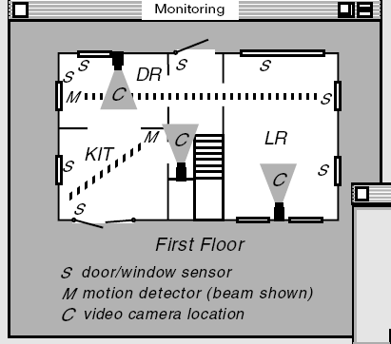
Floor Plan
The system operation is based on the fixed floor plan illustrated in the figure.
All sensor locations are static and predetermined.

Slide 3
Floor Plan
Safety zones are defined by the inclusion of specific sensors (represented by red dots).

Slide 4
Floor Plan
Safety zone
Safety zones are defined by the inclusion of specific sensors (represented by red dots).
A sensor is considered 'included' in a zone even if the zone only covers the sensor point itself, not the entire fixture (e.g., the whole window).

Slide 5
Floor Plan
Safety zone : on
Safety zone : off
For motion sensors, if a safety zone overlaps with any part of the sensor's detection area, the sensor is considered part of that zone.
Sensor Deactivation Logic: A motion sensor shared by multiple zones will remain active unless all zones it belongs to are deactivated.

Slide 6
For implementation
Virtual devices representing the sensors will be provided during the implementation stage.
Simple, scenario-based test cases will be provided for validation during implementation.

