Slide 1
Practical Guidelines for Tests through Safehome Example
Moonzoo Kim
SoC KAIST

Slide 2
General Guidelines for Tests
Tests should be carefully designed based on SRS, SDS, and the implementation.
Design tests of various levels based on SRS/SDS as follows (but, not limited to)
  Unit tests: based on state diagrams, class diagrams (and implicitly based on CRC cards and sequence diagrams)
  Integration tests: class diagrams, CRC cards, and sequence diagrams
  System-level tests: based on CRC cards, sequence diagrams and use case scenarios
Test documents should refer to corresponding requirements and designs, if any.
At the same time, try your best to make unexpected, exceptional, corner case tests to detect hidden corner case bugs (i.g., by generating random inputs, or fuzzed input, etc.)
Usually, test code file (e.g., test_xx.py) should be separated from target source code file for better maintenance.

Slide 3
General Guidelines for Unit Tests
You are expected to generate at least one unit test for every method in your target system
  but not for a method in 3rd party library (e.g., the virtual device in safehome)
A unit test usually means a test method that
  does not have parameters (i.e., 1 unit test per 1 specific input value), and
  has assert statement(s) at (the end of) the test method

Slide 4
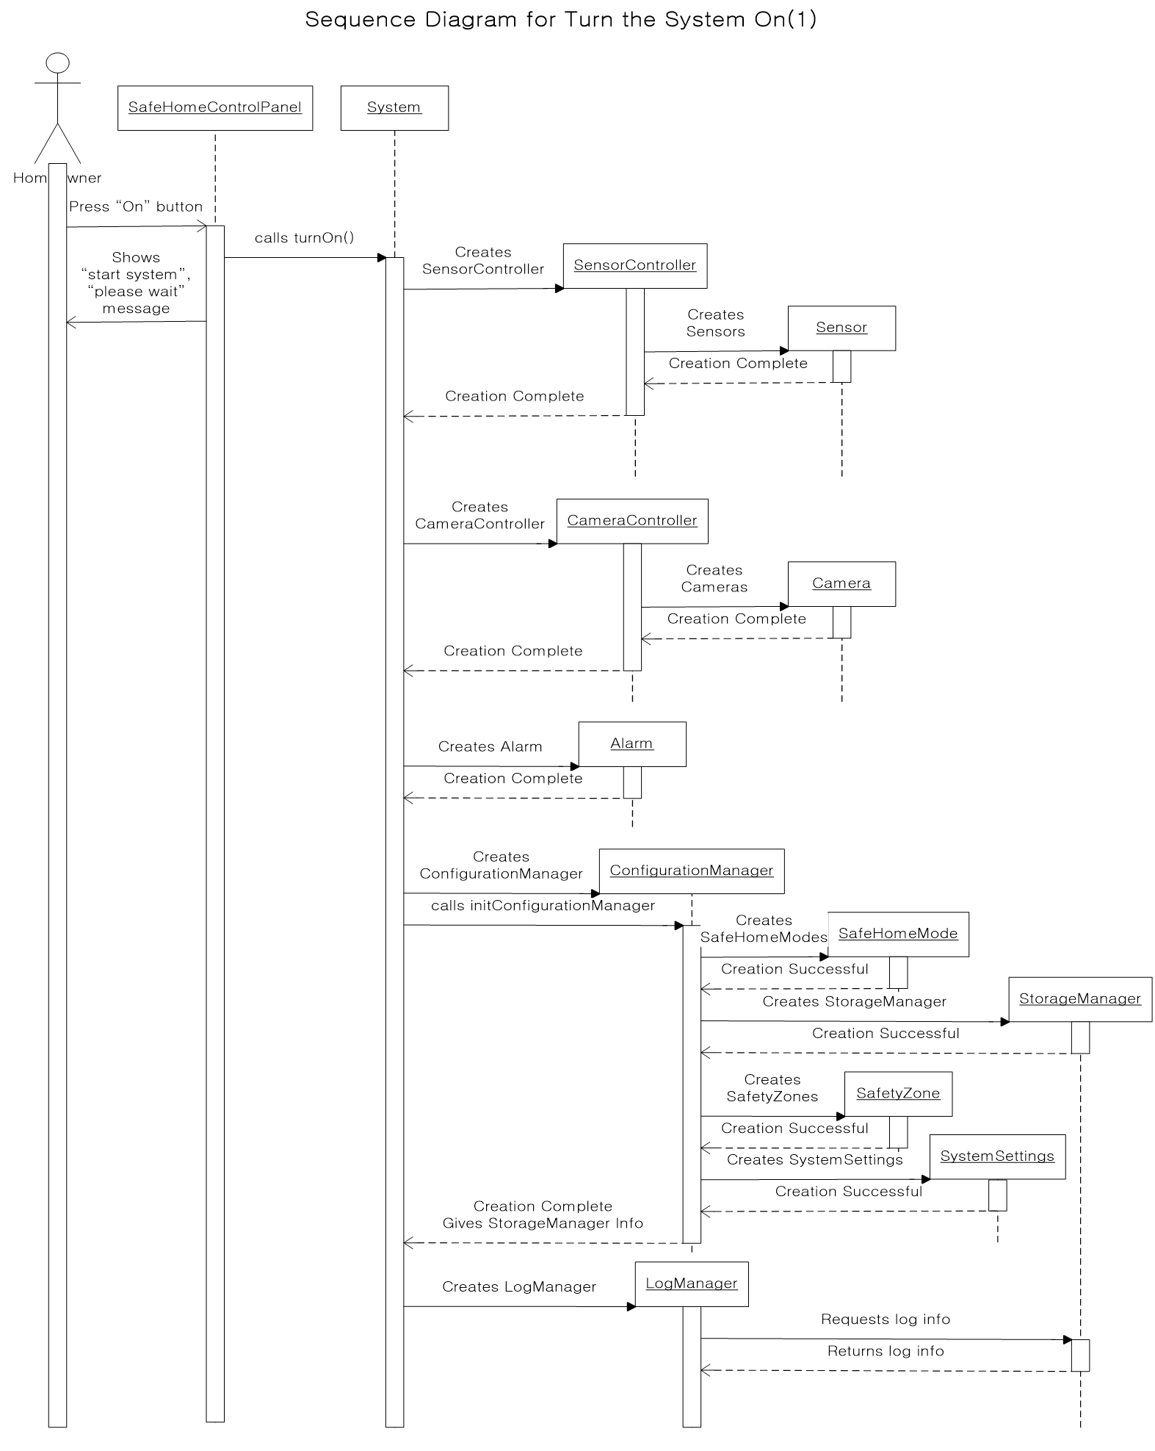
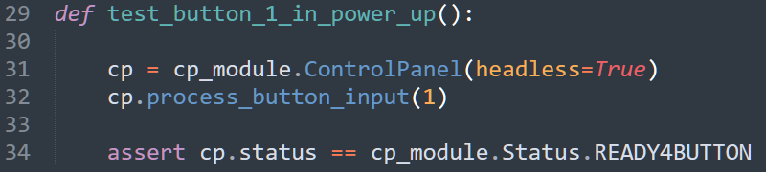
Unit Test Example
Test_button_1_in_power_up()
  Unit test to test ControlPanel.process_button_input w/ a parameter 1
  Context/precondition: ControlPanel’s constructor waits for a user to press a power button (i.e. button 1) and the button value 1 is passed as a parameter to process_button_input
  Test oracle (see assert at line 34): after pressing button 1, control panel’s status should be READY4BUTTON
Corresponding state diagrams, CRC cards, sequence diagrams should be referenced in the test document
  Ex. A target method under test process_button_input is a part of “Turn the system on” sequence diagram on page 50 of SDS (see the green oval in the sequence diagram on the right), although it is not explicitly shown in the diagram.
Unit test may not have corresponding diagrams, since the granularity of a unit is very small
  Ex. Ex. A target method under test process_button_input does not have a corresponding state diagram in SDS

Slide 5
Example of Unit Test Document
External Communication Management
  Control Panel Management
      ControlPanel class
        process_button_input() (handling key input from CP)
          test_button_1_in_power_up (UT-CP-btn1-PW-U)
Class | Method | Author | Date | Version
ControlPanel | process_button_input() |  |  | 1.0.1
Test Case Description
Verifies that pressing a button “1” results in status == READY4BUTTON, when the system is turned off.
Context/Precondition/Input Specifications
Call process_button_input(1) while the safehome system is powered off (which is performed by the constructor of ControlPanel class).
Expected Result
CP’s status remains Status.READY4BUTTON
Actual Result (Pass/Fail/Exception)
Pass: status remains Status.READY4BUTTON
Comment
Reference: “Turn the system on” sequence diagram on page 50 of SDS

Slide 6
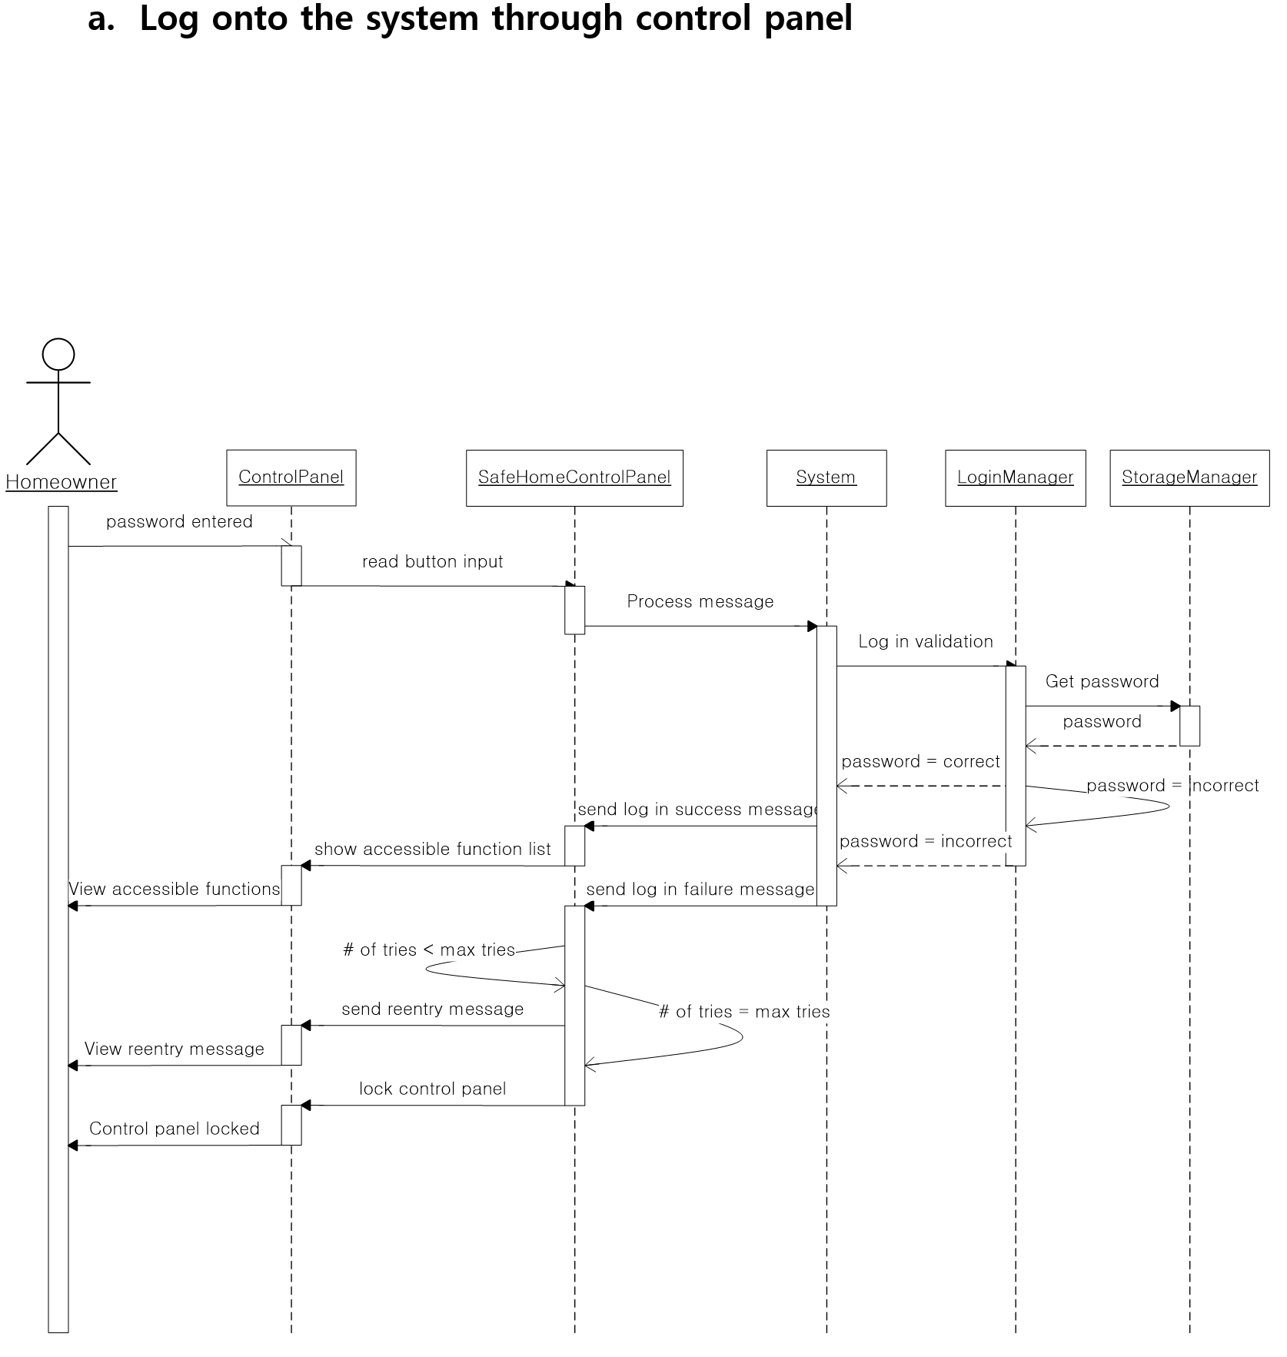
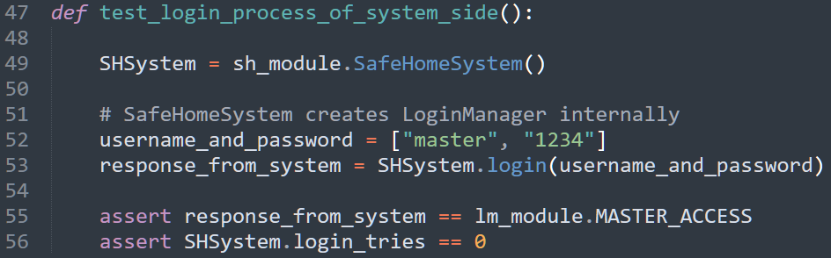
Integration Test Example
Test_login_process_of_system_side()
  Integration test to test login process in system side (i.e., not including user interaction through control panel)
  Context/precondition:
    a homeowner (by default, its user name is “master”) entered a password (i.e., “1234”) through control panel, which is stored in username_and_password (see line 52). We assume that “1234” is the correct password.
    Then, the homeowner’s password is passed as a parameter to login
  Test oracle (see assert at line 55 and 56):
    LoginManager should accept the password (i.e., login returns lm_module.MASTER_ACCESS)
    A number of login trial should not be increased, since the given password is correct
Corresponding CRC cards, sequence diagrams should be referenced in the test document
  Ex. The integration testing scenario is a part of “Log onto the system through control panel” sequence diagram on page 47 of SDS (see the green box in the sequence diagram on the right)

Slide 7
Example of Integration Test Document
Log onto system
test_login_process_of_system_side (IT-Login-Sys-Su)
Class | Function | Author | Date
System LoginManager StorageManager | Log onto the system
Test Case Description
Validate that SafeHomeSystem successfully authenticates the master user when valid credentials are provided and StorageManager returns the matching login record.
Input Specifications
Database has predefined username and password: “master” and “1234” Put list username and password: (["master", "1234”])
Detailed Step
1. Initialize SafeHomeSystem, which internally creates an instance of LoginManager and prepares StorageManager. 2. Call SafeHomeSystem.login() with "master" as the username and "1234" as the password. 3. Allow LoginManager to validate the provided credentials by comparing them against the stored credentials retrieved from StorageManager. 4. After successful authentication, SafeHomeSystem resets the login attempt counter and returns the access code for master. 5. Confirm that SafeHomeSystem does not increment the login attempt count after the successful authentication response.
Expected Result
login() of System class returns the MASTER_ACCESS (0x01). login_tries of System equals to 0 after successful authentication.
Actual Result (Pass/Fail/Exception)
Pass: login() of System class returns the MASTER_ACCESS (0x01). Pass: login_tries of System equals to 0 after successful authentication.
Comment (including references)
The right half of Sequence Diagram on System, LoginManager, and StorageManager, page 47 of SDS

Slide 8
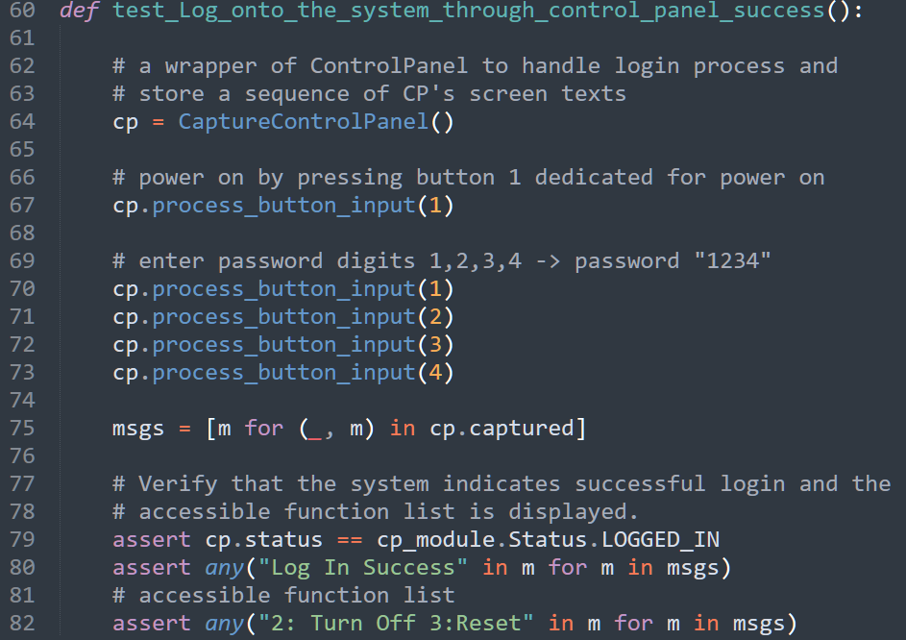
System-level Test Example
Test_log_onto_the_system_through_control_panel_success()
  Automated system-level test to test whole login process including user interaction through control panel (see lines 64-73), which is based on the sequence diagram on page 47 of SDS (see the previous slide).
  Context/precondition:
    CaptureControlPanel (see line 64) is a wrapper of ControlPanel to handle the login process and store its screen output
    The homeowner’s password is “1234”
  Test oracles (see assert at line 79-82):
    A homeowner should login correctly (i.e., cp.status should be cp_module.Status.LOGGED_IN) (line 79)
    A screen output should contain “Log In Success” message (line 80)
    A screen output also should show accessible function list (line 82)
Note that, to test end-to-end system including compatibility with hardware peripherals (e.g., physical button press, physical screen output, etc.), a system-level test can be manually performed
  You may press buttons w/ your hands (mouse clicks) and see the screen output w/ your eyes instead of using Test_log_onto_the_system_through_control_panel_success()
Corresponding CRC cards, sequence diagrams should be referenced in the test document
  Ex. The system-level testing scenario corresponds to “Log onto the system through control panel” sequence diagram on page 47 of SDS

Slide 9
Example of System-level Test Document
A. Log onto the system through control panel
Log onto the system through control panel success (ST-Login-Using-CP-Su)
Class | Function | Author | Date
ControlPanel SafeHomeControlPanel System LoginManager StorageManager | Log onto the system through control panel
Test Case Description
Validate the successful login path and the ControlPanel display of available functions after the authentication.
Input Specifications
ControlPanel receives button-press sequence of "1234". StorageManager contains master credentials ("1234").
Detailed Step
1. Seed StorageManager with the master user and password "1234" (if not already present). Reset login attempt counter. 2. Initialize ControlPanel and Simulate powering on the panel 3. Simulate button presses sequence of "1234" 4. Verify that the system indicates successful login and the accessible function list is displayed.
Expected Result
SafeHomeSystem.login() returns success code for master. ControlPanel transitions to LOGGED_IN state. ControlPanel displays "Log In Success" followed by accessible functions message such as "2: Turn Off 3: Reset.
Actual Result (Pass/Fail/Exception)
Pass: SafeHomeSystem.login() returns success code for master. Pass: ControlPanel transitions to LOGGED_IN state. Pass: ControlPanel displays "Log In Success" followed by accessible functions message such as "2: Turn Off 3: Reset.
Comment (including references)
Sequence Diagram on ControlPanel, SafeHomeControlPanel, System, LoginManager, and StorageManager, page 47 of SDS

