Slide 1
Comments on HW2. SDS on Safehome project
Moonzoo Kim
SoC KAIST

Slide 2
General Comments
Team 2 and Team 4’s SDS look relatively good.
  But, the design contents of them are still insufficient (i.e., not ready to smoothly develop Safehome in a programming language)
Most teams’ SDS lack detailed designs, which leads to giant logical jump in implementation.
  Ex. How to use safehome features by using control panel is not discussed sufficiently in SDS. Thus, you are going to implement those control panel related components w/o careful discussion nor design.
    This easily leads to implementation flaws (i.e., coding mistakes, mismatch and/or conclict w/ customer’s requirements, missing rationale or logical support for the current implementation, which will cause severe difficulty at future modification)

Slide 3
Common Weaknesses (Ex. Team 1)
Sloopy architecture refinement
  Overall architecture does not clearly match sub-architectures
    Core Security architecture has “Intelligent Security” and “Live Surveillance”. But the core security sub-architecture does not have components that are clearly mapping to the “Intelligent Security” and “Live Surveillance”
    System Admin has “System and User admin”. But the system admin sub-architecture does not have user admin component
Relation among the components is not clear
  Why not put “Live Surveillance” under “Surveillance and Monitoring”, but under “Core Security Functions”?
Document structures
  Missing explicit traceability or relation of class diagrams to other models
Critical weakness: missing detailed designs on
  Control Panel
  User authentication and system configuration if cloud service is not accessible

Slide 4
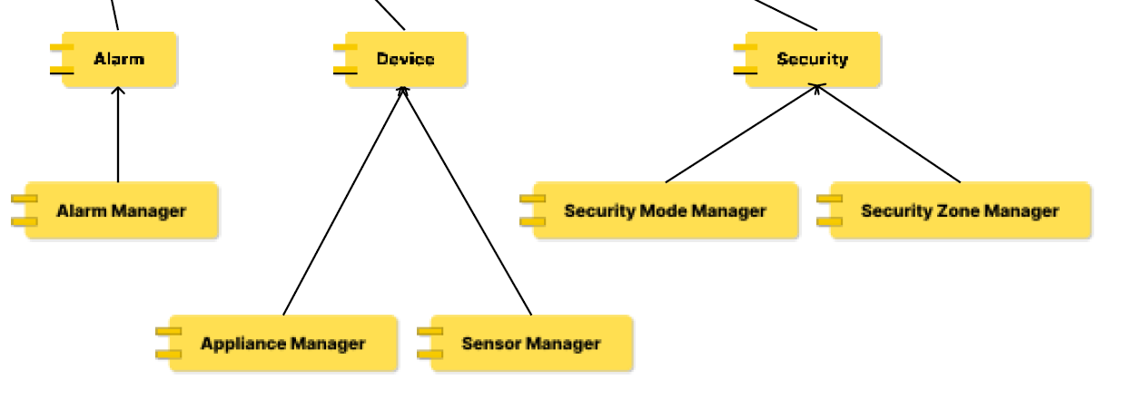
Common Weaknesses (Ex. Team 2)
Team 2’s architecture shows the team’s high interest in data managed by CloudServer.
  However, other equally important parts are missing in the architecture
    Ex. What about surveillance capability through camera?
Abstraction leveling in the overall architecture looks awkward
  Why do manager components
  belong to more specific components?
  Why not the other way?
Critical weakness: missing detailed designs on
  User authentication and system configuration in case of when cloud service is not accessible due to internet failure?

Slide 5
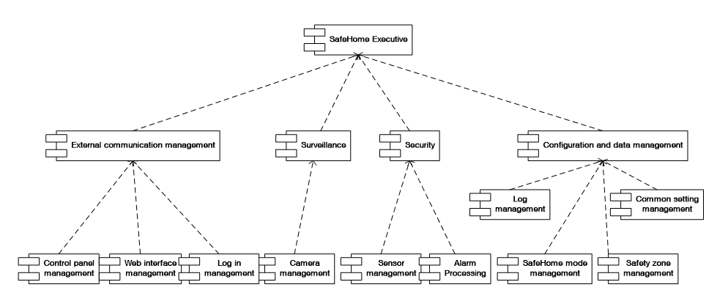
Better Designs (old Team 3 in 2007)
Intuitive hierarchical architecture based on SRS
3 different UI interfaces are commonly grouped/abstracted through “External communication management”
  But, “log in management” would be
  better to move to Config. & data
  management for higher cohesion

