Slide 1
CS30500: Introduction to Software Engineering
Spring 2025
Prof. In-Young Ko
School of Computing

Slide 2
Traditional Software Process Models

Slide 3
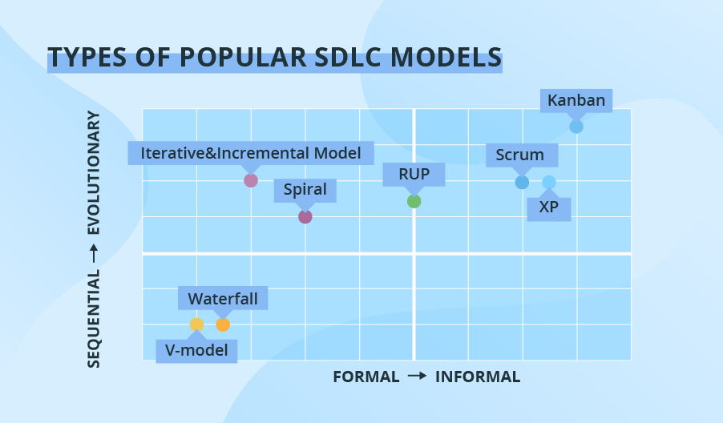
Software Development Lifecycle Models
[Shi19] Boris Shiklo, 8 Software Development Models: Sliced, Diced and Organized in Charts (https://www.scnsoft.com/blog/software-development-models)

Slide 4
Waterfall Model
Popular in 1970’s
A standard industrial practice
Document-oriented
Each stage produces concrete deliverables (documents)
The output of one phase constitutes the input to the next
There exist many variants
Feasibility
Study
Requirements
Analysis &
Specification
Design &
Specification
Coding &
Module Testing
Integration &
System Testing
Delivery
Maintenance
Adopted from Prof. Doo-Hwan Bae’s CS350 lecture material

Slide 5
Waterfall Model – Use Cases
Simple small and mid-size projects with clearly defined and unchanging requirements
Projects with the need for stricter control, predictable budget and timeline
Projects that must adhere to multiple rules and regulations
Projects where well-known technology and tools are used
[Shi19]

Slide 6
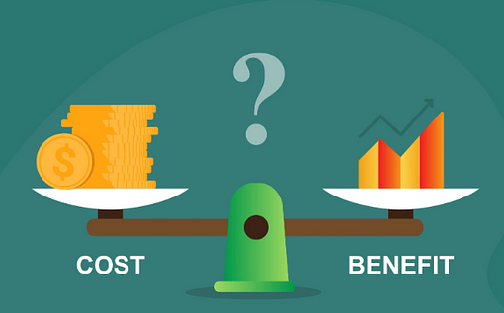
Waterfall Model – Feasibility Study
Evaluates the costs and benefits of the proposed solution
Analyzes the problem, at least at the global level
Simulates the future development process
Documents produced:
A definition of the problem
Alternative solutions and their expected benefits
Required resources, costs, and delivery dates in each
https://medium.com/@sadiamujtaba18/essentials-of-cost-benefit-analysis-in-business-4d3dc16083d1
Adopted from Prof. Doo-Hwan Bae’s CS350 lecture material
Notes:
Feasibility study
financial,
Technical
Resource & time
Risk
Legal

Slide 7
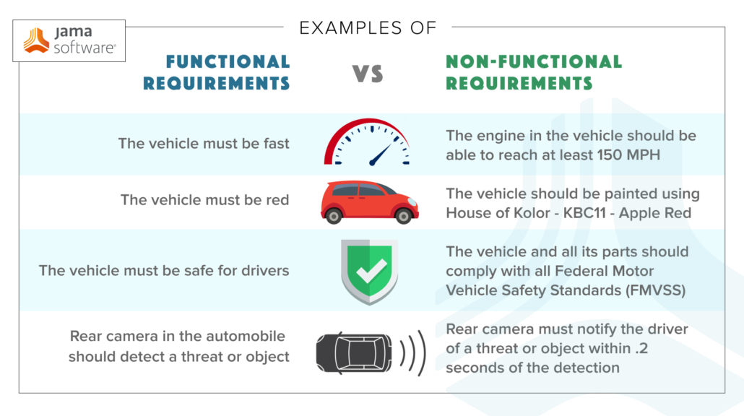
Waterfall Model – Requirements Analysis and Specification
Identify the qualities required for the application
Functional and nonfunctional
Must state what to do, not how to do
Used by both customers and designers
Separate functional requirements into three views:
Model of data
Model of function
Model of controls
Adopted from Prof. Doo-Hwan Bae’s CS350 lecture material
https://www.jamasoftware.com/requirements-management-guide/writing-requirements/functional-vs-non-functional-requirements

Slide 8
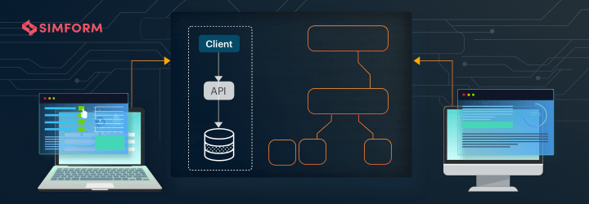
Waterfall Model – Design and Specification
Propose a solution to the problem
Decompose the system into modules
Specify the relationships among modules
Design each module
Can be divided into
High-level (preliminary, architectural)
Low-level (detailed)
User interface
https://www.simform.com/blog/software-architecture-patterns/
Adopted from Prof. Doo-Hwan Bae’s CS350 lecture material

Slide 9
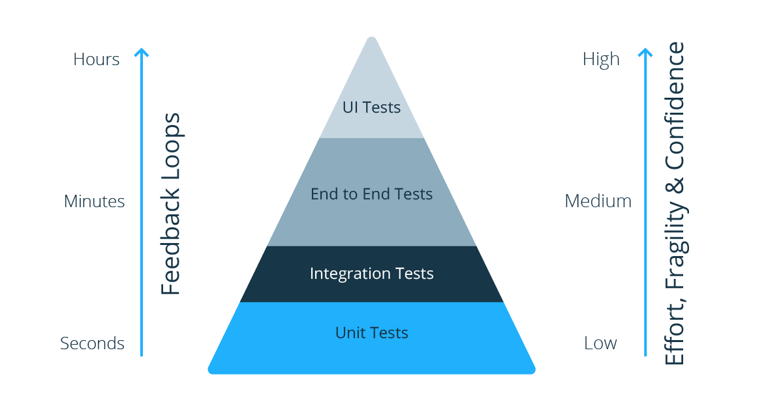
Waterfall Model – Coding and Testing
Ideally transform of design into code
Testing
Unit (module) testing
Integration testing
System testing
Acceptance testing
Etc….
https://pactflow.io/blog/contract-testing-vs-integration-testing/
Adopted from Prof. Doo-Hwan Bae’s CS350 lecture material

Slide 10
Waterfall Model – Delivery and Maintenance
Types of maintenance
Corrective: 20%
Adaptive: 20%
Perfective: 60%
Requirements analysis is a serious source of problems
Many errors are not removed until after the system is delivered
It is difficult to incorporate changes in the product
Adopted from Prof. Doo-Hwan Bae’s CS350 lecture material
Notes:
Identify a fault in the RAS and fix it: 1 unit, then, if that fault was not removed until after the system is delivered, it would cost more than 100 times.

Slide 11
Waterfall Model – Other Activities
Documentation
Verification
Monitor the quality of the application
Perform at the end of each phase
Methods
Review
Walk-through
Inspection
Management
Tailoring the process
Defining policies
Dealing all resources affecting the process
Adopted from Prof. Doo-Hwan Bae’s CS350 lecture material
Notes:
Walk-though is a form of software peer review "in which a designer or programmer leads members of the development team and other interested parties through a software product, and the participants ask questions and make comments about possible errors, violation of development standards, and other problems".

Slide 12
Characteristics of the Waterfall Model
Linear
Development may proceed linearly from analysis to coding
Rigid
The results of each phase are frozen before proceeding to the next
Monolithic
All planning is oriented toward a single delivery date
Adopted from Prof. Doo-Hwan Bae’s CS350 lecture material
Notes:
When the waterfallmodel is most appropriate
- Requirements are very well documented, clear and fixed.
- Product definition is stable.
- Technology is understood and is not dynamic.
- There are no ambiguous requirements.
Ample resources with required expertise are available to support the product.
Advantages
Simple and easy to understand and use
Easy to manage due to the rigidity of the model. Each phase has specific deliverables and a review process.
Phases are processed and completed one at a time.
Works well for smaller projects where requirements are very well understood.
Clearly defined stages.
Well understood milestones.
Easy to arrange tasks.
Process and results are well documented.
Diaadvantages
No working software is produced until late during the life cycle.
High amounts of risk and uncertainty.
Not a good model for complex and object-oriented projects.
Poor model for long and ongoing projects.
Not suitable for the projects where requirements are at a moderate to high risk of changing. So, risk and uncertainty is high with this process model.
It is difficult to measure progress within stages.
Cannot accommodate changing requirements.
Adjusting scope during the life cycle can end a project.
Integration is done as a "big-bang. at the very end, which doesn't allow identifying any technological or business bottleneck or challenges early.

Slide 13
Pros and Cons of the Waterfall Model
Pros
Enforced disciplined, planned and manageable approach
Product implementation is done after the objectives of doing so are well understood
Cons
Difficult to estimate resources accurately
Verification of requirements specification by customer is not effective
Stakeholders often do not know the exact requirements
Does not stress the need for anticipating changes
Leads to a somewhat bureaucratic style of work
Adopted from Prof. Doo-Hwan Bae’s CS350 lecture material

Slide 14
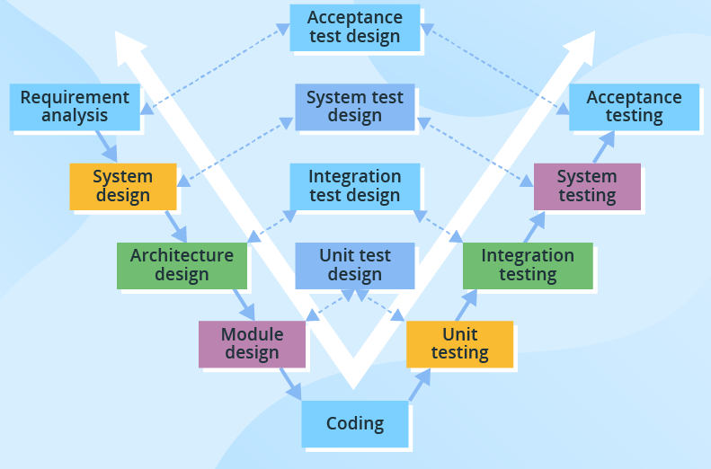
V-Model
Linear model – each stage has a corresponding testing activity
Exceptional quality control, expensive and time-consuming model
Changes during development are expensive and difficult to implement
Use cases:
Projects where failures and downtimes are unacceptable – e.g., Medical, aviation, and automobile software
[Shi19]
Verification
Validation
“Are we building the product right?”
“Are we building the right product?”
Adopted from Prof. Doo-Hwan Bae’s CS350 lecture material

Slide 15
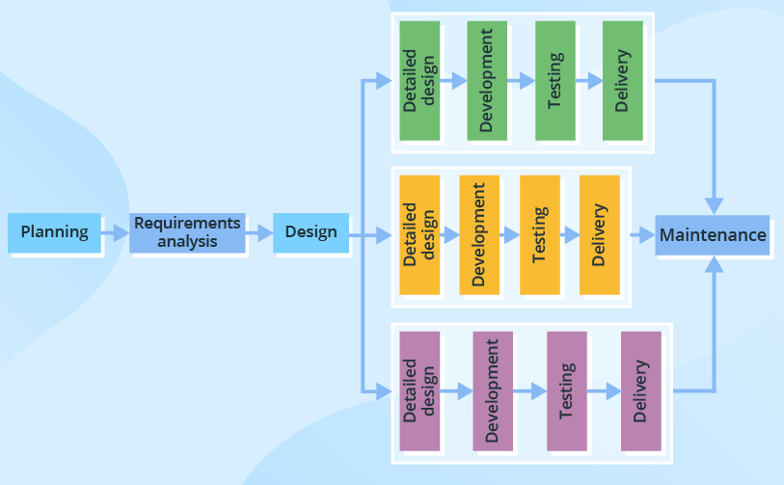
Incremental
Split into several iterations
New software modules are added in each iteration with no or little change in earlier added modules
Sequential and Parallel
[Shi19]
Adopted from Prof. Doo-Hwan Bae’s CS350 lecture material

Slide 16
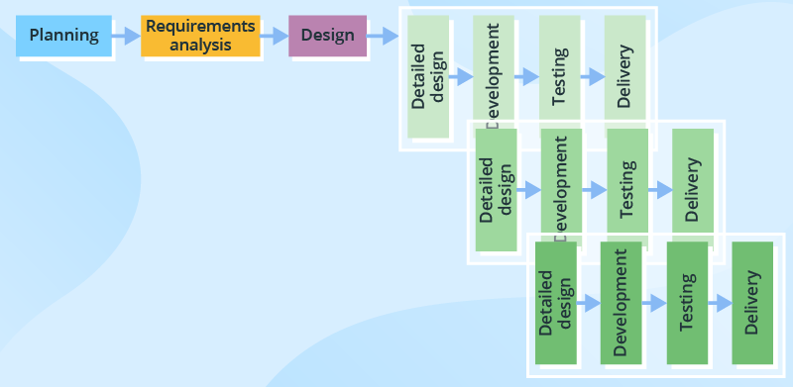
Iterative
Software changes on each iteration, evolves, and grows
No need for a full specification from the project’s start and small changes to requirements are possible in the course of development process
Entails some customer involvement
Use cases for Incremental and Iterative process
Large, mission-critical enterprise applications with loosely coupled parts
[Shi19]
Adopted from Prof. Doo-Hwan Bae’s CS350 lecture material

Slide 17
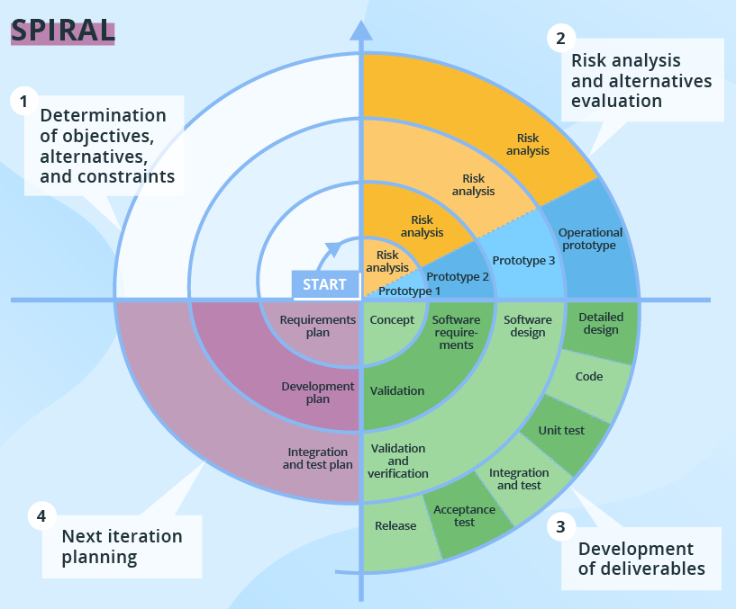
Spiral Model
Developed by Prof. Barry Boehm (1986)
Focus on through risk analysis
A typical iteration lasts about 6 months
Intensive customer involvement
Use cases:
Projects with unclear business needs or too ambiguous/innovative requirements
Large and complicated
R&D or introduction of new service/product
[Shi19]
Prof. Boehm’s talk - https://youtu.be/DXgL62w11Gk (13:52-17:15)
Adopted from Prof. Doo-Hwan Bae’s CS350 lecture material

Slide 18
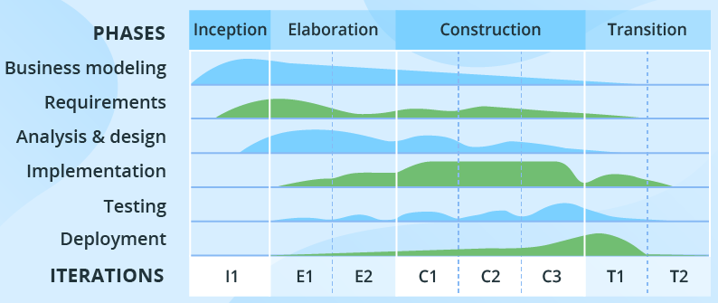
Rational Unified Process (RUP)
[Shi19]
Combination of linear and iterative processes
Consists of 4 phases: inception, elaboration, construction and transition
All basic activities (requirements, design, etc.) of the development process are done in parallel with different intensity
Use cases
Large and high-risk projects, especially use-case based development
Adopted from Prof. Doo-Hwan Bae’s CS350 lecture material

Slide 19
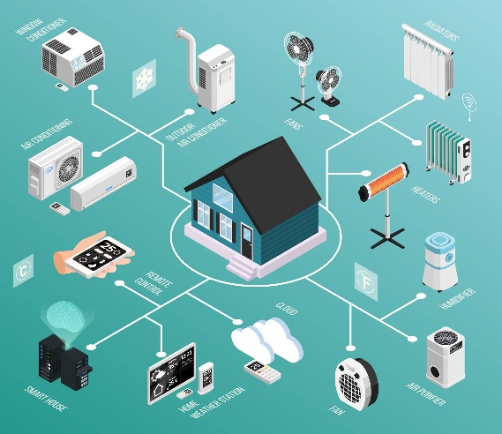

Quick Overview of SafeHome
The SafeHome company has developed an innovative HW box that implements wireless Internet (802.11n) connectivity in a very small form factor (the size of a matchbook).
The idea is to use this technology to develop and market a comprehensive home automation product line.
This would provide
security functions
control over telephone answering machines
lights
heating
air conditioning
home entertainment devices.
The first generation of the system will only focus on home security since that is a market the public readily understands.

Slide 20
Selecting a Process Model, Part 1(pg 28)
The scene:
Meeting room for the software engineering group at CPI Corporation, a (fictional) company that makes consumer products for home and commercial use.
The players:
Lee Warren, engineering manager;
Doug Miller, software engineering manager;
Jamie Lazar, software team member;
Vinod Raman, software team member;
Ed Robbins, software team member.
The conversation:
Lee: So let's recapitulate. I've spent some time discussing the SafeHome product line as we see it at the moment. No doubt, we've got a lot of work to do to simply define the thing, but I'd like you guys to begin thinking about how you're going to approach the software part of this project.
Doug: Seems like we've been pretty disorganized in our approach to software in the past.
Ed: I don't know, Doug. We always got product out the door.
Doug: True, but not without a lot of grief, and this project looks like it's bigger and more complex than anything we've done in the past.
Jamie: Doesn't look that hard, but I agree ... our ad hoc approach to past projects won't work here, particularly if we have a very tight timeline.
Doug (smiling): I want to be a bit more professional in our approach. I went to a short course last week and learned a lot about software engineering ... good stuff. We need a process here.
20
CS350 Intro. to SE Spring 2008

Slide 21
Jamie (with a frown): My job is to build computer programs, not push paper around
Doug: Give it a chance before you go negative on me. Here's what I mean. [Doug proceeds to describe the process framework described in Chapter 2 and the prescriptive process models presented to this point.
Doug: So anyway, it seems to me that a linear model is not for us ... assumes we have all requirements up front and knowing this place, that's not likely.
Vinod: Yeah, and that RAD model sounds way too IT- oriented ... probably good for building an inventory control system or something, but it's just not right for SafeHome
Doug: I agree.
Ed: That prototyping approach seems OK. A lot like what we do here anyway.
Vinod: That's a problem. I'm worried that it doesn't provide us with enough structure.
Doug: Not to worry. We've got plenty of other options, and I want you guys to pick what's best for the team and best for the project.
21
CS350 Intro. to SE Spring 2008

Slide 22
Selecting a Process Model, Part 2 (pg31)
The players:
Lee Warren: engineering manager
Doug Miller: SE manager
Ed and Vinod: members of the SE team
The conversation: (Doug describes evolutionary process options)
Ed: Now I see something I like. An incremental approach makes sense and I really like the flow of that spiral model thing. That’s keeping it real.
Vinod: I agree. We deliver an increment, learn from customer feedback, replan, and then deliver another increment. It also fits into the nature of the product. We can have something on the market fast and then add functionality with each version, er, increment.
Lee: Wait a minute, did you say that we regenerate the plan with each tour around the spiral, Doug? That’s not so great, we need one plan, one schedule, and we’ve got to stick to it.
Doug: That’s old school thinking, Lee. Like Ed said, we’ve got to keep it real. I submit that it’s better to tweak the plan as we learn more and as changes are requested. It’s way more realistic. What’s the point of a plan if it doesn’t reflect reality?
Lee (frowning): I suppose so, but senior management’s not going to like this… they want a fixed plan.
Doug (smiling): Then, you ‘ll have to reeducate them, buddy

