Slide 1
Bug Exposure
Sechang Jang

Slide 2
Team 1 – Bug Exposure Scenario
1. Enter Surveillance Function
2. Disable Camera 2
3. Get single view of camera 3
4. Re-entered the disabled camera, camera 2
-> It shows the view camera 3

Slide 3
Findings on Surveillance Test Cases
Only six system tests are provided for the Surveillance function.
Only two tests specifically cover the camera enable/disable feature, and both scenarios are very simple—limited to just enabling and disabling the camera without variations or edge cases.
  ST-024. Enable Camera
  ST-025. Disable Camera

Slide 4
Findings on Surveillance System Test Cases
There are inconsistencies between the described test steps and the actual system behavior.
Examples include (From ST-025. Disable Camera):
  “The system prompts for confirmation with reason (optional).”
  → It is unclear what “optional” refers to in this context, and system does not askes for the confirmation
  “System shows enabled cameras: Camera #1, #2, #3, #4 all ENABLED.”
  → The system actually has only three cameras, so this description is incorrect.

Slide 5
Team 4 – Bug Exposure Scenario
1. Enter Surveillance Function
2. Get Single view of camera 1
3. Switch to Camera 2
-> Zoom of Camera 1 is applied to Camera 2

Slide 6
Findings on Surveillance Test Cases
Eight system tests are provided for the Surveillance function.
Only one tests specifically cover the camera view, and Only one tests specifically cover the pan/zoom of specific camera, limited to just testing single camera without variations or edge cases.
  ST-Surv-SingleView-Su
  ST-Surv-PanZoom-Su

Slide 7
Team 7 – Bug Exposure Scenario
1. Enter Security Menu
2. Navigate to the Safety (Security) Zone section.
3. Select Add Safety Zone.
4. Create a Safety (Security) Zone by selecting Door Sensor S1 and Window Sensor 5.
-> The Safety (Security) Zone does not include Window Sensor 4, even though it is located within the same zone.

Slide 8
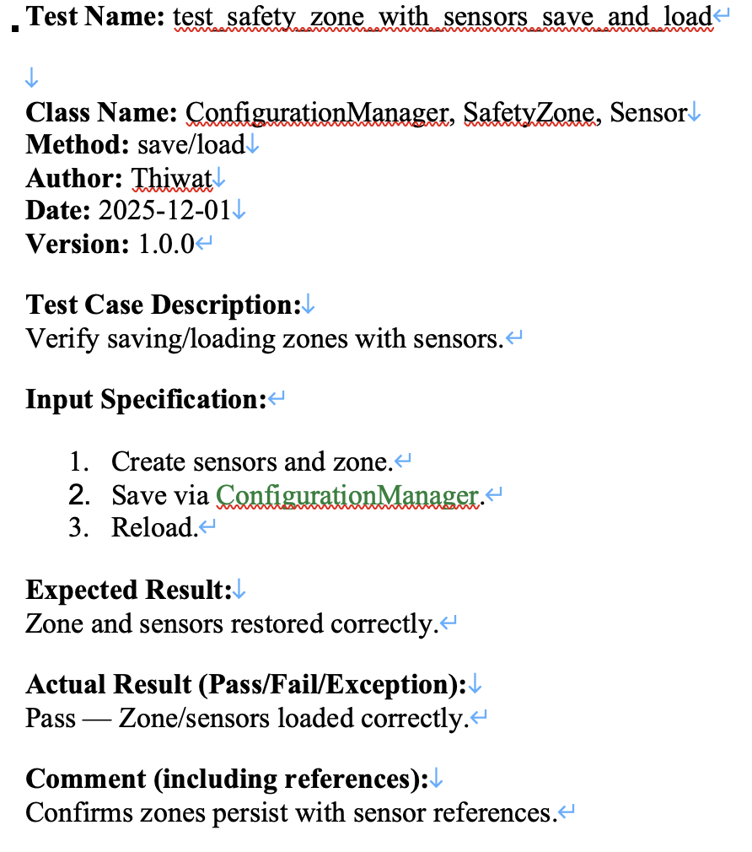
Findings on Safety (Security) Zone Test Cases
Only 4 system tests are provided for the Safety (Security) Zone function.
Only one tests specifically cover the Safety (Security) Zone creation, with too simple test case description

