Slide 1
Overview of Software Engineering
Moonzoo Kim
KAIST
(slides from CS550 ‘06 taught by prof. D. Bae)

Slide 2
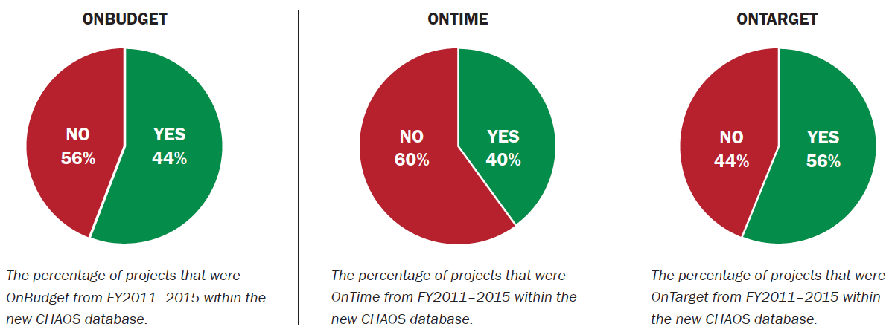
Challenges
In 2015, only 36% of software projects were successful.
The total number of software projects is 25,000-plus, with an average of 5,000 per yearly period.
 | 2011 | 2012 | 2013 | 2014 | 2015
SUCCESSFUL | 39% | 37% | 41% | 36% | 36%
CHALLENGED | 39% | 46% | 40% | 47% | 45%
FAILED | 22% | 17% | 19% | 17% | 19%
[Chaos Report 2015, Standish Group International, Inc.]
CS30500 Copyright (c) In-Young Ko, KAIST
Spring 2025

Slide 3
Challenges
Impact of project size:
Success rates by industry:
 | SUCCESSFUL | CHALLENGED | FAILED
Grand | 2% | 7% | 17%
Large | 6% | 17% | 24%
Medium | 9% | 26% | 31%
Moderate | 21% | 32% | 17%
Small | 62% | 16% | 11%
TOTAL | 100% | 100% | 100%
 | SUCCESSFUL | CHALLENGED | FAILED
Banking | 30% | 55% | 15%
Financial | 29% | 56% | 15%
Government | 21% | 55% | 24%
Healthcare | 29% | 53% | 18%
Manufacturing | 28% | 53% | 19%
Retail | 35% | 49% | 16%
Services | 29% | 52% | 19%
Telecom | 24% | 53% | 23%
Other | 29% | 48% | 23%
CS30500 Copyright (c) In-Young Ko, KAIST
Spring 2025

Slide 4
Why is it hard to make good software?
Software is intangible
There are no formal methods to develop software
Software needs to be changed over time
There are many different stakeholders who provide requirements
Software needs to be built by a group of people
Technology changes
Limited budget and schedule (high competition)
…
CS30500 Copyright (c) In-Young Ko, KAIST
Spring 2025

Slide 5
The Nature of Software
Complexity
  Due to a large number of interacting parts
  Causes difficulty in finding defects
Conformity
  There are no underlying natural principles that it must conform to.
  Makes it difficult to reuse existing software components
Changeability
  Because software is malleable
  However, changing software is not easy…
Invisibility
  Requirements/design documents, and source code are “representations” of software
  Software resides in computing devices and environments.
Uniqueness (Brooks)
  Software has no physical properties
  Software is the product of intellect-intensive teamwork
  …
  Software alone is useless, as it is always a part of a larger system
https://sebokwiki.org/wiki/The_Nature_of_Software
CS30500 Copyright (c) In-Young Ko, KAIST
Spring 2025

Slide 6

Software Engineering is about …
Understanding what to develop
Developing software the right way
Developing the right software
by effectively collaborating with
stakeholders, including
customers, users, and developers.
https://www.linkedin.com/pulse/go-digital-why-diverse-inputs-multi-stakeholder-feedback-chris-leong/
CS30500 Copyright (c) In-Young Ko, KAIST
Spring 2025

Slide 7
Coding vs. Programming vs. Software Engineering
Coding
U
Programming
U
SW Engineering
Implementing an algorithm by using a programming language
Designing an algorithm and data structures
Integrating libraries and modules
Debugging and testing
…
Modeling and specifying requirements
Designing software architecture
Project planning and management
…
Done by a
Coder
Done by a
Programmer
Done by a
SW Architect
Software Developer
Software Engineer
CS30500 Copyright (c) In-Young Ko, KAIST
Spring 2025

Slide 8
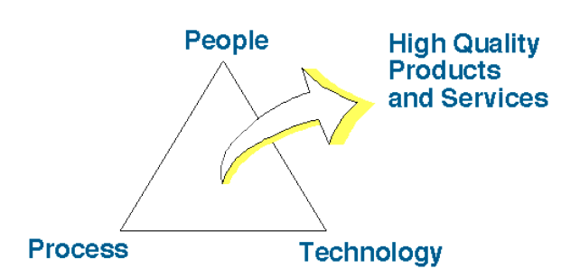
Three Aspects of Software Engineering (SE)
People Capability Maturity Model - SEI Digital Library, 1995
What are examples of each aspect?
Which one is more important than the others?
Adopted from Prof. Doo-Hwan Bae’s CS350 lecture material
CS30500 Copyright (c) In-Young Ko, KAIST
Spring 2025

Slide 9






Software Development Process
A SW Development Framework for SW with High Assurance
Requirement
analysis
System
design
Design
analysis
Implement-
ation
Testing
Monitoring
Formal
require-
ment
Spec.
Formal
system
modeling
Model
analysis/
verification
Model-
assisted
code
generation
Model-
based
testing
Runtime
monitoring
and
checking

Slide 10
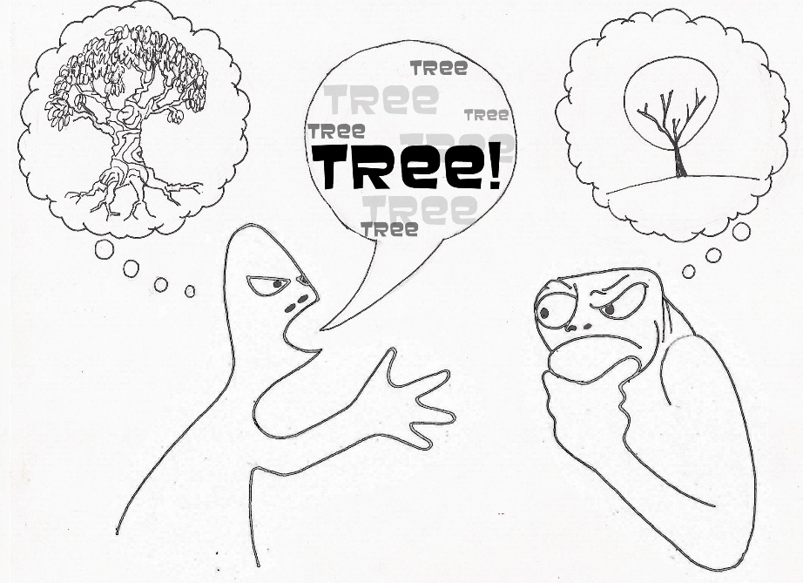
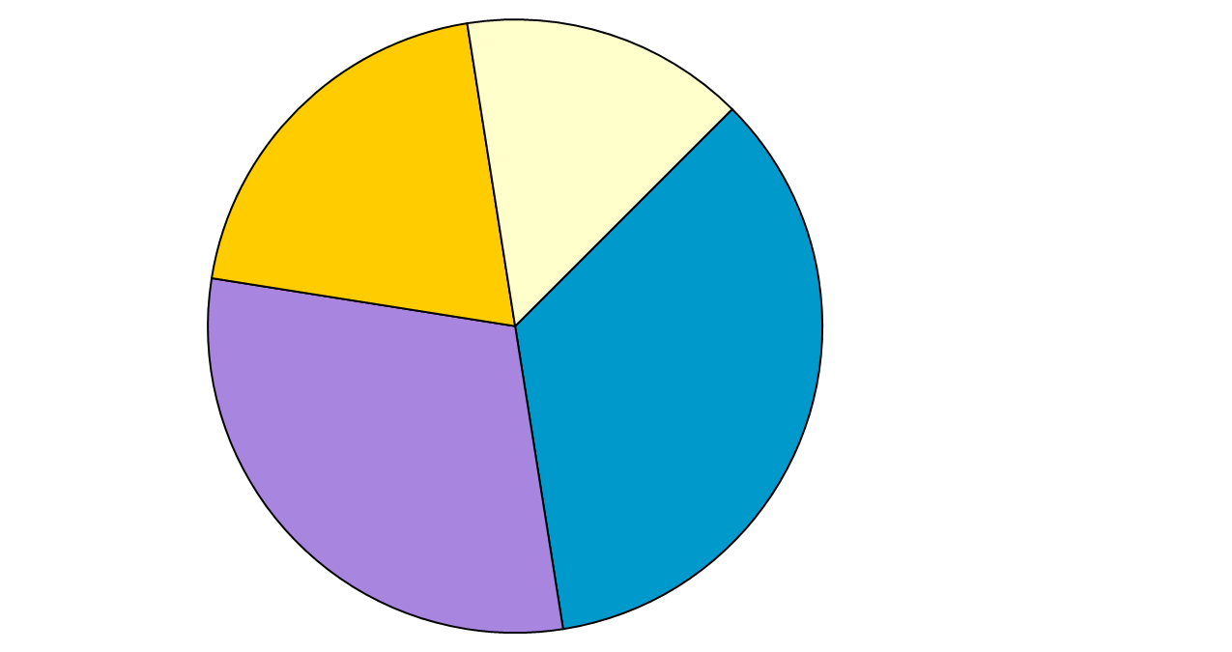
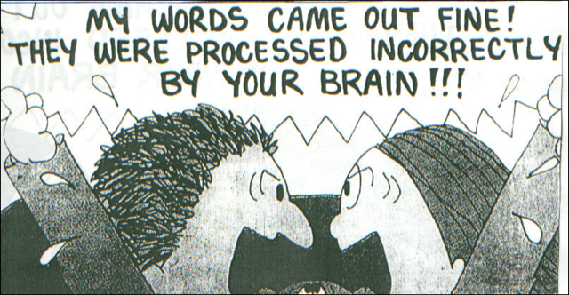
Sources of Errors in S/W Developments
Logic design &
Misunderstanding
20%
Functionality &
Misunderstanding
15%
Documentation
& Others 35%
Coding
30%

Slide 11
Ex. Requirement on Retail Chain Management Software
Find ambiguous points in the following requirement
  If the sales for the current month are below the target sales, then a report is to be printed,
    unless the difference between target sales and actual sales is less than half of the difference between target sales and actual sales in the previous month
    or if the difference between target sales and actual sales for the current month is under 5 percent.

Slide 12
Scope of S/W Engineering
Historical Aspects
Economic Aspects
Maintenance Aspects
Specification & Design Aspects
Team Programming Aspects

Slide 13
Historical Aspects
1967, A NATO group coined the term " Software Engineering"
1968, NATO conference concluded that software engineering should use the philosophies and paradigms of established engineering disciplines, to solve the problem of software crisis

Slide 14
Economic Aspects
Relationship between computer science and software engineering
  cf: chemistry and chemical engineering
Software engineer is intended in only those techniques which make sound economic sense, while computer scientists investigate a variety of ways of producing software, some good and some bad

Slide 15
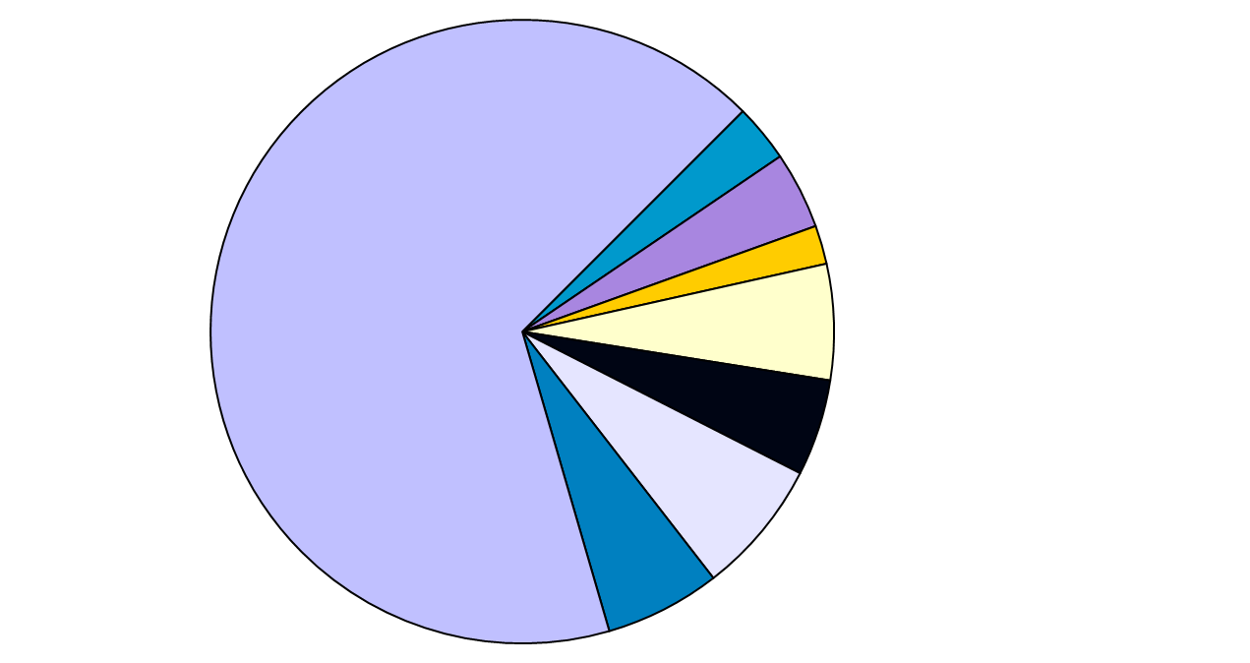
Maintenance Aspects
Maintenance
67 %
Requirements 3%
Specification 4%
Planning 2%
Design 6%
Module coding 5%
Module Testing 7%
Integration 6%

Slide 16
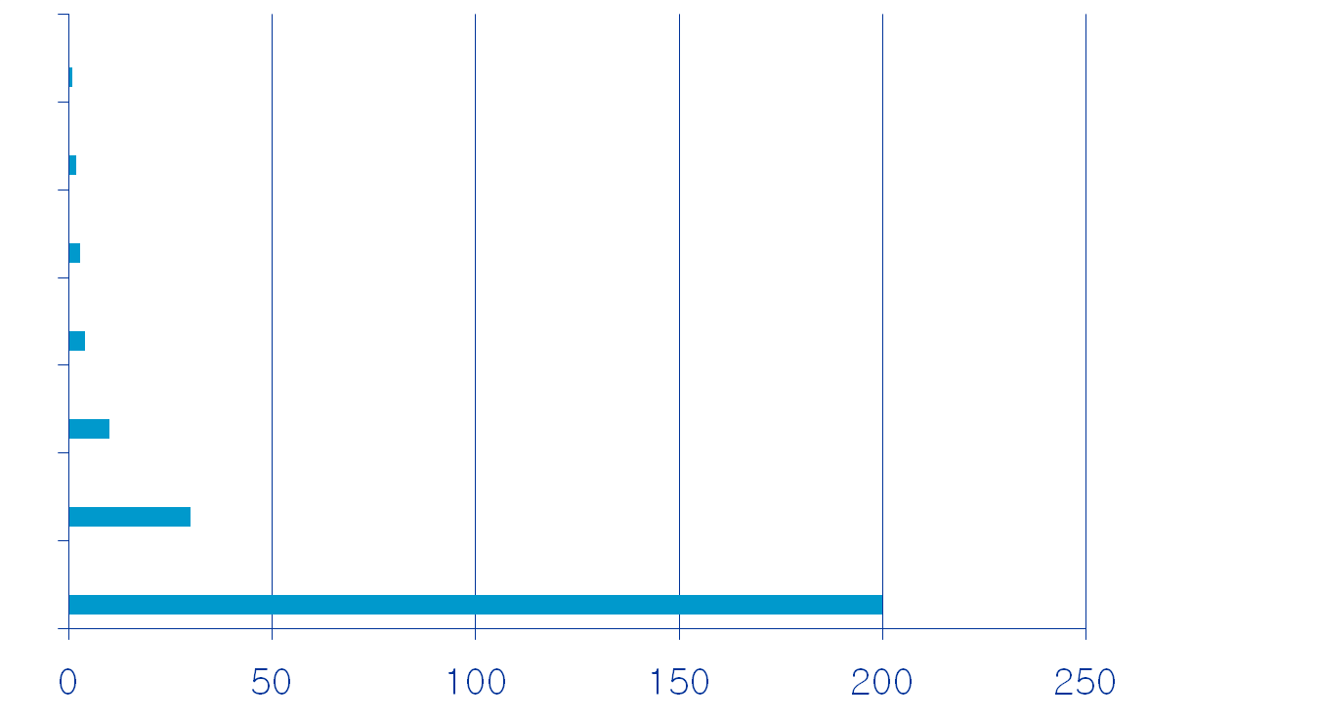
Specification and Design Aspects
Requirements
Specification
Planning
Design
Implementation
Integration
Maintenance
Approximate relative cost
to detect and correct a fault

Slide 17
Team Programming Aspect
Parnas, "Multi-person construction of multiversion software."
  Programming : personal activity
  S/W engineering : team activity

Slide 18
Team Programming Aspect (Cont.)
(From programming to sw engineering)
Programming in early days
  The problem is well understood.
  Mostly scientific applications.
  By a person, who is an expert in that area.
  User = programmer = maintainer
User and programmer separation
  User: specify the problem(tasks)
  Programmer: interpret and translate into code

Slide 19
Team Programming Aspect (Cont.)
Team project started in late 1960's
  IBM360 Operating system
  Software crisis observed
  ``Software Engineering'' coined
Solutions to software crisis
  Management techniques
  Team organization
    Chief programmer team
    Democratic team
    Hierarchical team
  Better languages and tools
  Standards
  ==> Applying engineering approach

Slide 20
Team Programming Aspect (Cont.)
Requirements in the programming-in-the-small
  Good programming skill
  Skilled in data structures and algorithms
  Fluent in programming languages
Requirements in the programming-in-the large
  Needs communication skills and interpersonal skills
  Be familiar with design approaches (i.e. system abstraction)
    Top-down design
    Divide and conquer paradigm
    Component based integration
  Be able to translate vague requirements and desires into precise spec.
  Be able to build and use a model of the application
  Needs ability to schedule work

Slide 21
Three Elements of S/W Development
Water-fall process
Incremental process
Evolutionary process
Process
Facilities
Staff
Budget
OOP
Model based testing
Technology
Resources
Quality/Productivity
Improvement
Product
Product
Product

Slide 22
Special Software Domain:Commercial Electronics and Embedded System

Slide 23
Software Characteristics by Domain
Ordinary IT Software System(e.g. systems developed by SI organizations)
  Size : Very Large
  Domain consistency: Low
  New technology sensitivity: High
  Hardware dependency: Low
  Time-to-market pressure: Low

Slide 24
Software Characteristics by Domain
Commercial Software(e.g. systems developed by software vendors)
  Size : Large
  Domain consistency: High
  New technology sensitivity: High
  Hardware dependency: Low
  Time-to-market pressure: Moderate

Slide 25
Software Characteristics by Domain
Controller Systems/Automation Systems
  Size : Medium
  Domain consistency: High
  New technology sensitivity: Low
  Hardware dependency: Moderate
  Time-to-market pressure: Moderate

Slide 26
Software Characteristics by Domain
Embedded Systems /Commercial Electronics
  Size : Small
  Domain consistency: High
  New technology sensitivity: High
  Hardware dependency: High
  Time-to-market pressure: High

Slide 27



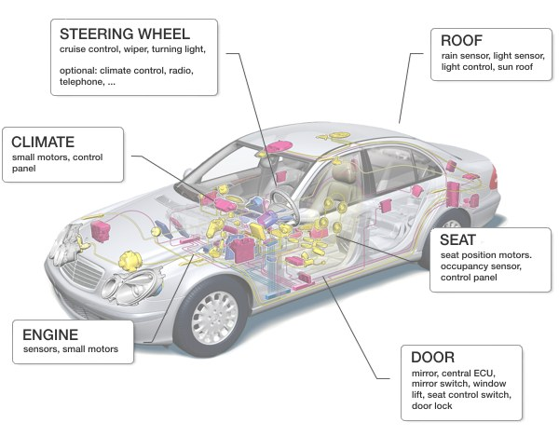

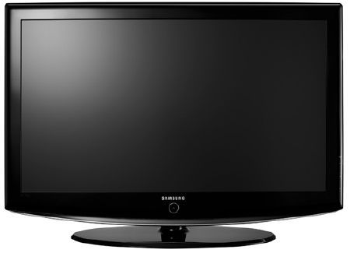
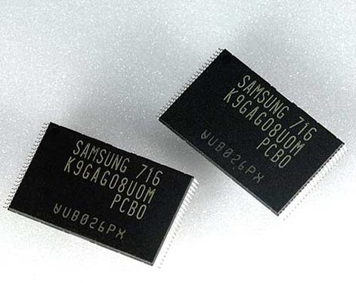


Strong Embedded System Industry in South Korea
Time-to-Market?
SW Quality?
Moonzoo Kim
Notes:
Not method oriented, but problem oriented research

Slide 28

Embedded Software in Two Different Domains
Conventional Testing
Concolic testing
Model checking
 | Consumer Electronics | Safety Critical Systems
Examples | Smartphones, flash memory platforms | Nuclear reactors, avionics, cars
Market competition | High | Low
Life cycle | Short | Long
Development time | Short | Long
Model-based development | None | Yes
Important value | Time-to-market | Safety
Moonzoo Kim
Notes:
Not method oriented, but problem oriented research

