Slide 1

Chapter 11, Testing

Slide 2
Outline
Terminology
Types of errors
Dealing with errors
Quality assurance vs Testing
Component Testing
  Unit testing
  Integration testing
Testing Strategy
Design Patterns & Testing
System testing
  Function testing
  Structure Testing
  Performance testing
  Acceptance testing
  Installation testing

Slide 3
Some Observations
It is impossible to completely test any nontrivial module or any system
  Theoretical limitations: Halting problem
  Practial limitations: Prohibitive in time and cost
Testing can only show the presence of bugs, not their absence (Dijkstra)
??
total number of execution paths?
loop 200 times

Slide 4
Testing Takes Creativity
Testing often viewed as dirty work.
To develop an effective test, one must have:
    Detailed understanding of the system
    Knowledge of the testing techniques
    Skill to apply these techniques in an effective and efficient manner
Testing is done best by independent testers
  We often develop a certain mental attitude that the program should in a certain way when in fact it does not.
Programmer often stick to the data set that makes the program work
  "Don’t mess up my code!"
A program often does not work when tried by somebody else.
  Don't let this be the end-user.

Slide 5
Testing Activities
Requirements
Analysis
Document
Subsystem
Code
Unit
Requirements
Analysis
Document
System
Design
Document
T
est
Tested
Subsystem
User
Manual
Subsystem
Code
Unit
T
est
Tested
Subsystem
Integration
Functional
Test
Test
Integrated
Subsystems
Functioning
System
Tested Subsystem
Subsystem
Code
Unit
T
est
All tests by developer
Cf. levels of testing

Slide 6
Testing Activities continued
Client’s
Understanding
of Requirements
Global
Requirements
User
Environment
Functioning
System
Validated
System
Accepted
System
Performance
Acceptance
Installation
Test
Test
Test
Usable
System
Tests by client
Tests by developer
User’s understanding
System in
Use
Tests (?) by user

Slide 7
Safehome Example: Levels of Designs in V Model
system
requirements
Control panel (CP) should serve as an interface
between a user and the Safehome system
Level of abstraction
software
requirements
Driver of the control panel should deliver button
events (press? release?) to Safehome
preliminary
design
CP should receive 12 keypad buttons and each
button has its callback functions for button press
detailed
design
A button press longer than 100 msec is considered
a long press and one shorter than 5 msec is ignored
analyze and design
code &
debug
void button1() { … }
---------------
button1()
button3()
…
Time

Slide 8
Levels of Testing in V Model
system
requirements
system
integration
Level of abstraction
software
requirements
acceptance
test
preliminary
design
integration
software
detailed
design
component
test
test and integrate
analyze and design
code &
debug
unit
test
Time

Slide 9
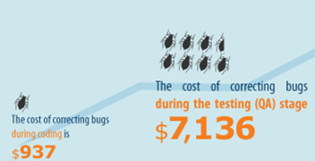
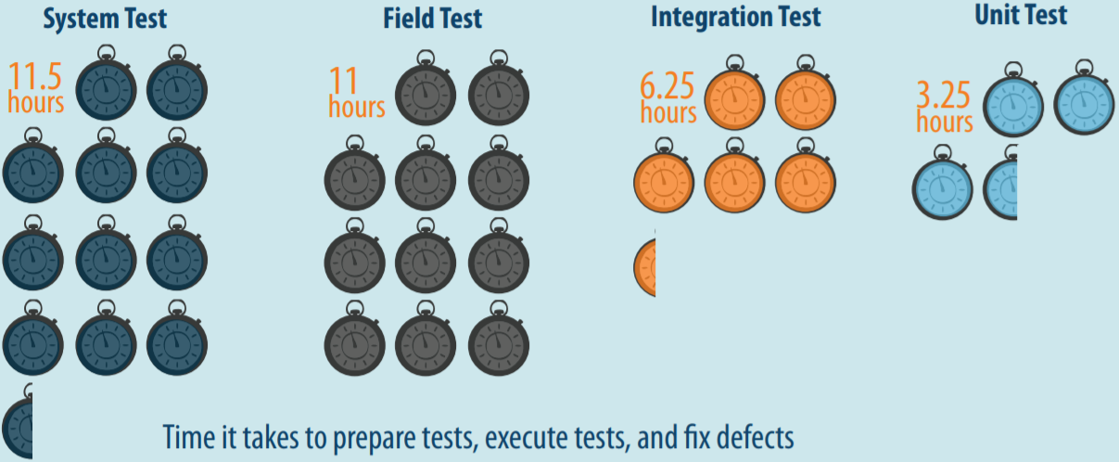
Many Benefits of Unit Testing
Bug correction cost: 7x cheaper than system tests
  $937 (unit test) vs $7,136 (system test)
Bug correction time: 3x faster than system testing
  3.25 hours vs 11.5 hours
Source: B. Boehm and V. Basil, Software Defect Reduction Top 10 List, IEEE Computer, January 2001
Source: Capers Jones, Applied Software Measurement: Global Analysis of Productivity and Quality
SLIDE <number>
Notes:
All of us know that unit testing has benefits over system testing. Unit testing is 7 times cheaper than system testing to detect and fix a bug as well as unit testing is 3 times faster than system testing to run and detect a bug. Unfortunately, such benefits of unit testing is not much enjoyed in real-world because of false alarm problems. To run a target unit in an isolated environment for unit testing, we have to write down stub and mock functions to provide contexts to the unit. If such stub and mock functions provide inaccurate context, unit testing raises a false alarm, which is feasible in unit execution, but infeasible in system execution. Such false alarm problem is severe in automated unit test generation techniques because such techniques do not know the appropriate context of the target unit. To address such false alarm problems in automated unit test generation techniques, we propose two ideas

Slide 10
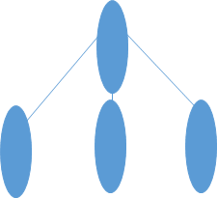
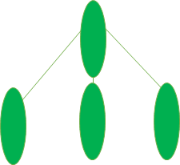
f()
3 exec. paths
g()
3 exec. paths
h()
3 exec. paths

Slide 11
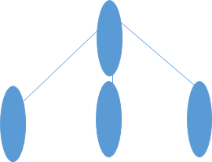
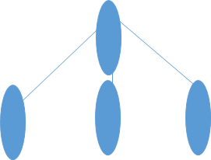
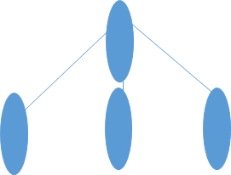

f()
f() + g()
f()
3 exec. paths
g()
g()
g()
g()
9 (=3²) execution paths
3 exec. paths
h()
3 exec. paths

Slide 12
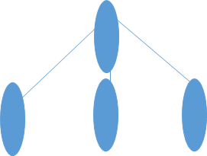

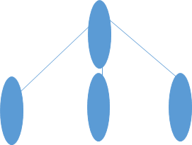


f()
f() + g() + h()
f()
3 exec. paths
g()
g()
g()
g()
h()
h()
3 exec. paths
h()
27 (= 3³ ) execution paths
3 exec. paths

Slide 13
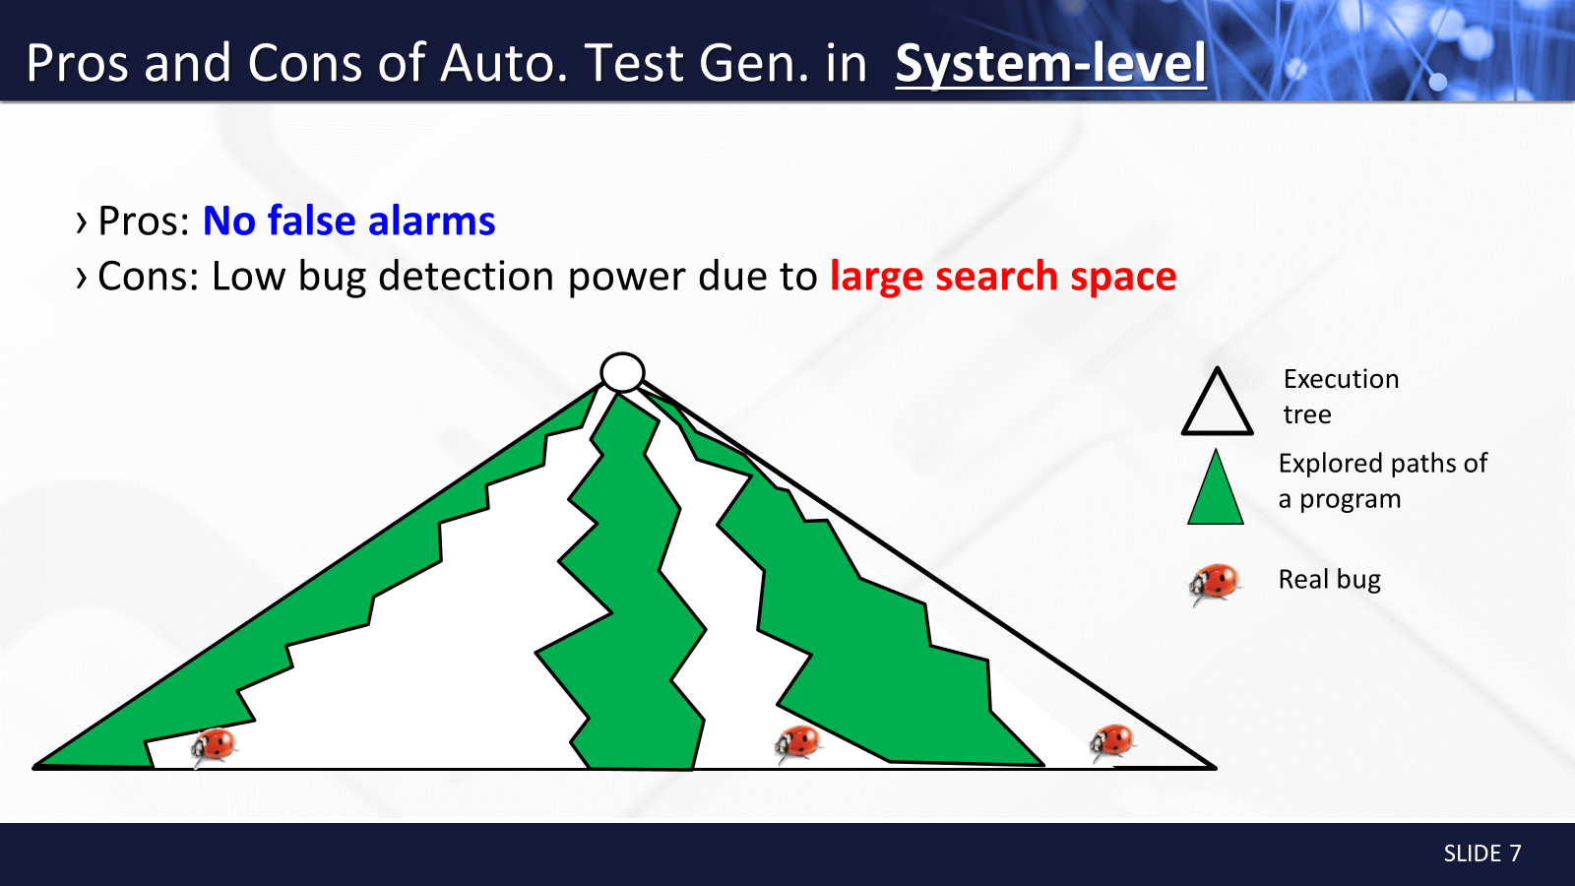
Notes:
Nowadays, automated test generation techniques are widely used in academia and industry at system-level and unit-level. First, let’s look at the pros and cons of system-level test generation.
The pros of system-level test generation is that we do not need to worry about false alarm. We can give any inputs to a target program and the program should handle unexpected inputs.
On the other hand, the cons of system-level test generation is low bug detection power due to large search space. Within a given limited time, it can explore only a few part of search space, so it can miss corner case bugs.

Slide 14
Automated Test Generation in System-Level
  Pros
  + Can be easy to generate system TCs due to clear interface specification
  + No false alarm (i.e., no assert violation caused by infeasible execution scenario)
  Cons
  - Low controllability of each unit
  - Large and complex search space to explore in a limited time
  - Hard to detect bugs in corner cases
T₁
T₂
T₃
T₄
Different system tests T₂ to T₄ exercise the same behavior of the target unit
g1
g2
f
h1
h3
h2
26年 11月 8日
Notes:
장점 Sys tc 만들기 쉽다.
Search space 가 너무 커서 어려움
시간문제
그림 컴포넌트 구분 안감 (입체감)

Slide 15






Pros and Cons of Auto. Test Gen. in Unit-level
Pros: High bug detection power for small search space
Cons: Many false alarms due to over-approximated context of a unit
[Gross et al., ISSTA12]
[Fraser and Arcuri, ESEJ13]
[Shamshiri et al., ASE15]
main
Execution tree
f₂
Explored paths of each unit
f₁
f₃
Real bug
False alarm
f₄
f₅
f₆
f₇
f₈
f₉
SLIDE <number>
Notes:
Unit-level test generation has entirely different charateristics. Pros of unit-level test generation is that it has high bug detection power because It can control individual unit functions which has small search space. However, unit-level test generation causes many false alarms because it can give any inputs to a target unit, but the inputs may not be feasible in system-execution. Many papers pointed out such false alarm problem is severe.
3~5 slides 애니메이션으로
조금 더 타이트하게. 너무 쳐지지 않게.

Slide 16
Automated Test Generation in Unit-Level
  Pros
  + High controllability of a target unit
  + Smaller search space to explore than system testing
  + High effectiveness for detecting corner cases bugs
  Cons
  - Hard to write down accurate unit test drivers/stubs due to unclear unit specification
  - High false/true alarm ratio
Different unit tests T_{u1} to T_{u3} directly exercise different behaviors of the target unit, but T_{u2} to T_{u3} exercise infeasible paths
g1
T_{u1}
T_{u2}
g2
T_{u3}
Legend
f
A feasible execution
h1
h3
An infeasible execution
h2
26年 11月 8日
Notes:
드라이버/스텁
Tu2, 3 로 가장 표면에서 가는 선 없는 거 보이기(visual)

Slide 17
Test Planning
[Pressman]
A Test Plan:
  covers all types and phases of testing
  guides the entire testing process
  who, why, when, what
  developed as requirements, functional specification, and high-level design are developed
  should be done before implementation starts
    I.e., test driven development (TDD)
A test plan includes:
  test objectives
  schedule and logistics
  test strategies
  test cases
    procedure
    data
    expected result
  procedures for handling problems

Slide 18
Fault Handling Techniques
Fault Handling
Fault Avoidance
Fault Detection
Fault Tolerance
Design
Methodology
Reviews
Atomic
Transactions
Modular
Redundancy
Verification
Configuration
Management
Testing
Debugging
Unit
Testing
Integration
Testing
System
Testing
Correctness
Debugging
Performance
Debugging

Slide 19
Quality Assurance encompasses Testing
Quality Assurance
Usability Testing
Scenario
Testing
Prototype
Testing
Product
Testing
Fault Avoidance
Fault Tolerance
Atomic
Transactions
Modular
Redundancy
Verification
Configuration
Management
Fault Detection
Reviews
Debugging
Walkthrough
Inspection
Testing
Correctness
Debugging
Performance
Debugging
Unit
Testing
Integration
Testing
System
Testing

Slide 20
Another View on How to Deal with Errors
Error prevention (before the system is released):
  Use good programming methodology to reduce complexity
  Use version control to prevent inconsistent system
  Apply verification to prevent algorithmic bugs
Error detection (while system is running):
  Testing: Create failures in a planned way
  Debugging: Start with an unplanned failures
  Monitoring: Deliver information about state. Find performance bugs
Error recovery (recover from failure once the system is released):
  Data base systems (atomic transactions)
  Modular redundancy
  Recovery blocks, check points

Slide 21
Types of Testing
Unit Testing:
  Individual subsystem
  Carried out by developers
  Goal: Confirm that subsystems is correctly coded and carries out the intended functionality
Integration Testing:
  Groups of subsystems (collection of classes) and eventually the entire system
  Carried out by developers
  Goal: Test the interface among the subsystem

Slide 22
System Testing
System Testing:
  The entire system
  Carried out by developers
  Goal: Determine if the system meets the requirements (functional and global)
Acceptance Testing:
  Evaluates the system delivered by developers
  Carried out by the client. May involve executing typical transactions on site on a trial basis
  Goal: Demonstrate that the system meets customer requirements and is ready to use
Implementation (Coding) and testing go hand in hand

Slide 23
Unit Testing
Informal:
  Incremental coding
Static Analysis:
  Hand execution: Reading the source code
  Walk-Through (informal presentation to others)
  Code Inspection (formal presentation to others)
  Automated Tools checking for
    syntactic and semantic errors
    departure from coding standards
Dynamic Analysis:
  Black-box testing (Test the input/output behavior)
  White-box testing (Test the internal logic of the subsystem or object)
  Data-structure based testing (Data types determine test cases)
Write a little, test a little
Which is more effective, static or dynamic analysis?

Slide 24
Black-box Testing
Focus: I/O behavior. If for any given input, we can predict the output, then the module passes the test.
  Almost always impossible to generate all possible inputs ("test cases")
Goal: Reduce number of test cases by equivalence partitioning:
  Divide input conditions into equivalence classes
  Choose test cases for each equivalence class. (Example: If an object is supposed to accept a negative number, testing one negative number is enough)
why?
If x = 3 then …
If x > -5 and x < 5 then …
What would be the equivalence classes?

Slide 25
Black-box Testing (Continued)
Selection of equivalence classes (No rules, only guidelines):
  Input is valid across range of values. Select test cases from 3 equivalence classes:
    Below the range
    Within the range
    Above the range
  Input is valid if it is from a discrete set. Select test cases from 2 equivalence classes:
    Valid discrete value
    Invalid discrete value
Another solution to select only a limited amount of test cases:
  Get knowledge about the inner workings of the unit being tested => white-box testing
Are these complete?

Slide 26
White-box Testing
Focus: Thoroughness (Coverage). Every statement in the component is executed at least once.
Four types of white-box testing
  Statement Testing
  Branch Testing
  Loop Testing
  Path Testing

Slide 27
White-box Testing (Continued)
Statement Testing: Test single statements
Branch Testing (Conditional Testing): Make sure that each possible outcome from a condition is tested at least once
Loop Testing:
  Cause execution of the loop to be skipped completely. (Exception: Repeat loops)
  Loop to be executed exactly once
  Loop to be executed more than once
Path testing:
  Make sure all paths in the program are executed
if ( i =
TRUE) printf("YES\n");
else
printf("NO\n");
Test cases: 1) i = TRUE; 2) i = FALSE

Slide 28
Loop Testing
White-Box Testing
[Pressman]
Simple
loop
Nested
Loops
Concatenated
Loops
Unstructured
Loops
Why is loop testing important?

Slide 29
Comparison of White & Black-box Testing 25.1.2002
White-box Testing:
  Potentially infinite number of paths have to be tested
  White-box testing often tests what is done, instead of what should be done
  Cannot detect missing use cases
Black-box Testing:
  Potential combinatorical explosion of test cases (valid & invalid data)
  Often not clear whether the selected test cases uncover a particular error
  Does not discover extraneous use cases ("features")
Both types of testing are needed
White-box testing and black box testing are the extreme ends of a testing continuum.
Any choice of test case lies in between and depends on the following:
  Number of possible logical paths
  Nature of input data
  Amount of computation
  Complexity of algorithms and data structures

Slide 30
Guidance for Test Case Selection
Use analysis knowledge about functional requirements (black-box testing):
  Use cases
  Expected input data
  Invalid input data
Use design knowledge about system structure, algorithms, data structures (white-box testing):
  Control structures
    Test branches, loops, ...
  Data structures
    Test records fields, arrays, ...
Use implementation knowledge about algorithms:
  Examples:
  Force division by zero
  Use sequence of test cases for interrupt handler

Slide 31
Unit-testing Heuristics
1. Create unit tests as soon as object design is completed:
  Black-box test: Test the use cases & functional model
  White-box test: Test the dynamic model
  Data-structure test: Test the object model
2. Develop the test cases
  Goal: Find the minimal number of test cases to cover as many paths as possible
3. Cross-check the test cases to eliminate duplicates
  Don't waste your time!
4. Desk check your source code
  Reduces testing time
5. Create a test harness
  Test drivers and test stubs are needed for integration testing
6. Describe the test oracle
  Often the result of the first successfully executed test
7. Execute the test cases
  Don’t forget regression testing
  Re-execute test cases every time a change is made.
8. Compare the results of the test with the test oracle
  Automate as much as possible
Big cost -> what should be done?

Slide 32
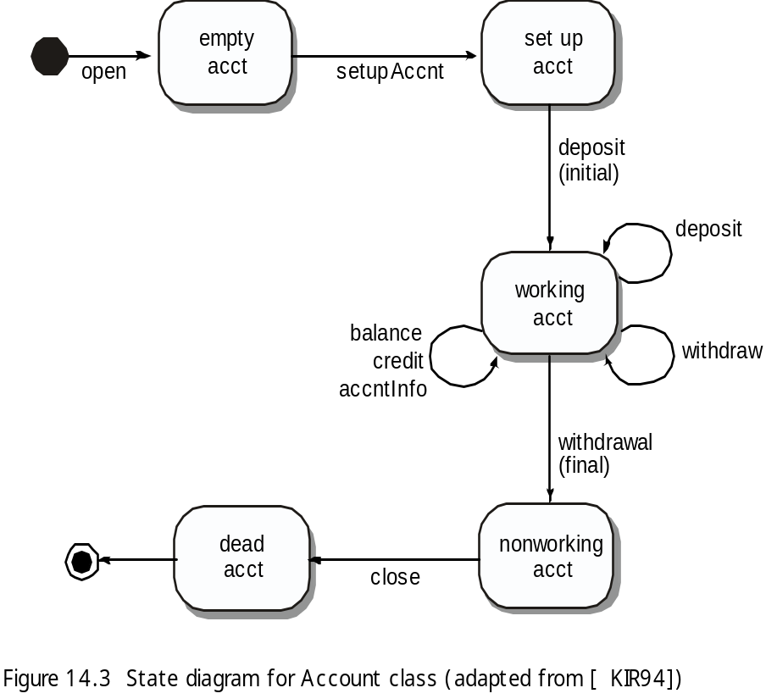
OOT Methods: Behavior Testing
[Pressman]
The tests to be designed should achieve all state coverage [KIR94]. That is, the operation sequences should cause the Account class to make transition through all allowable states
This can act as an oracle

Slide 33


Who Tests the Software?
[Pressman]
developer
independent tester
Understands the system
Must learn about the system,
but, will test "gently"
but, will attempt to break it
and, is driven by "delivery"
and, is driven by quality

Slide 34
NFRs: Reliability
[Chung, RE Lecture Notes]]
Counting Bugs
Sometimes reliability requirements take the form:
"The software shall have no more than X bugs/1K LOC"
But how do we measure bugs at delivery time?
Bebugging Process - based on a Monte Carlo technique for statistical analysis of random events.
1. before testing, a known number of bugs (seeded bugs) are secretly inserted.
2. estimate the number of bugs in the system
3. remove (both known and new) bugs.
# of detected seeded bugs/ # of seeded bugs = # of detected bugs/ # of bugs in the system
# of bugs in the system = # of seeded bugs x # of detected bugs /# of detected seeded bugs
Example: secretely seed 10 bugs
an independent test team detects 120 bugs (6 for the seeded)
# of bugs in the system = 10 x 120/6 = 200
# of bugs in the system after removal = 200 - 120 - 4 = 76
But, deadly bugs vs. insignifant ones; not all bugs are equally detectable; ( Suggestion [Musa87]:
"No more than X bugs/1K LOC may be detected during testing"
"No more than X bugs/1K LOC may be remain after delivery,
as calculated by the Monte Carlo seeding technique"

Slide 35
Summary
Testing is still a black art, but many rules and heuristics are available
Testing consists of component-testing (unit testing, integration testing) and system testing, and …
OOT and architectural testing, still challenging
User-oriented reliability modeling and evaluation not adequate
Testing has its own lifecycle

