Slide 1
Ch 2: Process Models Moonzoo Kim SoC. KAIST
Notes:
Two-dimension view: time (long life) and space (large group)
Maintainability distributed/collaborative development
=> Understandability => Documentation ( natural language is far familiar than C/C++!!!)

Slide 2
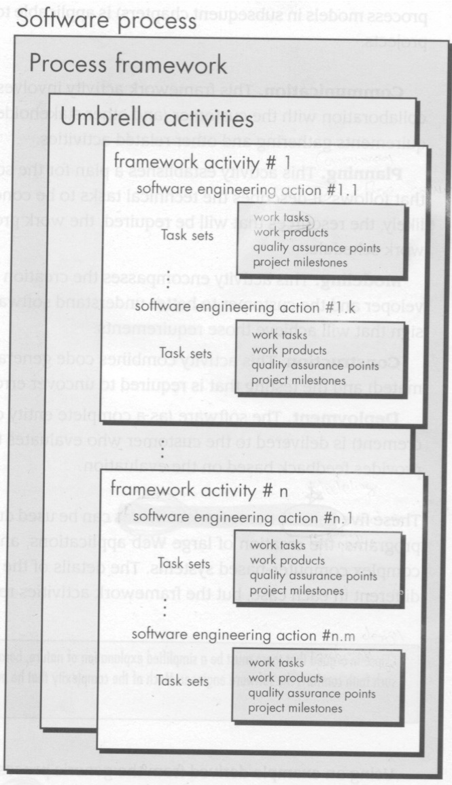
A SW Process Framework
Process framework
Framework activities
work tasks
work products
milestones & deliverables
QA checkpoints
Umbrella Activities

Slide 3
5 Framework Activities
Communication
Planning
Technical tasks
The risks
The resources
Work products
Work schedule
Modeling
To better understand the requirements and the design
Construction
Code generation
Testing
Deployment

Slide 4
Umbrella Activities
Software project tracking and control
Risk management
Software quality assurance
Technical reviews
Software configuration management
Reusability management
Work product preparation and production

Slide 5
The Waterfall Model
Bradac[BRA94] found that the linear nature of the waterfall model leads to “blocking states”
Where some members must wait for other members of the team to complete dependent tasks
Especially, at the beginning of the project
Still, however, the waterfall model serve as a useful process model where requirements are fixed and work is to proceed to completion in a linear manner

Slide 6
The Incremental Model
Can manage
technical risks
Can be implemented
with fewer people

Slide 7
Evolutionary Models: Prototyping (1/2)
A prototyping paradigm is the best-fit for the following situations
A customer does not identify detailed requirements for SW
SW engineers are not sure of the efficiency of an algorithm, usability of SW, and so on.
In other words, prototyping paradigm helps SW engineers and the customers to understand what is to be built
The quick design and implementation focuses on a representation of those aspects of the SW that will be visible to the customer
Ideally, the prototype serves as a mechanism for identifying SW requirements

Slide 8
Evolutionary Models: Prototyping (2/2)
Some problems in prototyping paradigm
SW engineers try to modify the prototype to use as a working version
Once the customer see the working prototype, he/she expects to get working product soon
Quick
plan
communication
Modeling
Quick design
Deployment
delivery &
feedback
Construction
of prototype

Slide 9
Evolutionary Models: The Spiral

Slide 10
Still Other Process Models
Component based development—the process to apply when reuse is a development objective
Formal methods—emphasizes the mathematical specification of requirements
AOSD—provides a process and methodological approach for defining, specifying, designing, and constructing aspects
Unified Process—a “use-case driven, architecture-centric, iterative and incremental” software process closely aligned with the Unified Modeling Language (UML)

Slide 11
The Unified Process (UP)
inception
elaboration
inception

Slide 12
UP Work Products
I
n
c
e
p
t
i
o
n
p
h
a
s
e
E
l
a
b
o
r
a
t
i
o
n
p
h
a
V
i
s
e
s
i
o
n
d
o
c
u
m
e
n
t
I
n
i
t
i
a
l
u
s
e
-
c
a
s
e
m
o
d
e
l
C
o
n
s
t
r
u
c
t
i
o
n
p
h
a
I
s
e
n
i
t
i
a
l
p
r
o
j
e
c
t
g
l
o
s
s
a
r
y
U
s
e
-
I
c
a
s
e
m
o
d
e
l
n
i
t
i
a
l
b
u
s
i
n
e
s
s
c
a
s
e
S
u
p
p
l
e
m
e
n
t
a
r
y
r
e
q
u
i
r
e
m
e
n
t
s
T
r
a
n
s
i
t
i
o
n
p
h
a
I
s
e
n
i
t
i
a
l
r
i
s
k
a
s
s
e
s
s
m
e
n
t
.
i
n
c
l
u
d
i
n
g
n
o
n
-
f
u
n
c
t
i
o
n
a
l
D
e
s
i
P
g
n
m
o
d
e
l
r
o
j
e
c
t
p
l
a
n
,
A
n
a
l
y
s
i
s
m
o
d
e
l
S
o
f
t
w
a
r
p
h
a
s
e
s
a
n
d
i
e
c
o
m
p
o
n
e
n
t
s
t
e
r
a
t
i
o
n
s
.
S
o
f
t
w
a
r
e
a
r
c
h
i
t
e
c
t
u
r
e
D
e
l
i
v
e
r
e
d
s
o
f
t
w
a
r
e
i
n
c
r
I
e
m
e
n
t
n
t
e
g
r
a
t
e
d
s
o
f
t
w
a
r
B
u
s
e
i
n
e
s
s
m
o
d
e
l
,
D
e
s
c
r
i
p
t
i
o
n
.
i
n
c
r
e
m
e
n
t
B
e
t
a
t
e
s
t
r
e
p
o
r
i
t
s
f
n
e
c
e
s
s
a
r
y
.
E
x
e
c
u
t
a
b
l
e
a
r
c
h
i
t
e
c
t
u
r
a
l
G
e
n
e
r
a
l
u
s
e
r
f
e
e
d
b
a
c
T
e
s
k
t
p
l
a
n
a
n
d
p
r
o
c
e
d
u
r
O
n
e
o
r
m
o
r
e
e
p
r
o
t
o
t
y
p
e
s
p
r
o
t
o
t
y
p
e
.
T
e
s
I
n
c
e
p
t
i
o
P
t
c
a
s
e
s
r
e
l
i
m
i
n
a
r
y
d
e
s
i
g
n
m
o
d
e
l
S
u
p
p
o
r
t
d
o
c
u
m
e
n
t
a
t
i
n
R
o
n
e
v
i
s
e
d
r
i
s
k
l
i
s
t
u
s
e
r
m
a
n
u
a
l
P
s
r
o
j
e
c
t
p
l
a
n
i
n
c
l
u
d
i
n
g
i
n
s
t
a
l
l
a
t
i
o
n
m
a
n
u
a
l
i
s
t
e
r
a
t
i
o
n
p
l
a
n
d
e
s
c
r
i
p
t
i
o
n
o
f
c
u
r
r
a
d
a
p
t
e
d
w
o
r
e
n
t
k
f
l
o
w
s
i
n
c
r
m
i
e
m
e
n
t
l
e
s
t
o
n
e
s
t
e
c
h
n
i
c
a
l
w
o
r
k
p
r
o
d
u
c
t
s
P
r
e
l
i
m
i
n
a
r
y
u
s
e
r
m
a
n
u
a
l

Slide 13
Quick Overview of SafeHome
The SafeHome company has developed an innovative HW box that implements wireless Internet (802.11) connectivity in a very small form factor (the size of a matchbook).
The idea is to use this technology to develop and market a comprehensive home automation product line.
This would provide
security functions
control over telephone answering machines
lights
heating
air conditioning
home entertainment devices.
The first generation of the system will only focus on home security since that is a market the public readily understands.

Slide 14
Selecting a Process Model, Part 1(pg 28)
The scene:
Meeting room for the software engineering group at CPI Corporation, a (fictional) company that makes consumer products for home and commercial use.
The players:
Lee Warren, engineering manager;
Doug Miller, software engineering manager;
Jamie Lazar, software team member;
Vinod Raman, software team member;
Ed Robbins, software team member.
The conversation:
Lee: So let's recapitulate. I've spent some time discussing the SafeHome product line as we see it at the moment. No doubt, we've got a lot of work to do to simply define the thing, but I'd like you guys to begin thinking about how you're going to approach the software part of this project.
Doug: Seems like we've been pretty disorganized in our approach to software in the past.
Ed: I don't know, Doug. We always got product out the door.
Doug: True, but not without a lot of grief, and this project looks like it's bigger and more complex than anything we've done in the past.
Jamie: Doesn't look that hard, but I agree ... our ad hoc approach to past projects won't work here, particularly if we have a very tight timeline.
Doug (smiling): I want to be a bit more professional in our approach. I went to a short course last week and learned a lot about software engineering ... good stuff. We need a process here.
14
CS350 Intro. to SE Spring 2008

Slide 15
Jamie (with a frown): My job is to build computer programs, not push paper around
Doug: Give it a chance before you go negative on me. Here's what I mean. [Doug proceeds to describe the process framework described in Chapter 2 and the prescriptive process models presented to this point.
Doug: So anyway, it seems to me that a linear model is not for us ... assumes we have all requirements up front and knowing this place, that's not likely.
Vinod: Yeah, and that RAD model sounds way too IT- oriented ... probably good for building an inventory control system or something, but it's just not right for SafeHome
Doug: I agree.
Ed: That prototyping approach seems OK. A lot like what we do here anyway.
Vinod: That's a problem. I'm worried that it doesn't provide us with enough structure.
Doug: Not to worry. We've got plenty of other options, and I want you guys to pick what's best for the team and best for the project.
15
CS350 Intro. to SE Spring 2008

Slide 16
Selecting a Process Model, Part 2 (pg31)
The players:
Lee Warren: engineering manager
Doug Miller: SE manager
Ed and Vinod: members of the SE team
The conversation: (Doug describes evolutionary process options)
Ed: Now I see something I like. An incremental approach makes sense and I really like the flow of that spiral model thing. That’s keeping it real.
Vinod: I agree. We deliver an increment, learn from customer feedback, replan, and then deliver another increment. It also fits into the nature of the product. We can have something on the market fast and then add functionality with each version, er, increment.
Lee: Wait a minute, did you say that we regenerate the plan with each tour around the spiral, Doug? That’s not so great, we need one plan, one schedule, and we’ve got to stick to it.
Doug: That’s old school thinking, Lee. Like Ed said, we’ve got to keep it real. I submit that it’s better to tweak the plan as we learn more and as changes are requested. It’s way more realistic. What’s the point of a plan if it doesn’t reflect reality?
Lee (frowning): I suppose so, but senior management’s not going to like this… they want a fixed plan.
Doug (smiling): Then, you ‘ll have to reeducate them, buddy

Slide 17
Prescriptive Models
Prescriptive process models advocate an orderly approach to software engineering
That leads to a few questions …
If prescriptive process models strive for structure and order, are they inappropriate for a software world that thrives on change?
Yet, if we reject traditional process models (and the order they imply) and replace them with something less structured, do we make it impossible to achieve coordination and coherence in software work?

Slide 18
The Waterfall Model (1/2)
Which problems does the waterfall model have?
Real projects rarely follow the sequential flow
Difficult to accommodating the uncertainty in requirements
A working version of SW will not be available until late in the project

Slide 19
The RAD (Rapid Application Development) Model
Requires sufficient human resources
Modularization is prerequisite
Global tuning is not possible

