Slide 1


CS40508: Intro. to Dynamic Analysis of
Software Source Code
https://github.com/swtv-kaist/cs40508-fall26
Moonzoo Kim
Notes:
Dynamic vs. Static vs. Automatic
Source code vs. binary vs. design

Slide 2
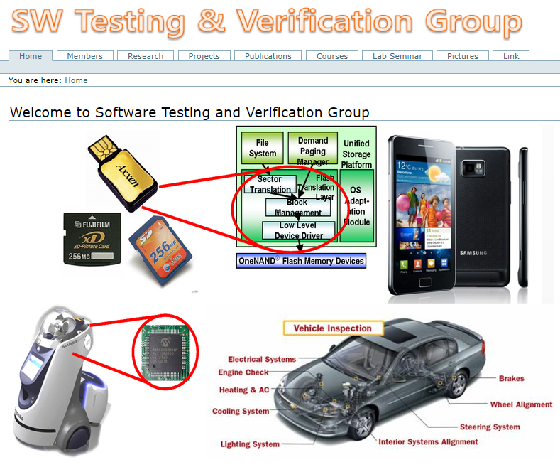
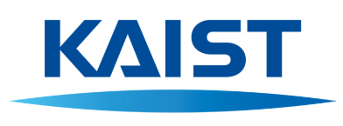
Software Testing Verification (SWTV) Group
Prof. Moonzoo Kim
E-mail:
moonzoo.kim@gmail.com
https://swtv.kaist.ac.kr/

Slide 3
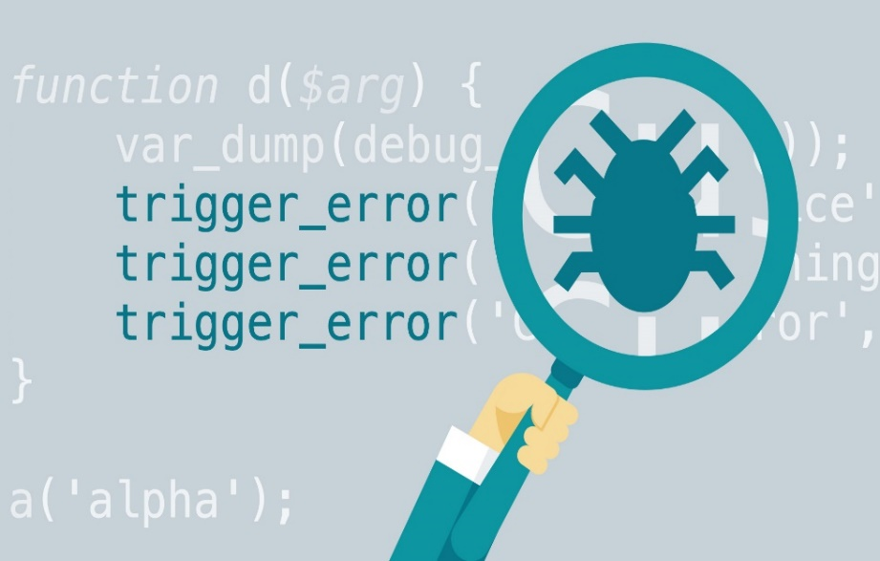
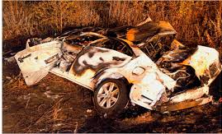
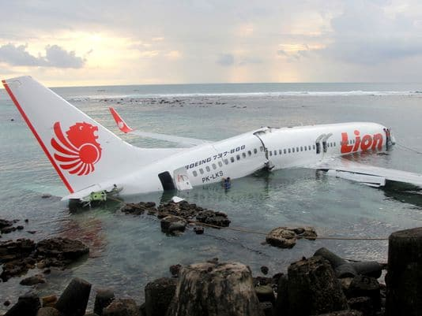

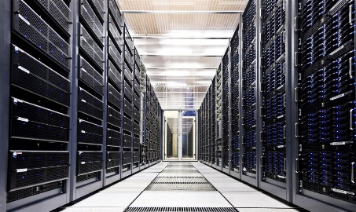
Necessity of Automated SW Testing
  Safety of SW becomes unreliable due to the high complexity of SW
89 people died caused by
Toyota SUA (sudden
unintended acceleration)
346 people died due
to Boeing 737 MAX
crash
  Modern SW is too large and complex for human engineers to manually test
  Decreased product quality due to the low effectiveness and efficiency of SW bug detection
  Scientific automated SW testing is the solution to the problem

Slide 4
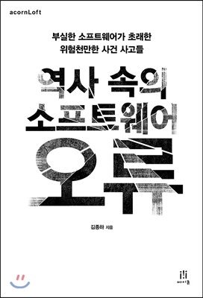
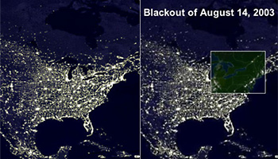
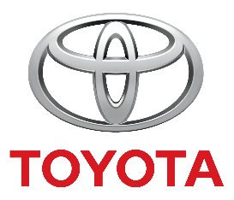



Social and Economic Loss due to High Complexity of SW
Although most areas of modern society depend on SW,
reliability of SW is not improved much due to its high complexity
(2003) US & Canada blackout
7 states in US and 1 state in Canada
suffered 3 days electricity blackout
Caused by the failures of MISO
monitoring SW
50 million people suffered and
economic loss of 6 billion USD
(2010s) Toyota sudden
unintended acceleration
89 people died since 2002
SW bugs detected in 2012
Fined 1.2 billion USD in 2014
(2018-2019) Boeing 737 MAX
accidents
346 people died in 2 accidents
SW bugs detected in 2019
Boeing 737 MAX is banned
all over the world
Notes:
20일 전자신문이 단독으로 입수한 바(BARR) 그룹의 도요타 급발진 조사보고서에 따르면, 캠리의 엔진 스로틀 컨트롤 시스템(ETCS)의 SW 결함이 급발진을 일으켰다. 보고서는 ETCS 전자제어장치(ECU)에 내장된 SW에 오류(버그)가 있었고, 오류가 있더라도 이를 커버해주는 방어수단(fail safes)도 작동하지 않았다고 지적했다.
바 그룹의 조사보고서는 지난해 10월 미국 오클라호마주 급발진 소송에서 도요타가 패소하는데 결정적 역할을 한 것으로 전해졌다. 도요타는 이 재판에서 피해자에게 300만달러의 손해배상금을 지급했다. 또 19일(현지시각) 도요타는 미국 법무부와 4년간의 급발진 관련 수사 종결에 합의하면서 벌금 12억달러(1조2800억원)를 부과받았다.
https://www.autoelectronics.co.kr/article/articleView.asp?idx=1513

Slide 5
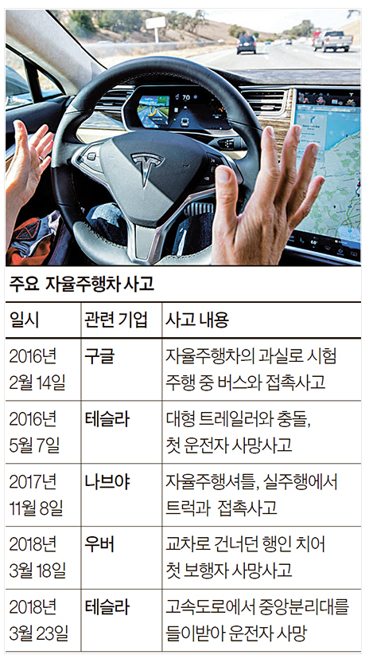
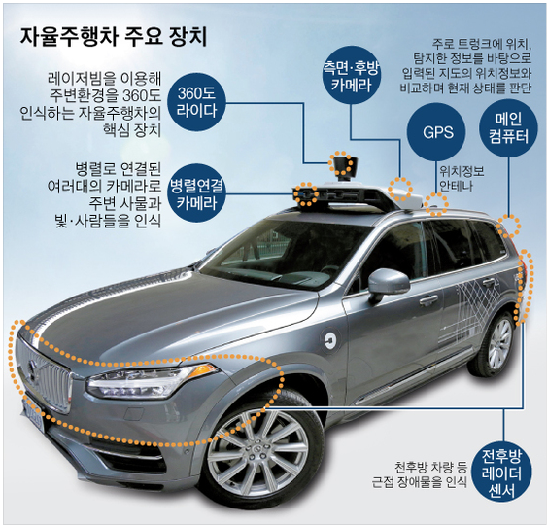
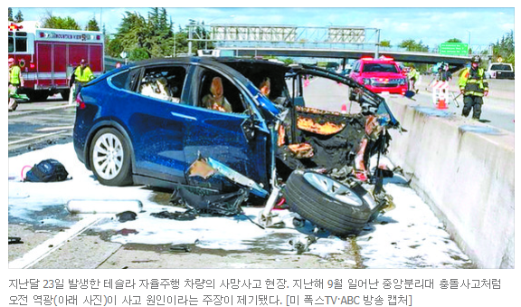
Accidents of Autonomous Vehicle
[출처: 중앙일보] “테슬라 사고, 태양 역광 탓” … 자율주행차 또 날씨 오작동

Slide 6
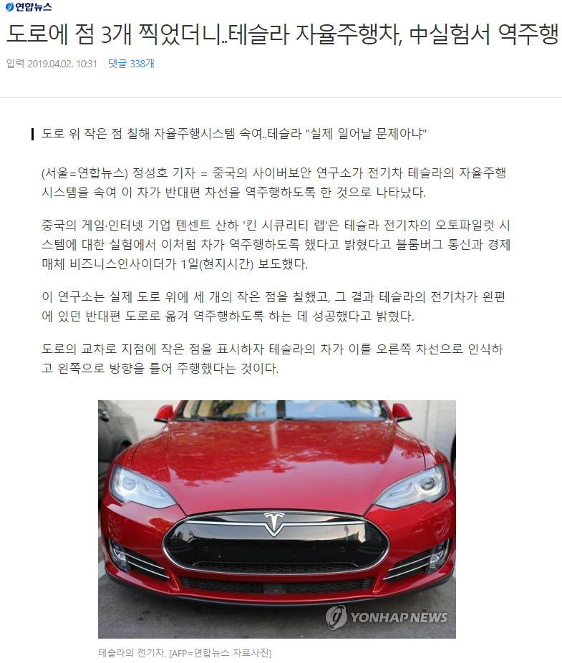
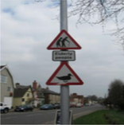
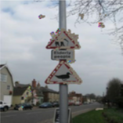
Bugs of Autopilot SW
The weakness of Data Driven AI/Machine Learning SW (adversarial example)
input image
(street sign)
Anomaly
(bird nest)

Slide 7
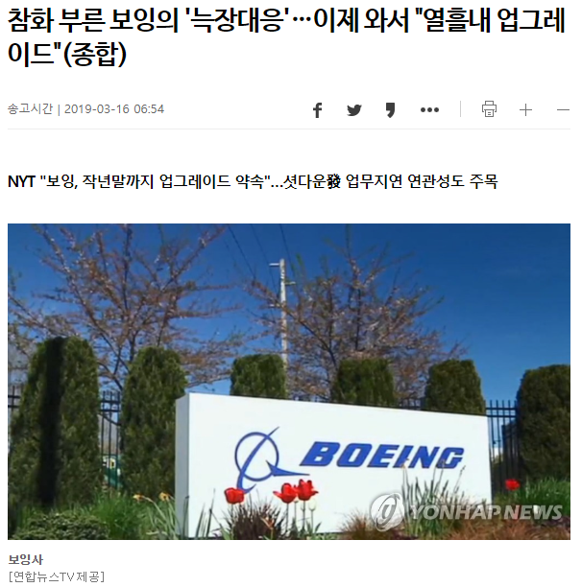
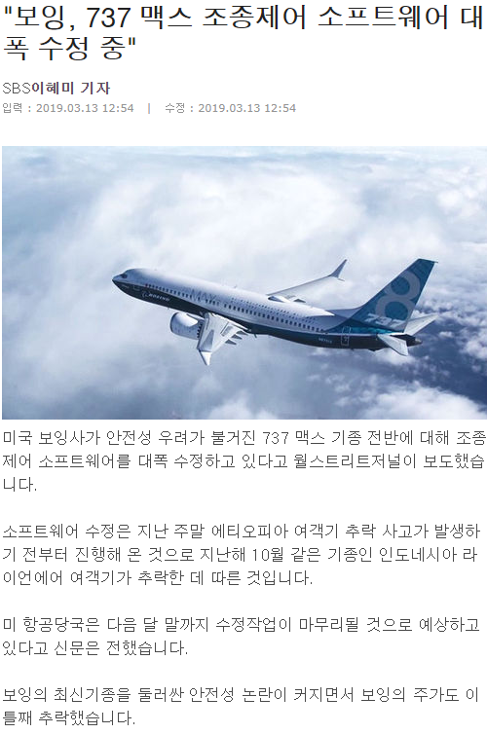
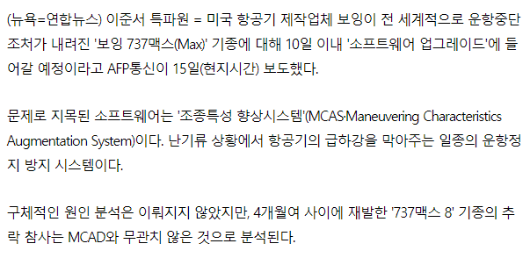
Boeing 737 MAX Crash due to SW Bugs

Slide 8
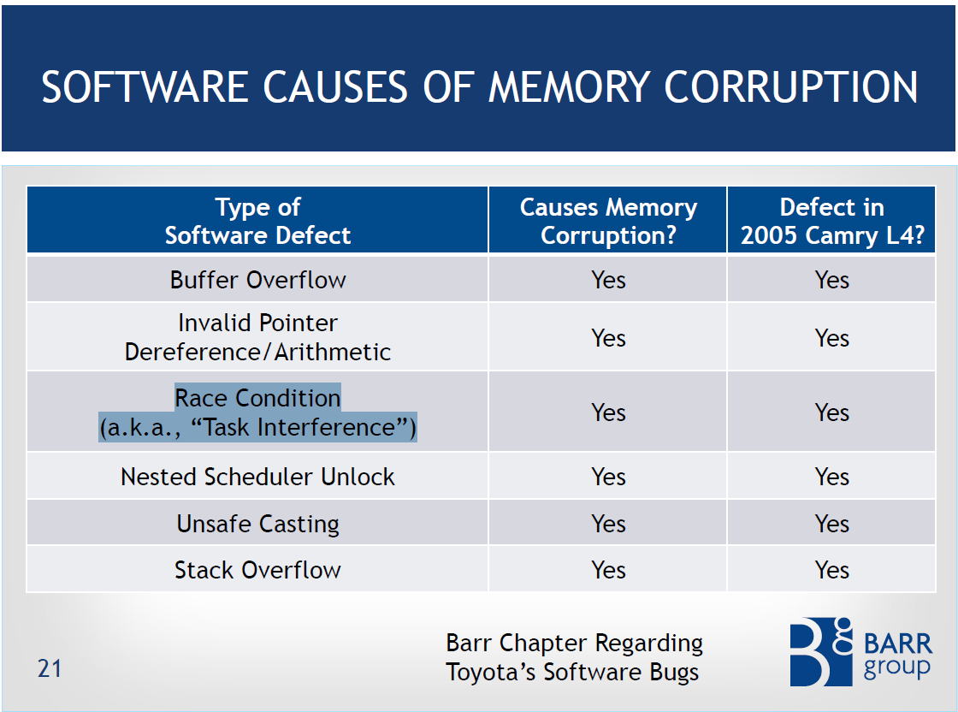
SW Causes of Toyota SUA
Static analysis falls short of detecting
such complex bugs accurately
High false negatives
High false positives
Systematic and dynamic analysis
(i.e. automated sw testing) is
MUST for high quality SW

Slide 9
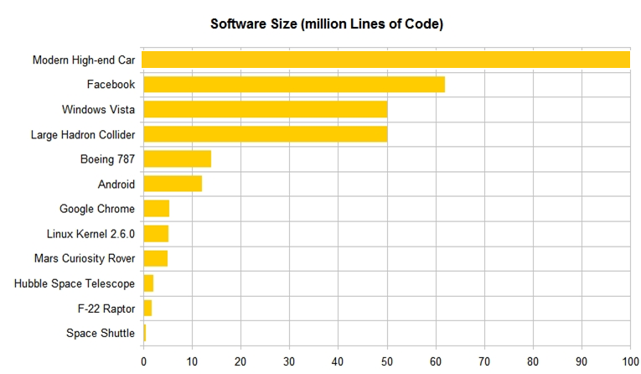
Size and Complexity of Modern SW
A.Busnelli, Counting, https://www.linkedin.com/pulse/20140626152045-3625632-car-software-100m-lines-of-code-and-counting
http://www.informationisbeautiful.net/visualizations/million-lines-of-code/

Slide 10
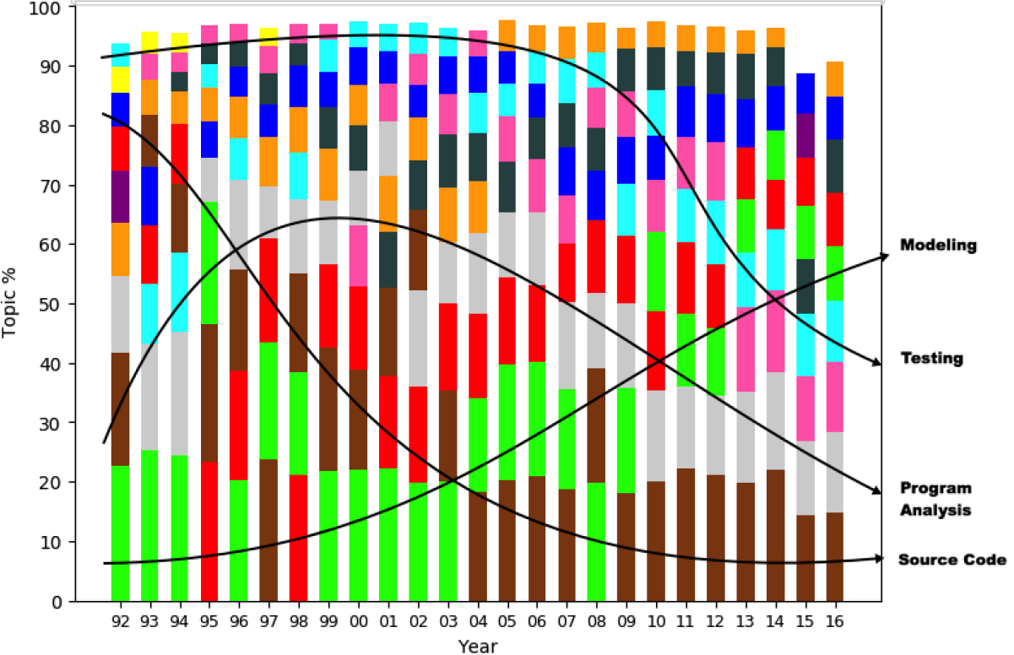
SE Research Topic Trends among 11 Major Topics (1992-2016)
Less papers
per topic
More papers
per topic
G.Mathew et al., Trends in Topics in Software Engineering, IEEE TSE 2018 submission

Slide 11
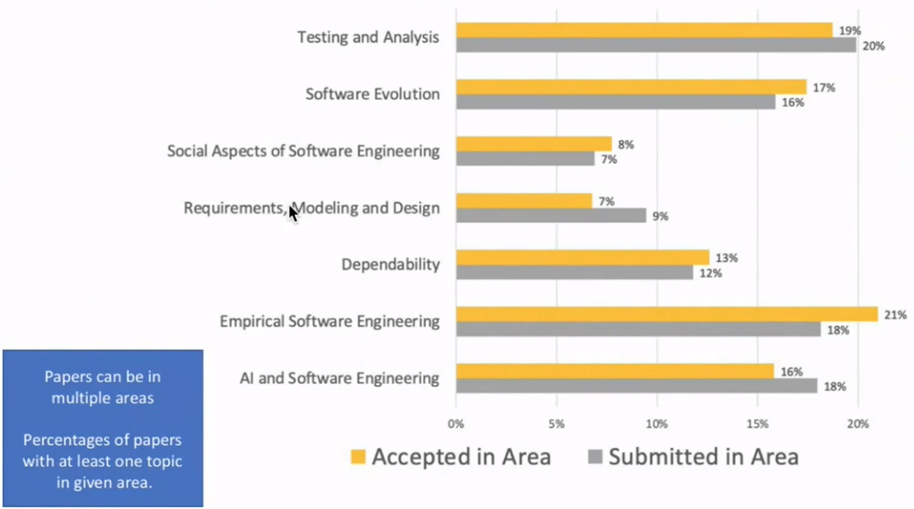
ICSE 2021 Topics

Slide 12
How to Improve the Quality of SW
Systematic testing (can be still manual)
  Coverage criteria
  Mutation analysis
Testing through automated analysis tools
  Scientific treatment of SW with computing power
    Generate test inputs to detect bugs
    Localize detected faults
    Repairing the fault with patches
Formal verification
  Guarantee the absence of bugs

Slide 13



Significance of Automated SW Testing
Software has become more ubiquitous and more complex at the same time
Human resources are becoming less reliable and more expensive for highly complex software
Computing resources are becoming ubiquitous and cheap
  Amazon AWS price: you can use thousands of CPUs @ 0.03$/hr for 2.5Ghz Quad-core CPU
To-do: Develop automated and scientific software testing tools to utilize computing resource effectively and efficiently

Slide 14
Various SW Testing Techniques w/ Different Cost and Effectiveness
_{Whitebox Testing}
SW
Reliability
_{Model Checking}
Concolic Testing
Search-based Testing
Branch Testing
Blackbox Testing
_{Stmt. Testing}
Equiv. Partition. Testing
_{T-way Testing}
Req. based
Testing
참고. 테스팅 국어 사전
http://dic.sten.or.kr/
Rand.
Testing
SW Testing Cost
Notes:
We have demonstrated that our new technique conbol could effectively detect 24 crash bugs. Now conbol is successfully adopted by the original development team. I personally believe that concolic testing is mature enough to be adopted by industry, not only academy. Traditionally, testing focuses on manual TC generation testing main scenarios, ~~. But I believe that our testing paradigm is changing to new testing new paradigm based on concolic testing like conbol. Now we generate millions of test cases automatically, and targeting exceptional scenarios as we detected 24 hidden bugs with unit-level testing and large # of TCs. So overall I believe automated testing has a lower V7V cost than manual testing for higher reliability. And our group and samsung electronics try hard to apply such automated technique to more larger product.

Slide 15
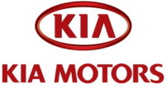
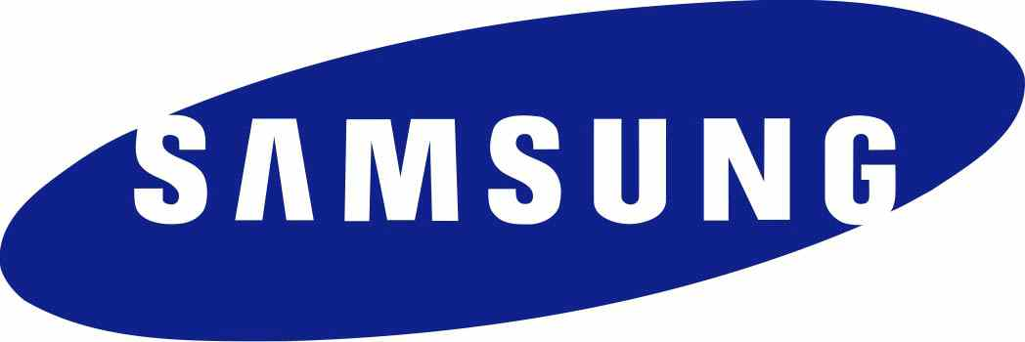

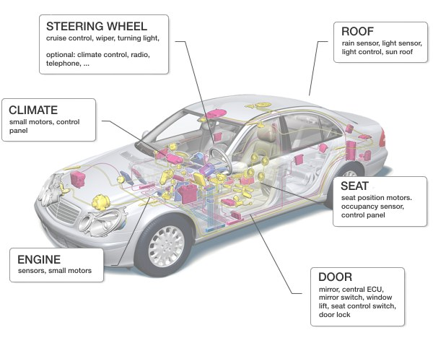
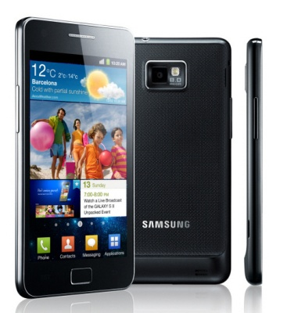
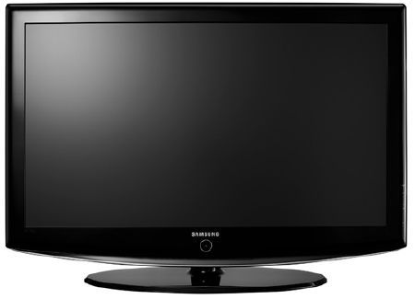
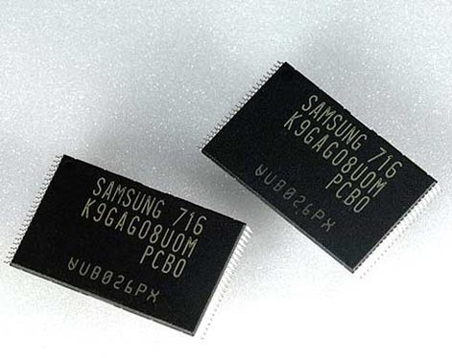
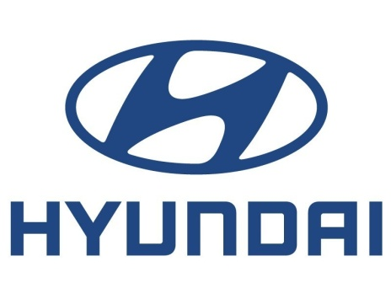
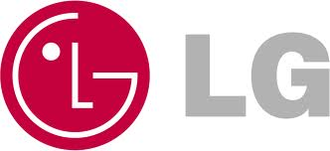
Strong IT Industry in South Korea
Time-to-Market?
SW Quality?

Slide 16
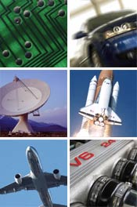
Embedded Software in 2 Different Domains
Conventional Testing
Concolic testing
Model checking
 | Consumer Electronics | Safety Critical Systems
Examples | Smartphones, flash memory platforms | Nuclear reactors, avionics, cars
Market competition | High | Low
Life cycle | Short | Long
Development time | Short | Long
Model-based development | None | Yes
Important value | Time-to-market | Safety

Slide 17
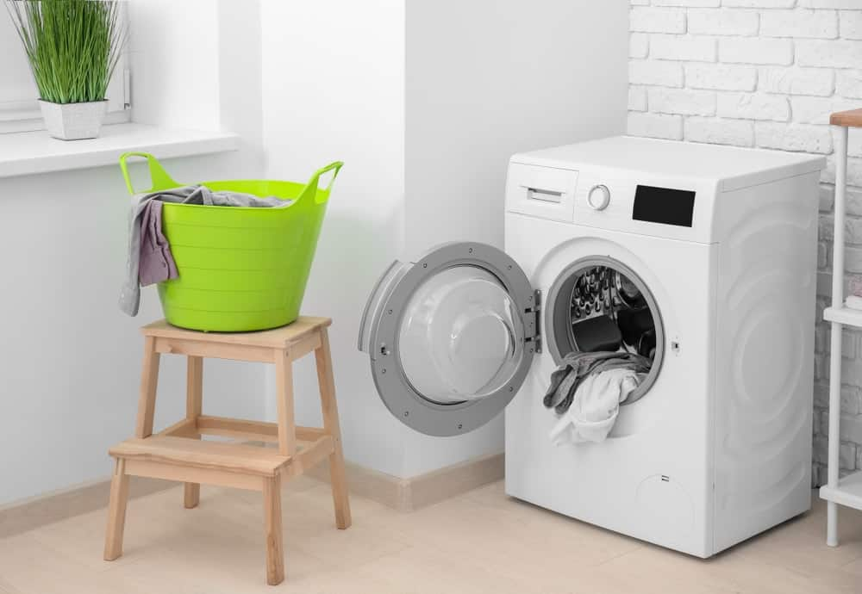


Automated Testing Machine (?) vs. Washing Machine
“ 6 Interesting Facts About Washing Machines …
Played a Role in Women’s Rights
Scholars and many others have long acknowledged the significant role washing machines played in the fight for women’s rights. The invention of automatic washing machines reduced the amount of time women spent doing household chores, which allowed them more time to enter the workforce.
https://www.danby.com/blog/6-interesting-facts-washing-machines/

Slide 18

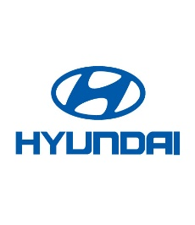

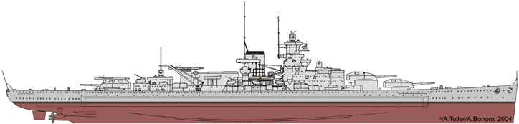
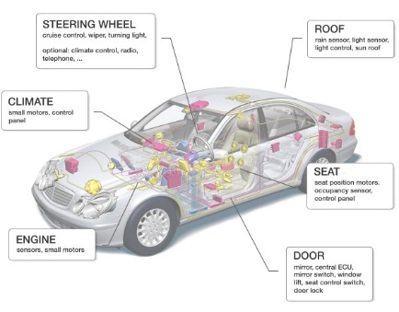


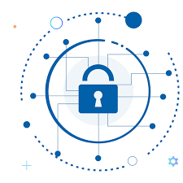
Roadmap for Improving Quality of SW Product and Service
Problem: Huge Economic & Social Cost due to Software Bugs
  Labor-intensive Manual Testing
  Large SW Testing Cost and Time
  Low Bug Detection Abilty
  Low Product Quality
  Solution: AI-based Highly Effective and
  Low Cost Automated SW Testing Technique
movie link https://bit.ly/3NS6RrQ
Existing Problems Developed Solutions
‘10-14 Project w/ Samsung Electronics
‘18 Project w/ LIGnex1
’15~20 Project w/ Hyundai/Mobis
’20 Project w/ Natl. Security Research Inst.
Detected dozens of crash bugs in the
comm. firmware
Detected several SW bugs in the 10 programs in the battleships
Acheived 90% branch cov. and reduced 80% of labor cost by using auto. testing tech.
Detected SW bugs in the software in the security equipments

Slide 19

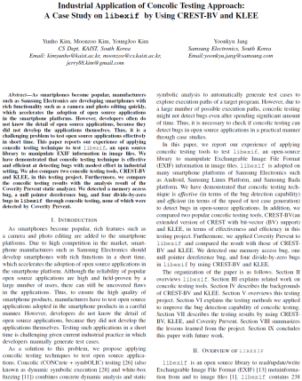
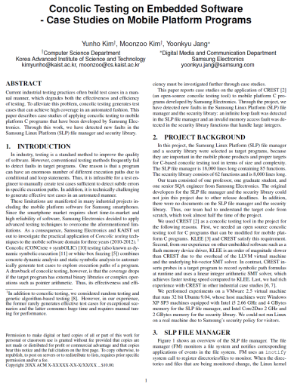
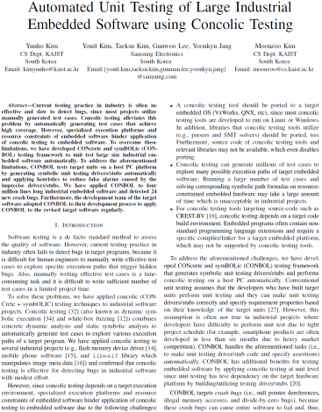

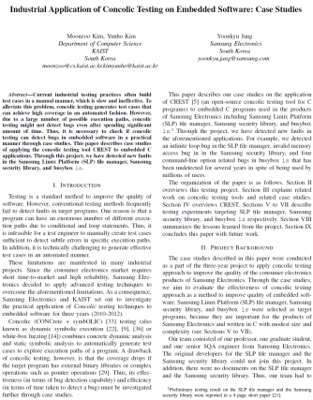

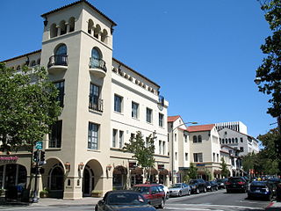

Concolic Unit Testing Project w/ Samsung DMC for 5 years
Goal: To detect bugs in Samsung smartphones
Project period: ‘10~’14
Project funding: 400,000 USD
Results:
Developed Concolic unit-testing tool CONBOL
Detected hundreds crashes in 4 MLOC smartphone SW
Industrial
project
progress
2011
2012
2013
2014
2010
ICSE 2012, ICST 2012
FSE '2011
ASE 2013

Slide 20
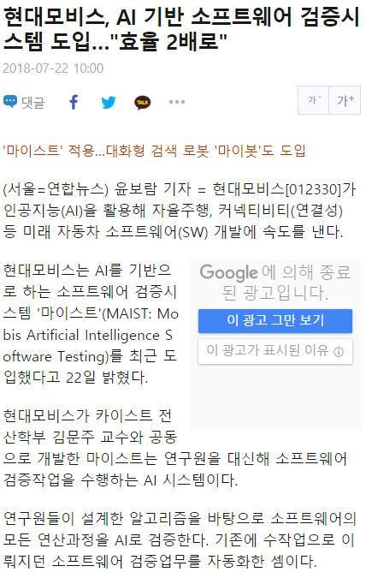
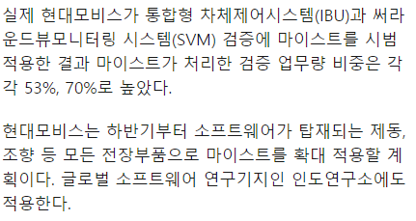
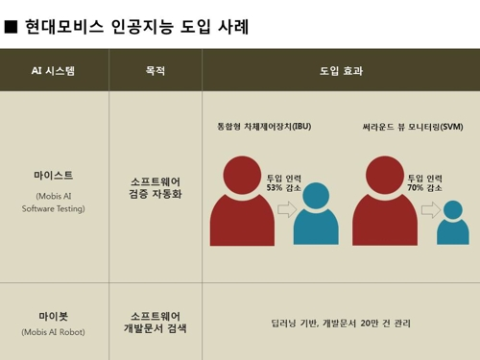
Successful Industrial Case: AI-based Automated SW Testing System
MAIST can reduce 53% and 70% of manual testing effort for IBU(Integrated Body Unit) and SVM(Surround View Monitoring)
IBU
SVM
53%
70%
MAIST
Hyundai Mobis and a research team lead by Prof. Moonzoo Kim at KAIST jointly developed MAIST for automated testing
MAIST automates unit coverage testing performed by human engineers by applying concolic unit testing
Reduction of manual testing effort
http://m.yna.co.kr/kr/contents/?cid=AKR20180720158800003&mobile

Slide 21
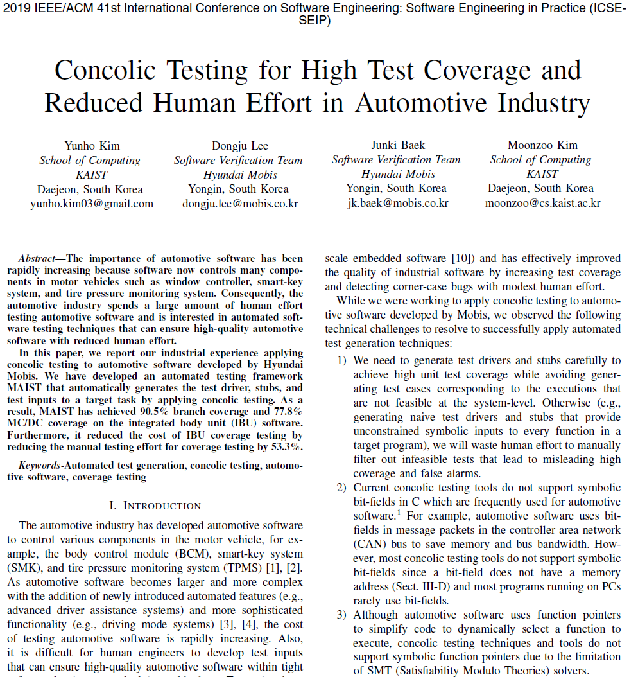
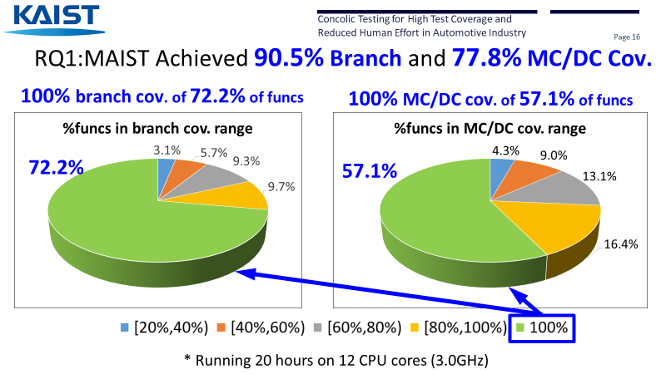
MAIST Paper Presentation @ ICSE 2019 SEIP Track
ICSE 2019 SEIP Acceptance ratio: 20%

Slide 22
Final Remarks
For undergraduate students:
  Highly recommend URP studies or independent studies
For graduate students:
  Welcome research discussions to apply SW analysis techniques
    Systematically testing/debugging C/C++ programs
Pre-requisite:
  Proficiency in C/C++/Linux/Shell
Expected HW time:
  >6 hours of analysis/programming per week

Slide 24
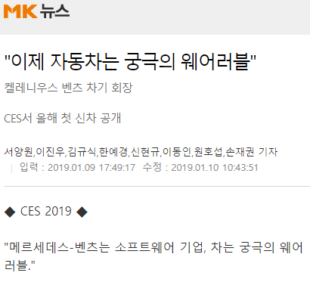
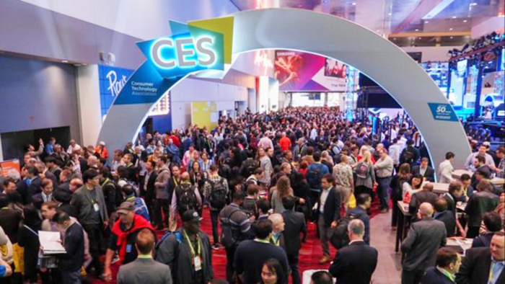
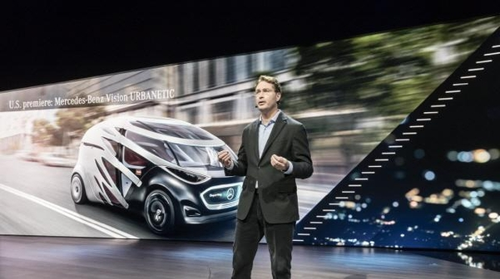
켈레니우스 총괄은 이날 CES 현장에서 벤츠의 월드 프리미어(전 세계에 최초로 공개되는 차)로 연결성(커넥티비티)을 강조한 콤팩트카 CLA를 내놨다.
IT 기업 위주인 CES에서 자동차회사가 신차를 공개한 것은 극히 이례적인 일
"벤츠 차량은 이제 디지털 혁신이 펼쳐지는 플랫폼이 됐다"고 그는 주장했다. 또 켈레니우스 총괄은 … "벤츠는 이제 SW 기업처럼 기업 활동을 한다＂

Slide 25
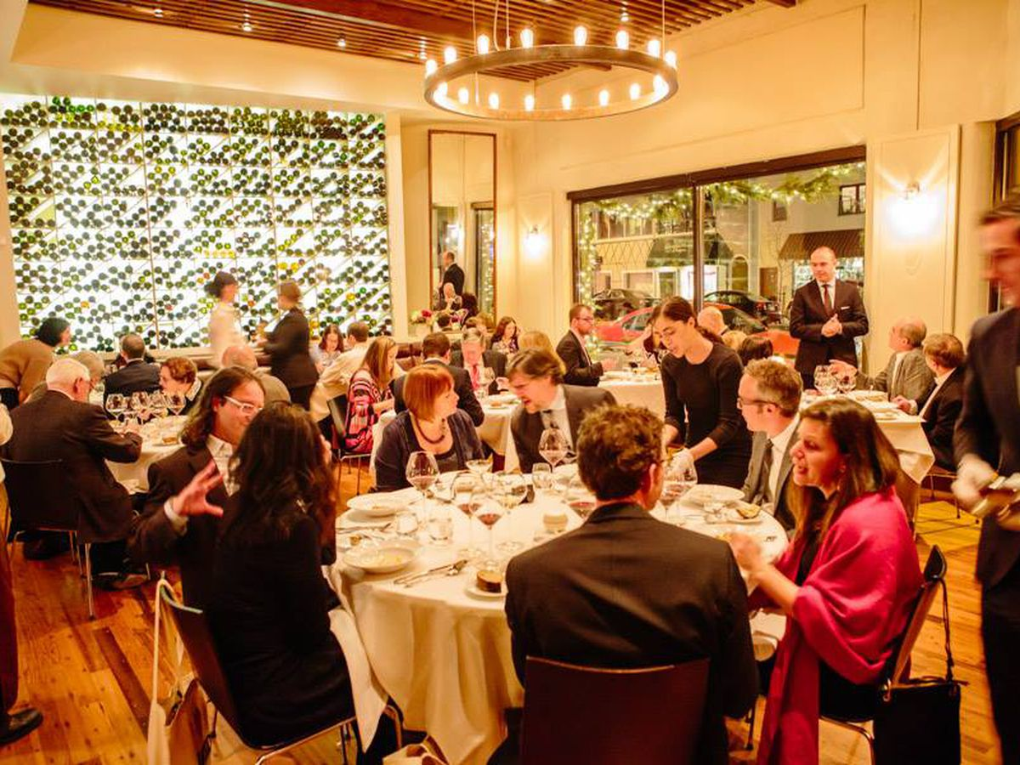

잘되는 음식점 요건 vs 성공적인 SW 개발회사 요건
맛
요리 속도
영양가 (단백질, 콜레스트롤, 앨러지…):
  과학적/실험적 분석을 통한 계량
SW 기능들
개발 속도
Code Quality (오류, 유지보수, 재사용…)
  과학적/실험적 분석을 통한 계량

Slide 26
Concolic 테스팅이란?
SW의 실제 (concrete) 수행 정보와 Symbolic 수행 정보를 통합하여,
  Concrete + Symbolic = Concolic
모든 가능한 수행 경로를 실제로 수행하고,
실행한 수행 정보로 부터, 새로운 테스트 입력값을 자동 생성 기술
학술적인 성공 뿐 아니라, 성공적인 산업체 사례 연구 다수
  자동차, 항공 등의 Safety-critical 분야에도 Concolic 테스팅 기술 적용
  상업화 시작 (예. 브이플러스랩 (주) CROWN 2.0)

Slide 27

Microsoft Security Risk Detection
Azure-based cloud service to find security bugs in x86 windows binary
Based on concolic testing techniques of SAGE

Slide 28


2016 Aug DARPA Cyber Grand Challenge
-the world's 1st all-machine hacking tournament
Each team’s Cyber Reasoning System automatically identifies security flaws and applies patches to its own system in a hack-and-defend style contest targeting a new Linux-based OS DECREE
Mayhem won the best score, which is CMU’s concolic testing based tool

Slide 29
SW 자동 검증 기술 동향
목표: SW가 수행 가능한 모든 다양한 동작들을 검사
랜덤 테스팅 (1970~):
  가장 간편하나, 실제 오류 검출력은 매우 낮음
Model Checking (1980~):
  오류 검출력이 제일 높지만, CPU/메모리 사용량이 엄청나게 많기에, 작은 SW에만 적용가능 (<1KLOC)
Search-based SW Testing (2000~):
  프로그램의 입/출력값에 집중하여, 다양한 입력값을 확률적 기술을 통해 생성
  Scalability가 매우 크나, 프로그램 로직을 직접 고려하지 않기에 오류 검출력에 한계가 있음
Concolic testing (2005~):
  프로그램 로직을 100% 정확도로 분석하여,
  모든 수행경로를 검사하는 기술
  Scalability는 Model checkin과 Search-based SW testing 중간 정도이나, 오류 검출력이 매우 높음 (사실상 model checking 과 동일)
Complete Value Coverage
CVC
Model
Checking
장점: 버그
검출 효과 향상
단점: 테스트
커버리지 만족
테스트 입력값
생성 어려움
Complete Path Coverage
CPC
Concolic
testing
Prime Path Coverage
PPC
Edge-Pair Coverage
EPC
화이트 박스
테스트
커버리지
hierarchy
Edge Coverage
EC
Node Coverage
NC

