Slide 1
How to build a program analysis tool using Clang/LLVM 20.0.1
Clang, the LLVM C/C++ front-end supports the full-features of C/C++ and compatible with GCC
Obtaining source code information
  Initialization of Clang
  Useful functions to print AST
  Line number information of Stmt
Modifying source code
  Writing Code modification using Rewriter
  Converting Stmt into String
  Obtaining SourceLocation

Slide 2
Initialization of Clang
Initialization of Clang is complicated
  To use Clang, many classes should be created and many functions should be called to initialize Clang environment
    Ex) CompilerInstance, TargetOptions, FileManager, etc.
It is recommended to use the initialization part of the sample source code from the course homepage as is, and implement your own ASTConsumer and RecursiveASTVisitor classes

Slide 3
Useful functions to print AST
dump() and dumpColor() in Stmt and FunctionDecl to print AST
  dump() shows AST rooted at Stmt or FunctionDecl object
  dumpColor() is similar to dump() but shows AST with syntax highlight
  Example: dumpColor() of myPrint
  Or use command : clang -Xclang -ast-dump -fsyntax-only print.c
FunctionDecl 0x368a1e0 <line:6:1> myPrint 'void (int)'
|-ParmVarDecl 0x368a120 <line:3:14, col:18> param 'int'
`-CompoundStmt 0x36a1828 <col:25, line:6:1>
`-IfStmt 0x36a17f8 <line:4:3, line:5:24>
|-<<<NULL>>>
|-BinaryOperator 0x368a2e8 <line:4:7, col:16> 'int' '=='
| |-ImplicitCastExpr 0x368a2d0 <col:7> 'int' <LValueToRValue>
| | `-DeclRefExpr 0x368a288 <col:7> 'int' lvalue ParmVar 0x368a120 'param' 'int'
| `-IntegerLiteral 0x368a2b0 <col:16> 'int' 1
|-CallExpr 0x368a4e0 <line:5:5, col:24> 'int'
| |-ImplicitCastExpr 0x368a4c8 <col:5> 'int (*)()' <FunctionToPointerDecay>
| | `-DeclRefExpr 0x368a400 <col:5> 'int ()' Function 0x368a360 'printf' 'int ()'
| `-ImplicitCastExpr 0x36a17e0 <col:12> 'char *' <ArrayToPointerDecay>
| `-StringLiteral 0x368a468 <col:12> 'char [11]' lvalue "param is 1"
`-<<<NULL>>>

Slide 4
Line number information of Stmt
A SourceLocation object from getBeginLoc() of Stmt has a line information
  SourceManager is used to get line and column information from SourceLocation
    In the initialization step, SourceManager object is created
    getExpansionLineNumber() and getExpansionColumnNumber() in SourceManager give line and column information, respectively
bool VisitStmt(Stmt *s) {
SourceLocation startLocation = s->getBeginLoc();
SourceManager &srcmgr=m_srcmgr;//you can get SourceManager from the initialization part
unsigned int lineNum = srcmgr.getExpansionLineNumber(startLocation);
unsigned int colNum = srcmgr.getExpansionColumnNumber(startLocation);
…
}

Slide 5
Code Modification using Rewriter
You can modify code using Rewriter class
Rewriter has functions to insert, remove and replace code
    InsertTextAfter(loc,str), InsertTextBefore(loc,str), RemoveText(loc,size), ReplaceText(…) , etc. where loc, str, size are a location (SourceLocation), a string, and a size of statement to remove, respectively
Example: inserting a text before a condition in IfStmt using InsertTextAfter()
1
2
3
4
5
6
7
bool MyASTVisitor::VisitStmt(Stmt *s) {
if (isa<IfStmt>(s)) {
IfStmt *ifStmt = cast<IfStmt>(s);
Expr * condition = ifStmt->getCond();
MyRewriter.InsertTextAfter(condition->getBeginLoc(), "/*start of cond*/");
}
}
if( param == 1 )
if( /*start of cond*/param == 1 )
Note. InsertText, InsertTextAfter, InsertTextbefore behaves differently when you apply multiple modifications to the same location.
https://clang.llvm.org/doxygen/classclang_1_1Rewriter.html#a5fd6f665d719a8f2dbd6a6e6b5e1436b

Slide 6
Output of Rewriter
Modified code is obtained from a RewriterBuffer of Rewriter through getRewriteBufferFor()
Example code which writes modified code in output.txt
1
2
3
4
5
6
7
8
int main(int argc, char *argv[]) {
…
const RewriteBuffer *RewriteBuf = MyRewriter.getRewriteBufferFor(SourceMgr.getMainFileID());
ofstream output("output.txt");
output << string(RewriteBuf->begin(), RewriteBuf->end());
output.close();
}

Slide 7
Converting Stmt into String
printPretty(raw_ostream&, PrinterHelper*, PrintingPolicy&) writes a string corresponding to Stmt to raw_ostream
Example code shows VisitStmt function which gets string from given Stmt
Check https://stackoverflow.com/a/9639239 for additional information
1
2
3
4
5
6
7
8
9
10
11
bool VisitStmt(Stmt *s) {
// MyASTVisitor should receive LangOptions from main as LangOpts
clang::PrintingPolicy Policy(LangOpts);
std::string str1;
llvm::raw_string_ostream os(str1);
s->printPretty(os, NULL, Policy);
llvm::outs() << os.str() << "\n";
return true;
}

Slide 8
SourceLocation
To change code, you need to specify where to change
  Rewriter class requires a SourceLocation class instance which contains location information
You can get a SourceLocation instance by:
  getBeginLoc() and getEndLoc() of Stmt which return a start and an end locations of Stmt instance respectively
  findLocationAfterToken(loc, tok,… ) of Lexer which returns the location of the first token tok occurring right after loc
    Lexer tokenizes a target code
  SourceLocation.getLocWithOffset(offset,…) which returns location adjusted by the given offset

Slide 9
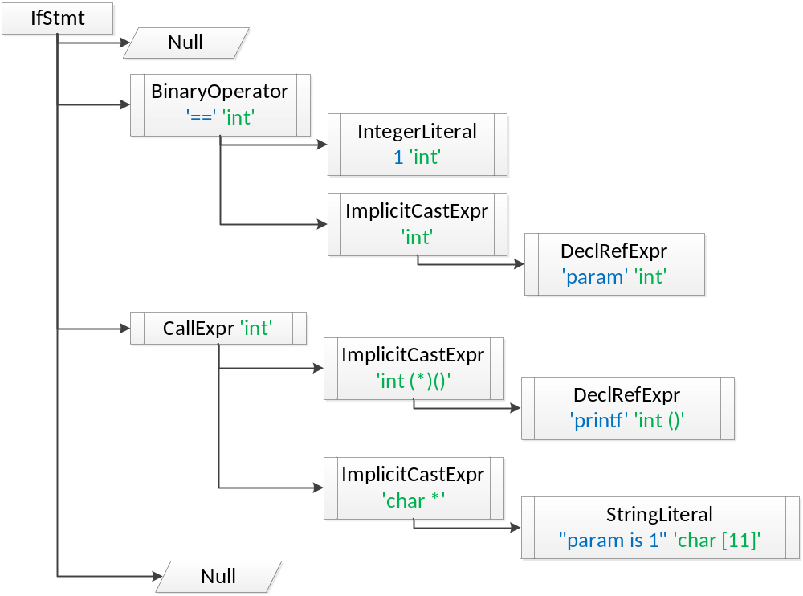
getBeginLoc() and getEndLoc()
getBeginLoc() returns the exact starting location of Stmt
getEndLoc() returns the location of Stmt that corresponds to the last-1 th token’s ending location of Stmt
  To get correct end location, you need to use Lexer class in addition
Example: getBeginLoc() and getEndLoc() results of IfStmt condition
The last token of IfStmt condition
getBeginLoc() points to
if (param == 1)
getEndLoc() points to the end of “==“ not “1”

Slide 10
SourceLocation getLocWithOffset( int offset )
// Ex. Logging Caller -> Callee function calls
bool insertProbe(const CallExpr *ce, std::string calleeName) {
// x = f(a,b); is modified as follows:
// x = (printf(“%s,%s\n”,CallerFuncName,calleeName)? f(a,b):0);
std::string probeFront = "(printf(\"%s,%s\\n\",\"“
+CallerFuncName + "\",\"" + calleeName + "\")?";
std::string probeBack= ": 0)";
MyRewriter.InsertTextAfter(ce->getBegintLoc(), probeFront);
SourceLocation funEndLoc = ce->getEndLoc().getLocWithOffset(1);
MyRewriter.InsertTextAfter(funEndLoc, probeBack);
return true;
}

Slide 11
References
Clang, http://clang.llvm.org/
Clang API Documentation, http://clang.llvm.org/doxygen/
How to parse C programs with clang: A tutorial in 9 parts, http://amnoid.de/tmp/clangtut/tut.html
  this tutorial may use deprecated/outdated Clang APIs

Slide 12
Appendix: Example Source Code (1/5)
This program prints the name of declared functions, statements and the class name of each Stmt in function bodies
1
2
3
4
5
6
7
8
9
10
11
12
13
14
15
16
17
18
19
20
21
22
23
24
25
26
27
28
29
30
31
// PrintFunction.cpp
#include <cstdio>
#include <string>
#include <iostream>
#include <sstream>
#include <fstream>
#include "clang/AST/AST.h"
#include "clang/AST/ASTConsumer.h"
#include "clang/AST/RecursiveASTVisitor.h"
#include "clang/Frontend/ASTConsumers.h"
#include "clang/Frontend/CompilerInstance.h"
#include "clang/Frontend/FrontendActions.h"
#include "clang/Rewrite/Core/Rewriter.h"
#include "clang/Tooling/CommonOptionsParser.h"
#include "clang/Tooling/Tooling.h"
#include "llvm/Support/raw_ostream.h"
using namespace clang;
using namespace clang::driver;
using namespace clang::tooling;
using namespace std;
static llvm::cl::OptionCategory MyOptionCategory("MyOptions");
static llvm::cl::opt<std::string> OutputFilename("o",
llvm::cl::desc("Specify output filename that contains stmt:type"),
llvm::cl::value_desc("output_filename"), llvm::cl::cat(MyOptionCategory));
LangOptions MyLangOpts;
SourceManager *ptrMySourceMgr;
Rewriter MyRewriter;

Slide 13
Appendix: Example Source Code (2/5)
33
34
35
36
37
38
39
40
41
42
43
44
45
46
47
48
49
50
51
52
53
54
55
56
class MyASTVisitor : public RecursiveASTVisitor<MyASTVisitor> {
public:
MyASTVisitor() {}
bool VisitStmt(Stmt *s) {
// Print a current statement and its type
std::string str1;
llvm::raw_string_ostream os(str1);
s->printPretty(os, NULL, MyLangOpts);
llvm::outs() << "-----------------\n";
llvm::outs() << os.str() << "\n";
llvm::outs() << "TYPE:" << s->getStmtClassName() << "\n";
return true;
}
bool VisitFunctionDecl(FunctionDecl *f) { // Print function name
llvm::outs() << "*********************************\n";
llvm::outs() << "*** FUNCTION NAME:" << f->getName() << '\n';
llvm::outs() << "*********************************\n";
return true;
}
};
The core part of
PrintFunctions.cpp

Slide 14
Appendix: Example Source Code (3/5)
57
58
59
60
61
62
63
64
65
66
67
68
69
70
71
class MyASTConsumer : public ASTConsumer {
public:
MyASTConsumer(): Visitor() {} //initialize MyASTVisitor
virtual bool HandleTopLevelDecl(DeclGroupRef DR) {
for (DeclGroupRef::iterator b = DR.begin(), e = DR.end(); b != e; ++b) {
// Travel each function declaration using MyASTVisitor
Visitor.TraverseDecl(*b);
}
return true;
}
private:
MyASTVisitor Visitor;
};

Slide 15
Appendix: Example Source Code (4/5)
73
74
75
76
77
78
79
80
81
82
83
84
85
86
87
88
89
class MyFrontendAction : public ASTFrontendAction {
public:
MyFrontendAction() {}
void EndSourceFileAction() override { // Fill out if necessary
}
std::unique_ptr<ASTConsumer> CreateASTConsumer(
CompilerInstance &CI, StringRef file) override {
MyLangOpts = CI.getLangOpts();
ptrMySourceMgr= &(CI.getSourceManager());
MyRewriter= Rewriter(*ptrMySourceMgr, MyLangOpts);
return std::make_unique<MyASTConsumer>();
}
};

Slide 16
Appendix: Example Source Code (5/5)
91
92
93
94
95
96
97
98
99
100
101
102
103
104
105
106
107
108
109
110
111
112
113
114
115
116
117
118
int main(int argc, const char **argv) {
auto cop = CommonOptionsParser::create(argc, argv, MyOptionCategory);
if (!cop) {
llvm::errs() << "error: can't parse command line arguments\n";
return 1;
}
ClangTool Tool(cop->getCompilations(), cop->getSourcePathList());
// ClangTool::run accepts a FrontendActionFactory, which is then used to
// create new objects implementing the FrontendAction interface. Here we use
// the helper newFrontendActionFactory to create a default factory that will
// return a new MyFrontendAction object every time.
// To further customize this, we could create our own factory class.
// AST Parsing
int rtn_flag = Tool.run(newFrontendActionFactory<MyFrontendAction>().get());
/* //
// Rewriter sample. Save changed target code into output.txt if any
const RewriteBuffer *RewriteBuf = MyRewriter.getRewriteBufferFor
((*ptrMySourceMgr).getMainFileID());
ofstream out_file ("output.txt");
out_file << string(RewriteBuf->begin(), RewriteBuf->end());
out_file.close();
*/
return rtn_flag;
}

Slide 17
Appendix: Output on example.c (1/2)
*********************************
*** FUNCTION NAME:main
*********************************
-----------------
{
int param = 1;
myPrint(param);
return 0;
}
TYPE:CompoundStmt
-----------------
int param = 1;
TYPE:DeclStmt
-----------------
1
TYPE:IntegerLiteral
-----------------
myPrint(param)
TYPE:CallExpr
-----------------
myPrint
TYPE:ImplicitCastExpr
-----------------
myPrint
TYPE:DeclRefExpr
-----------------
param
TYPE:ImplicitCastExpr
...
//clang_example.c
#include <stdio.h>
int global;
void myPrint(int param) {
if (param == 1)
printf("param is 1");
for (int i = 0 ; i < 10 ; i++ ) {
global += i;
}
}
int main(int argc, char *argv[]) {
int param = 1;
myPrint(param);
return 0;
}

Slide 18
Appendix: Output on example.c (2/2)
*********************************
*** FUNCTION NAME:myPrint
*********************************
-----------------
{
if (param == 1)
printf("param is 1");
for (int i = 0; i < 10; i++) {
global += i;
}
}
TYPE:CompoundStmt
-----------------
if (param == 1)
printf("param is 1");
TYPE:IfStmt
-----------------
param == 1
TYPE:BinaryOperator
-----------------
param
TYPE:ImplicitCastExpr
-----------------
param
TYPE:DeclRefExpr
-----------------
1
TYPE:IntegerLiteral
-----------------
printf("param is 1")
TYPE:CallExpr
-----------------
printf
TYPE:ImplicitCastExpr
-----------------
printf
TYPE:DeclRefExpr
-----------------
"param is 1"
TYPE:ImplicitCastExpr
-----------------
"param is 1"
TYPE:StringLiteral
-----------------
for (int i = 0; i < 10; i++) {
global += i;
}
TYPE:ForStmt
-----------------
int i = 0;
TYPE:DeclStmt
-----------------
0
TYPE:IntegerLiteral
-----------------
i < 10
TYPE:BinaryOperator
-----------------
i
TYPE:ImplicitCastExpr
-----------------
i
TYPE:DeclRefExpr
-----------------
10
TYPE:IntegerLiteral
-----------------
i++
TYPE:UnaryOperator
-----------------
i
TYPE:DeclRefExpr
…

