Slide 1
Software Model Checking
Moonzoo Kim

Slide 2
Operational Semantics of Software
σ₁
σ₂
σ₃
A system has its semantics as a set of system executions σ’s
A system execution σ is a sequence of states s₀s₁…
A state has an environment ρ_{s}:Var-> Val
x:0,y:0
s₀
x:0,y:1
s₁
x:1,y:2
x:5,y:1
s₂
s₁₁
x:1,y:3
x:5,y:2
s₃
s₁₂
x:2,y:4
x:5,y:3
x:7,y:3
s₄
s₁₃
s₂₁
x:5,y:4
x:7,y:4
s₁₄
s₂₂
Notes:
We view the program execution as a sequence of states. A state consists of variable environment rho and time stamp t. This viewpoint states that information of program remains between two consecutive states.
Furthermore, a state in the execution indicates that something happens at the time instant corresponding to the state.
As the execution has more states, more computational resource is required to analyze the execution. Therefore, to reduce the overhead, if possible, we need to abstract out unnecessary states in terms of properties. For example, for property p, we don’t need variable x. Thus removing states …
Furthermore, not every value of y is important because only s0 and s6 affects the property. Thus, we might want to remove states s1-s5. We will discuss this abstraction in more detail later

Slide 3
Example
active type A() {
byte x;
again:
x=x+1;;
goto again;
}
x:0
x:1
x:2
x:255
active type A() {
byte x;
again:
x=x+1;;
goto again;
}
active type B() {
byte y;
again:
y++;
goto again;
}
x:0,y:0
x:0,y:1
x:0,y:255
x:1,y:0
x:1,y:1
x:1,y:255
x:2,y:0
x:2,y:1
x:2,y:255
x:255,y:0
x:255,y:255
Note that model checking analyzes ALL possible execution scenarios while testing analyzes SOME execution scenarios

Slide 4
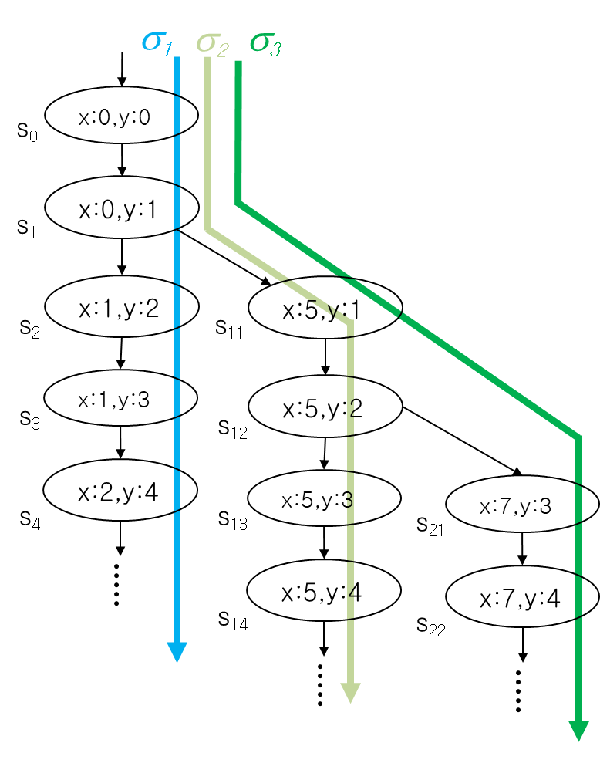
Bug Detection vs. Verification
Bug detection (testing):
a given assert statement (at a given code location) is violated
proof: for a some execution like σ₁, a given assert is violated
ex. σ₁ violates the assert( 2x != y) at s₂ and s₄
Verification (model checking):
a given assert statement will be never violated (i.e., always satisfied)
proof: for every possible execution σ₁, σ₂, σ₃, and so on, a given assert is satisfied
ex. there is no execution σ such that assert( x >= 0) is violated.

Slide 5
Verification: State Exploration Method
Model checking
Generate possible states from the model/program and then check whether given requirement properties are satisfied within the state space
On-the-fly v.s. generates all
Symbolic states v.s. explicit state
Model based v.s. code based
System
model
OK
Model Checking
(state exploration)
or
Requirement
properties
Counter
example
(Φ Ω)

Slide 6
Pros and Cons of Model Checking
Pros
Fully automated and provide complete coverage
Concrete counter examples
Full control over every detail of system behavior
Highly effective for analyzing
embedded software
multi-threaded systems
Cons
State explosion problem
An abstracted model may not fully reflect a real system
Needs to use a specialized modeling language
Modeling languages are similar to programming languages, but simpler and clearer

Slide 7










Companies Working on Model Checking

Slide 8

Model Checking History
1981 Clarke / Emerson: CTL Model Checking Sifakis / Quielle
1982 EMC: Explicit Model Checker Clarke, Emerson, Sistla
1990 Symbolic Model Checking
Burch, Clarke, Dill, McMillan
SMV: Symbolic Model Verifier
McMillan
1998 Bounded Model Checking using SAT
Biere, Clarke, Zhu
2000 Counterexample-guided Abstraction Refinement
Clarke, Grumberg, Jha, Lu, Veith
10⁵
10¹⁰⁰
10¹⁰⁰⁰

Slide 9
Example. Sort (1/2)
Suppose that we want to verify sort(unsigned char* a) on an array of 5 elements each of which is 1 byte long
unsigned char a[5]; // 40 bits
We wants to verify if sort() works correctly on every unsigned char array a[5]
a) Hash table based explicit model checker (ex. Spin) generates at least 2⁴⁰ (= 10¹² = 1 Tera) states
1 Tera states x 1 byte = 1 Tera byte memory required, no way…
b) Binary Decision Diagram (BDD) based symbolic model checker (ex. NuSMV) takes 100 MB in 100 sec on Intel Xeon 5160 3Ghz machine
c) Bounded model checker (i.e., CBMC) takes less than 100 MB in 1 sec
9
14
2
200
64
main() {
assign all possible values to a;
sort(a);
assert(a[0]<=a[1]<=a[2]<=a[3]<=a[4]);}

Slide 10
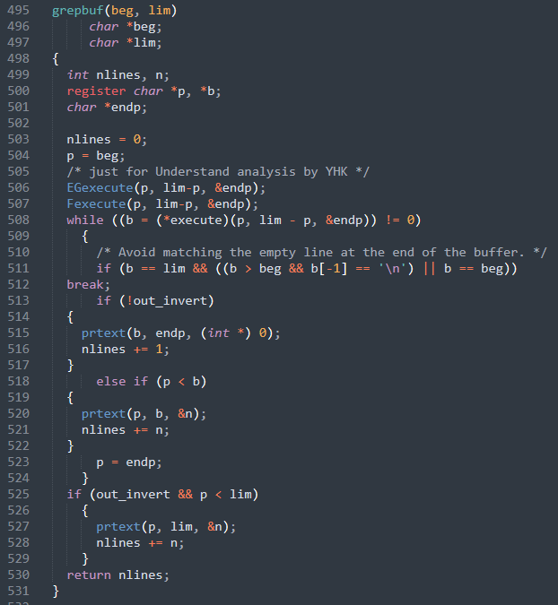
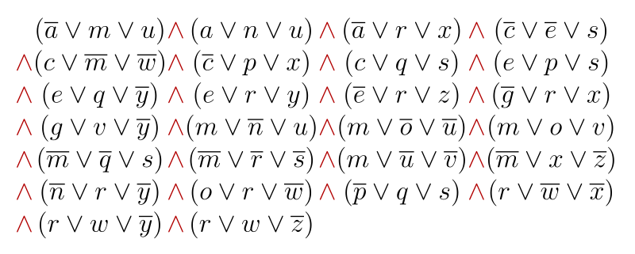
Bounded Model Checking
Boolean logic formula
(propositional logic)
A key idea: representing every (bounded) execution path as a pure Boolean logic formula
C program source code
Notes:
https://sabhijit.medium.com/logic-puzzles-and-sat-solvers-a-match-made-in-heaven-5e0a7a64c04b

Slide 11
Overview of SAT-based Bounded Model Checking
Requirements
C Program
Requirements
↓
↓
↓
Formal Requirement Properties
Abstract Model
Formal Requirement Properties in C
(ex. assert( x < a[i]); )
C Program
(Φ Ω)
Model Checker
Translation to SAT formula
Satisfied
SAT Solver
Not satisfied
Okay
Counter example
The formula is unsatisfiable
The formule is satisfiable
No bug
Counter example

Slide 12
Example. Sort (2/2)
1. #include <stdio.h>
2. #define N 5
3. int main {
4. unsigned char data[N], i, j, tmp;
5. /* Assign random values to the array*/
6. for (i=0; i<N; i++){
7. data[i] = nondet_int();
8. }
9. /* It misses the last element, i.e., data[N-1]*/
10. for (i=0; i<N-1; i++)
11. for (j=i+1; j<N-1; j++)
12. if (data[i] > data[j]){
13. tmp = data[i];
14. data[i] = data[j];
15. data[j] = tmp;
16. }
/* Check the array is sorted */
18. for (i=0; i<N-1; i++){
19. assert(data[i] <= data[i+1]);
20. }
21. }
SAT-based Bounded Model Checker (CBMC v 5.11) converts the (fixed version) of the left code to a Boolean formula
Total 2277 CNF clause with 905 boolean propositional variables
Theoretically, 2⁹⁰⁵ choices should be evaluated!!!
N | Exec time (CBMC 5.11 on i5-9600K ) | Mem | # of var | # of clause
10 | 50 sec | 43 M | 2,895 | 9,382
20 | 1317 sec | 150 M | 10,175 | 37,842
40 | 2 hours | 900 M | 37,935 | 151,762
100 | 40 hours | 18 GB | 226,815 | 949,522
Notes:
N=100. After 40 hours error occurs

Slide 13
SAT Basics (1/3)
SAT = Satisfiability = Propositional Satisfiability
NP-Complete problem
We can use SAT solver for many NP-complete problems
Hamiltonian path
3 coloring problem
Traveling sales man’s problem
Recent interest as a verification engine
SAT
Propositional
Formula
SAT problem
UNSAT

Slide 14
SAT Basics (2/3)
A set of propositional variables and Conjunctive Normal Form (CNF) clauses involving variables
(x₁ v x_{2’} v x₃) ∧ (x₂ v x_{1’} v x₄)
x₁, x₂, x₃ and x₄ are variables (true or false)
Literals: Variable and its negation
x₁ and x₁’
A clause is satisfied if one of the literals is true
x₁=true satisfies clause 1
x₁=false satisfies clause 2
Solution: An assignment that satisfies all clauses

Slide 15
SAT Basics (3/3)
º | x₁ | x₂ | x₃ | x₄ | f
º₁ | T | T | T | T | T
º₂ | T | T | T | F | T
º₃ | T | T | F | T | T
º₄ | T | T | F | F | T
º₅ | T | F | T | T | T
º₆ | T | F | T | F | F
º₇ | T | F | F | T | T
º₈ | T | F | F | F | F
º₉ | F | T | T | T | T
º₁₀ | F | T | T | F | T
º₁₁ | F | T | F | T | F
º₁₂ | F | T | F | F | F
º₁₃ | F | F | T | T | T
º₁₄ | F | F | T | F | T
º₁₅ | F | F | F | T | T
º₁₆ | F | F | F | F | T
DIMACS SAT Format
Ex. (x₁ ∨ x₂’ ∨ x₃)
∧ (x₂ ∨ x₁’ ∨ x₄)
Model/
solution
p cnf 4 2
1 -2 3 0
2 -1 4 0

Slide 16
Model Checking as a SAT problem (1/6)
Control-flow simplification
All side effect are removed
i++ => i=i+1;
Control flow is made explicit
continue, break => goto
Loop simplification
for(;;), do {…} while() => while()

Slide 17
Model Checking as a SAT problem (2/6)
Unwinding Loop
Original code
Unwinding the loop 2 times
Unwinding the loop 3 times
x=0;
while(x < 2){
y=y+x;
x=x+1;;
}
x=0;
if (x < 2) {
y=y+x;
x=x+1;;
if (x < 2) {
y=y+x;
x=x+1;;
}}
/* Unwinding assertion */
assert(!(x < 2))
x=0;
if (x < 2) {
y=y+x;
x=x+1;;
if (x < 2) {
y=y+x;
x=x+1;;
if (x < 2) {
y=y+x;
x=x+1;;
}}}
/*Unwinding assertion*/
assert (! (x < 2))
Unwinding the loop 1 times
x=0;
if (x < 2) {
y=y+x;
x=x+1;;
}
/* Unwinding assertion */
assert(!(x < 2))

Slide 18
Ex. Constant # of Loop Iterations
/*# of loop iter. is constant*/
for(i=0,j=0; i < 5; i++) {
j=j+i;
}
/* Complex but still constant # of loop iterations */
for(i=0; i < 5; i++) {
for(j=i; j < 5;j++) {
for(k= i+j; k < 5; k++) {
m += i+j+k;
}
}
}
/*# of loop iter. is constant*/
for(i=0,j=0; j < 10; i++) {
j=j+i;
}
/* # of loop iter. Is unknown */
for(i=0,j=0; i^6-4*i^5 -17*i^4 != 9604 ; i++) {
j=j+i;
}

Slide 19
Ex. Variable # of Loop Iterations Depending on Input
/* x: unsigned integer input
It iterates 0 to 2³²-1 times*/
for(i=0,j=0; i < x; i++) {
j=j+i;
}
/* j: unsigned integer input */
for(i=0; j < 10; i++) {
j=j+i;
}
/* a: unsigned integer array input */
for(i=0,sum=0; (i<2) || (sum<10) ;i++) {
sum += a[i];
}
/* Minimum # of iteration? Maximum # of iteration? */

Slide 20
Model Checking as a SAT problem (3/6)
From C Code to SAT Formula
Original code
Static single assignment (SSA)
x=x+y;
if (x!=1)
x=2;
else
x=x+1;
x₁==x₀+y₀;
if (x₁!=1)
x₂==2;
else
x₃==x₁+1;
Every feasible execution scenario of the original code has its corresponding solution of P and vice versa.
Generate SSA constraint of the original code:
P ≡ x₁==x₀+y₀
∧ x₂==2 ∧ x₃==x₁+1
Note that solutions/models of P represent feasible execution scenarios of the original code
Ex1. W/ initial values x=1 and y=0, x becomes 2 at the end.
See that P is true w/ the following corresponding solution (x₀,x₁,x₂,x₃,y₀) = (1,1,2,2,0)
Ex2. See that P is false w/ (x₀,x₁,x₂,x₃,y₀) = (1,1,2,3,0).
Note that no corresponding execution scenario of the original code

Slide 21
Model Checking as a SAT problem (4/6)
From C Code to SAT Formula
Original code
Convert to static single assignment (SSA)
x₁==x₀+y₀;
if (x₁!=1)
x₂==2;
else
x₃==x₁+1;
x₄==(x₁!=1)?x₂:x₃;
assert(x₄<=3);
x=x+y;
if (x!=1)
x=2;
else
x=x+1;
assert(x<=3);
Generate constraints
P ≡ x₁==x₀+y₀ ∧ x₂==2 ∧ x₃==x₁+1 ∧ ((x₁!=1∧x₄==x₂)∨(x₁==1∧x₄==x₃))
A ≡ x₄ <= 3
Check if P ∧ ¬ A is satisfiable.
If it is satisfiable, the assertion is violated (i.e., the program is buggy w.r.t A)
If it is unsatisfiable, the assertion is never violated (i.e., program is correct w.r.t. A)
Question: Why not P ∧ A but P ∧ ¬ A?

Slide 22
Model Checking as a SAT problem (5/6)
Original code
Convert to static single assignment (SSA)
x₁==x₀+y₀;
if (x₁!=1)
x₂==2;
else
x₃==x₁+1;
x₄==(x₁!=1)?x₂:x₃;
assert(x₄<=3);
1:x=x+y;
2:if (x!=1)
3: x=2;
4:else
5: x=x+1;;
6:assert(x<=3);
P ≡ x₁==x₀+y₀ ∧ x₂==2 ∧ x₃==x₁+1 ∧ ((x₁!=1∧x₄==x₂)∨(x₁==1∧x₄==x₃))
A ≡ x₄ <= 3
Observations on the code
1. An execution scenario starting with x==1 and y==0 satisfies the assert
2. The code is correct (i.e., no bug w.r.t. A)
-case 1: x==1 at line 2=> x==2 at line 6
-case 2: x!=1 at line 2 => x==2 at line 6
Observations on the P
A solution of P which assigns every free variable with a value and makes P true satisfies A
- ex. (x₀:1,x₁:1,x₂:2,x₃:2,x₄:2,y₀:0)
2. Every solution of P represents a feasible execution scenario
3. P ∧ ¬A is unsatisfiable because every solution has x₄ as 2

Slide 23
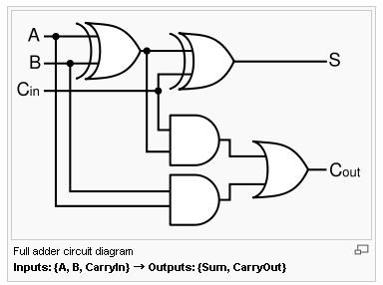
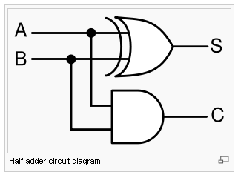
Model Checking as a SAT problem (6/6)
Finally, P ∧ ¬ A is converted to Boolean logic using a bit vector
representation for the integer variables y₀,x₀,x₁,x₂,x₃,x₄
Example of arithmetic encoding into pure propositional formula
Assume that x,y,z are three bits positive integers represented by
propositions x₀x₁x₂, y₀y₁y₂, z₀z₁z₂
P ≡ z=x+y ≡ (z₀$(x₀©y₀)©( (x₁Æy₁) Ç (((x₁©y₁)Æ(x₂Æy₂)))
Æ (z₁$(x₁©y₁)©(x₂Æy₂))
Æ (z₂$(x₂©y₂))

Slide 24
Example
/* Assume that x and y are 2 bit unsigned integers */
/* Also assume that x+y <= 3 */
void f(unsigned int y) {
unsigned int x=1;
x=x+y;
if (x==2)
x+=1;
else
x=2;
assert(x ==2);
}

Slide 26
Advanced Issues on Bounded Model Checking

Slide 27
Model checking (MC) v.s. Bounded model checking (BMC)
Target program is finite.
But its execution is infinite
MC targets to verify infinite execution
Fixed point computation
Liveness property check : <> f
Eventually, some good thing happens
Starvation freedom, fairness, etc
BMC targets to verify finite execution only
No loop anymore in the target program
Subset of the safety property (practically useful properties can still be checked)
assert() statement
a
b
c
a.b.c.a.b.c.a.b.c…

Slide 28
f_{ex} = σ₁∨σ₂…∨σ_{n}
x1==x0+y0
∧ x2==2
∧ x3==x1+1
α₁
σ_{n}
σ₁
σ₂
σ_{n}
β₁
β₂
x1 !=1
∧ x4==x2
x1==1
∧ x4==x3
σ₁=α₁∧β₂ σ₂=α₁∧β₂
Note that a whole execution tree (i.e. all target program executions) can be represented as a single SSA formulae.
A whole execution tree can be represented as a disjunction of SSA formulas each of which represents an execution (i.e. f_{ex} = ∨ σ_{i} ) since ∨ represents different worlds/scenarios.
Each execution can be represented as a SSA formula (saying σ_{i} )
Each execution can be represented using ∧ and ∨ for corresponding execution segments

Slide 29
Warning: # of Unwinding Loop (1/2)
1:void f(unsigned int n) { // n can be any number
2: int i,x;
3: for(i=0; i < 2+ n%7; i++) {
4: x = x/ (i-5);// div-by-0 bug
5: }//assert(!(i<2+n%7)) or __CPROVER_assume(!(i<2+n%7))
6:}
Q: What is the maximum # of iteration?
A: n_{max}=8
What will happen if you unwind the loop more than n_{max} times?
What will happen if you unwind the loop less than n_{max} times?
What if w/ unwinding assertion assert(!(i <2+n%7))?
What if w/o unwinding assertion?
What if w/ __cprover_assume((!(i <2+n%7)))?
What is the minimum # of iterations?
A: n_{min} =2
What will happen if you unwind the loop less than n_{min} times?

Slide 30
Warning: # of Unwinding Loop (2/2)
1:void f(unsigned int n) {
2: int i,x;
3: for(i=0; i < 2+ n%7; i++) {
4: x = x/ (i-5);// div-by-0 bug
5: }//assert(!(i<2+n%7)) or __CPROVER_assume(!(i<2+n%7))
6:}
--unwind 8
Target system
exec. scenarios to analyze
--unwind 6
Note that a bug usually causes a failure even in a small # of loop iteration because a static fault often affects all dynamic execution scenarios
(a.k.a., small world hypothesis in model checking)
--unwind 4
--unwind 1 ???
σ₁
σ₂
σ_{n}

