Slide 1

Unit Testing of Flash Memory Device Driver through a SAT-based Model Checker
Moonzoo Kim and Yunho Kim
Provable Software Lab, CS Dept, KAIST
Hotae Kim
Samsung Electronics, South Korea

Slide 2



Summary of the Talk
File
System
Demand
Paging
Manager
Unified
Storage
Platform
Sector
Translation
Flash
Translation Layer
OS
Adapt-
ation
Module
Block
Management
Low Level
Device Driver
OneNAND® Flash Memory Devices
In 2007, Samsung requested to debug the device driver for the OneNAND™ flash memory
We reviewed the requirement specifications, the design documents, and C code to identify code-level properties to check.
Then, we applied CBMC (C Bounded Model Checker) to check the properties
Found several bugs
Provided high confidence in multi-sector read operation through exhaustive exploration
Notes:
Two problems of model checking
Scalability
Separate model construction

Slide 3
Overview
Background
Logical-to-physical sector translation
Overview of the Unified Storage Platform (USP)
SAT-based model checking technique
Identification of properties to check
High-level requirements
Code-level properties
Unit analysis result through CBMC
Prioritized read operation (PRO)@ Demand Paging Manager (DPM)
Semaphore matching (SM)@ Block Management Layer (BML)
Semaphore exception handling (SEH)@ STL~BML
Multi-sector read operation (MSR) @ Sector Translation Layer (STL)
NuSMV : BDD-based model checker
Spin: Explicit model checker
CBMC: C-bounded model checker
Lessons learned and conclusion

Slide 4
Logical to Physical Sector Mapping
1:N mapping from a LUN to PUNs
Sector Allocation Map (SAM)
In flash memory, logical data are distributed over physical sectors.
Sector mapping
Notes:
Each logical unit is mapped to a linked list of physical units because one logical sector may consume several physical sectors through updates. So there is 1:N mapping from a logical unit to physical units. A simple sector mapping example is as follows. First logical unit has an empty physical unit. A new logical sector, LS0, is written in the physical sector0. Similarly LS1 is written in LS1. Then when LS1 is updated, PS1 is invalidated and LS1 is written in PS2 and so on. Sector allocation map keeps the Logical sector to physical sector mapping. SAM have information what physical sector stores a given logical sectors. for example when we read logical sector 0, then we find the physical sector offset from the logical sector offset 0 from SAM. If the physical offset is empty, then read operation traverse a linked list until find a physical offset or traverse all physical sector in a linked list.

Slide 5
Overview of the OneNAND® Flash Memory
Characteristics of OneNAND® flash
Each memory cell can be written limited number of times only
Logical-to-physical sector mapping
Bad block management
Wear-leveling
XIP by emulating NOR interface through demand-paging scheme
Multiple processes access the device concurrently
Urgent read operation should have a higher priority
Synchronization among processes is crucial
Performance enhancement
Multi-sector read/write
Asynchronous operations
Deferred operation result check
App₁
App₂
App₃
Source:
Software Center
of Samsung
Electronics ‘06
File
System
Demand
Paging
Manager (DPM)
PRO
Unified
Storage
Platform
‘08 Spin Workshop
MSR
Flash
Translation Layer
OS
Adapt-
ation
Module
Sector
Translation (STL)
SEH
Block
Management (BML)
SM
Low Level (LLD)
Device Driver
OneNAND® Flash Memory Devices
5/20
Unit Testing of Flash Memory Device Driver through a SAT-based Model Checker
Moonzoo Kim et al. Provable SW Lab

Slide 6
C Bounded Model Checker (CBMC)
Handles function calls using inlining
Unwinds the loops a fixed number of times (bounded MC)
A user has to know a upper bound of each loop
Loops often have clear upper bounds
We can still get debugging result without upper bounds
Specifies constraints to describe an environment of the target program, which can model non-deterministic user inputs, or multiple scenarios
Ex. __CPROVER assume(0<=nDev && nDev<=7)
Ex.__CPROVER_assume( SHDC.nPhySctsPerUnit == SHPC.nBlksPerUnit * SHVC.nPgsPerBlk * SHVC.nSctsPerPg)
Checks properties by assertions
6/20
Unit Testing of Flash Memory Device Driver through a SAT-based Model Checker
Moonzoo Kim et al. Provable SW Lab

Slide 7
Project Overview
The goal of the project
To check whether USP conforms to the given high-level requirements
we needed to identify the code-level properties to check from the given high-level requirements
A top-down approach to identify the code level properties from high-level requirements
USP has a set of elaborated design documents
Software requirement specification (SRS)
Architecture design specification (ADS)
Detailed design specification (DDS)
DPM, STL, BML, and LLD

Slide 8
Three High-level Requirements in SRS
SRS specifies 13 functional requirements, 3 of which have “very high” priorities
Support prioritized read operation
To minimize the fault latency, USP should serve a read request from DPM prior to generic requests from a file system.
This prioritized read request can preempt a generic I/O operation and the preempted operation can be resumed later.
Concurrency handling
BML and LLD should avoid a race condition or deadlock through synchronization mechanisms such as semaphores and locks.
Manage sectors
STL provides logical-to-physical mapping, i.e. multiple logical sectors written over the distributed physical sectors should be read back correctly.

Slide 9
Top-down Approach to Identify Code-level Property
Concurrency handling
Prioritized
read
Multi-sector
read
Page Fault
Handler
Page Cache
Management
BML
LLD
: OneNAND
Device
SRS
MMU
1: issue page fault exception
2: request a free frame in page cache
Page fault handling while a device is being read
Page fault handling while a device is being programmed
If there is a free frame,
3: find a free frame
go to Step6.
4: find a victim page
ADS
5: page out the victim page
6: return the free fram
7: find a location where the page is stored in OneNAND device
Check “Step 14. wait until the device is ready ”
Check “Step 18. store the status”
8: request read operation
DDS
9: request read operation
10: Set the Preempted flag
Is the status really stored?
11: request the ready/busy status
In case of busy status
because of program
operation
12: return the ready/busy status
C
Code
At line 494 of PriRead() in LLD.c
assert(bNeedToSave->saved)
13: check if the device is ready
14: wait until the device is ready
Legend
15: check the NeedToSave flag
Spec. in the
design docs
User defined
property to check
16: request the operation status
17: return the operation status
18: store the status
Total 43 code-level properties are identified
A sequence diagram of page fault handling
while a device is being programmed in LLD DDS

Slide 10
Results of Unit Testings
Prioritized read operation
Detected a bug of not saving the status of suspended erase operation
Concurrency handling
Confirmed that the BML semaphore was used correctly
Detected a bug of ignoring BML semaphore exceptions
Multi-sector read operation (MSR)
Provided high assurance on the correctness of MSR, since no violation was detected even after exhaustive analysis (at least with a small number of physical units(~10))
Notes:
Note that bounds for most loops in USP can be obtained easily based on the physical characteristics of OneNAND device
E.g. # of sectors per a unit,

Slide 11
A Bug in PriRead()
374: VOID PriRead(Read(UINT32 nDev, UINT32 nPbn, UINT32 nPgOffset) {
…
416: if ((bEraseCmd==FALSE32) && (pstInfo->bNeedToSave==TRUE32)) {
417: pstInfo->nSavedStatus = GET_ONLD_CTRL_STAT(pstReg, ALL_STATE);
418: pstInfo->bNeedToSave = FALSE32;
419: saved=1; // added for verification purpose }
…
424: assert(!(pstInfo->bNeedToSave) || saved);
We added a flag saved to denote whether the status of the preempted operation is saved
CBMC detected the given assertion was violated when an erase operation was preempted
It takes 8 seconds and 325 Mb on the 3Ghz Xeon machine
CBMC 2.6 with MiniSAT 1.1.4
01:...
02:State 14 file LLD.c line 408 function PriRead thread 0
03: LLD::PriRead::1::bEraseCmd=1
04:State 15 file LLD.c line 412 function PriRead thread 0
05: LLD::PriRead::1::1::2::nWaitingTimeOut=…
06:State 17 file LLD.c line 412 function PriRead thread 0
07: LLD::PriRead::1::1::2::nWaitingTimeOut=…
08:...
09:Violated property:
10: file LLD.c line 424 function PriRead
11: assertion !(_Bool)pstInfo->bNeedToSave || (_Bool)saved
12:VERIFICATION FAILED

Slide 12
BML Semaphore Usage
The standard requirements for a binary semaphore
Semaphore acquire should be followed by a semaphore release
Every function should return with a semaphore released
unless the semaphore operation creates an exception error.
There exist 14 BML functions that use the BML semaphore.
We inserted an smp to indicate the status of the semaphore
and simple codes to decrease/increase smp at the corresponding semaphore operation.
CBMC concluded that all 14 BML functions satisfied the above two properties.
Consumes 10 seconds and 300 megabytes of memory on average to analyze each BML function

Slide 13
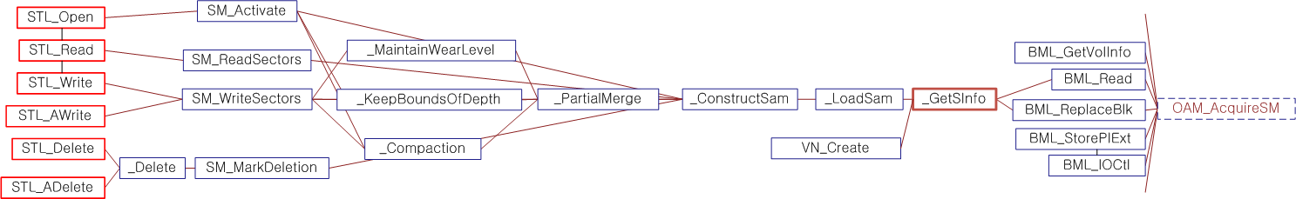
BML Semaphore Exception Handling (1/2)
Topmost STL functions
Bug detected
The BML semaphore operation might cause an exception depending on the hardware status.
Once such BML semaphore exception occurs, that exception should be propagated to the topmost STL functions to reset the file system
We checked this property by the following assert statement inserted before the return statement of the topmost STL functions:
assert(!(SMerr==1)||nErr==STL CRITICAL ERR)

Slide 14
BML Semaphore Exception Handling (2/2)
Topmost STL functions
Bug detected
CBMC analyzed a call graph of each of the topmost STL functions and detected that BML semaphore exception might not propagate due to bug at _GetSInfo()
The bug was detected when loop bound was set 2 with ignoring loop unwinding assertion.
Memory overflow occurred with the loop bound 3
For STL_Write(), this verification task consumed 616 megabytes of memory in 97 seconds
Each call sequence is around 1000 lines long on average.

Slide 15
Multi-sector Read Operation (MSR)
Assumptions:
- 1 Unit = 4 sectors=4 Bytes
- LU0: [LS0(‘A’),LS1(‘B’),LS2(‘C’),LS3(‘D’)]
- LU1: [LS4(‘E’),LS5(‘F’)]
a) LU0 is mapped to [PU0,PU1,PU2]
LU1 is mapped to [PU3,PU4]
b) LU0 is mapped to [PU2,PU1]
LU1 is mapped to [PU3,PU4]
LU0
LU1
LU0
LU1
LU0
LU1
LU0
LU1
SAM0~SAM4
PU0~PU4
SAM0~SAM4
PU0~PU4
Sector 0
Sector 1
Sector 2
Sector 3
1 |  |  | 0
 | 1 |  |  | 1
 | 2
 |  | 3
 |  |  | E
A | B |  |  | F
 | C
 |  | D
 | 3 |  |  | 3
0 |  |  | 2
3
 | 1
B
 | D
 |  |  | F
C | A |  |  | E
A distribution of “ABCDEF”
b) Another distribution of “ABCDEF”
MSR reads adjacent multiple physical sectors once in order to improve read speed
MSR is 157 lines long, but highly complex due to its 4 level loops
We built a small test environment for MSR
The test environment contains only upto 10 physical units
The test environment should follow constraints, which are described by _CPROVER_assume(Boolean exp) statement
SAM tables and PUs should correspond each other
For each logical sector, at least one physical sector that has the same value exists

Slide 16
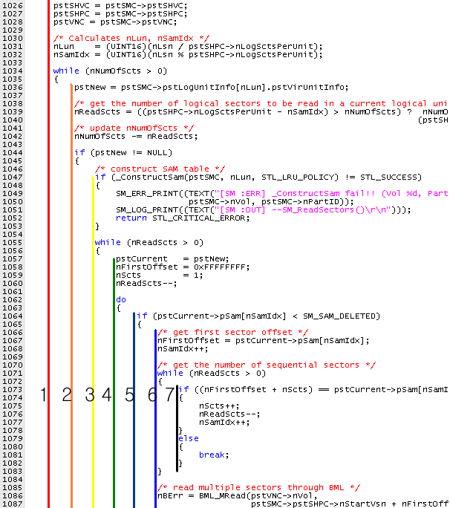
Multi-Sector Read Operations (MSR)
MSR reads consecutive physical sectors together for improving read performance
Statistics
157 lines long
4 level nested loops
4 parameters to specify logical data to read (from where, to where, how long, read flag )

Slide 17
Loop Structure of MSR
01:curLU = LU0;
02:while(numScts > 0 ) {
03: readScts = # of sectors to read in the current LU
04: while(readScts > 0 ) {
05: curPU = LU->firstPU;
06: while(curPU != NULL ) {
07: while(...) {
08: conScts = # of consecutive PS’s to read in curPU
09: offset = the starting offset of these consecutive PS’s in curPU
10: }
11: BML_READ(curPU, offset, conScts);
12: readScts = readScts - conScts;
13: curPU = curPU->next;
14: }
15: }
16: curLU = curLU->next;
17:}
Loop1: iterates over LUs until all data are read
Loop2: iterates until the current LU is read completely
Loop3: iterates over PUs linked to the current LU
Loop4: identify consecutive PS’s in the current PU
MSR reads consecutive physical sectors together for improving read performance
Statistics
157 lines long, 4 level nested loops
4 parameters to specify logical data to read (from where, to where, how long, read flag

Slide 18
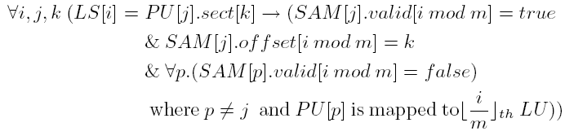
Environment Model
Environment model creation
The environment of MSR (i.e., PUs and SAMs configurations) can be described by invariant rules. Some of them are
One PU is mapped to at most one LU
Valid correspondence between SAMs and PUs:
If the i th LS is written in the k th sector of the j th PU, then the i th offset of the j th SAM is valid and indicates the k’th PS ,
Ex> 3rd LS (‘C’) is in the 3rd sector of the 2nd PU, then SAM1[2] ==2
i=2 k=2 j=1
3. For one LS, there exists only one PS that contains the value of the LS:
The PS number of the i th LS must be written in only one of the (i mod 4) th offsets of the SAM tables for the PUs mapped to the corresponding LU.
SAM0~SAM4
PU0~PU4
Sector 0
Sector 1
Sector 2
Sector 3
1 |  |  | 0
 | 1 |  |  | 1
 | 2
 |  | 3
 |  |  | E
A | B |  |  | F
 | C
 |  | D
Notes:
NuSMV is a symbolic model checker. Symbolic model checker represents a system model with a compact boolean formula. Because It does not store explicit state spaces, it is believed that symbolic model checker can handle large state space That is the reason why we use NuSMV first.
The modeling language of NuSMV is quite different from C. Therefore NuSMV model is quite long and hard to make. In our project, the most difficult and time consuming job is to make a NuSMV model. Moreover the verification performance is much worse than we expected.

Slide 19

Exponential Increase of Distribution Cases
n: # of physical units
l: # of logical sectors (<=8)
1 unit consists of 4 sectors

Slide 20
MSR Model Checking Results
Verification of MSR by using NuSMV, Spin, and CBMC
NuSMV: BDD-based symbolic model checker
Spin: Explicit model checker
CBMC: C-bounded model checker
The requirement property is to check
after_MSR -> (∀i. logical_sectors[i] == buf[i])
We compared these three model checkers empirically

Slide 21
Excerpts of the SMV Model
MODULE main
-- Variable declaration
VAR
SAM : array 0..4 of sam_type;
PU : array 0..4 of PU_type;
buf : array 0..4 of 0..5;
nScts : 0..5;
-- SPEC
INVARSPEC (after_first_do ->
PU[0].sect[0]=1 &
PU[0].sect[1]=2 &
PU[0].sect[2]=3 &
PU[0].sect[3]=4 &
PU[3].sect[0]=5)
init(buf[0]):=0;
-- if( pBuf==0 && 0 < nScts )
-- buf[0]= PU[PU_id].sect[nFirstOffset]
next(buf[0]):
case after_fourth_do :
case pBuf = 0 & 0 < nScts: -- i=0
case
PU_id=0 & nFirstOffset=0: PU[0].sect[0];
PU_id=0 & nFirstOffset=1: PU[0].sect[1];
PU_id=0 & nFirstOffset=2: PU[0].sect[2];
PU_id=0 & nFirstOffset=3: PU[0].sect[3];
…
PU_id=4 & nFirstOffset=3 : PU[4].sect[3];
esac;
esac;
init(buf[1]):=0;
next(buf[1]):= …

Slide 22
Verification Performance of NuSMV
Verification was performed on the machine equipped with Xeon5160 (3Ghz, 32Gbyte Memory), 64 bit Fedora Linux 7, NuSMV 2.4.3
The requirement property was proved correct for all the experiments (i.e., MSR is correct in this small model)
For 7 sectors long data that are distributed over 7 PUs consumes more than 11 hours while consuming only 550 mb memory

Slide 23
Excerpts of the Spin Model
active proctype SM_ReadSectors() {
byte buf[NUM_LS_USED];
byte nScts;
byte nFirstOffset;
byte nNumOfScts=NUM_LS_USED;
byte nReadScts=nNumOfScts;
byte nSamIdx;
do /* 1047: while (nNumOfScts >0) { */
:: nNumOfScts > 0 ->
PU_id = lui[nLun];
if /* nReadScts = ... */
:: (SECT_PER_U-nSamIdx)> nNumOfScts ->
nReadScts = nNumOfScts;
:: else->nReadScts =SECT_PER_U- nSamIdx;
fi;
nNumOfScts = nNumOfScts - nReadScts;
do /* line 1068: while (nReadScts > 0) */
:: (nReadScts > 0) -> PU_id = lui[nLun];
nFirstOffset=255;
nScts=1; nReadScts--;
do /* line 1075: do {... */
:: true;
if /* line 1077: if(pstCurrent->pSam[nSamIdx]...*/
:: SAM[PU_id].valid[nSamIdx]-> nFirstOffset = SAM[PU_id].offset[nSamIdx];nSamIdx++;
do /* line 1084:while (nReadScts > 0) { ...} */
:: (nReadScts > 0) ->
if
::FirstOffset+nScts==
SAM[PU_id].offset[nSamIdx] ->
nScts++;nReadScts--;nSamIdx++;
:: else-> break;
fi;
:: else->break;
od;
BML_MRead(PU_id,nFirstOffset,nScts,pBuf);
break;
:: else;
fi;
if /*line 1112: } while ( PU[PU_id].nil != true) */
:: PU[PU_id].nil -> break;
:: else;
fi;
PU_id++;
od;
}

Slide 24
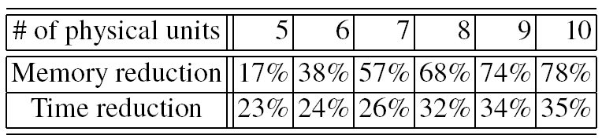
Verification Performance of Spin
(a) Time consumption
(b) Memory consumption
The requirement property was satisfied
The data abstraction technique shows significant performance improvement upto 78% of memory reduction and 35% time reduction (for 5 logical sectors data)

Slide 25
Modeling by CBMC
CBMC does not require an explicit target model creation
An environment for MSR was specified using assume statements and the environment model was similar to the environment model in NuSMV
For the loop bounds, we can get valid upper bounds from the loop structure and the environment setting
The outermost loop: L times (L is a # of LUs)
The 2nd outermost loop: 4 times (one LU contains 4 LS’s)
The 3rd outermost loop: M times
(M is a # of PUs)
The innermost loop: 4 times
(one PU contains 4 PS’s)
L=2, M=5
SAM0~SAM4
PU0~PU4
Sector 0
Sector 1
Sector 2
Sector 3
1 |  |  | 0
 | 1 |  |  | 1
 | 2
 |  | 3
 |  |  | E
A | B |  |  | F
 | C
 |  | D

Slide 26
Verification Performance of CBMC
(a) Time consumption
(b) Memory consumption
Exponential increase in both time and memory. However, the slope is much lower than those of NuSMV and Spin, which makes CBMC perform better for large problems
A problem of 10 PUs and 8 LS’s has 8.6x10⁵ variables and 2.9 x 10⁶ clauses.
Notes:
1.7x10⁵ conflicts, 10⁶ decisions, and 4.8x10⁹ propagations

Slide 27
Performance Comparison

Slide 28
Conclusion
We successfully applied CBMC to detect hidden bugs in the device driver for Samsung’s OneNAND flash memory
Also, we established confidence in the correctness of the complex MSR
Lessons learned
Software model checker as an effective unit testing tool
CBMC took modest amount of memory and time to detect bugs in USP
Exhaustive analysis can detect hidden bugs
Advantages of a SAT-based model checker
Analysis capability of whole ANSI-C
No abstract model required
We believe that a SAT-based model checker can be utilized effectively as a unit testing tool to complement conventional testing

Slide 30
001: VOID PriRead(Read(UINT32 nDev, UINT32 nPbn, UINT32 nPgOffset) {
…
if (GET_ONLD_INT_STAT(pstReg, PEND_INT) != PEND_INT) {
if ((nCmd==ONLD_CMD_ERASE_BLK) || (nCmd==ONLD_CMD_ERASE_RESUME)) {
/* Issue Erase suspend */
pstReg->nInt = (UINT16)INT_CLEAR;
pstReg->nCmd = (UINT16)ONLD_CMD_ERASE_SUSPEND;
408: bEraseCmd = TRUE32;
409: }
410:
411: /* Write, Read, and so on except Erase and Erase_Resume operation */
412: WAIT_ONLD_INT_STAT(pstReg, PEND_INT);
413:}
414:
419:if ((bEraseCmd == FALSE32) && (pstInfo->bNeedToSave == TRUE32)) {
420: pstInfo->nSavedStatus = GET_ONLD_CTRL_STAT(pstReg, ALL_STATE);
421: pstInfo->bNeedToSave = FALSE32;
420: saved=1; // added by user for verification purpose
423:}
424: assert(!(pstInfo->bNeedToSave) || saved);
…

