Slide 1


Industrial Application of Concolic Testing on Embedded Software: Case Studies
Moonzoo Kim¹, Yunho Kim¹, and Yoonkyu Jang²
Provable SW Lab, KAIST¹, Samsung Electronics²
South Korea
Notes:
Thanks you for coming. My name is Yunho Kim, from KAIST, South Korea. I will present the paper ~~ . This is joint work of KAIST and Samsung Electronics.

Slide 2
Contents
Motivation and overview of the concolic testing
Project scope
Case studies of concolic testing application
Case 1: Samsung Linux Platform file manager
Case 2: Samsung Security Library
Case 3: Busybox ls utility
Lessons learned
Conclusion
Notes:
Here are brief contents of this presentation. First I give you a motivation and scope of this project. Then I will explain details of case study. We conduct three case studies for this project, but I will present two of them in this presentation. For the other case study, please read our paper. Finally, I will conclude my presentation with lessons learned from this project and conclusion.

Slide 3
Weakness of Conventional Testing for Software
Current industrial practice forces a human engineer to generate test cases manually
Poor effectiveness
SW bugs usually exist in corner cases hard to expect
Easy to miss testing for exception handling of embedded HW failures
Poor efficiency due to labor intensive technique
Hard to generate a sufficient # of test cases in a given amount of project time
Notes:
Nowadays, embedded SW is widely used in our life, from big, safety-critical systems such as avionics, train control system, to our commodity mobile devices like mobile phones, tablet and so on. As the use of embedded software is increasing, the importance of reliability of embedded software is also increasing because embedded sw failure can damage human life, economics, and so on . However, conventional software testing that is a main technique to achieve reliability of embedded SW has a weakness that software testing is not yet much automated. Even though running software test cases is well automated in current industrial practice, writing software test cases is still performed by human engineers manually. Therefore, current testing practice makes software testing ineffective and inefficient. In effectiveness perspective, SW bugs are usually found in corner cases hard to expect for human engineers. In addition, for embedded SW it is easy to miss testing for exception handling of embedded HW failures because such failures occur rarely. In efficiency perspective, manually writing SW test cases is labor intensive technique, so it is hard for human engineers to generate a sufficient # of TCs in a limited amount of project time. Therefore, the needs of automated test case generation is increasing in industries.

Slide 4
Concolic Testing
Combine concrete execution and symbolic execution
Concrete + Symbolic = Concolic
Automated test case generation technique
Execute a target program on automatically generated test inputs
All possible execution paths are to be explored
Higher branch coverage than random testing
Notes:
To automate test case generation, concolic testing technique a.k.a dynamic symbolic execution was developed. Concolic testing is a combined approach of dynamic concrete analysis and static symbolic analysis. Concrete execution over a concrete input guides symbolic execution, and the symbolic execution is used to generate further concrete test cases automatically. In this way, concolic testing can generate test cases to explore all possible execution paths and achieve higher branch coverage than random testing. Thus, industries including Samsung electronics have interest in concolic testing and we performed this project.

Slide 5
Project Scope
A pilot project to investigate the practical application of concolic testing techniques
To investigate the effectiveness and efficiency of concolic testing techniques (also, challenges to overcome)
Our team consists of 1 professor, 1 Ph.D. student, and 1 Samsung Electronics senior engineer
Total man-month: 2 persons * 1 month
Target programs we tested
Samsung Linux Platform(SLP) file manager(18 KLOC, 85 functions)
Samsung security library(8 KLOC, 62 functions)
Busybox ls utillity(1.1 KLOC, 16 functions)
We used CREST as a concolic testing tool for target C programs
Notes:
This project is a pilot project to investigate the practical application of concolic testing technique for real-world embedded SW testing.
We applied concolic testing technique to real-world embedded sw testing and investigated the effectiveness and efficiency of concolic testing. in addition, we identified several challenges to overcome to apply concolic testing to embedded sw testing. our team consists of 1 prof. 1 phd student and 1 samsung electronics senior engineer. Total man months we put for this project is 2 persons times 1 month.
we applied concolic testing to 3 target programs. Two of the programs were developed by Samsung electronics. Samsung engineer suggested these programs because these two programs were tested by Samsung engiiners and they want to compare the effectiveness of SW testing by Samsung engineers and concolic testing. The other one is well-known open-source program. Samsung electronics use many open-source programs without any testing. So Samsung engineers want to automatically test open-source program by using conoclic testig. We use CREST as a concolic testing tool. At the project time, there exist two available concolic testing tool for C programs, CREST and KLEE. We evaluated both tools, and chose CREST. First, KLEE was far slower than CREST in terms of test case generation speed. Second, building target programs into KLEE’s Vm bytecode was difficult. KLEE use LLVM VM to perform concolic testing, so the target progrm have to be built into LLVM byte code. However, embedded SW uses specialized buliid process that makes builing embedded SW into LLVM bytecode difficult. With this project setting, we investigate and show the effectiveness of concolic testing.

Slide 6
Effectiveness of Concolic Testing
Concolic testing is highly effective to detect corner case bugs
Through this project, concolic testing can detect 6 hidden bugs in the 3 target embedded software
An infinite loop bug in Samsung Linux Platform file manager
A buffer overflow bug in Samsung security library
4 bugs in Busybox ls utility
Missing ‘@’ symbol for a symbolic link file with –F option
Missing space between adjacent two columns with –i or –b options
The order of mutual exclusive options is ignored
Option –n does not show files in a long format
Notes:
We found that Concolic testing is quite effective to detect corner case bugs in embedded SW, because concolic testing can explore all possible execution paths of target programs. Through this project, concolic testing can detect 6 hidden bugs in the 3 target embedded Sw. concolic testing could detect two bugs from Samsung software and 4 bugs in Busyox ls utility. Even though Samsung programs were tested by human engineers and especially, busybox ls has been used by millions of people, these corner case bugs were not detected until we applied concolic testing. However, the effectiveness of concolic testing could not be possible without overcoming several challenges in practice

Slide 7
Challenges
Concolic testing is not an one button technology in practice
Even though we showed high effectiveness of concolic testing through this project, we found several challenges for effective concolic testing
Ex1. Written requirement specifications often do not exist in industries
Ex2. Domain knowledge of a target program is necessary
Ex3. Users need to understand limitations of the concolic testing tool they use
We will share the challenges in detail through our case studies as well as the effectiveness of concolic testing

Slide 8
Case 1: Samsung SLP File Manager
Overview
Challenges
Symbolic input setting
Results
Observations
Concolic testing is effective to detect hidden corner case bugs
Concolic testing depends on the compile and run-time environments
Notes:
The first case study targets SLP file manager. Through this case study, we found three observations. First, concolic testing is effective to detect corner case bugs. We could found a bug related to embedded HW failure. Second, concolic testing depends on the compile and run-time environment. We address this challenge by modifying the tool and the target program.

Slide 9
Samsung Linux Platform(SLP) File Manager
SLP file manager monitors file systems on an internal flash storage and on a SD card of a mobile phone
We tested main routine for SLP file manger which dispatches the file system events
D-BUS
interface
File Systems
File Manager
Music
Player
Event
Notification
Inotify
events
(symbolic
inputs)
Movie
Player
Inotify
Event Queue
User
App

Slide 10
Challenges of Concolic Testing for FM
Concolic testing highly depends on compile and runtime environments
Complex build process
Embedded SW uses non-standard build process for performance
We modified the wrapper tool to keep the order of options
Specialized execution environment
The target platform of FM was Samsung Linux Platform on the ARM architecture
CREST does not run on the ARM architecture
We ported SLP and FM to the Scratchbox x86 simulator
Domain knowledge of target program is necessary to identify
Which input we need to set as symbolic inputs
How to build the target program with instrumentation
Notes:
When w applied concolic testing to FM, we encounter three challenges. First,
Written requirement specifications did not exist
We could not write test oracles, but could perform run-time conformance checking such as infinite loops, buffer overflows, etc.

Slide 11
Symbolic Inputs
Symbolic inotify event
Set 3 of 5 members of struct inotify_event as symbolic variable
wd, mask, cookie are set as symbolic variables
Since len and name are optional, len is set to 0, and name is set to “”
inotify_event queue contains up to two symbolic inotify_event
01: struct inotify_event {
02: int wd;
03: uint32_t mask;
04: uint32_t cookie;
05: uint32_t len;
06: char name[];};
Notes:
The input of FM is the inotify_event structure which Linux kernel generates for file system event.
inotify_event queue contains up to two symbolic inotify_event

Slide 12
Results
We found an infinite loop bug in the SLP FM
If ev->wd < 1(line 7), file manager ignores the event read from an inotify read descriptor
However, the value of i, an index of the inotify event in a buffer, is not increased
Thus, a loop from line 3 to line 9 is executed infinitely
After fix the bug, CREST generated 138 TCs in 5 mins and 1750/8152 (21.5%) branches are covered
01: length = read(event_queue, buf, BUF_LEN);
02: i=0;
03: while( i < length ){
04: struct inotify_event *ev =
05: (struct inotify_event*)&buf[i];
06: ...
07: if (ev->wd < 1) {
08: ERROR("invalid wd : %d",ev->wd);
09: continue;} //ev is NOT removed from the queue
10: else if (ev->mask & MOVE_IN){
11: ... // notify registered programs
12: i += ev_len(ev); //ev is removed from the queue
13: } else if (ev->mask & DELETE){ ...

Slide 13
Case 2: Busybox ls Utility
Overview
Challenges
Symbolic input setting
Test oracles
Results
Observations
Concolic testing is effective to detect hidden bugs in corner cases
Written specifications makes concolic testing more effective
Users need to address limitations of the concolic testing tool

Slide 14
Busybox ls Utility
Busybox is a one-in-all command-line utility that combines tiny versions of many UNIX utilities
We selected Busybox ls as our target utility
Busybox ls utility is the most frequently used utility and used/tested by millions of users
Thus, we can evaluate the effectiveness of concolic testing for field-proven application
Busybox follows a part of the POSIX specification as functional requirements

Slide 15
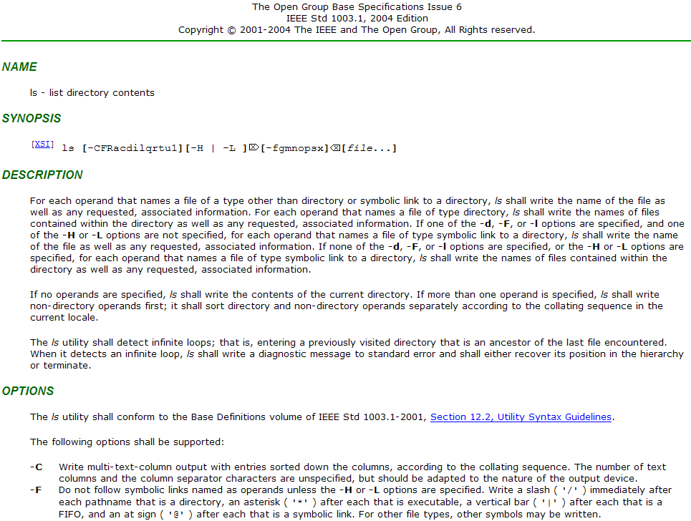
Notes:
-F Do not follow symbolic links named as operands unless the –H or –L options are specified

Slide 16
Challenges of Busybox ls Utility
Busybox ls utilizes bit-wise operations that CREST does not support
We developed a work-around solution by converting a 32-bit integer to a 32-elements integer array
1: unsigned int opt_list
2: …
3: if (opt_list & OPT_L){
4: …
1: int opt_list[32];
2: …
3: if(bit_and(opt_list, OPT_L)){
4:
Notes:
2nd bullet: VM의 bytecode로 컴파일하는 것도 어렵다. (build, library)

Slide 17
Symbolic Inputs for Busybox ls Utility
Concrete File System
stat()
struct stat {…
mode_t st_mode
…}
Directory1
…
file1
file2
lstat()
struct stat {…
mode_t st_mode
…}
…
Symbolic File System
sym_
stat()
struct stat {…
mode_t st_mode //symbolic value
…}
Directory1
file1
sym_
lstat()
struct stat {…
mode_t st_mode //symbolic value
…}
file2
Notes:
Symbolic environment 를 만들어 줘야 하는 게 하나의 큰 challenge

Slide 18
Test Oracles
For each command-line option in the POSIX specification, we inserted corresponding assert() as test oracles
-F does not follow symbolic links named as operands unless the –H or –L options are specified(from the POSIX specification)
(-F is set && -H and –L are not set) => ls should not follow symbolic links
assert (!(opt_list[21] && (!opt_list[23]&&!opt_list[24])) ||
-F is set -L is not set -H is not set
!((all_fmt & FOLLOW_LINKS)||force_follow))
ls should not follow symbolic links
Notes:
2nd bullet: VM의 bytecode로 컴파일하는 것도 어렵다. (build, library)

Slide 19
Results
1. Missing ‘@’ symbol for a symbolic link file with –F option
2. Missing space between adjacent two columns with –i or –b options
Output of Linux ls
Output of Linux ls
$ ls -F t.lnk
t.lnk@
$ ls -i ~user/12345 ~user/11111
154930324 /home/user/11111 154930124 /home/user/12345
Output of Busybox ls (incorrect behavior)
Output of Busybox ls (incorrect behavior)
$ ./busybox ls -F t.lnk
t.lnk
$ ./busybox ls -i ~user/12345 ~user/11111 154930324 /home/user/11111154930124 /home/user/12345
3. The order of options is ignored
4. –n does not show files in a long format
Output of Linux ls
Output of Linux ls
$ ls -1C
a.txt b.txt
$ ls –n a.txt
-rw-r--r-- 1 1000 1000 5833 Jun 24 2010 a.txt
Output of Busybox ls (incorrect behavior)
Output of Busybox ls (incorrect behavior)
$ ./busybox ls -1C
a.txt
b.txt
$ ./busybox ls –n a.txt
a.txt
13K TCs generated in 15 mins ( covered 68.6% branches(188/274) )
Notes:
2nd bullet: VM의 bytecode로 컴파일하는 것도 어렵다. (build, library)

Slide 20
Lessons Learned
We found that concolic testing is effective for covering exceptional scenarios
a corner case bug caused by a embedded HW failure in SLP FM
an invalid memory access bugs in Samsung Security library
4 exceptional bugs in busybox ls
To make concolic testing more effective, we need to address several challenges in practice
Written requirement specifications often do not exist in industries
Domain knowledge of a target program is necessary
Users need to understand limitations of the concolic testing tool they use
Notes:
2nd bullet: VM의 bytecode로 컴파일하는 것도 어렵다. (build, library)

Slide 21
Suggestions for More Effective Concolic Testing(1/2)
Write explicit requirement specifications
Concolic testing can detect bugs that violate GIVEN requirement specifications
The activity that makes SW testing effective also makes concolic testing effective
Have domain knowledge of a target program
To set which variables as symbolic inputs is critical to effectiveness and efficiency of concolic testing
E.g.) How many symbolic files would need to test Busybox ls utility?
Working with developers can reduce a significant amount of time to understand a target program
Notes:
2nd bullet: VM의 bytecode로 컴파일하는 것도 어렵다. (build, library)

Slide 22
Suggestions for More Effective Concolic Testing(2/2)
Understand the concolic testing tool you use
Evaluate available concolic testing tools and choose a best-fit one
Concolic testing highly depends on the compile and run-time environments
E.g.) We found that KLEE was much slower than CREST and compiling embedded SW to KLEE’s VM byte-code was difficult
You may need a work-around solution to address the limitations of the chosen concolic testing tool
E.g.) Compile problem in SLP FM, bit-wise operations problem in Busybox ls
Notes:
2nd bullet: VM의 bytecode로 컴파일하는 것도 어렵다. (build, library)

Slide 23
Conclusion & Future Work
We have successfully applied concolic testing to Samsung’s mobile platform software and field-proven open-source software
We found new bugs in all target programs
Samsung highly valued the results
Samsung Electronics and KAIST will continue collaboration
To overcome limitations and improve applicability of CREST: CREST-BV
Industrial Application of Concolic Testing Approach: A Case Study on libexif by Using CREST-BV and KLEE, ICSE SEIP track 2012

Slide 25
Concolic Testing Technique for Embedded SW
VM-based concolic testing
Modify VM to extract symbolic path formula (KLEE,PeX,SPF)
Instrumentation-based concolic testing
Insert probes to extract symbolic path formula (CUTE,CREST,SPLAT)
Advantages of instrumentation-based concolic testing for embedded SW
Do not require to port a VM to a specific platform
Run a target program on the target platform directly
Thus, we used CREST as a concolic testing tool
Notes:
Choosing an adequate concolic testing tool for embedded SW is important to successfully apply concolic testing. Concolic testing techniques can be divided into two groups. First, VM-based concolic testing technique uses a modified Vm to extract symbolic path formula during execution. On the other hand, instrumentation-based one modifies target program code and inserts probes to extract symbolic path formula. In our experience, instrumentation-based concolic testing has advantages over 프-based one for embedded Sw testing for 2 reasons. First, it does not require to port a 프 that supports concolic testing, which is expensive. Second, it can run a target program on the target platform directly. So, the target program can run an order of magnitude faster we can test HW function directly. Thus, we used CREST which implements instrumentation-based concolic testing technique for this project.

Slide 26
Concolic Approach
Combine concrete execution and symbolic execution
Concrete + Symbolic = Concolic
// Test input a, b, c
void f(int a, int b, int c) {
if (a == 1) {
if (b == 2) {
if (c == 3*a + b) {
Error();
} } } }
Concolic testing generates the following 4 test cases
(0,0,0): initial random input
Obtained symbolic path formula (SPF) φ: a!=1
Next SPF ψ generated from φ: !(a!=1)
(1,0,0): a solution of ψ (i.e. !(a!=1))
SPF φ: a==1 && b!=2
Next SPF ψ: a==1 && !(b!=2)
(1,2,0)
SPF φ: a==1 && (b==2) && (c!=3*a +b)
Next SPF ψ: a==1 && (b==2) && !(c!=3*a +b)
(1,2,5)
Covered all paths and
a!=1
a==1
(0,0,0)
b!=2
b==2
Error()
reached
(1,0,0)
c==
3*a+b
c!=3*a+b
(1,2,0)
(1,2,5)
Notes:
To automate test case generation, concolic testing technique a.k.a dynamic symbolic execution was developed. Concolic testing is a combined approach of dynamic concrete analysis and static symbolic analysis. Concrete execution over a concrete input guides symbolic execution, and the symbolic execution is used to generate further concrete test cases automatically. In this way, concolic testing can generate test cases to explore all possible execution paths and achieve higher branch coverage than random testing.

