Slide 1
Software Development Cycle
A SW Development Framework for SW with High Assurance
Requirement
analysis
System
design
Design
analysis
Implement-
ation
Testing
Monitoring
Formal
require-
ment
Spec.
Formal
system
modeling
Model
analysis/
verification
Model-
assisted
code
generation
Model-
based
testing
Runtime
monitoring
and
checking

Slide 2
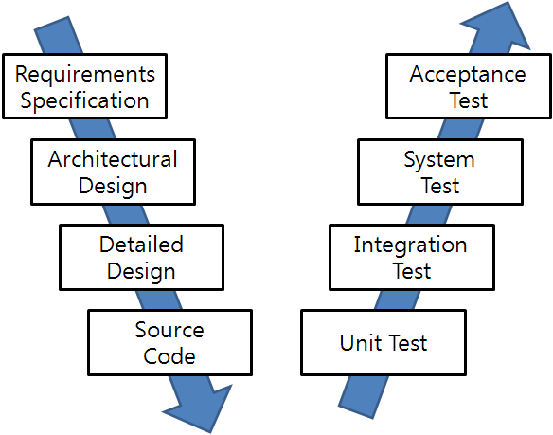
SW Development and Testing Model (a.k.a. V model)
Manual
Labor
Abstraction

Slide 3
Foundation of Software Testing
Test oracle
A pair of requirement spec and system design spec
Spec
2. implementation
1. Representation
Program
3. execution
Test case
Code that implements the system specification and satisfies the requirements
A pair of test input and expected test output for the input
Multiple targets for software testing
Does the test cases represent the requirement spec correctly? → Scenario based testing (black-box testing)
Is the design spec implemented as program correctly? → Model-based testing (grey-box testing)
Does the program satisfy test cases correctly? → Code-based testing (white-box testing)

Slide 4
Black Box Testing
A main goal of testing is to generate multiple test cases, one of which may reveal a bug.
Black box testing concerns only input/output of a target program (i.e., ignore program code)
Ex1. Requirement specification based testing
Ex2. Random (input generation) testing
Ex3. Category partitioning method
Ex4. T-way testing
Advantage of black box testing
Intuitive and simple
Requires little expertise on program/code analysis techniques
Requires less effort compared to white-box testing
cheaper but less effective

Slide 5
Various SW Testing Techniques w/ Different Cost and Effectiveness
_{Whitebox Testing}
SW Reliability
_{Model Checking}
Concolic Testing
Search-based Testing
Branch Testing
Blackbox Testing
_{Stmt. Testing}
Equiv. Partition. Testing
_{T-way Testing}
Req. based Testing
참고. 테스팅 국어 사전 http://dic.sten.or.kr/
Rand. Testing
SW Testing Cost
Notes:
We have demonstrated that our new technique conbol could effectively detect 24 crash bugs. Now conbol is successfully adopted by the original development team. I personally believe that concolic testing is mature enough to be adopted by industry, not only academy. Traditionally, testing focuses on manual TC generation testing main scenarios, ~~. But I believe that our testing paradigm is changing to new testing new paradigm based on concolic testing like conbol. Now we generate millions of test cases automatically, and targeting exceptional scenarios as we detected 24 hidden bugs with unit-level testing and large # of TCs. So overall I believe automated testing has a lower V7V cost than manual testing for higher reliability. And our group and samsung electronics try hard to apply such automated technique to more larger product.

Slide 6
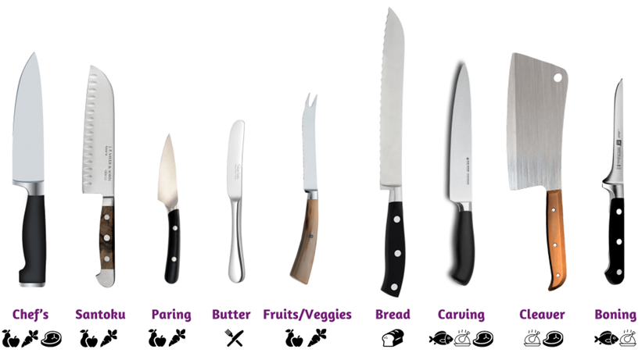
Analogy to Various Kitchen Knives for Different Purposes
https://nellions.co.ke/blog/types-storing-moving-knives/

Slide 7
Requirement based Blackbox Testing VS Logic based Whitebox Testing
 | Black Box Test | White Box Test
Def. | Functional test based on the requirement specification | Logical analysis based on target source code
View point | User | Developer
Bug detection criteria | Interface and/or performance problem | Logical problems
Verification &Validation level | High (user) | Low (testing)
Target bugs | Observable external errors | Internal errors due to logic problem, uncovered stmt.
Technique | Category partition, boundary value analysis, etc. | Loop, control structure test
Bug detection ability | Low | High
# of TC | Small | Large
Application | Beta test | Alpha test
도리의 디지털라이프 블로그에서 발췌/편집
http://blog.skby.net/%EB%B8%94%EB%9E%99%EB%B0%95%EC%8A%A4-%ED%85%8C%EC%8A%A4%ED%8A%B8-%ED%99%94%EC%9D%B4%ED%8A%B8%EB%B0%95%EC%8A%A4-%ED%85%8C%EC%8A%A4%ED%8A%B8/
If a requirement is specified as an assert statement requirement can be tested through whitebox texting
Notes:
http://blog.skby.net/%EB%B8%94%EB%9E%99%EB%B0%95%EC%8A%A4-%ED%85%8C%EC%8A%A4%ED%8A%B8-%ED%99%94%EC%9D%B4%ED%8A%B8%EB%B0%95%EC%8A%A4-%ED%85%8C%EC%8A%A4%ED%8A%B8/

Slide 8
Example of Blackbox Testing Technique: The Category-Partition Method for Specifying and Generating Functional Tests (Thomas J. Ostrand and Marc J.Balcer [ CACM,1988 ])
The original slides from Prof. Shmuel Sagiv’s lecture notes
msagiv@post.tau.ac.il

Slide 9
Content:
Introduction.
The category-partition method:
- characteristics.
- the method.
- examples.
Other methods.

Slide 10
The goal of functional testing
To find discrepancies between the actual behavior of the implemented system’s function and the desired behavior as described in the system’s functional specification.

Slide 11
How to achieve this goal ?
Tests have to be execute for all the system functions.
Tests have to be designed to maximize the chances of finding errors in the software.

Slide 12
Functional test can be derived from 3 sources:
1. The software specification.
2. Design information.
3. The code itself.

Slide 13
Partition - The standard approach
The main idea is to partition the input domain of function being tested, and then select test data for each class of the partition.
The problem of all the existing techniques is the lack of systematic.
Input domain
p1
p2
a
2
16
y
4
i
p3
p4
1
3
z
p
7
q

Slide 14
A strategy for test case generation
1. Transform the system’s specification to be
more concise and structured.
2. Decompose the specification into functional unit - to be tested independently.
3. Identify the parameters and environment
conditions.

Slide 15
A strategy for test case generation (cont)
4. Find categories that characterize each parameter and environment condition.
5. Every category should be partitioned into distinct choices .
formal test specification

Slide 16
A strategy for test case generation (cont)
?
6.
test frames - set of choices, one from
each category.
test cases - test frame with specific
values for each choices.
test scripts - sequence of test cases.

Slide 17
Example
Command: find
Syntax: find <pattern> <file>
Function: The find command is used to locate one or
more instance of a given pattern in a text file. All lines in the file that contain the pattern are written to standard output. A line containing the pattern is written only once, regardless of the number of times the pattern occurs in it.
The pattern is any sequence of characters whose length does not exceed the maximum length of a line in the file .To include a blank in the pattern, the entire pattern must be enclosed in quotes (“).To include quotation mark in the pattern ,two quotes in a row (“ “) must be used.

Slide 18
Example:
find john myfile
display lines in the file myfile which contain john
find “john smith” in myfile
display lines in the file myfile which contain john smith
find “john”” smith” in myfile
display lines in the file myfile which contain john” smith

Slide 19
Categories
Parameters:
Pattern size:
empty
single character
many character
longer than any line in the file
Quoting:
pattern is quoted
pattern is not quoted
pattern is improperly quoted
Embedded blanks:
no embedded blank
one embedded blank
several embedded blanks
Embedded quotes:
no embedded quotes
one embedded quotes
several embedded quotes
File name:
good file name
no file with this name
omitted
Environments:
Number of occurrence of pattern in file:
none
exactly one
more than one
Pattern occurrences on target line:
one
more than one
3
4
Total Tests frames:
1944 (=4*3*3*3*3*3*2)
3
3
3
3
2

Slide 20
Adding Constraints between Categories to Reduce #of TC’S
Parameters:
Pattern size:
empty [ property Empty ]
single character [ property NonEmpty ]
many character [ property NonEmpty ]
longer than any line in the file [ property NonEmpty ]
Quoting:
pattern is quoted [ property Quoted ]
pattern is not quoted [ if NonEmpty ]
pattern is improperly quoted [ if NonEmpty ]
Embedded blanks:
no embedded blank [ if NonEmpty ]
one embedded blank [ if NonEmpty and Quoted ]
several embedded blanks [ if NonEmpty and Quoted ]

Slide 21
Embedded quotes:
no embedded quotes [ if NonEmpty ]
one embedded quotes [ if NonEmpty ]
several embedded quotes [ if NonEmpty ]
File name:
good file name
no file with this name
omitted
Environments:
Number of occurrence of pattern in file:
none [ if NonEmpty ]
exactly one [ if NonEmpty ] [ property Match]
more than one [ if NonEmpty ] [ property Match ]
Pattern occurrences on target line:
one [ if Match ]
more than one [ if Match ]
Total Tests frames:
678

Slide 22
Parameters:
Pattern size:
empty [ property Empty ]
single character [ property NonEmpty ]
many character [ property NonEmpty ]
longer than any line in the file [ error ]
Quoting:
pattern is quoted [ property quoted ]
pattern is not quoted [ if NonEmpty ]
pattern is improperly quoted [ error ]
Embedded blanks:
no embedded blank [ if NonEmpty ]
one embedded blank [ if NonEmpty and Quoted ]
several embedded blanks [ if NonEmpty and Quoted ]

Slide 23
Embedded quotes:
no embedded quotes [ if NonEmpty ]
one embedded quotes [ if NonEmpty ]
several embedded quotes [ if NonEmpty ]
File name:
good file name
no file with this name [ error ]
omitted
Environments:
Number of occurrence of pattern in file:
none [ if NonEmpty ]
exactly one [ if NonEmpty ] [ property Match]
more than one [ if NonEmpty ] [ property Match ]
Pattern occurrences on target line:
one [ if Match ]
more than one [ if Match ]
Total Tests frames:
125
Total Tests frames:
125
Notes:
The number may be further reduced by using [single] markings. This annotation is intended to describe special, unusual, or redundant conditions that do not have to be combined with all possible choices. As with (error I choices, the generator does not com-a [single] choice with any choices from other categories.
The decision to use a [single ] marking is a judgment by the tester that the marked choice can be adequately tested with only one test case.

Slide 24
White Box Testing (1/2)
White box testing concerns program code itself
Many different viewpoints on “program code”
program code as a graph (i.e., structural coverage)
program code as a set of logic formulas (i.e., logical coverage)
program code as a set of execution paths (i.e., behavioral/dynamic coverage)
Advantages:
More effective than blackbox testing in general
Can measure the testing progress quantitatively based on coverage achieved
Should be used with blackbox testing together for maximal bug detection capability
Blackbox testing and whitebox testing often explore different segments of target program space

Slide 25
White Box Testing (2/2)
Coverage is a good predictor/indicator of testing effectiveness
Utilizing correlation between structural coverage and fault detection ability
coverage
metric A
Fault
finding
coverage
metric B
coverage
metric C
Coverage

Slide 26
Bug Observability/Detection Model: Reachability, Infection, Propagation, and Revelation (RIPR)
Terminology
Fault: static defect in a program text (a.k.a a bug)
Error: dynamic (intermediate) behavior that deviates from its (internal) intended goal
A fault causes an error (i.e. error is a symptom of fault)
Failiure: dynamic behavior which violates a ultimate goal of a target program
Not every error leads to failure due to error masking or fault tolerance
Graph coverage
Test requirement satisfaction == Reachability
the fault in the code has to be reached
Logic coverage
Test requirement satisfaction
== Reachability +Infection
the fault has to put the program into an error state.
Note that a program is in an error state does not mean that it will always produce the failure
Mutation coverage
Test requirement satisfaction
== Reachability +Infection + Propagation
the program needs to exhibit incorrect outputs
Furthermore, test oracle plays critical role to reveal failure of a target program (Revelation)

Slide 27

t1
t2
t3
t100
t101
t102
t200
t201
t202
t10000
Fault executed
Fault executed
Fault executed
Fault executed
Fault executed
Fault executed
Fault executed
Reachability
Error occurred
Error occurred
Error occurred
Error occurred
Reachability
+ Infection
Failure occured
Reachability
+ Infection + Propergation (+Revelation)

Slide 29
사용자 관점의 테스트 방법, Black Box Test
기법 | 설명
동등 분할 기법 (Equivalence Partitioning | 프로그램의 입력 도메인을 테스트 케이스가 산출될 수 있는 데이터 클래스로 분류하는 방법
경계값분석기법 (Boundary Value Analysis) | 입력 조건의 중간 값보다 경계 값에서 에러가 발생 될 확률이 높다는 점을 이용하여 테스트 케이스를 생성
오류 예측 기법 (Error Guessing) | 각 시험 기법들이 놓치기 쉬운 오류들을 감각 및 경험으로 찾아보는 방법
원인 결과 그래프 기법 (Cause Effect Graph) | 입력 데이터 간 관계가 출력에 미치는 영향을 그래프로 표현하여 오류를 발견하도록 함
의사결정 테이블 테스팅 | 논리적 조건이나 상황에서 입력 조건과 결과를 참, 거짓으로 표현하여 조합을 만들고 테스트케이스를 작성
상태전이 테스팅 | 시스템에 반영되는 이전의 상태가 무엇인지, 상태간 전이, 상태를 변화시키는 이벤트와 입력값을 파악
도리의 디지털라이프 블로그에서 발췌http://blog.skby.net/%EB%B8%94%EB%9E%99%EB%B0%95%EC%8A%A4-%ED%85%8C%EC%8A%A4%ED%8A%B8-%ED%99%94%EC%9D%B4%ED%8A%B8%EB%B0%95%EC%8A%A4-%ED%85%8C%EC%8A%A4%ED%8A%B8/

Slide 30
Parameters:
Pattern size:
empty [ property Empty ]
single character [ property NonEmpty ]
many character [ property NonEmpty ]
longer than any line in the file [ error ]
Quoting:
pattern is quoted [ property quoted ]
pattern is not quoted [ if NonEmpty ]
pattern is improperly quoted [ error ]
Embedded blanks:
no embedded blank [ if NonEmpty ]
one embedded blank [ if NonEmpty and Quoted ]
several embedded blanks [ if NonEmpty and Quoted ]

Slide 31
Embedded quotes:
no embedded quotes [ if NonEmpty ]
one embedded quotes [ if NonEmpty ]
several embedded quotes [ if NonEmpty ]
File name:
good file name
no file with this name [ error ]
omitted
Environments:
Number of occurrence of pattern in file:
none [ if NonEmpty ]
exactly one [ if NonEmpty ] [ property Match]
more than one [ if NonEmpty ] [ property Match ]
Pattern occurrences on target line:
one [ if Match ]
more than one [ if Match ]
[ single ]
Total Tests frames:
125
Total Tests frames:
40
[ single ]
[ single ]
Notes:
The number may be further reduced by using [single] markings. This annotation is intended to describe special, unusual, or redundant conditions that do not have to be combined with all possible choices. As with (error I choices, the generator does not com-a [single] choice with any choices from other categories.
The decision to use a [single ] marking is a judgment by the tester that the marked choice can be adequately tested with only one test case.

