Slide 1
SAT Encodings for Sudoku
Bug Catching in 2006 Fall
Sep. 26, 2006
Gi-Hwon Kwon

Slide 2
Various SAT Encoding
Encoding 1
C Program
Encoding 2
Optimal Path Planning
Encoding 3
CNF SAT Formula
SAT
Solver
Sudoku
Puzzle
Latin Square
Problem
Encoding n
Traveling Salesmen Probelm

Slide 3
Agenda
Introduction
Background and Previous Encodings
Optimized Encoding
Experimental Results
Conclusions

Slide 4
What is Sudoku ?
Problem
Solution
 |  | 6 | 1 |  | 2 | 5
 | 3 | 9 |  |  |  | 1 | 4
 |  |  |  | 4
9 |  | 2 |  | 3 |  | 4 |  | 1
 | 8 |  |  |  |  |  | 7
1 |  | 3 |  | 6 |  | 8 |  | 9
 |  |  |  | 1
 | 5 | 4 |  |  |  | 9 | 1
 |  | 7 | 5 |  | 3 | 2
Given a problem, the objectvie is to find a satisfying assignment w.r.t. Sudoku rules.
8 | 4 | 6 | 1 | 7 | 2 | 5 | 9 | 3
7 | 3 | 9 | 6 | 5 | 8 | 1 | 4 | 2
5 | 2 | 1 | 3 | 4 | 9 | 7 | 6 | 8
9 | 6 | 2 | 8 | 3 | 7 | 4 | 5 | 1
4 | 8 | 5 | 9 | 2 | 1 | 3 | 7 | 6
1 | 7 | 3 | 4 | 6 | 5 | 8 | 2 | 9
2 | 9 | 8 | 7 | 1 | 4 | 6 | 3 | 5
3 | 5 | 4 | 2 | 8 | 6 | 9 | 1 | 7
6 | 1 | 7 | 5 | 9 | 3 | 2 | 8 | 4
Sodoku rules
There is a number in each cell.
A number appears once in each row.
A number appears once in each column.
A number appears once in each block.

Slide 5
Sudoku as SAT Problem
symbol table
model
Encoder
CNF
SAT Solver
SAT?
yes
Decoder
☺
Sudoku
no
Solution
found
☹
No solution found

Slide 6
Previous Encodings
symbol table
model
Encoder
CNF
SAT Solver
SAT?
yes
Decoder
☺
Sudoku
Minimal encoding [Lynce & Ouaknine, 2006]
Extended encoding [Lynce & Ouaknine, 2006]
Efficient encoding [Weber, 2005]

Slide 7
Analysis of Previous Encodings
Encoding | Number of Variables | Number of Clauses
Minimal
Efficient
Extended

Slide 8
Exponential Growth in Clauses
size | minimal | efficient | extended
9x9 | 8829 | 11745 | 11988
16x16 | 92416 | 123136 | 123904
25x25 | 563125 | 750625 | 752500
36x36 | 2450736 | 3267216 | 3271104
49x49 | 8473129 | 11296705 | 11303908
64x64 | 24776704 | 33034240 | 33046528
81x81 | 63779481 | 85037121 | 85056804

Slide 9
Experimental Results
 |  | minimal encoding |  |  | efficient encoding |  |  | extended encoding
size | level | vars | clauses | time | vars | clauses | time | vars | clauses | time
9x9 | easy | 729 | 8854 | 0.00 | 729 | 11770 | 0.00 | 729 | 12013 | 0.00
9x9 | hard | 729 | 8859 | 0.00 | 729 | 11775 | 0.00 | 729 | 12018 | 0.00
16x16 | easy | 4096 | 92520 | 0.10 | 4096 | 123240 | 0.09 | 4096 | 124008 | 0.01
16x16 | hard | 4096 | 92514 | 0.46 | 4096 | 123234 | 0.21 | 4096 | 124002 | 0.01
25x25 | easy | 15625 | 563417 | 9.07 | 15625 | 750917 | 17.48 | 15625 | 752792 | 0.07
25x25 | hard | 15625 | 563403 | time | 15625 | 750903 | time | 15625 | 752778 | 0.21
36x36 | easy | 46656 | 2451380 | time | 46656 | 3267860 | time | 46656 | 3271748 | 0.50
36x36 | hard | 46656 | 2451400 | time | 46656 | 3267880 | time | 46656 | 3271768 | 0.67
49x49 | easy | 117649 | 8474410 | time | 117649 | 11297986 | time | 117649 | 11305189 | 1.47
64x64 | easy | 262144 | 24779088 | stack | 262144 | 33036624 | stack | 262144 | 33048912 | stack
81x81 | easy | 531441 | 63783464 | stack | 531441 | 85041104 | stack | 531441 | 85060787 | stack

Slide 10
Experimental Results
 |  | minimal encoding |  |  | efficient encoding |  |  | extended encoding
size | level | vars | clauses | time | vars | clauses | time | vars | clauses | time
9x9 | easy | 729 | 8854 | 0.00 | 729 | 11770 | 0.00 | 729 | 12013 | 0.00
9x9 | hard | 729 | 8859 | 0.00 | 729 | 11775 | 0.00 | 729 | 12018 | 0.00
16x16 | easy | 4096 | 92520 | 0.10 | 4096 | 123240 | 0.09 | 4096 | 124008 | 0.01
16x16 | hard | 4096 | 92514 | 0.46 | 4096 | 123234 | 0.21 | 4096 | 124002 | 0.01
25x25 | easy | 15625 | 563417 | 9.07 | 15625 | 750917 | 17.48 | 15625 | 752792 | 0.07
25x25 | hard | 15625 | 563403 | time | 15625 | 750903 | time | 15625 | 752778 | 0.21
36x36 | easy | 46656 | 2451380 | time | 46656 | 3267860 | time | 46656 | 3271748 | 0.50
36x36 | hard | 46656 | 2451400 | time | 46656 | 3267880 | time | 46656 | 3271768 | 0.67
49x49 | easy | 117649 | 8474410 | time | 117649 | 11297986 | time | 117649 | 11305189 | 1.47
64x64 | easy | 262144 | 24779088 | stack | 262144 | 33036624 | stack | 262144 | 33048912 | stack
81x81 | easy | 531441 | 63783464 | stack | 531441 | 85041104 | stack | 531441 | 85060787 | stack
☺
Solution found
☹
No solution found

Slide 11
Motivations
Sudoku was regarded as SAT problem
W Weber, A SAT-based Sudoku Solver, Nov. 2005.
Lynce & Ouaknine, Sudoku as a SAT Problem, Jan. 2006.
➔ Extended encoding shows the best performance in our experiments
Problems in previous works
Too many clauses are generated (e.g. 85,056,804 clauses)
Thus, large size puzzles are not solved
The extended encoding must be optimized for large size puzzles

Slide 12
Agenda
Introduction
Background and Previous Encodings
Optimized Encoding
Experimental Results
Conclusions

Slide 13
Encoding
Kowledge compilation into a target language
Knowlede about Sudoku
problem knowlege
CNF
A number appears once in each cell
A number appears once in each row
rules
CNF
A number appears once in each col
A number appears once in each block
9
A pre-assigned number
facts
CNF

Slide 14
Variables
Each cell has one number from 1..N
[1,1]=1 or [1,1]=2 or …… or [1,1]=N
Each cell needs N boolean variables to consider all cases
Total number of variables
N³
Boolean variable name as a triple
(r,c,v) (i.e., x_{rcv} ) iff [r,c] = v
¬(r,c,v) (i.e.,¬x_{rcv} ) iff [r,c] ≠ v
v
N
2
3
1
r
c

Slide 15
Cell Rule ➔ CNF
A number appears once in each cell
There is at least one number in each cell
(definedness)
There is at most one number in each cell
(uniqueness)

Slide 16
Row Rule ➔ CNF
A number appears once in each row
Each number appears at least once in each row
(definedness)
Each number appears at most once in each row
(uniqueness)

Slide 17
Column Rule ➔ CNF
A number appears once in each column
Each number appears at least once in each column
(definedness)
Each number appears at most once in each column
(uniqueness)

Slide 18
Block Rule ➔ CNF
A number appears once in each block
Each number appears at least once in each block
(definedness)
Each number appears at most once in each block
(uniqueness)

Slide 19
Pre-Assigned Fact ➔ CNF
 |  | 3
A pre-assigned number
As a constant; the number is never changed
It can be represented as a unit clause

Slide 20
Previous Encodings
Minimal encoding [Lynce & Ouaknine, 2006]
sufficient to characterize the puzzle
Extended encoding [Lynce & Ouaknine, 2006]
minimal encoding with redundant clauses
Efficient encoding [Weber, 2005]
between minimal encoding and extended encoding

Slide 21
Analysis (Recap)
Encoding | Number of Variables | Number of Clauses
Minimal
Efficient
Extended

Slide 23
Agenda
Introduction
Background and Previous Encodings
Optimized Encoding
Experimental Results
Conclusions

Slide 24
Example
 |  | 4 | 3
1 | 3
CNF
is represented using boolean variables
For example, consider the cell [1,1]
Four cases are considered; thus, four variables are needed
(1,1,1), (1,1,2), (1,1,3), (1,1,4)

Slide 25
Variables
A pre-assigned cell reduces the cases to be considered
Because the cell has a fixed number
The pre-assigned cell does not need a variable at all
It affects other cells located at the same row, or column, or block.
For example , consider the cell [1,1]
The case [1,1]=1 is not allowed since [4,1]=1 are already assigned
The case [1,1]=3 is not allowed since [1,4]=3 are already assigned
The case [1,1]=4 is not allowed since [1,3]=4 are already assigned
Thus, the only case to be cosidered is [1,1]=2
(1,1,2)
 |  | 4 | 3
1 | 3

Slide 27
Variables
Let V be a set of variables

Slide 28
Example
(1,1,2) | (1,2,1) (1,2,2) | 4 | 3
(2,1,2) (2,1,3) (2,1,4) | (2,2,1) (2,2,2) (2,2,4) | (2,3,1) (2,3,2) | (2,4,1) (2,4,2)
(3,1,2) (3,1,4) | (3,2,2) (3,2,4) | (3,3,1) (3,3,2) (3,3,3) | (3,4,1) (3,4,2) (3,4,4)
1 | 3 | (4,3,2) | (4,4,2) (4,4,4)
these parts are excluded

Slide 29
Cell Rule ➔ CNF
A number appears once in each cell
There is at least one number in each cell
(definedness)
There is at most one number in each cell
(uniqueness)

Slide 30
Example
{(1,1,2)}
{(1,2,1)∨(1,2,2)}
{(2,1,2)∨(2,1,3)∨(2,1,4)}
{(2,2,1)∨(2,2,2)∨(2,2,4)}
………
………
{(4,3,2)}
{(4,4,2)∨(4,4,4)}
(1,1,2) | (1,2,1) (1,2,2) | 4 | 3
(2,1,2) (2,1,3) (2,1,4) | (2,2,1) (2,2,2) (2,2,4) | (2,3,1) (2,3,2) | (2,4,1) (2,4,2)
(3,1,2) (3,1,4) | (3,2,2) (3,2,4) | (3,3,1) (3,3,2) (3,3,3) | (3,4,1) (3,4,2) (3,4,4)
1 | 3 | (4,3,2) | (4,4,2) (4,4,4)
{¬(1,2,1)∨¬(1,2,2)}
{¬(2,1,2)∨¬(2,1,3)}
{¬(2,1,2)∨¬(2,1,4)}
{¬(2,1,3)∨¬(2,1,4)}
………
………
{¬(4,4,2)∨¬(4,4,4)}

Slide 31
Row Rule ➔ CNF
A number appears once in each row
Each number appears at least in each row
(definedness)
Each number appears at most in each row
(uniqueness)

Slide 32
Example
{(1,2,1)}
{(1,1,2)∨(1,2,2)}
{(2,2,1)∨(2,3,1)∨(2,4,1)}
{(2,1,2)∨(2,2,2)∨(2,3,2)∨(2,4,2)}
………
………
{(4,3,2)∨(4,4,2)}
{(4,4,4)}
(1,1,2) | (1,2,1) (1,2,2) | 4 | 3
(2,1,2) (2,1,3) (2,1,4) | (2,2,1) (2,2,2) (2,2,4) | (2,3,1) (2,3,2) | (2,4,1) (2,4,2)
(3,1,2) (3,1,4) | (3,2,2) (3,2,4) | (3,3,1) (3,3,2) (3,3,3) | (3,4,1) (3,4,2) (3,4,4)
1 | 3 | (4,3,2) | (4,4,2) (4,4,4)
{¬(1,1,2)∨¬(1,2,2)}
{¬(2,2,1)∨¬(2,3,1)}
{¬(2,2,1)∨¬(2,4,1)}
{¬(2,3,1)∨¬(2,4,1)}
………
………
{¬(4,3,2)∨¬(4,4,2)}

Slide 33
Column Rule ➔ CNF
A number appears once in each column
Each number appears at least in each column
(definedness)
Each number appears at most in each column
(uniqueness)

Slide 34
Example
{(1,1,2)∨(2,1,2)∨(3,1,2)}
{(2,1,3)}
{(2,1,4)∨(3,1,4)}
………
………
………
{(2,4,2)∨(3,4,2)∨(4,4,2)}
{(3,4,4)∨(4,4,4)}
(1,1,2) | (1,2,1) (1,2,2) | 4 | 3
(2,1,2) (2,1,3) (2,1,4) | (2,2,1) (2,2,2) (2,2,4) | (2,3,1) (2,3,2) | (2,4,1) (2,4,2)
(3,1,2) (3,1,4) | (3,2,2) (3,2,4) | (3,3,1) (3,3,2) (3,3,3) | (3,4,1) (3,4,2) (3,4,4)
1 | 3 | (4,3,2) | (4,4,2) (4,4,4)
{¬(1,1,2)∨¬(2,1,2)}
{¬(1,1,2)∨¬(3,1,2)}
{¬(2,1,2)∨¬(3,1,2)}
{¬(2,1,4)∨¬(3,1,4)}
………
………
{¬(3,4,4)∨¬(4,4,4)}

Slide 35
Block Rule ➔ CNF
A number appears once in each block
Each number appears at least in each block
(definedness)
Each number appears at most in each block
(uniqueness)

Slide 36
Example
{(1,2,1)∨(2,2,1)}
{(1,1,2)∨(1,2,2)∨(2,1,2)∨(2,2,2)}
{(2,1,3)}
………
………
………
{(3,3,3)}
{(3,4,4)∨(4,4,4)}
(1,1,2) | (1,2,1) (1,2,2) | 4 | 3
(2,1,2) (2,1,3) (2,1,4) | (2,2,1) (2,2,2) (2,2,4) | (2,3,1) (2,3,2) | (2,4,1) (2,4,2)
(3,1,2) (3,1,4) | (3,2,2) (3,2,4) | (3,3,1) (3,3,2) (3,3,3) | (3,4,1) (3,4,2) (3,4,4)
1 | 3 | (4,3,2) | (4,4,2) (4,4,4)
{¬(1,2,1)∨¬(2,2,1)}
{¬(1,1,2)∨¬(1,2,2)}
{¬(1,1,2)∨¬(2,1,2)}
{¬(1,1,2)∨¬(2,2,2)}
………
………
{¬(3,4,4)∨¬(4,4,4)}

Slide 37
Optimized Encoding
The resulting CNF formula
φ is satisfiable iff Sudoku has a solution
Smaller variables and clauses than previous encodings
Number of variables are reduced 12 times on average in our experiments
Number of clauses are reduced 79 times on average in our experiments

Slide 38
Agenda
Introduction
Background and Previous Encodings
Optimized Encoding
Experimental Results
Conclusions

Slide 39
Experimental Results
 |  | extended encoding |  |  | proposed encoding |  |  | analysis of pre-assigned cells
size | level | vars | clauses | time | vars | clauses | time | k | ratio | vars↓ | claus↓
9x9 | easy | 729 | 12013 | 0.00 | 220 | 1761 | 0.00 | 26 | 32 | 3 | 7
9x9 | hard | 729 | 12018 | 0.00 | 164 | 1070 | 0.00 | 30 | 37 | 5 | 11
16x16 | easy | 4096 | 124008 | 0.01 | 648 | 5598 | 0.00 | 104 | 41 | 6 | 22
16x16 | hard | 4096 | 124002 | 0.01 | 797 | 8552 | 0.00 | 98 | 38 | 5 | 15
25x25 | easy | 15625 | 752792 | 0.07 | 1762 | 19657 | 0.04 | 292 | 47 | 9 | 38
25x25 | hard | 15625 | 752778 | 0.21 | 1990 | 24137 | 0.05 | 278 | 45 | 8 | 31
36x36 | easy | 46656 | 3271748 | 0.50 | 4186 | 57595 | 0.06 | 644 | 50 | 11 | 57
36x36 | hard | 46656 | 3271768 | 0.67 | 3673 | 45383 | 0.08 | 664 | 51 | 13 | 72
49x49 | easy | 117649 | 11305189 | 1.47 | 7642 | 112444 | 0.13 | 1282 | 53 | 15 | 101
64x64 | easy | 262144 | 33048912 | stack | 11440 | 169772 | 0.04 | 2384 | 58 | 23 | 195
81x81 | easy | 531441 | 85060787 | stack | 17793 | 266025 | 0.06 | 3983 | 61 | 30 | 320

Slide 40
81x81 Puzzle
Variables are reduced 30 times
☺
81x81 | 531441 | 85060787 | stack | 17793 | 266025 | 0.06
Clauses are reduced 320 times

Slide 41
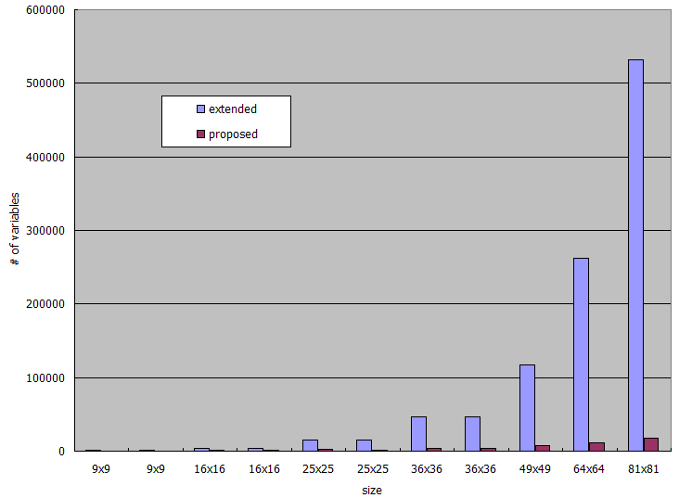
Variable Reduction

Slide 42
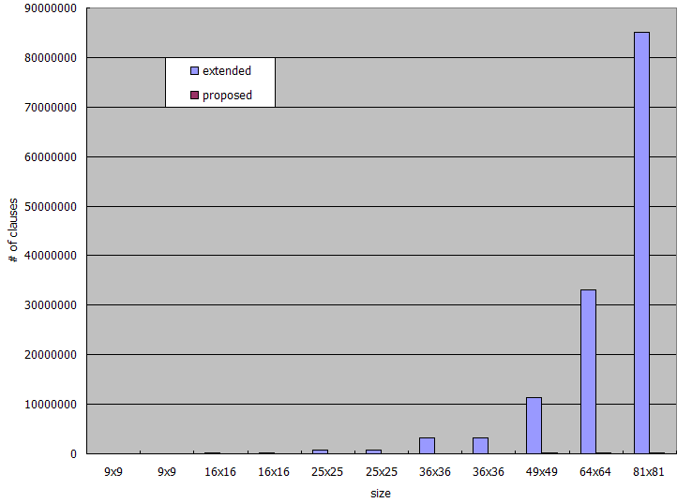
Clause Reduction

Slide 43
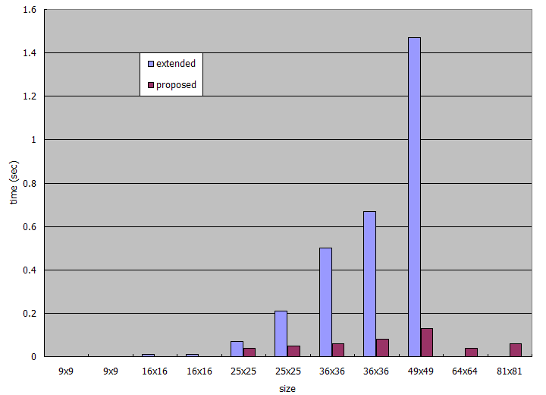
Time Reduction

Slide 44
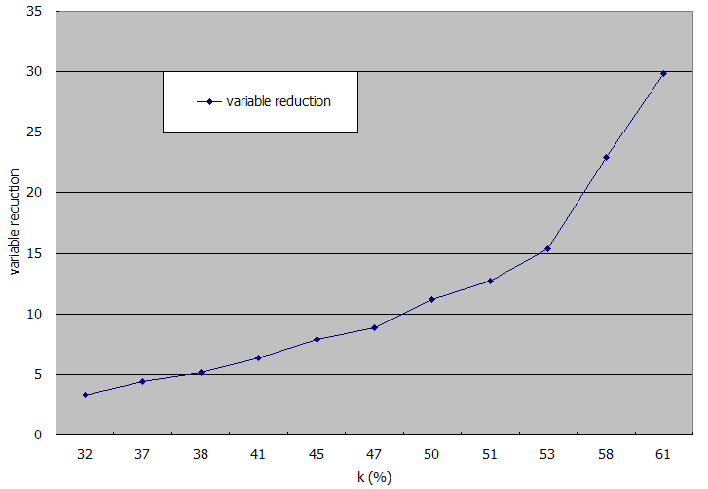
Variable Reduction Ratio

Slide 45
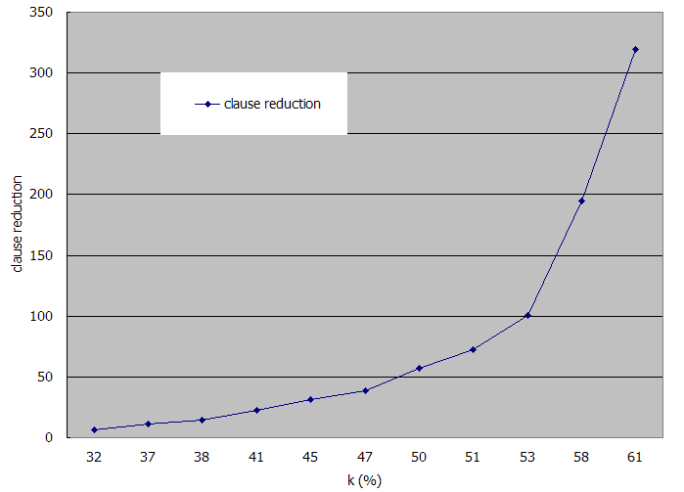
Clause Reduction Ratio

Slide 46
Agenda
Introduction
Background and Previous Encodings
Optimized Encoding
Experimental Results
Conclusions

Slide 47
Conclusions
Previous encodings
J. Ouaknine, Sudoku as a SAT Problem, 2006
T. Weber, A SAT-based Sudoku Solver, 2005
Props and cons
+ Ideal encoding techniques
+ Well used for small puzzles
− Too many clauses
− Hard to handle large size puzzles such as 81x81

Slide 48
Conclusions
Proposed techniques
Optimized encoding used to reduce a formula
Results from 11 different size puzzles
+ All given puzzles are successfully solved
+ Number of variables is greately reduced
+ Number of clauses is greately reduced
+ Execution time is greately reduced
+ Finally, encoding time is greately reduced
Thank You!!

Slide 49
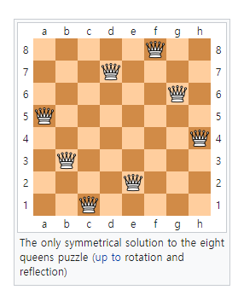
Another Example: 8 Queen Puzzle
Placing 8 chess queens on an 8×8 chessboard so that no two queens threaten each other
Thus, a solution requires that no two queens share the same row, column, or diagonal.
There are 92 solutions.
The asymptotic growth rate of the number of solutions for n queen puzzle is (0.143 n)n.
the exact number of solutions for n queen puzzle is only known for n ≤ 27,

