Slide 1
Clang Tutorial
Moonzoo Kim
School of Computing
KAIST
The original slides were written by Yongbae Park, yongbae2@gmail.com

Slide 2
Content
Motivation of learning code analysis technique
Overview of Clang
AST structure of Clang
Decl class
Stmt class
Traversing Clang AST

Slide 3
Motivation for Learning Code Analysis Technique
Biologists know how to analyze laboratory mice. In addition, they know how to modify the mice by applying new medicine or artificial organ
Mechanical engineers know how to analyze and modify mechanical products using CAD tools.
Software engineers also have to know how to analyze and modify software code which is far more complex than any engineering product. Thus, software analysis/modification requires automated analysis tools.
Using source level analysis framework (e.g., Clang, C Intermediate Language (CIL), EDG parser)
Using low-level intermediate representation (IR) analysis framework (e.g., LLVM IR)

Slide 4
Overview
There are frequent chances to analyze/modify program code mechanically/automatically
Ex1. Refactoring code for various purposes
Ex2. Generate test driver automatically
Ex3. Insert probes to monitor target program behavior
Clang is a library to convert a C program into an abstract syntax tree (AST) and manipulate the AST
Clang, the LLVM C/C++ front-end supports the full-features of C/C++ and compatible with GCC
Ex) finding branches, renaming variables, pointer alias analysis, etc
Clang is particularly useful to simply modify C/C++ code
Ex1. Add printf(“Branch Id:%d\n”,bid)at each branch
Ex2. Add assert(pt != null)right before referencing pt

Slide 5
Example C code
2 functions are declared: myPrint and main
main function calls myPrint and returns 0
myPrint function calls printf
myPrint contains if and for statements
1 global variable is declared: global
//clang_example.c
#include <stdio.h>
int global;
void myPrint(int param) {
if (param == 1)
printf("param is 1");
for (int i = 0 ; i < 10 ; i++ ) {
global += i;
}
}
int main(int argc, char *argv[]) {
int param = 1;
myPrint(param);
return 0;
}

Slide 6
Example AST
Clang generates 3 ASTs for myPrint(), main(), and global
A function declaration has a function body and parameters
ASTs for myPrint()
AST for global
ASTs for main()

Slide 7
Structure of AST
Each node in AST is an instance of either Decl or Stmt class
Decl represents declarations and there are sub-classes of Decl for different declaration types
Ex) FunctionDecl class for function declaration and ParmVarDecl class for function parameter declaration
Stmt represents statements and there are sub-classes of Stmt for different statement types
Ex) IfStmt for if and ReturnStmt class for function return
Comments (i.e. /* */, // ) are not built into an AST

Slide 8
Decl (1/4)
A root of the function AST is a Decl node
A root of function AST is an instance of FunctionDecl which is a sub-class of Decl
Function declaration
14
15
16
17
18
int main(int argc, char *argv[]) {
int param = 1;
myPrint(param);
return 0;}
Legend

Slide 9
Decl (2/4)
FunctionDecl can have an instance of ParmVarDecl for a function parameter and a function body
ParmVarDecl is a child class of Decl
Function body is an instance of Stmt
In the example, the function body is an instance of CompoundStmt which is a sub-class of Stmt
Function parameter declarations
14
15
16
17
18
int main(int argc, char *argv[]) {
int param = 1;
myPrint(param);
return 0;
}
Function body
Legend

Slide 10
Decl (3/4)
VarDecl is for a local and global variable declaration
VarDecl has a child if a variable has a initial value
In the example, VarDecl has IntegerLiteral
Global variable declaration
Initial value
14
15
16
17
18
int main(int argc, char *argv[]) {
int param = 1;
myPrint(param);
return 0;
}
Local variable declaration
Legend

Slide 11
Decl (4/4)
FunctionDecl, ParmVarDecl and VarDecl have a name and a type of declaration
Ex) FunctionDecl has a name ‘main’ and a type ‘void (int, char**)’
Types
14
15
16
17
18
int main(int argc, char *argv[]) {
int param = 1;
myPrint(param);
return 0;
}
Names
Legend
Types

Slide 12
Stmt (1/9)
Stmt represents a statement
Subclasses of Stmt
CompoundStmt class for code block
DeclStmt class for local variable declaration
ReturnStmt class for function return
14
15
16
17
18
int main(int argc, char *argv[]) {
int param = 1;
myPrint(param);
return 0;
}
Statements
Legend

Slide 13
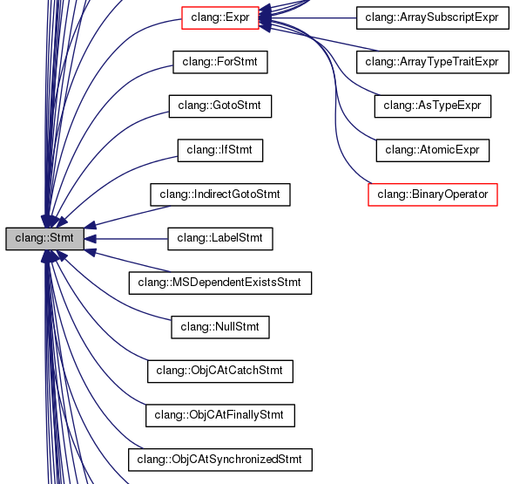
https://clang.llvm.org/doxygen/

Slide 14
Stmt (2/9)
Expr represents an expression (a subclass of Stmt)
Subclasses of Expr
CallExpr for function call
ImplicitCastExpr for implicit type casts
DeclRefExpr for referencing declared variables and functions
IntegerLiteral for integer literals
14
15
16
17
18
int main(int argc, char *argv[]) {
int param = 1;
myPrint(param);
return 0;
}
Expressions
(also statements)
Legend

Slide 15
Stmt (3/9)
Stmt may have a child containing additional information
CompoundStmt has statements in a code block of braces (“{}”)
int param = 1;
14
15
16
17
18
int main(int argc, char *argv[]) {
int param = 1;
myPrint(param);
return 0;
}
myPrint(param);
Legend
return 0;

Slide 16
Stmt (4/9)
Stmt may have a child containing additional information (cont’)
The first child of CallExpr is for a function pointer and the others are for function parameters
Legend
Declarations for DeclStmt
Function pointer for CallExpr
Function parameter for CallExpr
Return value for ReturnStmt

Slide 17
Stmt (5/9)
Expr has a type of an expression
Ex) a node of CallExpr has a type ‘void’
Some sub-classes of Expr can have a value
Ex) a node of IntegerLiteral has a value ‘1’
Legend
Values
Types
Value
Types

Slide 18
Stmt (6/9)
myPrint function contains IfStmt and ForStmt in its function body
6
7
8
9
10
11
12
void myPrint(int param) {
if (param == 1)
printf("param is 1");
for (int i=0;i<10;i++) {
global += i;
}
}

Slide 19
Stmt (7/9)
Condition variable
IfStmt has 4 children
A condition variable in VarDecl
In C++, you can declare a variable in condition (not in C)
A condition in Expr
Then block in Stmt
Else block in Stmt
Condition
6
7
8
9
10
11
12
void myPrint(int param) {
if (param == 1)
printf("param is 1");
for (int i = 0 ; i < 10 ; i++ ) {
global += i;
}
}
Then block
Else block

Slide 20
Stmt (8/9)
Initialization
Condition variable
ForStmt has 5 children
Initialization in Stmt
A condition variable in VarDecl
A condition in Expr
Increment in Expr
A loop block in Stmt
Condition
Increment
6
7
8
9
10
11
12
void myPrint(int param) {
if (param == 1)
printf("param is 1");
for (int i = 0 ; i < 10 ; i++ ) {
global += i;
}
}
Loop block

Slide 21
Stmt (9/9)
BinaryOperator has 2 children for operands
UnaryOperator has a child for operand
Two operands for BinaryOperator
6
7
8
9
10
11
12
void myPrint(int param) {
if (param == 1)
printf("param is 1");
for (int i = 0 ; i < 10 ; i++ ) {
global += i;
}
}
A operand for UnaryOperator

Slide 22
Traversing Clang AST (1/3)
Clang provides a visitor design pattern for user to access AST
ParseAST() starts building and traversal of an AST:
void clang::ParseAST (Preprocessor &pp, ASTConsumer *C, ASTContext &Ctx, …)
The callback function HandleTopLevelDecl() in ASTConsumer is called for each top-level declaration
HandleTopLevelDecl() receives a list of function and global variable declarations as a parameter
A user has to customize ASTConsumer to build his/her own program analyzer
1
2
3
4
5
6
7
8
9
10
11
12
class MyASTConsumer : public ASTConsumer
{
public:
MyASTConsumer(Rewriter &R) {}
virtual bool HandleTopLevelDecl(DeclGroupRef DR) {
for(DeclGroupRef::iterator b=DR.begin(), e=DR.end(); b!=e;++b){
… // variable b has each decleration in DR
}
return true;
}
};

Slide 23
Traversing Clang AST (2/3)
HandleTopLevelDecl() calls TraverseDecl() which recursively travel a target AST from the top-level declaration by calling VisitStmt (), VisitFunctionDecl(), etc.
1
2
3
4
5
6
7
8
9
10
11
12
13
14
15
16
17
18
19
20
21
22
23
class MyASTVisitor : public RecursiveASTVisitor<MyASTVisitor> {
bool VisitStmt(Stmt *s) {
printf("\t%s \n", s->getStmtClassName() );
return true;
}
bool VisitFunctionDecl(FunctionDecl *f) {
if (f->hasBody()) {
Stmt *FuncBody = f->getBody();
printf("%s\n", f->getName());
}
return true;
}
};
class MyASTConsumer : public ASTConsumer {
virtual bool HandleTopLevelDecl(DeclGroupRef DR) {
for (DeclGroupRef::iterator b = DR.begin(), e = DR.end(); b != e; ++b) {
MyASTVisitor Visitor;
Visitor.TraverseDecl(*b);
}
return true;
}
…
};
VisitStmt is called when Stmt is encountered
VisitFunctionDecl is called when FunctionDecl is encountered

Slide 24
Traversing Clang AST (3/3)
VisitStmt() in RecursiveASTVisitor is called for every Stmt object in the AST RecursiveASTVisitor visits each Stmt in a depth-first search order
If the return value of VisitStmt is false, recursive traversal halts
Example: main function of the previous example
RecursiveASTVisitor will visit all nodes in this box (the numbers are the order of traversal)
1
2
3
4
5
6
7
8
9
10
11

