Slide 1

The Satisfiability Modulo Theories Library (SMT-LIB)
Moonzoo Kim
SoC. KAIST

Slide 2
Motivation
How to convert the following C code into a logic formula to automatically solve by using a SMT (Satisfiability Modulo Theory) solver?
if( x*y + 3.14 * a[i]<<2 > x) {...}
1. There exist various SMT theories w/ different pros and cons
- There exists tradeoff between expressibility and computational complexity
2. Which SMT solver do you use?
a) LIA (linear integer arithmetic (i.e., not supporting bitwise operators &,<<))
b) AUFLIA (Array w/ Uninterpreted Func. and Linear Integer Arithmetic)
c) AUFLIRA (Array w/ Uninter. Func. and Linear Integer Real Arithmetic)
d) BV (Bit Vector)
...
2. Based on your choice of SMT solver, how to convert the C code into a logic formula?

Slide 3
Tradeoff: expressiveness/computational hardness.
Assume we are given theories L₁ ⊆ … ⊆ L_{n}
Computational
Challenge!
L₁
L_{n}
Easier to decide
More expressive
Tractable
(polynomial)
Intractable
(exponential)
Decidable
Undecidable
From the slides for the book “Decision procedures”
by D.Kroening and O.Strichman

Slide 4
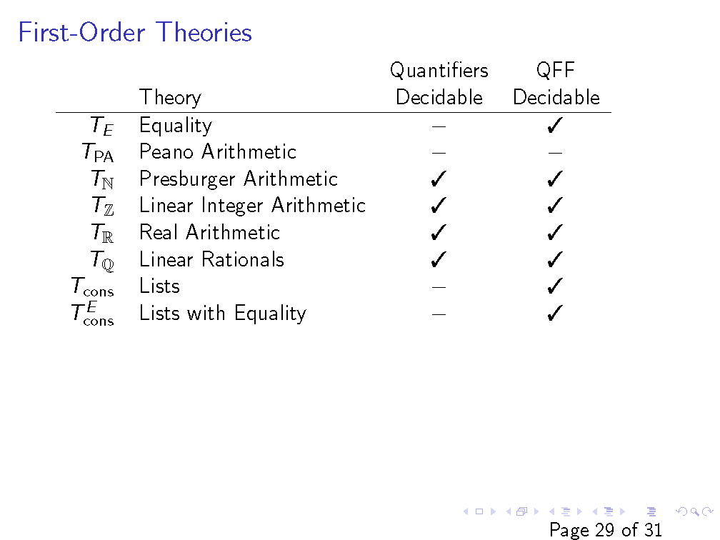
Slides from the original slides from CS156 by Prof. Z.Manna

Slide 5
Supported Theories (SMT-Lib v2)
ArraysEx
Functional arrays with extensionality.
Fixed_Size_BitVectors
Bit vectors with arbitrary size.
Core
Core theory, defining the basic Boolean operators
Ints
Integer numbers.
Reals
Real numbers.
Reals_Ints
Real and integer numbers.

Slide 6
Supported Sublogics
AUFLIA: Closed formulas over the theory of linear integer arithmetic and arrays extended with free sort and function symbols but restricted to arrays with integer indices and values. AUFLIRA: Closed linear formulas with free sort and function symbols over one- and two-dimentional arrays of integer index and real value. AUFNIRA: Closed formulas with free function and predicate symbols over a theory of arrays of arrays of integer index and real value. LRA: Closed linear formulas in linear real arithmetic. QF_ABV: Closed quantifier-free formulas over the theory of bitvectors and bitvector arrays. QF_AUFBV: Closed quantifier-free formulas over the theory of bitvectors and bitvector arrays extended with free sort and function symbols. QF_AUFLIA: Closed quantifier-free linear formulas over the theory of integer arrays extended with free sort and function symbols. QF_AX: Closed quantifier-free formulas over the theory of arrays with extensionality. QF_BV: Closed quantifier-free formulas over the theory of fixed-size bitvectors. QF_IDL: Difference Logic over the integers. In essence, Boolean combinations of inequations of the form x - y < b where x and y are integer variables and b is an integer constant. QF_LIA: Unquantified linear integer arithmetic. In essence, Boolean combinations of inequations between linear polynomials over integer variables. QF_LRA: Unquantified linear real arithmetic. In essence, Boolean combinations of inequations between linear polynomials over real variables. QF_NIA: Quantifier-free integer arithmetic. QF_NRA: Quantifier-free real arithmetic. QF_RDL: Difference Logic over the reals. In essence, Boolean combinations of inequations of the form x - y < b where x and y are real variables and b is a rational constant. QF_UF: Unquantified formulas built over a signature of uninterpreted (i.e., free) sort and function symbols. QF_UFBV: Unquantified formulas over bitvectors with uninterpreted sort function and symbols. QF_UFIDL: Difference Logic over the integers (in essence) but with uninterpreted sort and function symbols. QF_UFLIA: Unquantified linear integer arithmetic with uninterpreted sort and function symbols. QF_UFLRA: Unquantified linear real arithmetic with uninterpreted sort and function symbols. QF_UFNRA: Unquantified non-linear real arithmetic with uninterpreted sort and function symbols. UFLRA: Non-linear real arithmetic with uninterpreted sort and function symbols. UFNIA: Non-linear integer arithmetic with uninterpreted sort and function symbols.

Slide 7
Theory of Arrays
(theory Arrays
:written_by {Silvio Ranise and Cesare Tinelli}
:date {08/04/05}
:sorts (Index Element Array)
:funs ((select Array Index Element)
(store Array Index Element Array))
:definition
"This is a theory of functional arrays without extensionality.
It is formally and completely defined by the axioms below. "
:axioms (
(forall (?a Array) (?i Index) (?e Element)
(= (select (store ?a ?i ?e) ?i) ?e))
(forall (?a Array) (?i Index) (?j Index) (?e Element)
(or (= ?i ?j)
(= (select (store ?a ?i ?e) ?j) (select ?a ?j))))
)
:notes
"It is not difficult to prove that the two axioms above are logically equivalent to the following \"McCarthy axiom\":
(forall (?a Array) (?i Index) (?j Index)
(?e Element)
(= (select (store ?a ?i ?e) ?j)
(ite (= ?i ?j) ?e (select ?a ?j))))
Such an axiom appeared in the following paper:
Correctness of a Compiler for Arithmetic Expressions,
by John McCarthy and James Painter,
available at http://www-formal.stanford.edu/jmc/mcpain.html.
"
)
Predefined data types
Predefined functions
If-then-else term construct
Bounded variables
Prefix operator

Slide 8
Theory of Arrays w/ Extensionability
:axioms
(
(forall (?a Array) (?i Index) (?e Element)
(= (select (store ?a ?i ?e) ?i) ?e))
(forall (?a Array) (?i Index) (?j Index) (?e Element)
(or (= ?i ?j)
(= (select (store ?a ?i ?e) ?j)
(select ?a ?j))))
(forall (?a Array) (?b Array)
(implies (forall (?i Index) (= (select ?a ?i) (select ?b ?i)))
(= ?a ?b)))
)
:notes "This theory extends the theory Arrays with
an axiom stating that any two arrays with the same
elements are in fact the same array. " )
(theory ArraysEx
:written_by {Silvio Ranise and Cesare Tinelli}
:date {08/04/05}
:updated {28/10/05}
:history {
Bug fix in the third axiom, pointed out by Robert
Nieuwenhuis:
The scope of 'forall (?i Index)' was the whole implication
instead of just the premise of the implication.
}
:sorts (Index Element Array)
:funs ((select Array Index Element)
(store Array Index Element Array))
:definition
"This is a theory of functional arrays with extensionality.
It is formally and completely defined by the axioms below.
“

Slide 9
Theory of Integer
(theory Ints
:sorts (Int)
:notes
"The (unsupported) annotations of the function/predicate symbols have
the following meaning:
attribute | possible value | meaning
-------------------------------------------------------
:assoc // the symbol is associative
:comm // the symbol is commutative
:unit a constant
:trans // the symbol is transitive
:refl // the symbol is reflexive
:irref // the symbol is irreflexive
:antisym // the symbol is antisymmetric
"
:funs ((0 Int)
(1 Int)
(~ Int Int) ; unary minus
(- Int Int Int) ; binary minus
(+ Int Int Int :assoc :comm :unit {0})
(* Int Int Int :assoc :comm :unit {1}) )
:preds ((<= Int Int :refl :trans :antisym)
(< Int Int :trans :irref)
(>= Int Int :refl :trans :antisym)
(> Int Int :trans :irref)
)
:definition
"This is the first-order theory of the integers, that is
, the set of all the first-order sentences over the given
signature that are true in the structure of the integer
numbers interpreting the signature's symbols in the
obvious way (with ~ denoting the negation and - the
subtraction functions). "
:notes
"Note that this theory is not (recursively) axiomatizable
in a first-order logic such as SMT-LIB's underlying logic.
That is why the theory is defined semantically. "
)

Slide 10
Example of QF_LIA Benchmark
Theory
(set-logic QF_LIA)
(declare-const x1 Int)
(declare-const x2 Int)
(declare-const x3 Int)
(declare-const x4 Int)
(declare-const x5 Int)
;human readable form
; x1-1 >= x2 /\
; x1-3 <= x2 /\
; x1 = 2 x3+x5 /\
; x2 = 6 x4
(assert (>= (- x1 x2) 1))
(assert (<= (- x1 x2) 3))
(assert (= x1 (+ (* 2 x3) x5)))
(assert (= x2 (* 6 x4)))
(check-sat)
(get-model)
(exit)
User defined variables
x2
(x1,x2)=(1,0)
(x3,x4,x5)=(0,0,1)
x1
Comments
-1
-3
Target formula
(x1,x2)=(-3,-6)
(x3,x4,x5)=(-1,-1,-1)
Command to check satisfiability
Command to get a mode if SAT
Notes:
x1=1
x2=0
x3=0
x4=0
x5=1

Slide 11
Example of QF_UF Benchmark (1/2)
(set-logic QF_UF)
(declare-sort A 0)
(declare-sort B 0)
(declare-fun f (A A) B)
(declare-fun g (A B) B)
(declare-fun h1 (B A) B)
(declare-fun h2 (B B) B)
(declare-const x A)
(declare-const y B)
(declare-const w A)
;human readable form
; g(x,y) = h1(y,x) /\
; f(x,x) = h2(y,y) /\
; f(x,x) != f(x,w)
(assert (= (g x y) (h1 y x)))
(assert (= (f x x) (h2 y y)))
(assert (not (= (f x x) (f x w))))
(check-sat)
(get-model)
(exit)
User defined data types
(0 is arity of a type)
User defined functions
(define-fun h1 ((x!1 B) (x!2 A)) B
(ite (and (= x!1 B!val!0) (= x!2 A!val!0)) B!val!1
B!val!1))
(define-fun h2 ((x!1 B) (x!2 B)) B
(ite (and (= x!1 B!val!0) (= x!2 B!val!0)) B!val!2
B!val!2))
(define-fun g ((x!1 A) (x!2 B)) B
(ite (and (= x!1 A!val!0) (= x!2 B!val!0)) B!val!1
B!val!1))
(define-fun f ((x!1 A) (x!2 A)) B
(ite (and (= x!1 A!val!0) (= x!2 A!val!0)) B!val!2
(ite (and (= x!1 A!val!0) (= x!2 A!val!1)) B!val!3
B!val!2)))
If-Then-Else
Notes:
moonzoo@verifier4:~/smtlib$ z3 qf-uf-example.smt2
sat
(model
;; universe for A:
;; A!val!0 A!val!1
;; -----------
;; definitions for universe elements:
(declare-fun A!val!0 () A)
(declare-fun A!val!1 () A)
;; cardinality constraint:
(forall ((x A)) (or (= x A!val!0) (= x A!val!1)))
;; -----------
;; universe for B:
;; B!val!3 B!val!2 B!val!1 B!val!0
;; -----------
;; definitions for universe elements:
(declare-fun B!val!3 () B)
(declare-fun B!val!2 () B)
(declare-fun B!val!1 () B)
(declare-fun B!val!0 () B)
;; cardinality constraint:
(forall ((x B)) (or (= x B!val!3) (= x B!val!2) (= x B!val!1) (= x B!val!0)))
;; -----------
(define-fun w () A
A!val!1)
(define-fun y () B
B!val!0)
(define-fun x () A
A!val!0)
(define-fun h1 ((x!1 B) (x!2 A)) B
(ite (and (= x!1 B!val!0) (= x!2 A!val!0)) B!val!1
B!val!1))
(define-fun h2 ((x!1 B) (x!2 B)) B
(ite (and (= x!1 B!val!0) (= x!2 B!val!0)) B!val!2
B!val!2))
(define-fun g ((x!1 A) (x!2 B)) B
(ite (and (= x!1 A!val!0) (= x!2 B!val!0)) B!val!1
B!val!1))
(define-fun f ((x!1 A) (x!2 A)) B
(ite (and (= x!1 A!val!0) (= x!2 A!val!0)) B!val!2
(ite (and (= x!1 A!val!0) (= x!2 A!val!1)) B!val!3
B!val!2)))
)

Slide 12
Example of QF_UF Benchmark (2/2)
(set-logic QF_UF)
(declare-sort A 0)
(declare-sort B 0)
(declare-fun f (A A) B)
(declare-fun g (A B) B)
(declare-fun h1 (B A) B)
(declare-fun h2 (B B) B)
(declare-const x A)
(declare-const y B)
(declare-const w A)
;human readable form
; g(x,y) = h1(y,x) /\
; f(x,x) = h2(y,y) /\
; f(x,x) != f(x,w)
(assert (= (g x y) (h1 y x)))
(assert (= (f x x) (h2 y y)))
(assert (not (= (f x x) (f x w))))
(check-sat)
(get-model)
(exit)
User defined data types
(0 is arity of a type)
A model for the formula
x-> a0
y-> b0
w->a1
f->{(a0,a0)->b2,
(a0,a1)->b3,
else->b2}
g->{ (a0,b0)->b1,
else-> b1}
h1->{(b0,a0)->b1,
else -> b1}
h2->{(b0,b0)->b2,
else -> b2}
User defined functions
Notes:
moonzoo@verifier4:~/smtlib$ z3 qf-uf-example.smt2
sat
(model
;; universe for A:
;; A!val!0 A!val!1
;; -----------
;; definitions for universe elements:
(declare-fun A!val!0 () A)
(declare-fun A!val!1 () A)
;; cardinality constraint:
(forall ((x A)) (or (= x A!val!0) (= x A!val!1)))
;; -----------
;; universe for B:
;; B!val!3 B!val!2 B!val!1 B!val!0
;; -----------
;; definitions for universe elements:
(declare-fun B!val!3 () B)
(declare-fun B!val!2 () B)
(declare-fun B!val!1 () B)
(declare-fun B!val!0 () B)
;; cardinality constraint:
(forall ((x B)) (or (= x B!val!3) (= x B!val!2) (= x B!val!1) (= x B!val!0)))
;; -----------
(define-fun w () A
A!val!1)
(define-fun y () B
B!val!0)
(define-fun x () A
A!val!0)
(define-fun h1 ((x!1 B) (x!2 A)) B
(ite (and (= x!1 B!val!0) (= x!2 A!val!0)) B!val!1
B!val!1))
(define-fun h2 ((x!1 B) (x!2 B)) B
(ite (and (= x!1 B!val!0) (= x!2 B!val!0)) B!val!2
B!val!2))
(define-fun g ((x!1 A) (x!2 B)) B
(ite (and (= x!1 A!val!0) (= x!2 B!val!0)) B!val!1
B!val!1))
(define-fun f ((x!1 A) (x!2 A)) B
(ite (and (= x!1 A!val!0) (= x!2 A!val!0)) B!val!2
(ite (and (= x!1 A!val!0) (= x!2 A!val!1)) B!val!3
B!val!2)))
)

Slide 13
Another Example of QF_UF Benchmark
1. Prove that
F : a=b ^ b=c -> g(f(a), b) = g(f (c), a)
is T_{QF_UF}–satisfiable
2. Prove
F : a=b ^ b=c -> g(f(a), b) = g(f (c), a)
is T_{QF_UF}–valid through proof tree
(set-logic QF_UF)
(declare-sort A 0)
(declare-sort B 0)
(declare-sort C 0)
(declare-const a A)
(declare-const b A)
(declare-const c A)
(declare-fun f (A) B)
(declare-fun g (B A) C)
; a=b/\ b=c -> g(f(a),b) = g(f(c),a)
(assert (=> (and (= a b) (= b c)) (= (g ( f a) b) (g (f c) a))))
(check-sat)
(get-model)
A model for the formula
a->a0
b->a1
c->a2
f->{a0->b0, a2->b1, else->b0}
g->{(b0,a1)->c0,(b1,a0)->c1,else->c0}
Then, how to check
T_{QF_UF}–validity of F by
using a SMT solver???

Slide 14
Example of QF_AUFLIA
(set-logic QF_AUFLIA)
(declare-const data_3 (Array Int Int)) ; initial data[] declaration
; Iteration 1
(declare-const data_3_1_0 (Array Int Int))
(assert (= data_3_1_0 data_3)) ; data_(size)_(iteration)_(ssa idx)
(declare-const i_1 Int)
(assert (= i_1 0)) ; i = 0;
(declare-const j_1 Int)
(assert (= j_1 1)) ; j = 1;
(declare-const tmp_1 Int)
(assert (= tmp_1 (select data_3_1_0 0))) ; tmp = data[0];
(declare-const data_3_1_1 (Array Int Int))
(assert (= data_3_1_1 (store data_3_1_0 0 (select data_3_1_0 1)))) ; data[0] = data[1];
(declare-const data_3_1_2 (Array Int Int))
(assert (= data_3_1_2 (store data_3_1_1 1 tmp_1))) ; data[1] = tmp
(declare-const data_3_1_3 (Array Int Int))
; if (data[0] > data[1]) {tmp = data[0]; data[0] = data[1]; data[1] = tmp;}
(assert (= data_3_1_3 (ite (> (select data_3_1_0 0) (select data_3_1_0 1)) data_3_1_2 data_3_1_0)))
...
(assert (not (and (<= (select data_3_3_3 0) (select data_3_3_3 1))
(<= (select data_3_3_3 1) (select data_3_3_3 2)))))
#define N 7
int main(){
int data[N], i, j, tmp;
for (i=0; i<N-1; i++)
for (j=i+1; j<N; j++)
if(data[i]>data[j]){
tmp = data[i];
data[i] = data[j];
data[j] = tmp;
}
assert(data[0]<=data[1]…);
}

Slide 15
Theory of Fixed_Size_BitVectors[32]
:sorts_description
"All sort symbols of the form BitVec[i],
where i is a numeral between 1 and 32, inclusive.“
:funs_description
"All function symbols with arity of the form
(concat BitVec[i] BitVec[j] BitVec[m]) where
- i,j,m are numerals
- i,j > 0
- i + j = m <= 32 “
:funs_description
"All function symbols with arity of the form
(extract[i:j] BitVec[m] BitVec[n]) where
- i,j,m,n are numerals
- 32 >= m > i >= j >= 0,
- n = i-j+1. “
:funs_description
"All function symbols with arity of the form
(op1 BitVec[m] BitVec[m]) or
(op2 BitVec[m] BitVec[m] BitVec[m]) where
- op1 is from {bvnot, bvneg}
- op2 is from {bvand,bvor,bvxor,bvsub,bvadd,bvmul}
- m is a numeral
- 0 < m <= 32 “
:preds_description
"All predicate symbols with arity of the form
(pred BitVec[m] BitVec[m]) where
- pred is from {bvult, bvule, bvuge, bvugt, bvslt, bvsle, bvsge, bvsgt,}
- m is a numeral
- 0 < m <= 32 "
- Variables
If v is a variable of sort BitVec[m] with 0 < m <= 32, then
[[v]] is some element of [{0,...,m-1} -> {0,1}], the set of
total functions from {0,...,m-1} to {0,1}.
- Constant symbols bv0 and bv1 of sort BitVec[32]
[[bv0]] := \lambda x : [0...32). 0
[[bv1]] := \lambda x : [0...32). if x = 0 then 1 else 0
- Function symbols for concatenation
[[(concat s t)]] := \lambda x : [0...n+m).
if (x<m) then [[t]](x) else [[s]](x-m) where
s and t are terms of sort BitVec[n] and BitVec[m],
respectively, 0 < n <= 32, 0 < m <= 32, and n+m <= 32.
- Function symbols for extraction
[[(extract[i:j] s)]] := \lambda x : [0...i-j+1). [[s]](j+x)
where s is of sort BitVec[l], 0 <= j <= i < l <= 32.
- Function symbols for arithmetic operations
To define the semantics of the bitvector operators bvadd
, bvsub, bvneg, and bvmul, it is helpful to use these
ancillary functions:
o bv2nat which takes a bitvector b: [0...m) --> {0,1}
with 0 < m <= 32, and returns an integer in the range
[0...2^m), and is defined as follows:
bv2nat(b) := b(m-1)*2^{m-1} + b(m-2)*2^{m-2} + ... + b(0)*2^0
o nat2bv[m], with 0 < m <= 32, which takes a non-negative
integer n and returns the (unique) bitvector b: [0,...,m) -> {0,1}
such that b(m-1)*2^{m-1} + ... + b(0)*2^0 = n MOD 2^m
where MOD is usual modulo operation.
[[(bvadd s t)]] := nat2bv[m](bv2nat(s) + bv2nat(t))

Slide 16
QF_BV Example
; Modeling sequential code with bitvectors
; Correct swap with no temp var
; int x, y;
; x = x + y;
; y = x - y;
; x = x - y;
(set-logic QF_BV)
(set-option :produce-models true)
(declare-const x_0 (_ BitVec 32))
(declare-const x_1 (_ BitVec 32))
(declare-const x_2 (_ BitVec 32))
(declare-const y_0 (_ BitVec 32))
(declare-const y_1 (_ BitVec 32))
(assert (= x_1 (bvadd x_0 y_0)))
(assert (= y_1 (bvsub x_1 y_0)))
(assert (= x_2 (bvsub x_1 y_1)))
(assert (not (and (= x_2 y_0) (= y_1 x_0))))
(check-sat) ; unsat
(exit)

