Slide 1
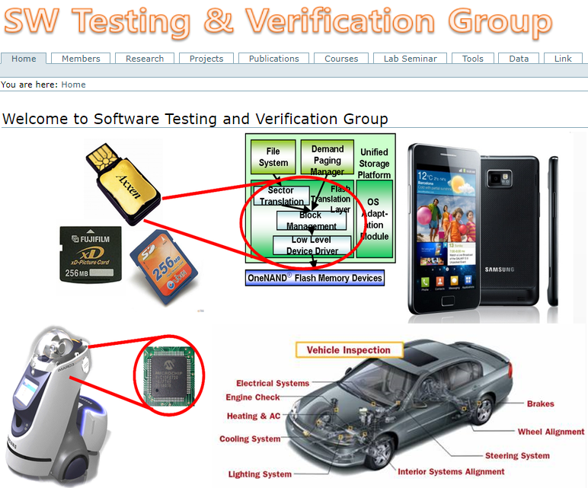

Automated Software Analysis Techniques For High Reliability: A Concolic Testing Approach
Moonzoo Kim

Slide 2
Contents
Automated Software Analysis Techniques
Background
Concolic testing process
Example of concolic testing
Case Study: Busybox utility
Future Direction and Conclusion

Slide 3
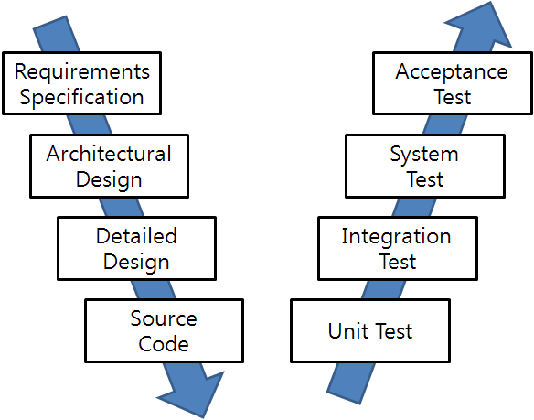
Main Target of Automated SW Analysis
Manual
Labor
Abstraction

Slide 4
Automated Software Analysis Techniques
Aims to explore possible behaviors of target systems in an exhaustive manner
Key methods:
Represents a target program/or executions as a “logical formula”
Then, analyze the logical formula (a target program) by using logic analysis techniques
Symbolic execution (1970)
Model checking (1980)
SW model checking (2000)
Concolic testing (2005 ~)
Weakness of
conventional
testing

Slide 5
Hierarchy of SW Coverages
Complete Value Coverage
CVC
(SW) Model checking
Complete Path Coverage
CPC
Concolic testing
Prime Path Coverage
PPC
All-DU-Paths Coverage
ADUP
Edge-Pair Coverage
EPC
All-uses Coverage
AUC
Complete Round Trip Coverage
CRTC
Edge Coverage
EC
All-defs Coverage
ADC
Simple Round Trip Coverage
SRTC
Node Coverage
NC

Slide 6

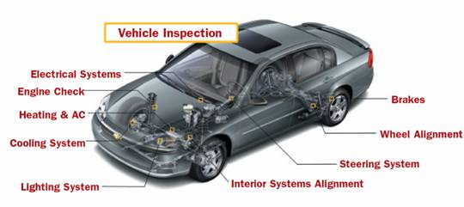
Weaknesses of the Branch Coverage
/* TC1: x= 1, y= 1;
TC2: x=-1, y=-1;*/
void foo(int x, int y) {
if ( x > 0)
x++;
else
x--;
if(y >0)
y++;
else
y--;
assert (x * y >= 0);
}
yes
no
x>0
x++
x--
y>0
y++
y--
assert(x*y>=0)
Systematic testing techniques are necessary for quality software!
-> Integration testing is not enough
-> Unit testing with automated test case generation is desirable
for both productivity and quality

Slide 7
Dynamic v.s. Static Analysis
 | Dynamic Analysis (i.e., testing) | Static Analysis (i.e. model checking)
Pros | Real result No environmental limitation Binary library is ok | Complete analysis result Fully automatic Concrete counter example
Cons | Incomplete analysis result Test case selection | Consumed huge memory space Takes huge time for verification False alarms
-> Concolic testing

Slide 8
Concolic Approach
Combine concrete and symbolic execution
Concrete + Symbolic = Concolic
In a nutshell, concrete execution over a concrete input guides symbolic execution
No false positives
Automated testing of real-world C Programs
Execute target program on automatically generated test inputs
All possible execution paths are to be explored
Higher branch coverage than random testing
Notes:
Concrete execution helps Symbolic execution to simplify complex and unmanageable symbolic expressions
by replacing symbolic values by concrete values

Slide 9
Overview of Concolic Testing Process
Select input variables to be handled symbolically
A target C program is statically instrumented with probes, which record symbolic path conditions
The instrumented C program is executed with given input values
Initial input values are assigned randomly
Obtain a symbolic path formula φ_{i} from a concrete execution over a concrete input
One branch condition of φ_{i} is negated to generate a modified symbolic path formula φ_{i}'
A constraint solver solves φ_{i}' to get next concrete input values
Ex. φ_{i} : (x < 2) && (x + y >= 2) and φ_{i}' : (x < 2) && (x + y < 2).
One solution is x=1 and y=0
Repeat step 3 until all feasible execution paths are explored
Itera-
tions

Slide 10
Concolic Testing Example
Random testing
Probability of reaching Error( ) is extremely low
Concolic testing generates the following 4 test inputs
(0,0,0): initial random input
Obtained symbolic path formula (SPF) φ: a!=1
A modified SPF φ' generated from φ : !(a!=1)
(1,0,0): a solution of φ' (i.e. !(a!=1))
SPF φ : a==1 && b!=2
A modified SPF φ' : a==1 && !(b!=2)
(1,2,0)
SPF φ : a==1 && (b==2) && (c!=3*a +b)
A modified SPF φ' : a==1 && (b==2) && !(c!=3*a +b)
(1,2,5)
Covered all paths and
// Test input a, b, c
void f(int a, int b, int c) {
if (a == 1) {
if (b == 2) {
if (c == 3*a + b) {
Error();
} } } }
a!=1
a==1
(0,0,0)
b!=2
b==2
Error()
reached
(1,0,0)
c==
3*a+b
c!=3*a+b
(1,2,0)
(1,2,5)

Slide 11
Concolic Testing Example’
Random testing
Probability of reaching Error( ) is extremely low
Concolic testing generates the following 4 test inputs
(0,0,0): initial random input
Obtained symbolic path formula (SPF) φ: a!=1
A modified SPF φ' generated from φ : !(a!=1)
(1,0,0): a solution of φ' (i.e. !(a!=1))
SPF φ : a==1 && b!=2
A modified SPF φ' : a==1 && !(b!=2)
(1,2,0)
φ : a==1 && (b==2) && b’== b +a && (c!=3*a +b’)
φ' : a==1 && (b==2) && b’== b +a && !(c!=3*a +b’)
(1,2,6)
Covered all paths and
// Test input a, b, c
void f(int a, int b, int c) {
if (a == 1) {
if (b == 2) {
b= b+a;
if (c == 3*a + b) {
Error();
} } } }
a!=1
a==1
(0,0,0)
b!=2
b==2
Error()
reached
(1,0,0)
c==
3*a+b’
c!=3*a+b
(1,2,0)
(1,2,6)

Slide 12
Example
typedef struct cell {
int v;
struct cell *next;
} cell;
int f(int v) {
return 2*v + 1;
}
int testme(cell *p, int x) {
if (x > 0)
if (p != NULL)
if (f(x) == p->v)
if (p->next == p)
Error();
return 0;
}
Random Test Driver:
random memory graph reachable from p
random value for x
Probability of reaching Error( ) is extremely low
Example from the slides “CUTE: A Concolic Unit Testing Engine for C” by K.Sen 2005

Slide 13
Concolic Testing
typedef struct cell {
int v;
struct cell *next;
} cell;
int f(int v) {
return 2*v + 1;
}
int testme(cell *p, int x) {
if (x > 0)
if (p != NULL)
if (f(x) == p->v)
if (p->next == p)
Error();
return 0;
}
Concrete Execution
Symbolic Execution
concrete state
symbolic state
constraints
p , x=236 NULL
p=p₀, x=x₀

Slide 14
Concolic Testing
typedef struct cell {
int v;
struct cell *next;
} cell;
int f(int v) {
return 2*v + 1;
}
int testme(cell *p, int x) {
if (x > 0)
if (p != NULL)
if (f(x) == p->v)
if (p->next == p)
Error();
return 0;
}
Concrete Execution
Symbolic Execution
concrete state
symbolic state
constraints
p , x=236 NULL
p=p₀, x=x₀

Slide 15
Concolic Testing
typedef struct cell {
int v;
struct cell *next;
} cell;
int f(int v) {
return 2*v + 1;
}
int testme(cell *p, int x) {
if (x > 0)
if (p != NULL)
if (f(x) == p->v)
if (p->next == p)
Error();
return 0;
}
Concrete Execution
Symbolic Execution
concrete state
symbolic state
constraints
x₀>0
p , x=236 NULL
p=p₀, x=x₀

Slide 16
Concolic Testing
typedef struct cell {
int v;
struct cell *next;
} cell;
int f(int v) {
return 2*v + 1;
}
int testme(cell *p, int x) {
if (x > 0)
if (p != NULL)
if (f(x) == p->v)
if (p->next == p)
Error();
return 0;
}
Concrete Execution
Symbolic Execution
concrete state
symbolic state
constraints
x₀>0
!(p₀!=NULL)
p , x=236 NULL
p=p₀, x=x₀

Slide 17
Concolic Testing
typedef struct cell {
int v;
struct cell *next;
} cell;
int f(int v) {
return 2*v + 1;
}
int testme(cell *p, int x) {
if (x > 0)
if (p != NULL)
if (f(x) == p->v)
if (p->next == p)
Error();
return 0;
}
Concrete Execution
Symbolic Execution
concrete state
symbolic state
constraints
solve: x₀>0 and p₀≠NULL
x₀>0
p₀=NULL
p , x=236 NULL
p=p₀, x=x₀

Slide 18
Concolic Testing
typedef struct cell {
int v;
struct cell *next;
} cell;
int f(int v) {
return 2*v + 1;
}
int testme(cell *p, int x) {
if (x > 0)
if (p != NULL)
if (f(x) == p->v)
if (p->next == p)
Error();
return 0;
}
Concrete Execution
Symbolic Execution
concrete state
symbolic state
constraints
solve: x₀>0 and p₀≠NULL
x₀=236, p₀
NULL
634
x₀>0
p₀=NULL
p , x=236 NULL
p=p₀, x=x₀

Slide 19
Concolic Testing
typedef struct cell {
int v;
struct cell *next;
} cell;
int f(int v) {
return 2*v + 1;
}
int testme(cell *p, int x) {
if (x > 0)
if (p != NULL)
if (f(x) == p->v)
if (p->next == p)
Error();
return 0;
}
Concrete Execution
Symbolic Execution
concrete state
symbolic state
constraints
p , x=236
NULL
p=p₀, x=x₀, p->v =v₀, p->next=n₀
634

Slide 20
Concolic Testing
typedef struct cell {
int v;
struct cell *next;
} cell;
int f(int v) {
return 2*v + 1;
}
int testme(cell *p, int x) {
if (x > 0)
if (p != NULL)
if (f(x) == p->v)
if (p->next == p)
Error();
return 0;
}
Concrete Execution
Symbolic Execution
concrete state
symbolic state
constraints
p , x=236
NULL
p=p₀, x=x₀, p->v =v₀, p->next=n₀
x₀>0
634

Slide 21
Concolic Testing
typedef struct cell {
int v;
struct cell *next;
} cell;
int f(int v) {
return 2*v + 1;
}
int testme(cell *p, int x) {
if (x > 0)
if (p != NULL)
if (f(x) == p->v)
if (p->next == p)
Error();
return 0;
}
Concrete Execution
Symbolic Execution
concrete state
symbolic state
constraints
x₀>0
p , x=236
NULL
p=p₀, x=x₀, p->v =v₀, p->next=n₀
p₀≠NULL
634

Slide 22
Concolic Testing
typedef struct cell {
int v;
struct cell *next;
} cell;
int f(int v) {
return 2*v + 1;
}
int testme(cell *p, int x) {
if (x > 0)
if (p != NULL)
if (f(x) == p->v)
if (p->next == p)
Error();
return 0;
}
Concrete Execution
Symbolic Execution
concrete state
symbolic state
constraints
x₀>0
p₀≠NULL
p , x=236
NULL
p=p₀, x=x₀, p->v =v₀, p->next=n₀
2x₀+1≠v₀
634

Slide 23
Concolic Testing
typedef struct cell {
int v;
struct cell *next;
} cell;
int f(int v) {
return 2*v + 1;
}
int testme(cell *p, int x) {
if (x > 0)
if (p != NULL)
if (f(x) == p->v)
if (p->next == p)
Error();
return 0;
}
Concrete Execution
Symbolic Execution
concrete state
symbolic state
constraints
x₀>0
p₀≠NULL
2x₀+1≠v₀
p , x=236
NULL
p=p₀, x=x₀, p->v =v₀, p->next=n₀
634

Slide 24
Concolic Testing
typedef struct cell {
int v;
struct cell *next;
} cell;
int f(int v) {
return 2*v + 1;
}
int testme(cell *p, int x) {
if (x > 0)
if (p != NULL)
if (f(x) == p->v)
if (p->next == p)
Error();
return 0;
}
Concrete Execution
Symbolic Execution
concrete state
symbolic state
constraints
solve: x₀>0 and p₀≠NULL and 2x₀+1=v₀
x₀>0
p₀≠NULL
2x₀+1≠v₀
p , x=236
NULL
p=p₀, x=x₀, p->v =v₀, p->next=n₀
634

Slide 25
Concolic Testing
typedef struct cell {
int v;
struct cell *next;
} cell;
int f(int v) {
return 2*v + 1;
}
int testme(cell *p, int x) {
if (x > 0)
if (p != NULL)
if (f(x) == p->v)
if (p->next == p)
Error();
return 0;
}
Concrete Execution
Symbolic Execution
concrete state
symbolic state
constraints
solve: x₀>0 and p₀≠NULL and 2x₀+1=v₀
x₀=1, p₀
NULL
3
x₀>0
p₀≠NULL
2x₀+1≠v₀
p , x=236
NULL
p=p₀, x=x₀, p->v =v₀, p->next=n₀
634

Slide 26
Concolic Testing
typedef struct cell {
int v;
struct cell *next;
} cell;
int f(int v) {
return 2*v + 1;
}
int testme(cell *p, int x) {
if (x > 0)
if (p != NULL)
if (f(x) == p->v)
if (p->next == p)
Error();
return 0;
}
Concrete Execution
Symbolic Execution
concrete state
symbolic state
constraints
p , x=1
NULL
p=p₀, x=x₀, p->v =v₀, p->next=n₀
3

Slide 27
Concolic Testing
typedef struct cell {
int v;
struct cell *next;
} cell;
int f(int v) {
return 2*v + 1;
}
int testme(cell *p, int x) {
if (x > 0)
if (p != NULL)
if (f(x) == p->v)
if (p->next == p)
Error();
return 0;
}
Concrete Execution
Symbolic Execution
concrete state
symbolic state
constraints
p , x=1
NULL
p=p₀, x=x₀, p->v =v₀, p->next=n₀
x₀>0
3

Slide 28
Concolic Testing
typedef struct cell {
int v;
struct cell *next;
} cell;
int f(int v) {
return 2*v + 1;
}
int testme(cell *p, int x) {
if (x > 0)
if (p != NULL)
if (f(x) == p->v)
if (p->next == p)
Error();
return 0;
}
Concrete Execution
Symbolic Execution
concrete state
symbolic state
constraints
x₀>0
p , x=1
NULL
p=p₀, x=x₀, p->v =v₀, p->next=n₀
p₀≠NULL
3

Slide 29
Concolic Testing
typedef struct cell {
int v;
struct cell *next;
} cell;
int f(int v) {
return 2*v + 1;
}
int testme(cell *p, int x) {
if (x > 0)
if (p != NULL)
if (f(x) == p->v)
if (p->next == p)
Error();
return 0;
}
Concrete Execution
Symbolic Execution
concrete state
symbolic state
constraints
x₀>0
p₀≠NULL
p , x=1
NULL
p=p₀, x=x₀, p->v =v₀, p->next=n₀
2x₀+1=v₀
3

Slide 30
Concolic Testing
typedef struct cell {
int v;
struct cell *next;
} cell;
int f(int v) {
return 2*v + 1;
}
int testme(cell *p, int x) {
if (x > 0)
if (p != NULL)
if (f(x) == p->v)
if (p->next == p)
Error();
return 0;
}
Concrete Execution
Symbolic Execution
concrete state
symbolic state
constraints
x₀>0
p₀≠NULL
p , x=1
NULL
p=p₀, x=x₀, p->v =v₀, p->next=n₀
2x₀+1=v₀
n₀≠p₀
3

Slide 31
Concolic Testing
typedef struct cell {
int v;
struct cell *next;
} cell;
int f(int v) {
return 2*v + 1;
}
int testme(cell *p, int x) {
if (x > 0)
if (p != NULL)
if (f(x) == p->v)
if (p->next == p)
Error();
return 0;
}
Concrete Execution
Symbolic Execution
concrete state
symbolic state
constraints
x₀>0
p₀≠NULL
2x₀+1=v₀
n₀≠p₀
p , x=1
NULL
p=p₀, x=x₀, p->v =v₀, p->next=n₀
3

Slide 32
Concolic Testing
typedef struct cell {
int v;
struct cell *next;
} cell;
int f(int v) {
return 2*v + 1;
}
int testme(cell *p, int x) {
if (x > 0)
if (p != NULL)
if (f(x) == p->v)
if (p->next == p)
Error();
return 0;
}
Concrete Execution
Symbolic Execution
concrete state
symbolic state
constraints
solve: x₀>0 and p₀≠NULL and 2x₀+1=v₀ and n₀=p₀
x₀>0
p₀≠NULL
2x₀+1=v₀
n₀≠p₀
p , x=1
NULL
p=p₀, x=x₀, p->v =v₀, p->next=n₀
3

Slide 33
Concolic Testing
typedef struct cell {
int v;
struct cell *next;
} cell;
int f(int v) {
return 2*v + 1;
}
int testme(cell *p, int x) {
if (x > 0)
if (p != NULL)
if (f(x) == p->v)
if (p->next == p)
Error();
return 0;
}
Concrete Execution
Symbolic Execution
concrete state
symbolic state
constraints
solve: x₀>0 and p₀≠NULL and 2x₀+1=v₀ and n₀=p₀
x₀=1, p₀
x₀>0
3
p₀≠NULL
2x₀+1=v₀
n₀≠p₀
p , x=1
NULL
p=p₀, x=x₀, p->v =v₀, p->next=n₀
3

Slide 34
Concolic Testing
typedef struct cell {
int v;
struct cell *next;
} cell;
int f(int v) {
return 2*v + 1;
}
int testme(cell *p, int x) {
if (x > 0)
if (p != NULL)
if (f(x) == p->v)
if (p->next == p)
Error();
return 0;
}
Concrete Execution
Symbolic Execution
concrete state
symbolic state
constraints
p , x=1
p=p₀, x=x₀, p->v =v₀, p->next=n₀
3

Slide 35
Concolic Testing
typedef struct cell {
int v;
struct cell *next;
} cell;
int f(int v) {
return 2*v + 1;
}
int testme(cell *p, int x) {
if (x > 0)
if (p != NULL)
if (f(x) == p->v)
if (p->next == p)
Error();
return 0;
}
Concrete Execution
Symbolic Execution
concrete state
symbolic state
constraints
p , x=1
p=p₀, x=x₀, p->v =v₀, p->next=n₀
x₀>0
3

Slide 36
Concolic Testing
typedef struct cell {
int v;
struct cell *next;
} cell;
int f(int v) {
return 2*v + 1;
}
int testme(cell *p, int x) {
if (x > 0)
if (p != NULL)
if (f(x) == p->v)
if (p->next == p)
Error();
return 0;
}
Concrete Execution
Symbolic Execution
concrete state
symbolic state
constraints
x₀>0
p , x=1
p=p₀, x=x₀, p->v =v₀, p->next=n₀
p₀≠NULL
3

Slide 37
Concolic Testing
typedef struct cell {
int v;
struct cell *next;
} cell;
int f(int v) {
return 2*v + 1;
}
int testme(cell *p, int x) {
if (x > 0)
if (p != NULL)
if (f(x) == p->v)
if (p->next == p)
Error();
return 0;
}
Concrete Execution
Symbolic Execution
concrete state
symbolic state
constraints
x₀>0
p₀≠NULL
p , x=1
p=p₀, x=x₀, p->v =v₀, p->next=n₀
2x₀+1=v₀
3

Slide 38
Concolic Testing
typedef struct cell {
int v;
struct cell *next;
} cell;
int f(int v) {
return 2*v + 1;
}
int testme(cell *p, int x) {
if (x > 0)
if (p != NULL)
if (f(x) == p->v)
if (p->next == p)
Error();
return 0;
}
Concrete Execution
Symbolic Execution
concrete state
symbolic state
constraints
Error()
reached
x₀>0
p₀≠NULL
p , x=1
p=p₀, x=x₀, p->v =v₀, p->next=n₀
2x₀+1=v₀
n₀=p₀
3

Slide 39
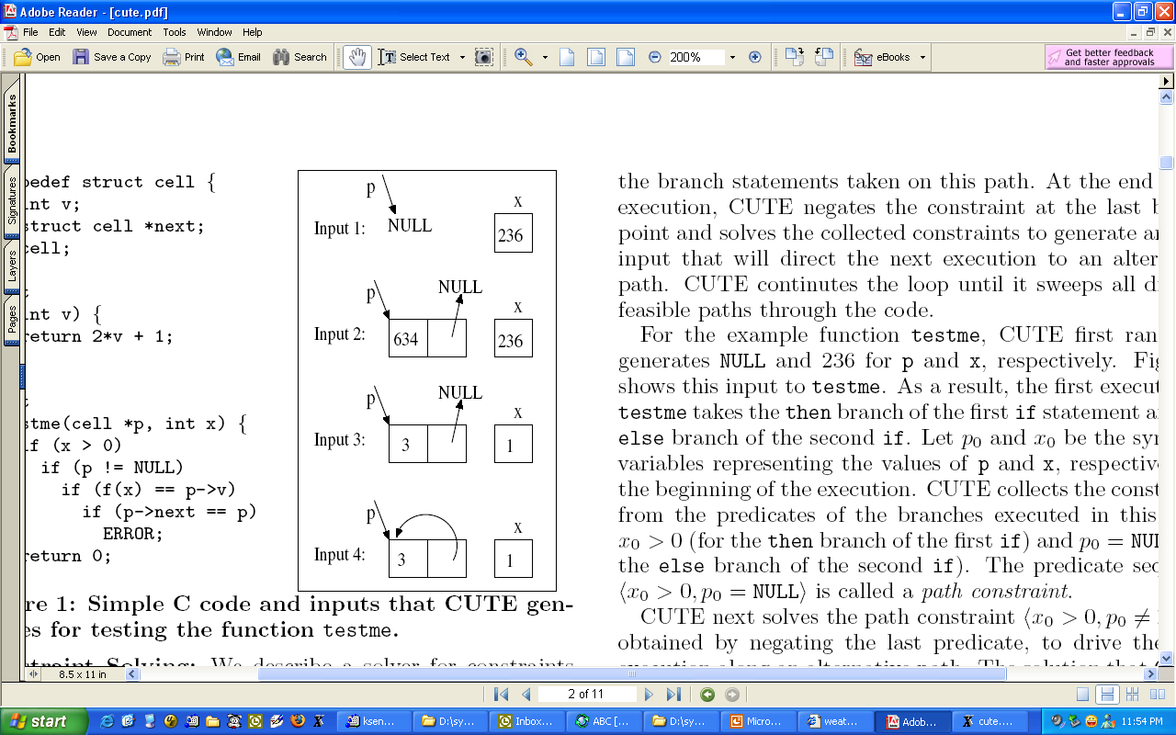
4 Test Inputs Generated
typedef struct cell {
int v;
struct cell *next;
} cell;
int f(int v) {
return 2*v + 1;
}
int testme(cell *p, int x) {
if (x > 0)
if (p != NULL)
if (f(x) == p->v)
if (p->next == p)
Error();
return 0;
}

Slide 40
Summary: Concolic Testing
Pros
Automated test case generation
High coverage
High applicability (no restriction on target programs)
Cons
If a target program has external binrary function calls, coverage might not be complete
Ex. if( sin(x) + query(y) == 0.3) { error(); }
Current limitation on pointer and array
Slow analysis speed due to a large # of TCs

Slide 41
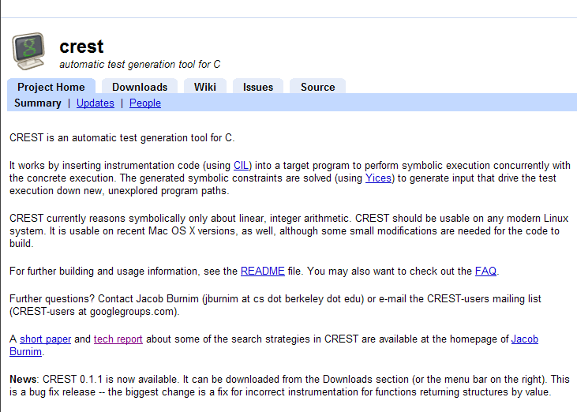


Concolic Testing Tools
CROWN
Target: C
Instrumentation based extraction
BV supported
https://github.com/swtv-kaist/CROWN
KLEE (open source)
Target: LLVM
VM based symbolic formula extraction
BV supported
Symbolic POSIX library supported
http://ccadar.github.io/klee/
PEX (IntelliTest incorporated in Visual Studio Enterprise)
Target: C#
VM based symbolic formula extraction
BV supported
Integrated with Visual Studio
http://research.microsoft.com/en-us/projects/pex/
CATG (open source)
Target: Java
Trace/log based symbolic formula extraction
LIA supported

Slide 42
Case Study: Busybox
We test a busybox by using CREST.
BusyBox is a one-in-all command-line utilities providing a fairly complete programming/debugging environment
It combines tiny versions of ~300 UNIX utilities into a single small executable program suite.
Among those 300 utilities, we focused to test the following 10 utilities
grep, vi, cut, expr, od , printf, tr, cp, ls, mv.
We selected these 10 utilities, because their behavior is easy to understand so that it is clear what variables should be declared as symbolic
Each utility generated 40,000 test cases for 4 different search strategies

Slide 43
Busybox Testing Result
Utility | LOC | # of branches | DFS #of covered branch/time | CFG #of covered branch/time | Random #of covered branch/time | Random_input #of covered branch/time | Merge of all 4 strategies #of covered branch/time
grep | 914 | 178 | 105(59.0%)/2785s | 85(47.8%)/56s | 136(76.4%)/85s | 50(28.1%)/45s | 136(76.4%)
vi | 4000 | 1498 | 855(57.1%)/1495s | 965(64.4%)/1036s | 1142(76.2)/723s | 1019(68.0%)/463s | 1238(82.6%)
cut | 209 | 112 | 67(59.8%)/42s | 60(53.6%)/45s | 84(75.0%)/53s | 48(42.9%)/45s | 90(80.4%)
expr | 501 | 154 | 104(67.5%)/58s | 101(65.6%)/44s | 105(68.1%)/50s | 48(31.2%)/31s | 108(70.1%)
od | 222 | 74 | 59(79.7%)/35s | 72(97.3%)/41s | 66(89.2%)/42s | 44(59.5%)/30s | 72(97.3%)
printf | 406 | 144 | 93(64.6%)/84s | 109(75.7%)/41s | 102(70.8%)/40s | 77(53.5%)/30s | 115(79.9%)
tr | 328 | 140 | 67(47.9%)/58s | 72(51.4%)/50s | 72(51.4%)/50s | 63(45%)/42s | 73(52.1%)
cp | 191 | 32 | 20(62.5%)/38s | 20(62.5%)/38s | 20(62.5%)/38s | 17(53.1%)/30s | 20(62.5%)
ls | 1123 | 270 | 179(71.6%)/87s | 162(64.8%)/111s | 191(76.4%)/86s | 131(52.4%)/105s | 191(76.4%)
mv | 135 | 56 | 24(42.9%)/0s | 24(42.9%)/0s | 24(42.9%)/0s | 17(30.3%)/0s | 24(47.9%)
AVG | 803 | 264 | 157.3(59.6%)/809s | 167(63.3%)/146s | 194.2(73.5%)/117s | 151.4(57.4%)/83s | 206.7(78.4%)/ 1155s

Slide 44
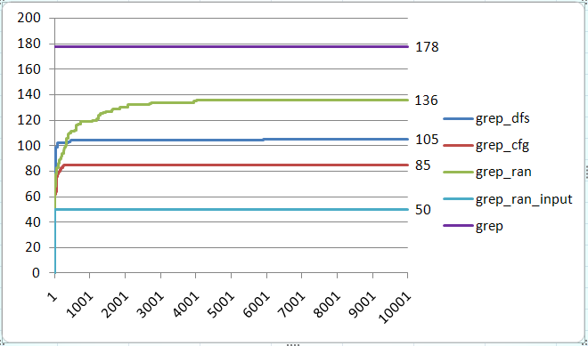
Result of grep
Experiment 1:
Iterations: 10, 000
branches in grep.c : 178
Execution Command:
run_crest './busybox grep "define" test_grep.dat' 10000 -dfs
run_crest './busybox grep "define" test_grep.dat' 10000 -cfg
run_crest './busybox grep "define" test_grep.dat' 10000 -random
run_crest './busybox grep "define" test_grep.dat' 10000 -random_input
Strategy | Time cost (s)
Dfs | 2758
Cfg | 56
Random | 85
Pure_random | 45

Slide 45
Test Oracles
In the busybox testing, we do not use any explicit test oracles
Test oracle is an orthogonal issue to test case generation
However, still violation of runtime conformance (i.e., no segmentation fault, no divide-by-zero, etc) can be checked
Segmentation fault due to integer overflow detected at busybox grep
This bug was detected by test cases generated using DFS
The bug causes segmentation fault when
-B 1073741824 (i.e. 2^32/4)
PATTERN should match line(s) after the 1st line
Text file should contain at least two lines
Bug scenario
Grep tries to dynamically allocate memory for buffering matched lines (-B option).
But due to integer overflow (# of line to buffer * sizeof(pointer)), memory is allocated in much less amount
Finally grep finally accesses illegal memory area

Slide 46
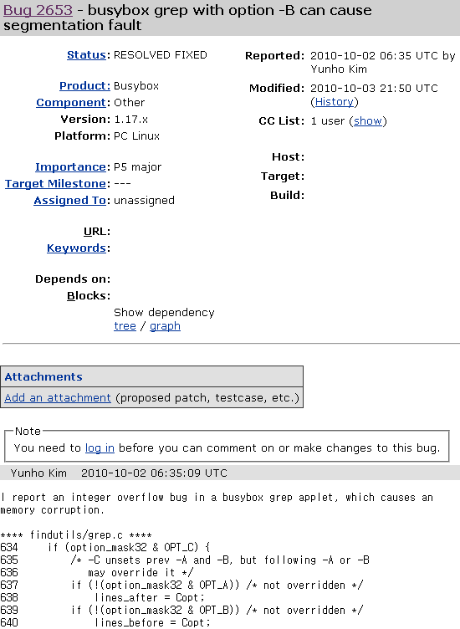
Bug patch was immediately made in 1 day, since this bug is critical one
Importance: P5 major
major loss of function
Busybox 1.18.x will have fix for this bug

Slide 47



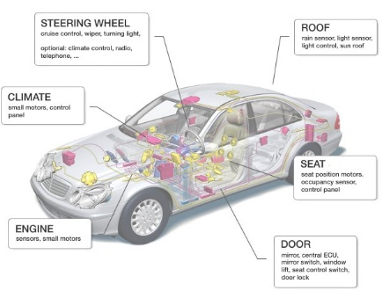
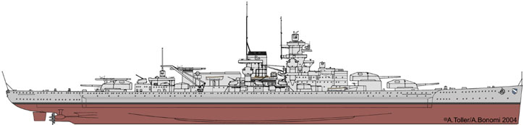



Solution for Huge Economic & Social Cost due to SW Bugs
Labor-intensive Manual Testing Large SW Testing Cost and Time
Low Bug Detection Abilty Low Product Quality
Solution: AI-based Automated Concolic Testing Technique
movie link https://bit.ly/3NS6RrQ
Existing Problems Developed Solutions
‘10-14 Project w/ Samsung Electronics
’15~20 Project w/ Hyundai/Mobis
‘18 Project w/ LIGnex1
’20 Project w/ Natl. Security Research Inst.
Detected dozens of crash bugs in the comm. firmware
Achieved 90% branch cov. and reduced 80% of labor cost by using auto. testing tech.
Detected several SW bugs in the 10 programs in the battleships
Detected SW bugs in the software in the security equipment

Slide 48
SAGE: Whitebox Fuzzing for Security Testing @ Microsoft
X86 binary concolic testing tool to generate millions of test files automatically targeting large applications
used daily in Windows, Office, etc.
Mainly targets crash bugs in various windows file parsers (>hundreds)
Impact: since 2007 to 2013
500+ machine years
3.4 Billion+ constraints
100s of apps, 100s of bugs
1/3 of all security bugs detected by Win7 WEX team were found by SAGE
Millions of dollars saved
This slide quotes PLDI 2013 MSR Open House Event poster
“SAGE: WhiteboxFuzzing for Security Testing” by
E.Bounimova, P.Godefroid, and D.Molnar
Notes:
Scalable Automated Guided Execution.
5

Slide 49

Microsoft Security Risk Detection
Azure-based cloud service to find security bugs in x86 windows binary
Based on concolic testing techniques of SAGE

Slide 50
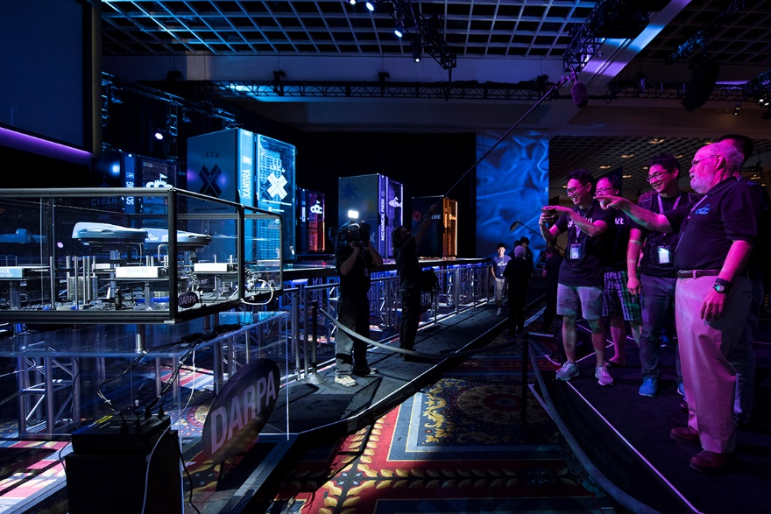
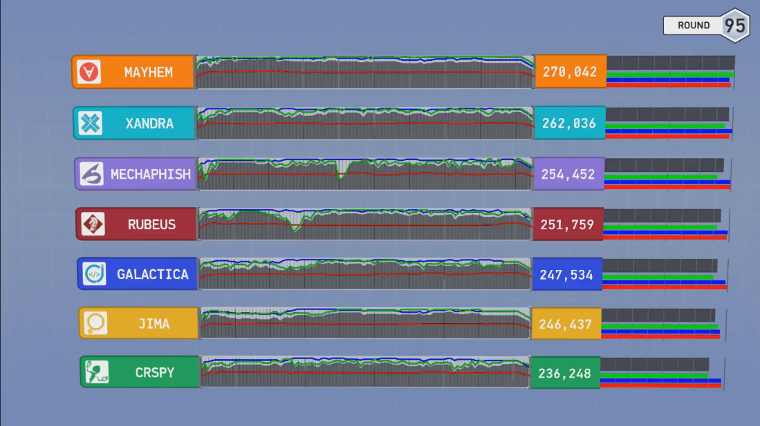
2016 Aug DARPA Cyber Grand Challenge -the world’s 1st all-machine hacking tournament
Each team’s Cyber Reasoning System automatically identifies security flaws and applies patches to its own system in a hack-and-defend style contest targeting a new Linux-based OS DECREE
Mayhem won the best score, which is CMU’s concolic testing based tool
Notes:
Sendmail crackaddr bug

Slide 51


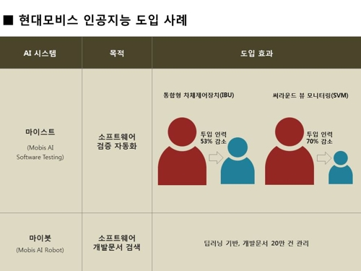
MAIST can reduce 53% and 70% of manual testing effort for IBU(Integrated Body Unit) and SVM(Surround View Monitoring)
IBU
SVM
53%
70%
MAIST
Hyundai Mobis and a research team lead by Prof. Moonzoo Kim at KAIST jointly developed MAIST for automated testing
MAIST automates unit coverage testing performed by human engineers by applying concolic unit testing
Reduction of manual testing effort
http://m.yna.co.kr/kr/contents/?cid=AKR20180720158800003&mobile

Slide 52
Model Checking vs Concolic Testing
 | Model checking | Concolic testing
Analysis approach | Monolithic (i.e., whole analysis should be completed) | Incremental (i.e., analysis results are accumulated step-by-step) - Anytime algorithm
Compositional analysis | No | Yes (analysis of each symbolic execution path is independent from each other)
Accuracy | Very high | Very high (per given assert statements) - Known as path model checker
Explicit test inputs | Not generated | Generated
Requires abstraction | Yes | No
Memory consumption | Very high | Low
CPU time consumption | Very high | Very high
External binary library handling | None | Partial
Debugging support | Limited (except a counter example generated) | Fully supported (you can freely use gdb or printf to analyze each concrete execution)
Scalability | Very limited | Large

Slide 53

Various Automated SW Analysis Techniques Have Its Own Pros/Cons and Its Best Uses !!!
https://www.escoffier.edu/blog/culinary-arts/different-knives-and-the-best-uses-for-each/

Slide 54
Future Direction
Tool support will be strengthened for automated SW analysis
Ex. CBMC, BLAST, CREST, KLEE, and Microsoft PEX
Automated SW analysis will be performed routinely like GCC
Labor-intensive SW analysis => automated SW analysis by few experts
Supports for concurrency analysis
Deadlock/livelock detection
Data-race detection
Less user input, more analysis result and less false alarm
Fully automatic C++ syntax & type check (1980s)
(semi) automatic null-pointer dereference check (2000s)
(semi) automatic user-given assertion check (2020s)
(semi) automatic debugging (2030s)

Slide 55
Conclusion
Automated concolic testing is effective and efficient for testing industrial embedded software including vehicle domain as well as consumer electronics domain
Successful application of automated testing techniques requires expertise of human engineers
SW
Testing
Cost
Automated
Testing
Manual
Testing
25%
50%
75%
100%
SW Reliability
Traditional testing
Concolic testing
Manual TC gen
Testing main scenarios
System-level testing
Small # of TCs
Automated TC gen
Testing exceptional scenarios
Unit-level testing
Large # of TCs
Notes:
We have demonstrated that our new technique conbol could effectively detect 24 crash bugs. Now conbol is successfully adopted by the original development team. I personally believe that concolic testing is mature enough to be adopted by industry, not only academy. Traditionally, testing focuses on manual TC generation testing main scenarios, ~~. But I believe that our testing paradigm is changing to new testing new paradigm based on concolic testing like conbol. Now we generate millions of test cases automatically, and targeting exceptional scenarios as we detected 24 hidden bugs with unit-level testing and large # of TCs. So overall I believe automated testing has a lower V7V cost than manual testing for higher reliability. And our group and samsung electronics try hard to apply such automated technique to more larger product.

