Slide 1
4 Main Steps of Concolic Testing
1. Instrumentation of a target program
To insert probes to build symbolic path formula
2. Transform a constructed symbolic path formula to SMT-compatible format
SMT solvers can solve simple formula only
3. Select one branch condition to negate
Core technique impacting both effectiveness and efficiency
4. Invoking SMT solvers on the SPF SMT formula
Selection of a SMT solver and proper configuration parameters

Slide 2
4 Main Tasks of Human Engineers
1. Adding proper assert() statements
W/o assert(), no test results obtained
2. Selection of symbolic variables in a target program
Identify which parts of a target program are most important
3. Construction of symbolic external environment
To detect real bugs
4. Performance tuning and debugging
To obtain better concolic testing results

Slide 3
Busybox Overview
We test a busybox by using CROWN.
BusyBox is a one-in-all command-line utilities providing a fairly complete programming/debugging environment
It combines tiny versions of ~300 UNIX utilities into a single small executable program suite.
Among those 300 utilities, we focused to test the following 10 utilities
grep, vi, cut, expr, od , printf, tr, cp, ls, mv.
We selected these 10 utilities, because their behavior is easy to understand so that it is clear what variables should be declared as symbolic

Slide 4
Experiment overview
Experimental environments
HW: Core(TM)2 E8400@3GHz, 4GB memory
OS: fc8 32bit
Target program: busybox 1.17.0
Strategies: 4 different strategies are used in our experiment.
dfs: explore path space by (reverse) Depth-First Search
cfg: explore path space by Control-Flow Directed Search
random: explore path space by Random Branch Search
random_input: testing target program by randomly generating input
In addition, a port-polio approach is applied (i.e., merging the test cases generated by all four above strategies).

Slide 5
Target description -- printf
Description: print ARGUMENT(s) according to FORMAT, where FORMAT controls the output exactly as in C printf.
Usage: printf FORMAT [ARGUMENT]...
Example :
input: ./busybox printf ‘%s is coming' 'autumn‘
output: autumn is coming

Slide 6
Target program setting -- printf
Experiment Setting :
Target utilities: busybox printf
Usage: printf FORMAT [ARGUMENT]...
Symbolic variables setting:
Set FORMAT as symbolic value.
Type of FORMAT is string. Restrict 5 symbolic characters as input of FORMAT.
Set ARGUMENT as symbolic value.
Type of ARGUMENT is array of string. Restrict ARGUMENT to 1 length, 10 symbolic characters for each string.
Replace library function by source code: strchr().
We perform experiments in the following approach:
run experiment by various strategies.

Slide 7
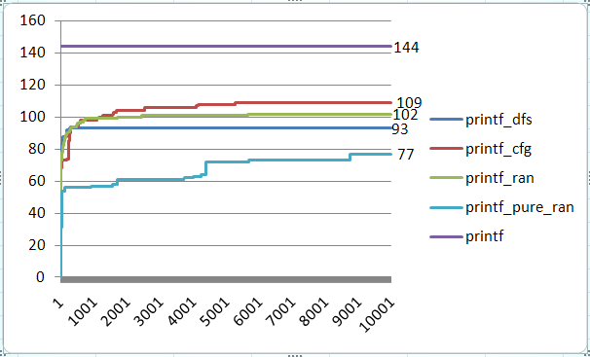
Result -- printf
Experiment setting:
Iterations: 10,000
branches in printf.c : 144
Execution command:
run_crown './busybox printf '%d123' 0123456789' 10000 -dfs
run_crown './busybox printf '%d123' 0123456789' 10000 -cfg
run_crown './busybox printf '%d123' 0123456789' 10000 -random
run_crown './busybox printf '%d123' 0123456789' 10000 -random_input
Command-line arguements are just place holders (i.e., their content will be replaced by symbolic values)
Strategy | Time cost (s)
Dfs | 84
Cfg | 41
Random | 40
Pure_random | 30

Slide 8
Symbolic setup in source code for printf
Two main instruments in busybox printf.c.
Set 2 symbolic inputs: FORMAT, ARGUMENT.
Replace library function strchr() by source code.
static void print_direc(char *format, unsigned fmt_length,
int field_width, int precision,
const char *argument)
{
//……
#ifndef CROWN
have_width = strchr(format, '*');
#else
have_width = sym_strchr(format, '*');
#endif
//……
}
//……
int printf_main(int argc UNUSED_PARAM, char **argv)
{
int conv_err;
char *format;
char **argv2;
//……
format = argv[1];
argv2 = argv + 2;
int i;
int argcc=strlen(format);
#ifdef CROWN
for( i=0 ; i<argcc ; i++){// argcc = 5 due to the fixed input
SYM_char(format[i]);
}
for(i= 0 ; i<10 ; i++){
SYM_char(argv2[0][i]);
}
#endif
//……
}
static char *sym_strchr(const char *str, char ch){
while (*str && *str != ch)
str++;
if (*str == ch)
return str;
return(NULL);
}

Slide 9
Target description -- grep
Description: Search for PATTERN in FILEs (or stdin).
Usage:grep [OPTIONS] PATTERN [FILE]
OPTIONS includes
[-1nqvscFiHhf:Lorm:wA:B:C:EaI] (option followed by “:” means one argument is required.)
Example :
test_grep.dat contains
define
enifed
what is defined?
def ine
input: busybox grep define test_grep.dat
output: define
what is defined?
Options:
-H Add 'filename:' prefix
-h Do not add 'filename:' prefix
-n Add 'line_no:' prefix
-l Show only names of files that match
-L Show only names of files that don't match
-c Show only count of matching lines
-o Show only the matching part of line
-q Quiet. Return 0 if PATTERN is found, 1 otherwise
-v Select non-matching lines
-s Suppress open and read errors
-r Recurse
-i Ignore case
-w Match whole words only
-F PATTERN is a literal (not regexp)
-E PATTERN is an extended regexp
-m N Match up to N times per file
-A N Print N lines of trailing context
-B N Print N lines of leading context
-C N Same as '-A N -B N'
-f FILE Read pattern from file

Slide 10
Symbolic Variable Declaration for grep
PATTERN was not declared as symbolic variables, since grep.c handles PATTERN using external binary libraries
CROWN would not generate new test cases for symbolic PATTERN
We used a concrete pattern “define”
We use a concrete file test_grep.dat as a FILE parameter
Set options as symbolic input (i.e. an array of symbolic characters)
23 different options can be given.
Specified options are represented by option_mask32, an uint32_t value, of which each bit field indicates a corresponding option is ON/OFF.
Function getopt32(char **argv, const char *applet_opts, …) is used to generate a bit array option_mask32 which indicates specified options from command line input.
Set 4 parameters to options as symbolic variables
Copt, max_matches, lines_before, lines_after.
Option argument fopt for option -f (read a pattern from a file) is ignored, since it is hard to set a file name as a symbolic value.

Slide 11
Instrumentation in grep.c
…
uint32_t option_mask32;
...
int grep_main (int argc UNUSED_PARAM, char **argv)
{
getopt32(argv, OPTSTR_GREP,
&pattern_head, &fopt,
&max_matches, &lines_after,
&lines_before,&Copt);
#ifdef CROWN
SYM_int(max_matches);
SYM_int(lines_after);
SYM_int(lines_before);
SYM_int(Copt);
#endif
//……
#ifdef CROWN
SYM_int(option_mask32);
#endif
if (option_mask32 & OPT_m) {
Notes:
instrumentation

Slide 12
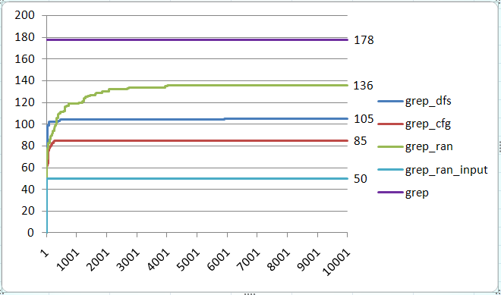
Result of Busybox grep
Experiment 1:
Iterations: 10, 000
branches in grep.c : 178
Execution Command:
run_crown './busybox grep "define" test_grep.dat' 10000 -dfs
run_crown './busybox grep "define" test_grep.dat' 10000 -cfg
run_crown './busybox grep "define" test_grep.dat' 10000 -random
run_crown './busybox grep "define" test_grep.dat' 10000 -random_input
Strategy | Time cost (s)
Dfs | 2758
Cfg | 56
Random | 85
Pure_random | 45

Slide 13
Test Oracles
In the busybox testing, we do not use any explicit test oracles
Test oracle is an orthogonal issue to test case generation
However, still violation of runtime conformance (i.e., no segmentation fault, no divide-by-zero, etc) can be checked
Segmentation fault due to integer overflow detected at grep 2.0
This bug was detected by test cases generated using DFS
The bug causes segmentation fault when
-B 1073741824 (i.e. 2^32/4)
PATTERN should match line(s) after the 1st line
Text file should contain at least two lines
Bug scenario
Grep tries to dynamically allocate memory for buffering matched lines (-B option).
But due to integer overflow (# of line to buffer * sizeof(pointer)), memory is allocated in much less amount
Finally grep finally accesses illegal memory area

Slide 14
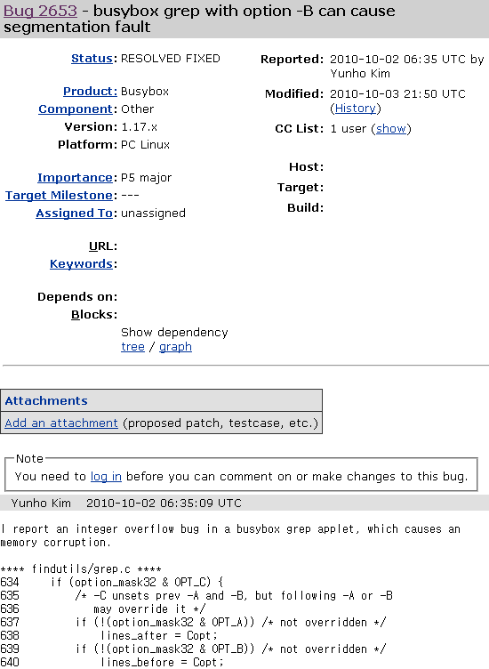
Bug patch was immediately made in 1 day, since this bug is critical one
Importance: P5 major
major loss of function
Busybox 1.18.x will have fix for this bug

Slide 15
Target description -- vi
Description: Edit FILE
Usage: vi [OPTIONS] [FILE] …
Options:
-c Initial command to run ($EXINIT also available)
-R Read-only
-H Short help regarding available features
Example :
input: cat read_vi.dat
test for initial command
input: cat test_vi.dat
this is the test for vi
@#$%&*vi?
input: ./busybox vi -c ":read read_vi.dat" test_vi.dat
output:
this is the test for vi
test for initial command
@#$%&*vi?

Slide 16
Symbolic Variable Declaration for vi
We declared a key stroke by a user as a symbolic input character
Restrict user key input to 50 symbolic characters.
We modified vi source code so that vi exits after testing 50th key stroke.
Set initial command as symbolic input (initial command is only used when option -c is specified).
Type of initial command is a string (i.e., an array of 17 characters)
Replace 4 library functions with source code: strncmp(), strchr(), strcpy(), memchr().
We used a concrete file test_vi.dat

Slide 17
Symbolic Key-stroke Setting
static int readit(void){
//……
#ifndef CROWN
c = read_key(STDIN_FILENO, readbuffer, -2);
#else
if(count<50){
char ch;
SYM_char(ch);
putc(ch, finput);
c=(int)ch;
count++;
}else {
fclose(finput);
exit(0);
}
#endif
//……
}

Slide 18
4 Functions Added
static int sym_strncmp (const char *first,const char *last,int count)
{
if (!count)
return(0);
while (--count && *first && *first == *last){
first++;
last++;
}
return( *(unsigned char *)first - *(unsigned char *)last );
}
static char *sym_strchr(const char *str, char ch){
while (*str && *str != ch)
str++;
if (*str == ch)
return str;
return(NULL);
}
static char *sym_strcpy(char *to, const char *from)
{
char *save = to;
for (; (*to = *from) != '\0'; ++from, ++to);
return(save);
}
void *sym_memchr(const void* src, int c, size_t count)
{
assert(src!=NULL);
char *tempsrc=(char*)src;
while(count&&*tempsrc!=(char)c)
{
count--;
tempsrc++;
}
if(count!=0)
return tempsrc;
else
return NULL;
}

Slide 19
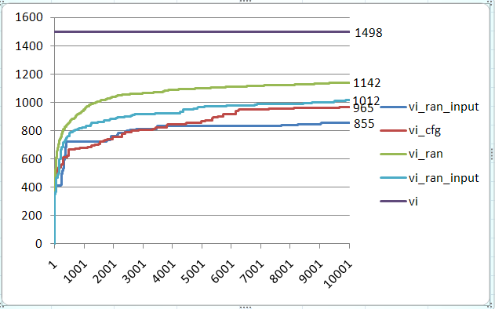
Result of vi
Experiment 1:
Iterations: 10,000
Branches in vi.c : 1498
Execution Command:
run_crown './busybox -c ":read read_vi.dat" test_vi.dat' 10000 -dfs
run_crown './busybox -c ":read read_vi.dat" test_vi.dat' 10000 -cfg
run_crown './busybox -c ":read read_vi.dat" test_vi.dat' 10000 -random
run_crown './busybox -c ":read read_vi.dat" test_vi.dat' 10000 -random_input
Strategy | Time cost (s)
Dfs | 1495
Cfg | 1306
Random | 723
Pure_random | 463

