Slide 1


Industrial Application of Concolic Testing to Detect Crash Bugs - A Case Study on libexif
Yunho Kim, Moonzoo Kim, YoungJoo Kim, and Yoonkyu Jang
Provable SW Lab, KAIST, Samsung Electronics
South Korea
Notes:
Thanks you for coming. My name is , from KAIST, South Korea. I will present the paper ~~ . This is joint work of KAIST and Samsung Electronics.

Slide 2
Content
Motivation and project scope
libexif case study
Lessons learned and conclusion

Slide 3





Main Talk Summary
Industry builds products based on OSS heavily
Concolic testing is a good technique for testing open source programs with modest effort
We applied concolic testing to an open-source program libexif and detected 6 crash bugs in 4 man-week (reported 2 security bugs to CVE)
Notes:
Today, I will explain our case study with samsung electronics for smaprthone platforms. Nowadays, many open-source program based smartphones have been used in the world. Even though use of open source programs make development cost down, it causes another problem. Smartphnoe manufacturer does not make open-source programs by themselves, engineers in samsung, lg or apple do not know the details of open source programs. But they need to assure high quality of open source programs because their smartphone use the open-source programs. Then the problem is that how to assure the quality of open source program with modest effort.
Industry OSS 많이 쓴다.

Slide 4
Motivation
Effective SW code testing is expensive
Test oracle should be defined
Explicit high-level requirements are necessary
Target code knowledge is necessary to insert concrete low-level assert
High test coverage should be achieved
Deep understanding of target code is necessary to write test cases that achieve high coverage
Notes:
~~
This is a serious problem especially for industry that tests OSS because OSS is not developed by engineers in industry usually.

Slide 5
Problems in the Current Industrial Practice (1/2)
Industry uses many open source software(OSS) in their smartphone platforms
Samsung’s cases: Android(30+ OSS packages), Tizen(40+ OSS packages)
Most of OSS are shipped in smartphones without high quality assurance

Slide 6
Problems in the Current Industrial Practice (2/2)
Industry does not have enough resources to test open source program code due to time constraints
Field engineers do not have deep knowledge of target program code
Writing effective test cases is a time-consuming task
Automated software testing techniques with modest testing setup effort to test open source program

Slide 7
Project Scope
Goal: To evaluate effectiveness and efficiency of concolic testing for testing open source programs
Our team: 1 professor, 2 graduate students, and 1 Samsung Electronics senior engineer
Total M/M: 4 persons £ 1 week
We tested an open source program libexif used by Samsung smart phones
libexif consists of 238 functions in C (14KLOC, 3696 branches)
We used CREST-BV and KLEE as concolic testing tools and Coverity Prevent as a static analysis tool
We compared CREST-BV and Coverity Prevent in terms of bug detection capability
We compared the two concolic testing tools in terms of TC generation speed and bug detection capability

Slide 8
CREST-BV and KLEE
CREST-BV and KLEE are concolic testing tools
They can analyze target C programs
They are open source tools
CREST-BV
An extended version of CREST with bit-vector support
Instrumentation-based concolic testing tool
Insert probes to extract symbolic path formula
KLEE
Implemented on top of the LLVM virtual machine
Modify VM to extract symbolic path formula
Implements POSIX file system environment model

Slide 9
Effectiveness of Concolic Testing
Concolic testing is effective to detect hidden bugs in open-source programs with modest effort
We took only 1 week to detect 6 crash bugs in libexif without background of the target program
Previous case studies
Industrial Application of Concolic Testing on Embedded Software: Case Study, ICST 2012
Concolic Testing of the Multi-sector Read Operation for Flash Storage Platform Software, FACJ 2012
Concolic testing was more effective than static analysis in this project
All the detected bugs were not detected by Coverity Prevent

Slide 10

EXchangeable Image file Format(EXIF)
EXIF is a standard that specifies metadata for image and sound files
Header
EXIF | Tag | Value
 | Width | 200
 | Height | 430
 | Date | 110522
 | … | …
Maker note | Tag | Value
 | ISO | 200
 | Focus | AI Focus
 | … | …
EXIF defines image structure, characteristics, and picture-taking conditions
Maker note is manufacturer-specific metadata
Camera manufactures define a large number of their own maker note tags
Ex. Canon has 400+ tags, Fuji has 200+ tags, and so on
No standard

Slide 11
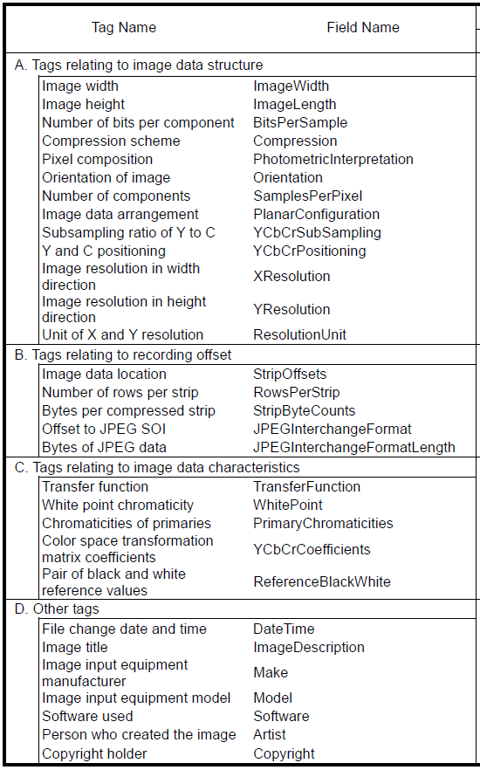
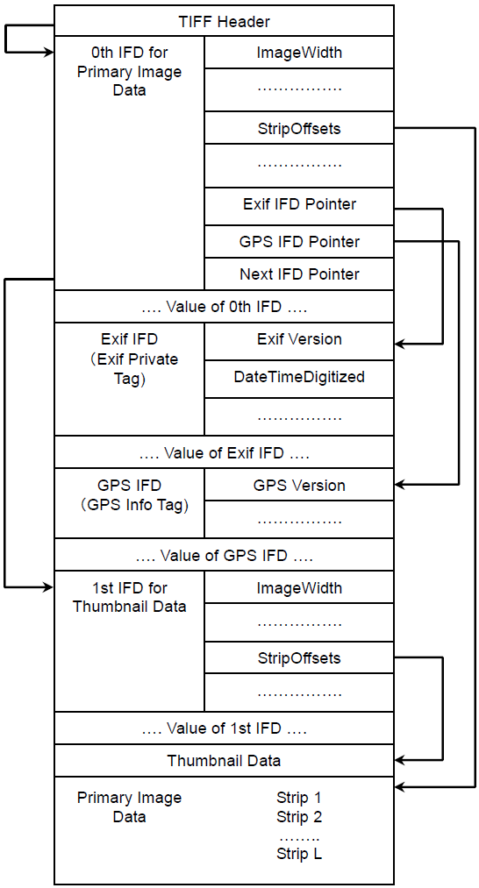
Exif structure

Slide 12
Test Experiment Setting
Max time is set to 15, 30 and 60 minutes
We used test-mnote.c in libexif as a test driver program
HW setting
Intel Core2duo 3.6 GHz, 16GB RAM running Fedora 9 64bit

Slide 13
Testing Strategies
Open source oriented approach for test oracles
Focusing on runtime failure/crash bugs only
Null-pointer dereference, divide-by-zero, out-of-bound memory accesses, etc
How to setup effective and efficient symbolic input?
Baseline concolic testing
Focus on the maker note tags with concrete image files

Slide 14

Baseline Concolic Testing
Input EXIF metadata size fixed at 244 bytes
Minimal size of a valid EXIF metadata generated by a test program in libexif
244 bytes long minimal symbolic input file
Header
EXIF | Tag | Value
 | … | …
244 bytes
 |  | ……
In CREST-BV
1:char array[244];
2:for (i=0;i<244;i++)
3: sym_char(array[i]);

Slide 15
Testing Result of Baseline (1/2)
One out-of-bound memory access bug was detected (CVE-2012-2836)
KLEE is slower due to
Overhead of VM
Complex symbolic execution features such as symbolic pointer dereference
exif_data_load_data() in exif-data.c
1:if (offset + 6 + 2 > ds) { return; }
2:n = exif_get_short(d+6+offset, ...)

Slide 16
Testing Result of Baseline (2/2)
We analyzed uncovered code to improve branch coverage
5 among 238 functions take 27% of total branches
Baseline concolic testing could not generate maker notes in a given time
We focused on maker notes to improve code coverage

Slide 17
Focus on the Maker Note
Focus on the maker note tags with concrete image files.
We used 6 image files from http://exif.org
We used concrete header and standard EXIF metadata and set maker note as symbolic inputs
Header
EXIF | Tag | Value
 | Width | 200
 | Height | 430
 | Date | 110522
 | … | …
Maker note | Tag | Value
 | ISO | 200
 | Focus | AI Focus
 | … | …
Header and standard EXIF metadata are concrete
Set maker note tags in the image as symbolic inputs

Slide 18
Rationale for the Focus on Maker Note
We expect that the libexif code that handles maker notes is error-prone due to lack of official specification
Note that 5 functions among the top 10 largest functions are related to maker notes
These 5 functions takes around 27% of total libexif branches
Rank | Function name | # of branches | Cum. # of branches | Cum. # of branches /Total(%)
1 | mnote_olympus_entry_get_value | 508 | 508 | 14.3
2 | exif_entry_get_value | 396 | 904 | 25.5
3 | exif_entry_initialize | 204 | 1108 | 31.3
4 | mnote_canon_entry_get_value | 146 | 1254 | 35.4
5 | mnote_pentax_entry_get_value | 140 | 1394 | 39.4
6 | exif_entry_fix | 140 | 1534 | 43.3
7 | mnote_fuji_entry_get_value | 100 | 1634 | 46.1
8 | exif_mnote_data_olympus_load | 96 | 1730 | 48.8
9 | exif_loader_write | 92 | 1822 | 51.4
10 | exif_data_load_data_content | 72 | 1894 | 53.5

Slide 19
Testing Result of Maker Note (1/2)
KLEE detected 1 null-pointer-dereference
CREST-BV detected the null-pointer-dereference bug and 4 divide-by-zero bugs

Slide 20
Testing Result of Maker Note (2/2)
Null-pointer-dereference bug
Divide-by-zero bug (CVE-2012-2837)
mnote_canon_tag_get_description() in mnote-canon-tag.c
1: table[] = { …
2: {MNOTE_CANON_TAG_CUSTOM_FUNCS, "CustomFunctions",
N_("Custom Functions"), ""},
3: {0, NULL, NULL, NULL} // Last table entry
…
4:for(i=0;i<sizeof(table)/sizeof(table[0]);i++)
5: //t is a maker note tag read from an image
6: if (table[i].tag==t) {
7: //Null-pointer dereference occurs when t is 0!!!
8: if(!*table[i].description)
9: return "";
mnote_olympus_entry_get_value() in mnote-olympus-entry.c
1:vr=exif_get_rational(...);
2://Added for concolic testing
3:assert(vr.denominator!=0);
4:a = vr.numerator / vr.denominator;

Slide 21
Total result (Baseline + MakerNote)
Different testing strategies improve coverage
Total # of covered branches: 1717 (46.5%) among 3696 branches in 1.5 days
110 branches are covered by only the Baseline strategy
734 branches are covered by only the MakerNote strategy
873 branches are covered by both
In fact, we generated test cases quicker by using multiple machines
Branches universe
1979
Strategy1
Strategy2
110
873
734

Slide 22
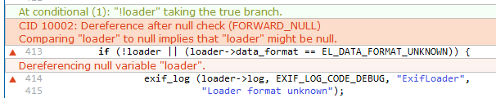
Comparison between CREST-BV and Prevent
Prevent failed to detect bugs detected by concolic testing
Prevent generated 14 false warnings out of total 15 warnings
Prevent detected the following null-pointer dereference bug in 5 minutes
KLEE/CREST-BV did not detect the bug because our test driver program does not call the buggy function

Slide 23
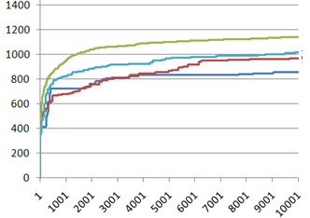
Summary of the Challenges
Libexif is a hard target for concolic testing
Hard to specify assertions
Requirement specification is very large and complex (182 page official documents + unofficial maker note specifications)
Code size is large (14k LOC) and components are hard to understand due to strong connectivity
Hard to generate valid inputs
Libexif requires strictly structured/formatted input
If any one byte of an EXIF header input violates EXIT structure, that entire input is thrown away
Search space is very large
10,000 test cases are too little compared to a number of all possible execution paths of a large program such as libexif
For example, in another study, 700,000 test cases for grep ( 12k lines) covers only 42% of branches.

Slide 24
Lessons Learned from Real-world Application
Practical strength of concolic testing
1 null-pointer dereference, 1 out-of-bound memory access, and 4 divide-by-zero in 4 man-weeks
Note that
libexif is very popular OSS used by millions of users
we did not have background on libexif!!!
Importance of testing strategy
Still state space explosion is a big obstacle
Average length of symbolic path formula = 100(baseline strategy)
=> In theory, there can exist 2¹⁰⁰ different execution paths
Advantages of CREST-BV over KLEE and Prevent
Concolic testing can supplement static analysis

