Slide 1
Unit-testing Busybox ls
We performed unit-testing Busybox ls by using CROWN
We tested 14 functions of Busybox ls (1100 lines long)
Note that this is a refined testing activity compared to the previous testing activity for 10 Busybox utilities in a system-level testing

Slide 2
Busybox ls Requirement Specification
POSIX specification (IEEE Std 1003.1, 2004 ed.) is a good requirement specification document for ls
A4 ~10 page description for all options
We defined test oracles using assert statements based on the POSIX specification
However, it still required human expertise on Busybox ls code to define concrete assert statements from given high-level requirements

Slide 3
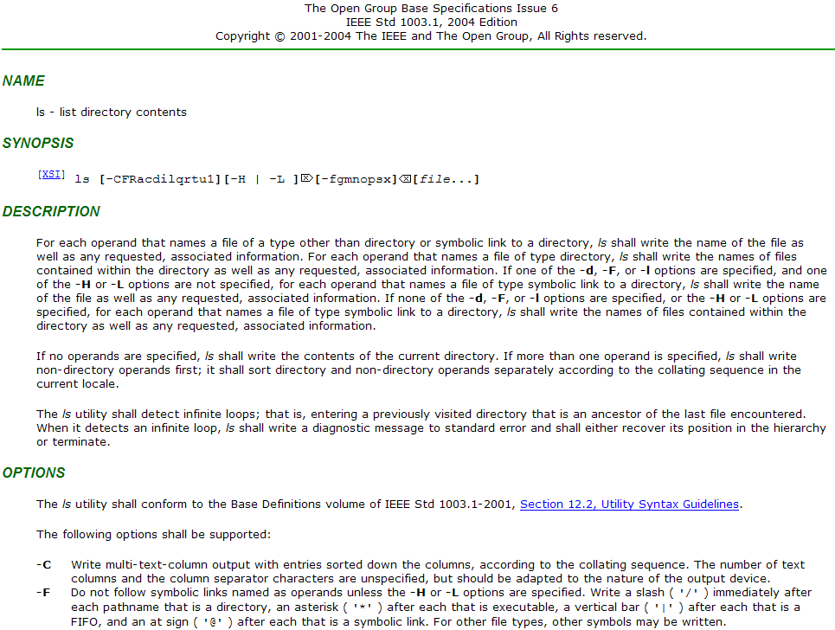

Slide 4
4 Bugs Detected
Missing @ symbol for a symbolic link file with –F option
Missing space between adjacent two columns with –i or –b options
The order of options is ignored
According to the ls specification, the last option should have a higher priority (i.e., -C -1 and -1 -C are different)
Option –n does not show files in a long format
-n enforces to list files in a long format and print numeric UID and GID instead of user/group name

Slide 5
Examples for the 4 Bugs Detected
1. Missing ‘@’ symbol for a symbolic link file with –F option
2. Missing space between adjacent two columns with –i or –b options
Output of Linux ls
Output of Linux ls
$ ls -F t.lnk
t.lnk@
$ ls -i ~user/12345 ~user/11111
154930324 /home/user/11111 154930124 /home/user/12345
Output of Busybox ls (incorrect behavior)
Output of Busybox ls (incorrect behavior)
$ ./busybox ls -F t.lnk
t.lnk
$ ./busybox ls -i ~user/12345 ~user/11111 154930324 /home/user/11111154930124 /home/user/12345
3. The order of options is ignored
4. –n does not show files in a long format
Output of Linux ls
Output of Linux ls
$ ls -1C
a.txt b.txt
$ ls –n a.txt
-rw-r--r-- 1 1000 1000 5833 Jun 24 2010 a.txt
Output of Busybox ls (incorrect behavior)
Output of Busybox ls (incorrect behavior)
$ ./busybox ls -1C
a.txt
b.txt
$ ./busybox ls –n a.txt
a.txt
Notes:
13K TCs generated in 15 mins ( covered 68.6% branches (188/274) )

Slide 6
Missing ‘@’ symbol for symbolic link with –F option
Busybox ls does not print a type marker ‘@’ after a symbolic link file name, when -F is specified and a file name is specified in the command line.
Output of linux ls:
Output of Busybox ls (incorrect behavior):
-F means write a marker (/*|@=) for different type of files.
t.lnk is a symbolic link, which links to file t in the directory ~yang/
$ ls -F t.lnk
t.lnk@
$ ./busybox ls -F t.lnk
t.lnk
We found that the bug was caused by the violation of a precondition of my_stat()

Slide 7
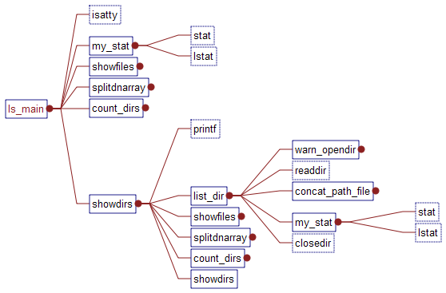
Calls Graph of Busybox ls
buggy behavior
unit-stat
Replaced by unit-stat()
and unit-lstat() for unit-testing
unit-lstat
Replaced by unit-stat() and unit-lstat() for unit-testing
unit-stat
unit-lstat
correct behavior

Slide 8
Stub Function – unit-stat(), unit-lstat()
File System
stat()
struct stat {…
mode_t st_mode
…}
file1
lstat()
struct stat {…
mode_t st_mode
…}
File System
unit-stat()
struct stat {…
mode_t st_mode //symbolic value
…}
unit-lstat()
struct stat {…
mode_t st_mode //symbolic value
…}

Slide 9
Symbolic Environment Setting
Symbolic variables:
Command line options
Replacing unsigned int opt with a symbolic value.
opt = getopt32(argv, ……);
Target file status
we partially simulate status of a file (struct stat dstat) in a file system by a symbolic value
Symbolic stubs:
stat() and lstat() are replaced by unit-stat() and unit-lstat() for generating symbolic file status
stat(const char *path, struct stat *buf)
lstat(const char *path, struct stat *buf)
Notes:
S_ISLNK(mode) : a macro used to check whether mode is a symbolic link.
12th bit - 15th bit are used to indicate file type.
Flag 0120000 means a symbolic link. (in octal format)
unsigned char modemask[32] is defined as the symbolic mode.
Redefine S_ISLNK(mode) by giving control on 12th - 15th elements of modemask.

Slide 10
Testing target function: my_stat
static struct dnode *my_stat(const char *fullname, const char *name, int force_follow)
Test oracles (cont.):
len (fullname) >= len(name)
When fullname is a real file name, the following condition should be satisfied:
(cur!=NULL && cur->fullname==fullname &&
cur->name==name)
struct stat {
dev_t st_dev; /* ID of device containing file */
ino_t st_ino; /* inode number */
mode_t st_mode; /* protection */
nlink_t st_nlink; /* number of hard links */
uid_t st_uid; /* user ID of owner */
gid_t st_gid; /* group ID of owner */
dev_t st_rdev; /* device ID (if special file) */
off_t st_size; /* total size, in bytes */
blksize_t st_blksize; /* blocksize for filesystem I/O */
blkcnt_t st_blocks; /* number of blocks allocated */
time_t st_atime; /* time of last access */
time_t st_mtime; /* time of last modification */
time_t st_ctime; /* time of last status change */};
struct dnode {
const char *name;
const char *fullname;
/* point at the next node */
struct dnode *next;
smallint fname_allocated;
/* the file stat info */
struct stat dstat;
}

Slide 11
Testing target function: my_stat
static struct dnode *my_stat(const char *fullname, const char *name, int force_follow)
Purpose:
my_stat gets file status by fullname, and store file status in struct dnode *cur which is returned by my_stat
If a file/dir entry corresponding to fullname is available in the file system, cur->stat should stores the corresponding file info. Otherwise, NULL is turned.
Test oracles:
If any of -d, -F, or -l options is given, and -L option is not given, follow_symlink should be false
((-d || -F || -l) && !-L) -> !follow_symlink
-d: list directory entries instead of contents, and do not dereference symbolic links
-F: append indicator (one of */=>@|) to entries
-l: use a long listing format
-L: when showing file information for a symbolic link,
show information for the file the link references
rather than for the link itself
t.lnk
(stat_t_lnk)
t
(stat_t)

Slide 12
Assertions in my_stat
With -F without -L, the last parameter of my_stat() becomes true, when my_stat is called directly from ls_main()
static struct dnode *my_stat(const char *fullname, const char *name, int force_follow)
{
#ifdef ASSERTION
assert(strlen(fullname) >= strlen(name));
#endif
struct stat dstat;
struct dnode *cur;
IF_SELINUX(security_context_t sid = NULL;)
#ifdef ASSERTION
/* If any of -d, -F, or -l options is given, and -L
* option is not given, ls should print out the status
* of the symbolic link file. I.e.,
* ((d || F || l) && !L) -> !FOLLOW_SYM_LNK
*/
unsigned char follow_symlink =
(all_fmt & FOLLOW_LINKS) || force_follow;
assert(!((opt_mask[2] || opt_mask[17] || opt_mask[4])
&& !opt_mask[19]) || !follow_symlink);
#endif
if (follow_symlink) { /*get file stat of link itself*/
//……
#if !CROWN
if (stat(fullname, &dstat))
#else
if (unit_stat(fullname, &dstat))
#endif
{
bb_simple_perror_msg(fullname);
exit_code = EXIT_FAILURE;
return 0;
}
} else { /*get file stat of real file which sym_lnk linked to*/
//……
#if !CROWN
if (lstat(fullname, &dstat))
#else
if (unit_lstat(fullname, &dstat))
#endif
{
bb_simple_perror_msg(fullname);
exit_code = EXIT_FAILURE;
return 0;
}
}
cur = xmalloc(sizeof(*cur));
cur->fullname = fullname;
cur->name = name;
cur->dstat = dstat;
IF_SELINUX(cur->sid = sid;)
return cur;
}
Notes:
With -F without -L, the last parameter of my_stat() at line 2 becomes true, since STYLE_LONG and
LIST_BLOCKS are constant masks to display files in a long format and with a block size respectively and none of them are enabled by -F.
Then, force_follow (the last formal parameter of my_stat()) becomes true and my_stat() obtains the status of linked instead of slnk, which violates the requirement for -F option. For example, busybox ls -F -i slnk does not display the ‘@’ mark for slnk and displays the inode number of linked.

