Slide 1








Automated Unit Testing of Large Industrial Embedded Software using Concolic Testing
Yunho Kim, Moonzoo Kim
SW Testing & Verification Group KAIST, South Korea
Youil Kim, Taeksu Kim, Gunwoo Lee, Yoonkyu Jang
Samsung Electronics, South Korea
http://swtv.kaist.ac.kr
Notes:
Manual testing과 automated testing의 대결구도
Thanks for coming. My name is yunho kim. I am from kaist south korea. Today I will present my talk automated unit testing of large industrial embedded software using concoclic testing. This work is joint work with samsung electronics. As you see taeksu kim is here. You can ask detailed question later about how we apply this wonderful technique CONBOL to real instury. He can answer better than I do

Slide 2


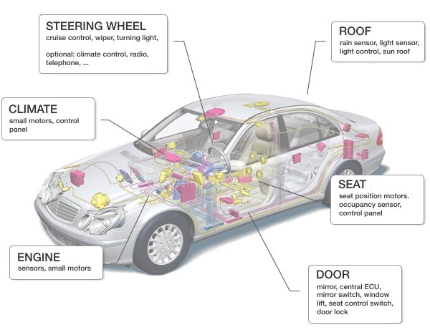


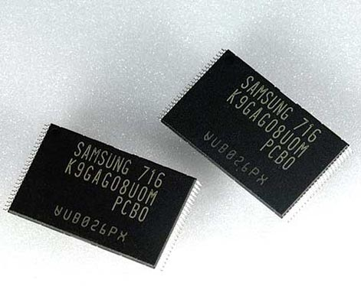


Strong IT Industry in South Korea
Time-to-Market?
SW Quality?
V.S
Notes:
Our goal is to provide a Lightweight and practical technique
our technique should be lightweight so that developers apply our technique and get the results easily and quickly.
Also, our technique should be effective so that corner case bugs were effectively detected to improve sw quality.
As you know, south korea has many strong IT industry like samsung, lg kia, and hyundai. And engineers at such it companies always struggle between two different values Time to market and SW quality. Unfortunately, it is hard for developers to achieve both values using current testing practice. In the current testing practice developers write test cases manually. To achieve high Sw quality developers should write a sufficient number of effective test cases which requires a lot of time and developers’ effort. Thus, developers trade-off time to market and SW quality. Our goal is to provide lightweight but still effective testing technique to achieve both time-to market and SW quality. Our technique CONBOL is an automated test generation technique that can detect bugs effectively.
First one is time to market. As you in see every month new smartphnoe came out to the market. At the same time, not only the time to market, SW quality is quite important for their sales and customer evaluation. So those two properties both are very important for the success of products. Developers have hard time to achieve both goals so our research goal is to provide more practical solution to satisfy both time to market and sw quality in the middle. So our goal is to provide lightweight and effective technique to achieve both time to market and high SW quality. Our technique CONBOL is a fully automated and effective test case generation technique that can satisfy both values.

Slide 3




Summary of the Talk
Embedded SW is becoming larger and more complex
Ex. Android: 12 MLOC, Tizen > 6 MLOC
Smartphone development period is very short
No time to manually test smartphones sufficiently
Solution: Automated unit test generation for industrial embedded SW using CONBOL (CONcrete and symBOLic testing)
CONBOL automatically generates unit-test driver/stubs
CONBOL automatically generates test cases using concolic testing
CONBOL targets crash bugs (i.e. null pointer dereference, etc.)
CONBOL detected 24 crash bugs in 4 MLOC Android SW in 16 hours
Notes:
Pointer 로 가리치면서
Let me summarize this talk. Most of you know that embedded software becomes large and large and more complex. For example, android consists of 12 MLOC and tizen consist of more than 6 MLOC. At the same time, smartphone development period is becoming shorter and shorter due to heavy market competition. So the problem is that conventional manual testing is hard to achieve high quality of industrial embedded software in a limited project time. Based on such situation, we propose and developed the solution Automated unit test generation tools for large-scale embedded SW as a tool to solve those problems. we called it CONBOL.
CONBOL is quite different from conventional unit testing. Converntional unit testing developers write a unit test case manually and each unit test can exercise target program with only one test input. Also to write unit tests, developers have knowledge of target code. On the other hand, CONBOL is fully automated.
In short conbol unit test driver and stubs automatically, to perform unit testing fully automatically. Second conbol generates test cases for such unit using concolic testing again fully automatilly. finally, conbol to make an automation degree large, targets crash bugs currently. It means that user does not have to write down their assert, conbol automatically detcts crash bugs such as null pointer dereference, divide by zero, and array out of bound. So we have applied CONBOL to Samsung smartphone software which is 4 Mlines long and we detected 24 crash bugs. And after the experiments, CONBOL was utilized regularly to Samsung product and we detected around 40 more bugs.

Slide 4
Contents
Motivation
Background on concolic testing
Overview of CONBOL
Unit test driver/stub generator
Pre-processor module
Real-world application: Project S on Samsung smartphones
Lessons learned and conclusion

Slide 5
Motivation
Manual testing of SW is often ineffective and inefficient
Ineffectiveness: SW bugs usually exist in corner cases that are difficult to expect
Inefficiency: It is hard to generate a sufficient # of test cases in a given amount of project time
For consumer electronics, these limitations become more threatening
Complex control logic
Large software size
Short development time
Testing platform limitation
Notes:
Ineffective and inefficiency ~~
But for consumer elctornics those limitations become more serious because embedded software usually contains complex control logic to control hardware, finite state machine, device driver, and so on. Although it’s embedded SW, software size already become more than multi-million lines long. As I told you for consumer electronics product line smartphone, development time is very short and it is hard to test target software on specific embedded hardware platform. So in order to solve such problem,

Slide 6
Concolic Testing
Combine concrete execution and symbolic execution
Concrete + Symbolic = Concolic
In a nutshell, concrete execution over a concrete input guides symbolic execution
Symbolic execution is performed along with a concrete execution path
Automated test case generation technique
Execute a target program on automatically generated test inputs
All possible execution paths are to be explored
Higher branch coverage than random testing
Notes:
빈 칸 채워넣기
To automate test case generation, concolic testing technique a.k.a dynamic symbolic execution was developed. Concolic testing is a combined approach of dynamic concrete analysis and static symbolic analysis. Concrete execution over a concrete input guides symbolic execution, and the symbolic execution is used to generate further concrete test cases automatically. In this way, concolic testing can generate test cases to explore all possible execution paths and achieve higher branch coverage than random testing. Thus, industries including Samsung electronics have interest in concolic testing and we performed this project.

Slide 7
Industrial Experience w/ Concolic Testing
Target platform: Samsung smartphone platforms
Testing Level | Target Programs | Results | Publication
Unit-testing | Busybox ls | Detected 4 bugs and covered 98% of branches | Kim et al. [ICST12]
 | Samsung security library | Detected 1 memory bug and covered 73% of branches | Kim et al. [ICST12]
System-testing | Samsung Linux Platform (SLP) file manager | Detected 1 infinite loop bug and covered 20% of branches | Kim et al. [FSE11]
 | 10 Busybox utilities | Detected 1 bug in grep and covered 80% of branches
 | Libexif | Detected 6 bugs including 2 security bugs registered in Common Vulnerabilities and Exposures, and covered 43% of branches | Kim et al. [ICSE12]
Notes:
Hidden bug -> Corner case bug
We have applied this wonderful technique to severl industrial case studies. In unit-level, busybox ls and samsung security. At system level, we ~~
In our experience concolic testing was effecitve to detect hidden bugs. For example, concolic testing detected 2 NPD bugs and 5 DBZ bugs in libexif. Among them 2 bugs were security bugs which allow attackers to execute malicious command on digital cameras or smartphones.
Based on such sequence of industrial application of concolic testing, we observed the following obstacle to solve for applying concolic testing to embedded SW.

Slide 8
Obstacles of Concolic Testing for Industrial Embedded SW
Each execution path can be very long, which causes a huge state space to analyze
Generating and running test cases on embedded platforms would take significant amount of time
Porting of a concolic testing tool to a target embedded OS can be difficult
Due to resource constraint of embedded platforms
Embedded SW often uses target-specific compiler extensions

Slide 9
Solutions of CONBOL
Automatically generate unit tests including test drivers/stubs
We can apply concolic testing on industrial embedded SW that has 4 MLOC
Test embedded SW on a host PC
Most unit functions can run on a host PC
Only a few unit functions are tightly coupled with target embedded platforms
Port target-specific compiler extensions to GCC compatible ones
Notes:
So our solution is conbol. Conbol solves such obstacles as following. First conbol automatically generate unit testing.

Slide 10


Overview of CONBOL
We have developed the CONcrete and symBOLic (CONBOL) framework: an automated concolic unit testing tool based-on CREST-BV for embedded SW
Target
source code
for embedded platform
GCC compatible
source code
Porting
Module
Pre-processor
Module
Instru-mentor
Instru-mented code
CREST-BV
Defect/Coverage
Report
Unit test driver/stub
generator
Unit test
driver+stub code
Legend
Symbolic
Library
New module
CREST-BV extension
External tool
Notes:
Let me give you a high level overview of ~~
Test driver/stub generator is a key component of conbol.
Test driver -> Unit test driver

Slide 11
Porting Module
The porting module automatically modifies the source code of unit functions so that the code can be compiled and executed at the host PC
The porting module removes unportable functions
Inline ARM assembly code, hardware dependent code, unportable RVCT(RealView Compilation Tools) extensions
The porting module translates target code to be compatible with GCC and CIL(C Intermediate Language) which is an instrumentation tool
RVCT | Translation for GCC
__asm {…} | Not Portable
__swi (0x01) | Not Portable
__align(8) | __attribute__((aligned(8)))
__packed | __attribute__((packed))
Notes:
~~
This is a serious problem especially for industry that tests OSS because OSS is not developed by engineers in industry usually.

Slide 12
Unit Test Driver/Stub Generator(1/2)
The unit test driver/stub generator automatically generates unit test driver/stub functions for unit testing of a target function
A unit test driver symbolically sets all visible global variables and parameters of the target function
The test driver/stub generator replaces sub-functions invoked by the target function with symbolic stub functions
Type | Description | Code Example
Primitive | set a corresponding symbolic value | int a; SYM_int(a);
Array | set a fixed number of elements | int a[3]; SYM_int(a[0]); … SYM_int(a[2]);
Structure | set NULL to all pointer fields and set symbolic value to all primitive fields | struct _st{int n,struct _st*p}a; SYM_int(a.n); a.p=NULL;
Pointer | allocate memory for a pointee and set a symbolic value of corresponding type of the pointee | int *a; a = malloc(sizeof(int)); SYM_int(*a);
Notes:
Backup slide Table 다시 추가
~~
This is a serious problem especially for industry that tests OSS because OSS is not developed by engineers in industry usually.

Slide 13
Unit Test Driver/Stub Generator(2/2)
Example of an automatically generated unit-test driver
01:typedef struct Node_{
02: char c;
03: struct Node_ *next;
04:} Node;
05:Node *head;
06:// Target unit-under-test
07:void add_last(char v){
08: // add a new node containing v
09: // to the end of the linked list
10: ...}
11:// Test driver for the target unit
12:void test_add_last(){
13: char v1;
14: head = malloc(sizeof(Node));
15: SYM_char(head->c);
16: head->next = NULL;
17: SYM_char(v1);
18: add_last(v1); }
Unit Test Driver
Generate symbolic inputs for global variables and a parameter
Set global variables
Call target function
Set parameter
Notes:
~~
This is a serious problem especially for industry that tests OSS because OSS is not developed by engineers in industry usually.

Slide 14
Pre-processor Module
The pre-processor module inserts probes for three heuristics to improve bug detection precision
assert()insertion to detect more bugs
Scoring of alarms to reduce false alarms
Pre-conditions insertion to reduce false alarms
Notes:
~~
This is a serious problem especially for industry that tests OSS because OSS is not developed by engineers in industry usually.

Slide 15
Unit-testing Strategy to Reduce False Alarms
CONBOL raises a false NPD alarm because ctx(line 6) is not correctly initialized by init_ctx()(line 8)
init_ctx() is replaced with a symbolic stub function
We are developing a technique to automatically identify sub-functions that should not be replaced with stub functions
01:int init_ctx(struct CONTEXT &ctx){
02: ctx.f = malloc(…);
03: …
04: return 0;}
05:void f(){
06: struct CONTEXT ctx;
07: int ret;
08: ret = init_ctx(&ctx);
09: if (ret == -1){
10: return;}
11: if (ctx.f[1] > 0){
12: /* Some code */
13: }
14:}
init_ctx() is replaced with a symbolic stub that does not initialize ctx
A false NPD alarm is raised at line 11 because ctx is not properly initialized
Notes:
~~
This is a serious problem especially for industry that tests OSS because OSS is not developed by engineers in industry usually.

Slide 16
Inserting assert() Statements
The pre-processor module automatically inserts assert()to cause and detect the following three types of run-time failures
Out-of-bound memory access bugs(OOB)
Insert assert(0<=idx && idx<size) right before array access operations
Divide-by-zero bugs(DBZ)
Insert assert(denominator!=0) right before division operators whose denominator is not constant
Null-pointer-dereference bugs(NPD)
Insert assert(ptr!=NULL) right before pointer dereference operations
Notes:
In Manual unt testing, developers write test oracles to check test results.
~~
This is a serious problem especially for industry that tests OSS because OSS is not developed by engineers in industry usually.

Slide 17
Scoring of Alarms (1/2)
CONBOL assigns a score to each alarm as follows:
Every violated assertion(i.e., alarm) gets 5 as a default score.
The score of the violated assertion increases by 1 if the assertions contains a variable x which is checked in the target function containing the assertion (e.g., if(x<y+1)...)
An explicit check of x indicates that the developer considers x important, and the assertion on x is important consequently.
01: void f(int x, int y){
02: int array[10];
03: if (x < 15){
04: assert(x<10);
05: array[x]++;
06: assert(y<10);
07: array[y]++;
08:}}
No | Type | Location | Assert Expression | Score
1 | OOB | src.c:f():4 | x<10 | 6(=5+1)
2 | OOB | src.c:f():6 | y<10 | 5
Notes:
~~
This is a serious problem especially for industry that tests OSS because OSS is not developed by engineers in industry usually.

Slide 18
Scoring of Alarms (2/2)
For each violated assertion assert(expr), the score of the assertion decreases by 1, if expr appears five or more times in other violated assertions in the entire target software.
Developers write code correctly most of the time: target code that is repeated frequently is not likely to be buggy
CONBOL reports alarms whose scores are 6 or above
No | Type | Location | Assert Expression | Score
1 | OOB | src.c:f():1287 | A.index - 1 >= 0 | 4(=5-1)
2 | OOB | src.c:g():1300 | A.index - 1 >= 0 | 4(=5-1)
3 | OOB | src.c:h():1313 | A.index - 1 >= 0 | 4(=5-1)
4 | OOB | src.c:x():1326 | A.index - 1 >= 0 | 4(=5-1)
5 | OOB | src.c:y():1339 | A.index - 1 >= 0 | 4(=5-1)
Notes:
~~
This is a serious problem especially for industry that tests OSS because OSS is not developed by engineers in industry usually.

Slide 19
Inserting Constraints to Satisfy Pre-conditions
The pre-processor module automatically inserts assume() to avoid false alarms due to violation of implicit pre-conditions
Pre-conditions for array indexes
Insert array pre-conditions if the target function does not check an array index variable
Pre-conditions for constant parameters
Insert constant parameter pre-conditions if the parameter of the target function is one of some constant values for all invocations
Ex.) the third parameter of fseek() should be one of SEEK_SET, SEEK_CUR, or SEEK_END
Pre-conditions for enum values
CONBOL considers an enum type as a special int type and generates concrete test cases defined in the corresponding the enum type
Notes:
~~
This is a serious problem especially for industry that tests OSS because OSS is not developed by engineers in industry usually.

Slide 20
Inserting Constraints to Satisfy Pre-conditions(1/3)
An automatically generated unit test driver can violate implicit pre-conditions of a target unit function
Violation of implicit pre-conditions raises false alarms
01:int array[10];
02:void get_ith_element(int i){
03: return array[i];
04:}
05:// Test driver for get_ith_element()
06:void test_get_ith_element(){
07: int i, idx;
08: for(i=0; i<10; i++){
09: SYM_int(array[i]);
10: }
11: SYM_int(idx);
12:
13: get_ith_element(idx);
14:}
Line 3 can raise an OOB alarm because i can be greater than or equal to 10
However, developers often assume that get_ith_element() is always called under a pre-condition (0<=i && i<10)
Notes:
~~
This is a serious problem especially for industry that tests OSS because OSS is not developed by engineers in industry usually.

Slide 21
Inserting Constraints to Satisfy Pre-conditions(3/3)
An example of pre-conditions for array index
Developers assume that callers of get_ith_element() performs sanity checking of the parameter before they invoke get_ith_element()
01:int array[10];
02:void get_ith_element(int i){
03: return array[i];
04:}
05:// Test driver for get_ith_element()
06:void test_get_ith_element(){
07: int i, idx;
08: for(i=0; i<10; i++){
09: SYM_int(array[i]);
10: }
11: SYM_int(idx);
12: assume(0<=idx && idx<10);
13: get_ith_element(idx);
14:}
assume(expr) enforces symbolic values to satisfy expr
Notes:
~~
This is a serious problem especially for industry that tests OSS because OSS is not developed by engineers in industry usually.

Slide 22
Statistics of Project S
Project S, our target program, is an industrial embedded software for smartphones developed by Samsung Electronics
Project S targets ARM platforms
Metric |  | Data
Total lines of code |  | About 4,000,000
# of branches |  | 397,854
# of functions | Total | 48,743
 | Having more than one branch | 29,324
# of files | Sources | 7,243
 | Headers | 10,401
Notes:
~~
This is a serious problem especially for industry that tests OSS because OSS is not developed by engineers in industry usually.

Slide 23
Test Experiment Setting
CONBOL uses a DFS strategy used by CREST-BV in Kim et al. [ICSE12 SEIP]
Termination criteria and timeout setting
Concolic unit testing of a target function terminates when
CONBOL detect a violation of an assertion, or
All possible execution paths are explored, or
Concolic unit testing spends 30 seconds (Timeout1)
In addition, a single test execution of a target unit should not spend more than 15 seconds (Timeout2)
HW setting
Intel i5 3570K @ 3.4 GHz, 4GB RAM running Debian Linux 6.0.4 32bit
Notes:
~~
This is a serious problem especially for industry that tests OSS because OSS is not developed by engineers in industry usually.

Slide 24
Results (1/2)
Results of branch coverage and time cost
CONBOL tested 86.7%(=25,425) of target functions on a host PC
13.3% of functions were not inherently portable to a host PC due to inline ARM assembly, direct memory access, etc
CONBOL covered 59.6% of branches in 15.8 hours
Statistics | Number
Total # of test cases generated | About 800,000
Branch coverage (%) | 59.6
Execution time (hour) | 15.8
# of functions reaching timtout1 (30s) | 742
# of functions reaching timtout2 (15s) | 134
Execution time w/o timeout (hour) | 9.0

Slide 25
Results (2/2)
CONBOL raised 277 alarms
2 Samsung engineers (w/o prior knowledge on the target program) took 1 week to remove 227 false alarms out of 277 alarms
We reported 50 alarms and 24 crash bugs were confirmed by the developers of Project S
Pre-conditions and scoring rules filtered out 14.1% and 81.2% of likely false alarms, respectively
Note that Coverity prevent could not detect any of these crash bugs
# of reported alarms | Out-of-bound |  | NULL-pointer-dereference |  | Divide-by-zero |  | Total
 | # of alarms | Ratio (%) | # of alarms | Ratio (%) | # of alarms | Ratio (%) | # of alarms | Ratio (%)
W/O any heuristics | 3235 | 100.0 | 2588 | 100.0 | 61 | 100.0 | 5884 | 100.0
W/ inserted pre-conditions | 2486 | 76.8 | 2511 | 97.0 | 58 | 95.1 | 5055 | 85.9
W/ inserted pre-conditions + scoring rules | 220 | 6.8 | 42 | 1.6 | 15 | 24.6 | 277 | 4.7
Confirmed and fixed bugs | 13 | 0.4 | 5 | 0.2 | 6 | 9.8 | 24 | 0.4
Notes:
Coverity가 못잡고 우리것이 잡았던 이유
Coverity analysis depth shallow하다.
~~~
As you see, Interestingly, we detected more than 24 crash bugs, and none of them were detected by coverity prevent.
(It is surprising to somebody but not very surprising the other, because as you know,)
although coverity prevent and conbol target the same type of bugs, npd, OOB, DBZ and so on, the analysis technique is quite different. coverty is purely static and fast. It can analyze multi million lines in 10 minutes, CONBOl as you see takes more than 16 hours. Thus, It is no wonder that conbol detected such kind of crash bugs which coverity prevent never detected. The original development team applied coverity prevent weekly base and now they saw the outcome of conbol and they started applying conbol regurly too.

Slide 26
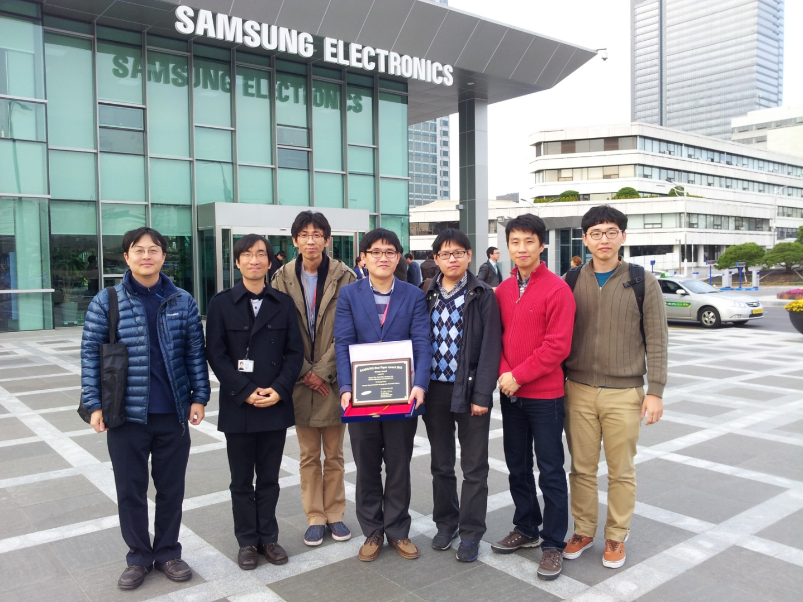
Recognition of Success of CONBOL at Samsung Electronics
Bronze Award at Samsung Best Paper Award
Oct’s Best Practice Award
Notes:
And samsung electronics recognize our technique and recently we got several awards. We got Bronze award at Samsung Best Paper Award, Oct’s best practice award, and out team leader Dr. Jang, received Samsung Award of Honor, which is the most prestigious award for Samsung employee.

Slide 27
Lessons Learned
Effective and efficient automated concolic unit testing approach for industrial embedded software
Detected 24 critical crash bugs in 4 MLOC embedded SW
Samsung engineers were sensitive to false positives very much ( >10 false/true alarms ratio)
False alarm reduction techniques are very important
We have developed a new automated unit testing platform CONCERT which reduces false alarms by
Synthesizing realistic target unit contexts based on dynamic function correlation observed in system testing
Utilizing common dynamic invariants of various contexts
Notes:
From this study, we realized and confirmed that CONBOL, automated unit testing is effective and efficient for large-scle embedded softwrae. We detected 24 bugs in 4 MLOC. And when we interacted with developers, we realized that developers are more sensitve to false positive than false negative because if they have lots of false positives they have to analyze them which takes lots of time. And although I am not going into details of such technical challenges, we also find several interesting technique challens to solve. So we will pusue our research into these directions.

Slide 28
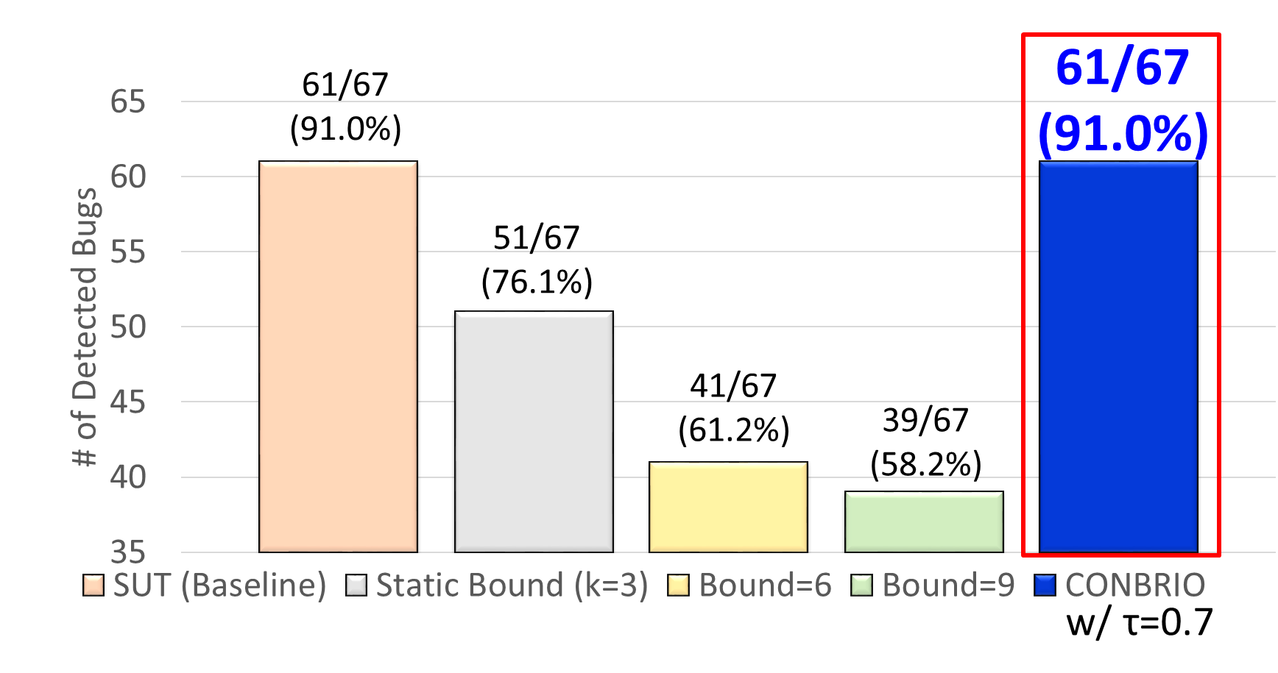
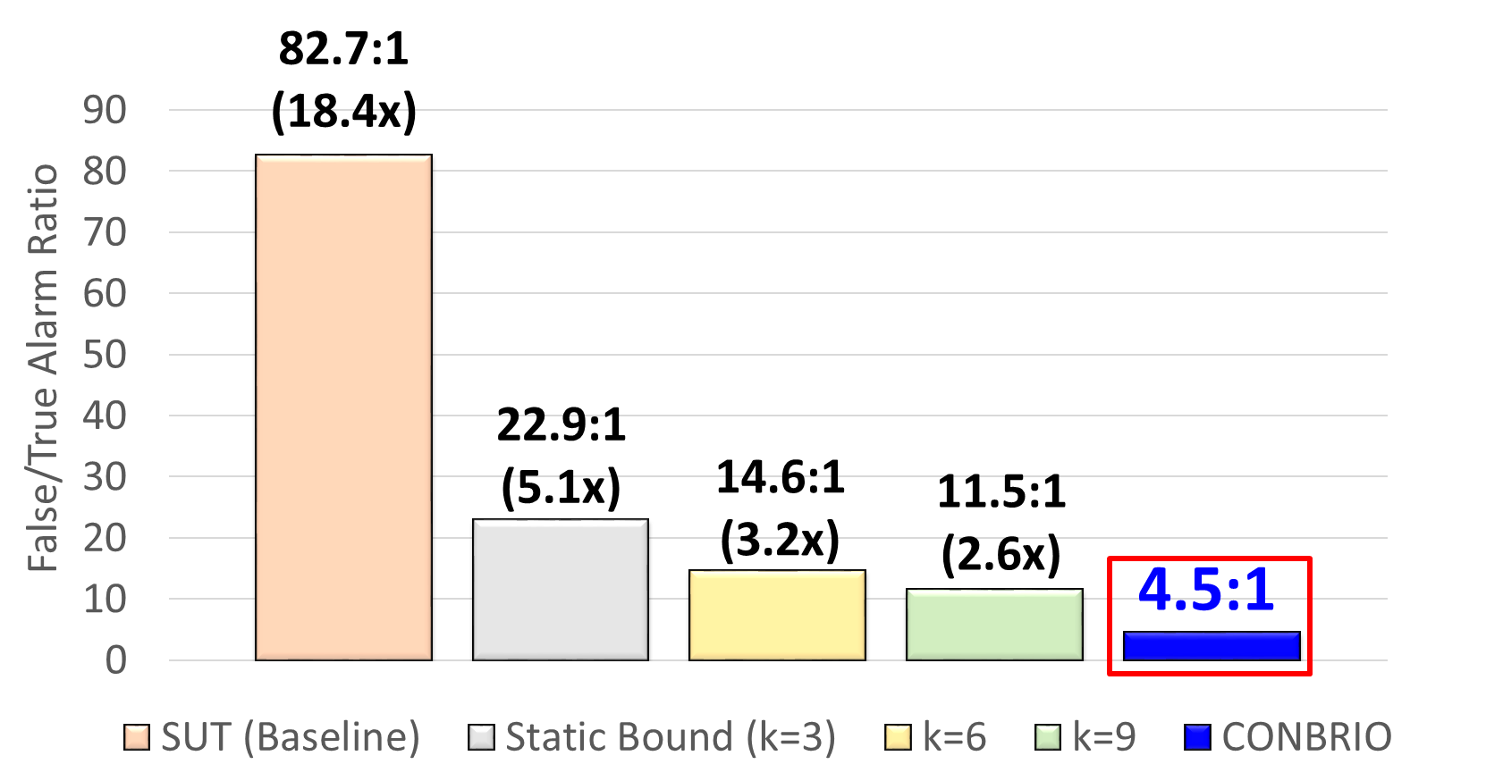
CON BRIO [ICSE2018]: Detecting 91% of target crash bugs on SIR and SPEC06 w/ 4.5 F/T alarm ratio

Slide 29
Conclusion
Automated concolic testing is effective and efficient for testing industrial embedded software including vehicle domain as well as consumer electronics domain
LG electronics introduced the technique from 2014 (c.f. ICSE SEIP 2015 paper)
Hyundai motors started to apply the technique from 2015
Successful application of automated testing techniques requires expertise of human engineers
SW
Testing
Cost
Automated
Testing
Manual
Testing
25%
50%
75%
100%
SW Reliability
Traditional testing
Concolic testing
Manual TC gen
Testing main scenarios
System-level testing
Small # of TCs
Automated TC gen
Testing exceptional scenarios
Unit-level testing
Large # of TCs
Notes:
We have demonstrated that our new technique conbol could effectively detect 24 crash bugs. Now conbol is successfully adopted by the original development team. I personally believe that concolic testing is mature enough to be adopted by industry, not only academy. Traditionally, testing focuses on manual TC generation testing main scenarios, ~~. But I believe that our testing paradigm is changing to new testing new paradigm based on concolic testing like conbol. Now we generate millions of test cases automatically, and targeting exceptional scenarios as we detected 24 hidden bugs with unit-level testing and large # of TCs. So overall I believe automated testing has a lower V7V cost than manual testing for higher reliability. And our group and samsung electronics try hard to apply such automated technique to more larger product.

