Slide 1
Generating Control-Flow Graph using Open-Source S/W
GCC: version 4.8+ (recommend 5.x+)
Graphviz (for processing .dot file)
The original slides were made by Hyunsu Lim bookman01@kaist.ac.kr

Slide 2
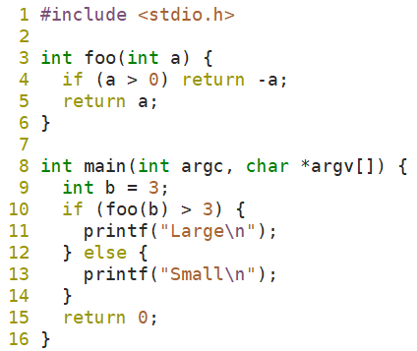
Get the target .c file
Sample .c file that will be used: sample.c

Slide 3
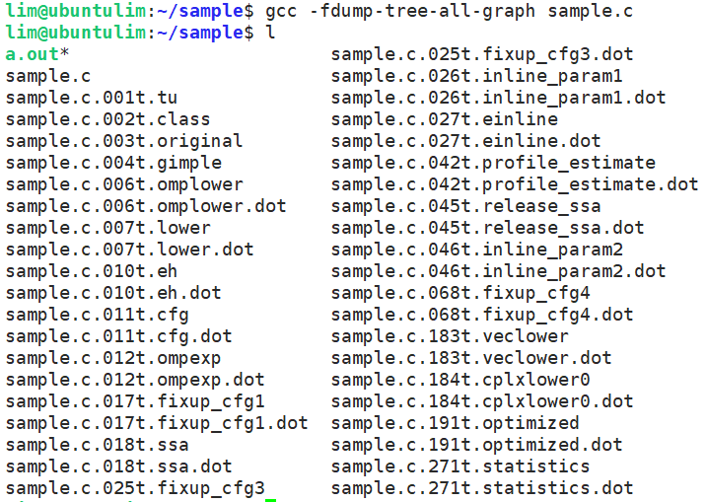
Generate .dot file using gcc
$ gcc -fdump-tree-all-graph <target.c>
Or $ gcc -fdump-tree-all-graph-lineno <target.c>
For more detailed options, https://gcc.gnu.org/onlinedocs/gcc/Developer-Options.html

Slide 4
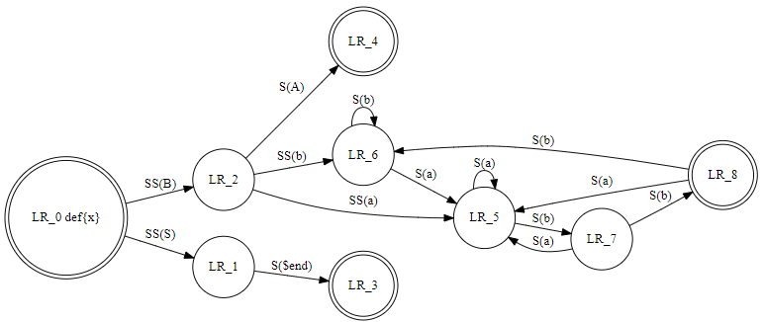
DOT (graph description language)
DOT is a plain text graph description language ( *.gv or *.dot)
The DOT language defines a graph, but not layout of the graph.
Graphviz –libraries and utilities to manipulate graphs
http://www.webgraphviz.com/
https://commons.wikimedia.org/wiki/Category:Images_with_Dot_source_code
digraph finite_state_machine {
rankdir=LR;
size="8,5"
node [shape = doublecircle];
“LR_0 def{x}” LR_3 LR_4 LR_8;
node [shape = circle];
"LR_0 def{x}" -> LR_2 [ label ="SS(B)" ];
"LR_0 def{x}" -> LR_1 [ label = "SS(S)" ];
LR_1 -> LR_3 [ label = "S($end)" ];
LR_2 -> LR_6 [ label = "SS(b)" ];
LR_2 -> LR_5 [ label = "SS(a)" ];
LR_2 -> LR_4 [ label = "S(A)" ];
LR_5 -> LR_7 [ label = "S(b)" ];
LR_5 -> LR_5 [ label = "S(a)" ];
LR_6 -> LR_6 [ label = "S(b)" ];
LR_6 -> LR_5 [ label = "S(a)" ];
LR_7 -> LR_8 [ label = "S(b)" ];
LR_7 -> LR_5 [ label = "S(a)" ];
LR_8 -> LR_6 [ label = "S(b)" ];
LR_8 -> LR_5 [ label = "S(a)" ];
}

Slide 5
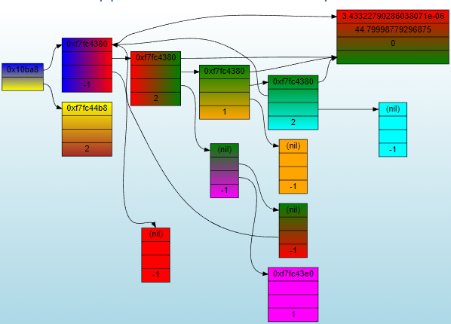
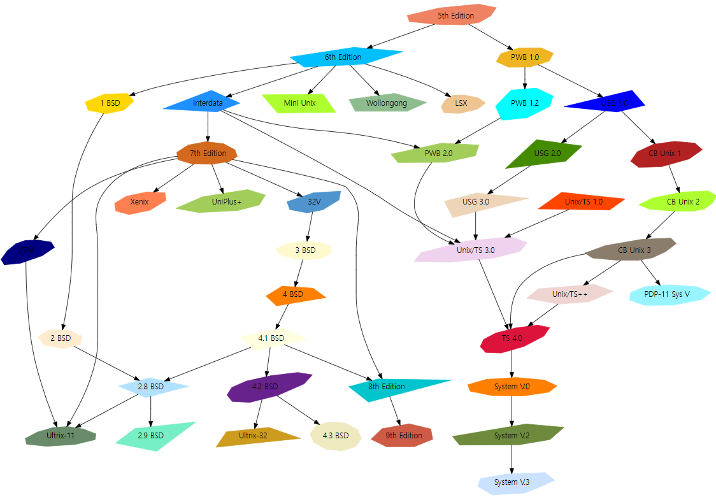
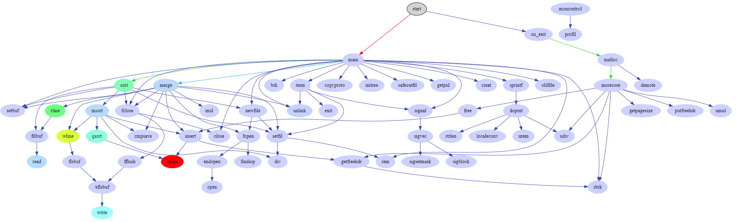

Slide 6
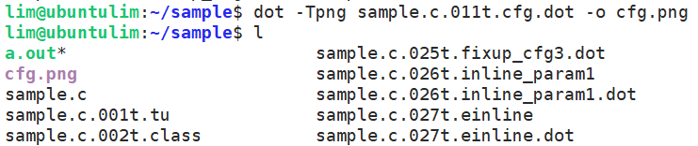
Process .dot file using Graphviz
You can use http://www.webgraphviz.com/ to generate visual graph from .dot file.
Or
$ dot -Tpng <target.dot> -o <output.png>
<target.dot> file is the file that ends with .cfg.dot
In sample case, it is `sample.c.011t.cfg.dot`

Slide 7
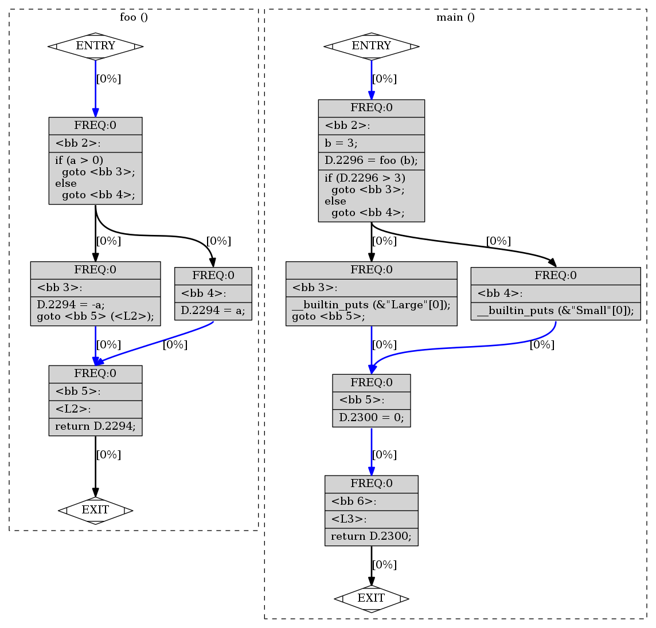
Result graph image
Warning: Gcc 4.x may generate only cfg of the last function in a target C file

