Slide 1
Greybox Fuzzing
Shin Hong
CSEE Handong Global Univ.

Slide 2
Topics
fuzzing background
mutation-based fuzzing
greybox fuzzing
introduction to the libFuzzer tool
functionalities
tool structure
walkthrough example
engineering aspects of unit test fuzzing

Slide 3


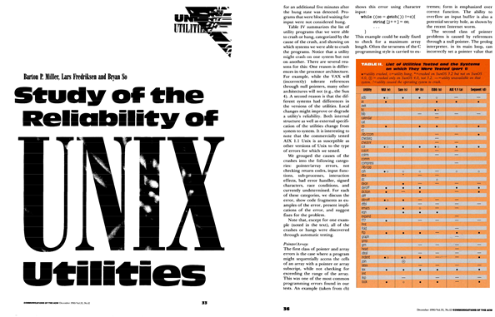
It was a Dark and Stormy Night in the Fall of 1988 http://pages.cs.wisc.edu/~bart/fuzz/Foreword1.html
Barton Miller, a professor of U. Wisconsin-Madison experienced that UNIX systems crashed extraordinary frequently.
He conjected that it was because unexpectedly strong electric noise induced multiple tweaks in packets
To test his conjecture, Miller gave an assignment to students to test UNIX utilities by feeding intentionally randomized inputs
Miller et al., An empirical study of the reliability of UNIX utilities, CACM, 1990

Slide 4
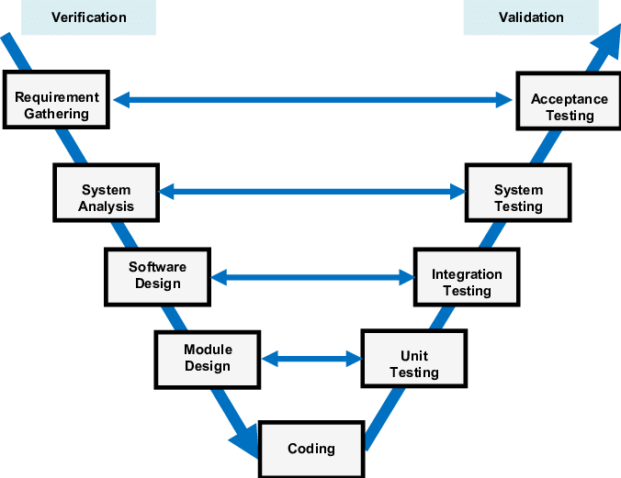

Ancient Fuzzers
Generate a long sequence of random texts that have similar aspects as formatted text input for testing UNIX command utilities
intermix comma, semicolon, and many control characters
e.g., '!7#%"*#0=)$;%6*;>638:*>80"=</>(/*:-(2<4 !:5*6856&?""11<7+%<%7,4.8
Feed randomly generated texts to a target UNIX utility, and repeat this for many hours
By using this kind of ancient fuzzers, new bugs were found from one third of the UNIX utilities
Requirement gathering
Acceptance Testing
System Analysis
System Testing
Software Design
Integration Testing
Coding
Unit Testing
Coding
Unit Testing
Coding
Unit Tesitng
Coding
Unit Testing
Coding
Unit Testing
Coding
Unit Testing
Coding
Unit Testing

Slide 5
Shortcomings of Ancient Fuzzers
Ancient fuzzers detect only crashes and hangs, but cannot uncover silent illegal behaviors which can result much critical consequences
reliability issue ⇒ security issue (adversarial users)
employ dynamic analyzers to detect and/or predict silent violations
e.g., valgrind, electric fence, LLVM sanitizer suites (AddressSanitizer, MemorySanitizer, UndefinedBehaviorSanitizer)
Randomly generated inputs cover only restricted portion of the source code
random inputs are often rejected quickly because they likely have trivial input grammar errors
extremely low probability for a randomly generated text to pass grammar checks

Slide 6
Mutation-based Fuzzing
Ideas
start with a set of valid inputs (seeds)
repeatedly introduce small changes to the existing inputs (mutation) with a hope that they exercise new behaviors
Example: fuzzing a URL parsing libary
Seed
http://www.google.com/search?q=fuzzing
Fuzzed inputs
http://www.g=oNogl.om/search?q=fuzzing/
RttpX://w)ww.goo(gle.comq/sarc(q=fuzzng
hdt8p://"wWw.goole.com/seDarb`*?q=fuzzing
hup://www.google.comC/search?q=fuzzing
http://w7w.google.com/search?q=ufuzgzing
http://w&ww.google.cKom/search7q=fuzzing

Slide 7
Mutation Operators
Flip one random bit
Alternate one or multiple consecutive bytes
Erase one or multiple bytes from random offsets
Insert one or multiple bytes to random offsets
Repeat existing bytes multiple times
Add a word from a predefined dictionary
Shuffle consecutive bytes (reorder multiple bytes randomly)
Copy a substring and paste it randomly offsets
Crossover
Apply mutation one or more times on a single seed input
Fine-grained
Coarse-grained

Slide 8
Why Mutation Effectively Disclose Subtle Behaviors?
It is likely to obtain quality seed inputs from existing test cases
An error-revealing input mostly resides close to a valid input
close in lexical distance, or numerical distance
competent programmer hypothesis
A part of a program input is likely associated with only few program components
an aspect of an input text can be represented as a short subsequence
strong locality exists in a well-modularized program
A critical value of a specific part of input is likely found in the other parts of the inputs

Slide 9
Greybox Fuzzing: Use Structural Coverage to Guide Fuzzing
Idea
Start with a set of valid inputs
Repeatedly introduce small changes to the existing inputs while expecting they exercise new behaviors
Include the mutated input as a seed only if it explores a new behavior
covering a new structural test requirement
Greybox fuzzers (e.g., AFL, libFuzzer) show in practice that use of structural coverage dramatically improves effectiveness of mutation-based fuzzing
Google runs fuzzing on 160 open-source projects with 250,000 machines
Google found more than 16,000 bugs in Chrome by fuzzing

Slide 10

Basic Algorithm
Input: a target program Prog
a set of seeds S = {s₁, s₂, ... s_{n}}
Output: two sets of tests P = {p₁, p₂, ..., p_{m}}, F={f₁, f₂, ..., f_{k}}
Procedure:
P $←$ S , F $←∅$, C $←∅$
while p $∈$P begin
C $←$ C $∪$ Cov(Prog, p)
end while
while termination condition is not satisfied begin
p $←$ select a random test input from P
p$′$ $←$ mutate p with a certain mutation operator
if Prog(p$′$) fails then
F $←$ F $∪$ { p$′$ }
else
if Cov(Prog, p$′$) – C $≠∅$ then
P $←$ P $∪${ p$′$ }
C $←$ C $∪$ Cov(Prog, p$′$)
end if
end if
end while

Slide 11

libFuzzer: Fuzzing Tool for LLVM https://llvm.org/docs/LibFuzzer.html
libFuzzer is a greybox fuzzer inspired by AFL for testing C/C++ libraries
developed as a component of LLVM
target C/C++ programs
well integrated with the LLVM sanitizer suites
generate inputs to public APIs in a unit test driver (rather than a system input)
provide a plugin API for defining and managing custom mutation operators
easy to implement structure-aware, grammar-based fuzzing
libFuzzer, together with AFL, is used as a core component of OSS-Fuzz and ClusterFuzz https://google.github.io/clusterfuzz/

Slide 12
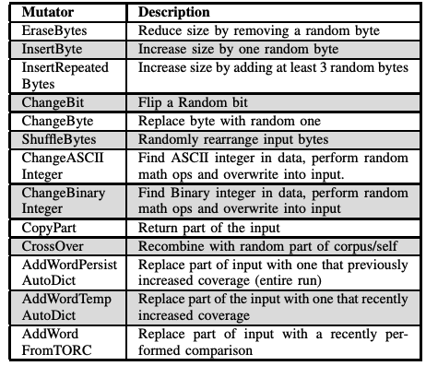
libFuzzer Mutation Operators
Domain-specific word dictionary can be configured for a specific target function
We can add custom mutation operators
alternate an input text considering its grammar or constraints on input validity

Slide 13
Writing Unit Fuzzing Driver (parameterized unit test case)
target function accepts array of bytes, and feed accepted data into the API under test
aspects
set prerequisite environment to run target API
configure test execution environment
invoke other APIs to set the starting state and also mock objects
cast given fuzzed input to the arguments of a target API
typecasting (e.g., a region of string to an integer)
precondition checking
selecting sub-cases of a test scenario
configure fuzzing engine
// target.cc
extern "C" int LLVMFuzzerTestOneInput(const uint8_t *Data, size_t Size) {
DoSomethingInterestingWithMyAPI(Data, Size);
return 0; // Non-zero return values are reserved for future use.
}

Slide 14
Example - Triangle
Fuzzing target
Commands
clang -g -O1 -fsanitize=fuzzer,signed-integer-overflow triangle.c fuzz_target.c -o test-target
export UBSAN_OPTIONS=halt_on_error=1
./test-target corpus seed -max_len=100
extern int LLVMFuzzerTestOneInput (const uint8_t *Data, size_t Size) {
if (Size != 12)
return 0 ;
int a, b, c ;
a = *((int *) (Data + 0)) ; b = *((int *) (Data + 4)) ; c = *((int *) (Data + 8)) ;
triangle_type(a, b, c) ;
}

Slide 15
Advanced Fuzzing Techniques

Slide 16

Recent Advances of Fuzz Testing Techniques
automated construction of
unit fuzzing drivers
target
fuzzing driver
hybrid uses of different fuzzers
fuzzers
mutation
scheduling
mutation
test
execution
corpus management
corpus
directed searching
input model extraction

Slide 17
Unit Fuzzing Driver Generation
Challenges: unit fuzzing requires fuzzing drivers for testing an API function, but writing a unit fuzzing driver is laborsome and tricky
soundness issues
comprehensiveness issue
Approaches
FUDGE extracts a fuzzing driver of a specific function via slicing from where the function is used in the production code [ESEC/FSE’19]
FuzzGen infers API dependency graphs from the source code and synthesize likely API sequences as fuzzing drivers [USENIX Sec’20]
G-EvoSuite generates unit fuzzing drivers by extending their method sequences according to coverage feedback [ASE’20]

Slide 18
Hybrid Use of Different Fuzzers
Challenges: no single golden fuzzer exists – the effectiveness of a certain fuzzer varies depending on target program characteristics
Approaches: intermix different fuzzers and test generation techniques
Zest cooperates grammar-aware input construction and mutation fuzzing to induce synergetic effects [ISSTA’19]
EnFuzzer collaboratively runs multiple fuzzers via seed synchronization [USENIX-Sec’19]
MUEZZ learns an effective seed scheduling scheme for hybrid uses of greybox fuzzing and concolic testing techniques [RAID’20]
HFL combines fuzzing and symbolic execution for testing kernel code [NDSS’20]
CUPID automatically suggests for a combination of different fuzzers, that provide reliable performance to various targets [ACSAC’20]

Slide 19
Directed Searching
Challenge: conventional fuzzers simply explores diverse paths without considering their values under testing context
Approaches
ParmaSan gives high priorities to the seeds that cover more sanitizer warnings for detecting memory errors quickly [USENIX-Sec’20]
IJSON receives and interprets developer’s annotations in guiding a fuzzing process [SP’20]
Wustholz et al. utilizes static analyses to predict likely paths to target code locations and uses the prediction as fuzzing guidance [ICSE’20]
TortoiseFuzzer assigns higher weights to the code that seem relevant to memory corruption faults to avoid searching meaningless paths [NDSS’22]
TOFU prioritizes seeds that reaches to closer paths to the given target code locations [preprint]

Slide 20
Input Model Extraction
Challenges: fuzzers must be aware of the constraints on structured inputs, but it is hard for users to specify input grammar correctly and completely
Approaches
LFuzzer extracts useful input tokens online and uses the extracted tokens within the fuzzing process [ISSTA’20]
FuzzGuard trains a CNN to predict if an input will reach to a target location and uses the model to reject useless inputs [USENIX-Sec’20]
MTFuzz trains a neural model to predict which coverage items are covered from input offsets and uses the model to guide mutations [ESEC/FSE’20]

Slide 21
References
The Fuzzing Book: Tools and Techniques for Generating Software Tests
Andreas Zeller, Rahul Gopinath, Marcel Böhme, Gordon Fraser, and Christian Holle
https://www.fuzzingbook.org/
libFuzzer – a library for coverage-guided fuzz testing
https://llvm.org/docs/LibFuzzer.html
The Art, Science and Engineering of Fuzzing: A Survey
V. J.M. Manes, H. Han, C. Han, S. K. Cha, M. Egele, E. J. Schwartz, and M. Woo
IEEE Transactions on Software Engineering, Volume: 47, Issue: 11, 01 November 2021

