Slide 1
GNU gcov (1/6) [from Wikipedia]
gcov is a source code coverage analysis and statement-by-statement profiling tool.
gcov generates exact counts of the number of times each statement in a program has been executed
gcov does not produce any time-based data (you should use gprof for this purpose) and works only on code compiled with the GCC suite.
gcov [-b] [-c] [-v] [-n] [-l] [-f] [-o directory] sourcefile
-a: Write individual execution counts for every basic block.
-b: Write branch frequencies to the output file
-c: Write branch frequencies as the number of branches taken
-f: Output summaries for each function in addition to the file level summary.
-o The directory where the object files live. Gcov will search for `.bb', `.bbg', and `.da' files in this directory

Slide 2
GNU gcov (2/6)
Each source file should be compiled by gcc with --coverage, which generates a <source filename>.gcno file that is a graph file of the source file in the current working directory.
After the instrumented target program completes its execution, execution statistics is recorded in a <source filename>.gcda file in the same directory to the current working directory.
gcov creates a human readable logfile .gcov from a binary.gcda file, which indicates how many times each line of a source file has executed.

Slide 3
GNU gcov (3/6)
For example, if you measure coverage of example.c,
[moonzoo@verifier gcov]$ l
example.c
[moonzoo@verifier gcov]$ gcc -fprofile-arcs -ftest-coverage example.c
[moonzoo@verifier gcov]$ a.out 5
i=5
j=2
[moonzoo@verifier gcov]$ gcov -b example.c
File 'example.c'
Lines executed:78.57% of 14
Branches executed:100.00% of 10
Taken at least once:50.00% of 10
Calls executed:60.00% of 5
example.c:creating 'example.c.gcov'
1 #include <stdio.h>
2 int main(int argc, char **argv){
3 int i=0,j=0;
4 if (argc < 2) {
5 printf("Usage:…\n”);exit(-1);}
6 i = atoi(argv[1]);
7 printf("i=%d\n",i);
8
9 if( i == 0)
10 j=0;
11 else {
12 if (i == 1)
13 j=1;
14 if (i > 1 && i < 10)
15 j=2;
16 }
17 printf("j=%d\n",j);
18 }

Slide 4
“Branches executed” vs. “Taken at least once”
GNU gcov (4/6)
For measuring branch coverage, be careful to use “Taken at least once”, not “Branches executed”
Ex.
Branch executed: 100%
Taken at least once: 50%
execution

Slide 5
GNU gcov (5/6)
-: 0:Source:example.c
-: 0:Graph:example.gcno
-: 0:Data:example.gcda
-: 0:Runs:1
-: 0:Programs:1
-: 1:#include <stdio.h>
function main called 1 returned 100% blocks executed 71%
1: 2:int main(int argc, char **argv){
1: 3: int i=0,j=0;
1: 4: if (argc < 2) {
branch 0 taken 0% (fallthrough)
branch 1 taken 100%
#####: 5: printf("Usage:…\n");exit(-1);}
call 0 never executed
call 1 never executed
1: 6: i=atoi(argv[1]);
call 0 returned 100%
1: 7: printf("i=%d\n",i);
call 0 returned 100%
-: 8:
1: 9: if( i == 0)
branch 0 taken 0% (fallthrough)
branch 1 taken 100%
#####: 10: j=0;
-: 11: else {
1: 12: if (i == 1)
branch 0 taken 0% (fallthrough)
branch 1 taken 100%
#####: 13: j=1;
1: 14: if(i>1&&i<10)
branch 0 taken 100% (fallthrough)
branch 1 taken 0%
branch 2 taken 100% (fallthrough)
branch 3 taken 0%
1: 15: j=2;
-: 16: }
1: 17: printf("j=%d\n",j);
call 0 returned 100%
1: 18:}
1 #include <stdio.h>
2 int main(int argc, char **argv){
3 int i=0,j=0;
4 if (argc < 2) {
5 printf("Usage:…\n”);exit(-1);}
6 i = atoi(argv[1]);
7 printf("i=%d\n",i);
8
9 if( i == 0)
10 j=0;
11 else {
12 if (i == 1)
13 j=1;
14 if (i > 1 && i < 10)
15 j=2;
16 }
17 printf("j=%d\n",j);
18 }
Executed function info
Not executed
Call info
Non-executable statement
Note that a "branch" for gcov is anything that causes the code to execute non-straight line
Conditional statement with a compound condition (i.e., a Boolean formula containing && or ||) has more than 2 branches
Branch info for each condition

Slide 6
GNU gcov (6/6)
1 #include <stdio.h>
2 int main(int argc, char **argv){
3 int i=0,j=0;
4 if (argc < 2) {
5 printf("Usage:…\n”);exit(-1);}
6 i = atoi(argv[1]);
7 printf("i=%d\n",i);
8
9 if( i == 0)
10 j=0;
11 else {
12 if (i == 1)
13 j=1;
14 if (i > 1 && i < 10)
15 j=2;
16 }
17 printf("j=%d\n",j);
18 }
mz@hp-x360-mz:~/tmp$ ./a.out 5
i=5
j=2
mz@hp-x360-mz:~/tmp$ gcov -b -i example.c
File 'example.c'
Lines executed:84.62% of 13
Branches executed:100.00% of 10
Taken at least once:60.00% of 10
Calls executed:100.00% of 5
Creating 'example.c.gcov'
mz@hp-x360-mz:~/tmp$ cat example.c.gcov
file:example.c
function:2,1,main
lcount:2,1
lcount:3,1
lcount:4,1
branch:4,nottaken
lcount:5,0
lcount:6,1
lcount:7,1
lcount:9,1
branch:9,nottaken
lcount:10,0
lcount:12,1
branch:12,nottaken
lcount:13,0
lcount:14,1
branch:14,taken
branch:14,taken
lcount:15,1
lcount:17,1
Intermediate output
This intermediate coverage information format (obtained with –i option) is mainly used by coverage visualization tools like lcov, gcovr, etc.
Note that recent gcov –i (version 9.1 or higher) generates the intermediate coverage information in a json file.
Notes:
{"gcc_version": "9.4.0", "files": [{"lines": [{"branches": [], "count": 1, "line_number": 2, "unexecuted_block": false, "function_name": "main"}, {"branches": [], "count": 1, "line_number": 3, "unexecuted_block": false, "function_name": "main"},
{"branches": [{"fallthrough": true, "count": 0, "throw": false}, {"fallthrough": false, "count": 1, "throw": false}], "count": 1, "line_number": 4, "unexecuted_block": false, "function_name": "main"},
{"branches": [], "count": 0, "line_number": 5, "unexecuted_block": true, "function_name": "main"},
{"branches": [], "count": 1, "line_number": 6, "unexecuted_block": false, "function_name": "main"},
{"branches": [], "count": 1, "line_number": 7, "unexecuted_block": false, "function_name": "main"},
{"branches": [{"fallthrough": true, "count": 0, "throw": false}, {"fallthrough": false, "count": 1, "throw": false}], "count": 1, "line_number": 9, "unexecuted_block": false, "function_name": "main"},
{"branches": [], "count": 0, "line_number": 10, "unexecuted_block": true, "function_name": "main"},
{"branches": [{"fallthrough": true, "count": 0, "throw": false}, {"fallthrough": false, "count": 1, "throw": false}], "count": 1, "line_number": 12, "unexecuted_block": false, "function_name": "main"},
{"branches": [], "count": 0, "line_number": 13, "unexecuted_block": true, "function_name": "main"},
{"branches": [{"fallthrough": true, "count": 1, "throw": false}, {"fallthrough": false, "count": 0, "throw": false}, {"fallthrough": true, "count": 1, "throw": false}, {"fallthrough": false, "count": 0, "throw": false}], "count": 1, "line_number": 14, "unexecuted_block": false, "function_name": "main"},
{"branches": [], "count": 1, "line_number": 15, "unexecuted_block": false, "function_name": "main"},
{"branches": [], "count": 1, "line_number": 17, "unexecuted_block": false, "function_name": "main"}],
"functions": [{"blocks": 15, "end_column": 1, "start_line": 2, "name": "main", "blocks_executed": 11, "execution_count": 1, "demangled_name": "main", "start_column": 5, "end_line": 18}], "file": "example.c"}], "format_version": "1", "current_working_directory": "/home/user/tmp", "data_file": "example.c"}

Slide 7
Visual Coverage Tools based on gcov
lcov
https://github.com/linux-test-project/lcov
gcovr
https://github.com/linux-test-project/lcov
grcov
https://github.com/mozilla/grcov

Slide 8
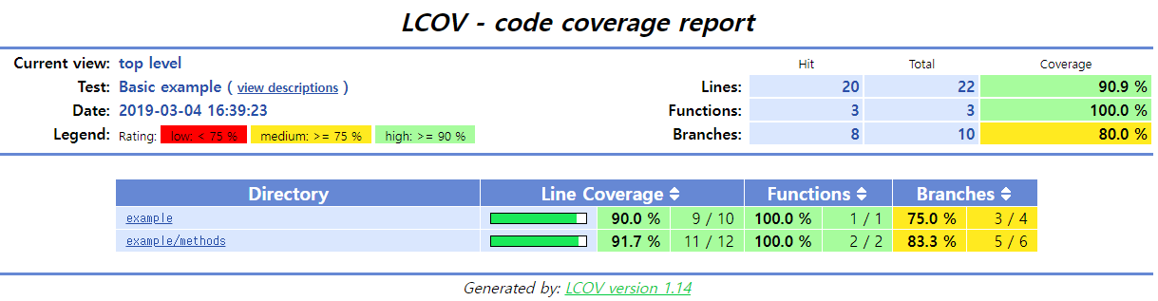
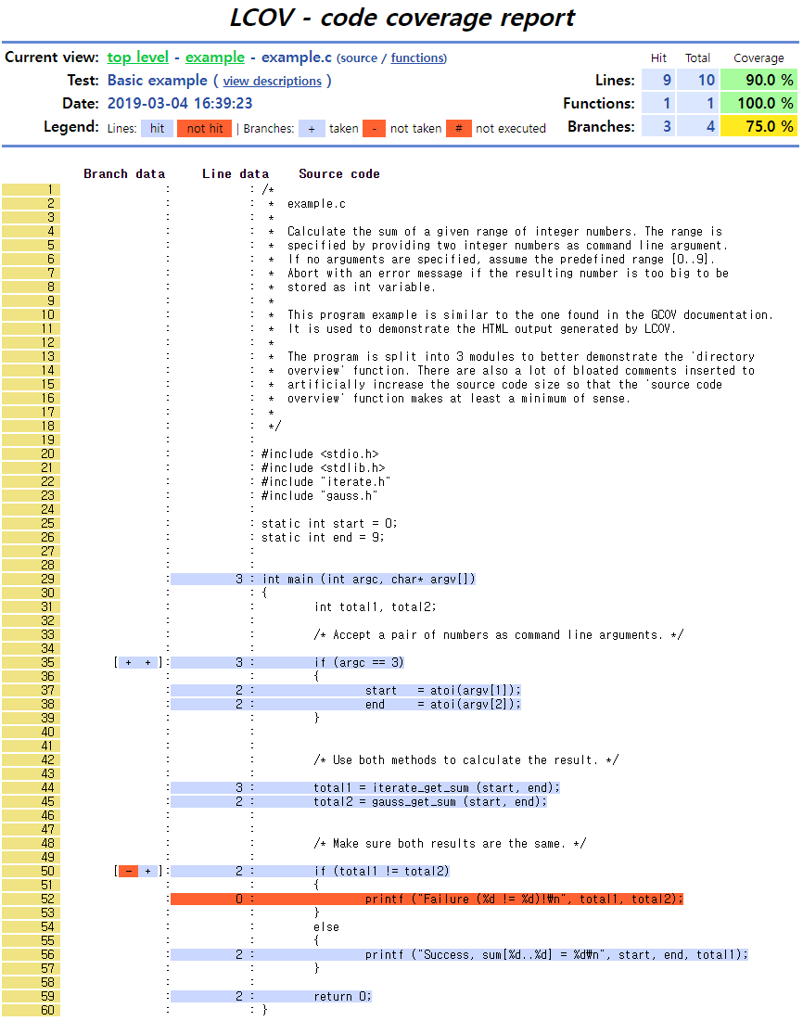
lcov

Slide 9
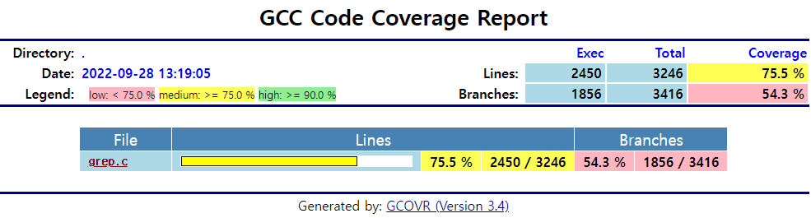
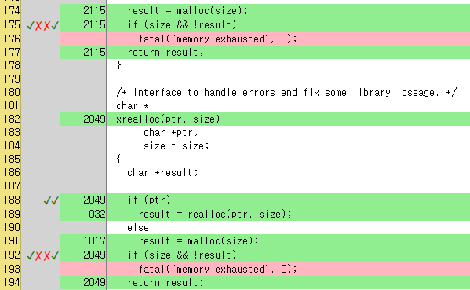
gcovr
grep-v2.0-simplified$ gcovr --html --html-detail -o index.html

Slide 10
gcovr
grep-v2.0-simplified$ gcovr -b
------------------------------------------------------------------------------
GCC Code Coverage Report
Directory: .
------------------------------------------------------------------------------
File Branches Taken Cover Missing
------------------------------------------------------------------------------
grep.c 3416 1856 54% 147,175,192,252,259,284,287,289,293,311,312,317,402,419,457,508,552,579,588,643,657,679,686,691,696,704,725,726,741,789,800,810,813,821,825,835,838,846,848,851,854,1712,2782,2806,2808,2818,2828,2839,2840,2854,2855,2865,2870,2872,2874,2898,2900,2901,2904,2906,2908,2909,2929,2948,2955,2956,2957,2958,2973,2974,2987,2997,3005,3009,3015,3023,3030,3036,3038,3041,3043,3045,3053,3058,3065,3066,3067,3068,3072,3075,3080,3083,3089,3093,3097,3101,3102,3103,3112,3128,3132,3134,3140,3157,3173,3195,3209,3216,3221,3233,3237,3256,3259,3277,3278,3284,3289,3297,3298,3327,3333,3341,3344,3349,3377,3387,3390,3391,3403,3405,3411,3415,3422,3423,3425,3433,3435,3438,3440,3449,3451,3453,3462,3464,3481,3483,3490,3502,3545,3547,3549,3577,3583,3588,3592,3596,3600,3604,3608,3613,3618,3622,3626,3642,3658,3661,3663,3664,3665,3666,3668,3674,3678,3690,3787,3791,3793,3807,3812,3814,3815,3829,3832,3862,3880,3881,3889,4211,4216,4218,4234,4257,4258,4265,4268,4269,4275,4276,4282,4283,4290,4294,4299,4355,4363,4364,4372,4373,4391,4393,4399,4414,4474,4544,4549,4551,4556,4558,4565,4566,4576,4578,4584,4587,4591,4592,4593,4597,4604,4608,4614,4615,4620,4623,4627,4629,4917,4924,4936,4937,4955,4977,4988,5005,5039,5041,5046,5047,5064,5075,5076,5078,5089,5099,5103,5107,5112,5126,5129,5137,5141,5142,5161,5174,5193,5197,5198,5201,5207,5220,5222,5223,5226,5240,5241,5253,5270,5280,5281,5296,5316,5317,5329,5340,5350,5364,5365,5366,5372,5381,5395,5396,5408,5415,5420,5426,5446,5457,5458,5459,5464,5466,5467,5474,5477,5484,5489,5505,5507,5509,5521,5523,5527,5528,5538,5546,5573,5611,5614,5621,5626,5652,5653,5654,5658,5669,5671,5678,5685,5686,5690,5691,5696,5732,5765,5778,5796,5835,5841,5847,5853,5854,5918,5919,5927,5928,5930,5943,5956,5962,5973,5974,5975,5983,5990,6020,6026,6036,6056,6062,6072,6079,6092,6107,6128,6133,6143,6167,6193,6196,6203,6214,6225,6252,6254,6399,6412,6417,6421,6422,6428,6446,6478,6490,6495,6500,6505,6507,6511,6541,6542,6553,6558,6560,6579,6586,6591,6718,6730,6743,6974,6993,7001,7007,7012,7017,7019,7021,7022,7023,7024,7025,7026,7027,7028,7041,7069,7073,7078,7080,7085,7089,7094,7104,7105,7110,7111,7116,7121,7130,7132,7134,7140,7148,7149,7150,7165,7172,7176,7178,7197,7200,7203,7216,7217,7225,7228,7229,7230,7233,7234,7244,7245,7246,7247,7269,7388,7402,7442,7508,7516,7522,7584,7586,7607,7610,7643,7645,7647,7665,7666,7667,7668,7670,7710,7716,7876,7924,8148,8210,8240,8255,8297,8327,8329,8330,8335,8347,8350,8353,8475,8479,8493,8507,8551,8590,8593,8594,8597,8598,8600,8605,8701,8711,8742,8752,8769,8771,8799,8819,8822,8831,8839,8852,8857,8874,8877,8885,8892,8932,8943,8944,8958,8960,8977,8984,9009,9011,9015,9023,9029,9038,9050,9058,9061,9066,9074,9081,9087,9095,9100,9117,9286,9292,9293,9362,9364,9368,9370,9402,9405,9423,9434,9587,9591,9599,9704,9706,9726,9731,9743,9745,9747,9760,9762,9764,9766,9794,9801,9833,9839,9841,9843,9844,9861,9874,9876,9879,9884,9890,9892,9894,9895,9899,9902,9912,9917,9921,9948,9951,9971,10577,10602,10611,10614,10632,10687,10698,10773,10775,10782,10806,10809,10817,10818,10820,10821,10823,10830,10833,10866,10874,10888,10893,10895,10897,10901,10902,10904,10906,10921
------------------------------------------------------------------------------
TOTAL 3416 1856 54%
------------------------------------------------------------------------------

Slide 11
clang, llvm-cov
You can use clang/llvm-cov tools in a similar way to gcc/gcov.
1. To build a coverage-enabled executable, run
clang --coverage example.c –o example
2. Run generated executable
./example
3. To get coverage of example.c, run
llvm-cov gcov –b example.c
4. Then, you will get the same result as gcov (including the same example.c.gcov file)
File 'example.c'
Lines executed:28.57% of 14
Branches executed:20.00% of 10
Taken at least once:10.00% of 10
No calls
Creating 'example.c.gcov'
Notes:
clang -fsanitize=address -fsanitize-coverage=trace-pc-guard
ASAN_OPTIONS=coverage=1 ./a.out
sancov symbolize

