Slide 1


Automated Test Input Generation through Fuzzing
Moonzoo Kim

Slide 2
Various SW Testing Techniques w/ Different Cost and Effectiveness
_{Whitebox Testing}
SW Reliability
Model Checking
Concolic Testing
Search-based Testing
Branch Testing
Blackbox Testing
_{Stmt. Testing}
Equiv. Partition. Testing
_{T-way Testing}
Req. based Testing
참고. 테스팅 국어 사전 http://dic.sten.or.kr/
Rand. Testing
SW Testing Cost
Notes:
We have demonstrated that our new technique conbol could effectively detect 24 crash bugs. Now conbol is successfully adopted by the original development team. I personally believe that concolic testing is mature enough to be adopted by industry, not only academy. Traditionally, testing focuses on manual TC generation testing main scenarios, ~~. But I believe that our testing paradigm is changing to new testing new paradigm based on concolic testing like conbol. Now we generate millions of test cases automatically, and targeting exceptional scenarios as we detected 24 hidden bugs with unit-level testing and large # of TCs. So overall I believe automated testing has a lower V7V cost than manual testing for higher reliability. And our group and samsung electronics try hard to apply such automated technique to more larger product.

Slide 3

Fuzzing - Automated Test Input Generation via Random Mutation
Java
Java
script
HTML
Sequence of bytes
New test case!
Java
L
o
r
e
m
I
Mut
L
o
i
e
m
I
Jpeg
image
...
...
Java
txt
file
Mut. Input File1
Mut. Input File1
2. Mutation
Mut. Input File N
Selected Test Input File
3. Target Runs
1. Selection
Pool of Test Input Files
Cov. Result of N
Cov. Result of N
Cov. Result of N
4. Store or Remove Mutated Test Input Files
Notes:
일단 퍼징이란, 무작위 변이 기반 테스트 생성 기술입니다. 테스트 케이스는 타겟 프로그램에 따라 Html, jpeg 이미지 파일 또는 txt 파일 등이 될 수 있는데, 퍼징은 각 파일의 구조를 단순히 바이트의 나열이라 보고, 무작위의 바이트를 무작위의 값으로 바꾸어서 새로운 테스트 케이스를 생성하는 기술입니다.
기본적인 퍼징의 프로세스는 아래 그림과 같이 이루어 집니다. 이미 존재하는 테스트 입력값 중 하나를 선택해서, 이 입력값을 변이해 새로운 입력값을 만들어, 이 새로운 입력값을 타겟 프로그램에 실행하여 커버리지 결과를 구해 만약 새로운 커버리지를 보이면 저장하고, 아니라면 버리기를 반복합니다.
하지만 예상하실 수 있다시피 나이브하게 아무 바이트나 골라서 아무 값으로 넣어 줬는데 프로그램의 새로운 behavior를 만들기는 어렵겠죠,
어떤 바이트를 골라서 어떤 값으로 변이해야 하는지에 대한 기법이 많이 나와 있습니다.

Slide 4
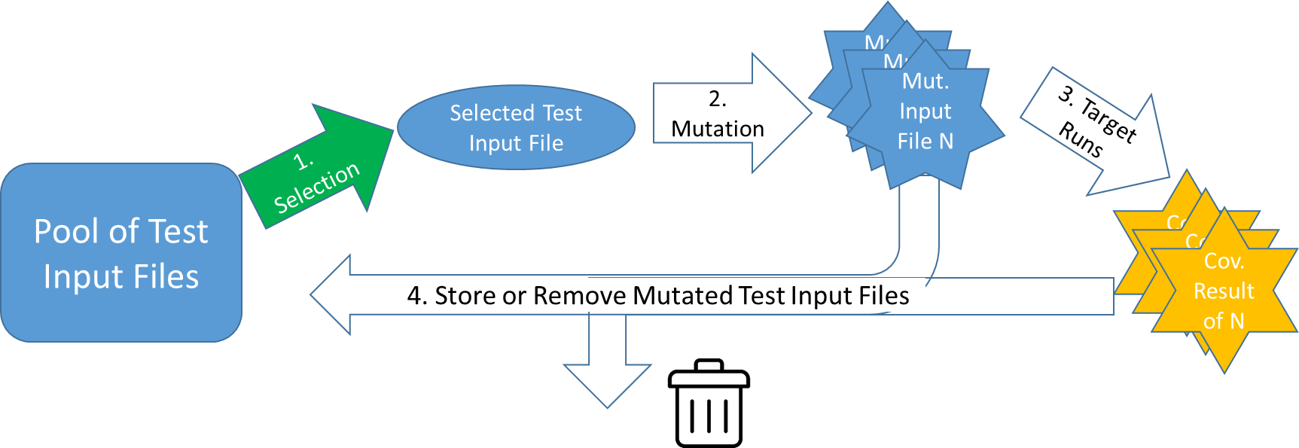
_{Fuzzing Challenge #1}
Which test input file to select to mutate?
Fuzzer | Heuristic
AFL | Favor test inputs whose execution time and length are short - semantic characteristics of test inputs are ignored)
FairFuzz (ASE 2018), Vuzzer (NDSS 2017) | Favor test inputs such that those test inputs covers hardly covered branches - semantic characteristics of test inputs are a little bit used
CollAFL (SP 2018), Angora (SP 2018) | Favor test inputs that cover many branches whose branch condition statements are executed but these branches are rarely covered - semantic characteristics of test inputs are a little bit used
Notes:
퍼징에서 첫번째로 고민해볼 점은 어떤 테스트 입력값을 변이할지 입니다.

Slide 5
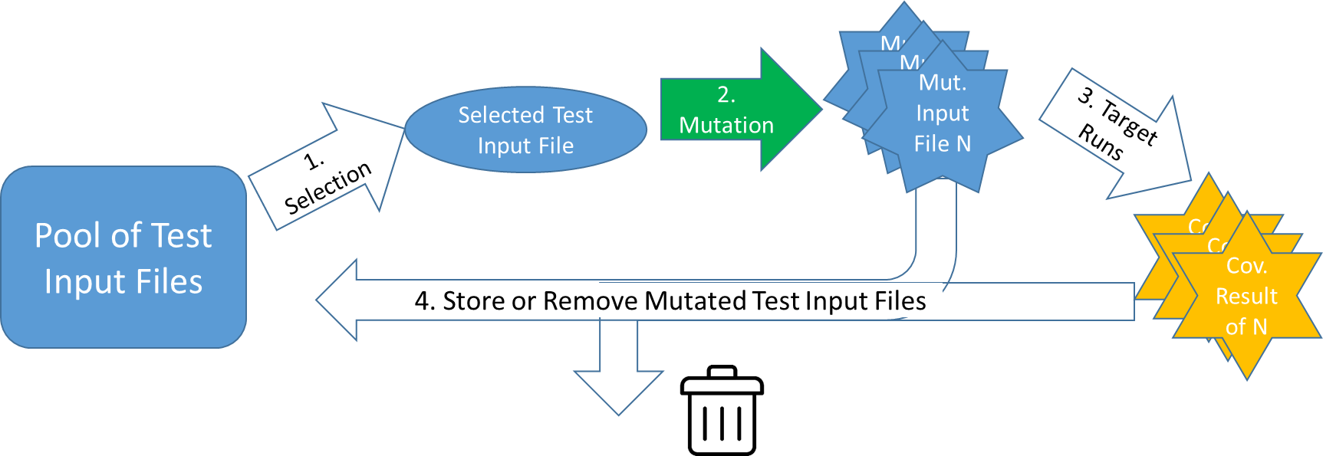
_{Fuzzing Challenge #2}
Which bytes in the selected test input file should be mutated?
Fuzzer | Heuristic
AFL | Bytes of random # are randomly selected to mutate - No semantic information on the bytes are utilized
FairFuzz (ASE 2018), Profuzzer(SP 2019), GreyOne (USENIX security ‘20) | Guess which bytes are important based on the runtime information (e.g., if one byte is mutated and the runtime information does not change at all, a fuzzer does not select that byte afterward)
BuzzFuzz(ICSE 2009), Dowser(USENIX security ‘13), Vuzzer(NDSS 2017), Angora (SP 2018), Matryoska(CCS ‘19) | Select the bytes which have dependency with "important" branches through Dynamic Taint Analysis (DTA) - Control dependency is not considered

Slide 6


_{Intro to Fuzzing}

Slide 7
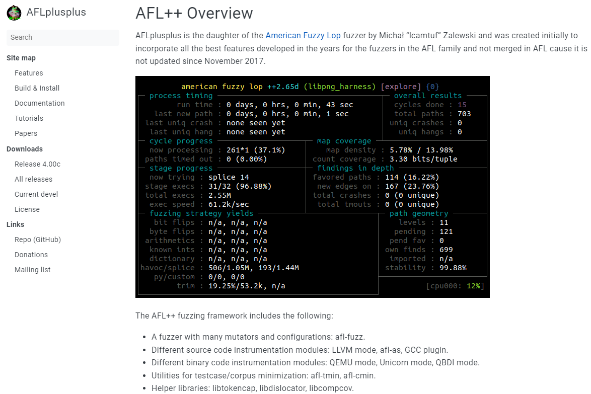

Slide 8
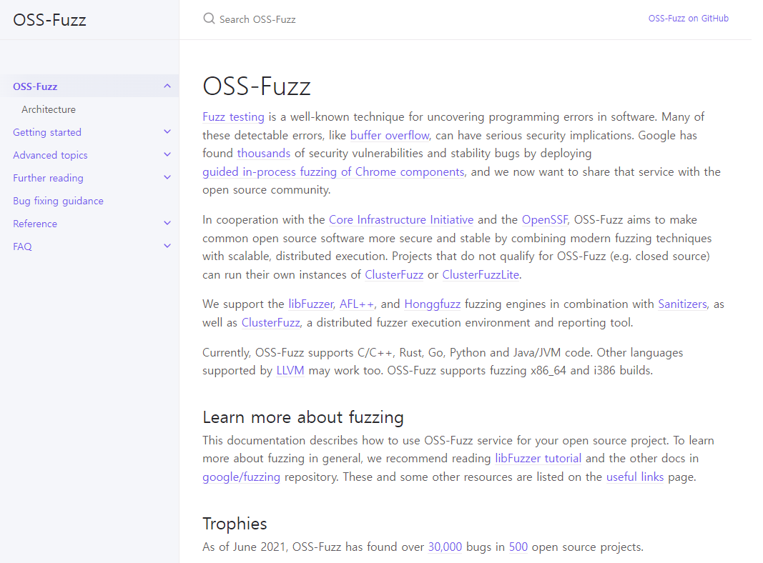

Slide 9
Fuzzing Algorithm of AFL/AFL++
How execution paths of test input files are defined and analyzed
How to select test input files
How to mutate selected test input files

Slide 10
_{Example of a New Path}
A path is considered new, if it covers a new branch, or a branch's hit count is in a new range of hit counts.
The list of ranges are as follows:
[1, 2, 3, 4-7, 8-15, 16-31, 32-127, 128+]
These ranges are called buckets.
For 2 test input files that have the same branch coverage
tc1: A-B-C-A-B-D
tc2: A-B-C-A-B-C-A-B-D
Branch hit count of tc1:
A
b₁
b₃
B
C
b₂
Branch hit count of tc2:
b₄
Branch ID | b₁ | b₂ | b₃ | b₄
Hit count | 2 | 1 | 1 | 1
Branch ID | b₁ | b₂ | b₃ | b₄
Hit count | 3 | 2 | 2 | 1
D
tc2 covers a new path compared to tc1
the hit count for b_{1,} b_{2,} and b₃ of tc1 and tc2 cover different buckets.

Slide 11
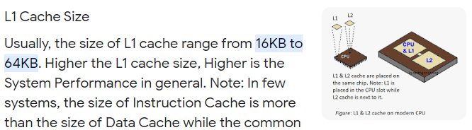
How Path Information is Stored by AFL
Branch hit count is used to find a new path
AFL keeps the path coverage data in a 64kB mem.
Each byte represent hit count bucket for each branch as follows:
Note: multiple branches may use the same byte
the location of a branch's byte is determined by hashing (i.e., hash collision)
1 hit bucket: 1 | 1 hit bucket: 0
2 hits bucket: 1 | 2 hits bucket: 1
3 hits bucket: 1 | 3 hits bucket: 0
4-7 hits bucket: 0 | 4-7 hits bucket: 0
8-15 hits bucket: 0 | 8-15 hits bucket: 0
16-31 hits bucket: 0 | 16-31 hits bucket: 1
32-127 hits bucket: 0 | 32-127 hits bucket: 0
128+ hits bucket: 0 | 128+ hits bucket: 0
1 hit bucket: 0
2 hits bucket: 0
3 hits bucket: 0
4-7 hits bucket: 1
8-15 hits bucket: 1
16-31 hits bucket: 0
32-127 hits bucket: 0
128+ hits bucket: 0
1 byte (8 bits)
...
64K branches

Slide 12
Finding the Set of Favored Inputs
Def) a favored input for a branch b:
input that has the lowest performance score for b:
Performance score: exec_time(μs) x length(byte)
exec_time: time it takes for the target program to execute the input in nanoseconds
length: size of the input in bytes
Input 410 Exec_time: 10 Length: 10 | Input 324 Exec_time: 5 Length: 12
Empty
...
64K favored inputs corresponding to the 64K branches
AFL selects favored inputs at:
the initialization phase after calculating performance score based on the initial seed inputs, and
the beginning of each fuzzing cycle

Slide 13
y
Selecting Input from Pool (1/4)
AFL can skip inputs in the pool with probability decided by the following algorithm:
y
Skip probability: 0%
A pending favored is an input that:
Is favored and
is not fuzzed yet
yes
Current one is pending favored?
Pool has pending favored inputs?
n
Skip probability: 99%
no
Current is favored?
y
Skip probability: 0%
n
Current is fuzzed?
y
Skip probability: 95%
n
Skip probability: 75%
Pool of inputs (singly linked list)
Input 1
favored: X
was_fuzzed: X
Input 2
favored: O
was_fuzzed : X
Input 3
favored: X
was_fuzzed : X
Input 4
favored: X
was_fuzzed : O
Skip with 99% chance

Slide 14
y
Selecting Input from Pool (2/4)
AFL can skip inputs in the pool with probability decided by the following algorithm:
y
Skip probability: 0%
A pending favored is an input that:
Is favored and
is not fuzzed yet
yes
Current one is pending favored?
Pool has pending favored inputs?
n
Skip probability: 99%
no
Current is favored?
y
Skip probability: 0%
n
Current is fuzzed?
y
Skip probability: 95%
n
Skip probability: 75%
Pool of inputs (singly linked list)
Input 1
favored: X
was_fuzzed: X
Input 2
favored: O
was_fuzzed : X
Input 3
favored: X
was_fuzzed : X
Input 4
favored: X
was_fuzzed : O
Do not skip

Slide 15
y
Selecting Input from Pool (3/4)
AFL can skip inputs in the pool with probability decided by the following algorithm:
y
Skip probability: 0%
A pending favored is an input that:
Is favored and
is not fuzzed yet
yes
Current one is pending favored?
Pool has pending favored inputs?
n
Skip probability: 99%
no
Current is favored?
y
Skip probability: 0%
n
Current is fuzzed?
y
Skip probability: 95%
n
Skip probability: 75%
Pool of inputs (singly linked list)
Input 1
favored: X
was_fuzzed: X
Input 2
favored: O
was_fuzzed : X
Input 3
favored: X
was_fuzzed : X
Input 4
favored: X
was_fuzzed : O
Skip with 75% chance

Slide 16
y
Selecting Input from Pool (3/4)
AFL can skip inputs in the pool with probability decided by the following algorithm:
y
Skip probability: 0%
A pending favored is an input that:
Is favored and
is not fuzzed yet
yes
Current one is pending favored?
Pool has pending favored inputs?
n
Skip probability: 99%
no
Current is favored?
y
Skip probability: 0%
n
Current is fuzzed?
y
Skip probability: 95%
n
Skip probability: 75%
Pool of inputs (singly linked list)
Input 1
favored: X
was_fuzzed: X
Input 2
favored: O
was_fuzzed : X
Input 3
favored: X
was_fuzzed : X
Input 4
favored: X
was_fuzzed : O
Skip with 95% chance

Slide 17
_{Fuzzing/Mutating Input Bytes}
The selected input file is fuzzed using the following fuzzing methods in order:
Bitflip – flip 1 or 2 or 4 bits of the input
Byteflip – flip 1 or 2 or 4 bytes of the input
Arithmetic – add or subtract an integer up to 35 to 8-bit or 16-bit or 32-bit values of the input
Interest – similar to arithmetic, but overwrite interesting values instead of add or subtract
Extras – overwrite or insert to the input using user-given or auto-generated terms
Havoc – makes a random number of modifications to the input using the above 5 methods
Splice – splice the input with another in the pool and apply havoc

Slide 18
Fuzzing Inputs – bitflip, byteflip
AFL flips L bits at a time, stepping over the input file by S-bit increments. The possible L/S variants are:
1/1, 2/1 and 4/1 for bitflip
8/8, 16/8, 32/8 for byteflip
Example. The following input (of size 1 byte) is represented in bits as follows:
If we apply bitflip 2/1 to the input, it will produce the following fuzzed inputs:
1 | 0 | 1 | 0 | 0 | 0 | 0 | 1
0 | 1 | 1 | 0 | 0 | 0 | 0 | 1
1 | 1 | 0 | 0 | 0 | 0 | 0 | 1
1 | 0 | 0 | 1 | 0 | 0 | 0 | 1
1 | 0 | 1 | 1 | 1 | 0 | 0 | 1
1 | 0 | 1 | 0 | 1 | 1 | 0 | 1
1 | 0 | 1 | 0 | 0 | 1 | 1 | 1
1 | 0 | 1 | 0 | 0 | 0 | 1 | 0

Slide 19
_{Fuzzing Inputs – arithmetic}
AFL adds or subtracts integers ranging from 1 to 35 to 8-bit, 16-bit and 32-bit values of the input while stepping over by 8 bits. The possible variants are:
arith 8/8, arith 16/8, and arith 32/8
Example. The following input (of size 2 bytes) is represented in bits as follows:
If we apply arith 8/8 to the input, it will produce the following fuzzed inputs:
byte 1
byte 2
1 | 0 | 1 | 0 | 0 | 0 | 0 | 1
0 | 1 | 1 | 1 | 0 | 0 | 1 | 1
byte 1
byte 2
byte 1
byte 2
1 | 0 | 1 | 0 | 0 | 0 | 1 | 0
0 | 1 | 1 | 1 | 0 | 0 | 1 | 1
1 | 0 | 1 | 0 | 0 | 0 | 1 | 1
0 | 1 | 1 | 1 | 0 | 0 | 1 | 1
*add 1 to byte 1
*add 2 to byte 1
... (up to 35)
byte 1
byte 2
byte 1
byte 2
1 | 0 | 1 | 0 | 0 | 0 | 0 | 0
0 | 1 | 1 | 1 | 0 | 0 | 1 | 1
1 | 0 | 0 | 1 | 1 | 1 | 1 | 1
0 | 1 | 1 | 1 | 0 | 0 | 1 | 1
*subtract 1 from byte 1
*subtract 2 from byte 1
... (up to 35)

Slide 20
Fuzzing Inputs – interest (1/2)
AFL overwrites interesting values to 8-bit, 16-bit and 32-bit values of the input while stepping over by 8 bits. The possible variants are:
interest 8/8, interest 16/8, and interest 32/8
The list of interesting values are as follows:
interesting 8-bit values:
-128, -1, 0, 1, 16, 32, 64, 100, 127
interesting 16-bit values:
-32768, -129, 128, 255, 256, 512, 1000, 1024, 4096, 32767
interesting 32-bit values:
-2147483648, -100663046, -32769, 32768, 65535, 65536, 100663045, 2147483647

Slide 21
Fuzzing Inputs – interest (2/2)
Example. The following input (of size 2 bytes) is represented in bits as follows:
If we apply interest 8/8 to the input, it will produce the following fuzzed inputs:
byte 1
byte 2
1 | 0 | 1 | 0 | 0 | 0 | 0 | 1
0 | 1 | 1 | 1 | 0 | 0 | 1 | 1
byte 1
byte 2
byte 1
byte 2
1 | 0 | 0 | 0 | 0 | 0 | 0 | 0
0 | 1 | 1 | 1 | 0 | 0 | 1 | 1
1 | 1 | 1 | 1 | 1 | 1 | 1 | 1
0 | 1 | 1 | 1 | 0 | 0 | 1 | 1
...
*overwrite -128 to byte 1
*overwrite -1 to byte 1
byte 1
byte 2
byte 1
byte 2
1 | 0 | 1 | 0 | 0 | 0 | 0 | 1
1 | 0 | 0 | 0 | 0 | 0 | 0 | 0
1 | 0 | 1 | 0 | 0 | 0 | 0 | 1
1 | 1 | 1 | 1 | 1 | 1 | 1 | 1
...
*overwrite -128 to byte 2
*overwrite -1 to byte 2

Slide 22
_{Fuzzing Inputs – extras}
AFL overwrites or inserts dictionary terms to the input. The dictionary terms can be given by the user or automatically generated by the fuzzer. The possible variants are:
user extras (over), user extras(insert) - overwrite or insert user given terms
auto extras (over), auto extras(insert) - overwrite or insert auto generated terms
Example. The following input (of size 8 bytes) is represented in characters:
If we overwrite an arbitrary dictionary term “int”, it will produce the following fuzzed inputs:
a | b | c | d | e | f | g | h
i | n | t | d | e | f | g | h
a | i | n | t | e | f | g | h
a | b | i | n | t | f | g | h
a | b | c | i | n | t | g | h
a | b | c | d | i | n | t | h
a | b | c | d | e | i | n | t

Slide 23
_{Fuzzing Inputs – havoc}
AFL makes a random number (max 128) of random edits to the input. The number of fuzzed inputs produced is proportional to the performance score of the input.
The list of possible edits are as follows:
bitflip 1/1
interest 8/8, 16/8, 32/8
arith 8/8, 16/8, 32/8
User extra (over,insert), auto extra (over,insert)
Set a random byte to a random value
Remove random number of bytes from random location
Copy random number of bytes to random location

Slide 24

_{Fuzzing Inputs – splice}
AFL splices together two random inputs from the queue at some arbitrarily selected midpoint and apply havoc
- Applied only after the first full queue cycle ends with no new paths.
Input 1
Input 2
Input 3

Slide 26
Fuzzing Challenge #1-alternatives
Fuzzing Techniques of Different Characteristics
PerfFuzz (ISSTA 2018)
Aims to generate test inputs whose execution time is very long
Testing target program performance
Favors and mutates test input files that execute a large # of instructions
MemFuzz (ICST 2019)
Aims to generate test inputs that contain many memory read/write operations
conjecture: many SW bugs are caused by memory access operations
Favors and mutates test input files that contains a large # of instructions for memory access operations

Slide 27
_{Fuzzing Challenge #2}
Which bytes in the selected test input file should be mutated?
Note that a long test input may not cover a target branch.
Thus, fuzzers utilize characteristics of input bytes to generate small test inputs
FILE * f1 = open(“tmp.txt”, “rb”)
char buf[4000];
fread(buf, 1, 4000, f1);
if (buf[2030] == ‘h’) { // 2031 th byte value should be ‘h’
…

Slide 28
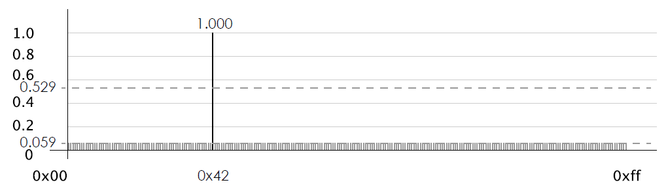
_{입력 바이트 타입 분류}
Profuzzer (SP 2019)의 경우 입력 바이트를 5가지 타입으로 분류하여 퍼징을 진행.
Assertion type
특정한 값이 들어와야만 특정 분기를 달성할 수 있는 경우
해당 바이트에 0~255 값을 넣었을 때 특정 하나의 값(0x42)에서만 다른 실행을 보이는 것을 감지가능
1 2 3 4 5 | int main (){ //input = 4 bytes input; char a = input[1]; if (a != 0x34) exit_error(); ...

Slide 29
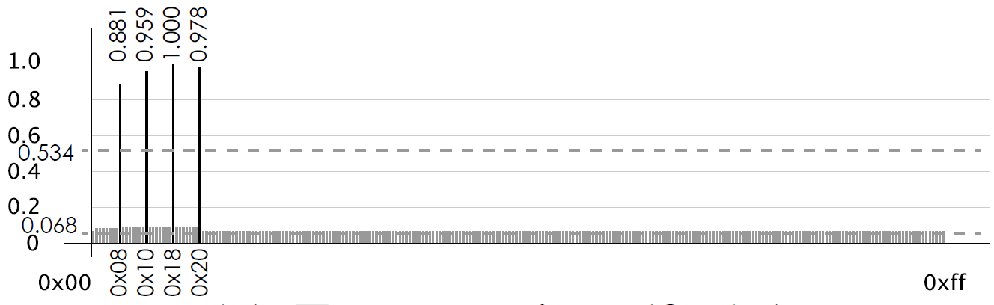
_{입력 바이트 타입 분류}
2. Enumeration type
switch의 case같은 경우 (특정 값들 (0x08, 0x10, …) 이 유효하게 작용)
Assertion과 비슷하게 탐지가 가능
1 2 3 4 5 6 7 8 9 | int main (){ char a = input[1]; switch (a) { case 0x08 : foo(); break; case 0x10 : foo2(); break; case 0x18 : foo3(); break; case 0x20 : foo4(); break; default : exit_error(); } ...

Slide 30
_{입력 바이트 타입 분류}
3. Loop count
Loop가 몇번 실행될 것인지 정하는 입력 바이트
바이트의 값을 바꿔보았을 때, 비슷한 실행을 보이지만, 얼마나 loop를 많이 실행하는지가 다른 경우가 발생하는지 탐지
4. Raw Data
해당 바이트가 입력의 실행에 거의 영향을 안주는 경우.
이경우에는 변이하는 것이 의미가 없는 경우가 많음.
1 2 3 4 5 | int main (){ //input = 4 bytes input; char a = input[1]; for (int i = 0; i < a ; i ++){ ...

Slide 31
_{입력 바이트 타입 분류}
5. Offset
이후 입력을 얼마나 사용할 것인가를 결정하는 바이트
offset의 값에 따라서, buffe에 얼마나 많은 바이트를 복사할 건지를 결정.
특정 값 이상이 들어오는 경우, 보통 프로그램이 오류가 발생하고 종료되기 때문에, 이를 쉽게 감지 가능.
1 2 3 4 5 | int main (){ //input = 40 bytes input file; char offset = input[0]; char buffer[400]; if (fread(buffer, 1, offset , input + 1) == NULL) { …

Slide 32
_{Dynamic taint analysis (동적 분석)}
동적 데이터 의존성 (data dependency)분석으로 얻은 바이트에 관한 정보도 사용. (Angora, SP 2018)
1 2 3 4 5 6 7 8 9 10 11 | int main (){ char input[9]; int a = input[4]; int b = input[5]; if (input[1] == 30) { if (a + b > 20) { return 1; } } return 0; }
초기 입력값: 9-byte 길이의 0
0
0
0
0
0
0
0
0
0
각 바이트를 특정 색깔 (id)로 표지를 하고 실행

Slide 33
_{Dynamic taint analysis (동적 분석)}
동적 데이터 의존성 (data dependency)분석으로 얻은 바이트에 관한 정보도 사용. (Angora, SP 2018)
1 2 3 4 5 6 7 8 9 10 11 | int main (){ char input[9]; int a = input[4]; int b = input[5]; if (input[1] == 30) { if (a + b > 20) { … } } … }
0
0
0
0
0
0
0
0
0
변수 a가 하늘색 5번째 바이트 값을 사용하므로, 하늘색으로 표지
변수 b가 남색 6번째 바이트 값을 사용하므로, 남색으로 표지
5번째 줄의 if문이 주황색 2번째 바이트 값을 사용하므로, 주황색으로 표지
6번째 줄의 if문이 하늘색 a와 남색 b의 값을 사용하므로, 두가지 색으로 표지
… 이를 계속해서 반복
특정 분기가 어떤 바이트를 참조하는지 알아내어, 특정 분기를 빠르게 달성할 수 있음. (6번째 줄의 if문을 달성하기 위해, 5번째, 6번째 바이트를 집중적으로 변이)

Slide 35
_{관련 연구}
Concolic 테스팅 최신 연구
광대한 심볼릭 경로 공간(symbolic path space)안에서 중복되는 탐색을 최소화하며
"조립식 동적 심볼릭 테스팅"
모든 탐색 공간(search space)을 살펴보기보다 특정한 코드 영역을 집중하여 탐색하고
"목표지향적 탐색 알고리즘",
또한 동적 심볼릭 테스팅 기술의 한계를 탐색 기반 테스팅 기술과 결합하여 극복하는 기술
"Concolic 테스팅과 탐색 기반 테스팅 기술을 혼합 적용"
분산 시스템을 활용한 동적 심볼릭 테스팅의 속도를 향상하기 위한 기술
"분산 Concolic 테스팅"
Fuzzing 최신 연구
GREYONE: Data Flow Sensitive Fuzzing (USENIX Security2020)
Fuzzing Symbolic Expressions (ICSE 2021)
IntelliGen: Automatic Driver Synthesis for Fuzz Testing (ICSE 2021 SEIP)
The Use of Likely Invariants as Feedback for Fuzzers (USENIX Security2021)
Constraint-guided Directed Greybox Fuzzing (USENIX Security2021)
POWER: Program Option-Aware Fuzzer for High Bug Detection Ability (ICST’2022)
35

Slide 36
_{Concolic 테스팅의 약점 예}
⦁ 첫번째 TC 생성이 매우 중요
- 첫번째 TC에 따라, 탐색하는 search space가 크게 변동됨
- 심지어, 첫번째 TC가 crash 인 경우, 해당 유닛 후속 테스팅 진행이 불가능
// Symbolic input: a, b, c
void f(int a, int b, int c) {
if (a == 1)
if (b == 2)
if (c == a + b)
Error();
}
a!=1
a==1
(0,0,0)
b!=2
b==2
(1,0,0)
c!=a+b
c==a+b
(1,2,0)
(1,2,3)
36
Notes:
애니메이션으로 회색 사라지게

Slide 37
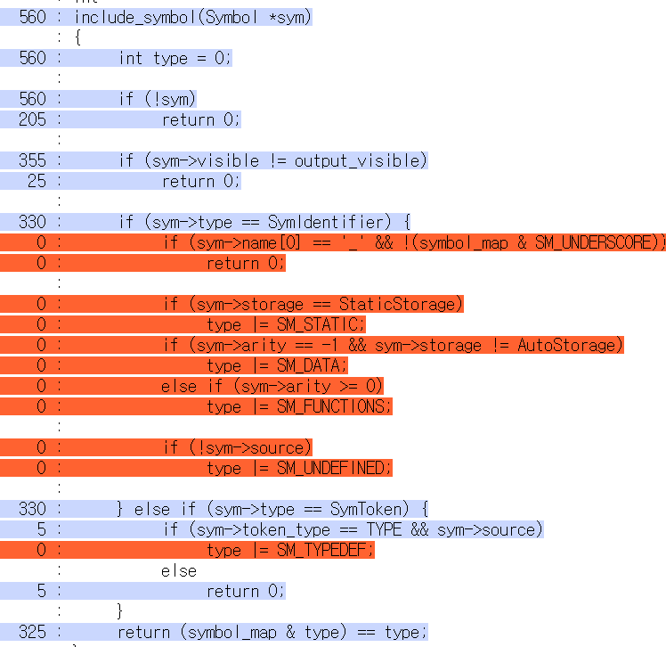
_{Fuzzing의 약점 예}
Applied AFL++ on unit drivers generated with CROWN2
⦁ 복잡한 조건식을 만족하는 TC
생성이 거의 불가능
- 랜덤하게 변이한 TC 입력값이 특정 조건을 만족하기 어려움
cflow, include_symbol (30 lines)
2 hours run
37
Notes:
애니메이션으로 회색 사라지게

Slide 39
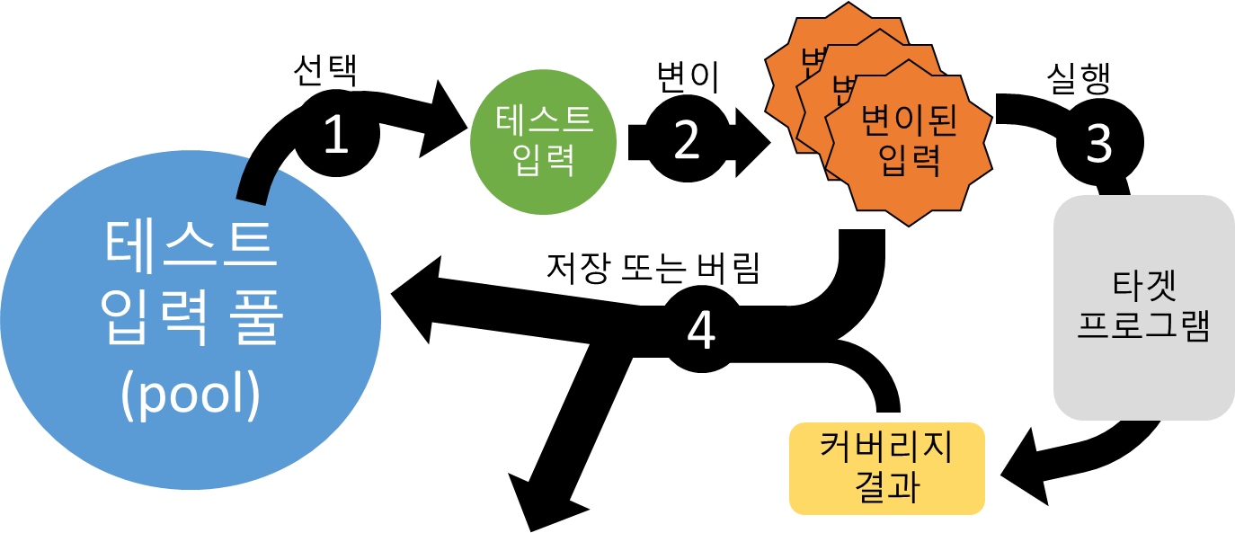
_{Concolic vs. Fuzzing}
⦁퍼징의 장점인 빠르고 다양한 테스트 입력값 생성과 Concolic 테스팅의 장점인 정확한 SW 동적 분석 능력을 결합하여, 보다 효과적인 테스팅 효과 달성
⦁Deep path를 탐색하는 능력이 제한적인 퍼징의 약점 및 Concolic Testing의 핵심이지만 속도가 느린 symbolic execution 엔진 상호 보완
// Symbolic input: a, b, c
void f(int a, int b, int c) {
if (a == 1)
if (b == 2)
if (c == a + b)
Error();
}
a!=1
a==1
(0,0,0)
b!=2
b==2
(1,0,0)
c!=a+b
c==a+b
(1,2,0)
(1,2,3)
39
Notes:
애니메이션으로 회색 사라지게

Slide 40
_{연구 내용}
⦁ 퍼징과 Concolic testing을 상호보완적으로 결합한 CONUZZ Framework 연구
1) 퍼징이 필요로 하는 test input pool에, concolic testing이 생성한 test input들을 test input들의 특성에 기반하여 선택적으로 추가
2) 제한된 테스팅 시간 안에 Concolic 테스팅이 커버하기 힘든 복잡한 자료구조를 활용하는 로직을 Fuzzing을 통해 검사
40
Notes:
애니메이션으로 회색 사라지게

Slide 41
CONUZZ (CONcolic + fUZZing): KCSE ‘22 발표
테스트 입력 파일 기반 융합 프레임워크
TC1
Concolic Engine
Fuzzing Engine
TC2
테스트 입력풀
TCn
41

Slide 42
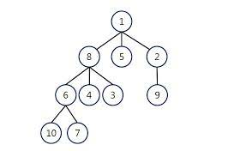


Concolic Testing과 Fuzzing의 교차 이용
DFS 사용시 Init TestCase에서 Crash가 발생하지 않는 경우
DFS 사용시 Init TestCase에서 Crash가
발생하는 경우
Zero Based Initial Value 사용
생성 TestCase를 Seed로 사용
생성 TestCase를 Seed로 사용
Target Program
Strongswan
Depth First Searching based
Unit Test
Target Program
Strongswan
Test Cases
Crashes
Coverages
AFL++ Fuzzing
Test Cases
Crashes
Coverages
CONUZZ
CONUZZ

Slide 43
_{결론}
⦁ 퍼징의 장점인 빠르고 다양한 테스트 입력값 생성과 Concolic 테스팅의 장점인 정확한 SW 동적 분석 능력을 결합하여, 보다 효과적인 테스팅 효과 달성
⦁ Deep path를 탐색하는 능력이 제한적인 퍼징의 약점 및 Concolic Testing의 핵심이지만 속도가 느린 symbolic execution 엔진 상호 보완
// Symbolic input: a, b, c
void f(int a, int b, int c) {
if (a == 1)
if (b == 2)
if (c == a + b)
Error();
}
a!=1
a==1
(0,0,0)
b!=2
b==2
(1,0,0)
c!=a+b
c==a+b
(1,2,0)
(1,2,3)
Notes:
애니메이션으로 회색 사라지게

