Slide 1
Tutorial for LLVM Intermediate Representation
Prof. Moonzoo Kim
CS Dept., KAIST

Slide 2
Motivation for Learning LLVM Low-level Language (i.e., Handling Intermediate Representation)
Biologists know how to analyze laboratory mice. In addition, they know how to modify the mice by applying new medicine or artificial organ
Mechanical engineers know how to analyze and modify mechanical products using CAD tools.
Software engineers also have to know how to analyze and modify software code which is far more complex than any engineering product. Thus, software analysis/modification requires automated analysis tools.
Using source level analysis framework (e.g., Clang, C Intermediate Language (CIL), EDG parser)
Using low-level intermediate representation (IR) analysis framework (e.g., LLVM IR)

Slide 3
LLVM is Professional Compiler
Clang, the LLVM C/C++ front-end supports the full-features of C/C++ and compatible with GCC
The executable compiled by Clang/LLVM is as fast as the executable by GCC

Slide 4
LLVM Compiler Infrastructure (1/2)
Clang, the LLVM C/C++ front-end supports the full-features of C/C++ and compatible with GCC
The executable compiled by Clang/LLVM is as fast as the executable by GCC

Slide 5
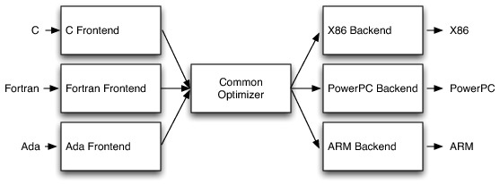
LLVM Compiler Infrastructure (2/2)
A collection of modular compilers and analyzers written in C++ with STL.
LLVM provides 108⁺ Passes http://llvm.org/docs/Passes.html
Analyzers (41): alias analysis, call graph constructions, dependence analysis, etc.
Transformers (57): dead code elimination, function inlining, constant propagation, loop unrolling, etc.
Utilities (10): CFG viewer, basic block extractor, etc.
C
C Frontend
C++
C++ Frontend
Object-C
Object-C Frontend
…
…
…
…
LLVM IR
LLVM IR’
LLVM Passes

Slide 6
LLVM IR as Analysis Target
The LLVM IR of a program is a better target for analysis and engineering than the program source code.
Language-independent
Able to represent C/C++/Object-C programs
Simple
register machine
Infinite set of typed virtual registers
3-address form instruction
Only 31 instruction opcodes
static single assignment (SSA)
composed as basic blocks
Informative
typed language
control-flow
LLVM IR is also called as LLVM language, assembly, bitcode, bytecode, code representation

Slide 7
LLVM IR At a Glance
C program language
LLVM IR
Scope: file, function
module, function
Type: bool, char, int, struct{int, char}
i1, i8, i32, {i32, i8}
A statement with multiple expressions
A sequence of instructions each of which is in a form of “x = y op z”.
Data-flow: a sequence of reads/writes on variables
1. load the values of memory addresses (variables) to registers;
2. compute the values in registers;
3. store the values of registers to memory addresses
* each register must be assigned exactly once (SSA)
Control-flow in a function: if, for, while, do while, switch-case,…
A set of basic blocks each of which ends with a conditional jump (or return)

Slide 8
Example
simple.c
simple.ll (simplified)
…
6 @x = common global i32 0, align 4
7 @y = common global i32 0, align 4
11 define i32 @main() #0 {
12 entry:
…
14 %t = alloca i32, align 4
…
16 %call = call i32 (i8*, ...)*
@__isoc99_scanf(…i32* @x,i32* @y)
17 %0 = load i32* @x, align 4
18 %1 = load i32* @y, align 4
19 %sub = sub nsw i32 %0 %1
20 store i32 %sub, i32* %t, align 4
21 %2 = load i32* %t, align 4
22 %cmp = icmp sgt i32 %2, 0
23 br i1 %cmp, label %if.then, label %if.end
24 if.then:
25 %call1 = call i32 … @printf(…
26 br label %if.end
27 if.end:
28 ret i32 0
1
2
3
4
5
6
7
8
9
10
11
#include <stdio.h>
int x, y ;
int main() {
int t ;
scanf(“%d %d”,&x,&y);
t = x – y ;
if (t > 0)
printf(“x > y”) ;
return 0 ;
}
2
4
5
6
7
8
9
$ clang –S –emit-llvm -fno-discard-value-names simple.c
10

Slide 9
Contents
LLVM IR Instruction
architecture, static single assignment
Data representation (page 13)
types, constants, registers, variables
load/store instructions, cast instructions
computational instructions
Control representation (page 32)
control flow (basic block)
control instructions
* LLVM Language Reference Manual http://llvm.org/docs/LangRef.html
* Mapping High-Level Constructs to LLVM IR http://llvm.lyngvig.org/Articles/Mapping-High-Level-Constructs-to-LLVM-IR

Slide 10
LLVM IR Architecture
RISC-like instruction set
Only 31 op-codes (types of instructions) exist
Most instructions (e.g. computational instructions) are in three-address form: one or two operands, and one result
Load/store architecture
Memory can be accessed via load/store instruction (for variables)
Computational instructions operate on registers (for values)
Infinite and typed virtual registers
It is possible to declare a new register any point (the backend maps virtual registers to physical ones).
A register is declared with a primitive type (boolean, int, float, pointer)

Slide 11
Static Single Assignment (1/2)
In SSA, each variable is assigned exactly once, and every variable is defined before its uses.
Conversion
For each definition, create a new version of the target variable (left-hand side) and replace the target variable with the new variable.
For each use, replace the original referred variable with the versioned variable reaching the use point.
1
2
3
4
5
6
x = y + x ;
y = x + y ;
if (y > 0)
x = y ;
else
x = y + 1 ;
11
12
13
14
15
16
x1 = y0 + x0 ;
y1 = x1 + y0 ;
if (y1 > 0)
x2 = y1 ;
else
x3 = y1 + 1 ;

Slide 12
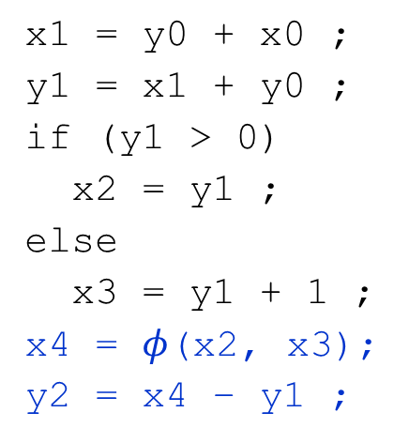
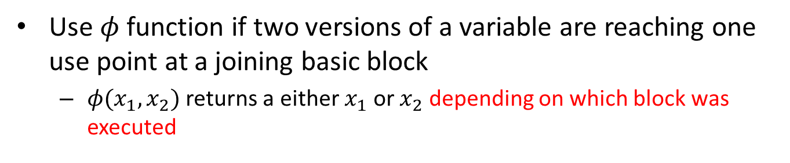
Static Single Assignment (2/2)
Use $φ$ function if two versions of a variable are reaching one use point at a joining basic block
$φ(x_{1}, x_{2})$ returns a either $x_{1}$ or $x_{2}$ depending on which block was executed
1
2
3
4
5
6
7
x = y + x ;
y = x + y ;
if (y > 0)
x = y ;
else
x = y + 1 ;
y = x – y ;
11
12
13
14
15
16
17
18
x1 = y0 + x0 ;
y1 = x1 + y0 ;
if (y1 > 0)
x2 = y1 ;
else
x3 = y1 + 1 ;
x4 = $φ$(x2, x3);
y2 = x4 – y1 ;

Slide 13
Data Representations
Primitive types
Constants
Registers (virtual registers)
Variables
local variables, heap variables, global variables
Load and store instructions
Aggregated types

Slide 14
Primitive Types
Language independent primitive types with predefined sizes
void: void
bool: i1
integers: i[N] where N is 1 to 2²³-1 e.g. i8, i16, i32, i1942
floating-point types: half (16-bit floating point value) float (32-bit floating point value) double (64-bit floating point value)
Pointer type is a form of <type>* (e.g. i32*, (i32*)*)

Slide 15
Constants
Boolean (i1): true and false
Integer: standard integers including negative numbers
Floating point: decimal notation, exponential notation, or hexadecimal notation (IEEE754 Std.)
Pointer: null is treated as a special value

Slide 16
Registers
Identifier syntax
Named registers: [%][a-zA-Z$._][a-zA-Z$._0-9]*
Unnamed registers: [%][0-9][0-9]*
A register has a function-level scope.
Two registers in different functions may have the same identifier
A register is assigned for a particular type and a value at its first (and the only) definition

Slide 17
Variables
In LLVM, all addressable objects (“lvalues”) are explicitly allocated.
Global variables
Each variable has a global scope symbol that points to the memory address of the object
Variable identifier: [@][a-zA-Z$._][a-zA-Z$._0-9]*
Local variables
The alloca instruction allocates memory in the stack frame.
Deallocated automatically if the function returns.
Heap variables
The malloc function call allocates memory on the heap.
The free function call frees the memory allocated by malloc.

Slide 18
Load and Store Instructions
Load
<result>=load <type>* <ptr>
result: the target register
type: the type of the data (a pointer type)
ptr: the register that has the address of the data
Store
store <type> <value>,<type>* <ptr>
type: the type of the value
value: either a constant or a register that holds the value
ptr: the register that has the address where the data should be stored
Memory
CPU
Address | Var
0
1 | x
…
99 | y
100
Virtual registers
%0
%1
ALU
load
%x
%y
store

Slide 19
Variable Example
1 #include <stdlib.h>
2
3 int g = 0 ;
4
5 int main() {
6 int t = 0;
7 int * p;
8 p=malloc(sizeof(int));
9 free(p);
10 }
1 @g = global i32 0, align 4
…
8 define i32 @main() #0 {
…
%t = alloca i32, align 4
11 store i32 0, i32* %t, align 4
12 %p = alloca i32*, align 8
13 %call = call noalias i8* @malloc(i64 4) #2
14 %0 = bitcast i8* %call to i32*
15 store i32* %0, i32** %p, align 8
16 %1 = load i32** %p, align 8
…
Notes:
#0: attribute groups

Slide 20
Integer Conversion (1/2)
Truncate
Syntax: <res> = trunc <iN1> <value> to <iN2> where iN1 and iN2 are of integer type, and N1 > N2
Examples
%X = trunc i32 257 to i8 ;%X becomes i8:1
%Y = trunc i32 123 to i1 ;%Y becomes i1:true
%Z = trunc i32 122 to i1 ;%Z becomes i1:false

Slide 21
Integer Conversion (2/2)
Zero extension
<res> = zext <iN1> <value> to <iN2> where iN1 and iN2 are of integer type, and N1 < N2
Fill the remaining bits with zero
Examples
%X = zext i32 257 to i64 ;%X becomes i64:257
%Y = zext i1 true to i32 ;%Y becomes i32:1
Sign extension
<res> = sext <iN1> <value> to <iN2> where iN1 and iN2 are of integer type, and N1 < N2
Fill the remaining bits with the sign bit (the highest order bit) of value
Examples
%X = sext i8 -1 to i16 ;%X becomes i16:65535
%Y = sext i1 true to i32 ;%Y becomes i32:2³²-1

Slide 22
Other Conversions
Float-to-float
fptrunc .. to, fpext .. to
Float-to-integer (vice versa)
fptoui .. to, fptosi .. to, uitofp .. to, sitofp .. To
Ex. %X = fptoui double 123.0 to i32
Pointer-to-integer
ptrtoint .. to, inttoptr .. to
Bitcast
<res> = bitcast <t1> <value> to <t2> where t1 and t2 should be different types and have the same size
bitcast does not change any bit (i.e., no-op cast)
%z = bitcast <2 x int> %v to i64
%z = bitcast <2 x i32*> %v to <2 x i64*>

Slide 23
Computational Instructions
Binary operations:
Add: add, fadd ,sub, fsub
Multiplication: mul , fmul
Division: udiv , sdiv , fdiv
Remainder: urem , srem , frem
Bitwise binary operations
shift operations: shl , lshr , ashr
logical operations: and , or , xor

Slide 24
Add Instruction
<res> = add [nuw][nsw] <iN> <op1>, <op2>
nuw (no unsigned wrap): if unsigned overflow occurs, the result value becomes a poison value (undefined)
E.g., add nuw i8 255, i8 1
nsw (no signed wrap): if signed overflow occurs, the result value becomes a poison value
E.g., add nsw i8 127, i8 1

Slide 25
Control Representation
The LLVM front-end constructs the control flow graph (CFG) of every function explicitly in LLVM IR
A function has a set of basic blocks each of which is a sequence of instructions
A function has exactly one entry basic block
Every basic block is ended with exactly one terminator instruction which explicitly specifies its successor basic blocks if there exist.
Terminator instructions: branches (conditional, unconditional), return, etc.
Due to its simple control flow structure, it is convenient to analyze, transform the target program in LLVM IR

Slide 26
Label, Return, and Unconditional Branch
A label is located at the start of a basic block
Each basic block is addressed as the start label
A label x is referenced as register %x whose type is label
The label of the entry block of a function is “entry”
Return ret <type> <value> | ret void
Unconditional branch br label <dest>
At the end of a basic block, this instruction makes a transition to the basic block starting with label <dest>
E.g: br label %entry

Slide 27
Conditional Branch
<res> = icmp <cmp> <ty> <op1>, <op2>
Returns either true or false (i1) based on comparison of two variables (op1 and op2) of the same type (ty)
cmp: comparison option
eq (equal), ne (not equal), ugt (unsigned greater than), uge (unsigned greater or equal), ult (unsigned less than), ule (unsigned less or equal), sgt (signed greater than), sge (signed greater or equal), slt (signed less than), sle (signed less or equal)
br i1 <cond>, label <thenbb>, label <elsebb>
Causes the current execution to transfer to the basic block <thenbb> if the value of <cond> is true; to the basic block <elsebb> otherwise.
Example:
11 %0 = load i32* %x
12 %1 = load i32* %y
13 %cmp = icmp sgt i32 %0, %1
14 br i1 %cmp, label %if.then, label %if.end
15 if.then:
…
1 if (x > y)
2 return 1 ;
3 return 0 ;

Slide 28
Switch
switch <iN> <value>, label <defaultdest> [<iN> <val>, label <dest> …]
Transfer control flow to one of many possible destinations
If the value is found (val), control flow is transferred to the corresponding destination (dest); or to the default destination (defaultdest)
Examples:
1
2
3
4
5
6
7
8
switch(x) {
case 1:
break ;
case 2:
break ;
default:
break ;
}
11
12
13
14
15
16
17
18
19
20
21
%0 = load i32* %x
switch i32 %0, label %sw.default [
i32 1, label %sw.bb
i32 2, label %sw.bb1]
sw.bb:
br label %sw.epilog
sw.bb1:
br label %sw.epilog
sw.default:
br label %sw.epilog
sw.epilog:
…

Slide 29

PHI ($Φ$) instruction
<res> = phi <t> [ <val_0>, <label_0>], [ <val_1>, <label_1>], …
Return a value val_i of type t such that the basic block executed right before the current one is of label_i
Example
11 %0 = load i32* %x
12 %c = icmp sgt i32 %0 0
13 br i1 %c, label %c.t, %c.f
14 c.t:
15 %1 = load i32* %x
16 br label %c.end
17 c.f:
18 br label %c.end
19 c.end:
20 %res = phi i32 [%1, %c.t], [0, %c.f]
21 store i32 %res, i32* %y
1 y = (x > 0) ? x : 0 ;

Slide 30
Select
<result> = select <selty> <cond>, <ty> <val1>, <ty> <val2> ;
<selty> is either i1 or {<N x i1>}
Ex> %X = select i1 true, i8 17, i8 42 ; yields i8:17
The ‘select‘ instruction is used to choose one value based on a condition, without IR-level branching.
If <cond> ==1, the instruction returns the first value argument; the second value argument otherwise
If the condition is a vector of i1, then the value arguments must be vectors of the same size, and the selection is done element by element.
If the condition is an i1 and the value arguments are vectors of the same size, then an entire vector is selected.

Slide 31
Function Call
<res> = call <ResType> [<FunType>] @<FunName>([arg list])
<ResType>: the type of the call return value
<FunType>: the signature of the pointer to the target function (optional)
@<FunName>: an LLVM value containing a pointer to a target function
[arg list]: argument list whose types match the function signature
Examples:
11 @.str = constant [3 x i8] c”%d\00”
12 %0 = load i32* %x
13 %abs_x = call i32 @abs(i32 %0)
14 %printf = call i32 (i8*, ...) @printf(i8* getelementptr ([3 x i8]* @.str, i32 0, i32 0), i32 %abs_x)
1 printf(“%d”, abs(x));

Slide 32
Function Declaration
declare <ResType> @<FunName>([arg list])
<ResType>: the type of the call return value
@<FunName>: an LLVM value containing a pointer to a target function
[arg list]: argument list whose types match the function signature
Examples:
int printf(char *,...)
declare i32 @printf(i8 *, ...)

Slide 33
A Simple Example
1 declare i32 @printf(i8*, ...)
2
3 @.str = global [4 x i8] c"%d\0A\00"
4
5 define i32 @sum(i32 %x) {
6 entry:
7 %x.addr = alloca i32
8 %i = alloca i32
9 %sum = alloca i32
10 store i32 %x, i32* %x.addr
11 store i32 0, i32* %sum
12 store i32 1, i32* %i
13 br label %for.cond
14
15 for.cond: ; preds = %for.inc, %entry
16 %0 = load i32, i32* %i
17 %1 = load i32, i32* %x.addr
18 %cmp = icmp sle i32 %0, %1
19 br i1 %cmp, label %for.body, label %for.end
20
21 for.body: ; preds = %for.cond
22 %2 = load i32, i32* %i
23 %3 = load i32, i32* %sum
24 %add = add i32 %3, %2
25 store i32 %add, i32* %sum
26 br label %for.inc
27
28 for.inc: ; preds = %for.body
29 %4 = load i32, i32* %i
30 %inc = add i32 %4, 1
31 store i32 %inc, i32* %i
32 br label %for.cond
33
34 for.end: ; preds = %for.cond
35 %5 = load i32, i32* %sum
36 ret i32 %5
37 }
38
39 define i32 @main() {
40 %sum = call i32 @sum(i32 4)
41 %printf= call i32 (i8*, ...) @printf(i8* getelementptr ([4 x i8], [4 x i8]* @.str, i64 0, i64 0), i32 %sum)
42 ret i32 0
43 }
1 int sum(int x) {
2 int i, sum=0;
3 for (i=1; i <=x; i++)
4 sum += i;
5 return sum;
6 }
7
8 int main() {
9 printf("%d\n",sum(4));
10 }
Notes:
#0: attribute groups

Slide 34
Aggregate Types and Function Type
Array: [<# of elements> x <type>]
Single dimensional array ex: [40 x i32], [4 x i8]
Multi dimensional array ex: [3 x [4 x i8]], [12 x [10 x float]]
Structure: type {<a list of types>}
E.g. type{ i32, i32, i32 }, type{ i8, i32 }
Function: <return type> (a list of parameter types)
E.g. i32 (i32), float (i16, i32*)

Slide 35
Getelementptr Instruction
A memory in an aggregate type variable can be accessed by load/store instruction and getelementptr instruction that obtains the pointer to the element.
Syntax:
<res> = getelementptr <pty>* <ptrval>{,<t> <idx>}*
res: the target register
pty: the register that defines the aggregate type
ptrval: the register that points to the data variable
t: the type of index
idx: the index value

Slide 36
Aggregate Type Example 1 (1/2)
1 struct pair {
2 int first;
3 int second;
4 };
5 int main() {
6 int arr[10];
7 struct pair a;
8 a.first = arr[1];
…
%struct.pair = type{ i32, i32 }
define i32 @main() {
entry:
%arr = alloca [10 x i32]
%a = alloca %struct.pair
%arrayidx = getelementptr
[10 x i32]* %arr,i32 0,i64 1
%0 = load i32* %arrayidx
%first = getelementptr %struct.pair* %a,i32 0,i32 0
store i32 %0, i32* %first
11
12
13
14
15
16
17
18
19

Slide 37
Aggregate Type Example 1 (2/2)
%first=getelementptr %struct.pair* %a,i32 0,i32 0
1. The first operand of getelementptr (e.g., %a) is a pointer to a data structure.
2. An element of an aggregate data structure must be accessed by getelementptr with a pointer (e.g., %a) and an offset index (a.first== (&a)[0].first, and/or (&a)->first == (&a)[0].first)
struct point {
int x;
struct point* p;};
int main() {
struct point s, s1;
s.p=&s1; // (&s)[0].p=&s1;
(s.p)->x = 0;
}
%struct.point = type { i32, %struct.point* }
define i32 @main() #0 {
entry:
%s = alloca %struct.point, align 8
%s1 = alloca %struct.point, align 8
// s.p=&s1;
%p = getelementptr %struct.point* %s, i32 0, i32 1
store %struct.point* %s1, %struct.point** %p, align 8
// (s.p)->x = 0
%p1 = getelementptr %struct.point* %s, i32 0, i32 1
%0 = load %struct.point** %p1, align 8
%x = getelementptr %struct.point* %0, i32 0, i32 0
store i32 0, i32* %x, align 4
ret i32 0
}

Slide 38
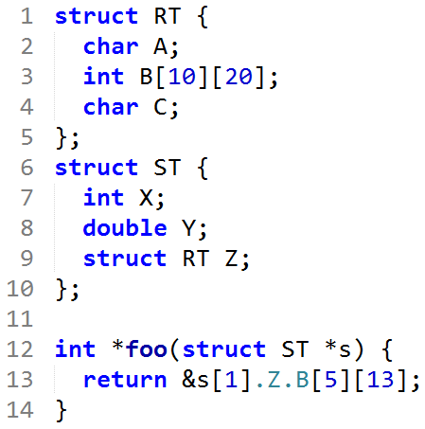
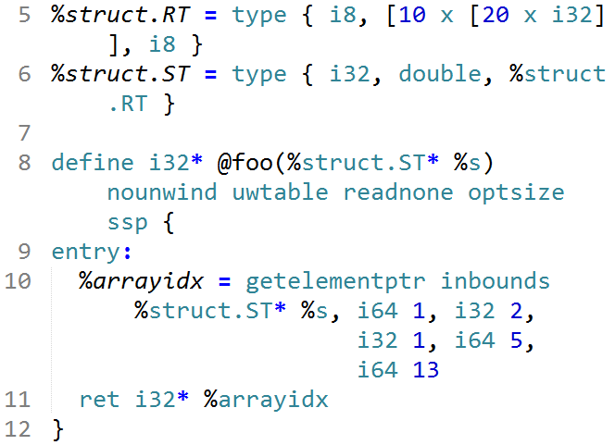
Aggregate Type Example 2
(s)[0]
a pointer parameter s
index 0
(s)[1]
index 1

Slide 39
Aggregate Type Example 3
%MyVar = global { [10 x i32] }
%idx1=getelementptr {[10xi32]},{[10xi32]}* %MyVar,i64 0,i32 0,i64 1
%idx2=getelementptr {[10xi32]},{[10xi32]}* %MyVar,i64 1
idx1 computes the address of the 2nd integer in the array that is in the structure in %MyVar, that is MyVar+4.
The type of idx1 is i32*.
idx2 computes the address of the next structure after %MyVar. The value of idx2 is MyVar + 40 because it indexes past the ten 4-byte integers in MyVar.
The type of idx2 is { [10 x i32] }*

Slide 40
Aggregate Type Example 4
%MyVar = global { [10 x i32] }
%idx1=getelementptr {[10xi32]},{[10xi32]}* %MyVar,i64 1,i32 0,i64 0
%idx2=getelementptr {[10xi32]},{[10xi32]}* %MyVar,i64 1
The value of %idx1 is %MyVar+40
its type is i32*
The value of %idx2 is also %MyVar+40
but its type is { [10 x i32] }*.

Slide 41
Unaddressed Issues
Many options/attributes of instructions
Vector data type (SIMD style)
Exception handling
Object-oriented programming specific features
Concurrency issues
Memory model, synchronization, atomic instructions
* http://llvm.org/docs/LangRef.html

