Slide 1


Automated Test Input Generation through Fuzzing
Moonzoo Kim

Slide 2
Various SW Testing Techniques w/ Different Cost and Effectiveness
_{Whitebox Testing}
SW Reliability
Model Checking
Concolic Testing
Search-based Testing
Branch Testing
Blackbox Testing
_{Stmt. Testing}
Equiv. Partition. Testing
_{T-way Testing}
Req. based Testing
참고. 테스팅 국어 사전 http://dic.sten.or.kr/
Rand. Testing
SW Testing Cost
Notes:
We have demonstrated that our new technique conbol could effectively detect 24 crash bugs. Now conbol is successfully adopted by the original development team. I personally believe that concolic testing is mature enough to be adopted by industry, not only academy. Traditionally, testing focuses on manual TC generation testing main scenarios, ~~. But I believe that our testing paradigm is changing to new testing new paradigm based on concolic testing like conbol. Now we generate millions of test cases automatically, and targeting exceptional scenarios as we detected 24 hidden bugs with unit-level testing and large # of TCs. So overall I believe automated testing has a lower V7V cost than manual testing for higher reliability. And our group and samsung electronics try hard to apply such automated technique to more larger product.

Slide 3

Fuzzing - Automated Test Input Generation via Random Mutation
Java
Java
script
HTML
Sequence of bytes
New test case!
Java
L
o
r
e
m
I
Mut
L
o
i
e
m
I
Jpeg
image
...
...
Java
txt
file
Mut. Input File1
Mut. Input File1
2. Mutation
Mut. Input File N
Selected Test Input File
3. Target Runs
1. Selection
Pool of Test Input Files
Cov. Result of N
Cov. Result of N
Cov. Result of N
4. Store or Remove Mutated Test Input Files
Notes:
일단 퍼징이란, 무작위 변이 기반 테스트 생성 기술입니다. 테스트 케이스는 타겟 프로그램에 따라 Html, jpeg 이미지 파일 또는 txt 파일 등이 될 수 있는데, 퍼징은 각 파일의 구조를 단순히 바이트의 나열이라 보고, 무작위의 바이트를 무작위의 값으로 바꾸어서 새로운 테스트 케이스를 생성하는 기술입니다.
기본적인 퍼징의 프로세스는 아래 그림과 같이 이루어 집니다. 이미 존재하는 테스트 입력값 중 하나를 선택해서, 이 입력값을 변이해 새로운 입력값을 만들어, 이 새로운 입력값을 타겟 프로그램에 실행하여 커버리지 결과를 구해 만약 새로운 커버리지를 보이면 저장하고, 아니라면 버리기를 반복합니다.
하지만 예상하실 수 있다시피 나이브하게 아무 바이트나 골라서 아무 값으로 넣어 줬는데 프로그램의 새로운 behavior를 만들기는 어렵겠죠,
어떤 바이트를 골라서 어떤 값으로 변이해야 하는지에 대한 기법이 많이 나와 있습니다.

Slide 4
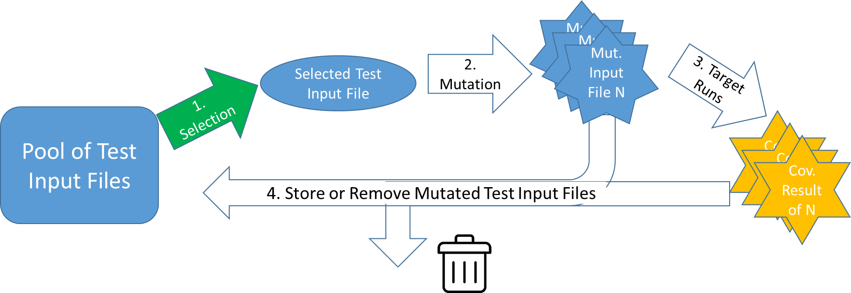
_{Fuzzing Challenge #1}
Which test input file to select to mutate?
Fuzzer | Heuristic
AFL | Favor test inputs whose execution time and length are short - semantic characteristics of test inputs are ignored)
FairFuzz (ASE 2018), Vuzzer (NDSS 2017) | Favor test inputs such that those test inputs covers hardly covered branches - semantic characteristics of test inputs are a little bit used
CollAFL (SP 2018), Angora (SP 2018) | Favor test inputs that cover many branches whose branch condition statements are executed but these branches are rarely covered - semantic characteristics of test inputs are a little bit used
Notes:
퍼징에서 첫번째로 고민해볼 점은 어떤 테스트 입력값을 변이할지 입니다.

Slide 5
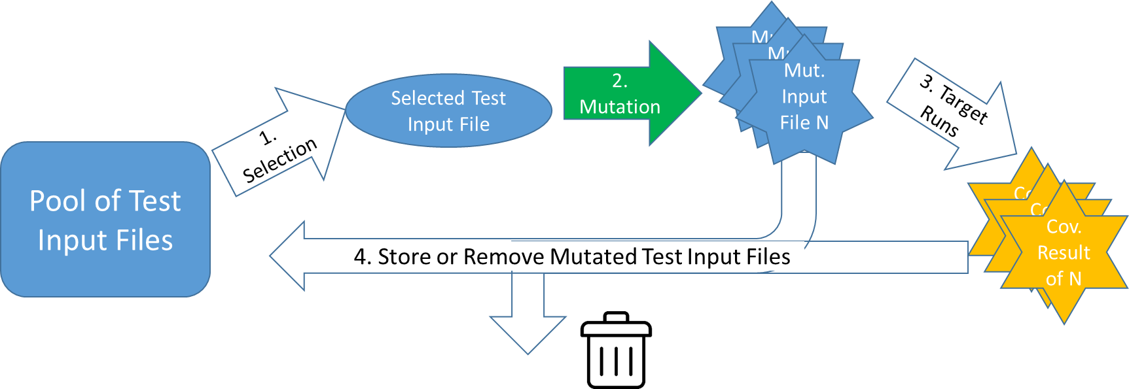
_{Fuzzing Challenge #2}
Which bytes in the selected test input file should be mutated?
Fuzzer | Heuristic
AFL | Bytes of random # are randomly selected to mutate - No semantic information on the bytes are utilized
FairFuzz (ASE 2018), Profuzzer(SP 2019), GreyOne (USENIX security ‘20) | Guess which bytes are important based on the runtime information (e.g., if one byte is mutated and the runtime information does not change at all, a fuzzer does not select that byte afterward)
BuzzFuzz(ICSE 2009), Dowser(USENIX security ‘13), Vuzzer(NDSS 2017), Angora (SP 2018), Matryoska(CCS ‘19) | Select the bytes which have dependency with "important" branches through Dynamic Taint Analysis (DTA) - Control dependency is not considered

Slide 6


_{Intro to Fuzzing}

Slide 7
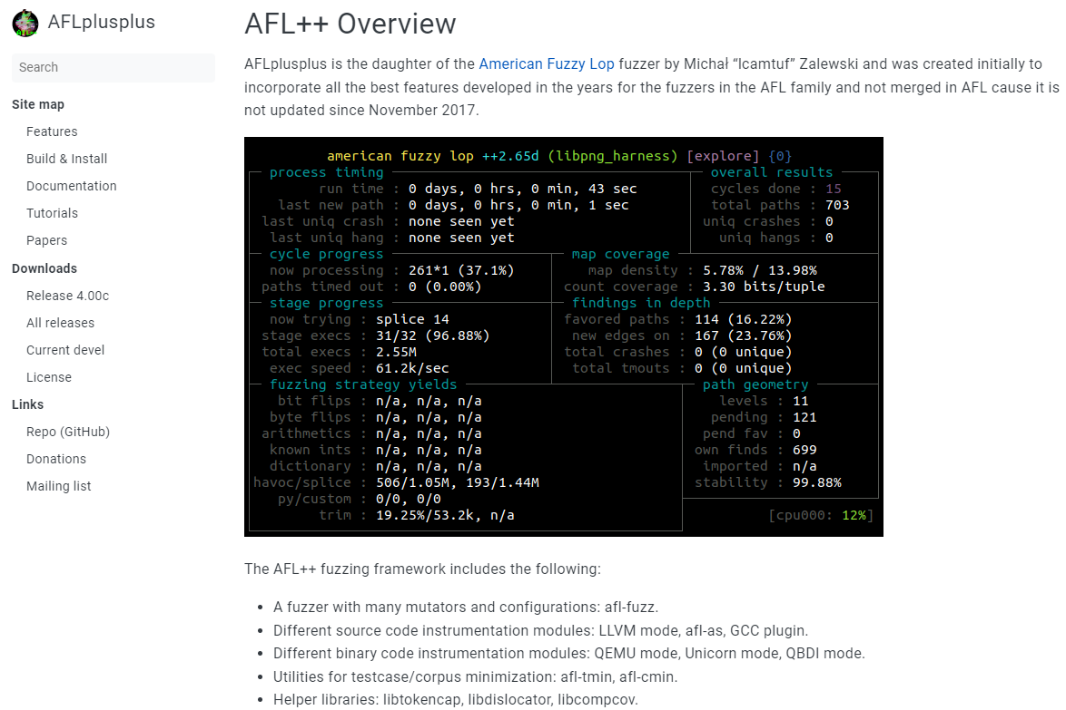

Slide 8
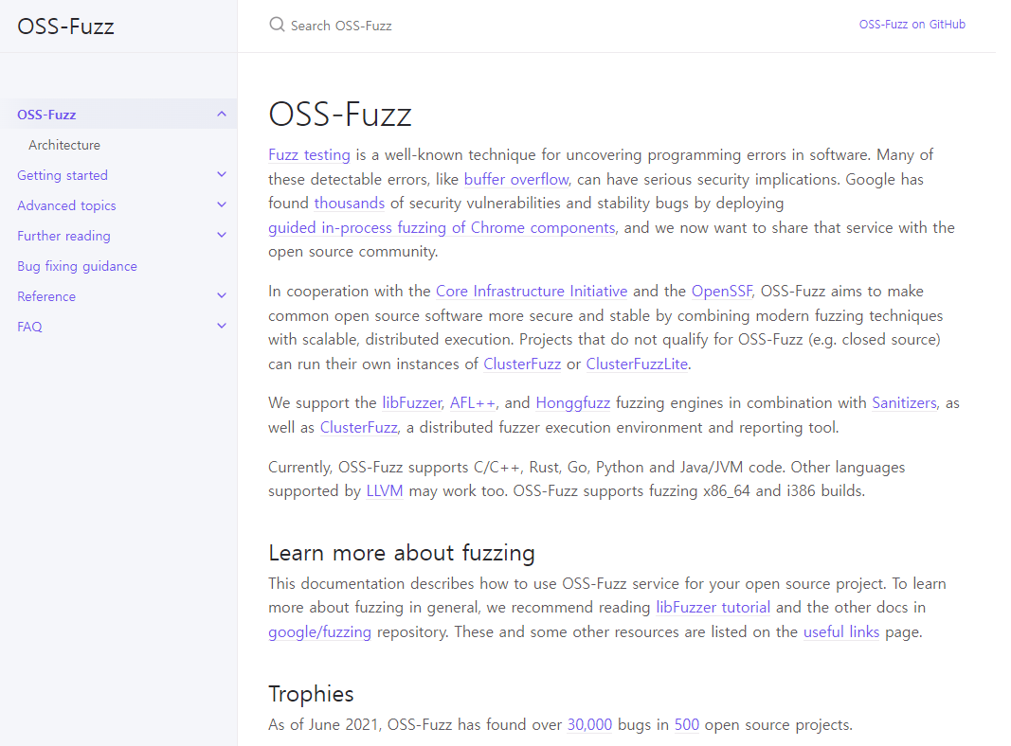

Slide 9
Fuzzing Algorithm of AFL/AFL++
How execution paths of test input files are defined and analyzed
How to select test input files
How to mutate selected test input files

Slide 10
_{Example of a New Path}
A path is considered new, if it covers a new branch, or a branch's hit count is in a new range of hit counts.
The list of ranges are as follows:
[1, 2, 3, 4-7, 8-15, 16-31, 32-127, 128+]
These ranges are called buckets.
For 2 test input files that have the same branch coverage
tc1: A-B-C-A-B-D
tc2: A-B-C-A-B-C-A-B-D
Branch hit count of tc1:
A
b₁
b₃
B
C
b₂
Branch hit count of tc2:
b₄
Branch ID | b₁ | b₂ | b₃ | b₄
Hit count | 2 | 1 | 1 | 1
Branch ID | b₁ | b₂ | b₃ | b₄
Hit count | 3 | 2 | 2 | 1
D
tc2 covers a new path compared to tc1
the hit count for b_{1,} b_{2,} and b₃ of tc1 and tc2 cover different buckets.

Slide 11
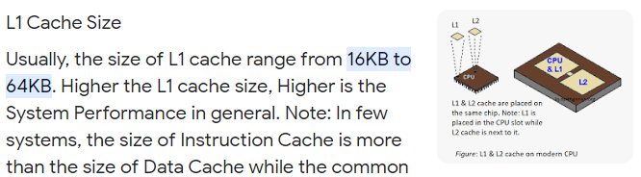
How Path Information is Stored by AFL
Branch hit count is used to find a new path
AFL keeps the path coverage data in a 64kB mem.
Each byte represent hit count bucket for each branch as follows:
Note: multiple branches may use the same byte
the location of a branch's byte is determined by hashing (i.e., hash collision)
1 hit bucket: 1 | 1 hit bucket: 0
2 hits bucket: 1 | 2 hits bucket: 1
3 hits bucket: 1 | 3 hits bucket: 0
4-7 hits bucket: 0 | 4-7 hits bucket: 0
8-15 hits bucket: 0 | 8-15 hits bucket: 0
16-31 hits bucket: 0 | 16-31 hits bucket: 1
32-127 hits bucket: 0 | 32-127 hits bucket: 0
128+ hits bucket: 0 | 128+ hits bucket: 0
1 hit bucket: 0
2 hits bucket: 0
3 hits bucket: 0
4-7 hits bucket: 1
8-15 hits bucket: 1
16-31 hits bucket: 0
32-127 hits bucket: 0
128+ hits bucket: 0
1 byte (8 bits)
...
64K branches

Slide 12
Finding the Set of Favored Inputs
Def) a favored input for a branch b:
input that has the lowest performance score for b:
Performance score: exec_time(μs) x length(byte)
exec_time: time it takes for the target program to execute the input in nanoseconds
length: size of the input in bytes
Input 410 Exec_time: 10 Length: 10 | Input 324 Exec_time: 5 Length: 12
Empty
...
64K favored inputs corresponding to the 64K branches
AFL selects favored inputs at:
the initialization phase after calculating performance score based on the initial seed inputs, and
the beginning of each fuzzing cycle

Slide 13
y
Selecting Input from Pool (1/4)
AFL can skip inputs in the pool with probability decided by the following algorithm:
y
Skip probability: 0%
A pending favored is an input that:
Is favored and
is not fuzzed yet
yes
Current one is pending favored?
Pool has pending favored inputs?
n
Skip probability: 99%
no
Current is favored?
y
Skip probability: 0%
n
Current is fuzzed?
y
Skip probability: 95%
n
Skip probability: 75%
Pool of inputs (singly linked list)
Input 1
favored: X
was_fuzzed: X
Input 2
favored: O
was_fuzzed : X
Input 3
favored: X
was_fuzzed : X
Input 4
favored: X
was_fuzzed : O
Skip with 99% chance

Slide 14
y
Selecting Input from Pool (2/4)
AFL can skip inputs in the pool with probability decided by the following algorithm:
y
Skip probability: 0%
A pending favored is an input that:
Is favored and
is not fuzzed yet
yes
Current one is pending favored?
Pool has pending favored inputs?
n
Skip probability: 99%
no
Current is favored?
y
Skip probability: 0%
n
Current is fuzzed?
y
Skip probability: 95%
n
Skip probability: 75%
Pool of inputs (singly linked list)
Input 1
favored: X
was_fuzzed: X
Input 2
favored: O
was_fuzzed : X
Input 3
favored: X
was_fuzzed : X
Input 4
favored: X
was_fuzzed : O
Do not skip

Slide 15
y
Selecting Input from Pool (3/4)
AFL can skip inputs in the pool with probability decided by the following algorithm:
y
Skip probability: 0%
A pending favored is an input that:
Is favored and
is not fuzzed yet
yes
Current one is pending favored?
Pool has pending favored inputs?
n
Skip probability: 99%
no
Current is favored?
y
Skip probability: 0%
n
Current is fuzzed?
y
Skip probability: 95%
n
Skip probability: 75%
Pool of inputs (singly linked list)
Input 1
favored: X
was_fuzzed: X
Input 2
favored: O
was_fuzzed : X
Input 3
favored: X
was_fuzzed : X
Input 4
favored: X
was_fuzzed : O
Skip with 75% chance

Slide 16
y
Selecting Input from Pool (3/4)
AFL can skip inputs in the pool with probability decided by the following algorithm:
y
Skip probability: 0%
A pending favored is an input that:
Is favored and
is not fuzzed yet
yes
Current one is pending favored?
Pool has pending favored inputs?
n
Skip probability: 99%
no
Current is favored?
y
Skip probability: 0%
n
Current is fuzzed?
y
Skip probability: 95%
n
Skip probability: 75%
Pool of inputs (singly linked list)
Input 1
favored: X
was_fuzzed: X
Input 2
favored: O
was_fuzzed : X
Input 3
favored: X
was_fuzzed : X
Input 4
favored: X
was_fuzzed : O
Skip with 95% chance

Slide 17
_{Fuzzing/Mutating Input Bytes}
The selected input file is fuzzed using the following fuzzing methods in order:
Bitflip – flip 1 or 2 or 4 bits of the input
Byteflip – flip 1 or 2 or 4 bytes of the input
Arithmetic – add or subtract an integer up to 35 to 8-bit or 16-bit or 32-bit values of the input
Interest – similar to arithmetic, but overwrite interesting values instead of add or subtract
Extras – overwrite or insert to the input using user-given or auto-generated terms
Havoc – makes a random number of modifications to the input using the above 5 methods
Splice – splice the input with another in the pool and apply havoc

Slide 18
Fuzzing Inputs – bitflip, byteflip
AFL flips L bits at a time, stepping over the input file by S-bit increments. The possible L/S variants are:
1/1, 2/1 and 4/1 for bitflip
8/8, 16/8, 32/8 for byteflip
Example. The following input (of size 1 byte) is represented in bits as follows:
If we apply bitflip 2/1 to the input, it will produce the following fuzzed inputs:
1 | 0 | 1 | 0 | 0 | 0 | 0 | 1
0 | 1 | 1 | 0 | 0 | 0 | 0 | 1
1 | 1 | 0 | 0 | 0 | 0 | 0 | 1
1 | 0 | 0 | 1 | 0 | 0 | 0 | 1
1 | 0 | 1 | 1 | 1 | 0 | 0 | 1
1 | 0 | 1 | 0 | 1 | 1 | 0 | 1
1 | 0 | 1 | 0 | 0 | 1 | 1 | 1
1 | 0 | 1 | 0 | 0 | 0 | 1 | 0

Slide 19
_{Fuzzing Inputs – arithmetic}
AFL adds or subtracts integers ranging from 1 to 35 to 8-bit, 16-bit and 32-bit values of the input while stepping over by 8 bits. The possible variants are:
arith 8/8, arith 16/8, and arith 32/8
Example. The following input (of size 2 bytes) is represented in bits as follows:
If we apply arith 8/8 to the input, it will produce the following fuzzed inputs:
byte 1
byte 2
1 | 0 | 1 | 0 | 0 | 0 | 0 | 1
0 | 1 | 1 | 1 | 0 | 0 | 1 | 1
byte 1
byte 2
byte 1
byte 2
1 | 0 | 1 | 0 | 0 | 0 | 1 | 0
0 | 1 | 1 | 1 | 0 | 0 | 1 | 1
1 | 0 | 1 | 0 | 0 | 0 | 1 | 1
0 | 1 | 1 | 1 | 0 | 0 | 1 | 1
*add 1 to byte 1
*add 2 to byte 1
... (up to 35)
byte 1
byte 2
byte 1
byte 2
1 | 0 | 1 | 0 | 0 | 0 | 0 | 0
0 | 1 | 1 | 1 | 0 | 0 | 1 | 1
1 | 0 | 0 | 1 | 1 | 1 | 1 | 1
0 | 1 | 1 | 1 | 0 | 0 | 1 | 1
*subtract 1 from byte 1
*subtract 2 from byte 1
... (up to 35)

Slide 20
Fuzzing Inputs – interest (1/2)
AFL overwrites interesting values to 8-bit, 16-bit and 32-bit values of the input while stepping over by 8 bits. The possible variants are:
interest 8/8, interest 16/8, and interest 32/8
The list of interesting values are as follows:
interesting 8-bit values:
-128, -1, 0, 1, 16, 32, 64, 100, 127
interesting 16-bit values:
-32768, -129, 128, 255, 256, 512, 1000, 1024, 4096, 32767
interesting 32-bit values:
-2147483648, -100663046, -32769, 32768, 65535, 65536, 100663045, 2147483647

Slide 21
Fuzzing Inputs – interest (2/2)
Example. The following input (of size 2 bytes) is represented in bits as follows:
If we apply interest 8/8 to the input, it will produce the following fuzzed inputs:
byte 1
byte 2
1 | 0 | 1 | 0 | 0 | 0 | 0 | 1
0 | 1 | 1 | 1 | 0 | 0 | 1 | 1
byte 1
byte 2
byte 1
byte 2
1 | 0 | 0 | 0 | 0 | 0 | 0 | 0
0 | 1 | 1 | 1 | 0 | 0 | 1 | 1
1 | 1 | 1 | 1 | 1 | 1 | 1 | 1
0 | 1 | 1 | 1 | 0 | 0 | 1 | 1
...
*overwrite -128 to byte 1
*overwrite -1 to byte 1
byte 1
byte 2
byte 1
byte 2
1 | 0 | 1 | 0 | 0 | 0 | 0 | 1
1 | 0 | 0 | 0 | 0 | 0 | 0 | 0
1 | 0 | 1 | 0 | 0 | 0 | 0 | 1
1 | 1 | 1 | 1 | 1 | 1 | 1 | 1
...
*overwrite -128 to byte 2
*overwrite -1 to byte 2

Slide 22
_{Fuzzing Inputs – extras}
AFL overwrites or inserts dictionary terms to the input. The dictionary terms can be given by the user or automatically generated by the fuzzer. The possible variants are:
user extras (over), user extras(insert) - overwrite or insert user given terms
auto extras (over), auto extras(insert) - overwrite or insert auto generated terms
Example. The following input (of size 8 bytes) is represented in characters:
If we overwrite an arbitrary dictionary term “int”, it will produce the following fuzzed inputs:
a | b | c | d | e | f | g | h
i | n | t | d | e | f | g | h
a | i | n | t | e | f | g | h
a | b | i | n | t | f | g | h
a | b | c | i | n | t | g | h
a | b | c | d | i | n | t | h
a | b | c | d | e | i | n | t

Slide 23
_{Fuzzing Inputs – havoc}
AFL makes a random number (max 128) of random edits to the input. The number of fuzzed inputs produced is proportional to the performance score of the input.
The list of possible edits are as follows:
bitflip 1/1
interest 8/8, 16/8, 32/8
arith 8/8, 16/8, 32/8
User extra (over,insert), auto extra (over,insert)
Set a random byte to a random value
Remove random number of bytes from random location
Copy random number of bytes to random location

Slide 24

_{Fuzzing Inputs – splice}
AFL splices together two random inputs from the queue at some arbitrarily selected midpoint and apply havoc
- Applied only after the first full queue cycle ends with no new paths.
Input 1
Input 2
Input 3

