Slide 1



POWER : Program Option-Aware Fuzzer for High Bug Detection Ability (ICST 2022)
Ahcheong Lee (KAIST, South Korea)
Irfan Ariq (KAIST)
Yunho Kim (Hanyang Univ. , South Korea)
Moonzoo Kim (KAIST)
ICST 2023 Ireland
Notes:
We also extended POWER for last one year, and named as POWERUP,
so I’ll also present how POWERUP has been improved.

Slide 2

POWERUP: Program Option-Aware Interleaving Fuzzing Platform for High Bug Detection TBD
Ahcheong Lee (KAIST, South Korea)
Youngseok Choi (KAIST)
Yunho Kim (Hanyang Univ. , South Korea)
Shin Hong (Handong Global Univ., South Korea)
Moonzoo Kim (KAIST)
Notes:
We also extended POWER for last one year, and named as POWERUP,
so I’ll also present how POWERUP has been improved.

Slide 3




POWER : Program Option-Aware Fuzzer for High Bug Detection Ability
page 1
In Short - Mutate Command Lines as a Separated Domain!
CLI (Command Line Interface) programs use command lines to determine which features (functions) to execute
vim execution search space
vim –s input
vim input
vim –cmd input
Notes:
In summary, POWER also tries to mutate command lines along with input file.
This part on the photo is called rudder, it decides where a huge ship head to.
By changing this small part a little bit, the ship will head totally different direction, so it is a very important part,
And command lines do the same thing on programs.

Slide 4
POWER : Program Option-Aware Fuzzer for High Bug Detection Ability
page 1
In Short - Mutate Command Lines as a Separated Domain!
CLI (Command Line Interface) programs use command lines to determine which features (functions) to execute
vim execution search space
vim –s input
vim input
vim –cmd input
Notes:
In summary, POWER also tries to mutate command lines along with input file.
This part on the photo is called rudder, it decides where a huge ship head to.
By changing this small part a little bit, the ship will head totally different direction, so it is a very important part,
And command lines do the same thing on programs.

Slide 5

POWER : Program Option-Aware Fuzzer for High Bug Detection Ability
page 2
Previous Fuzzing Techniques Did Not Care Command Lines
vim execution search space
vim –s input
vim input
vim –cmd input

Slide 6
POWER : Program Option-Aware Fuzzer for High Bug Detection Ability
page 3
Previous Fuzzing Techniques Did Not Care Command Lines
3/4 of 100 recent fuzzing papers provide NO command line information.
vim execution search space
vim –s input
vim input
vim –cmd input
Notes:
We surveyed 100 recent fuzzing papers, and we found that about 75 papers did not even provide any command line information.
So we find high potential on mutating command lines, so we developed POWER and POWERUP to find such bugs in diverse command line configurations.

Slide 7
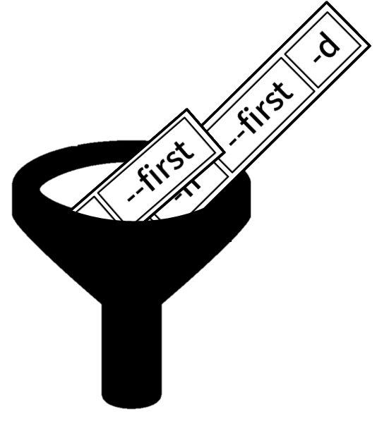
POWER : Program Option-Aware Fuzzer for High Bug Detection Ability
page 4
Contributions
Contribution 1.
POWER mutates and selects command lines in strategic way.
Contribution 2.
POWERUP found 88 crashes in 15 subjects
(which is significant more than AFL++, ConfigFuzz, Eclipser)
Notes:
So, how does POWER carefully mutate command lines?

Slide 8
POWER : Program Option-Aware Fuzzer for High Bug Detection Ability
page 5
2 Key features
Separated mutation with interleaving
Mutate command lines and files individually
Distinct Command line selection
Mutate files of selected distinct command lines only
Notes:
So, how does POWER carefully mutate command lines?

Slide 9
POWER : Program Option-Aware Fuzzer for High Bug Detection Ability
page 6
Overall Process - Command Line Mutation
CL mutation
File mutation
CL mutation
File mutation
CL mutation
File mutation
CL mutation
File mutation
-a -c filename
<!DOCTYPE html…
command line
-a -b filename
file
-b filename
<!DOCTYPE html…
<!DOCTYPE html…
-a -b filename -e
<!DOCTYPE html…
Notes:
So, how does POWER carefully mutate command lines?

Slide 10
POWER : Program Option-Aware Fuzzer for High Bug Detection Ability
page 7
Overall Process - File Mutation
CL mutation
File mutation
CL mutation
File mutation
CL mutation
File mutation
CL mutation
File mutation
-a -c filename
<!DOCTYPE html…
<!DOCTYPE html…
-a -c filename
<!DOCTYPE html…
<!DO html…
command line
-a -b filename
-b filename
<!DOCTYPE html…
-b filename
<!DOCT hhtml…
file
<!DOCT hhtml…
<!DOCT hhtml…
<!DOCTYPE html…
-a -b filename -e
<!DOCTYPE html…
<!DOCTYPE html…
-a -b filename -e
<!DOCTYPE html…
<!TYPE htm…
Notes:
So, how does POWER carefully mutate command lines?

Slide 11
POWER : Program Option-Aware Fuzzer for High Bug Detection Ability
page 8
Overall Process - Corpus Shrinking (Get Distinct CL)
CL mutation
File mutation
CL mutation
CL mutation
File mutation
File mutation
CL mutation
CL mutation
File mutation
File mutation
CL mutation
File mutation
-a -c filename
<!DOCTYPE html…
<!DOCTYPE html…
<!DO html…
-b filename
<!DOCT hhtml…
<!DOCT hhtml…
<!DOCT hhtml…
<!DOCTYPE html…
-a -b filename -e
<!DOCTYPE html…
<!TYPE htm…
Notes:
So, how does POWER carefully mutate command lines?

Slide 12
POWER : Program Option-Aware Fuzzer for High Bug Detection Ability
page 9
Strategic mutation – separated mutation
One naïve way to mutate command lines: Concatenation
1. Make a long byte string
command line
input file
-a -b -c -opt -s
<!DOCTYPE html><!-- saved from url=https://www. / --><html
2. Mutation
-a -e -format -opt -s
<!DOCTYPE html><!-- saved asasdfsdfsdfs://www. / --><html

Slide 13

POWER : Program Option-Aware Fuzzer for High Bug Detection Ability
page 10
Strategic mutation – separated mutation
If either one of them become “invalid”, the test case become useless.
Command line bytes
Input file bytes
good!
New Command line bytes
New input file bytes
POWERUP covered 22% more branches and found 120% more crashes than the concatenation method.
Notes:
The problem is, if we make either one of them invalid, the test case might become useless.
Even if you generate a good input file by mutation, if there was something wrong in the command line,
then the program will refuse to parse the command line and immediately terminate the execution.

Slide 14
POWER : Program Option-Aware Fuzzer for High Bug Detection Ability
page 11
Strategic Selection of Command Lines
Focus on Distinct Command lines
vim execution search space
vim –s input_file
vim input_file
vim –s -a input_file

Slide 15
POWER : Program Option-Aware Fuzzer for High Bug Detection Ability
page 12
Strategic Selection of Distinct Command Lines
1. Function call profile extraction
CL1
main, f1, f2, g1, g2
CL2
main, g1, h1, h2

Slide 16

POWER : Program Option-Aware Fuzzer for High Bug Detection Ability
page 13
Strategic Selection of Distinct Command Lines
2. Clustering (K-means)
Distance = $1 −\frac{|A∩B|}{|A∪B|}$

Slide 17


POWER : Program Option-Aware Fuzzer for High Bug Detection Ability
page 14
Evaluation
RQ1
Are POWER and POWERUP better than other command-line fuzzing techniques like Configfuzz [TOSEM], AFL++-argv, and Eclipser?
RQ2
Did separated mutation contribute to POWERUP’s performance?
Measurement: the # of detected unique crashes
Setup : 12 hours run, repeated 5 times.

Slide 18
POWER : Program Option-Aware Fuzzer for High Bug Detection Ability
page 15
Test subjects
20 C/C++ open source programs that are used by other fuzzing papers
Subjects | Size (Loc) | # of CLI keywords | Subjects | Size (Loc) | # of CLI keywords
avconv | 454,936 | 761 | nasm | 70,903 | 218
bison | 54,423 | 51 | objdump | 877,165 | 84
cjpeg | 6,308 | 33 | pdftohtml | 38,111 | 26
dwarfdump | 83,545 | 103 | pdftopng | 97,890 | 18
exiv2 | 33,417 | 76 | pspp | 4,901 | 20
ffmpeg | 774,186 | 1817 | readelf | 74,789 | 98
gm | 197,891 | 757 | tiff2pdf | 8,234 | 30
gs | 1,174,673 | 350 | tiff2ps | 5,646 | 34
jasper | 2,920 | 20 | xmllint | 11,285 | 66
mpg123 | 11,298 | 122 | xmlwf | 4,147 | 15
Avg. Loc : 199,333
Avg. # of keywords : 235
Median # of keywords : 71

Slide 19

POWER : Program Option-Aware Fuzzer for High Bug Detection Ability
page 16
Result – RQ 1 : Are POWER and POWERUP better than other command-line fuzzing techniques?
# of crash detected
AFL++-argv:
AFL++’s feature that mutates only command lines
ConfigFuzz:
A tool that can generate test driver from json grammar file, so that a fuzzer can mutate both command lines and input files
x2.44
AFL++-argv
Configfuzz
POWER
POWERUP

Slide 20
POWER : Program Option-Aware Fuzzer for High Bug Detection Ability
page 17
Result – Crash example
One crash found in mpg123 contains 13 command line keywords:
The developer of mpg123 commented that:
./mpg123 –smooth –listentry –z –w 1 –-quiet –-index - -4to1 -2 –q –fifo --outfile
“Interesting approach you find stuff where oss-fuzz didn’t anymore.”

Slide 21
POWER : Program Option-Aware Fuzzer for High Bug Detection Ability
page 18
Result – RQ2
RQ2: Did separated mutation contribute to POWERUP’s performance?
POWERUP^{concat}
# of crash detected
x2.59
POWERUP^{concat}
POWERUP

Slide 22
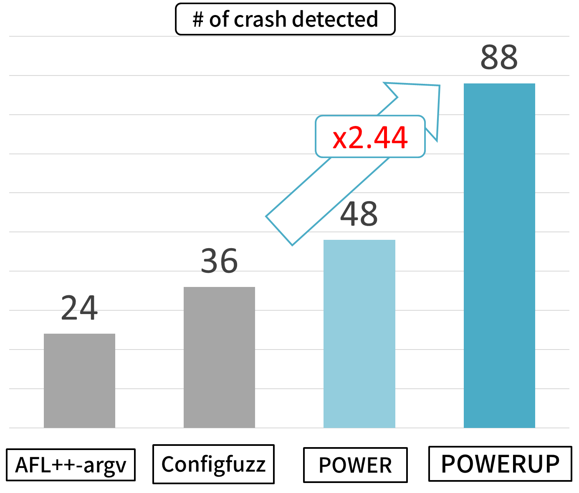
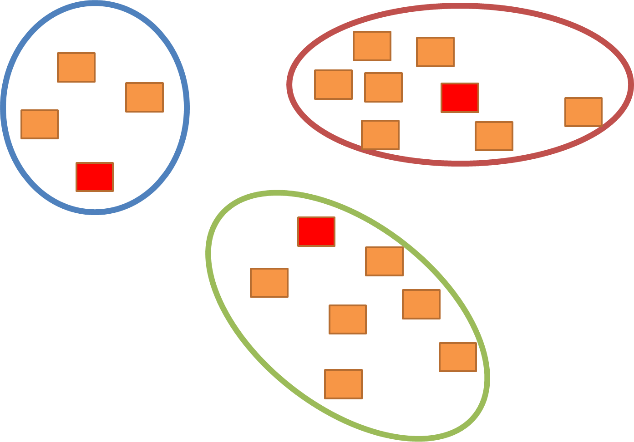
POWER : Program Option-Aware Fuzzer for High Bug Detection Ability
page 19
Conclusion

Slide 24
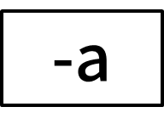
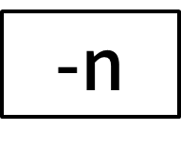


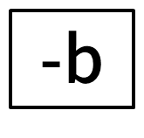


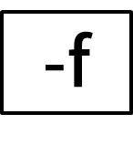
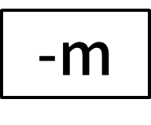
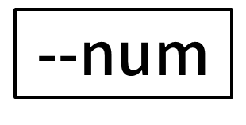

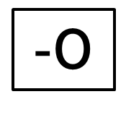
POWER : Program Option-Aware Fuzzer for High Bug Detection Ability
page 5
Careful Generation of Command Line Options
Dictionary-based mutation to generate valid command line options
Set of keywords
Command line options
-a
-n
-d
Doc. of P
-m
-out
-b
Help msg. of P
Man. page of P
-i
-I
--num
-O
-f
--first

Slide 25
POWER : Program Option-Aware Fuzzer for High Bug Detection Ability
page 6
Careful Selection of Distinct Command Line Options
Generated
Command line options
command line options
that are far different from each other
Selection

Slide 26

POWER : Program Option-Aware Fuzzer for High Bug Detection Ability
page 7
Careful Selection of Distinct Command Line Options
command line options
that are far different from each other
Mutate input file with selected command line options
…
…
…

Slide 27
POWER : Program Option-Aware Fuzzer for High Bug Detection Ability
page 5
Valid Mutation
POWER
Dictionary-based mutation to generate valid command lines
Set of keywords
New command lines
-a
-n
-d
Doc. of P
-m
-out
-b
Help msg. of P
Man. page of P
-i
-I
--num
-O
-f
--first

Slide 28
POWER : Program Option-Aware Fuzzer for High Bug Detection Ability
page 6
Intermixed Mutation
POWERUP!!
Random mutation to generate diverse command lines
-a=20
Doc. of P
Help msg. of P
Man. page of P
--res 1920:1080
--regex “[a-z]*&^*[0-8]{2,4}@#”
POWERUP covered 15% more branches and found 64% more crashes
by Applying both dictionary based mutations and random mutations
Notes:
However, POWER had a limitation that
it can not generate these kind of options with random parameter values.
The values of parameters can be very diverse depending on the program.
It could takes some numbers, or some complex strings like regular expressions.
So, POWERUP adapted random mutations on the command lines
by applying both dictionary-based mutations and random mutations, POWERUP could cover 15% more branches and 64% more crashes
than original POWER

Slide 29
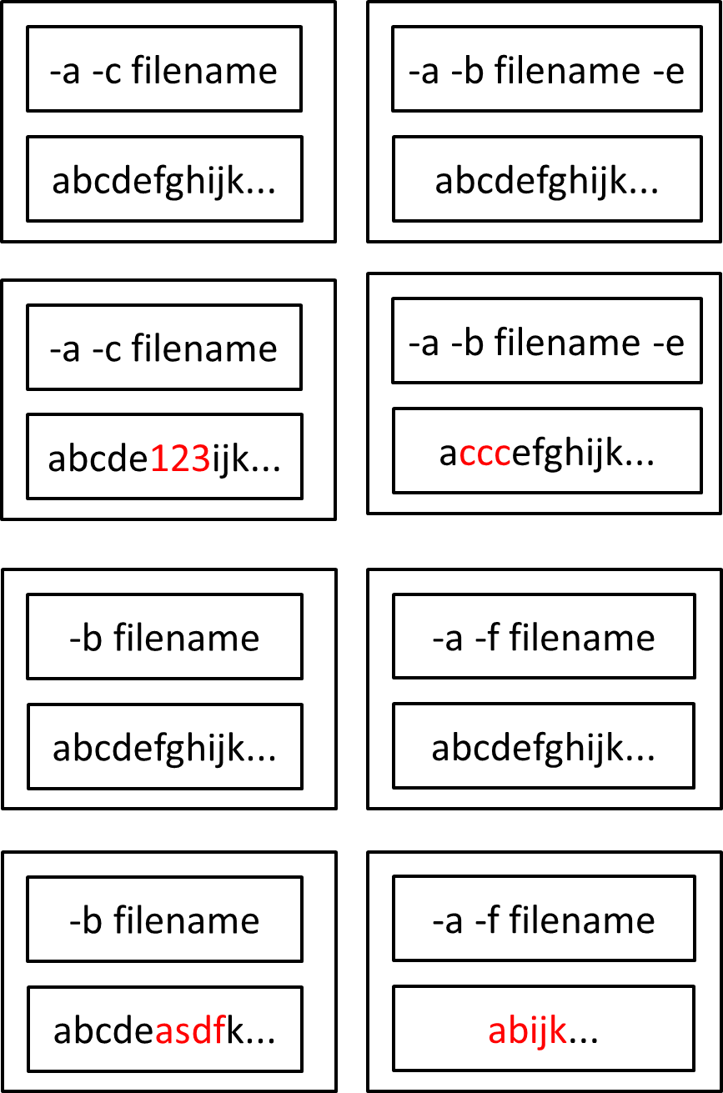
POWER : Program Option-Aware Fuzzer for High Bug Detection Ability
page 6
Overall Process - Command Line Mutation
CL mutation
File mutation
CL mutation
CL mutation
CL mutation
File mutation
File mutation
File mutation
CL mutation
CL mutation
CL mutation
File mutation
File mutation
File mutation
CL mutation
File mutation
command line
-a -c filename
-a -b filename -e
-a -b filename
abcdefghijk...
abcdefghijk...
file
abcdefghijk...
-b filename
-a -f filename
abcdefghijk...
abcdefghijk...
Notes:
So, how does POWER carefully mutate command lines?

Slide 30
POWER : Program Option-Aware Fuzzer for High Bug Detection Ability
page 9
Strategic mutation – separated mutation
A program is a mixture of command line constraints and input file constraints
1
2
3
4
5
6
7
8
9
10
process_args(argc, argv, &gf); // Command check, set global flags filename = argv[argc - 1];
open_and_read_type(filename, &filetype); // File checks (magic bytes, …)
if ((filetype == 2) && (gf.name == "ELF"))) {
process_one_file(filename, …); // Main logic
} else {
exit(EXIT_FAILURE);
}
POWERUP covered 22% more branches and found 120% more crashes than the concatenation method.
Notes:
Let me make a more detailed example.
If a program takes this kind of command line,
You also have to make a good input files.
There should be many magic bytes checks and other sanity checks in the program,
so if you ruin the input files, the program will reject to proceed.
So, POWERUP seprates command lines and input files, and mutate them individually.

