Slide 1
Introduction to Static Analyzer
Moonzoo Kim
SWTV group
School of Computing, KAIST

Slide 2

Content
Coverity Static Analysis
Use cases of Coverity
Examples
C program 1
C program 2
Java program

Slide 3
Coverity Static Analysis
Coverity Static Analysis is a static code analysis tool for C, C++, C#, Java, and JavaScript
Coverity Static Analysis is is derived from the Stanford Checker, a research tool for finding bugs through static analysis [from Wikipedia]
Coverity Static Analysis detects dozens of defect patterns in the following categories
Memory corruptions
Concurrency
Security
Performance inefficiencies
Unexpected behavior

Slide 4
Power of Coverity
Coverity can find critical issues such as:
Memory corruptions
Memory illegal accesses
Path manipulation
Performance inefficiencies
Program hangs
Security misconfigurations
SQL Injection
Uninitialized members
Control flow issues
Hard-coded credentials
API usage errors
Buffer overflows
Concurrent data access violations
Cross-site scripting (XSS)
Cross-site request forgery (CSRF)
Deadlocks
Error handling issues
Integer overflows
Integer handling issues

Slide 5






Coverity and Open Source Projects
Coverity is providing a free service for open source projects
741 projects
2.5M LOC
Coverity Scan
44,641 defects are fixed
(Only 10.2% of identified defects are false positives in 2013)

Slide 6

Coverity and Linux
18,103 defects are identified in Linux for 8 years (- 2013)
11,695 defects are fixed
Linux defects fixed in 2013
Category | Fixed
Memory illegal access, corruption | 1,135
Integer handling issues | 816
Null pointer dereferences | 291
Uninitialized variables | 207
Resource leaks | 128
Concurrent data access violations | 3
Others | 766
Total | 3,346
http://softwareintegrity.coverity.com/rs/coverity/images/2013-Coverity-Scan-Report.pdf
http://events.linuxfoundation.org/sites/events/files/slides/2013_10_16_sent.pdf

Slide 7
How To Analyze a program with Coverity
Configure coverity
cov-configure --config [configure file] --[gcc | msvc | java]
Build with coverity
cov-build --dir [output directory] --config [configure file] [compile command]
Analyze
cov-analyze --dir [output directory] --all --aggressiveness-level high
Commit analyzed results to server
cov-commit-defects --dir [output directory] --host [server host] --stream [stream name] --user [id] --password [password]
$ cov-configure --config gcc.config --gcc
$ cov-build --dir output --config gcc.config gcc example1.c
$ cov-analyze --dir output --all aggressiveness-level high
$ cov-commit-defects --dir output --host localhost--stream cs453stream --user cs453 --password 1234

Slide 8
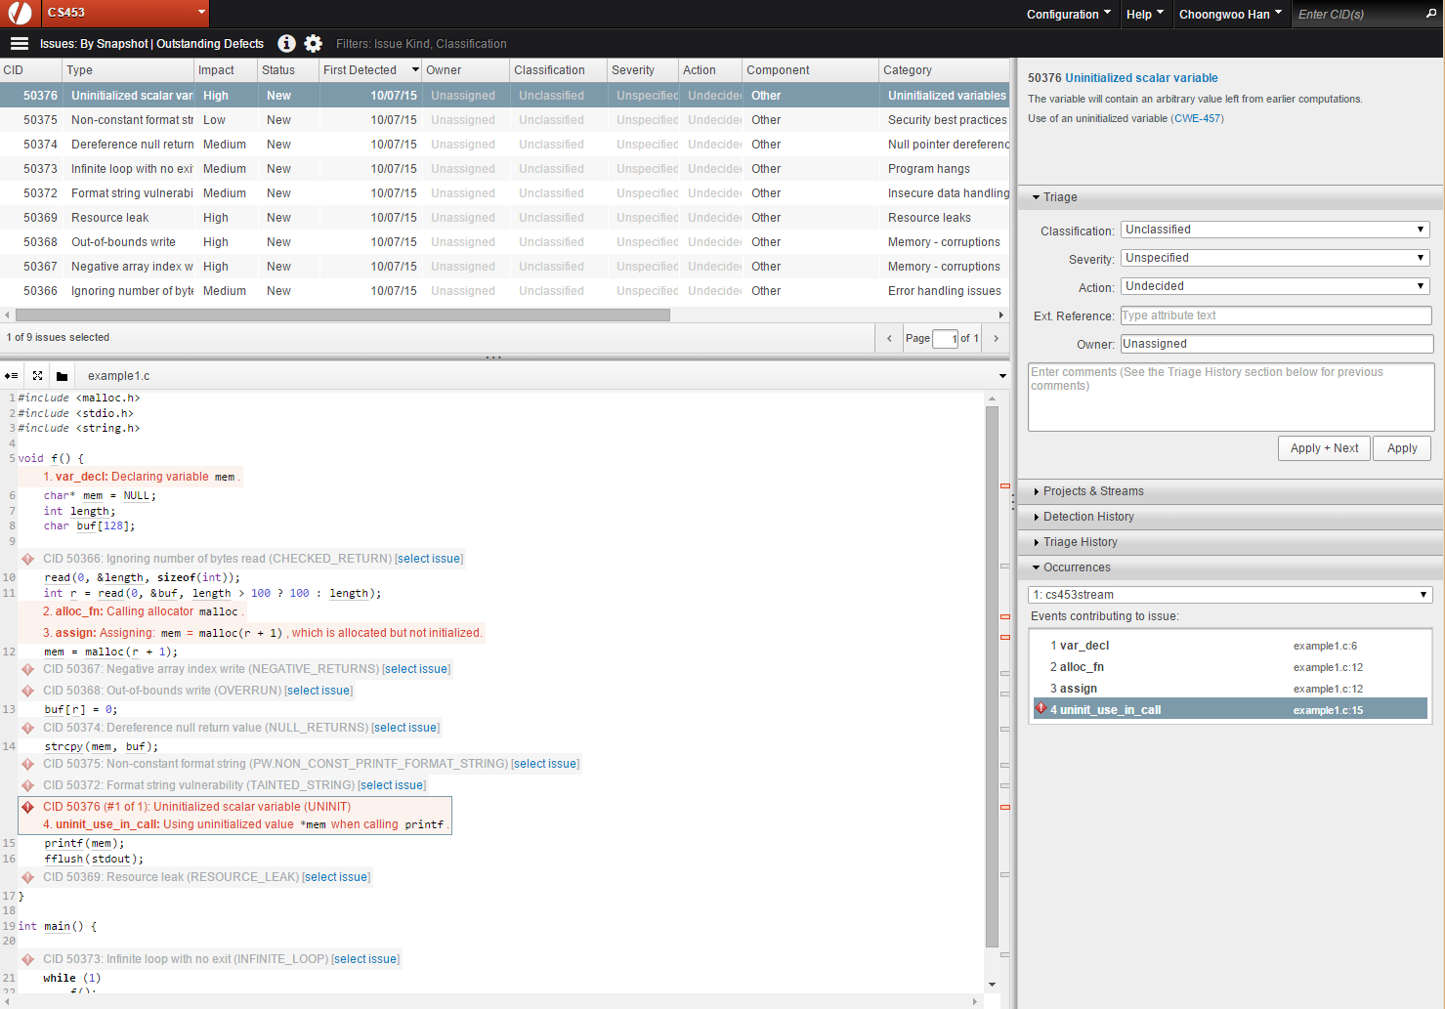
Manage Analyzed Results in Web Interface
Bug list
Bug description
Bug detail

Slide 9
Example1 - Target C source code
Bug in this code
Copy & paste error
//example2.c
#include <stdio.h>
int main(int argc, char** argv) {
int num1=0, num2=0;
if (argc >= 2) {
int n1 = atoi(argv[1]);
int n2 = atoi(argv[1]);
if (n1 >= 0 && n1 <= 100)
num1 = n1;
else
num1 = 5;
if (n2 >= 0 && n2 <= 100)
num2 = n1;
else
num2 = 5;
}
printf("%d %d", num1, num2);
}

Slide 10
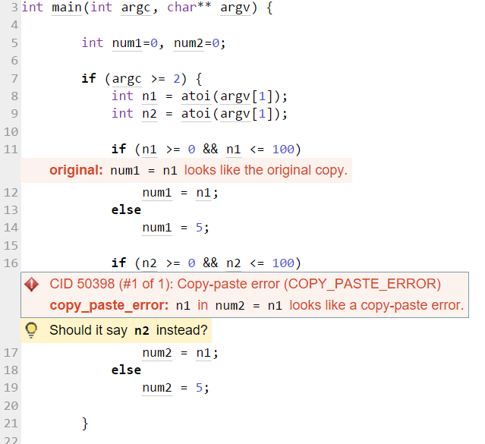
Example1 - Target C source code
Copy-paste mistakes also can be detected
n1 (line 17) may be relevant to be n2

Slide 11
Example2 - Target C source code
Bugs in this code
Infinite loop
Null pointer dereference
Format String Bug
Resource Leak
Negative Array Index
//example1.c
#include <malloc.h>
#include <stdio.h>
#include <string.h>
void f() {
char* mem = NULL;
int length;
char buf[100];
// file descriptor 0 is connected to keyboard
read(0, &length, sizeof(int));
int r = read(0, &buf, length > 100 ? 100 : length);
mem = malloc(r + 1);
buf[r] = 0;
strcpy(mem, buf);
printf(mem);
fflush(stdout);
}
int main() {
while (1)
f();
}

Slide 12
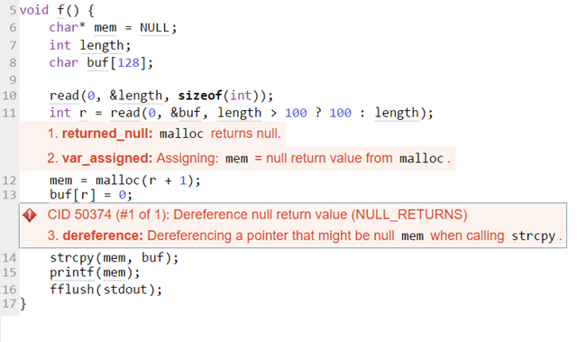
Example2 – Null pointer dereference
malloc() may return null if it fails to allocate a memory (line 12)
e.g.) malloc(0)
e.g.) malloc(BIG_NUMBER)
Execution sequence that triggers the bug
Attempt to write a data to mem (NULL)

Slide 13
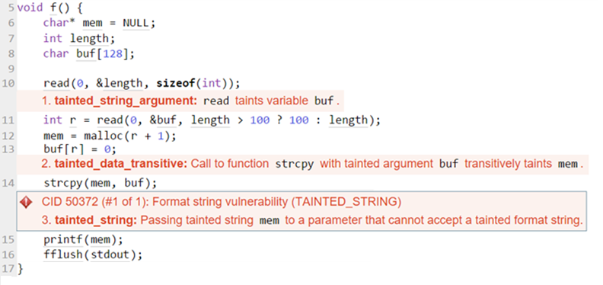
Example2 – Format String Bug
User input is directly used for the first argument of printf() (line 15)
User can inputs arbitrary format strings such as printf(“%s”) and printf(“%n”) without second argument
The program considers a garbage memory value is a second argument
This bug causes information leakage or remote code execution vulnerability

Slide 14
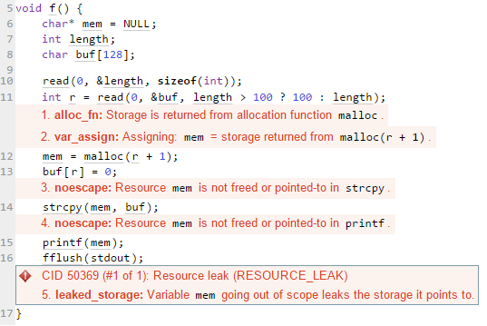
Example2 – Resource Leak
mem is not freed although the mem goes out of scope (line 17)
Not freed
Out of scope of mem

Slide 15
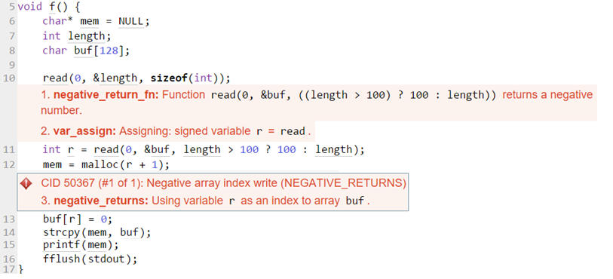
Example2 – Negative Array Index
read() (line 11) can return negative number if it fails to read
The return value is used for array indexing (out of index)

Slide 16
A Missing Bug Case in Example 2
If a user inputs -1 for length variable (line 9)
(length > 100) is false (line 10)
read() receives -1 as a third argument (line 10)
The type of the third argument of read() is unsigned integer type
-1 is converted to 0xffffffff
read an input to buf more than 100 bytes (line 10)
Stack overflow
//example1.c
#include <malloc.h>
#include <stdio.h>
#include <string.h>
void f() {
char* mem = NULL;
int length;
char buf[100];
read(0, &length, sizeof(int));
int r = read(0, &buf, length > 100 ? 100 : length);
mem = malloc(r + 1);
buf[r] = 0;
strcpy(mem, buf);
printf(mem);
fflush(stdout);
}
int main() {
while (1)
f();
}

Slide 17
Example3 – Target Java Source Code
There exists a bug in this Java source code
Race Condition
3 methods
Synchronized add and remove methods (line 6, 9)
A getter method (line 12)
// Example3.java
import java.util.*;
public class Example3 {
private final Object guardingLock = new Object();
private List<Object> data = new ArrayList<Object>();
public void addData(Object o) {
synchronized(guardingLock) { data.add(o); }
}
public void removeData(Object o) {
synchronized(guardingLock) { data.remove(o); }
}
public Object guardedByViolation(int i) {
return data.get(i);
}
}
[from coverity example]

Slide 18
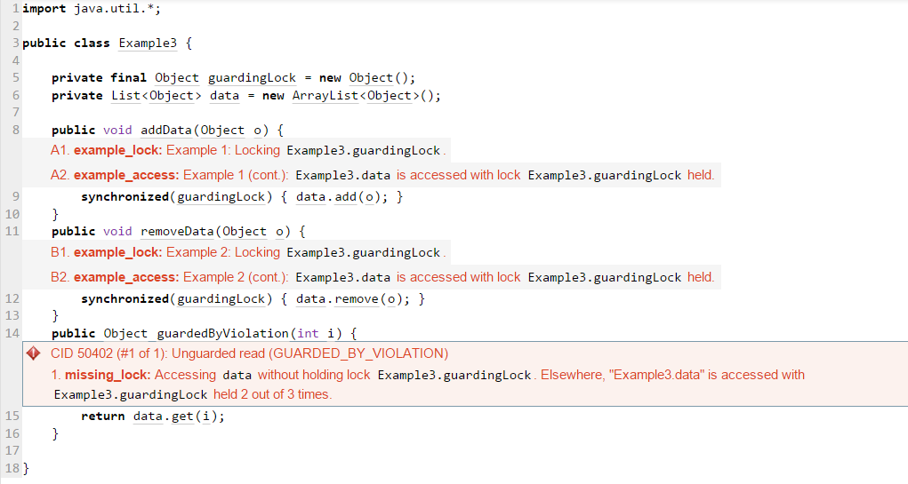
Example3 – Race Condition
Context switching can happens while executing get() method (line 15)

